Slide 1
Comprehensive & Targeted Support (CTS) Presentation A helpful guide for Comprehensive and Targeted Support for Public School Units (PSU) and School-level leaders for PRC 0105 funding, compliance, and more.
Notes:
Welcome to the 2025-26 Comprehensive and Targeted Support overview. Today’s session is really about grounding our work for this new three-year cycle. This year marks Year One, the Planning Year, where our focus is on diagnosing needs, engaging stakeholders, and designing strong, evidence-based plans that will carry us into implementation. We’ll talk through designations, funding, compliance, and most importantly, how all of these pieces connect to support student outcomes and sustainable improvement.

Slide 2

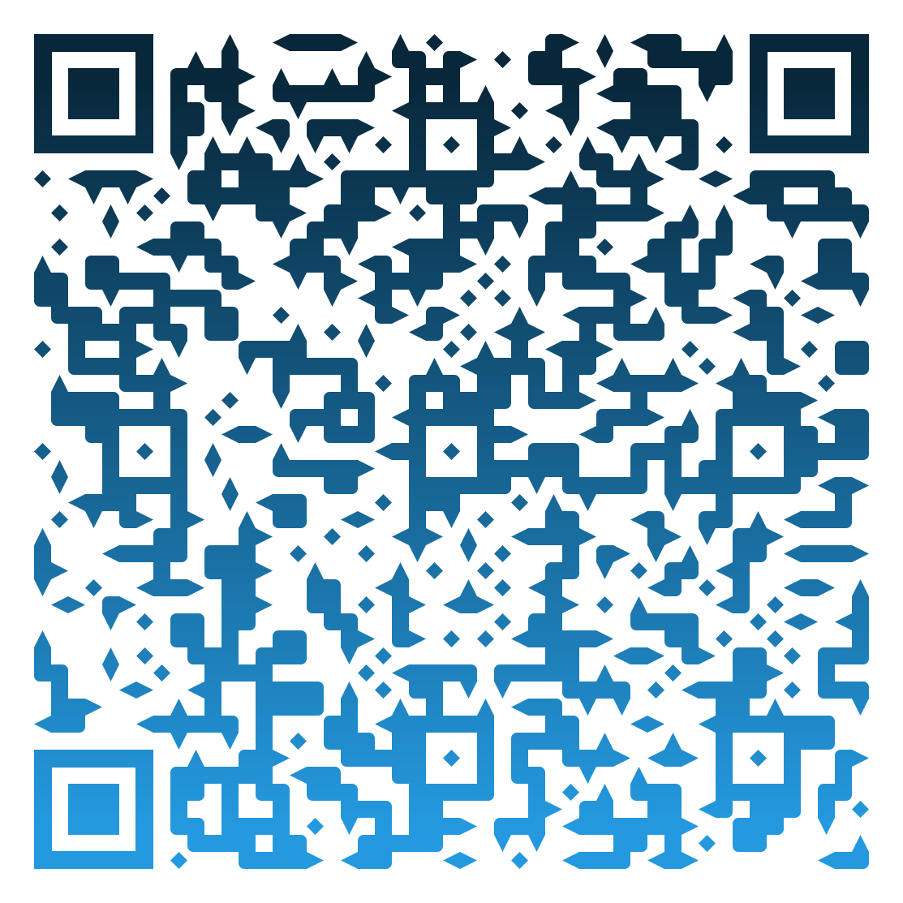
Resources from our presentation
https://www.dpi.nc.gov/districts-schools/federal-program-monitoring/comprehensive-and-targeted-support
CTS Website
Notes:
Our Comprehensive and Targeted Support (CTS) website has been redesigned to make it easier for PSUs and schools to find the tools, templates, and resources needed for successful implementation.
You’ll find:
Updated guidance documents, reference materials, and sample templates
Direct links to NCStar, Parent Notification Sample Letters, and PRC 0105 resources
Upcoming training dates and recorded webinar archives

Slide 3
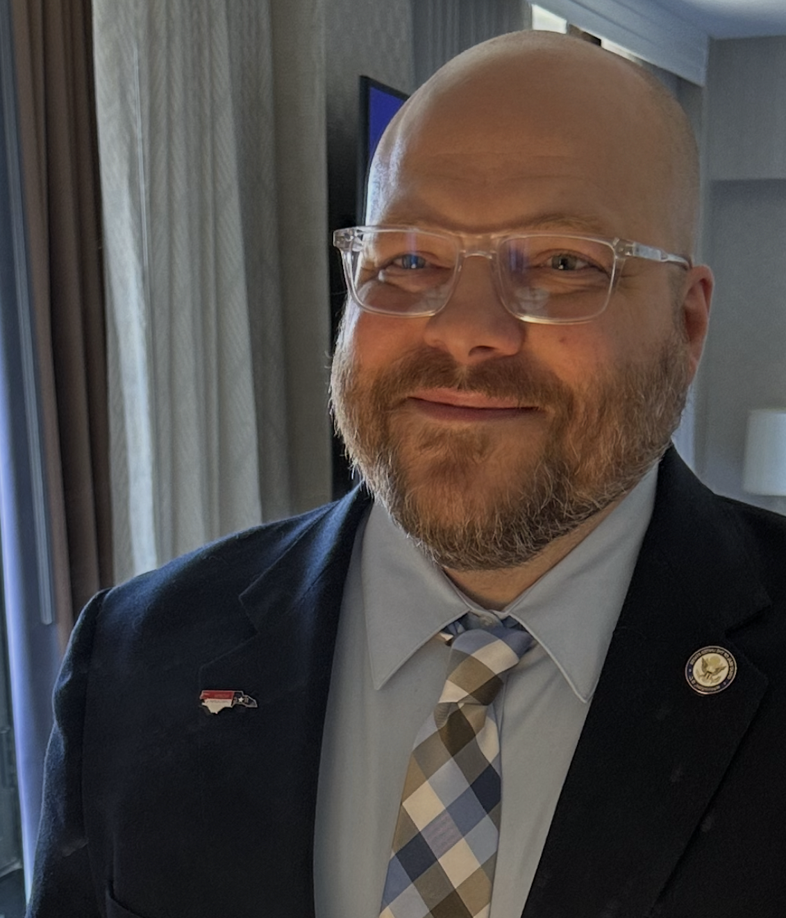


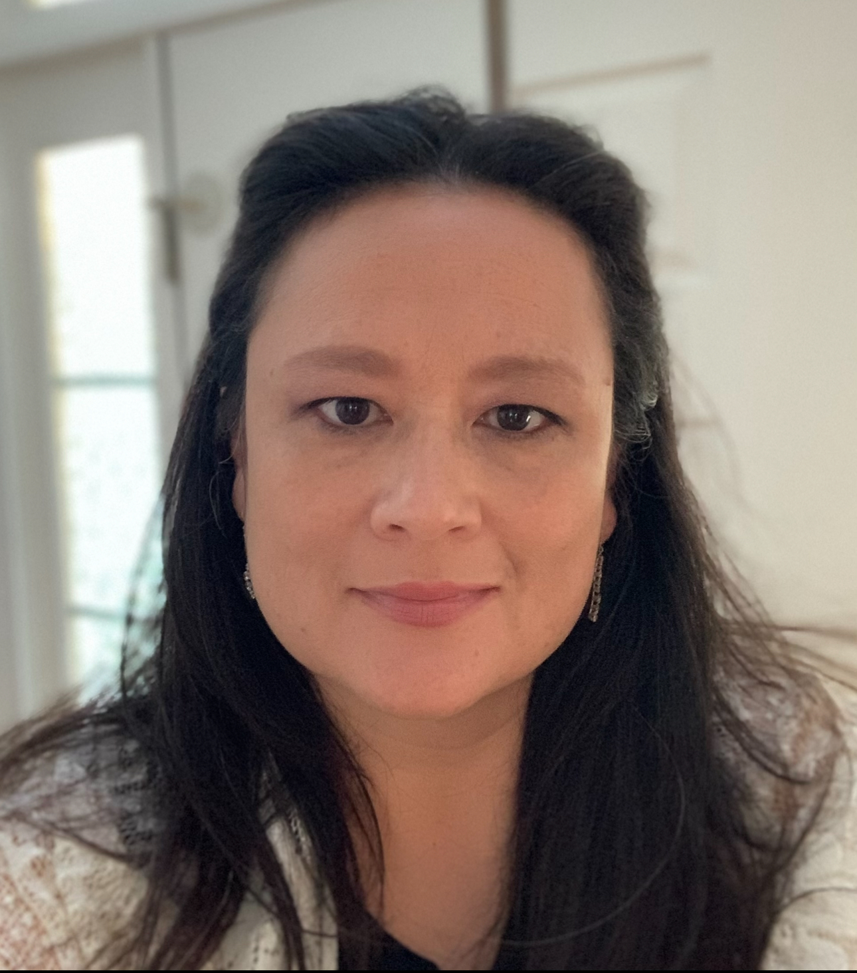

Dr. James Popp – CTS Section Chief
Tenisea Madry – CTS Program Administrator
Northeast, Southeast (including charters: 00A, 00B, 33A, 35A, 35C, 51A, 51B, 64A, & 98B in the North Central Region)
Dr. Richard Lewis – CTS Program Administrator
North Central, Sandhills (NOT including charters: 00A, 00B, 33A, 35A, 35C, 51A, 51B, 64A, 98B, & 62N)
Dr. Penny Crooks – CTS Program Administrator
Northwest, Piedmont-Triad (including charters 13A, 13C, 13D, 49B, & 49F in the Southwest Region and 62N in the Sandhills)
Julia Higdon – CTS Program Administrator
Western, Southwest (NOT including charters: 13A, 13C, 13D, 49B, and 49F)
Notes:
Before we dive in, let’s take a moment to introduce the CTS team. We are a statewide support team within the Office of Federal Programs. You’ll see that each Program Administrator supports specific regions and assigned charters or lab schools. Our work is collaborative; we’re here to help PSUs and schools interpret requirements, plan strategically, and align resources for impact. Please make note of your CTS contact; they’ll be your first call for support and technical assistance.

Slide 4

Session Agenda
Welcome & Objectives
Designations
Requirements
Implementation
Funding Overview
Upcoming Support / Feedback
Notes:
Before we get started, I’d like to share an overview of what we’ll cover today. We’ll begin with our Welcome and Objectives to set the stage for the session, from there we’ll move into Designations, where we’ll review the current CSI and TSI identifications and what those mean for schools and PSUs., Next, we’ll talk through the Requirements, including key expectations, attestations, and how to align plans and activities in NCStar. We’ll then transition to Implementation, focusing on what Year 1 looks like as we diagnose, engage, and design for improvement. After that, we’ll review the Funding Overview, walking through PRC 0105 allocations, allowable uses, and important fiscal timelines. Finally, we’ll close with Upcoming Support and Feedback, highlighting the scheduled CTS webinars and ways for you to stay connected and share input as we move forward together.

Slide 5

Session Objectives
To empower PSUs to support CSI/ATSI-identified schools to:
Understand their school's CSI/ATSI status
Navigate compliance requirements
Plan a successful and sustainable CSI/ATSI exit
Notes:
Our goal today is simple: to make sure every PSU feels confident supporting schools identified for Comprehensive or Targeted Support. We want to build a shared understanding of what these designations mean, how to meet the compliance pieces, and how to plan for a successful and sustainable exit. You’ll hear me use that word ‘sustainable’ a lot today, because PRC 0105 funds are temporary. They’re designed to help schools accelerate growth, not depend on the funding long-term. When the grant ends, the systems and practices should still be standing.

Slide 6
Comprehensive and Targeted Support Federal Requirements
Federal: ESSA Section 1111(d)
NC Implementation: PRC 0105 / Title I Part A
Develop evidence-based improvement plans
Address subgroup performance gaps
Engage families & stakeholders
Monitor & report progress
Notes:
All of our work connects back to ESSA Section 1111(d), which defines the federal requirements for school improvement. North Carolina implements those requirements through PRC 0105 Title I, Part A School Improvement. So, when we talk about compliance, we’re talking about ensuring that our plans, our budgets, and our actions all align with the federal intent: evidence-based interventions, opportunity for all subgroups, and continuous improvement. It’s not just a compliance exercise it’s the framework for how we sustain improvement over time.
These four bullets really drive everything we do: develop evidence-based plans, address performance gaps, engage families, and monitor progress. Every expenditure, every PD session, every initiative needs to trace back to one of these areas. If it’s not tied to the CSI or TSI plan, it shouldn’t be charged to PRC 0105. Think of your plan as your roadmap, if it’s not in the plan you have two options. 1st option is to not fund it through PRC 0105 funds and the 2nd option is to revise your CSI / TSI plan and resubmit for review and approval.

Slide 7
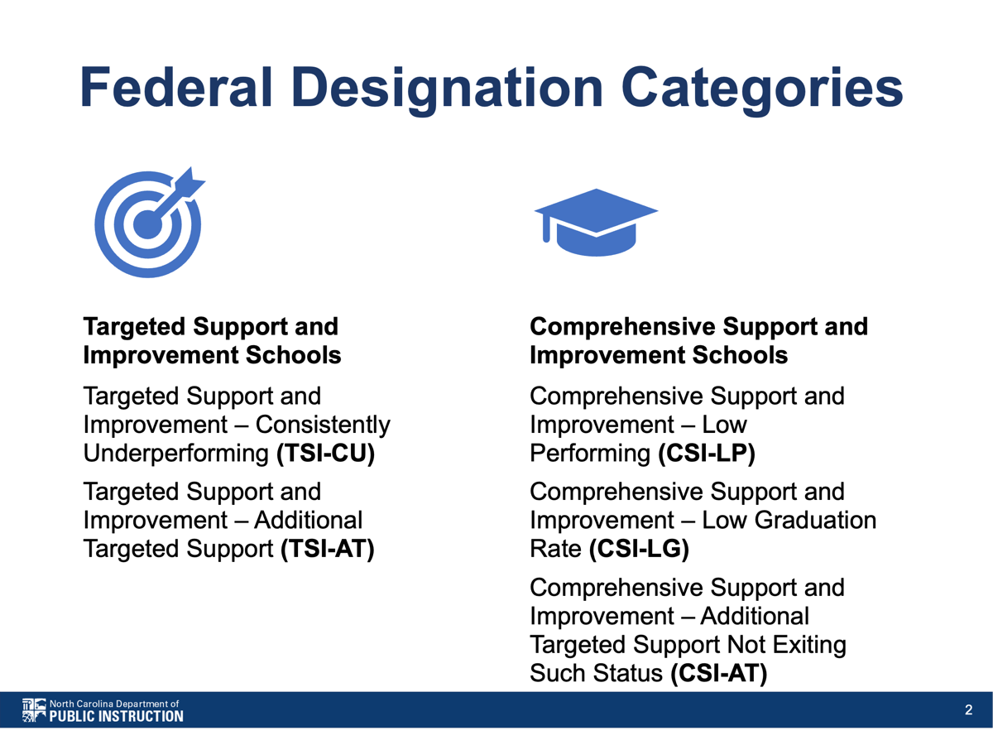
Notes:
When we talk about Targeted Support and Improvement – Consistently Underperforming, we are focusing on schools where specific subgroups have shown persistent underperformance over time. A school is identified as TSI-CU when one or more of the same student subgroups have earned a letter grade of ‘F’ on the School Performance Grades for the most recent year and two previous years. In short, the concern is not based on a single year’s result, but on a pattern of underperformance across three consecutive years. To exit the TSI-CU designation, those same subgroups must demonstrate sustained improvement by earning a letter grade of ‘D’ or higher for both the most recent year and the previous year. This shows that the strategies being implemented are not only improving outcomes but maintaining progress over time. Now let’s review Targeted Support and Improvement – Additional Targeted Support. A school is identified as TSI-AT which we also refer to as ATSI when any of its student subgroups perform below the All Students subgroup score of the highest-performing CSI-identified school. In addition, that school must also have one or more subgroups that have been identified as TSI-CU in the same year. To exit the ATSI designation, a school must show clear and sustained improvement for the identified subgroups. A school can meet exit criteria in one of three ways: 1. The identified subgroup achieves a 1.0 growth index or higher in the current and two previous years. 2. The subgroup is on track to meet its twelve-year proficiency goal in reading and math, or 3. There is no longer any subgroup whose performance falls at or below the CSI-LP threshold, and previously identified subgroups show measurable improvement in their school performance grade scores compared to when they were first identified. In short, the goal is to demonstrate both progress and sustainability, that the strategies in place are producing meaningful gains for historically underperforming subgroups. Let’s look at the Comprehensive Support designations. CSI-Low Performing schools represent the lowest-performing five percent of Title I schools in the state based on the school performance grade score. CSI-Low Graduation Rate schools have graduation rates below 67 percent. Then we have CSI-Additional Targeted – these are schools that were previously ATSI and did not exit ATSI status by the end of the six-year identification period. Once identified, schools remain in the cohort for three years, giving them time to implement and demonstrate improvement. It’s important to understand how schools demonstrate progress toward exiting their CSI designation. For CSI-LP, a school must meet its measure of interim progress for the all students subgroup in all subjects. In addition, the school must perform above the lowest five percent of Title I served schools for both the most recent and previous school year. This shows that improvement is not only achieved but sustained over time. For CSI-LG, the exit criteria require that the school’s graduation rate exceeds 66.7% in both the most recent and previous year. Again, the emphasis is on consistent improvement rather than a single-year gain. For CSI-AT, the exit criteria align with those used for ATSI in the exit year.

Slide 8
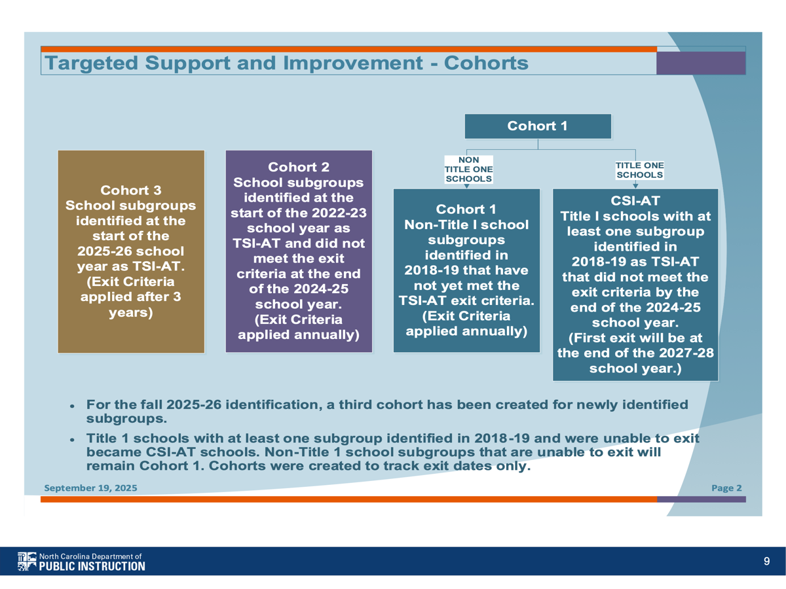
Notes:
Read the bullets on the slide.

Slide 9
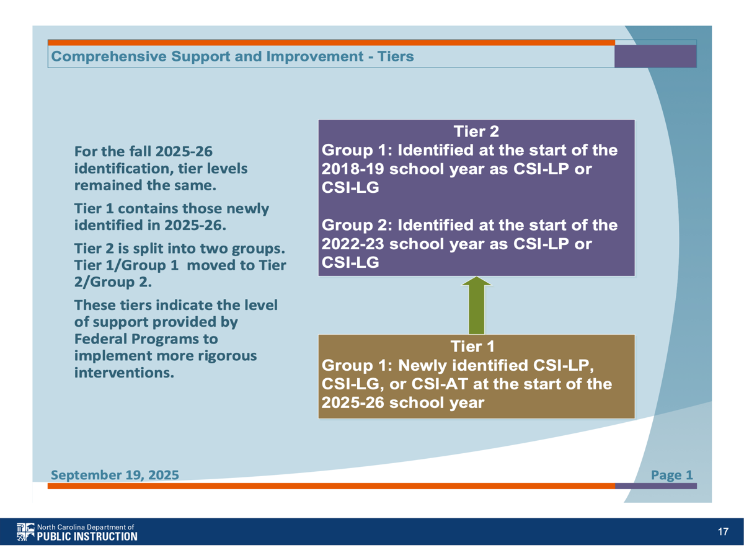
Notes:
Read the bullets on the slide and then read the following:
For any additional information or clarification regarding identification or exit criteria, please reach out to your testing and accountability staff within your PSU. The NCDPI Office of Accountability and Testing is responsible for creating and maintaining the official identification lists for CSI and TSI schools. The Office of Federal Programs Comprehensive and Targeted Support Team then works directly with PSUs to provide guidance, technical assistance, and support for schools included on the CSI and TSI lists.

Slide 10

Comprehensive and Targeted Support Implementation Overview 2025 - 2028

Slide 11
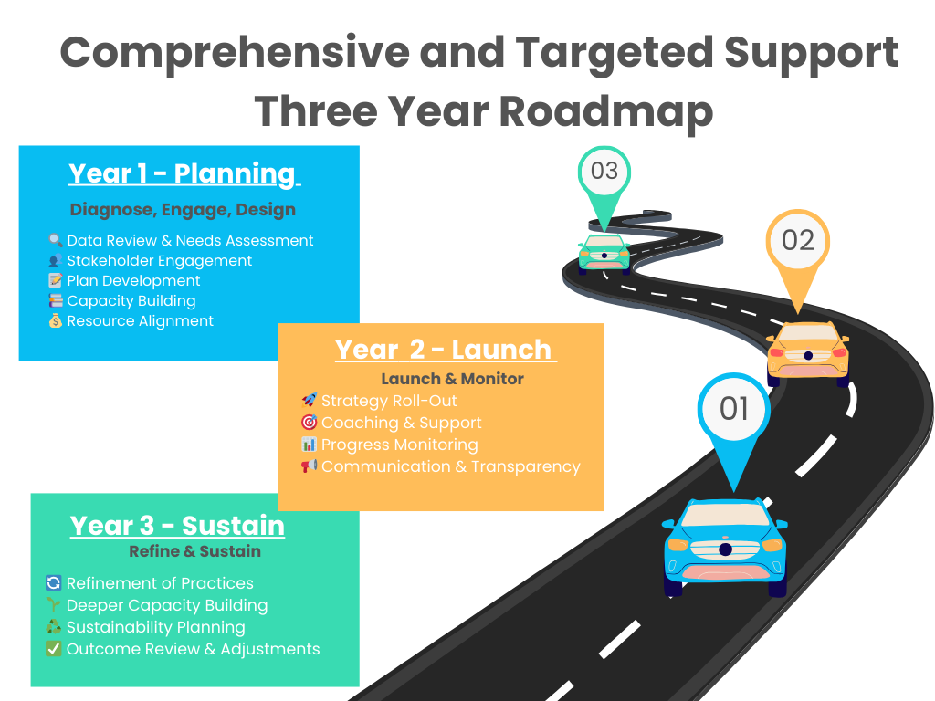
Notes:
Here’s the big picture for the three-year cycle. Year One – that’s where we are now – is the Planning Year: Diagnose, Engage, and Design. Next year, 2026-27, we move into Implementation: Launch and Monitor. And then 2027-28 is about Refining and Sustaining the work. That progression mirrors the natural cycle of improvement: build the foundation, implement with fidelity, and then embed practices that last beyond the grant.

Slide 12
Support and Improvement Requirements,
by School Identification
Support and Improvement Plan Requirements | CSI | ATSI | TSI - CU
Entity Responsible for Developing Plan | PSU (for each CSI school) | School | School
Developed in Partnership with Stakeholders, including Principals and Other School Leaders, Teachers, Parents, and, as applicable, Tribes | Required | Required | Required
Based on a Needs Assessment | Required | Recommended | Recommended
Informed by All Indicators in the State’s Accountability System | Required | Required | Required
Includes Evidence-Based Interventions | Required | Required | Required
Identifying and Addressing Resource Inequities (RAR) | Required | Required | Recommended
Approval | Required (by school, PSU, and State) | Required (by PSU only) | Required (by PSU only)
Monitoring the Implementation | Required (by State) | Required (by PSU) | Required (by PSU)
Table B.1 Pg. 19 – Non-Regulatory Guidance – School Improvement and Related Provisions
Notes:
As we look at this chart, it outlines the key requirements for support and improvement plans across CSI, ATSI, and TSI–CU designations.
For Comprehensive Support and Improvement (CSI) schools, the Public School Unit is responsible for developing the plan for each identified CSI school. That plan must be created in partnership with stakeholders, including principals, teachers, parents, and, when applicable, tribal representatives. It’s based on a comprehensive needs assessment (which may be included within the FAM-S), informed by all indicators in the state’s accountability system, and must include evidence-based interventions. In addition, CSI plans must address resource inequities through a Resource Allocation Review, also known as a RAR. Each plan is reviewed and approved at multiple levels; by the school, the PSU, and the State.
The District Level Resource Allocation Review should summarize the findings from each school’s individual RAR self-assessment. For single site PSUs, such as Charter or Lab schools, one primary RAR will be required to capture the Charter or Lab school overall review and findings.
The District, Charter, or Lab approved CSI plans and RARs are required for submission in CCIP for state approval and/or review on or before June 30, 2026.
It’s important to note that the Resource Allocation Review (RAR) is not a one-time activity, it must be completed annually. The information gathered through these annual reviews will be utilized during the comprehensive and targeted support team Resource Allocation Review session held in year 2 and/or year 3 of the cycle to help PSUs evaluate how resources are being aligned to support improvement goals and ensure equitable distribution.
For Additional Targeted Support and Improvement (ATSI) schools, the ATSI plan is developed at the school level, following the same principles of stakeholder engagement, data-driven planning, and evidence-based practices. PSUs are also expected to complete a Resource Allocation Review for ATSI schools to ensure resources are equitably distributed to support subgroup needs. Similar to CSI, It’s important to note that the Resource Allocation Review (RAR) is not a one-time activity, it must be completed annually. The information gathered through these annual reviews will be utilized during the comprehensive and targeted support team Resource Allocation Review session held in year 2 and/or year 3 of the cycle to help PSUs evaluate how resources are being aligned to support improvement goals and ensure equitable distribution.
The District, Charter, or Lab ATSI Resource Allocation Review are required for submission in CCIP for state review on or before June 30, 2026.
For Targeted Support and Improvement – Consistently Underperforming (TSI–CU) schools, the state often refers to this group as a “watch list.” However, it’s important to remember that key planning requirements still apply; stakeholder collaboration, data-based planning, and implementation of evidence-based interventions. Because of this alignment, when PRC 0105 funds are allotted to a PSU, those funds may also be used to support TSI–CU schools, provided the activities are allowable and aligned with the PSU’s approved TSI-CU plan.
As a reminder, we will review RARs in our October 21st Webinar.
Overall, this table reinforces how each designation; CSI, ATSI, and TSI–CU operates within the same framework of improvement. The level of oversight may vary, but the expectations remain consistent: each plan should be inclusive, data-informed, and designed to address resource inequities while building sustainable systems that lead to lasting student success.

Slide 13
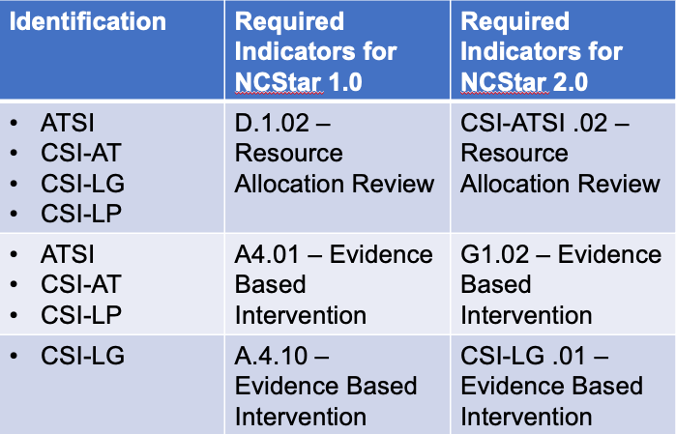
NCStar Required Indicators
https://www.dpi.nc.gov/districts-schools/districts-schools-support/office-school-improvement/school-improvement-planning-and-ncstar#ncstar-info
Notes:
It’s important to note that NCStar is a required platform for all schools identified as CSI or ATSI school. Each PSU will be responsible for providing feedback to its identified schools directly within the NCStar platform.
The Comprehensive and Targeted Support (CTS) team is working collaboratively within the agency to develop guidance and supports to assist PSUs in providing this feedback effectively. CTS will also use NCStar to review PSU feedback and monitor for compliance.
Schools will be required to submit their progress on the indicators by clicking the Comprehensive Plan Report submit button twice each year; once in the fall and once in the spring. While the planning may still be in progress at the time of the December 2025 submission, schools must still click the submit button to capture and document their current progress. By the spring 2026 submission, it is expected that all required indicators are active and include corresponding action steps.
The work within the required indicators should be directly aligned to the school’s CSI and/or ATSI plan. The indicators serve as the living work; reflecting the strategies, action steps, and continuous progress being made to achieve the goals outlined in the CSI and/or ATSI plans.
It is both allowable and encouraged to archive outdated or irrelevant information within the indicators to keep plans accurate and current. Schools should also extend their overall plan timeline to span four to five years, which provides for the three-year identification cycle and an additional period for sustainability. While individual action steps may be designed around one- or two-year timelines, full implementation should extend across four to five years to ensure lasting impact.
Finally, the Notes section in NCStar is essential. It should be used to document the narrative behind the work; how the action steps are being implemented, the progress being made, and lessons learned. This context ensures that when an action step is marked complete, it clearly reflects how and why the work was accomplished.
Training on NCStar is free and available throughout the year. Please visit the link provided on this slide for more information and contacts for NCStar support.

Slide 14

PRC 0105 Funding Allocation

Slide 15
Comprehensive and Targeted Support FY26 - PRC 0105 Funding Allotment
Allocations will be calculated in the first year of the three-year allotment cycle and will remain consistent through the three-years, unless modified by a special provision listed below.
Up to 40% of the funds reserved will be used to provide the base allocation for all CSI-LP and CSI-LG identified schools.
Up to 30% of the funds reserved will be used to provide allocations per CSI-AT and ATSI identified schools.
Notes:
Allocations are calculated in the first year of the three-year allotment cycle and will stay the same for all three years unless adjusted by a special provision in the PRC 0105 allotment policy or changes in the available funding (year 1 may be less than year 2 and 3 due to IPG funding during year 1).
We are projecting up to $30 million per year in PRC 0105 funding.
This slide defines the first part of the PRC 0105 formula. Up to 40% of available PRC 0105 funding will be used to provide a base allocation to CSI-LP and CSI-LG schools, and up to 30% will be used to provide a base allocation to CSI-AT and ATSI schools.

Slide 16
Comprehensive and Targeted Support FY26 - PRC 0105 Funding Allotment
The remaining portion of funds will be allocated through a per-pupil amount to CSI-LP (based on total ADM) and CSI-LG (based on ADM grades 9-12), utilizing the data source of the best 1 or 2 Actual ADM from previous year.
At least 80% of funds must directly support identified schools, with up to 20% allowed for district level admin costs, contracted Charter Management Organization (CMO) support, or contracted institutions of Higher Education (IHE) Lab Schools Support
All identified schools (ATSI, CSI-AT, CSI-LG, and CSI-LP) must benefit
District intentionality with CSI / ATSI plans
Notes:
This slide explains the second part of the formula. Any unallocated PRC 0105 funds are distributed on a per-pupil basis. CSI-LP schools receive funds based on their total ADM, while CSI-LG schools receive funds based on grades 9-12 ADM. If a school is identified as both CSI-LP and CSI-LG, total ADM is used. The ADM is determined using the data source from the best 1 of 2 ADM from the prior fiscal year.
At least 80% of the total PRC 0105 allotment must be directed to CSI and TSI identified schools. Up to 20% may be used for district-level administration, contracted Charter Management Organizations, or Lab Schools partnered with an institution of higher education.
While the formula is used to distribute funds to PSUs, once received, the PRC 0105 funding is not restricted by the formula. PSUs must ensure that all identified CSI and ATSI schools receive support. Funds may be distributed based on current data and needs to any CSI / TSI identified schools within the PSU. This includes any unexpended PRC 0105 funds from FY25/GY35 that remained as of September 30, 2025.
FY26 (Year 1) funding is anticipated to be available as early as November, while FY27 (Year 2) and FY28 (Year 3) funding are expected to be available as early as July or August of their respective fiscal years.

Slide 17
Attestations
A. The PSU attests that at least 80% of PRC 0105 funds will directly support identified CSI/TSI schools, with up to 20% allowable for district-level administrative costs, contracted Charter Management Organization (CMO) support, or contracted Institutions of Higher Education (IHE) Lab School support.
B. The PSU attests that all identified CSI/ATSI schools will utilize NCStar for school improvement planning with fidelity, including completion of all required indicators.
C. The PSU attests that the Parent Notification Letter will be developed and distributed on or before November 30th annually to meet federal and state communication requirements.
D. The PSU attests that all PRC 0105-funded activities align directly with the strategies and interventions identified in the approved CSI/TSI plan at the school and PSU levels.
E. The PSU acknowledges that PRC 0105 funds are temporary and supplemental, intended to accelerate improvement in CSI/TSI schools so that, when funds expire, effective systems and evidence-based practices remain in place to sustain continued progress.
F. The PSU attests that all PRC 0105-funded expenditures are:
a. Necessary to carry out the approved CSI/TSI plan and directly support improved outcomes; and
b. Reasonable, reflecting sound fiscal judgment and cost-effectiveness
G. The PSU attests that PRC 0105 funds are used to supplement, not supplant, other funding sources, and that activities enhance or expand services beyond what is otherwise required or funded through other programs.
H. The PSU attests that PRC 0105-funded activities are designed to build capacity and implement systems that can be sustained beyond the availability of PRC 0105 funds.
I. The PSU attests to fully supporting all CSI and ATSI identified schools within the PSU through coordinated leadership, monitoring, data analysis, resource allocation review (RAR) and technical assistance.
J. The PSU attests to active collaboration with NCDPI staff and compliance with required supports, monitoring, and reporting processes established for CSI/TSI identified schools.
Notes:
Exciting news! This year, the Attestations will serve as the PRC 0105 application. The application will open in CCIP as soon as the allotment formula is finalized, approved, and synced. Potentially as early as November! This streamlined process will make it quicker and easier for PSUs to confirm compliance and begin planning.
Parent Notification Letters are a required component for all schools identified as CSI or ATSI. Each school must develop and distribute the letter on or before November 30, 2025, and annually thereafter for the duration of the identification cycle.
It is fully understood that this year’s letter may not yet include detailed activities, since 2025–26 serves as the planning year. However, the letter should clearly communicate the school’s identification status, note that this is a planning year, and inform families that specific strategies and activities will be shared in next year’s letter, by November 30, 2026.
The Parent Notification Letter must be distributed directly to families; for example, through book bag delivery or another direct communication method, to ensure all parents and guardians receive the information.
To assist with this process, sample Parent Notification Letters are available on the Office of Federal Programs – Comprehensive and Targeted Support (CTS) website. These samples can be used to help schools meet communication requirements.

Slide 18
CSI/TSI Expenses
Activity | Approved ✅ | Not Approved ❌
Hiring tutors for subgroup gap intervention | ✅
Paying for staff holiday party |  | ❌
Purchasing evidence-based reading software | ✅
Buying school mascot costumes |  | ❌
Professional development in Science of Reading | ✅
Gift cards for student attendance incentives |  | ❌
Stipends for teachers leading after-school tutoring | ✅
Paying off old district debt |  | ❌
Translating parent communication materials | ✅
Refreshments for weekly staff lounge |  | ❌
Notes:
As we review allowable and non-allowable expenses under PRC 0105, it’s important to ensure that all CSI and TSI expenditures directly align with the approved CSI / TSI plan, support evidence-based strategies, and meet federal cost principles of being necessary, reasonable, and allocable.
Hiring tutors for subgroup gap intervention
Yes
Directly supports evidence-based interventions to close achievement gaps.
Paying for staff holiday party
No
Not an educational expense; federal funds cannot be used for entertainment or social activities.
Purchasing evidence-based reading software
Yes
Supports evidence-based instructional strategies.
Buying school mascot costumes
No
Not tied to instructional improvements or evidence-based interventions.
Professional development in Science of Reading
Yes
Evidence-based professional learning directly tied to improving student outcomes.
Gift cards for student attendance incentives
No
Incentives such as gift cards are considered unallowable under federal guidance.
Stipends for teachers leading after-school tutoring
Yes
Supports extended learning opportunities and evidence-based interventions; stipends are allowable when tied to extra duties outside of the normal billable hours.
Paying off old district debt
No
Federal funds cannot be used to cover prior debts or liabilities.
Translating parent communication materials
Yes
When it ensures meaningful family engagement and access, is directly tied to the approved CSI/TSI plan and is used solely for activities outlined in the plan (not for general translation needs outside the approved CSI/TSI plan).
Refreshments for weekly staff lounge
No
Refreshments not tied to parent engagement are unallowable.

Slide 19
2025–26 Year at a Glance Fall 2025: Planning and Identification
October 1–2, 2025: Official CSI/TSI Identification List Approved
October 3, 2025: NCStar Fall Comprehensive Plan Submitting Window Opens for all CSI and ATSI schools to begin entering indicator information and initial progress updates.
October 8, 2025: In-Person CTS Support Session at NCFEPA This session provided clarity and support around CSI and TSI identifications, explaining what the designations mean, their associated requirements, and the framework of support available to PSUs.
October 15, 2025: CTS Webinar – Understanding CSI/TSI Identifications (similar to the Oct. 8 in-person NCFEPA session)
October 21, 2025: CTS Webinar – Strengthening Improvement Efforts Focuses on practical strategies to enhance PSU improvement efforts, including NCStar support, evidence-based interventions, parent and family engagement, resource allocation reviews, and MTSS integration/support.
Early November 2025: FY26 PRC 0105 Funding Available and CCIP application opens (Tentative) Funding anticipated to open as early as November, pending allotment formula approval and syncing.
November 5, 2025: CTS Webinar – PRC 0105 CCIP Application Support Assists PSUs with completing the PRC 0105 CCIP application; includes step-by-step guidance and submission tips (including related documents for future submissions).
November 12, 2025: CTS Webinar – Implementation Q&A and Updates This session will provide an opportunity to follow up feedback from the field and address questions raised during previous sessions. Participants will receive clarifications, additional guidance, and practical updates to support continued implementation efforts and what can be expected moving forward.
November 30, 2025: Parent Notification Letters Due Letters must be developed and distributed directly to families (e.g., via book bag) on or before November 30 each year. For this planning year, letters should explain the identification status and note that specific activities will be shared by November 30, 2026.
December 6, 2025: NCStar Fall Comprehensive Plan Report Closes (Due) Fall submission captures current indicator progress for CSI and ATSI schools.
December 15, 2025 (Tentative): PRC 0105 CCIP Applications Due Attestations will serve as the PRC 0105 application; the application opens once the allotment formula is finalized, approved, and synced.
Notes:
As we move into the fall, here’s a look at the key milestones that set the foundation for the 2025–26 planning year.
On October 1st and 2nd, the State Board of Education approved the official CSI and TSI identification lists, officially launching the new support cycle. Then, beginning October 3rd, the NCStar Fall Comprehensive Plan submission window opened, allowing all CSI and ATSI schools to begin entering required indicator information and documenting early progress.
We kicked off support for PSUs through our in-person CTS session at NCFEPA on October 8th, where we walked through what these designations mean, the associated requirements, and the overall framework of support. Similar content is being shared again during this CTS webinar, ensuring that everyone has access to this information.
On October 21st, our next webinar focused on strengthening improvement efforts — highlighting practical strategies to enhance NCStar planning, implement evidence-based interventions, increase family engagement, and align resource allocation reviews as well MTSS avaiable supports.
Moving into early November, FY26 PRC 0105 funding and the CCIP application are anticipated to open once the allotment formula is finalized and synced. To support PSUs through that process, we’ll hold a PRC 0105 CCIP Application Support Webinar on November 5th, which will provide step-by-step guidance on completing the application and understanding future submission requirements.
Then, on November 12th, we’ll host an Implementation Q&A and Update Session to address feedback from the field, clarify lingering questions, and share practical updates as PSUs move deeper into the planning year.
By November 30th, all Parent Notification Letters must be developed and distributed directly to families — for example, through book bag delivery. This year’s letter should explain the identification status and clarify that 2025–26 is a planning year, with activities to be shared in next year’s communication.
Finally, as we wrap up the semester, the NCStar Fall Comprehensive Plan Report closes on December 6th, and PRC 0105 CCIP applications are tentatively due December 15th. This completes the first phase of the planning year.

Slide 20
2025–26 Year at a Glance Spring 2026: Planning and Submission
January 12, 2026: Onsite Support Sessions and Charter/Lab School Regional Convenings CTS team will begin onsite District support sessions and Charter/Lab School Regional Convenings. The full schedule for these visits and sessions will be shared by the first week of December to allow PSUs time to plan.
March 1, 2026: NCStar Spring Comprehensive Plan Report Opens Schools update progress and ensure all required indicators and action steps are active and aligned with CSI/ATSI plans.
June 30, 2026: NCStar Spring Comprehensive Plan Report Closes (Due) Final spring submission due. Each school’s Resource Allocation Review (RAR) self-assessment should be uploaded into the Resource Allocation Review Required Indicator D.1.02 or CSI-ATSI .02 (Initial Assessment).
June 30, 2026: CSI Plans Due in CCIP (Related Documents) CSI plans must be submitted for SEA approval on or before June 30.
June 30, 2026: CSI & ATSI Resource Allocation Reviews (RARs) Due in CCIP (Related Documents) PSU-level RARs must be submitted for SEA review on or before June 30.
June 30, 2026: CSI Needs Assessment Due in CCIP (Related Documents) Needs Assessments submitted for SEA review; may include need assessment uploads or directions for where to locate (NCStar, FAM-S, etc.).
June 30, 2025: PSU NCStar Feedback Due PSUs provide feedback reflecting progress, data review, requirements, and alignment of action steps with the CSI / ATSI plan. Feedback must confirm active monitoring or required indicators.
Notes:
As we transition into the spring, our focus shifts from planning to documenting progress and preparing required submissions for SEA review/approval.
Beginning January 12, 2026 the CTS team will begin onsite District support sessions and Charter/Lab school regional convenings. The full schedule for these visits and sessions will be shared by the first week of December to allow PSU time to plan.
March 1, 2026, the NCStar Spring Comprehensive Plan Report window opens, giving schools the opportunity to update their progress and ensure that all required indicators and action steps are active, current, and clearly aligned with their approved CSI or ATSI plans. This spring submission marks the midpoint of the planning cycle and should reflect meaningful movement toward implementation readiness.
By June 30, 2026, the NCStar Spring Comprehensive Plan Report closes, marking the final submission opportunity for the year. Each school must also ensure to have uploaded its Resource Allocation Review (RAR) self-assessment into the Resource Allocation Review Required Indicator — D.1.02 or CSI-ATSI.02 — under the Initial Assessment section. This documentation demonstrates how resources are being analyzed and aligned to support identified needs and improvement strategies.
Also due by June 30, 2026, are several key submissions in CCIP Related Documents.
CSI Plans must be submitted for SEA approval, reflecting the district’s comprehensive planning and alignment with school-level efforts.
PSU CSI and ATSI Resource Allocation Reviews (RARs) are required for SEA review, summarizing findings from each school’s self-assessment and identifying areas for continued support.
The CSI Needs Assessment must also be submitted for SEA review either as an upload or with clear directions on where the needs assessment can be found, such as within NCStar or where the FAM-S can be located for accessible review.
Finally, by June 30, 2026, PSU feedback in NCStar is also due. Each PSU must provide detailed feedback reflecting the school’s progress, use of data, and the alignment of action steps with the CSI or ATSI plan. Feedback should confirm that required indicators are being actively monitored and that continuous improvement is underway.
As a reminder, we will review NCStar and required documents in our October 21st Webinar which will also be recorded and made available on our website.

Slide 21


Dr. James Popp – CTS Section Chief
james.popp@dpi.nc.gov (984) 236-2801
Dr. Penny Crooks – CTS Program Administrator
penny.crooks@dpi.nc.gov (984) 236-2978
Julia Higdon – CTS Program Administrator
julia.higdon@dpi.nc.gov (828) 361-5277
Dr. Richard Lewis – CTS Program Administrator
richard.lewis@dpi.nc.gov (980) 533-5071
Tenisea Madry – CTS Program Administrator
tenisea.madry@dpi.nc.gov (984) 236-2886
Notes:
Our CTS team is available to provide guidance, technical assistance, and ongoing support to help your PSU navigate CSI and TSI requirements. Each Program Administrator will be reaching out this fall to offer virtual one-on-one office hours to answer questions and provide individualized support. PSUs are also encouraged to reach out at any time to schedule additional support sessions as needed.

Slide 22
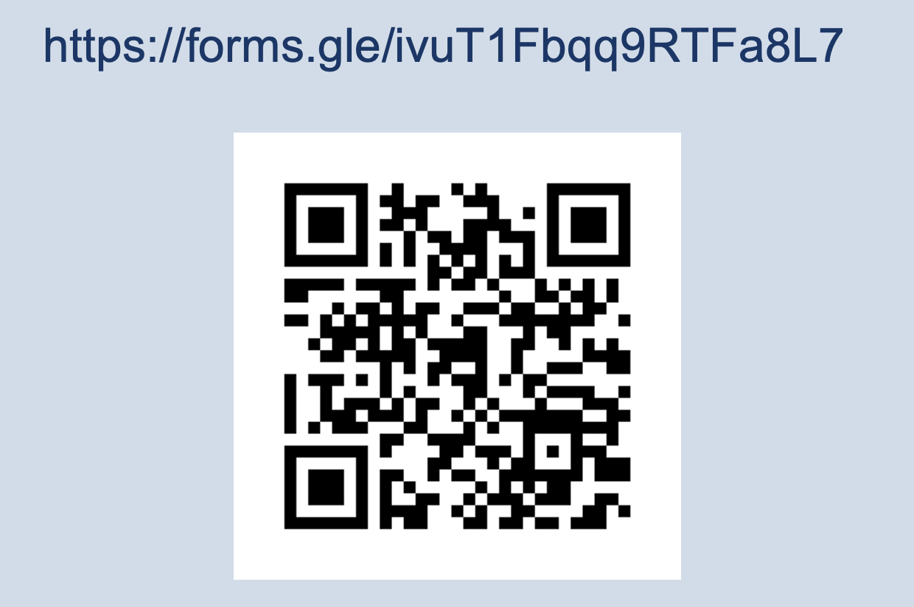
We Value your feedback
Notes:
Thank you for joining today’s session! Your input helps us strengthen the support and resources we provide across the state. Please take a few moments to share your feedback on today’s presentation — what was helpful, what could be clearer, and what additional topics you’d like us to cover in future sessions.
Your insights guide our continuous improvement, just as we support yours! Thank you

