Slide 1

Targeted Support and Improvement
Identification and Exit Criteria
Updated May 2024
Notes:
This presentation will share the 2023-24 exit criteria and the 2024-25 identification criteria for schools federally designated as Targeted Support and Improvement Consistently Underperforming (commonly referred to as TSI-CU) and Targeted Support and Improvement Additional Targeted Support (which is commonly referred to as TSI-AT or ATSI). These designations are applied to schools if they have a subgroup within the school that meets the conditions documented in the ESSA State Plan. This information will be discussed further on the upcoming slides.

Slide 2
Targeted Support and Improvement
Consistently Underperforming
Notes:
The first federal designation is Targeted Support and Improvement Consistently Underperforming. This is referred to as the annual watch list.

Slide 3
Targeted Support and Improvement- Consistently Underperforming
2023–24 Exit Criteria | 2024–25 Identification Criteria
Achieve a letter grade of “D” or higher (School Subgroup Performance Grade) for previously identified subgroup(s) in the most recent and previous year. | One or more of the same subgroup(s) with a designation of “F” (School Subgroup Performance Grade) for the most recent and previous two years.
*Annual Exit and Identification
Notes:
At the end of the 2023-24 school year, TSI-CU schools will have exit criteria applied to their targeted subgroup or subgroups to see if they can exit the status. If the targeted subgroup or subgroups achieve a subgroup school performance grade of D or higher for the 2022-23 and 2023-24 school year, those subgroups will exit this status. The school will continue with this designation until there are no longer identified subgroups and all subgroups have exited this status.
At the beginning of the 2024-25 school year, more subgroups will be identified as TSI-CU using 2023-24 data. Subgroups will be identified if they received a subgroup school performance grade of F for the 2021-22, 2022-23, and 2023-24 school years. This federal designation is identified and exited annually.

Slide 4
Targeted Support and Improvement
Additional Targeted Support
Notes:
The next federal designation for Targeted Support and Improvement is Additional Targeted Support not exiting such status.

Slide 5
Targeted Support and Improvement-Additional Targeted Support
2023–24 Exit Criteria | 2025–26 Identification Criteria
Identified subgroup(s) achieve a three-year growth index of 1.0 or higher; or are on track to meet the subgroup(s) twelve-year proficiency goals in reading and math; or there is no longer a subgroup whose overall performance as measured by the School Performance Grade score is at or below the score designated for CSI-LP identification and previously identified subgroup(s) improved performance on the School Subgroup Performance Grade score as compared to the score at the time of identification. | Subgroup(s) performance grade is at or below the highest CSI-LP identified school, and the school’s subgroup(s) is identified as TSI-CU in the identification year.
Notes:
At the end of the 2023-24 school year, TSI-AT schools will have exit criteria applied to their targeted subgroup or subgroups to see if they can exit the status. There are three ways these subgroups can exit this status. The first way is if the subgroups achieve a three-year growth index of 1.0 or higher. For clarification, the three-year growth index calculation will require three years of growth indices, be an average of the index scores, use the most recent three years of available data, and require a minimum-n of thirty students for each of the three years used.
The next way subgroups can exit is if they are on track to meet their long-term goals in both reading and math.
The last way subgroups can exit is if their subgroup school performance grade is above the score designated for CSI-LP identification (this is currently 32), and the subgroup must have shown improvement on the subgroup school performance grade from the time of identification. As indicated earlier, the school will continue with this designation until they no longer have an identified subgroup and all subgroups have exited this status.
At the beginning of the 2025-26 school year, more subgroups will be identified as TSI-AT using 2024-25 data. Subgroups will be identified as TSI-AT if their subgroup performance grade is at or below the highest CSI-LP identified school, and the subgroup was also identified as TSI-CU in the identification year. For clarification, the score designated for CSI-LP identification is recalculated at the time of CSI-LP identification. This score is currently 32 but will be recalculated at the time of this identification.

Slide 6
Notes:
TSI-AT designated subgroups cannot exit this status until three years have passed from the time of identification. After that, the subgroup can exit annually for an additional three years. Because of this, cohorts have been established to track identification years.
At the beginning of the 2025-26 school year, cohort 3 will be established. These newly identified subgroups will be unable to exit for 3 years.
Cohort 2 contains subgroups that were identified at the beginning of the 2022-23 school year. These subgroups will have the ability to exit annually. This first exit is early but allows us to be back on track with the ESSA State Plan. This cohort will continue to exit annually for the next three years.
Cohort 1 contains the subgroups that were identified in the 2018-19 school year. At the end of the 2023-24 school year this cohort will have the ability to exit. The subgroups in cohort 1 that are not Title 1, will remain in cohort 1 with the ability to exit annually.
For the 2025-26 fall identification, Title 1 subgroups that are unable to exit will move to the comprehensive support and improvement- additional targeted support designation (commonly referred to as CSI-AT). Once the subgroup is in this status, they will not have the ability to exit for four years.

Slide 7
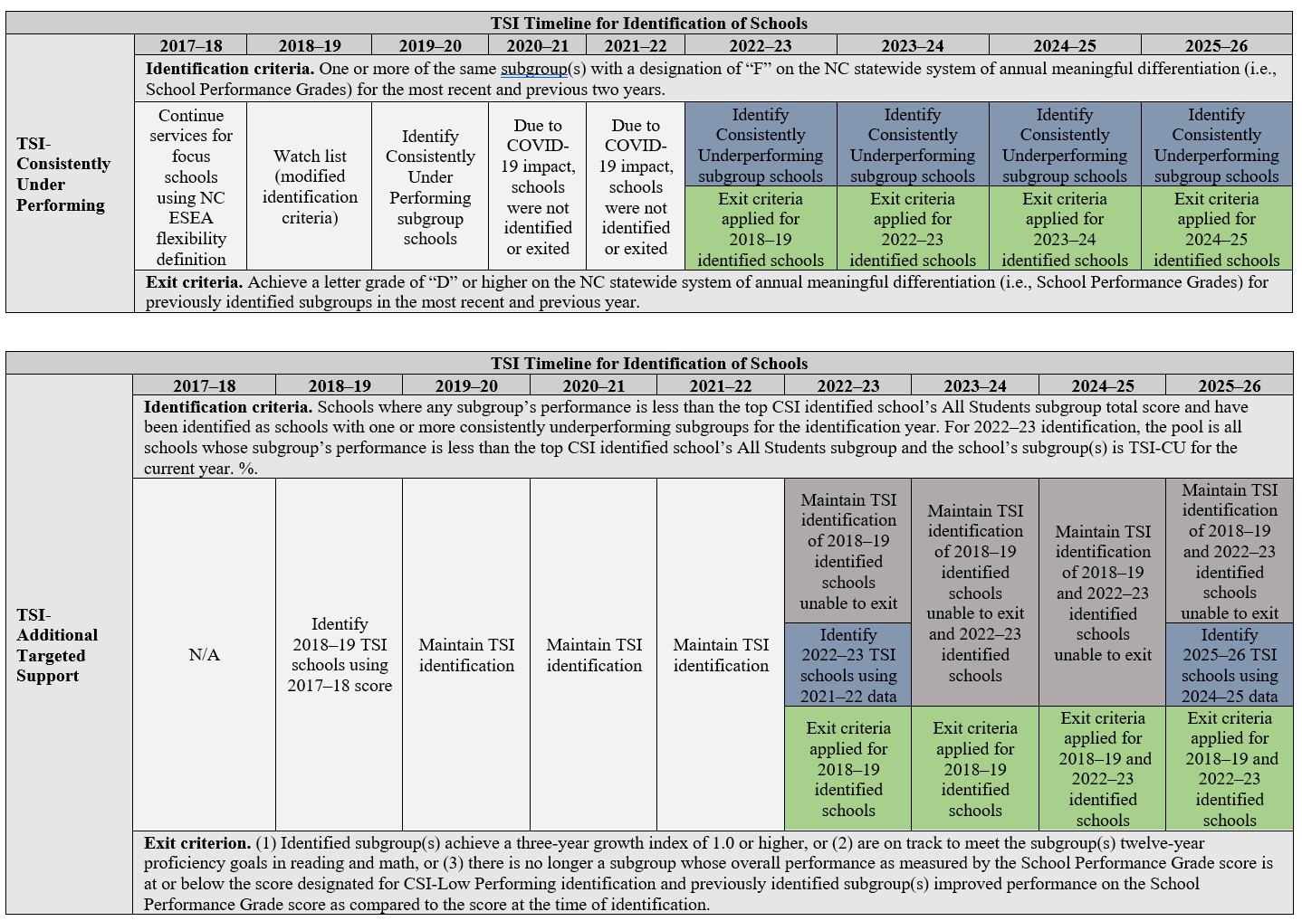
Notes:
The following screen shots are available in the ESSA State Plan but help schools see exits and identifications visually. As you can see TSI-CU is an annual identification and exit.

Slide 8
Notes:
TSI-AT will have exit criteria applied to both cohort 1 and 2. Cohort 3 will be newly identified in the fall of the 2025-26 school year. At that time, Title 1 subgroups that were unable to exit will become CSI-AT.

Slide 9
Designation Timeline
2023–24 School Year | Action
End of the 2023–24 school year | TSI-CU exit criteria applied
End of the 2023–24 school year | TSI-AT exit criteria applied (Cohort 1 and Cohort 2)
2024–25 School Year | Action
Beginning of 2024–25 school year | TSI-CU will be identified
Due to the 2024 amendment, there will not be any new CSI or TSI-AT designations at the beginning of the 2024-25 school year.
Notes:
On this slide you can see the upcoming exits and identifications. At the end of the 2023-24 school year only TSI-CU and TSI-AT will have the ability to exit. Due to the 2024 amendment, only Targeted Support and Improvement- Continually Underperforming will be identified at the beginning of the 2024-25 school year.

Slide 10
Frequently Asked Questions
Notes:
At this time, I will shift to address some frequently asked questions.

Slide 11
Question 1: Who do I ask if I have more questions about identification and exit criteria?
Notes:
Question 1: Who do I ask if I have more questions about the identification and exit criteria? Public school units can reach out to their accountability district testing coordinator for assistance.

Slide 12
Question 2: Who do I ask if I have questions about compliance and federal funding?
Notes:
Question 2: Who do I ask if I have questions about compliance and federal funding? Public school units can reach out to federal programs. Pauletta Thompson is the contact for Targeted Support and Improvement questions regarding compliance and funding.

Slide 13
Question 3: Where can I look to see if my school has a federal designation?
Notes:
Question 3: Where can I look to see if my school has a federal designation? Public school units can reach out to their accountability district testing coordinator. The public school unit testing coordinator has access to this information.

Slide 14
Question 4: How do I know the reason why my school exited the designation?
Notes:
Question 4: How do I know the reason why my school exited the designation? Public school units can reach out to their accountability district testing coordinator. The public school unit testing coordinator has access to this information.

Slide 15
Question 5: How do I exit the designation if I am a K–2 school?
Notes:
Question 5: How do I exit the federal designation if I am a K-2 school? K-2 schools are identified as TSI schools based on the school they feed into in an identification year. When exit criteria is applied for a TSI identification, if the school that identified the K-2 school is exited, so is the K-2 school. If, in a future identification year for the same TSI identification currently assigned, the K-2 school is feeding into a different school, the K-2 school will assume the status of the new school and will be dropped from the previous school’s identification status.

Slide 16
Question 6: Can my school be put back on the list if they just exited?
Notes:
Question 6: Can my school be put back on the list if they just exited? Yes, it is possible for a school to exit status and then be reidentified with a different subgroup or reidentified with the same subgroup when the cutoff score for CSI-LP is recalculated.

Slide 17
Notes:
Thank you for time. If you have any questions, please contact your district accountability testing coordinator.

