Slide 1
Prior Year Refunds

Slide 2
Refunding State with Local Funds

Slide 3
Prior Year Refund (PYR)- Refunding State with Local Funds
LEA will send the PYR BUD Batch
Year ending: 06/30/2024 Creation date: 07/12/2023 Batch #: 2 Trans type: PYR
F Purp Prc Obj Amount
- ---- --- --- ---------------
1 5110 001 121 3,000.00-
1 5110 001 211 227.79-
1 5110 001 221 735.00-
1 5110 001 231 438.72-
Fund 1 Total 4,401.51-
2 5110 001 121 3,000.00
2 5110 001 211 227.79
2 5110 001 221 735.00
2 5110 001 231 438.72
Fund 2 Total 4,401.51
Since the batch contains certified salary account codes, this batch will process through the salary compliance system (LicSal).
For batches without certified salary account codes, DPI will process the batches as Approved.
DPI will send the Communication form to the LEA
LEA posts the State Refund to their general ledger as an adjusting entry. – PYR State Expenditure Refunds are not included in the LEA’s monthly MFR file.

Slide 4
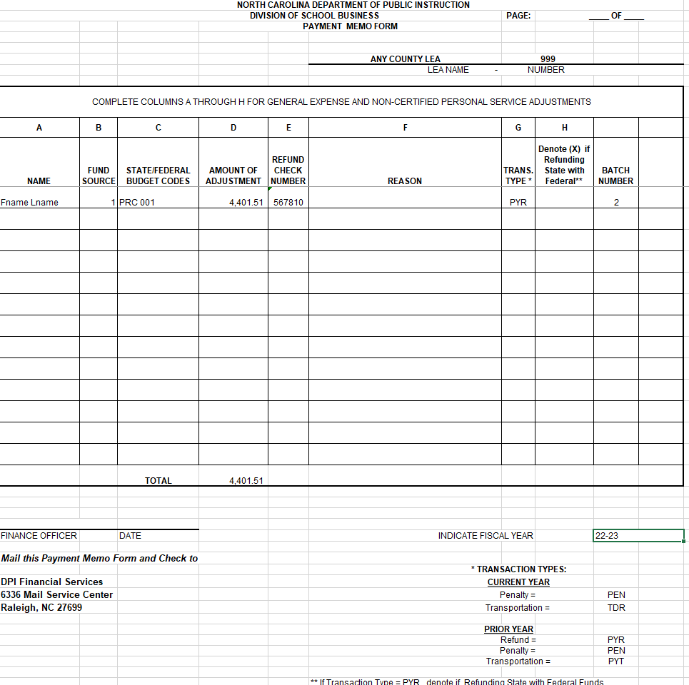
LEA will send check to DPI Financial Services with a Payment Memo that includes the batch number(s). Example of Payment memo for a batch that has certified salaries.

Slide 5
Check Memo Form
Please Note:
BATCH NUMBER(s) must be included on the Memo.
For Batches with Certified Salaries – Do NOT include salary detail information - include
Only Summary Adjustment Amounts and Budget Codes
FISCAL YEAR
MAIL CHECK AND CHECK MEMO Form to:
DPI Financial Services
6336 Mail Service Center
Raleigh NC 27699

Slide 6
Refunding Federal with Local Funds

Slide 7
Prior Year Refund (PYR)- Refunding Federal with Local Funds
LEA will send the PYR BUD Batch
Year ending: 06/30/2024 Creation date: 07/18/2023 Batch #: 600 Trans type: PYR
F Purp Prc Obj Amount
- ---- --- --- ---------------
2 5110 001 121 5,000.00
2 5110 001 211 382.50
Fund 2 Total 5,382.50
3 5110 050 121 5,000.00-
3 5110 050 211 382.50-
Fund 3 Total 5,382.50-
Since the batch contains certified salary account codes, this batch will process through the salary compliance system (LicSal)
For batches without certified salary account codes, DPI will process the batches as Approved.
DPI will send the Communication form to the LEA
LEA posts the Federal Refund to their general ledger and the expenditures activity will be included in the LEA’s monthly MFR file.

Slide 8
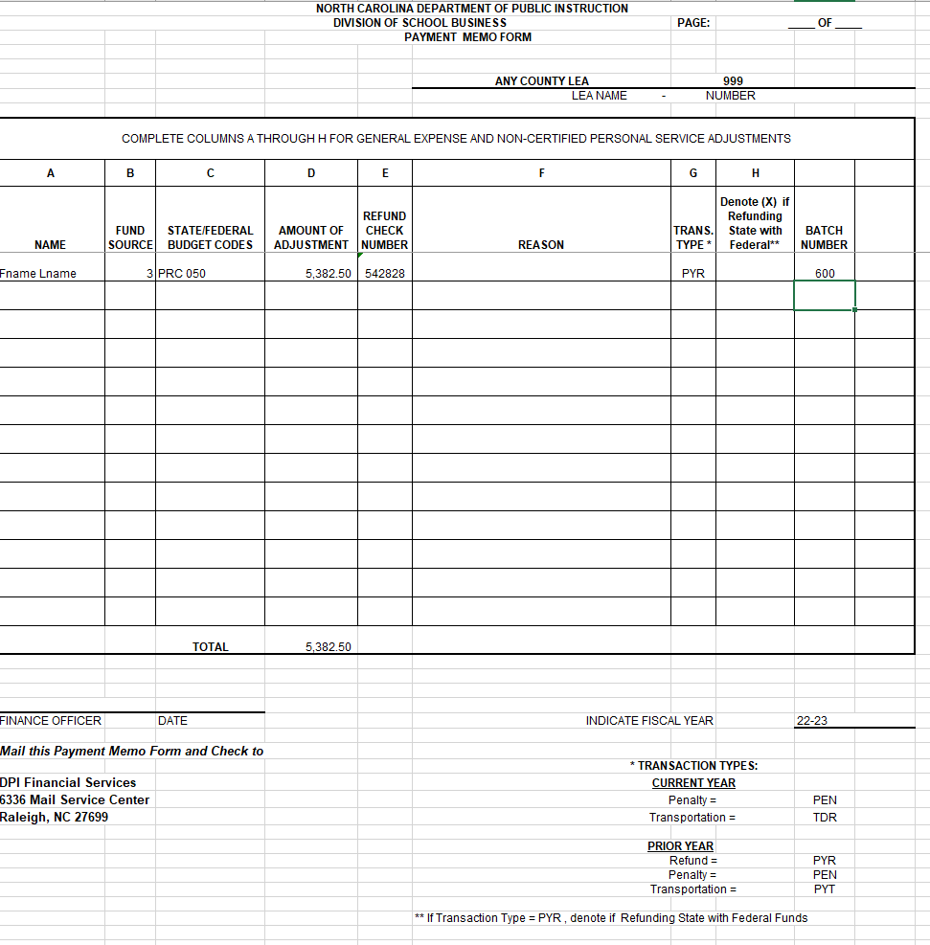
LEA will send check to DPI Financial Services with a Payment Memo that includes the batch number(s).

Slide 9
Check Memo Form
Please Note:
BATCH NUMBER(s) must be included on the Memo.
For Batches with Certified Salaries – Do NOT include salary detail information - include
Only Summary Adjustment Amounts and Budget Codes
FISCAL YEAR
MAIL CHECK AND CHECK MEMO Form to:
DPI Financial Services
6336 Mail Service Center
Raleigh NC 27699

Slide 10
Prior Year Refund (PYR)- Refunding Federal with Local Funds
LEA posts the Federal Refund to their current fiscal year general ledger and the expenditures activity will be included in the LEA’s monthly MFR file. This records the $5,382.50 reduction in the federal expenditures.
After the monthly expenditures are posted, the zero-out will be processed. The reduction in expenditures will result in a negative certification of $5,382.50 to pull the monies back from the LEA for the refund.

Slide 11
Refunding State with Federal Funds

Slide 12
Prior Year Refund (PYR)- Refunding State with Federal Funds
LEA will send the PYR BUD Batch
Year ending: 06/30/2024 Creation date: 08/03/2023 Batch #: 27 Trans type: PYR
F Purp Prc Obj Amount
- ---- --- --- ---------------
1 5830 068 131 1,624.38-
1 5830 068 211 124.27-
1 5830 068 221 371.82-
Fund 1 Total 2,120.47-
3 5330 181 121 1,624.38
3 5330 181 211 124.27
3 5330 181 221 371.82
Fund 3 Total 2,120.47
Since the batch contains certified salary account codes, this batch will process through the salary compliance system (LicSal)
DPI will send the Communication form to the LEA.

Slide 13
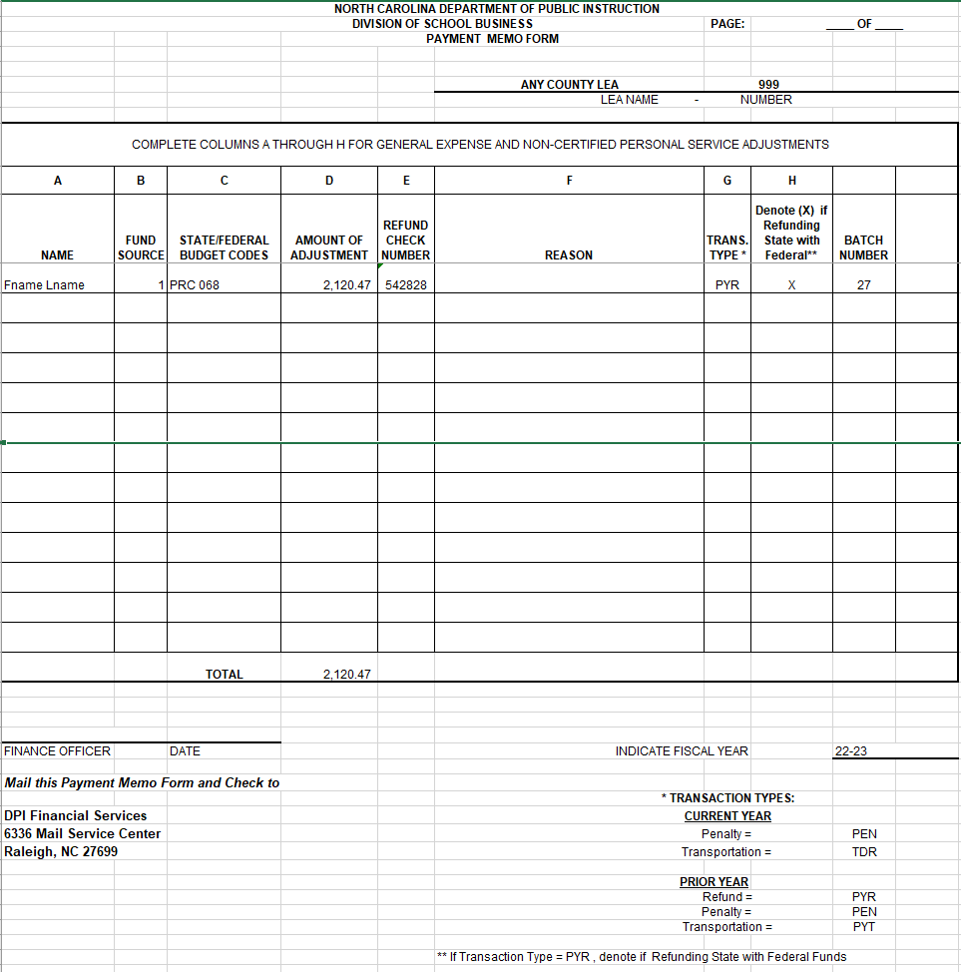
LEA will send the completed Payment Memo to DPI Financial Services. Be sure to include the batch number(s), TransType of PYR and place an X in the Denote (X) if Refunding State with Federal field on the form below. Note: There will be no check sent with the form for this type of Prior Year Refund.

Slide 14
Prior Year Refund (PYR)- Refunding State with Federal Funds
LEA posts the Federal Refund to their current fiscal year general ledger and the expenditures activity will be included in the LEA’s monthly MFR file. This records the $2,120.47 reduction in the federal expenditures.
After the monthly expenditures are posted, the zero-out will be processed. The reduction in expenditures will result in a certification of $2,120.47 to the LEA for the refund.
Financial Services will initiate a transaction to pull the STATE funds back from the LEA's state account at DST.

Slide 15
Prior Year Refund (PYR)- Refunding State with Federal Funds
LEA will send the PYR BUD Batch
Year ending: 06/30/2024 Creation date: 08/03/2023 Batch #: 27 Trans type: PYR
F Purp Prc Obj Amount
- ---- --- --- ---------------
1 5830 068 131 1,624.38-
1 5830 068 211 124.27-
1 5830 068 221 371.82-
Fund 1 Total 2,120.47-
3 5330 181 121 1,624.38
3 5330 181 211 124.27
3 5330 181 221 371.82
Fund 3 Total 2,120.47
Since the batch contains certified salary account codes, this batch will process through the salary compliance system (LicSal)
DPI will send the Communication form to the LEA.

Slide 16
LEA will send the completed Payment Memo to DPI Financial Services. Be sure to include the batch number(s), TransType of PYR and place an X in the Denote (X) if Refunding State with Federal field on the form below. Note: There will be no check sent with the form for this type of Prior Year Refund.

Slide 17
Prior Year Refund (PYR)- Refunding State with Federal Funds
LEA posts the Federal Refund to their current fiscal year general ledger and the expenditures activity will be included in the LEA’s monthly MFR file. This records the $2,120.47 increase in the federal expenditures.
After the monthly expenditures are posted, the zero-out will be processed. The increase in expenditures will result in a certification of $2,120.47 to the LEA for the refund.
Financial Services will initiate a transaction to pull the STATE funds back from the LEA's state account at DST.

Slide 18
Refunding Local with Federal Funds

Slide 19
Prior Year Refund (PYR)- Refunding Local with Federal Funds
LEA will send the PYR BUD Batch
Year ending: 06/30/2024 Creation date: 07/12/2023 Batch #: 34 Trans type: PYR
F Purp Prc Obj Amount
- ---- --- --- ---------------
2 5110 050 121 3,000.00-
2 5110 050 211 227.79-
2 5110 050 221 735.00-
2 5110 050 231 438.72-
Fund 2 Total 4,401.51-
3 5110 050 121 3,000.00
3 5110 050 211 227.79
3 5110 050 221 735.00
3 5110 050 231 438.72
Fund 3Total 4,401.51
Since the batch contains certified salary account codes, this batch will process through the salary compliance system (LicSal).
For batches without certified salary account codes, DPI will process the batches as Approved.
DPI will send the Communication form to the LEA

Slide 20
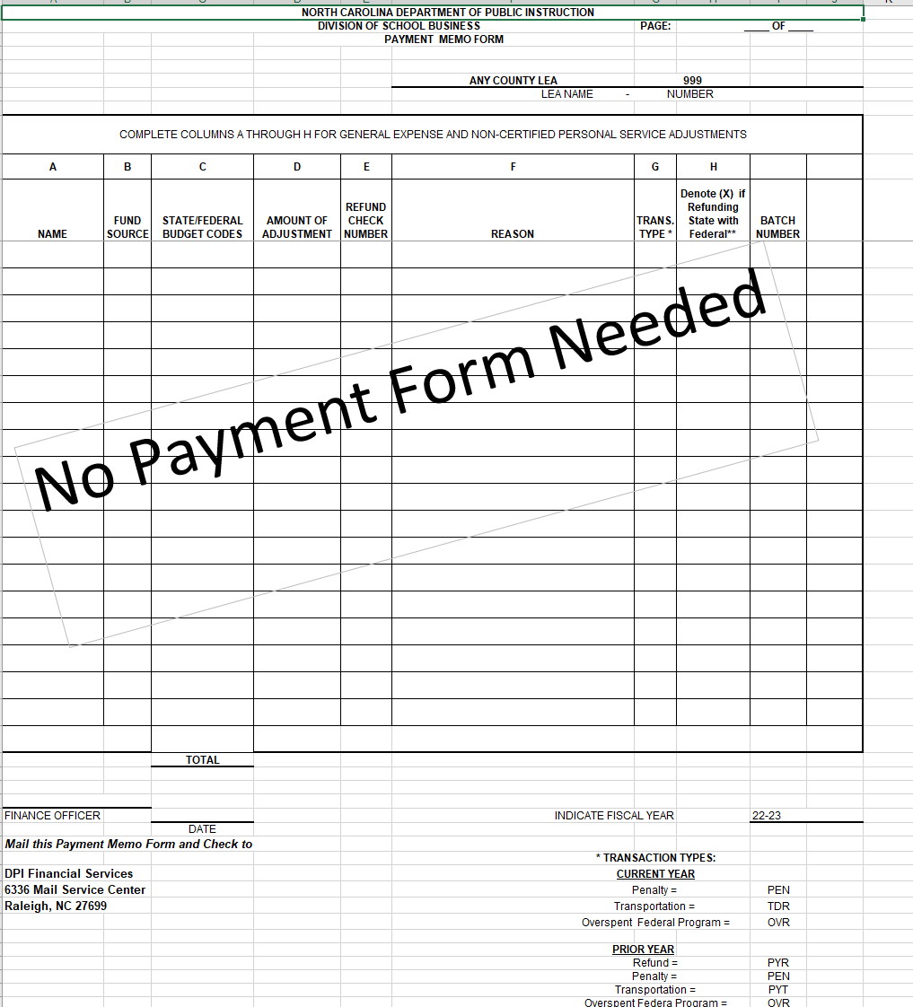

Slide 21
LEA posts the Federal Refund activity to their current fiscal year general ledger and the expenditures activity will be included in the LEA’s monthly MFR file. This records the $4,401.51 increase in the Federal expenditures.
After the monthly expenditures are posted, the zero-out will be processed. The increase in expenditures will result in a certification of $2,120.47 to the LEA for the refund.
The LEA will initiate a wire transfer to move the funds from the State Disbursing bank account to the LEA’s Local Bank account.

Slide 22
Refunding Prior Year Transportation

Slide 23
Prior Year Refund (PYR)- Refunding State Transportation with Local Funds
AIPT TRANSPORATION REFUND - SUMMARY 8/31/23 20:51:01
GTUCKER ANY COUNTY SHOOLS
F Purp Prc Obj Loc Use 503 Amount Sub Totals
- ---- --- --- --- --- --- ----------------- -----------------
1 6550 056 171 000 000 00 4,200.96-
1 6550 056 175 000 000 00 2,662.67-
1 6550 056 211 000 000 00 4,720.81-
1 6550 056 221 000 000 00 9,448.52-
1 6550 056 231 000 000 00 10,576.16-
1 6550 056 422 000 000 00 9,506.79-
1 6550 056 423 000 000 00 61,629.07-
1 6550 056 424 000 000 00 517.96-
1 6550 056 425 000 000 00 3,350.75-
*** Adjustment total *** 106,613.69-
LEA cash account 106,613.69 106,613.69
*** Fund 1 Total *** 106,613.69-

Slide 24
AIPT TRANSPORATION REFUND - SUMMARY 8/31/23 21:01:43
GTUCKER ANY COUNTY SHOOLS
F Purp Prc Obj Loc Use 503 Amount Sub Totals
- ---- --- --- --- --- --- ----------------- -----------------
2 2421 000 000 000 000 00 87,996.45
2 6550 881 329 000 000 00 9,934.49
2 6580 802 329 000 000 00 8,682.75
*** Adjustment total *** 106,613.69
LEA cash account 106,613.69- 106,613.69-
*** Fund 2 Total *** 106,613.69
*** Net total ***
(Excluding maj replacemnt .00
and insurance cost)

Slide 25
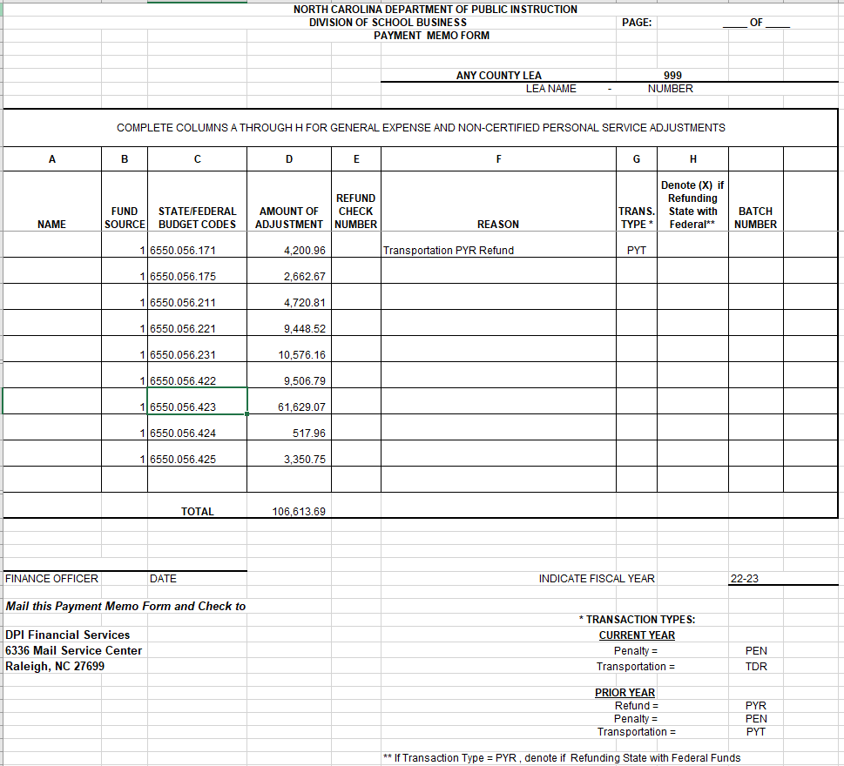
LEA will no longer submit a BUD Batch. The LEA will submit to Financial Services the Payment Memo Form and a check written on their Local Bank Account. Note: Please detail all state expenditures, including Tort and/or Major Replacements on the Payment Memo Form.

Slide 26
Processing at DPI- External Books
Using the Payment Memo Form, the School Reporting Accountants will prepare the key the entries for Company 8000 (PRIOR YEAR).
DR | Cash | 1.1010.000.000/LEA-000
CR | Various Transportation Expenditures | 5-xxxx.xxx.xxx/LEA-056
Tort and Major Replacement Expenditures are not posted to DPI’s External Ledger. DPI Financial Services will post Tort and Major Replacement Expenditures on the Agency books.

Slide 27
Processing Overdraft Penalty Payments

Slide 28
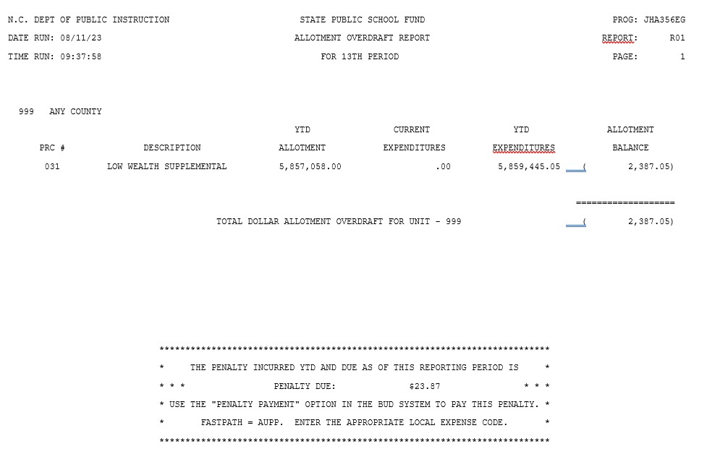
Penalty Payments – Allotment Overdrafts
LEA will send check to DPI Financial Services with a Payment Memo that includes the batch number(s). LEA must also send copy of the JHA356EG .

Slide 29
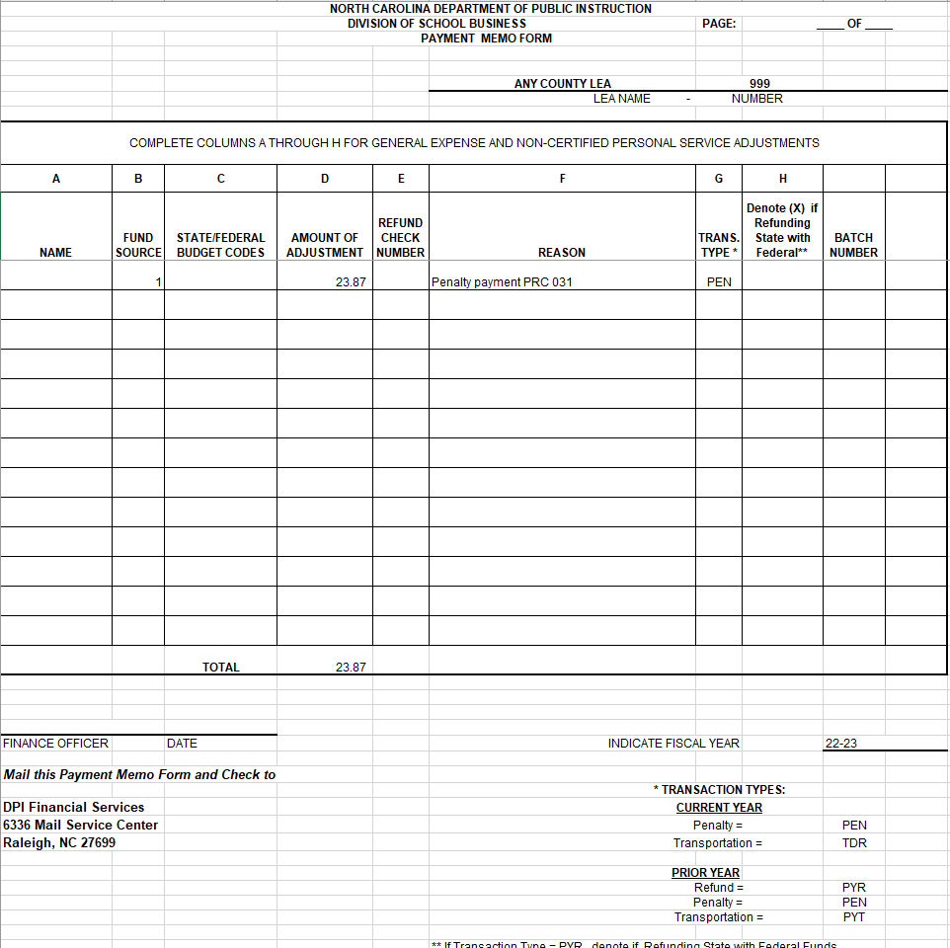
LEA will send the completed Payment Memo to DPI Financial Services. Be sure to include the batch number(s) .

Slide 30
Penalty Payments on DPI External Ledger
Using the Payment Memo Form the School Reporting Accountants will prepare the following entries for CURRENT(1000) and PRIOR YEAR(8000).
DR | Overdraft Penalty Payment Account | 1-1000-002/LEA -001
CR | Overdraft Penalty Account (Clearing) | 1-1000-001/LEA-001

Slide 31
Refunding a Federal Overspent Program

Slide 32
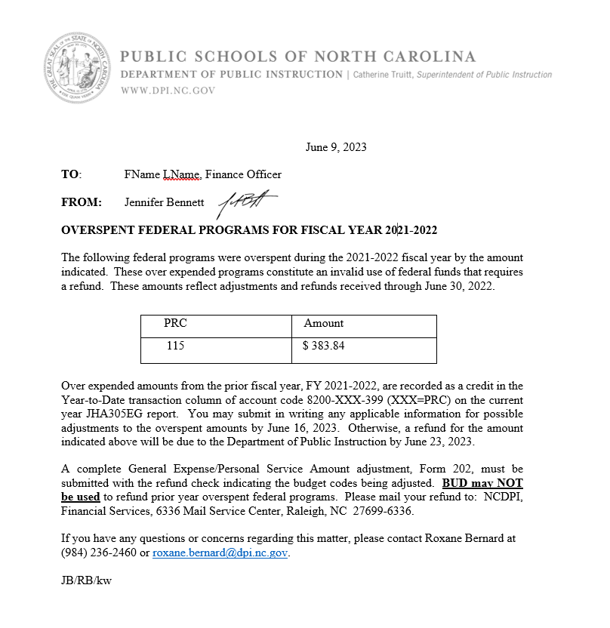
Federal Programs OverSpent Payments
Do Not Use BUD for these payments. LEA must complete a Payment Memo Form and paper check from their Local Bank Account. LEA

Slide 33
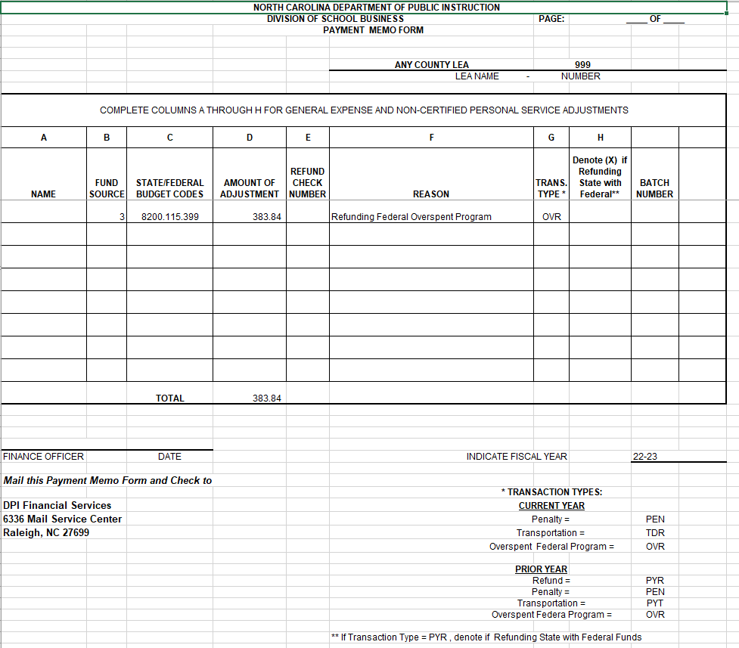

Slide 34
Refund of Overspent Federal Program on DPI External Ledger
Using the Payment Memo Form the School Reporting Accountants will prepare the following entries.
DR | Overexpended Project | 3-8200-399/LEA -yyy
CR | Cash Advance Account | 3-2430-000/LEA-yyy
DR | Cash | 1-1010-000/LEA -000
CR | Overspent Clearing Account | 3-3300-000/LEA-yyy

Slide 35
Processing Penalty Payments on DPI Financial Services' Ledger
Using the Payment Memo Form Agency Financial Services will prepare the following entries for PRIOR YEAR.
DR | Cash | 111270 1000
CR | State Aid to LEAs/Clearing – Refund – Prior Year | 538300 180010999000

