Slide 1
NCDPI Exceptional Children Director and Coordinator Webinar 10/12/2021

Slide 2
Time | Agenda Item | Presenter
10:00 - 10:05 | Welcome | Sherry Thomas
10:05 - 10:15 | Re-evaluation and Rules of Completion | Carol Ann Hudgens
10:15 - 10:25 | Indicators 11 and 12 and Determinations | Sherry Thomas
10:25 - 10:35 | Fiscal Updates: ESSER/ PRC 082 / Special Grants | Matt Hoskins
10:35 - 10:40 | HB 1030 & Text to Braille Conversion Demonstration | Sherri Vernelson
10:40 - 10:45 | Staff Updates | Sherry Thomas
10:45 - 10:55 | Compliance Cohort | Carol Ann Hudgens
10:55 -11:00 | CEC Next Steps | Matt Hoskins

Slide 3
Child Count & Eligibility

Slide 4
Essential Questions | Initial
When do I initiate the process? | Suspect Disability OR Out of State Transfer
Must I complete evaluations (testing)? | Yes If there are no current relevant, and existing data for the NC required screening/evaluations for each suspected disability. No If there is current, relevant, and existing data for the required screening/evaluations for each suspected disability needed to establish eligibility and develop the IEP.
What happens to eligibility? | Eligibility is determined once the IEP Team reviews all the required evaluation data.
May I count on Child Count? | Yes, if there is a current eligibility and IEP on December 1 and April 1.

Slide 5
Essential Questions | Reevaluation
When do I initiate the process? | Suspect a change in eligibility OR Information needed for programming
Must I complete evaluations? | Yes If the IEP Team suspects the eligibility category has changed OR the IEP Team requires formal evaluation data for programming.
What happens to eligibility? | No change to eligibility if the purpose of the reevaluation is programming only. If the IEP Team suspects the disability has changed, then evaluations must be completed. Once completed, the IEP Team must convene for the purposes of eligibility.
May I count on Child Count? | Yes, if there is a current IEP on December 1 and April 1.

Slide 6
Essential Questions | Triennial
When do I initiate the process? | Required every three years to review eligibility AND programming
Must I complete evaluations? | Yes If the IEP Team suspects the eligibility category has changed OR the IEP Team requires formal evaluation data for programming. No If there is current, relevant and existing data for all required screenings/evaluations to establish eligibility and develop the IEP.
What happens to eligibility? | Evaluations must be completed, and eligibility determined before current eligibility expires. If there is current, relevant and existing data for all required screening/evaluations at the time of the triennial and the IEP Team agrees that the eligibility category remains appropriate, eligibility can be determined, and the three-year clock is restarted.
May I count on Child Count? | Yes, if there is a current IEP on December 1 and April 1.

Slide 7
ECATS: Rules of Completion
EC Process
A new IEP cannot be finalized if the eligibility has expired.
Federal Reporting
A student may be counted on Child Count if there is a current IEP on December 1 and April 1.
Trouble spot - when these two separate rules of completion intersect.
Eligibility Expired Student cannot be counted on Child
IEP Expired Count if these two events exist on
December 1 or April 1.

Slide 8
Troubleshooting
Review Local Practices That May be Problematic
Is testing required for all required screening/evaluations at initial, reevaluation and/or triennial, regardless?
We test every other triennial?
We test for all required evaluations even if we have existing data that may be current and relevant?
We test all out of state transfers?
We test all in state transfers?

Slide 9
Troubleshooting
Review Local Practices That May be Problematic
Do we address eligibility at every reevaluation even if it is only for programming?
Do we schedule the triennial reevaluation too close to the eligibility expiration date?

Slide 10
Indicators 11 & 12

Slide 11
This Year…..
No process or calculation change in 20-21
Presented to Superintendents & Charter Administrators
Quarterly meeting August 11 & 12
Anticipate non-compliance data on indicators
State impact on OSEP Determination

Slide 12
Fiscal Updates

Slide 13
Fiscal Updates
ARP Funds (PRC 185 and 186)
Allotment, applications, budget, period of availability, MOE
PRC 082
No cost extension, applications

Slide 14
Special Grants
Grant applications opened on September 7, 2021. Special grants, with the status of Chief Administrator Approved, are reviewed monthly after the 15th. Notification of review is made through NCCCIP
For your review, the Special Grants Training recording, along with the PowerPoint are available on the EC Website here under the Special Grants section

Slide 15
MOE
Maintenance of Effort (MOE) Training & Technical Assistance
If you were unable to attend the MOE training or if you need a refresher, the recording, along with the PowerPoint, are available on the Exceptional Children website here: https://www.dpi.nc.gov/districts-schools/classroom-resources/exceptional-children/compliance-and-fiscal-monitoring/fiscal-monitoring and on the NC CCIP Home Page. The MOE Expenditure Table opened for PSUs with approved IDEA grant on October 1, 2021 and is due on October 31, 2021.
Note: If you were unable to attend the MOE technical assistance session last week, there will be another session from 8-11:30 and 1-4:30 on Tuesday, October 19th. These sessions are available for EC Directors to ask MOE questions and receive direct feedback from the Fiscal Monitors about the new MOE process. Please click on this link to attend the session: https://ncgov.webex.com/meet/adam.parent.

Slide 16
Reminder
LEA Self Assessments
The LEASA Improvement Plan is due October 31, 2021
PSUs will submit only the improvement plan portion this year (Core Element ratings are not required).
PSUs can write/upload a new plan, revise/upload an existing plan, or maintain an existing plan (no upload/changes).
A blank template for the Improvement Plan can be used as a work space prior to submission in Qualtrics at https://ncdpi.az1.qualtrics.com/jfe/form/SV_bemd4L5Nsb9tcl8

Slide 17
House Bill 1030

Slide 18
House Bill 1030
Consent for Release of Information to the Residential Schools for the Deaf and Blind
October 1 deadline to disseminate consent form to parents of students with:
Primary eligibilitiies of DF, HI, DB, VI, MU with vision and/or hearing impairment
November 30 deadline to:
submit any "yes" consents; OR
Indicate no parents in district provided consent
Electronic forms and reporting link

Slide 19
Converting Text to Braille Demo
Braille Blaster demo
Free through American Printing House for the Blind
Can convert text to different size fonts or braille
If you have a braillist or someone interested in learning to convert files to braille, reach out to:
Crystal Patrick, crystal.patrick@dpi.nc.gov
Dr. Alan Chase, alan.chase@dpi.nc.gov

Slide 20
Staff Changes
PIPD SC--In interview process
SPD SC--In interview process
NEW IDEA Fiscal Consultants
Milinda Martina
Lisa Blanton
New: Consultant for VI
Dr. Alan Chase
Virginia Madorin and Dr. Alan Chase will serve as co-directors of the Deaf/Blind grant
NE/SE Regional Coordinator -- In Process

Slide 21
Staff Updates
New: PIPD re-assignments:
Melissa Towery-- Project Director for NCSIP
Currently, FOM backup
Regions 7 & 8 Literacy: Teri Queen
Regions 7 & 8 Math: In hiring process
Region 5 & 6 Math: In hiring process

Slide 22
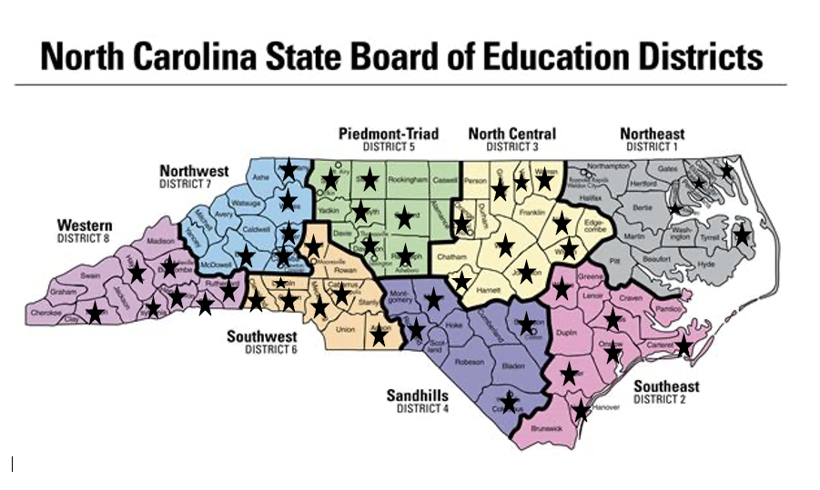
Compliance Cohort
131 Participants
61 Public School Units

Slide 23
CEC Partnership

Slide 24
CEC Partnership
Purpose: Increase retention of early career special educators
Teachers are twice as likely to leave the profession within the first two years of employment
Most common exit interview reasons:
Lack of administrative support
Behavioral issues
Paperwork

Slide 25
CEC Partnership
First and Second Year teachers / RSPs receive:
CEC membership / Special Division membership
All print journals
Access to all CEC webinars
National CEC mentorship
NC CEC conference registration
NC CEC mentoring
NC EC Conference registration
Ongoing meetings with DPI and CEC
First Year Special Education Teacher Survival Guide

