Slide 1
North Carolina
Mathematics Standard Setting
NCEXTEND1 Grades 3–8 and Math 1 Angoff Training Session
July 9, 2019

Slide 2
Training Session
Dave Chayer
Sr. Vice President, Research
Data Recognition Corporation

Slide 3
Workshop Goal
To recommend cut scores that categorize students into one of three achievement levels:
  Level 2 & Below
  Level 3
  Level 4

Slide 4

Cut Scores & Achievement Levels
Two cut scores classify students into three achievement levels.
Level 2 & Below
Students
Level 3
Students
Level 4
Students
Level 3
Cut Score
Level 4
Cut Score

Slide 5
Yes/No Angoff Procedure
Item-centered method
Content-based decisions
Iterative process

Slide 6
Process Overview
Today
Discuss the threshold students for grade 6
Study the test items
Round 1: Make cut score recommendations on your own
Tomorrow and Thursday
Round 1: Make cut score recommendations on your own
Discuss recommendations with your table
Round 2: Make cut score recommendations on your own
Discuss your recommendations with your group
Round 3: Make cut score recommendations on your own
Repeat the process for remaining grades
Review the group’s recommendations
Evaluate the workshop

Slide 7
Achievement Level Descriptors (ALDs)
ALDs describe the knowledge, skills, and understandings expected of students in each achievement level.
  They are linked to the content standards.
  ALDs describe students in the middle of each level, not on the thresholds.

Slide 8
ALDs and Achievement Levels
ALDs describe the student in the middle of each achievement level.
Level 2 & Below
Students
Level 3
Students
Level 4
Students
Level 3
Cut Score
Level 4
Cut Score

Slide 9
Two Threshold Students
Threshold students are those just barely leaving one level and entering the next level.
  The ALDs do not describe these students directly.
  There are two threshold students.
Threshold
Level 2 & Below/Level 3
Student
Threshold
Level 3/Level 4
Student

Slide 10
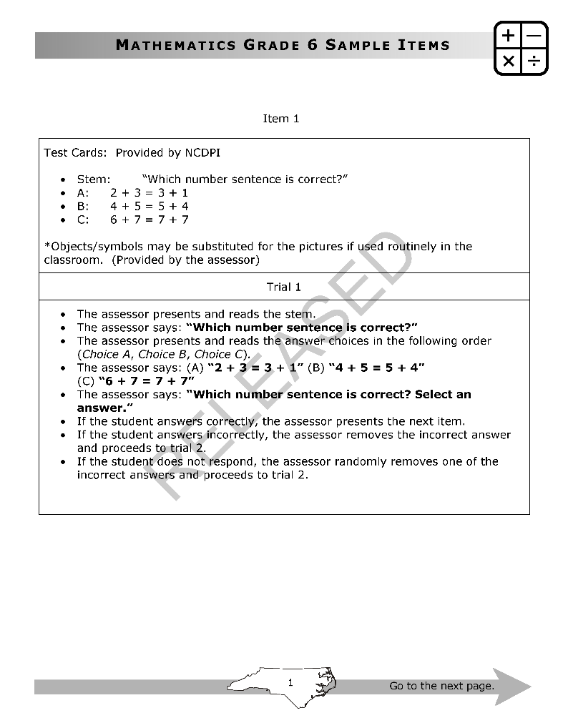
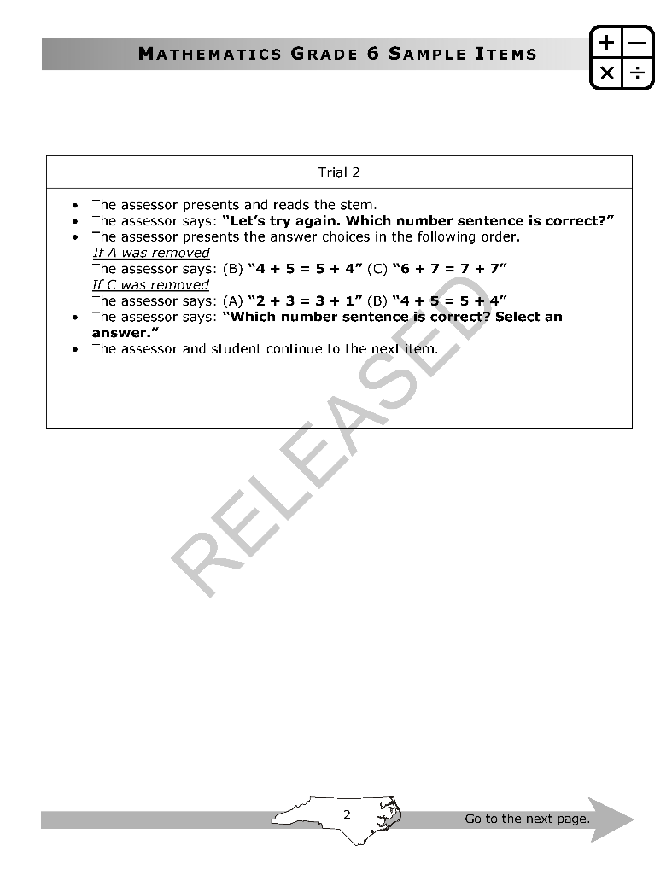

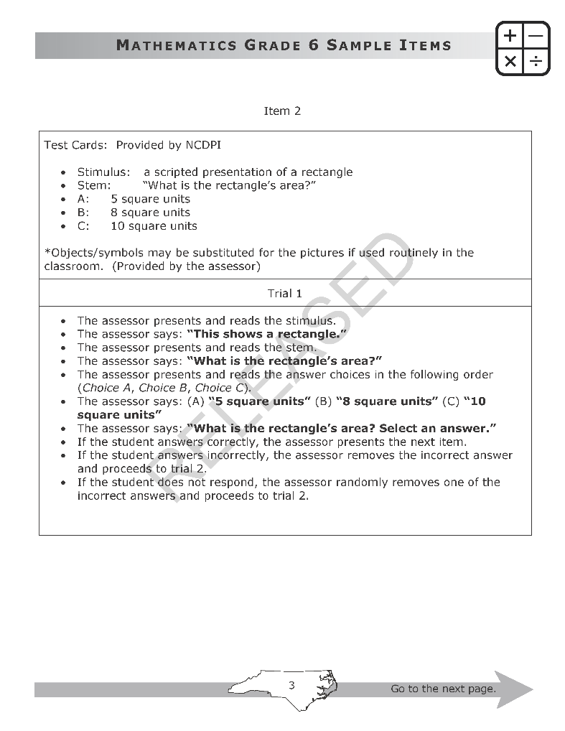
Examine the Test Items
By examining the test questions, you will better understand students’ testing experience during the assessment.
Then you will consider how the two hypothetical threshold students are expected to perform.

Slide 11
Threshold Students and Ratings
Yes/No Angoff ratings and cut scores are linked to the student just in each level.
Level 2 & Below
Students
Level 3
Students
Level 4
Students
Level 3
Cut Score
Level 4
Cut Score

Slide 12
Three Rounds
Round 1
Study items and make your own Yes/No Angoff ratings
Discuss your ratings with your tablemates
Round 2
On your own, make your own Yes/No Angoff ratings
See feedback and discuss your ratings with your group
Round 3
On your own, make your own Yes/No Angoff ratings
Then review recommended cut scores

Slide 13
Roles and Responsibilities
You will recommend achievement standards to DPI.
During the workshop, remember to:
  Contribute to discussions at your table
  Participate in group-wide discussions
  Make your Yes/No Angoff ratings independently
  Ask a member of staff any questions
  Use workshop materials only in meeting rooms
  Keep workshop conversations confidential

Slide 14
Workshop Security
Your facilitators will collect your materials each afternoon in a structured way.
Always leave the workshop materials in the meeting rooms. Do not discuss the contents of the materials outside your meeting room.
You are welcome to use phones, tablets, and laptops in the lunchroom and hallways, but never in the meeting rooms.

Slide 15
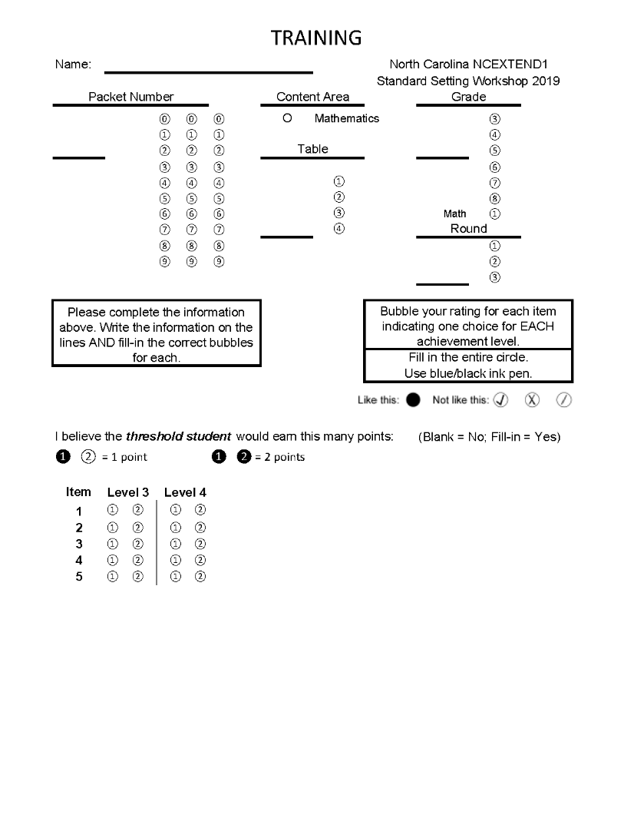
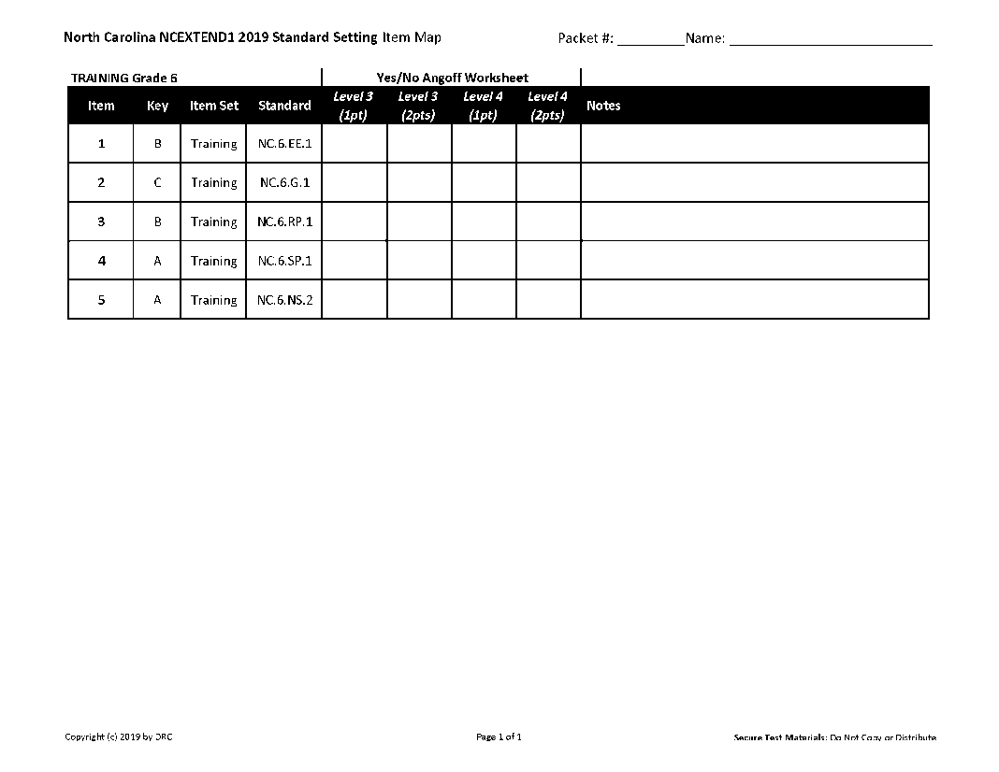
Training Materials
Item map
Training items
Training rating form

Slide 16
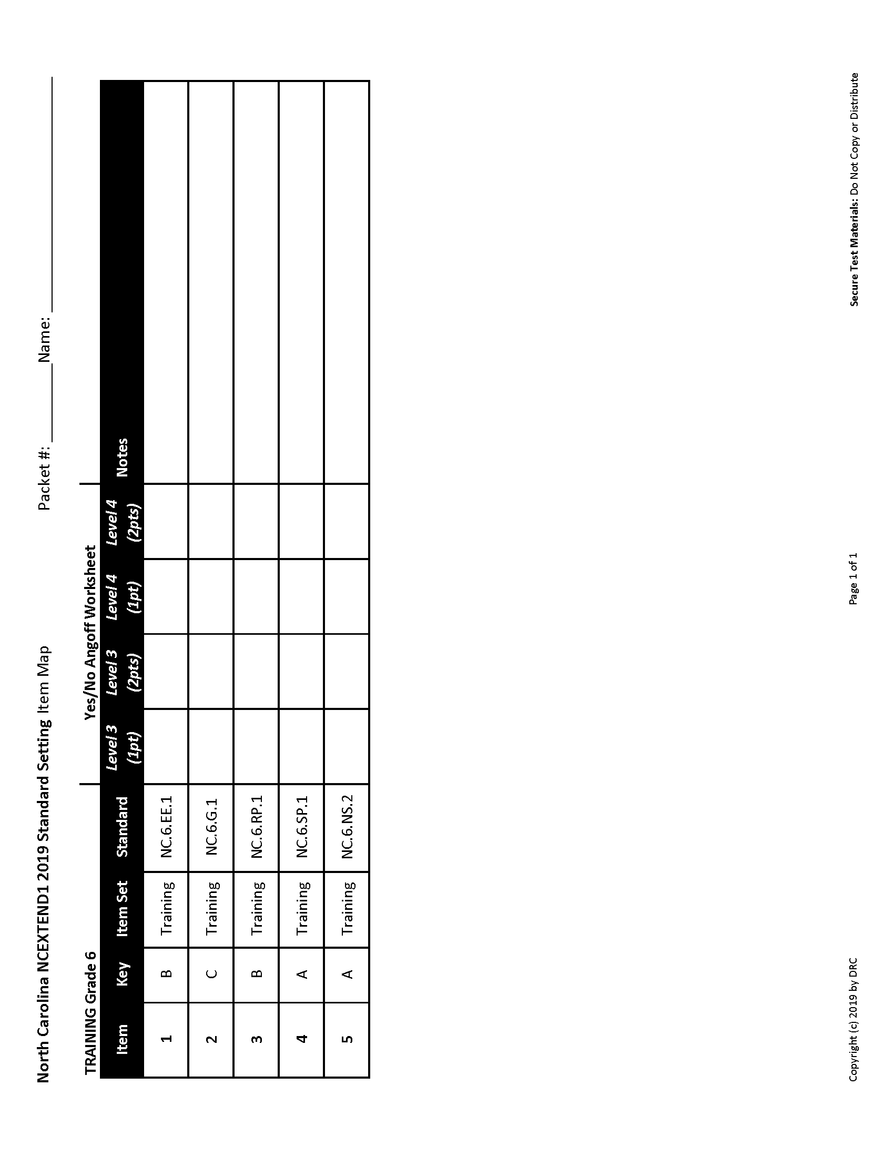
Item Map

Slide 17
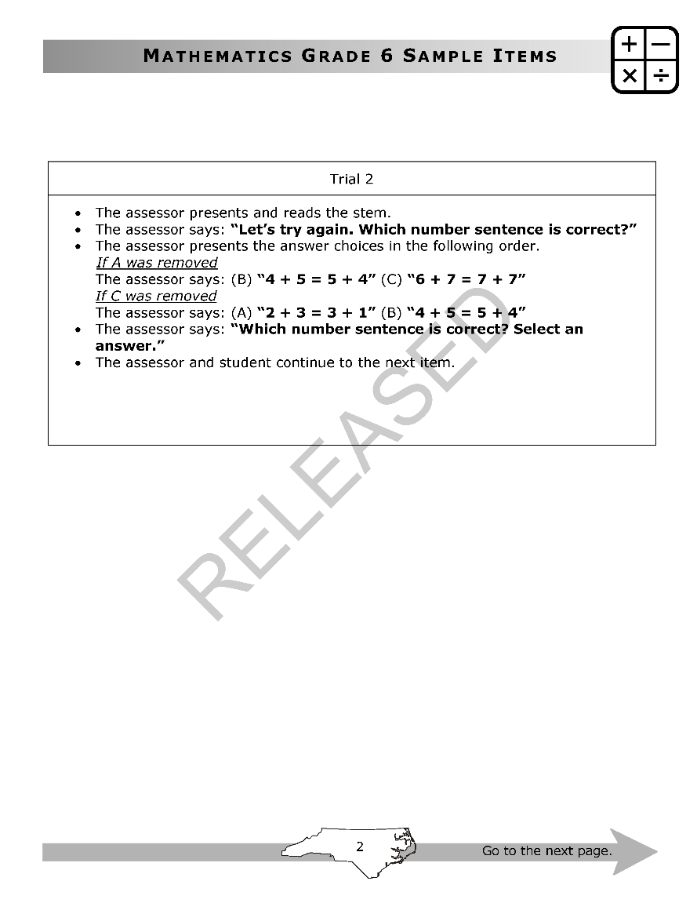
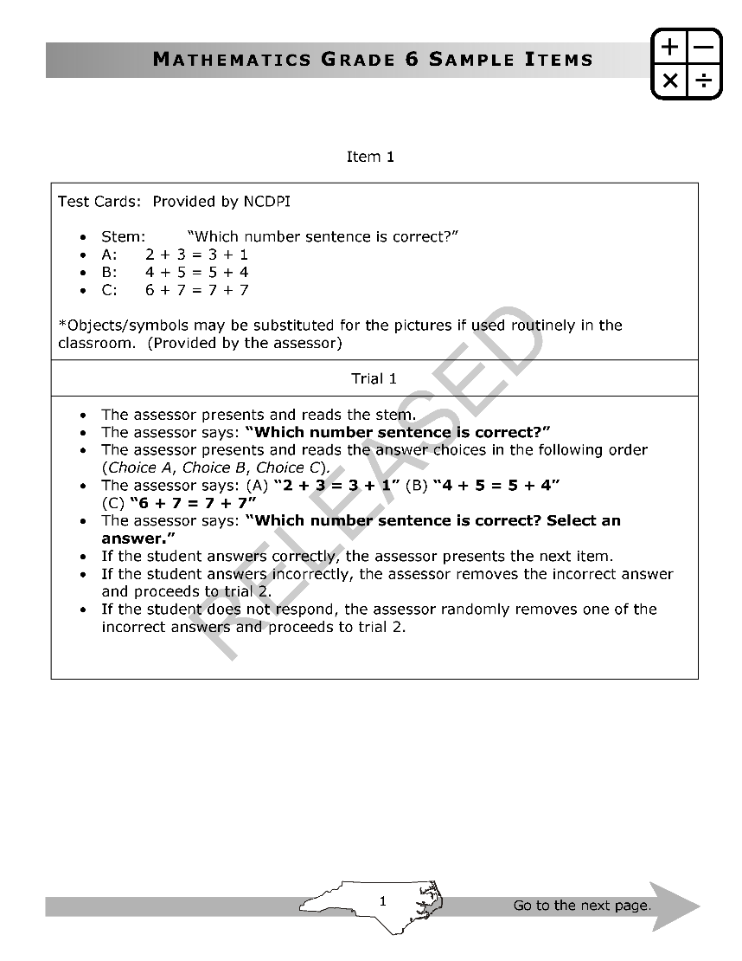
Item Structure
Items are presented by the teacher to the student.
  If the student gets the item correct in
  Trial 1 (i.e., on the first try), the student earns two points.
  If the student gets the item wrong (or doesn’t respond), an incorrect answer choice is removed. If the student gets the item correct in Trial 2 (i.e., on the second try), the student earns one point.
The training packet includes detailed instructions for the teacher.
  In the actual standard setting, only the item is shown.

Slide 18
Examining an Item and Making Ratings
Make a brief note to yourself about what the item measures.
Consider a threshold student. Ask yourself if the threshold student is expected to:
  Earn two points on the item
  Earn one point on the item
  Earn zero points on the item
Record your judgment on your item map, then go on to the next item.

Slide 19
Items and the Threshold Student
Remember to consider the threshold student, not the student in the middle of the achievement level.
  For example, is the Level 3 threshold student expected to earn two points on the item (i.e., answer the question correctly in Trial 1)?
Level 3
Students
Level 3
Cut Score

Slide 20

Recording Your Angoff Ratings
Use the Rating Sheet to record your Angoff ratings.
  Full circle for “yes.”
  Empty circle for “no.”

Slide 21
Recap
Steps in Round 1:
  Discuss expectations for the threshold students
  Examine the test items
  Consider the two threshold students
  Review each test item
  Ask yourself how each threshold student would be expected to perform on each item
  Record judgments on the item map
  Transfer judgments to rating form

Slide 22
Pacing
Some people will take longer than others to study the test items and make their Angoff ratings.
  During conversations, please be considerate of others at your table and in the room.
  If you finish earlier than your neighbors, you may wish to check-in with your facilitator, leave your materials at your table, and take a short break.

Slide 23
Practice Exercise
North Carolina Mathematics Standard Setting
Angoff Training Session
July 9, 2019

Slide 24
Consider the Threshold Student
Review these policy ALDs for Level 2 and Below and Level 3.
  Consider the student who is just barely in Level 3.
  What knowledge, skills, and understandings would you expect of this threshold student?
Level 2 & Below | Level 3
Students at Level 2 & Below demonstrate inconsistent understanding of the North Carolina Extended Content Standards and will need significant support at the next grade/course. | Students at Level 3 demonstrate sufficient understanding of the North Carolina Extended Content Standards though some support may be needed to engage with content at the next grade/course.

Slide 25
Examine Items Using Item Info Sheet
For each item…
  Consider what the item measures.
  Ask yourself if the threshold Level 3 student is expected to earn one point on the item. Then ask whether they would earn two points.
  Make a check mark for “Yes” and leave a blank for “No.”

Slide 26
Repeat the Process Twice More
Now repeat the process for the threshold Level 4 student.
  Remember: the threshold Level 4 student will do at least as well on each item as the threshold Level 3 student.
Remember the steps:
  Review the ALDs
  Examine the test items
  Consider the two threshold students
  Review each test item
  Ask yourself whether each threshold student would be expected to earn zero points, one point, or two points.
  Record your judgments on your item map.

Slide 27
Review Your Item Info Sheet
After you have studied the items, look over your ratings.
  Be sure your expectations for the threshold Level 4 student are at least as high as those for the threshold Level 3 student.
  It’s okay if you don’t expect either threshold student to earn points on some items.
✓
✓
✓
✓
✓
✓
✓
✓
✓
✓

Slide 28

Transfer Your Angoff Ratings
Transfer your Angoff ratings to the bubble sheet.
  Fill in:
  two circles for two points,
  one circle for one point, or
  zero circles for zero points.

Slide 29
After Round 1
To calculate cut score recommendations after each round, we sum the number of points expected of each threshold student.
  The median of the cut score recommendations across participants is the group’s recommendation.
After Round 1, you will receive additional information to consider.
  Feedback on recommended cut scores
  benchmarks, based on the 2013 NCEXTEND1 results.
The benchmarks are provided as contextual information for you to consider.

Slide 30
Using the Feedback
Compare your cut score recommendations with your tablemates’ recommendations.
Consider the stringency of your recommendations.
  Compare the group’s recommendations against the benchmarks.
  Talk with your tablemates about the items.
  Then make your Round 2 ratings.
  You do not have to agree with your colleagues.

Slide 31
Discussion of Round 1 Ratings
In the actual workshop, you will discuss your Round 1 ratings at your table.
Feel free to discuss:
  Your ratings for each item
  Items where you had a hard time making a rating
After discussion, you will have a second opportunity to make Angoff ratings.
  You can change any, all, or none of your ratings.
  Making ratings is always an individual activity.

Slide 32
Suggestions for Discussions
Practice active listening.
Be open to changing your mind.
Work to understand your colleagues’ rationales for their Angoff ratings.
In a respectful manner, feel free to ask questions of your colleagues.
Do not discuss your ratings until everyone at the table has made theirs.
Keep the contents of your discussions private.

Slide 33
After Round 2
After Round 2, you will see:
  the medians recommendations from Round 2
  benchmarks, based on the 2013 results
  impact data, the percent of students that would be classified in each achievement level if the Round 2 cut scores were implemented

Slide 34
Round 3
After Round 2, you will discuss your ratings across tables.
  Your table will report-out and share a bit of the discussions that happened after Round 1.
  Be sure to share any items for which (a) your table disagreed on the ratings for, even after discussion; or (b) your table had insightful conversations about.
Then you will make Round 3 ratings.
  Making Angoff ratings is always an individual activity.

Slide 35
Repeat the Process
After Round 3, the group will divide and repeat the process for the remaining grades.
  The group will likely pick up speed as it goes.
Grades 3-6 Group | Grades 6-HS Group
Grade 6 | Grade 6
Grade 5 | Grade 7
Grade 4 | Grade 8
Grade 3 | Math 1

Slide 36
Reviewing the Recommendations
After the Yes/No Angoff process is complete for the final grade, your facilitator will show you a presentation of the Round 3 recommendations from all seven tests.
  You will be asked to look at the articulation of the achievement standards across grades.
  You may wish to consider adjustments to your recommendations to improve the articulation across grades.
  The table leaders will convene in a special session to look over the recommendations and, if needed, recommend adjustments to promote better across-grade articulation.

Slide 37
After the Workshop
Your recommendations will be considered by DPI.
  The recommendations from all groups will be considered by DPI and its advisors.

Slide 38
Workshop Structure
Discuss threshold students
Study items and make Round 1 ratings
Discuss Round 1 at tables
Make Round 2 ratings
Discuss Round 2 as a group
Make Round 3 ratings
Repeat the process for remaining grades
Review recommendations

Slide 39
Questions
Do you have any questions?
  If questions come up later, ask your facilitator, or write them on an index card.

Slide 40
Yes/No Angoff Refresher Training
NCEXTEND1 Mathematics Standard Setting
July 9, 2019

Slide 41
Cut Scores & Achievement Levels
Two cut scores classify students into three achievement levels.
Level 2 & Below
Students
Level 3
Students
Level 4
Students
Level 3
Cut Score
Level 4
Cut Score

Slide 42
Threshold Students and Ratings
Yes/No Angoff ratings and cut scores are linked to the student just in each level.
Level 2 & Below
Students
Level 3
Students
Level 4
Students
Level 3
Cut Score
Level 4
Cut Score

Slide 43
Examining an Item and Making Ratings
Make a brief note to yourself about what the item measures.
Consider a threshold student. Ask yourself if the threshold student is expected to:
  Earn two points on the item
  Earn one point on the item
  Earn zero points on the item
Record your judgment on your item map, then go on to the next item.

Slide 44
Review Your Item Info Sheet
After you have studied the items, look over your ratings.
  Be sure your expectations for the threshold Level 4 student are at least as high as those for the threshold Level 3 student.
  It’s okay if you don’t expect either threshold student to earn points on some items.
✓
✓
✓
✓
✓
✓
✓
✓
✓
✓

Slide 45
Trials and Points
Remember:
  If you expect a threshold student will answer the question correctly on Trial 1, you expect they will earn two points.
  You would fill in both circles for this item.
  If you expect a threshold student will answer the question correctly on Trial 2, you expect they will earn one points.
  You would fill in the first circle for this item.

Slide 46
Transfer Your Angoff Ratings
Transfer your Angoff ratings to the bubble sheet.
  Fill in:
  two circles for two points,
  one circle for one point, or
  zero circles for zero points.

Slide 47
Rounds
Round 1: Make ratings on your own
Round 2: See feedback and benchmarks, discuss with your tablemates, make ratings on your own
Round 3: See feedback and impact, discuss with the group, make ratings on your own

Slide 48
Mid-Process Evaluation
Before we continue, let’s complete the mid-process evaluation.

Slide 49
Directional Slides: Tuesday
These slides are for facilitators’ use at the 2019 North Carolina mathematics standard setting.

Slide 50
Welcome!
If needed, please check-in with a facilitator to make sure you are in the right group.

Slide 51
Introductions
Let’s take a moment to introduce ourselves:
  Name
  Where you’re from
  Where you work
  What you do there
  What grade you usually teach or work with

Slide 52
Secure Materials Distribution
Please print your name on the sign-out list next to your participant number.
  The facilitator will give you a sticker with your participant number to put on your folder.
  At the end of the day, you will be asked to return all of the workshop materials.
As you receive your workshop materials, write your name on each piece.

Slide 53
Threshold Students
Remember that we will consider two hypothetical threshold students.
Level 2 & Below
Students
Level 3
Students
Level 4
Students
Level 3
Cut Score
Level 4
Cut Score

Slide 54
Review ALDs
On your own, please take a few minutes to review the achievement level descriptors (ALDs).
  It may help to highlight words that differentiate one achievement level from another.
  Ask yourself: if you were going to describe to a colleague the differences between a high-level Level 2 and Below student from a low-level Level 3 student, what would you say?

Slide 55
Tables: Threshold Student Descriptors
In your tables, make a bulleted list that describes the content-based expectations for each threshold student.
  Start with the threshold Level 3 student, then continue with threshold Level 4.
Level 2 & Below
Students
Level 3
Students
Level 4
Students
Level 3
Cut Score
Level 4
Cut Score

Slide 56
Group: Discuss Threshold Students
Let’s discuss the remaining threshold students as a group.
  What are the content-based expectations for the student who is on the threshold between Level 2 & Below and Level 3 (i.e., the just Level 3 student)?
  What are the content-based expectations for the student who is on the threshold between Level 3 and Level 4 (i.e., the just Level 4 student)?

Slide 57
Study the Test Items
Consider the items in the test booklet one at a time.
  Make notes on the item map about what each item measures. What do you know about a student who can get the item correct?
  Only plan to spend a moment or two looking at any item. Table leaders should help keep their tables on pace.
  Everyone at the table should take notes on their own copy of the item map.
  It is okay to start thinking about the Angoff ratings you might make for each item, but please do not share them with your colleagues yet.

Slide 58
Round 1 Angoff Ratings
Making Angoff ratings is an individual activity.
  Please maintain quiet until everyone has finished.
Go through the items first thinking about the Level 3 threshold student, then go through the items again thinking about the Level 4 threshold student.
Make your Angoff ratings on your item map, then transfer them to the rating sheet.
  Leave your rating sheet with your facilitator.
  People will finish this activity at different times. Thank you for maintaining a quiet environment for people still working.

Slide 59
Round 1 Feedback
Now that Round 1 is complete, we will examine:
  The median cut scores recommended by participants at each table and overall
    See how similar or different the table medians are
  Benchmarks based on the 2013 NCEXTEND1 results
    Look to see how similar or different the group’s median is from the benchmarks

Slide 60
About the Benchmarks
The facilitator will present the benchmarks for the test.
If the recommended cut scores are near the benchmarks, the percent of students classified in each achievement level will be similar to 2013.

Slide 61
Benchmarks for Grade 3
Some helpful tips:
  Compare the recommended cut scores with the benchmarks.
  The benchmarks are another piece of information for you to consider.
  It is not meaningful to compare benchmarks across grades.
Cut Score | Benchmark
Level 3 | 00
Level 4 | 00

Slide 62
Benchmarks for Grade 4
Some helpful tips:
  Compare the recommended cut scores with the benchmarks.
  The benchmarks are another piece of information for you to consider.
  It is not meaningful to compare benchmarks across grades.
Cut Score | Benchmark
Level 3 | 00
Level 4 | 00

Slide 63
Benchmarks for Grade 5
Some helpful tips:
  Compare the recommended cut scores with the benchmarks.
  The benchmarks are another piece of information for you to consider.
  It is not meaningful to compare benchmarks across grades.
Cut Score | Benchmark
Level 3 | 00
Level 4 | 00

Slide 64
Benchmarks for Grade 6
Some helpful tips:
  Compare the recommended cut scores with the benchmarks.
  The benchmarks are another piece of information for you to consider.
Cut Score | Benchmark
Level 3 | 00
Level 4 | 00

Slide 65
Benchmarks for Grade 7
Some helpful tips:
  Compare the recommended cut scores with the benchmarks.
  The benchmarks are another piece of information for you to consider.
  It is not meaningful to compare benchmarks across grades.
Cut Score | Benchmark
Level 3 | 00
Level 4 | 00

Slide 66
Benchmarks for Grade 8
Some helpful tips:
  Compare the recommended cut scores with the benchmarks.
  The benchmarks are another piece of information for you to consider.
  It is not meaningful to compare benchmarks across grades.
Cut Score | Benchmark
Level 3 | 00
Level 4 | 00

Slide 67
Benchmarks for Math 1
Some helpful tips:
  Compare the recommended cut scores with the benchmarks.
  The benchmarks are another piece of information for you to consider.
  It is not meaningful to compare benchmarks across grades.
Cut Score | Benchmark
Level 3 | 00
Level 4 | 00

Slide 68
Discussion After Round 1
Each table should discuss its Round 1 ratings.
  The table leader should facilitate this discussion.
  Go through each item one at a time.
  Each participant should share their Angoff ratings.
  If there is agreement, move onto the next item.
  If there is disagreement, share why you make your Angoff ratings the way you did.
  You may choose to change any, all, or none of your ratings.
  You do not have to agree on your Angoff ratings as a table.

Slide 69
Round 2 Ratings
Making Angoff ratings is an individual activity.
  Please maintain quiet until everyone has finished.
Make your Angoff ratings on your item map, then transfer them to the rating sheet.
  Leave your rating sheet with your facilitator.
  People will finish this activity at different times. Thank you for maintaining a quiet environment for people still working.

Slide 70
Round 2 Feedback
Now that Round 2 is complete, we will examine:
  The median cut scores recommended by participants at each table and overall
  The percent of students who would be classified in each achievement level
Remember: impact data are helpful to consider, but at its core, this is a content-based process. Our conversations will always return to content.

Slide 71
Discussion After Round 2
The group will discuss its Round 2 ratings.
  The facilitator will guide this discussion.
  Each table should share a little bit of its discussion it had before Round 2, especially about items for which there was disagreement.
  Listen actively; however, the goal is not consensus.

Slide 72
Round 3 Ratings
Making Angoff ratings is an individual activity.
  Please maintain quiet until everyone has finished.
Make your Angoff ratings on your item map, then transfer them to the rating sheet.
  Leave your rating sheet with your facilitator.
  People will finish this activity at different times. Thank you for maintaining a quiet environment for people still working.
  When you are finished, bring your materials up to the front for collection.

Slide 73
Directional Slides: Wednesday
These slides are for facilitators’ use at the 2019 North Carolina mathematics standard setting.

Slide 74
Repeating the Process
We will now repeat the process for the next grade.
  If you still have your materials from the last grade, please bring them up to exchange them for new materials.
  If you already have your new materials, start reading the ALDs and get ready to discuss the threshold students with your table.
Grades 3-6 Group | Grades 6-HS Group
Grade 6 | Grade 6
Grade 5 | Grade 7
Grade 4 | Grade 8
Grade 3 | Math 1

Slide 75
Secure Materials Collection
Please listen to the facilitator for important information about secure materials collection.
Be sure to initial the sign-out list to indicate you have returned your materials.

Slide 76
Directional Slides: Thursday
These slides are for facilitators’ use at the 2019 North Carolina mathematics standard setting.

Slide 77
Break
Before we move on, both groups need to finish making their Angoff ratings.
  We have finished before the other group.
We will take a break until our results are tabulated.

Slide 78
Reviewing Recommendations
Now that the Angoff process is done, we will examine the impact data for all seven tests of mathematics.
When examining the impact data across grades, ask yourself whether there is good across-grade articulation (consistency).
  Which cut scores, if any, would you consider adjusting to promote better across-grade articulation?

Slide 79
Table Leaders and Articulation
The table leaders will soon convene in the across-grade articulation discussion. Table leaders should record their participants thoughts about these questions:
  What pattern(s) do we see in the impact data across grades, and is the pattern reasonable and explainable?
  What questions, if any, do we have for other groups considering their cut score recommendations?
  What flexibility do we have around our own group’s cut score recommendations?

Slide 80
Secure Materials Collection
Please listen to the facilitator for important information about secure materials collection.
Be sure to initial the sign-out list to indicate you have returned your materials.
Complete your workshop evaluation before you leave.
Thank you for your participation!

