Slide 1


Adapted Physical Education (APE)
Also known as specially designed instruction in physical education

Slide 2

Pop Quiz!
Top 10 List of Most Common Misconceptions about Physical Education for Students with Disabilities
http://www.wrightslaw.com/info/phys.fit.htm
Notes:
View the slide presentation to learn the answers.
[ Question 1-9 false, Question 10 - true ]
- See more at: http://www.wrightslaw.com/info/phys.fit.htm#sthash.pztLVjJH.dpuf

Slide 3

Question #1
The Healthful Living/Physical education curriculum is part of an education for all students.
True or False?
The answer is:
TRUE
Notes:
All students should learn and progress through the healthful living curriculum; both PE and Health components!

Slide 4

Question #2
Students with disabilities are automatically eligible for adapted physical education services.
True or False?
The answer is:
FALSE
Notes:
No student is automatically eligible for APE. All eligibility is determined individually by IEP teams based on that student’s information and performance data.

Slide 5
Question #3
Adapted physical education placement is only for students with physical disabilities; automatic if the student uses a wheelchair or walker.
APE is not for students with emotional or behavioral disabilities.
True or False?
The answer is:
FALSE
Notes:
If a student is not able to learn, progress and participate in General Education PE, an IEP team should consider if that student requires specially designed instruction in PE, modification or adaptation.

Slide 6
Question #4
All physical education teachers have the professional knowledge, skills, and dispositions, to meet the needs of all children with disabilities.
• True or False?
The answer is:
FALSE
“All Physical Educators are
Not Creatively Equal”
Notes:
It often takes a team effort with great collaboration to meet student’s unique needs.

Slide 7
Question #5
A student with a disability is either included full-time in the general physical education curriculum or has a separate adapted physical education program.
True or False?
The answer is:
FALSE
Notes:
Adapted PE or specially designed instruction in PE is a continuum of service. Service delivery is determined individually for each student based on performance data and consideration of her/his unique needs and least restrictive environment.

Slide 8
Question #6
Physical education and physical therapy (or other related services) are interchangeable and can be substituted for the physical education requirement.
True or False?
Oh, WE know THIS one!!
The answer is:
FALSE
Notes:
NO! APE is specially designed instruction, a direct Special Education service. PT is a related service. Although they both have physical in the title, these are completely separate disciplines. More on this later…

Slide 9
Question #7
Physical education can be the only special education service on the IEP.
True or False?
The answer is:
True
Rare, but true.

Slide 10
Question #8
Students with disabilities can be exempt or excused from physical education.
True or False?
The answer is:
FALSE
Notes:
In very few cases, APE cannot be sufficiently adapted to ensure a student’s safe participation. In these cases, the IEP team should rely on input, health and medical information from the student’s physician describing the concern, time frame, any precautions and prognosis.

Slide 11
Question #9
Adapted physical educators are not involved in the IEP Process.
True or False?
The answer is:
FALSE
Notes:
What! No, someone with knowledge of the PE curriculum must be involved with IEP development for student areas of need in PE or that overlap with PE.

Slide 12
Question #10
Instructional assistants/paraprofessionals should not teach a physical education class.
True or False?
The answer is:
True
Not implementers
but key partners!
Notes:
NC DPI offers a guidance as to how Teacher Assistants can prepare students for and support participation in PE; available here:
https://ec.ncpublicschools.gov/instructional-resources/adapted-physical-education/memos-guidance

Slide 13
Question #11
A student must receive occupational or physical therapy in order to receive adapted physical education.
True or False?
The answer is:
FALSE
Notes:
APE eligibility is determined by IEP team based on that student’s needs and performance data. There are no precursors.

Slide 14
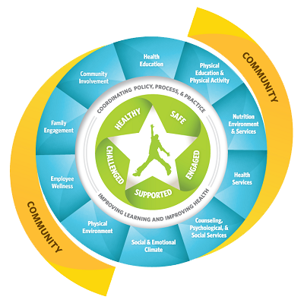

NC State Board of Education
Healthy Active Children Policy-
Section 2
Whole School,
Whole Community,
Whole Child Model
http://www.nchealthyschools.org/wholechild/
Notes:
R- The Whole School, Whole Community, Whole Child (WSCC) model expands on the eight elements of CDC’s coordinated school health (CSH) approach and is combined with the whole child framework. CDC and ASCD developed this expanded model - in collaboration with key leaders from the fields of health, public health, education, and school health - to strengthen a unified and collaborative approach designed to improve learning and health in our nation’s schools. NC Healthy Schools frames its work in the context of this model

Slide 15
NC State Board of Education
Healthy Active Children Policy- Section 4
PHYSICAL EDUCATION AND HEALTHFUL LIVING
To address issues such as overweight, obesity, cardiovascular disease, and Type II diabetes, students enrolled in kindergarten through eighth grades shall participate in physical activity as part of the LEA’s Physical Education curriculum.
  Elementary schools should consider the benefits of and move toward having 150 minutes of quality Physical Education per week with a certified Physical Education teacher throughout the school year.
  Middle schools should consider the benefits of and move toward having 225 minutes per week of Healthful Living Education. Middle school Healthful Living Education should be divided equally between Health and Physical Education with certified Health and Physical Education teachers throughout the school year.
Notes:
A minimum of 30 minutes of moderate to vigorous physical activity shall be provided by schools for all K-8 students daily. This requirement can be achieved through a regular physical education class and/or through activities such as recess, dance, classroom energizers, or other curriculum based physical education activity programs. However, such use of this time should complement and not substitute for the physical education program.
The physical activity required by this section must involve physical exertion of at least a moderate to vigorous intensity level and for a duration sufficient to provide a significant health benefit to students.

Slide 16
NC State Board of Education
Healthy Active Children Policy- Section 4 continued…
Physical Education shall take place in a supportive environment in which students learn, practice, and receive assessment on developmentally appropriate motor skills, social skills, and knowledge as defined by the North Carolina Healthful Living Standard Course of Study and that fosters support and guidance for being physically active.
In order to meet enhanced goals, these classes should be the same class size as other academic classes with at least fifty percent of Physical Education class time spent with students engaged in moderate to vigorous physical activity.
  http://stateboard.ncpublicschools.gov/policy-manual/student-health-issues/healthy-active-children-policy-20161201

Slide 17

NC State Board of Education
Healthy Active Children Policy- Section 5
  For schools in which Physical Education is not currently offered daily to all K-8 students, a minimum of 30 minutes, daily, of moderate to vigorous physical activity shall be provided by schools for all K-8 students.
  This requirement can be achieved through a Physical Education class offered to all students.
  On days when Physical Education is not part of a student’s schedule, the 30-minute physical activity requirement can be met by activities such as: recess, dance, classroom energizers, or other curriculum-based physical activity programs.
http://www.nchealthyschools.org/legislation/stateboard/

Slide 18
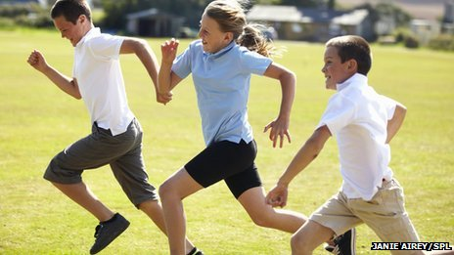
NC State Board of Education
Healthy Active Children Policy- Section 5 continued…
The physical activity required by this section must involve physical exertion of at least a moderate to vigorous intensity level and for a duration sufficient to provide a significant health benefit to students according to National Physical Activity and Health Guidelines. Activity sessions should be no less than ten-minute segments that, when combined, total 30 minutes of daily physical activity.
http://www.nchealthyschools.org/legislation/stateboard/

Slide 19
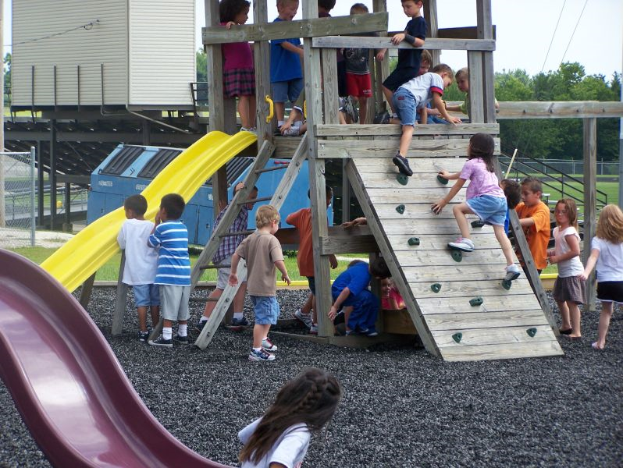

NC State Board of Education
Healthy Active Children Policy- Section 5 continued…
  Recess shall consist of unstructured free play or structured games and activities. Recess and physical activity shall not be taken away from students as a form of punishment; furthermore, exercise shall not be assigned for use as a form of punishment for students.
  http://stateboard.ncpublicschools.gov/policy-manual/student-health-issues/healthy-active-children-policy-20161201
Notes:
Structured/unstructured recess and other physical activity (such as, but not limited to, physical activity time, physical education or intramurals) shall not be taken away from students as a form of punishment. In addition, severe and/or inappropriate exercise may not be used as a form of punishment for students.

Slide 20
NC Board of Education Goals
The NC State Board of Education is committed to the health of all students in North Carolina and includes healthy, safe and responsible students as part of their strategic plan.
Goal 5: Every student is healthy, safe, and responsible
Objective 1: Create and maintain a safe, respectful school environment
Objective 2: Promote healthy, active lifestyles for students
Objective 3: Decrease the number of students who are chronically absent, dropout, or suspended out of school
Objective 4: Decrease violence and crime in schools
http://www.nchealthyschools.org/legislation/
Notes:
R

Slide 21
The Importance of APE!!!!
The purpose of PE and APE is:
  for students to learn, practice, and master skills-
  to build capacity in students to be active for a lifetime
  to provide students physical activity
Recreation and wellness activities are a critical dimension of the quality of life for all people, including those with developmental disabilities. There are a vehicle through which people have fun, meet new friends, and develop skills and competencies.
    Physical/motoric
    Fitness
    Social
    Functional

Slide 22
The Importance of APE!!!!
The President's Council on Fitness, Sports and Nutrition reported that physical activity is 4.5 times lower for children and youth with disabilities compared to their peers without disabilities.
Every student can benefit from physical education
APE can be an important component of the secondary transition plan for students with disabilities.

Slide 23
NC 1500-2.1 Adapted Physical Education
NC 1500-2.1 Adapted Physical Education
(a) Children with disabilities shall have equal access to the provision of physical education. Physical education includes the development of:
  (1) Physical and motor fitness;
  (2) Fundamental motor skills and patterns; and
  (3) Skills in individual and group games, sports, and activities (including intramural and life-time sports).
Notes:
IDEA 1990 re-authorization described APE as a direct, educational service

Slide 24
(b) If a child with a disability cannot participate in the regular physical education program, individualized instruction in physical education designed to meet the unique needs of the child shall be provided. Physical education may include:
  (1) Modified physical education,
  (2) Adapted/special physical education,
  (3) Movement education, and
  (4) Motor development.
(c) Modified physical education is appropriate for a child who can participate in the general physical education program with accommodations or modifications. These modifications can include changing rules, equipment, time limits, etc. It can also include supports such as a sign language interpreter.
(d) Adapted physical education (also called specially designed or special physical education) is instruction in physical education that is designed on an individual basis specifically to meet the needs of a child with a disability.
Notes:
IDEA 1990 re-authorization described APE as a direct, educational service
APE is not only included, but specified in IDEA definition for Special Education

Slide 25
NC 1501-2.6 Physical Education
LEAs must comply with the following:
(a) General. Physical education services, specially designed if necessary, must be made available to every child with a disability receiving FAPE unless the LEA enrolls children without disabilities and does not provide physical education to children without disabilities in the same grades.
(b) Regular physical education. Each child with a disability must be afforded the opportunity to participate in the regular physical education program available to nondisabled children unless--
(1) The child is enrolled full time in a separate facility; or
(2) The child needs specially designed physical education, as prescribed in the child's IEP.
(c) Special physical education. If specially designed physical education is prescribed in a child's IEP, the goals should be drafted and monitored by individuals knowledgeable of the physical education curriculum. The LEA responsible for the education of the child must provide the services directly or make arrangements for those services to be provided through other public or private programs.
(d) Education in separate facilities. The LEA responsible for the education of a child with a disability who is enrolled in a separate facility must ensure that the child receives appropriate physical education services.

Slide 26
Special Education: Common Core Curriculum a
Adapted PE : Healthful Living/PE Curriculum
Individuals with Disabilities Education Act (IDEA), requires Adapted Physical Education for those students with disabilities who require specially designed instruction in order to receive Physical Education.
APE first described in 1990 re-authorization of IDEA as a direct, educational service
North Carolina State Board Policy requires physical education for all students, as a part of the Healthful Living Curriculum.
Not all students with disabilities require APE; not all students with IEPs require APE
IEP teams determine the need for specially designed instruction in PE or APE
North Carolina Adapted Physical Education Advisory Council (NC-APE-AC) and Laurie Ray (NC DPI APE Liaison) can assist with questions
Notes:
Special Education is to the Common Core Curriculum as APE is to the Healthful Living/PE Curriculum

Slide 27
AdaptED (not Adaptive) Physical Education…
IS Special Education
APE is NOT a related service. It is NOT an accommodation. It is a Special Education direct service for identified student need in the area of instruction for physical education.
APE is special education or specially designed instruction in the curricular area of Healthful Living. Same considerations are determined by the IEP as with any other curricular area (e.g. ELA, Math, etc.)
What are the areas of need for this student?
Does s/he qualify under one of the fourteen educational categories for special education?
Does s/he require APE as specially designed instruction for the Healthful Living/PE curriculum?
APE is direct special education required by IDEA; it is not a local option or decision.
Notes:
Adapted not adaptive- adapted requires a person to adapt
Eligibility = 3 prongs

Slide 28
APE National Standards (APENS)
APENS defines APE as: “physical education which has been adapted or modified, so that it is as appropriate for the student with a disability as it is for a student without a disability”
Standard 1= Human Development
Standard 2= Motor Behavior
Standard 3= Exercise Science
Standard 4= Measurement & Evaluation
Standard 5= History & Philosophy
Standard 6= Unique Attributes of Learners
Standard 7= Curriculum Theory & Development
Standard 8= Assessment
Standard 9= Instructional Design & Planning
Standard 10= Teaching
Standard 11= Consultation & Staff Development
Standard 12= Program Evaluation
Standard 13= Continuing Education
Standard 14= Ethics
Standard 15= Communication
Notes:
These are the national standards for Physical Educators providing APE. This makes it clear that PTs or OTs or teachers without PE licensure do not have sufficient expertise to provide APE.

Slide 29

CURRENTLY- When APE is included in the IEP…
“Does this student require Adapted Physical Education?”(on DEC 4)...
Checking yes means:
An evaluation has provided the IEP team with sufficient data to determine whether the student requires APE
The IEP team has determined the student requires adapted physical education
The student’s present level of academic and functional performance has been developed
There are goals developed by the IEP team including someone knowledgeable in the PE curriculum
The least restrictive environment for this student to learn the PE curriculum has been discussed, determined from the student’s data and documented on the IEP
The IEP indicates how student progress on the goal will be reported
Notes:
CURRENTLY…If a need for APE is determined, a Present Level of Academic and Functional Performance and student Goals are developed by the IEP team with input from someone knowledgeable about the PE curriculum

Slide 30
IEP development: The sequence
Determine eligibility for Special Education & Related Services (all 3 prongs)
Describe HOW THE DISABILITY AFFECTS THE STUDENT’S INVOLVEMENT AND PROGRESS IN PE CURRCULUM
Establish required intensity of APE service
Write prioritized goals in Physical Education for this student at this school with this team for this IEP time frame
Determine Least Restrictive Environment for each goal/service
Discuss transition and exit (every time!)
Determine how to monitor student progress
Determine services and supports required to achieve student goals
NOTE:
Services are determined AFTER a lot of other important steps

Slide 31

Eligibility for Special Education (APE): Three Prongs
The student is a ‘student with a disability’ that meets the criteria under one of the fourteen IDEA eligibility categories.
The disability adversely affects educational (academic and/or functional) performance at school.
The performance deficits related to the disability are such that the student requires specially designed instruction in order to ensure access to and participation in the general (PE) curriculum.
This Photo by Unknown Author is licensed under CC BY-ND

Slide 32
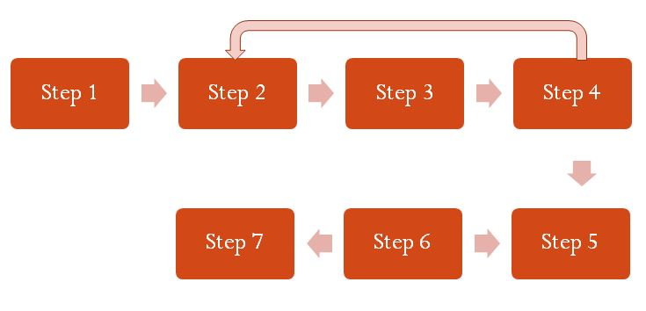

STEP #1: Evaluation
--Show me the data!
All students must be provided PE.
Whether a student receives APE is an IEP team decision driven by evaluation and student performance data:
Assess available, existing data or consider need for evaluation
  If additional data are needed “Other” should be checked on the DEC 2
  Write in “Adapted Physical Education Evaluation”
When considering APE eligibility, the IEP team includes a physical educator/curricular expert with knowledge of the student’s abilities and needs for participating in and learning the Healthful Living/PE Essential Standard
  Participation
  Fitness
  Endurance
  Motor patterns
  Sport skills
  Gross/Fine Motor Skills
This Photo by Unknown Author is licensed under CC BY-SA
This Photo by Unknown Author is licensed under CC BY-NC-SA
Notes:
NASPE Statement: Students should be considered eligible for adapted physical education services if their comprehensive score is 1.5 standard deviations below on a norm referenced test, or at least two years below age level on criterion referenced tests or other tests of physical and motor fitness.

Slide 33
APE Guiding Questions
What are this student’s strengths in PE?
What are this student’s needs in PE?
How does this student’s disability affect her/his participation in PE?
Can this student participate in PE with non-disabled peers? Have they had an opportunity to do so?
Can PE instruction be differentiated so s/he can participate?
In order for this student to participate in and learn the PE curriculum, do we have to design PE instruction just for him/her?
  Is s/he learning PE as every other student in that grade?
  Must we alter what we teach (APE/Specially Designed Instruction) or how we provide instruction (accommodation/Supplementary Aid/Service)?
What does the general education physical educator report about this student’s participation, abilities and needs in PE class?
Notes:
Provide written instructions in advance
Deliberate small group assignment
Small ratio (teachers : students) or small groups
Modify tasks or skills

Slide 34
STEP #2: IEP Team Discussion
This Photo by Unknown Author is licensed under CC BY-NC-SA
This Photo by Unknown Author is licensed under CC BY-SA
Can s/he keep pace with peers during activities? Consider fitness, coordination, rhythm, endurance, strength…
Is her/his ability to play, follow instructions and remain on task in Physical Education similar to peers?
Is the student similar to peers in gross and fine motor function: walking, jumping, catching, throwing, striking, kicking (e.g. force, speed, accuracy)?
Can s/he interact appropriately with peers during play, games and activities?
Does s/he understand and demonstrate the skills and rules required for the sport or game?
What supports, accommodations or modifications are appropriate?
Is specially designed instruction required?
What are student needs for transition? What will be her/his life-long physical or recreational activities?
How does the student’s disability affects the student’s involvement and progress in the Healthful Living/PE curriculum?

Slide 35
Specially Designed Instruction (SDI)
Definition:
Specially designed instruction means adapting, as appropriate to the needs of an eligible child under this part, the content, methodology, or delivery of instruction--
  (i) To address the unique needs of the child that result from the child's disability; and
  (ii) To ensure access of the child to the general curriculum, so that the child can meet the educational standards within the jurisdiction of the public agency that apply to all children.
IDEA Part 300(A)300.39; NC 1500-2.34(b)(3)
Notes:
Address the unique needs infers that we know and understand what the unique needs of the learner are- this is often where the role of the specialist comes in
We ensure access AND individualize, adapt, and intensify our instruction based on the students unique needs and response
Specially designed instruction is the instruction provided to a student with a disability who has an IEP in order to help him/her master IEP goals/objectives. Specially designed instruction is specific to a student who qualifies for special education services in order to help him/her master IEP goals/objectives and ensure access to and progress in the general curriculum. Specially designed instruction goes beyond differentiated instruction and addresses the unique needs that exist because of a student’s disability. Specially designed instruction should be implemented in addition to, not in place of, differentiated instruction.

Slide 36
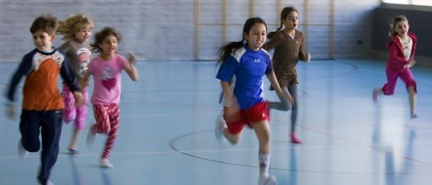
Should this student’s IEP include APE?
APPLY THE SAME STANDARD APPIED FOR ANY OTHER CURRICULAR AREA (e.g. English language arts, Math)
Yes= if s/he is not learning & participating in the grade level PE curriculum like all other ?th graders. Are there:
  consistent expectations (e.g. rules, skills)
  consistent class ratios
  similar supports- differentiated instruction not individualized instruction
No= if s/he is learning & participating in the grade level PE curriculum like all other ?th graders. The team should also consider accommodations/supplementary aids or services:
  different ball, racquet, net, bat, distance
  assigned partners or stations
  communication supports
  sensory supports
Notes:
If a student is in a special school, receiving PE without peers without disabilities- that is adapted PE.

Slide 37
STEP #3: Determining need for special education in PE or APE
The IEP Team discusses, then determines (via consensus decision) if the student’s needs in PE can be met with supplementary aids, services, modifications, accommodations or if s/he requires specially designed instruction to learn, progress through the PE curriculum and participate in class.
This Photo by Unknown Author is licensed under CC BY-NC-SA
This Photo by Unknown Author is licensed under CC BY-SA

Slide 38
Accommodations or Supplementary Aides & Services in PE
Specially Designed
or Adapted PE
Modifying tools (using a beach ball instead of a volleyball)
Adjusting environment (using noise cancelling headphones, deliberate group assignment)
Providing supports (list of activities or stations provided in advance)
Changing the instructional:
Content (what is taught)
Method (decreasing # of rules taught or game/skill expectations)
and/or
Context (where, with whom, instructor to student ratio or significant supports)

Slide 39
Step #4: Developing the IEP
What are the direct special education and/or related services (how much/what type/where) required for the student to meet his/her annual goal(s) in PE?
This Photo by Unknown Author is licensed under CC BY-NC-SA
This Photo by Unknown Author is licensed under CC BY-SA

Slide 40
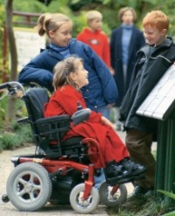
APE Goals/Objectives/Outcomes
Written by someone with knowledge of the PE curriculum
Working towards participation in general education physical education
Student-centered function (What do we want to see the student doing?)
Measurable
  Specific behavior, conditions, criteria
Meaningful
Realistic; attainable within time frame
Age & developmentally appropriate
Clear - no jargon

Slide 41

Areas to Consider for APE GOALS
Fitness, Motor Skills, Participation:
To develop and improve cardio- endurance
To develop eye-hand; eye-foot coordination; rhythm
To increase time on task in Physical Education
To develop functional competence in locomotor and object control skills (e.g. force, speed, accuracy)
To improve social interaction with peers
To demonstrate understanding of skills and rules required for the sport or game
To build endurance, CV capacity, strength
Notes:
Examples of goals that may be written for Adapted PE / IEP – align with both NC Essential Standards and NASPE

Slide 42
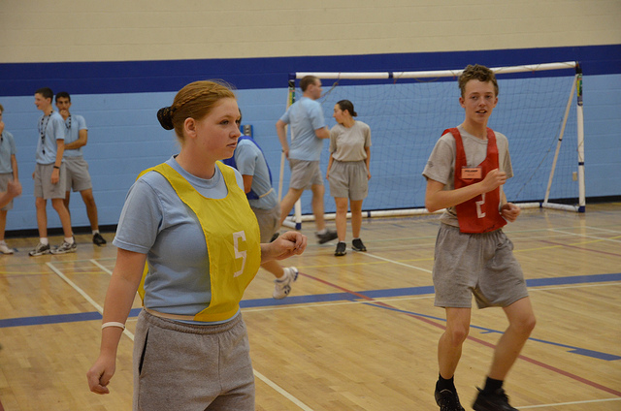
Step #5: Determining LRE
Where on the LRE continuum can this student make satisfactory progress towards their annual goals AND be educated with students who are not disabled to the MAXIMUM EXTENT POSSIBLE?
This Photo by Unknown Author is licensed under CC BY-NC-SA
This Photo by Unknown Author is licensed under CC BY-SA

Slide 43
Continuum of Possibilities for APE Services
Hospitals/ Homebound
Special/ Separate Schools
Full-time individual class (1:1)
Part-time individual class placement
Full-time SpEd class
Part-time SpEd class placement
GenEd class with assistance
Full-time GenEd class placement
Part-time GenEd class placement
Peers w/o disabilities participate in SpEd class
Every LEA MUST offer a full continuum of placement options & service delivery options to meet the UNIQUE needs of each student
Desired progression
Most restrictive Least restrictive
Adapted from Winnick, 2011
Notes:
Every LEA MUST offer a full continuum of placement options and service delivery options to meet the UNIQUE needs of each student

Slide 44


Step #6:
Monitoring Progress & Documenting APE Services
Student progress towards the goal(s) reported:
  By someone knowledgeable about the PE curriculum
  By someone present in the APE/PE class on a consistent basis
  On schedule with report cards!
Does not have to be in depth, just the facts
The point of measurable goals is to measure
progress, no estimates or opinions allowed
This Photo by Unknown Author is licensed under CC BY-SA
This Photo by Unknown Author is licensed under CC BY-NC-SA

Slide 45
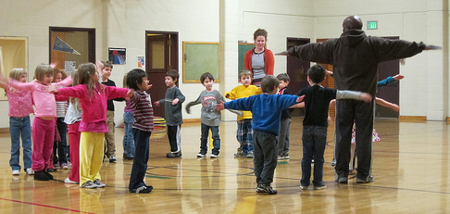
Who Can Provide APE?
Best practice is to employ a physical educator with Certification in Adapted Physical Education (CAPE) to plan and implement your APE program
States that require CAPE: CA, FL, LA, MA, MI, MN, NE, NV, ND, OH, OR, RI, WS, WY
PE and APE classes are planned and lead by educators who hold current state licensure in Physical Education
Physical educators may be qualified to provide adapted physical education—this does not mean they feel prepared to do so!! NC DPI and NC-APE-AC offer continuing education sessions at NC DPI Fall EC Conference, Summer Institutes and NCAAPHERD Annual Conference
Notes:
(IN=dual PE & APE; attempting=SD & TX; dropped CAPE=AK, KS; http://www.wrightslaw.com/info/pe.index.htm)

Slide 46

No APE Specialist???
Without an APE Specialist, APE services still must be delivered.
  Providing APE without an APE specialist can be challenging
  Encourage PE staff to update knowledge of disabilities and teaching strategies
  Collaboration between general education PE teachers and special educators and/or related service providers (especially OTs & PTs) can be very effective
  Explore and utilize all resources (NC-APE-Advisory Council, NC DPI, community resources, colleges, universities, parks and recreation programs, sports programs for the disabled, etc.)

Slide 47
APE Service Delivery Examples
Assessment, IEP development & APE instruction by CAPE or state certified adapted physical educator
Assessment & IEP development by CAPE or state certified adapted physical educator who consults with a general physical educator and shares instruction for APE
Assessment & IEP development by CAPE or state certified adapted physical educator who occasionally consults with a general physical educator for APE instruction
Assessment, IEP development & APE instruction by a general physical educator with occasional review & consultation with a CAPE or state certified adapted physical educator
Assessment, IEP development & APE instruction by a general physical educator in collaboration with or consultation from a special educator &/or related service provider
Adapted from Auxter, 2010

Slide 48
APE & PT- Physical is physical?
Many people are confused about APE: Administrators, Parents/Families, GenEd & SpEd instructional staff, Students and Related service providers
Blurred lines/ Overlapping practice & expertise
Related services (PT) support Special education (APE)
PT & APE different perspectives on similar areas of student development
Not interchangeable, PT cannot supplant PT or vice versa
Sometimes improvements in physical development cannot be attained by a physical educator using the usual time allotments, methods or activities associated with PE
Sometimes fitness or endurance improvements cannot be attained by a physical therapy related service using the customary service delivery, dosing and interventions
Winnick, 2010
Notes:
“Much has been written about the relation of APE to PT & OT. The lines of responsibility among these areas are often blurred. One thing that is clear is that related services must be provided if a student requires them to benefit from direct services. For example, both PT & OT must be provided to the extent that a student needs them to benefit from PE or other direct (educational) services in the school program. IDEA specifies that PE must be made available to children with disabilities. Also, states have their own requirements concerning the provision of PE. Clearly, PT & APE are not identical and related services should not supplant PE or APE, which are direct services under IDEA.
…Sometimes improvements in physical development cannot be attained by a physical educator using the usual time allotments, methods or activities associated with PE. In such cases, PT or OT can enhance physical fitness development. Activities included in the PE programs of students with disabilities should be those that are typically within the scope of PE.

Slide 49


Appropriate collaboration with APE
  Integrated Student Goal(s)
  Provide RS within PE or APE class routines
  Consultation for APE Assessment
  Provide consultation for APE modification, adaptation or AT
With SpEd, PE or RS
With APE, PE or SpEd
With PE or SpEd
With PE, SpEd or RS
  Individual Transition Plan
  Community options for life-long fitness, Recreation & Leisure
  Problem solving difficult, challenging & complex issues with participation, engagement and physical activity
  Special projects, programs or initiatives
With SpEd & RS
With APE, SpEd & RS
With APE, PE, SpEd or RS

Slide 50

Inappropriate Related Service or Special Educator
Collaboration for APE
  Provide APE assessment to IEP team
  Provide APE recommendations to IEP team
  Develop student goal(s) addressing PE curriculum
  Provide APE services
Not qualified to provide curricular-based assessment
Not qualified to provide APE recommendations & insufficient data
No knowledge of PE curriculum & not licensed in PE
No knowledge of PE curriculum & not licensed in PE

Slide 51
Should high school students receive APE until they graduate?
Students with disabilities are required to receive the same number of (PE) credits as their nondisabled peers. The community recreational needs of high school students should be addressed in his/her post-secondary transition plan. Students’ community-based leisure and/or recreational pursuits must also be addressed in his/her IEPs. If the IEP Team believes it is appropriate, a student with an IEP may continue to receive APE services throughout the high school years; even if no other student in the school is provided this opportunity. Again, the decision is based on the unique needs of the student with the disability. (Courtesy of the Texas Department of Education)
Any high school student may choose to take PE as an elective. If s/he does elect to take PE and requires APE service, it must be provided.

Slide 52

APE Resources
DPI APE website: http://ec.ncpublicschools.gov/instructional-resources/adapted-physical-education (check out resources tab)
North Carolina Adapted Physical Education Advisory Council (NC-APE-AC) website: www.nc-ape.com
Bridge II Sports and other sports/recreation programs for people with disabilities
Local Parks and Recreation departments or programs
State Educational Agency supports or resources
Local or community programs or resources
Local colleges & universities, especially with physical education, exercise science or exercise physiology majors

Slide 53
Laurie Ray, PT, PhD
APE Liaison for NC DPI
919)636-1827 laurie_ray@med.unc.edu http://ec.ncpublicschools.gov/instructional-resources/adapted-physical-education
NC-APE-Advisory Council=please see map for your regional contact www.nc-ape.com
Thank you for your interest!

