Slide 1
Indicator 4, 9/10 Webinar April 7, 2022

Slide 2
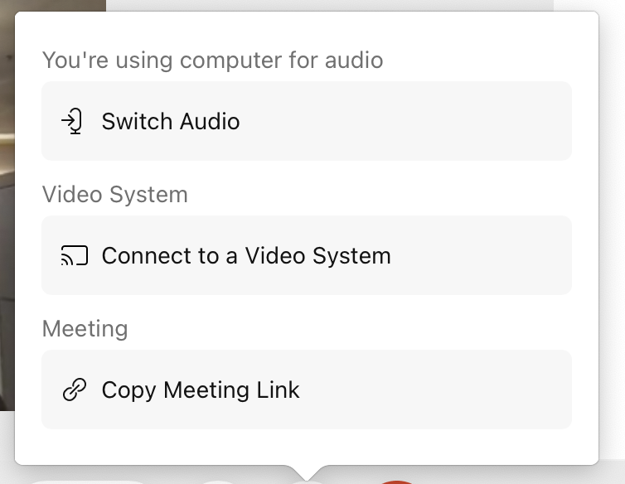
Welcome
Bottom control panel
Go Here to Adjust
Your Computer
Audio Settings
Notes:
Your bottom control panel has the following functions:
Mute/Unmute
Video/Stop Video
Share
Emoji/Reactions
Ellipsis (3 dots) which will lead you to your Computer Audio Settings
Leave Meeting Button (Red X)

Slide 3
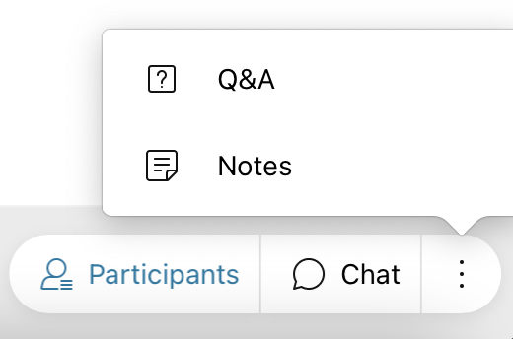
To the far right of the bottom control panel:
*Please use the Chat box to ask questions to our presenters today!
Notes:
To the far right of the bottom control panel you will see the participant list button, chat and another ellipsis that will take you to a Q&A Box.
NOTE: (Customize this slide, depending on how you would like questions to be asked/entered.)

Slide 4
Zoom In & Out
When content is being shared by the presenter, you can control the size of the view on your screen by accessing the control panel on the left/side.

Slide 5
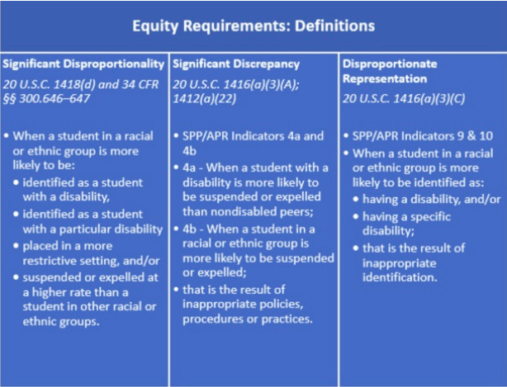
Significant Disproportionality
Every year, as required by federal law, the NCDPI EC Division examines data to
determine if significant disproportionality, significant discrepancy and disproportionate
representation is occurring in the state and its local education agencies (LEAs). These requirements are referred to as Equity Requirements under IDEA. Below you will find more information about each requirement including definition.
Warning and Significant Disproportionality List
Indicator 4 a and b
Indicator 9 & 10
Notes:
Good Afternoon everyone, we just want to give you a brief overview of the review process that has been developed for Indicators 4, 9, 10. As a reminder, this is a requirement from the OSEP measurement table that any district found to have Significant Discrepancy in discipline which is Indicator 4 or Disproportionate Representation in Identification (Indicators 9/10) are required to conduct a review of their policies, procedures and practices to determine if the discrepancy or disproportionate representation is due to either inappropriate identification or as a result of ineffective policies and practices.
Another important distinction is that the notifications that will go out to districts around these indicators are separate and apart from the notifications districts received on Friday around Significant Disproportionality. Indicators 9 and 10 are a subset of the data from the significant disproportionality data for Identification. The only difference in the calculation is that Indicator 9/10 uses students ages 5k-21 while the calculation for Significant Disproportionality uses students ages 3-21. Indicator 4 is also a subset of the Significant Disproportionality data for Discipline. Instead of using multiple consequences such as in school suspension < 10 days and > 10 days, like we do in Sig Dispro, Indicator 4 only looks at Out of School Suspensions and Expulsions cumulating greater than 10 days. Also, the calculation for Indicator 4 is different in that instead of looking at a risk ratio of greater than 3.0, Indicator 4 uses a rate ratio comparing out of school suspension and expulsions for SWD to non-disabled students. If a district is found to be suspending and expelling SWD at a rate of greater than 2.5 x the amount that they are suspending and expelling non-disabled students, they are considered to have a significant discrepancy and identified on Indicator 4.

Slide 6
Universal TA on new 4/9/10 Review Process & Tools
NCDPI calculates Significant Discrepancy/
Disproportionate Representation & notifies PSUs
NCDPI & PSUs (on list) review PSU policies and procedures
PSUs policies and procedures ARE compliant/complete
NCDPI provides technical assistance on student record review to find and address implementation gaps
NCDPI provides technical assistance to address policies and procedures
PSU addresses implementation gaps and submits actions to NCDPI
NCDPI verifies correction of non-compliant policies and procedures
NCDPI verifies completion of plan/correction of implementation gaps
PSUs policies and procedures are NOT compliant/complete
Notes:
High level overview
Process for digging in the data - teams eventually created

Slide 7
PowerPoint presentation timeline template
Review PSU-level Policies and Procedures (virtual)
Determine Corrections
If non-compliant
If compliant
DPI reports on review/ corrections outcomes in 2023 APR
PSUs address corrections and/or recommendations with RDT support
Review student-level practices (on site)
APRIL
MAY-JUNE
JULY
AUG-SEPT
OCT
NOV-DEC
7th: Statewide Overview Webinar
8th: Notification to 2019-2020 PSUs (19)
5/31 Complete PSU Doc Upload
DPI verifies corrections have been completed
PSUs notified of required corrections and/or recommended improvements, if any
Meet with 19 PSUs at May Institute

Slide 8
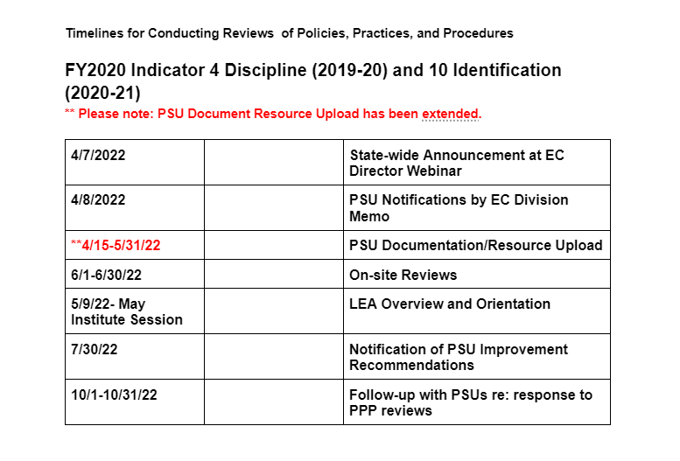

Slide 9
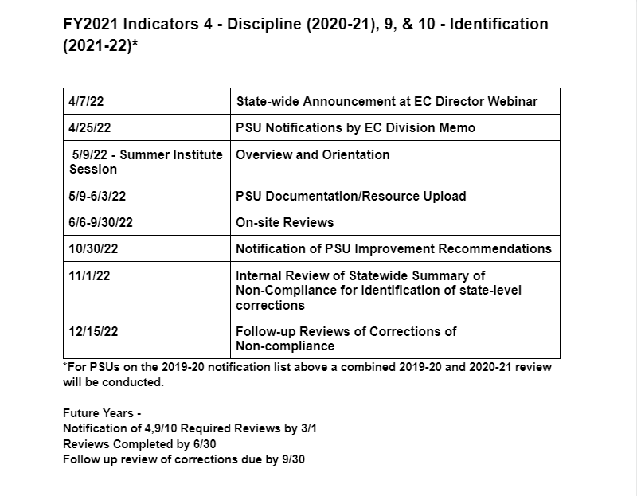
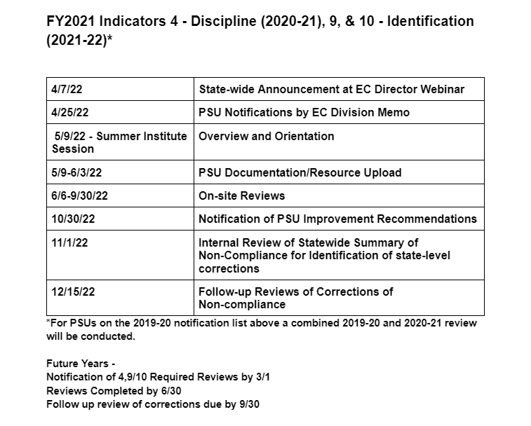

Slide 10
Review Teams for Indicators 4/9/10 (2022 APR)
19 PSU’s Identified
Teams of 3-4 DPI staff per PSU Review
PSU Review Team composition suggestions:
Curriculum Leads
EC Director
Student Services Director
Equity Officer
MTSS Coordinator
Building Administrator
SISP (e.g., school counselor, social worker, school psychologist)
Special education teacher & general education teacher
Parent of a student with a disability

Slide 11
PSU Resources
PSU Preparation for review of policies, practices and procedures
Indicator 4 Review Process Tool
Indicator 4 Methodology
Indicator 9/10 Review Process Tool
Indicator 9/10 Methodology

Slide 12
Contact Information
Contact your Regional Consultant for review process questions
Contact Kelley Blas or Lauren Holahan for data questions.
Questions about the review process or tools can be entered into our Indicators 4, 9/10 Padlet so that an FAQ and technical assistance can be developed.
This webinar and materials will be posted to the EC Division website under Reporting

