Slide 1
Comprehensive & Targeted Support (CTS) Presentation
A helpful guide for Comprehensive and Targeted Support (CTS) for Public School Units (PSU) and School-level leaders. Viewers will be guided through resources related to evidence-based interventions, tools for enhancing parent and family engagement, resource allocation review, NCStar strategies, and more.

Slide 2

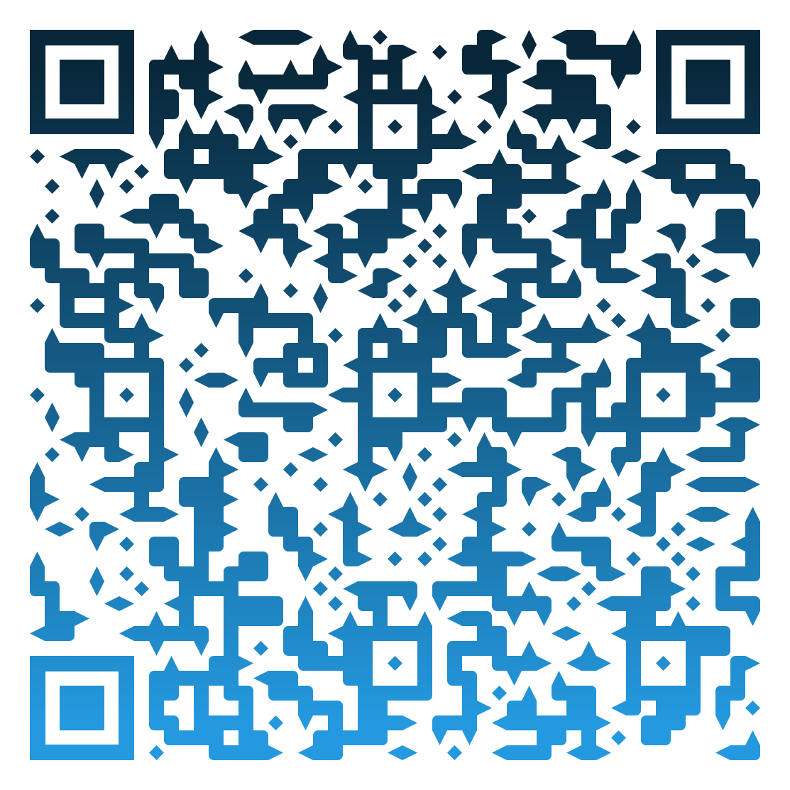
Resources from our presentation
https://www.dpi.nc.gov/districts-schools/federal-program-monitoring/comprehensive-and-targeted-support
CTS Website
Notes:
Our Comprehensive and Targeted Support (CTS) website has been redesigned to make it easier for PSUs and schools to find the tools, templates, and resources needed for successful implementation.
You’ll find:
The reference materials we discuss today, sample documents,
Direct links to NCStar, Parent Notification Sample Letters, and PRC 0105 resources
Upcoming webinar dates as well as recorded webinars like todays

Slide 3
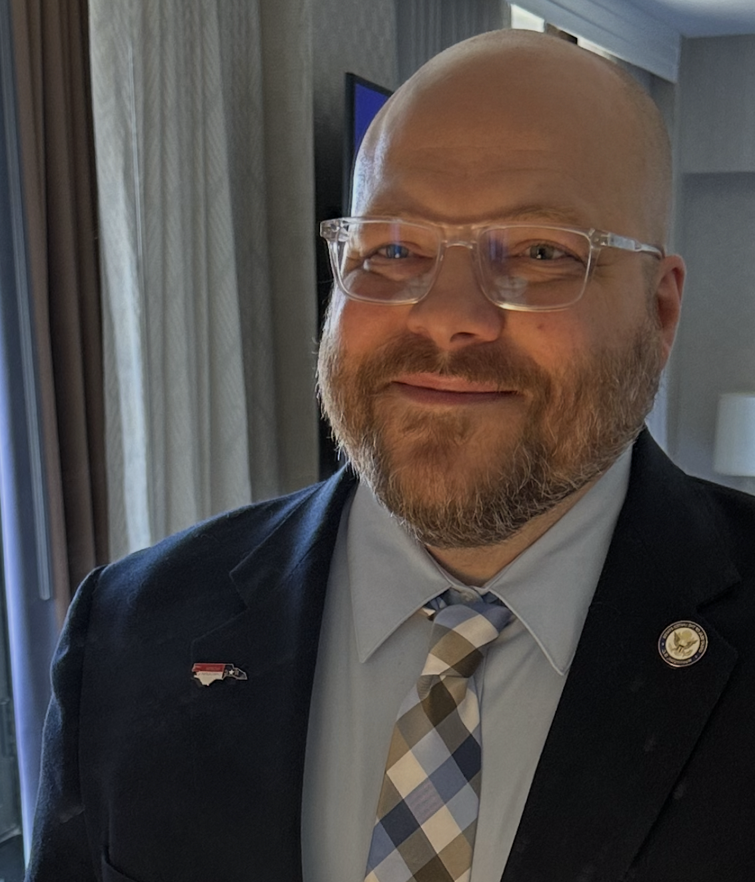


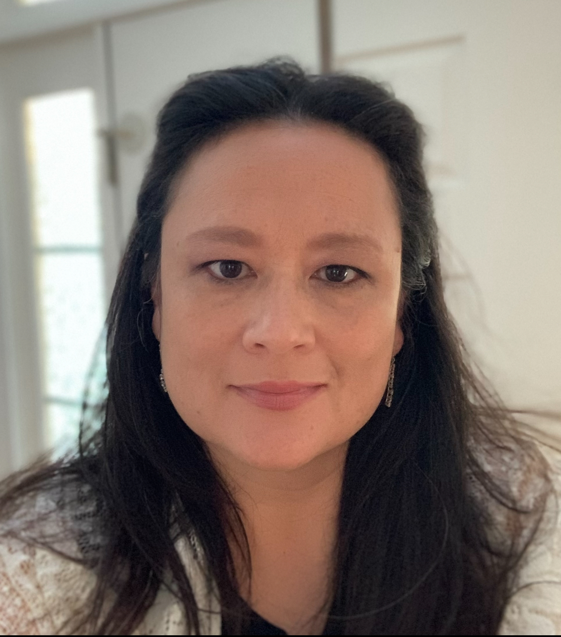

Dr. James Popp – CTS Section Chief
Tenisea Madry – CTS Program Administrator
Northeast, Southeast (including charters: 00A, 00B, 33A, 35A, 35C, 51A, 51B, 64A, & 98B in the North Central Region)
Dr. Richard Lewis – CTS Program Administrator
North Central, Sandhills (NOT including charters: 00A, 00B, 33A, 35A, 35C, 51A, 51B, 64A, 98B, & 62N)
Dr. Penny Crooks – CTS Program Administrator
Northwest, Piedmont-Triad (including charters 13A, 13C, 13D, 49B, & 49F in the Southwest Region and 62N in the Sandhills)
Julia Higdon – CTS Program Administrator
Western, Southwest (NOT including charters: 13A, 13C, 13D, 49B, and 49F)
Notes:
Before we dive in, let’s take a moment to introduce the CTS team. We are a statewide support team within the Office of Federal Programs. You’ll see that each Program Administrator supports specific regions and assigned charters or lab schools. Our work is collaborative; we’re here to help PSUs and schools interpret requirements, plan strategically, and align resources for impact. Please make note of your CTS contact; they’ll be your first call for support and technical assistance.

Slide 4

Session Agenda
Welcome & Objectives
Resource Allocation Review (RAR)
PSU NCStar Feedback
Non-Regulatory Guidance – School Improvement and Related Provisions
Non-Regulatory Guidance – Using Evidence to Strengthen Education Investments
PRC 0105 Allowable Use Reference Guide
Resources: Parent and Family Engagement / Multi-Tiered System of Support (MTSS)
Notes:
Welcome, everyone, and thank you for joining today’s webinar. Our time together will focus on strengthening our shared understanding of the tools, guidance, and resources that support ATSI and CSI across North Carolina.
We’ll begin with an overview of the Resource Allocation Review (RAR) process, examining how each school’s use of resources connects directly to student outcomes and needs. From there, we’ll move into the PSU NCStar Feedback process to ensure we’re aligned on expectations for school plan review and monitoring.
Next, we’ll review two key non-regulatory guidance documents from the U.S. Department of Education. The first addresses School Improvement and Related Provisions, outlining how federal requirements support continuous improvement planning. The second, Using Evidence to Strengthen Education Investments, helps us make informed, evidence-based decisions about strategies and interventions.
We’ll also walk through the PRC 0105 Allowable Use Reference Guide, which provides clarity on how CSI and ATSI funds can be used effectively and compliantly to support improvement efforts.
Finally, we’ll highlight additional NCDPI resources that reinforce this work, including Parent and Family Engagement supports and the Multi-Tiered System of Support (MTSS) framework through the Integrated Academic and Behavior Systems (IABS) office. Together, these tools provide a comprehensive foundation for advancing evidence-based improvements.

Slide 5
Resource Allocation Review (RAR)
Required by ESSA to review resource allocation the at state, district, and school levels
Identifies needs affecting disadvantaged students
Informs continuous improvement and funding decisions
Notes:
To begin, this section focuses on the Annual Resource Allocation Review (RAR) required for schools identified as Additional Targeted Support and Improvement (ATSI) or Comprehensive Support and Improvement (CSI). We’ll walk through the purpose, expectations, and dimensions of the self-assessment, and how this process helps ensure equitable allocation of resources that truly support student learning. We will have a separate webinar for the PSU Resource Allocation Review.
The Every Student Succeeds Act requires annual resource allocation reviews to identify where needs may exist and how resources can be better aligned with student needs. This process isn’t just about compliance, it’s about reflection, transparency, and ensuring that every dollar supports improved student outcomes.

Slide 6
Resource Allocation Review (RAR)
State – Level Review: Evaluates PSUs with ATSI / CSI identified schools
PSU – Level Review: Assesses resource distribution among schools
School – Level Review: Examines needs and impact within the school itself
Notes:
Resource allocation happens at multiple levels. At the state level, reviews identify PSUs needing targeted support. Districts then examine how funds and supports are distributed among schools, and at the school level, leadership teams analyze whether resources directly improve instruction and student performance.

Slide 7
Resource Allocation Review (RAR)
How to Complete the School Self-Assessment
Review and rate each statement
Note: Meets, Partially Meets, Does Not Meet, or N/A
Calculate total and overall score
Upload completed school self-assessment to NCStar Indicator D.1.02 / CSI-ATSI .02
Notes:
The self-assessment is designed for reflective discussion by the school leadership team. Each statement should be reviewed collaboratively, and the ratings should reflect actual implementation, not intentions. Once complete, the final document is uploaded into NCStar to serve as annual evidence of review and progress as well as to assist the PSU when completing the PSU Resource Allocation Review.

Slide 8
Resource Allocation Review (RAR)
Dimension #1: School-wide Supports for ATSI and CSI schools
Adequacy and clarity of funding structures
Autonomy to use funds based on school needs
Comprehensive and active ATSI / CSI plans
Annual review of resources
Notes:
Dimension 1 focuses on whether systems and structures are in place to support effective use of resources. This includes clarity from the district, flexibility at the school level, and the existence of an actionable CSI or ATSI plan. Schools demonstrating strong alignment between funding and needs typically show quicker progress in exiting identification status.

Slide 9
Resource Allocation Review (RAR)
Dimension #2: Teacher Quality in ATSI and/or ATSI schools
Certification, experience, and effectiveness of teachers
Equitable distribution of highly effective teachers
Support and professional learning for novice educators
Notes:
Teacher quality is one of the most powerful predictors of student achievement. This dimension examines whether effective teachers are equitably distributed and whether novice teachers receive sufficient support. Schools should use this reflection to strengthen recruitment, retention, and development strategies.

Slide 10
Resource Allocation Review (RAR)
Dimension #3: High-Quality Teaching and Learning in ATSI / CSI Schools
Standards-aligned curriculum and relevant materials
Instructional time and class size
Access to advanced courses and enrichment opportunities
Evidence-based intervention supports
Notes:
Dimension 3 assesses the instructional core curriculum, instruction, and access. Schools should ensure that all students, including those from historically underrepresented groups, have access to advanced learning opportunities, intervention supports, and resources that reflect their cultures and identities.

Slide 11
Resource Allocation Review (RAR)
Dimension #4: Whole Child Supports in ATSI / CSI schools
Safety, belonging, and positive relationships
Fair discipline practices
Mental health and social-emotional supports
Family engagement and communication
Notes:
This final dimension reminds us that student success extends beyond academics. Whole-child supports ensure that students feel safe, connected, and supported socially and emotionally. Strong partnerships with families and community agencies enhance these efforts and help remove barriers to learning.

Slide 12
Resource Allocation Review (RAR)
Each dimension receives a total score
Scores determine rating:
  Resources are allocated equitably
  At least one resource inequity is present
  Several resource inequities are present
  Resource inequities are prevalent
Describe needs if concerns are identified
Notes:
Scores provide a snapshot within each dimension, but the written reflection is where real value lies. Teams should describe not just what needs improvement, but also what strategies will address those findings moving forward.

Slide 13
Resource Allocation Review (RAR)
Next steps and submission
  Finalize and upload in NCStar under D.1.02 / CSI-ATSI .02
  Use findings to update ATSI / CSI plans and budgets
  Engage PSU for support
Notes:
Once the self-assessment is complete, schools should use the findings to work with the PSU to adjust their improvement plans and resource allocations. The goal is continuous improvement, aligning dollars, time, and talent to strategies that have the greatest impact on student achievement and opportunity.

Slide 14
PSU NCStar Feedback
Update Profile – Profile and Team
  Specific Membership
Manage Meetings – Our Meetings
  Agendas and Minutes
Set Direction – Mission, Vision, Values
Notes:
Now we move into The required NCStar feedback. The PSU NCStar feedback form will help PSUs in reviewing and documenting feedback on each school’s ATSI and/or CSI plan in NCStar. It aligns with state and federal requirements and reinforces the PSU’s responsibility for monitoring and providing feedback through the NCStar platform.
Each school’s school improvement team should demonstrate broad and balanced representation of the school community. Membership must include a parent representative who is not a school employee, and all member names and positions should be publicly available. This ensures transparency and inclusive participation in the school improvement process.
Schools must hold at least one documented school improvement team meeting each month. Meeting minutes should reflect the full scope of discussion, decisions, and action items, including monitoring of ATSI and/or CSI indicators. Minutes must be shared publicly, easily accessible, and kept current in NCStar.
Each school must have clearly documented mission, vision, and values statements that align with its ATSI or CSI plan and overall school improvement efforts. These foundational statements help ensure alignment between the school’s goals, actions, and accountability priorities.

Slide 15
PSU NCStar Feedback
Set Direction – Goals and Performance Measures
Set Direction – Data Review and Indicator Selection
General Feedback – Distributed Leadership
Notes:
Each school’s plan should include clearly defined goals written with SMART characteristics: specific, measurable, attainable, relevant, and time-bound, to ensure meaningful progress toward ATSI and/or CSI outcomes. These goals should focus on the current school year and include performance measures that allow the school and PSU to effectively monitor and adjust implementation as needed.
PSUs must ensure that school’s current data is available to inform decision-making and that all required ATSI and/or CSI indicators are selected and active in NCStar. As part of this process, the Resource Allocation Review (RAR) school self-assessment must be uploaded within the Initial Assessment section of indicator D.1.02 / CSI-ATSI .02, ensuring alignment between resource use and improvement priorities.
Finally, evidence of distributed leadership is essential. Leadership roles, responsibilities, and indicator assignments should be shared across multiple School Improvement Team members to build collaboration, accountability, and sustainability of improvement efforts over time.

Slide 16
PSU NCStar Feedback
General Feedback – Monitoring Indicators and Action Steps
For Schools Identified as Comprehensive Support and Improvement – Low Performing (CSI-LP)
Coaching Comments & Review
  PSUs are required to provide coaching comments
Notes:
PSUs should consistently monitor all indicators and action steps to ensure they remain current and actively reflect implementation progress. No indicators or action steps should be past due, demonstrating that the school is maintaining steady momentum toward achieving its improvement goals.
For schools identified as Comprehensive Support and Improvement – Low Performing (CSI-LP), performance measures must be established based on student performance aligned with the State’s long-term goals, providing a clear benchmark for tracking growth and success over time.
Each PSU is responsible for providing monthly coaching comments and reviews within the NCStar platform for each ATSI and/or CSI identified school. These comments serve as ongoing documentation of PSU support and progress monitoring, ensuring consistent feedback and accountability throughout the school improvement process.

Slide 17
Non-Regulatory Guidance – School Improvement and Related Provisions
Clarifies roles under ESSA
Defines identification and support
Emphasizes flexibility and continuous improvement
Notes:
The first non-regulatory guidance we’ll look at explains how states and PSUs can support CSI and TSI schools under Title I, Part A. It clarifies expectations for identification, planning, and exit from improvement status. Most importantly, it emphasizes that improvement should be flexible and responsive—not one-size-fits-all—and should focus on building local capacity to sustain results over time.

Slide 18
Non-Regulatory Guidance – School Improvement and Related Provisions
Key Guidance Concepts
  Identifications
  Planning
  Support
  Exit Based on Accountability Data and Local Context
Notes:
The federal guidance lays out the process clearly: identify schools through accountability data, develop and implement plans based on local needs, provide ongoing support, and define clear exit criteria. The goal is continuous improvement—not temporary compliance. Each phase of the process builds upon the last, keeping schools focused on progress and sustainability.

Slide 19
Non-Regulatory Guidance – School Improvement and Related Provisions
Building Local Capacity
  Focus on capacity
  Not just compliance
  Use evidence-based strategies
  Coordinate supports for sustainability
Notes:
This guidance encourages schools and PSUs to think beyond meeting requirements. Building local capacity means developing systems and practices that will continue after the designation ends. It’s about integrating evidence-based strategies into everyday operations and aligning all supports—financial, instructional, and human—so that success can continue independently.

Slide 20
Non-Regulatory Guidance – Using Evidence to Strengthen Education Investments
Updated federal guidance
Supports evidence-based decision making
Applies across all Federal Programs
Notes:
The second non-regulatory guidance, updated in 2023, focuses on using evidence to strengthen educational investments. It expands the ESSA framework to include all federal programs and provides a simple process for selecting and implementing strategies that are proven to work. It reinforces the idea that every decision, every dollar spent, should connect to evidence of impact.

Slide 21
Non-Regulatory Guidance – Using Evidence to Strengthen Education Investments
The Cycle of Continuous Improvement
  Identify needs
  Select evidence-based strategies
  Plan for implementation
  Implement
  Examine and reflect
Notes:
This cycle is at the heart of continuous improvement. It starts with identifying needs through data and stakeholder input, then selecting strategies supported by research. After that, teams plan and implement with fidelity, and finally, they reflect and adjust based on results. It’s the same rhythm used in NCStar—planning, doing, checking, and acting for improvement.

Slide 22
Non-Regulatory Guidance – Using Evidence to Strengthen Education Investments
Applying the cycle locally
  Engage stakeholders
  Monitor implementation
  Use data to adapt and sustain
Notes:
As PSUs and schools apply this model, the key is engagement and reflection. Engage your stakeholders early—teachers, parents, and community voices matter. Monitor your progress throughout implementation and use data to make informed adjustments. The goal is not perfection; it’s progress built through learning and refinement over time.

Slide 23
Non-Regulatory Guidance – Using Evidence to Strengthen Education Investments
Criteria for EDGAR Evidence Levels
  Strong Evidence
  Moderate Evidence
  Promising Evidence
  Demonstrates a Rationale
Notes:
The Education Department General Administrative Regulations provide a common framework for defining and applying levels of evidence across federal education programs. This framework supports consistent use of research-based strategies in programs such as ESEA, IDEA, Perkins, and the Higher Education Act, helping the Department and grantees make informed, evidence-driven decisions when implementing or funding interventions.
EDGAR defines four levels of evidence used to determine the strength and reliability of educational practices:
Strong Evidence – Supported by at least one well-designed experimental study showing a statistically significant, positive effect on relevant outcomes across multiple sites or populations.
Moderate Evidence – Supported by experimental or quasi-experimental research showing positive effects with no significant negative findings, demonstrating effectiveness in settings similar to those proposed.
Promising Evidence – Supported by at least one credible study—experimental, quasi-experimental, or well-designed correlational—with statistical controls indicating a positive impact on relevant outcomes.
Demonstrates a Rationale – Based on a clear logic model and informed by prior research or evaluation findings that suggest the approach is likely to improve outcomes.
This framework helps PSUs identify and select evidence-based interventions that meet federal standards and are most likely to yield measurable, sustainable improvements in student performance.

Slide 24
Non-Regulatory Guidance – Using Evidence to Strengthen Education Investments
Connecting evidence to CSI / TSI
  Use Evidence Levels to justify strategies
  Document rationale in NCStar and CCIP
  Reflect through RAR & monitoring
Notes:
Evidence is what ties all of this together. Each CSI or TSI plan should clearly show how chosen interventions connect to one of the four evidence levels. The rationale and supporting documentation belong in NCStar and CCIP. During your RAR and monitoring updates, reflect on whether those strategies are achieving the intended results, and adjust if needed. This cycle ensures both compliance and continuous growth.

Slide 25
Non-Regulatory Guidance – Using Evidence to Strengthen Education Investments
Accessing Key Guidance Documents
Comprehensive and Targeted Support (CTS) Website:
https://www.dpi.nc.gov/districts-schools/federal-program-monitoring/comprehensive-and-targeted-support
  School Improvement Non-Regulatory Guidance
  Using Evidence to Strengthen Investments
  What Works Clearinghouse
Notes:
You can access each of these federal documents directly online through our CTS website. The School Improvement guidance clarifies responsibilities under ESSA. The Evidence-Based Investments guidance helps you apply the right strategies. And the What Works Clearinghouse is a searchable database where you can explore interventions by grade, subject, or population, making it a great resource when designing your plans.

Slide 26
PRC 0105 Allowable Use Reference Guide
Temporary and supplemental funding source
Designed to accelerate improvement in CSI / TSI schools
Intended to build sustainable systems that continue after funds expire
Notes:
This next section will focus on the PRC 0105 Allowable Use Reference Guide: PRC 0105 funds are temporary and supplemental, not permanent or recurring. Their purpose is to accelerate improvement in CSI and TSI schools by funding targeted, evidence-based interventions. The real measure of success isn’t just what we implement while the funds are active, but what continues when the funds expire

Slide 27
PRC 0105 Allowable Use Reference Guide
Aligned: Activities must connect directly to the approved CSI / TSI plan
Necessary: Essential for improving identified outcomes
Reasonable: Cost-effective and fiscally sound
Supplemental: Expands beyond required activities
Sustainable: Designed to continue after the funding period
Notes:
Every allowable use must meet these five key principles. First, funds must be aligned with the CSI/TSI plan, meaning each expenditure should clearly connect to an identified strategy. Activities should be necessary and reasonable, ensuring fiscal integrity and targeted use. Funding must be supplemental, enhancing rather than replacing existing resources. Finally, sustainability is critical, each funded activity should leave behind a system or practice that endures beyond the life of the grant

Slide 28
PRC 0105 Allowable Use Reference Guide
Instructional Supports
Allowable Examples | Not Allowable
Hiring tutors or interventionist | Incentive pay or long-term positions without sustainability
Purchasing evidence-based instructional software and materials | General supplies not tied to evidence-based strategies
Contracting with instructional coaches tied to the CSI / TSI plan | Covering existing staff salaries already funded elsewhere

Slide 29
PRC 0105 Allowable Use Reference Guide
Professional Development
Allowable Examples | Not Allowable
Training in evidence-based instructional practices. | Holiday parties.
Coaching cycles, mentoring programs, or workshops linked to the CSI / TSI plan. | Entertainment.
Travel and registration for staff attending approved instructional conferences (must directly support the CSI/TSI plan).

Slide 30
PRC 0105 Allowable Use Reference Guide
Student & Family Engagement
Allowable Examples | Not Allowable
Translating parent communication materials (tied to CSI/TSI plan). | Translation services unrelated to the CSI/TSI plan.
Hosting family literacy/math nights with evidence-based instructional materials and light snacks. | Gift cards or cash incentives for student attendance or activities.
Printing parent resource guides in multiple languages (tied to CSI/TSI plan). | Catering or entertainment at parent events.

Slide 31
PRC 0105 Allowable Use Reference Guide
Extended Learning & Incentives
Allowable Examples | Not Allowable
Stipends for teachers leading after-school or summer tutoring aligned to the CSI/TSI plan (activities outside of the regular school day and responsibilities). | Incentive pay for regular duties (not sustainable).
Extended learning programs (before/after school, summer) targeting identified gaps (activities outside of the regular school day and responsibilities). | Trips to amusement parks, movies, or other recreational sites.
Field trips that directly support career or college readiness (e.g., college tours, worksite visits, STEM centers).

Slide 32
PRC 0105 Allowable Use Reference Guide
District / Charter / CMO Administration
Allowable Examples (up to 20% of annual funding) | Not Allowable
Staff time dedicated to CSI/TSI plan implementation (e.g., monitoring, compliance, coordination). | Paying off old PSU debt.
Contracted services for data analysis or program evaluation. | General operations (e.g., utilities, custodial services, office furniture).
 | Staff lounge refreshments.

Slide 33
PRC 0105 Allowable Use Reference Guide
Next Steps:
Review your PSUs use of funds
Align all expenditures to approved CSI / TSI plans
Contact your assigned Program Administrator for clarification
Notes:
As a reminder, this guide serves as a reference to support consistency and compliance across the state and is subject to change. Always confirm allowability when in doubt, and document how each expense ties back to the CSI/TSI plan. Collaboration with your assigned Program Administrator ensures alignment, transparency, and accountability

Slide 34
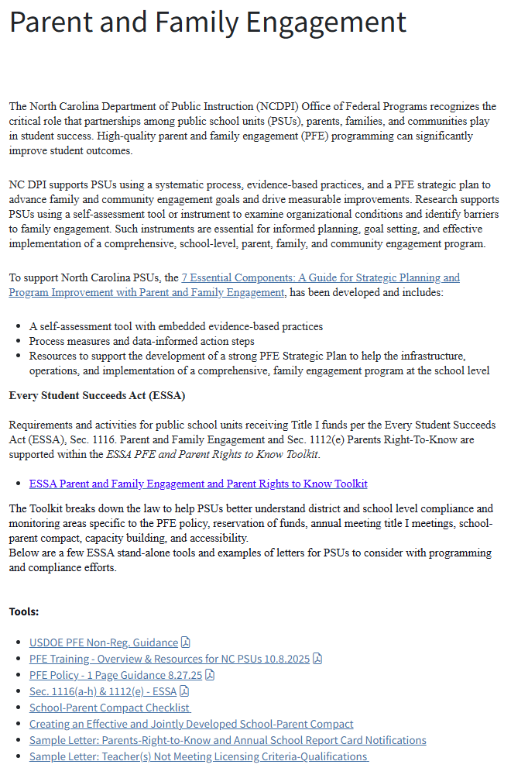
The NC Office of Federal Programs webpage
Recognizes the critical role that partnerships among public school units (PSUs), parents, families, and communities play in student success.
High-quality parent and family engagement (PFE) programming can significantly improve student outcomes.
Notes:
As we continue to align with North Carolina’s 2025–2030 Strategic Plan, Pillar 3 The updated PFE webpage consolidates state and federal resources designed to help PSUs move beyond compliance toward sustainable, evidence-based engagement practices. This includes new and updated tools such as the ESSA Parent and Family Engagement Toolkit, the School-Parent Compact Checklist, and sample parent communication templates aligned with federal “Right-to-Know” and school report card notifications.
The Dual Capacity Building Framework and The 7 Essential Components Guide provide PSUs with practical strategies for building comprehensive parent, family, and community engagement systems. Evidence shows that using structured leadership teams, self-assessment tools, and strategic plans leads to more consistent, effective implementation across schools.
Ultimately, these resources are designed to help districts and schools go beyond compliance, to build engagement practices that are collaborative, data-informed, and embedded in continuous improvement efforts. By applying evidence-based approaches, PSUs can ensure that family engagement is not an event, but a sustained partnership that supports every student’s success.

Slide 35
Go Beyond Compliance - APPLY EVIDENCE-BASED PRACTICES
With Comprehensive Parent, Family, and Community Engagement (PFCE)
PROGRAMMING
Dr. Karen Mapp: Family-school relationships are a two-way street. Schools and districts hoping to improve family engagement must focus on building the capacity of both families and staff around student learning and development. Only then can schools and districts cultivate deep partnerships with families that support student achievement and other key educational outcomes.
RESEARCH SAYS schools with strong, effective Family Engagement Programming in Schools have:
Better Student Attendance
Students with Improved Pro-Social Skills
Higher Graduation Rates
Students with Higher Test Scores, Improved Academic Performance
Evidence suggests that PSUs using a PFE leadership team structure, a self-assessment instrument, and a strategic plan are vital for PFCE planning, improvement, and implementation.
The 7 Essential Components: A Guide for Strategic Planning and Program Improvement with Parent and Family Engagement to improve comprehensive family and community engagement programming:
The Dual Capacity-Building Framework for Family-School Partnerships, Version 2 - https://www.dualcapacity.org (Mapp, K. L. & Bergman, E. (2019))
Notes:
Dr. Mapp’s research highlights the need for both districts and schools to be intentional with building capacity of staffs and families to improve family engagement programming.
Use the available address link to access Dr. Mapp’s videos, resources, and the Dual Capacity-Building Framework for Family-School Partnerships

Slide 36
Resources
Integrated Academic & Behavior Systems (IABS)
  North Carolina Multi-Tiered System of Support (NC MTSS)
  https://www.dpi.nc.gov/districts-schools/districts-schools-support/integrated-academic-behavior-systems
Year-at-a-Glance
https://www.dpi.nc.gov/districts-schools/federal-program-monitoring/comprehensive-and-targeted-support#Tab-Resourcesegpresentationsrecordingsnon-regulatoryguidance-7788
Notes:
As we continue discussing how schools can strengthen improvement efforts, it’s important to recognize one of our key statewide support structures, the Integrated Academic and Behavior Systems (IABS) Office at NCDPI.
The IABS team supports the work of implementing and sustaining a Multi-Tiered System of Support (MTSS) framework through the lens of data, systems and practices for all students. The MTSS framework for districts and schools focuses on academics and behavior from Pre-K through 12th grade.
NC MTSS is a school improvement framework that encompasses academic, behavioral, social, and emotional instruction and support. NC MTSS employs a systems approach using data-driven problem-solving to maximize growth for all.
Their mission is to build the capacity of public school systems to implement and sustain a Multi-Tiered System of Support through the provision of professional development, coaching, technical assistance, and resources.
Please access and review the address link provided for resources
Please take a moment to review the Year at a Glance located on the CTS website. This resource provides an overview of key dates, deadlines, and activities to help ensure timely planning and implementation throughout the school year.

Slide 37


Dr. James Popp – CTS Section Chief
james.popp@dpi.nc.gov (984) 236-2801
Dr. Penny Crooks – CTS Program Administrator
penny.crooks@dpi.nc.gov (984) 236-2978
Julia Higdon – CTS Program Administrator
julia.higdon@dpi.nc.gov (828) 361-5277
Dr. Richard Lewis – CTS Program Administrator
richard.lewis@dpi.nc.gov (919) 548-6435
Tenisea Madry – CTS Program Administrator
tenisea.madry@dpi.nc.gov (984) 236-2886
Notes:
Our CTS team is available to provide guidance, technical assistance, and ongoing support to help your PSU navigate CSI and TSI requirements. Each Program Administrator will be reaching out after this presentation to offer virtual one-on-one office hours to answer questions and provide individualized support. PSUs are also encouraged to reach out to the assigned PA at any time to schedule additional support sessions as needed.

Slide 38
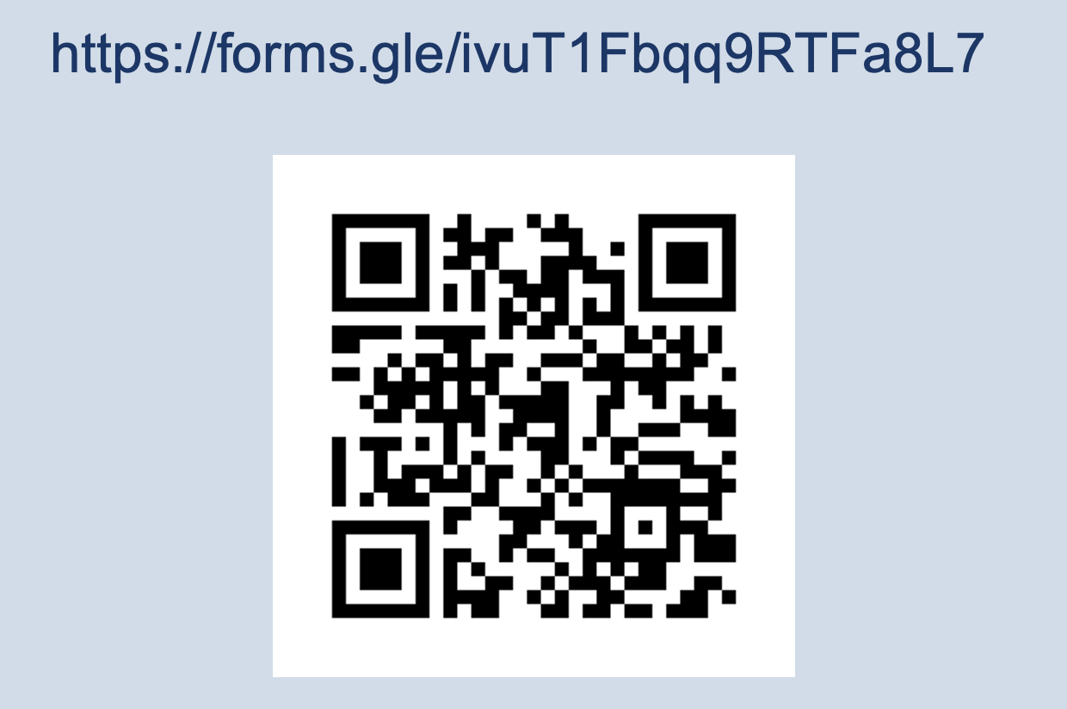
We value your feedback
Notes:
Thank you for joining today’s session! Your input helps us strengthen the support and resources we provide across the state. Please take a few moments to share your feedback on today’s presentation — what was helpful, what could be clearer, and what additional topics you’d like us to cover in future sessions.
Your insights guide our continuous improvement, just as we support yours! Thank you

