Slide 1

Verification: The Process
September 2023
presented by:
Jacquelyn McGowan, Compliance Specialist
Office of School Nutrition
USDA is an equal opportunity provider and employer.
Notes:
Good morning. My name is Jacquelyn McGowan and I am the Compliance Specialist for the Office of School Nutrition at the NC Department of Public Instruction. I want to welcome you to the verification webinar which is an in depth look at the Federal requirements to conduct a successful verification process from beginning to end.
Verification season will be starting very soon – specifically on Monday October 2, 2023. This webinar is designed for the person conducting the verification process. While we hope it will be beneficial to all participants, we truly hope that the individual responsible for Verification activities in the SFA is listening in to gain understanding and clarity on the process.
Please remember that all Dates in this webinar are subject to change!!! If they change, we will notify you as quickly as possible. The notification will be done through blast email or the SN update so make sure you are receiving the updates and review them when you receive it.

Slide 2
Learning Objectives
Key Terms
What is Verification?
Important Verification Dates 2023-2024
Initial Verification
Establishing the Sample Pool
Establishing the Sample Size
Application Selection Procedures
Standard
Alternate 1
Alternate 2
Completing the Sample Size
Notes:
Let’s talk about our Learning Objectives for this webinar

Slide 3
Learning Objectives
Qualifying to Use an Alternate Sample Size
Lowered Non-Response Rate
Improved Non-Response Rate
Post Selection Procedures
Confirmation reviews
Replacing applications
Household Notification of Selection
Contacting the household
Sources For Verification
Collateral Contacts
Agency Records
Notes:
Let’s talk about our Learning Objectives for this webinar
Lowered Non-Response Rate
Improved Non-Response Rate
Notification of Use of Alternative Sample Size
Confirmation reviews
Outcome of confirmation
Replacing applications
Contacting the household
Sources for Verification such as
Collateral Contacts
Agency Records
And also we’ll talk about
When a Household Indicates No Income

Slide 4
Learning Objectives
Households that Re-apply for Program Benefits
Recordkeeping
Individual Applications
Verification for Cause
General
Verification for Cause for School District Employees
Common Misunderstandings
Documentation
Notes:
During this webinar, we will also discuss how to address households that reapply, recordkeeping, the Verification for cause process and we will wrap up with common misunderstandings and findings.

Slide 5
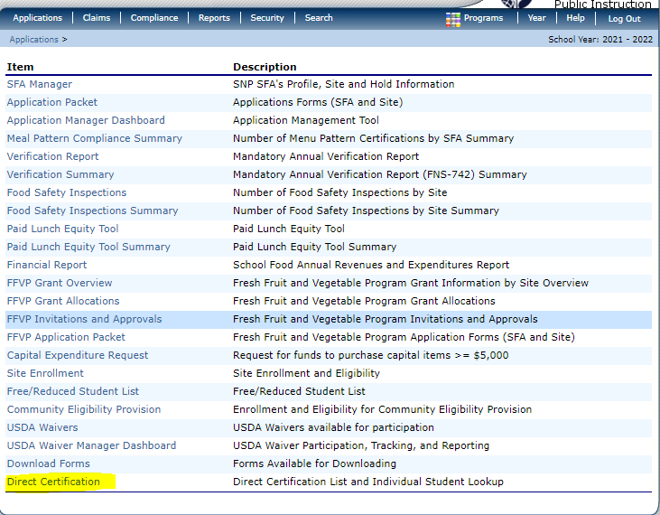
Key Terms
Direct Verification
Using records from public agencies to verify income and/or program participation.
(The State Agency’s Direct Verification Module is
https://www.ncchildnutrition.org/
Notes:
Just a few key terms that you will hear throughout this session.
DIRECT VERIFICATION is using records from public agencies to verify income and/or program participation. The State Agency offers this as a part of the DCV module. The individual who has access to the DC would also be able to do Direct Verification.

Slide 6
Key Terms:
Error Prone
Applications within $100 per month of the applicable Income Eligibility Guidelines.
Random Sampling
Each application has an equal chance of being selected.
Notes:
Next key term is ERROR PRONE which are applications within $100 per month of the applicable Income Eligibility Guideline or For example, if we are looking at the Income Eligibility Guideline for the 2023-2024 household of 4 within monthly income of $***** for the free benefit and $**** for the reduced benefit would be marked error prone.
(A statistically valid random sample is not required, the SFA must determine a selection interval by dividing the number of applications by the required sample size)

Slide 7
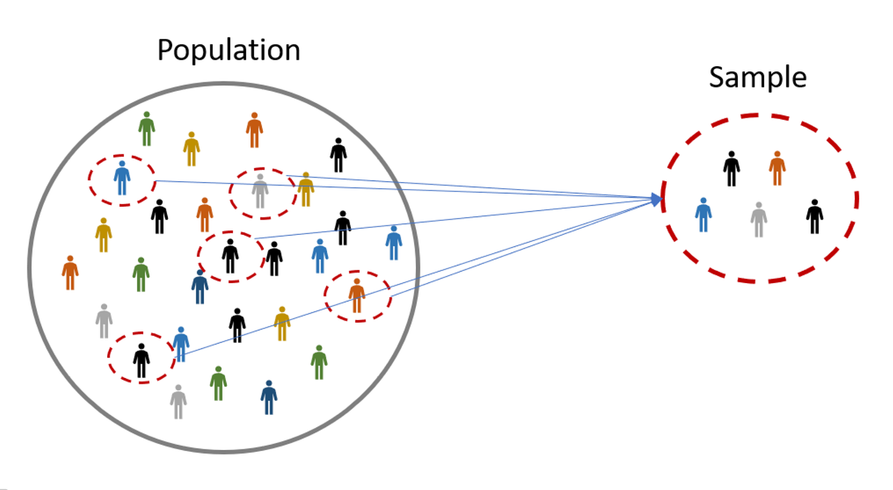
Key Terms:
Sample Pool
The total number of free and reduced applications approved as of October 2
Sample Size
The number of applications subject to Verification;
Notes:
SAMPLE POOL means the total number of applications approved as of October 2

Slide 8

What is Verification ?
VERIFICATION is the confirmation of eligibility for Free and Reduced Price meals. For complete instructions refer to the Eligibility Manual for School Meals, July 2017 Section 6, pages 96-115.
https://fns-prod.azureedge.us/sites/default/files/cn/SP36_CACFP15_SFSP11-2017a1.pdf
Notes:
Verification is a Federal Requirement in the 7 CFR 245.6a. It is the confirmation of Eligibility for Free and Reduced Price Meals under the National School Lunch Program and the School Breakfast Program. Please note that we stated it is for free and reduced price meals…so verification is not for applications that have been denied.
Verification is only required when eligibility is determined through the application process, not through direct certification conducted with an Assistance Program or officials or agencies who documented Other Source Categorical Eligibility.
For detailed information on verification please refer to the Eligibility Manual for School Meals July 2017 Section 6 pages 96-115. We have pulled a lot of this information from the Eligibility Manual, particularly the things that you need to be mindful of as you go through the Verification process. Make sure you have a copy of the Manual on your computer, laptop or print a copy to reference as you go through the Verification process.

Slide 9
What
Must
Verification include?
Confirmation of either income eligibility OR
The child or any member of the household is receiving assistance under FNS, FDPIR, or TANF/Work First Cash Assistance OR
The child is Other Source Categorically Eligible.
Notes:
Verification must include either confirmation of income eligibility or confirmation that the child or any member of the household is receiving assistance under Food and Nutrition Services (formerly Food Stamps, and recognized in all other states as SNAP, (FNS, formerly food stamps), Food Distribution Program on Indian Reservations (FDPIR), or Work First Cash Assistance , formerly known as Temporary Assistance for Needy Families (TANF) or Work First or that a child is Other Source Categorically Eligible (homeless, migrant, runaway, foster or federally funded Even Start and Head Start programs)
Verification MAY include Confirmation of any other information on the application such as household size.

Slide 10
When is Verification not required?
Children certified under Direct Certification
Children in RCCIs
Does not include day students
Schools are approved for special cash assistance
Special Milk Program (SMP) Sponsors
Notes:
According to 7 CFR 245.6a(c)(2) verification is not required For children who have been certified in the DC system. They are not required for children documented as eligible migrant, runaway, homeless children; foster children; and children enrolled in federally funded Head Start;
For children in RCCIs, except for applications that are received for day students at the institution;
In schools where FNS has approved special cash assistance claims based on economic statistics regarding per capita income, such as in Puerto Rico and the Virgin Islands;
Special Milk Program participants

Slide 11
When is Verification not required?
Schools with Non-Pricing Programs
100% Community Eligibility Provision or in Provisions 1, 2, 3
Other FNS determined exemptions
Notes:
In schools with non-pricing programs, which claim only the paid rate of reimbursement, where all children are served with no separate charge for food service and no special cash assistance is claimed;
In LEAs where all schools participate in CEP or in Provisions 1, 2, 3, except in the base years in Provision 1, 2, or 3 schools in which applications are taken for all children in attendance; and
For other FNS determined exemptions, on a case-by-case basis.

Slide 12
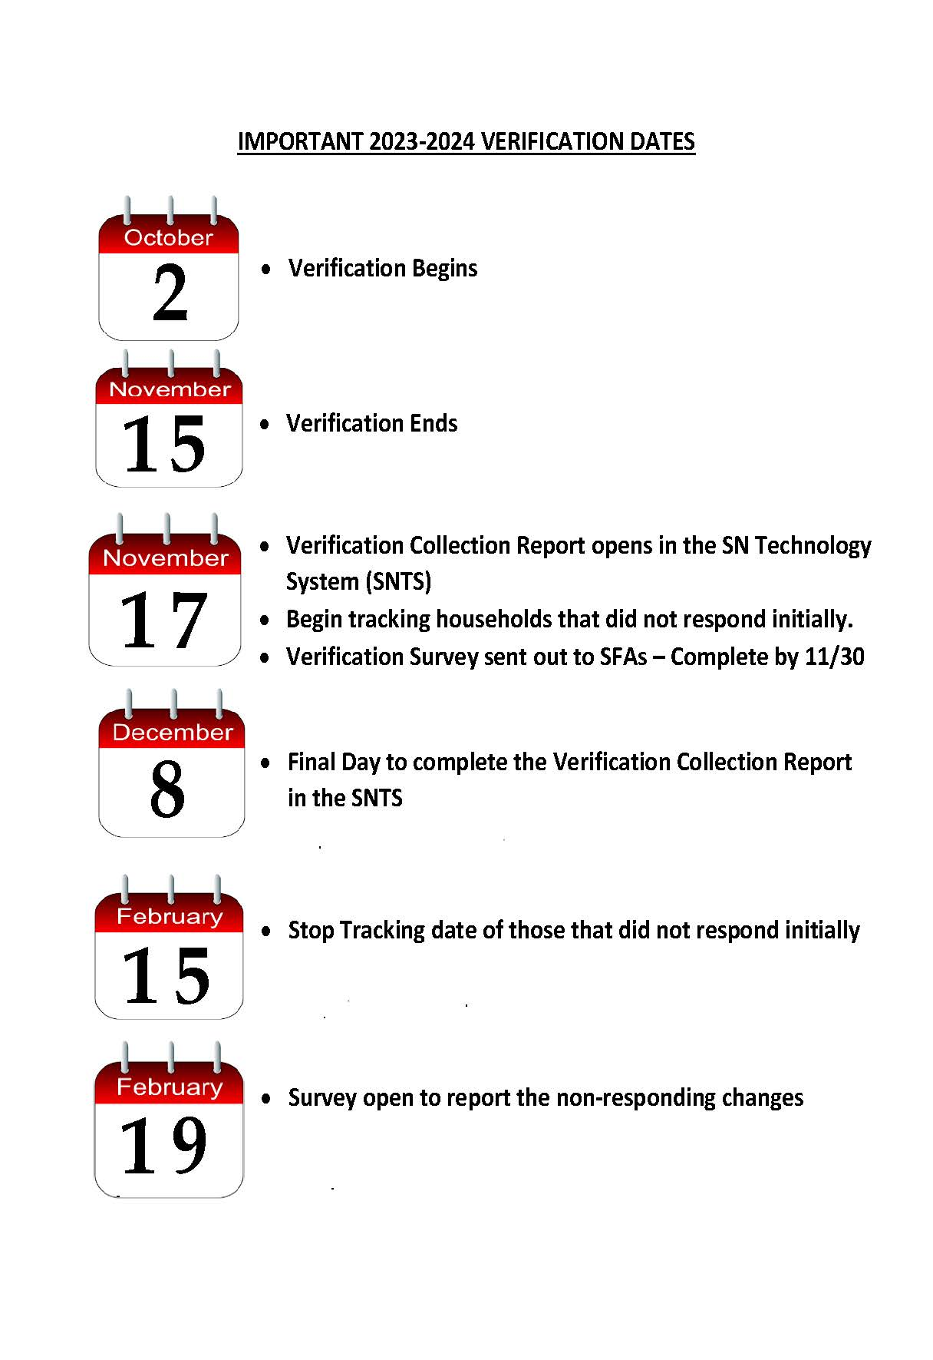
Important 2023-2024 Verification Dates
Notes:
Monday October 2, 2023 (Verification Begins)
Wednesday November 15, 2023
Friday November 17, 2023 (Survey starts and the Verification Summary Report is opened to SFAs)
Friday December 8, 2023 (The Verification Summary Report is closed to SFAs)
Thursday February 15, 2024 (Date to end the report for those who responded after verification)
Monday February 19, 2024 (Report due to State Agency on the number that did not respond to verification until after the period ended through February 15, 2024)

Slide 13
When does Verification begin?
    Each SFA must verify a sample that is selected from all approved free and reduced applications as of Monday October 2 for the 2023-24 school year.
October 2
Verification Begins
November 15
Verification Ends
Notes:
This year October 1 is on a Sunday so that we are looking at the number of applications on file as of Monday October 2. REMEMBER: The confirmation process must take place before notification letters are distributed to the household. We will discuss in detail what confirmation means to all SFAs in NC

Slide 14
When does Verification end?
Verification of the selected applications must be completed by Wednesday November 15, 2023
(If the SFA knows in advance the deadline cannot be met, a written request for an extension must be made to the SA).
October 2
Verification Begins
November 15
Verification Ends
Notes:
The Verification process ends on Wednesday November 15 so the process should end on that day. Remember the reporting is still not complete.
If the SFA sees that the deadline cannot be met, a written request must be made to the state agency before the November 15 deadline, if not then a Correction Action Plan will be required. USDA only allows the deadline extension to be 30 days for SA approval, beyond must be approved by the Southeast Regional Office

Slide 15
Online Verification Report Opens
Friday November 17, 2023
The online Verification Report opens in the School Nutrition Technology System AND
Online survey - the SFA must report to the State Agency that verification activities
October 2
Verification Begins
November 17 Online Verification Report Opens AND Online Survey to SFAs
November 15
Verification Ends
Notes:
Two things will happen on Friday November 17- a brief online survey will be sent only to determine if the verification process has been completed
November 17 is also the date the Verification Report is opened to all SFAs. Since the process is so fresh in all minds the SA encourages completion of this report immediately after the closing deadline.

Slide 16
Online Verification Report Closes
Friday December 8, 2023
the online Verification Collection Report closes in the School Nutrition Technology System.
October 2
Verification Begins
November 15
Verification Ends
November 17 Online Verification Report Open AND Online Survey to SFAs
December 8 Online Verification Report Closes
Notes:
The closing date for the online Verification Report is Friday December 8, 2023

Slide 17
Survey - Verification Households Reapply
16 Nov. 2023 – 15 Feb. 2024
Data must be collected from November 16, 2023 - February 15, 2024 for the households that did not respond to verification.
17 Feb. 2024
The data must be reported on a survey to be distributed online on February 17, 2024.
Notes:
Even though the verification process ends on November 15, the entire reporting process is not complete until data is collected through February 15 for households that did not respond before the November 15th deadline but elected to re-apply between November 16 and February 15.
It is imperative that SFA maintains tracking of all households that did not respond on November 15 but re-applied by February 15. Reporting of this data is required by USDA and we will announce the collection method closer to the reporting deadline in a SN Update.

Slide 18
Recap of Verification Dates 2023-24
October 2 Verification begins
November 15 Verification ends
November 17 (Verification online survey report/Verification Report open in SNTS)
December 8 (Verification Report closes in the SNTS)
February 15 (Collection of data {applications and students} for the non-response households that Reapplied or were Reapproved between November 16 and February 15)
February 19 Online survey to report the above
October 2 Verification Begins
November 15 Verification Ends
November 17 Verification Summary Report Opens/Online Survey
December 8 Verification Report Closes
February 15 Data Collection
February 19 Online Survey

Slide 19

  Initial
  Verification
  Process
Notes:
Okay, let’s get started

Slide 20

How do I establish the Sample Pool?
Total number of approved applications on file as of October 2 of the current school year.
The sample pool depends on the number of applications (paper or electronic)
Mixed Household applications
Notes:
So let’s proceed with completing the verification process, the first step is establishing the Sample Pool.
The sample pool uses the total number of approved applications on file as of October 2 of the current school year. LEAs may choose not to count applications for students in split- session kindergarten programs participating in the SMP when determining the verification sample pool.
The sample pool depends on the number of applications (paper or electronic) and is not based on the number of children eligible for free and reduced priced meals.
Mixed household applications (other source categorical and income apps) are included in the sample pool.

Slide 21

How do I establish the Sample Size?
The SFA calculates the sample size (number of applications to be verified)—ALWAYS ROUND UP
You must verify at least one application.
NEVER verify 100% of the applications!
Round UP
Notes:
After determining the Sample Pool then the Sample Size must be determined:
To do this, the SFA calculates the sample size—ALWAYS ROUND UP 3125 applications on October 2 and we are multiplying it by 3% equal 93.75 (example 93.75 would be 94 applications). If you have a low number of applications due to being a smaller district or charter school – 25 applications (.75) then you still have to round up. At least one application must be verified.
With the exception of “verification for cause” the SFA MUST VERIFY the EXACT NUMBER REQUIRED..NOT more than or less than the standard sample size or the alternate sample size. If you do more or less then it is underverifying or oververifying and will result in a Corrective Action Plan.
NEVER verify 100% of the applications!
Verification “for cause” is done in addition to the required sample size. An SFA may do verification for cause at any point in time during the school year and make sure you document it because this information will be requested

Slide 22
  Application
  Selection
  Procedures
Notes:
Okay, let’s get started

Slide 23
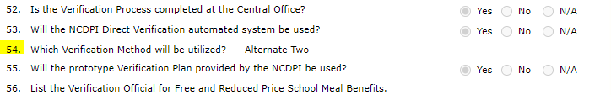
What Verification Method should I use?
The State Agency (SA) provided each School Food Authority (SFA) with the Verification Method they should use for SY 23- 24.
The SFA used this information to complete the electronic application (Question #54)
Notes:
You should have received your Verification Method from your Zone Consultant in the Spring 2023 (either standard or the choice to choose an alternate method). The SFA uses this information in the electronic application to complete question #54 in the SFA section appropriately. If you are a new SN Administrator and was not in the district or school during the agreement renewal process, we encourage you to go in and look at which verification method your school district or school is supposed to use.

Slide 24

How To Determine Sample Size
Three Methods:
Standard
Alternate One
Alternate Two
Notes:
We have now determined the Sample Pool and are now going to determine the sample size which is based on the method that you are required to use:
The three methods are:
Standard
Alternate One
Alternate Two

Slide 25

Standard Sample Size
Verify the lesser of:
3% of all applications approved as of October 2 selected from error prone for the school year OR
3,000 error prone approved applications as of
October 3 for the school year.
3% or 3,000
Notes:
The standard sample size must be used by an LEA unless it qualifies to use one of the other sample sizes.
Verify the lesser of:
3% of all applications approved as of October 2 selected from error prone for the school year
or 3,000 error prone approved applications as of October 2 for the school year.
Once sample size is determined, error prone applications are the first selected ~ error prone are those with income within $100 monthly or $1200 annually
If not enough error prone applications on file, the remainder of the applications verified are selected randomly from all applications subject to verification (including income and case number).
If Applications are processed manually all SFAs are encouraged to mark an error prone application during the eligibility determination process so applications can easily be selected when the verification process begins, otherwise the SFA will have to go back through the applications to see which ones are error prone. All software system should be doing this (please contact your vendor to ensure the process is in place if you have questions about error prone applications). Error prone applications must be reported on question 5-4 of the verification report.

Slide 26
Example # 1 for Standard
245 approved free and reduced applications on file
50 applications (Error Prone)
You would select 8 applications randomly from the 50 error prone applications.
Example: 3% X 245 = 7.35
# to verify = 8
Notes:
Let’s look at an example for Standard Sample Size:
X 245 approved free and reduced applications on file (excludes all DC, homeless, migrant, runaway, headstart and foster children)
3% of 245 would be 7.35
Number to verify = 8
50 applications make up the Error Prone Sample because they fall within $100 of the monthly guidelines or $1200 annually
You would select 8 applications from the error prone applications

Slide 27
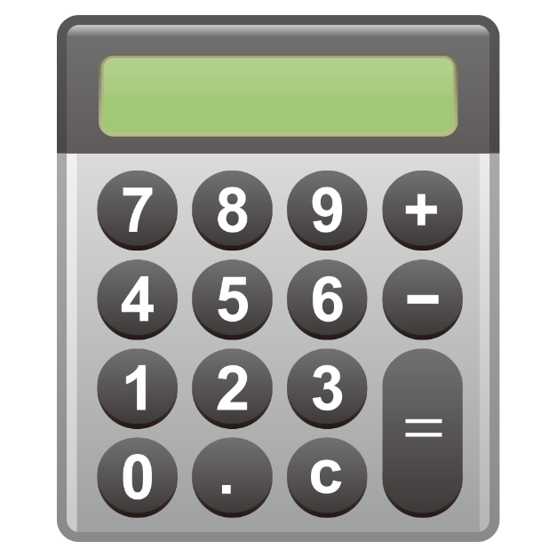
Example # 2 for Standard
Example:
3% X 135 = 4.05
# to verify = 5
135 approved free and reduced applications on file
3 applications make up the Error Prone Sample
Notes:
Here is another example for the standard method
135 approved free and reduced applications on file
3% of 135 would be 4.05
Number to verify = 5
3 applications make up the Error Prone Sample because they fall within $100 of the monthly guidelines or $1200 annually
You would select all 3 error prone and randomly select 2 applications from the other 132 applications on file. This is known as COMPLETING the Sample Size.
If the SFA is using a software program, generally the error prone applications selection is in the “programing” part of the software. If the SFA has to do this manually a good way to do this is during the determination process star or mark the application denoting it is an Error prone application in case the standard or Alternate Two method is used.

Slide 28

Alternate One Sample
Verify the lesser of:
3% of all approved applications selected at random as of October 2
OR
3,000 applications selected at random from all the applications approved as of October 2
3% or 3,000
Notes:
If the SFA has the opportunity to elect Alternate One they must:
Verify the lesser of:
3,000 applications selected at random from all the applications approved as of October 1 of the school year.
or 3% of all approved applications selected at random as of October 1 of the school year.
Once the sample size is determined, all applications are selected at random.

Slide 29
Example of Alternate One
2001 approved free and reduced applications on file
Example:
3% X 2005 = 60.15
# to verify = 61
Notes:
Let’s review an example of Alternate One:
2001 approved free and reduced applications on file
3% of 2005 would be 60.15
Number to verify = 61
Select all 61 applications randomly from the approved free and reduced applications.

Slide 30

Example of Alternate Two
The lesser of the sum of:
1000 applications approved as October 2
OR
1% all applications approved as of October 2
PLUS
The lesser of 500 or .5% of all applications approved as of October 2 that provided a case number
Notes:
If the SFA has the opportunity to select Alternate Two, they must
Verify the lesser of the sum of:
1000 of all applications approved as October 2 of the school year, selected from error prone applications
or 1% of all applications approved as of October 2 selected from error prone applications
PLUS
The lesser of 500 or .5% of all applications approved as of October 3 that provided a case number in lieu of income information.

Slide 31
Example of Alternate Two
1500 Approved Free and Reduced Applications (on file) | 102 Applications are approved using case number
1% of 1500 = 15 applications | .5% of 102 applications = .51 applications
15 applications | 1 application
**Select applications from error prone applications** | **Select application randomly from the approved case number applications**
15 applications + 1 application = 16 applications to VERIFY
Notes:
Let’s review an example of Alternate Two:
The SFA has 1500 approved free and reduced applications on file….REMEMBER this includes those with case numbers as it states ALL Approved applications
1% of 1500 would be 15
Number to verify = 15
Select all 15 applications from error prone applications.
102 applications are approved using a case number.
.5% of 102 = .51
Select 1 application randomly from the approved case number applications.
Total number of applications to verify is 16

Slide 32

How Do I Complete the Sample Size?
Error prone applications? Select applications at random from all approved applications including income and case numbers.
If the number of error prone applications exceed the amount required, then randomly select the sample size from the error prone applications.
Notes:
For sample sizes based on error prone applications, there may not be enough applications that meet this criterion. When this happens, the SFA must select, at random, additional approved applications to complete the required sample size. If you look back at example # 2 for the Standard Verification Method you will see how we randomly selected 2 applications to complete the sample size.
In other situations, the number of error prone applications may exceed the required sample size. When this happens, the SFA must randomly select the required number of applications from all error prone applications.

Slide 33
How do I qualify for an Alternate Sample Size?
Lowered Non-Response Rate
An SFA may choose an alternate sample size method when the non-response rate for the previous year is less than 20%
Improved Non-Response Rate
An SFA (20,000+ children) may choose an alternate sample size method if their non-response rate for Year 2 is 10% below the non-response rate for the Year 1.
Notes:
How does an SFA qualify to use an Alternate Sample size?
To be able to use the Alternate Sample Size the SFA must have either have a lowered non-response rate an improved non-response rate:
(1) Lowered non-response rate--a Non-Response Rate from preceding SY of less than 20%. ( 10 apps 8 responded 20% non-response rate)
(2) Improved non-response rate for SFAs with >20,000 children approved by application (excluding DC) by 10/3. Non-Response Rate from preceding year is less than 10% below the verification non-response rate for the second preceding SY
REMEMBER that qualifying for an alternate sample size is on an annual basis. So just because last year the SFA was able to do Alternate one does not mean that this can happen this year…if the non-response rate exceeded 20% then the standard method would have to be used…and remember if the criteria is met, the State Agency will notify the SFA that the option is available for an alternate sample size and then it is up to the SFA to notify the SA which sample size will be used.

Slide 34
How do I qualify for an Alternate Sample Size?
From Year 1 to Year 2
Must improve non-response by 10%
YEAR 1 | YEAR 2
21,000 Children (6,000 Applications) | 21,000 Children (6,000 Applications)
180 Applications Verified (3% X 6,000) | 180 Applications (3% X 6,000)
180 Applications – 45 Households did not respond | 180 Applications - 40 Households did not respond
Non-Response Rate = 25% | Non-Response Rate = 22.2%
Notes:
How does an SFA qualify to use an Alternate Sample size?
Here’s an example. The non-response rate on year 1 is 25%, the non-response rate for year 2 is 22.5%. 10% of 25% is 2.5%=22.5% since 22.2% (of year 2) is less than 22.5% then the SFA may use an alternate method.

Slide 35

Before you contact the household…
Post Selection Procedures
#1 Required Confirmation Reviews
# 2 Optional Replacement of certain applications
Notes:
Now we are ready to proceed with verifying the sample size. wait
Prior to sending a selection letter to the households the SFA must do these two procedures:
#1 Required Confirmation Reviews (NC does not grant waivers for confirmation reviews)
# 2 Optional Replacement of certain applications

Slide 36
Required Confirmation Reviews
Confirming Official must confirm
The eligibility status of application was approved correctly.
This person must initial or sign the selected application(s) prior to mailing letter to the household.
Notes:
Prior to verification of any selected application
a person (known as the confirming official) other
than the determining official of the application
must confirm that the eligibility status of
application selected for verification was
approved correctly. This is someone other than the Determining Official
This person must initial or sign the selected
application(s) prior to mailing the selection
letter(s). If this process takes place at the beginning of the school year when the applications are being processed…it is still important for the confirming official to initial or sign the application or the batch file.

Slide 37

2nd Review of Applications
All SFAs are conducting the 2nd review of applications, this process is complete (ensure the signature is in place).
Look one last time at the application to ensure the eligibility determination is correct!
Notes:
In NC all SFAs are conducting the 2nd review of applications so as a reminder make sure you sign off on this document
Don’t forget to look at the application one last time to ensure the eligibility determination is
correct prior to sending the household the
verification selection letter!

Slide 38

Replacing Applications
After completing the
confirmation review, the SFA
may on a case-by-case basis
replace up to 5% of the
applications selected.
Example: 60 applications approved replace up to 5% = 3
Notes:
The second process that must take place before sending letters to the households is the replacing of applications if deemed necessary. THIS IS A GOOD Time to look to see if the student has withdrawn from school…if the student has withdrawn then the SFA should select an application to replace the withdrawn application with a like application (income with income, categorical with categorical)…let’s say it is only one day left before verification concludes, November 14 and the SFA finds out the student has withdrawn…what do you do…you write the SA request an extension and verify another “like” application.
When may an SFA replace an application?
Upon the confirmation review, the SFA may on a case by case basis replace up to 5% of the applications selected. (Example 60 applications approved, replace up to 5%= 3)
For example the sample size has in a an application that the SFA believes would be unable to satisfactorily respond to the request.
The application removed should be replaced with like applications and the confirmation process must take place on the replaced application.

Slide 39
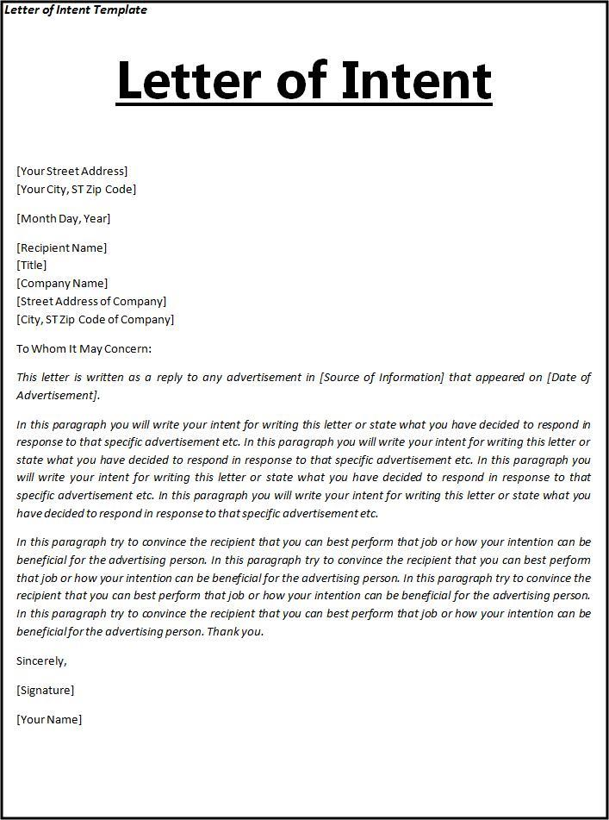
Verification Selection Letter
You’ve Been Selected
The letter must include the following:
Household was selected for
verification;
Types of acceptable information that may be provided to confirm current income including:
  Pay stubs
  Award letters from assistance agencies
  Support payment decrees from courts
Notes:
The SFA must send a letter informing the household of selection and of the types of information acceptable to the SFA.
(Retain a copy of these letters in the verification file as some software systems re-generate letters with the date of regeneration not the actual date the letter was previously mailed.
All letters should have been approved by the state agency and so The verification selection letter should contain the following elements.
• That the household was selected for verification;
• The types of acceptable information that may be provided to confirm current income, including pay stubs, award letters from assistance agencies for benefits such as social security or supplemental security income, and support payment decrees from courts;

Slide 40
Requirements of the Selection Letter cont.
Proof of benefit(s)
Date information is required;
Name of an SFA official who can answer questions; and
No-cost telephone number
Verification
Selection
Letter
Notes:
• That the household may provide proof that a child or any household member is receiving benefits under the Assistance Programs instead of providing income information or that a child is Other Source Categorically Eligible; that documentation of income or receipt of assistance may be provided for any point in time between the month prior to application and the time the household is required to provide income documentation;
• That information must be provided by a date as specified by the LEA and that failure to do so will result in termination of benefits;
Name of an LEA official who can answer questions and provide assistance; and
A no-cost to the household telephone number.

Slide 41
Once a school becomes aware of a language need, the school is responsible for ensuring meaningful access.
Application materials including Verification letters must be provided in an understandable language.
Simply offering the most common non-English language is not sufficient.
Foreign Language Translations
Notes:
Once a school becomes aware of a language need, the school is responsible for ensuring the individual’s application and other household materials (letter, instructions, notices, and verification materials) are available in an understandable language. Simply offering the most common non-English language is not sufficient. LEAs may use the translated application materials available through FNS to ensure households comprised of LEP individuals have access to free and reduced price application materials in a language they can understand. See SP 37-2016 Meaningful Access for Persons with Limited English Proficiency in the School Meal Programs: Guidance and Q&As,

Slide 42
SOURCES
FOR
VERIFICATION

Slide 43
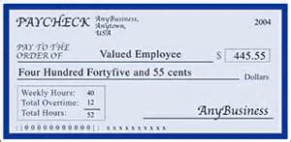

Written Evidence
Primary Source of Verification is most often pay stubs, award letters from welfare departments or governmental agencies
Acceptable written evidence for income eligible households
Name of household member
Amount of income received
Frequency received
Date received
Notes:
Written evidence is primary source of income verification including Work First/TANF, FDPIR, Other Source Categorical Eligibility Programs, and foster child households. Written evidence is most often pay stubs from employers, award letters from welfare departments or governmental agencies.
Written evidence needs to have the name of the household member, amount of income received, frequency and the date received (so a pay stub without a date is not acceptable). The SFA may request this information from the FNS WorkFirst/TANF FDPIR agency, but still must notify the parent.
Acceptable written evidence for children who are receiving benefits from an Assistance Program is a official letter or notice indicating that the child or any household member is receiving benefits from that program; for example, a notice of eligibility. For Other Source Categorical Eligibility Programs, an official letter, notice or list from the appropriate State agency; from a social services agency or court system for foster children; or for Head Start/Even Start enrollees, from the office or coordinator for those programs. The verifying official should examine the document provided to ensure that the child for whom the application was made is part of a household currently participating in any of these programs noted above or is a foster child. Electronic Benefit Transfer (EBT) cards cannot be used to confirm eligibility in SNAP and therefore cannot be used for categorical eligibility purposes.
A document from an assistance program that does not specify the certification period is not adequate for documentation. For example, the FNS identification card is not acceptable because it usually does not have an expiration date. Acceptable FNS TANF FDPIR would have the child’s name listed EBT CARD IS NOT SUFFICIENT.
A household that does not have satisfactory documentation from the assistance office, State or local agency for other source categorical eligibility may request a signed, dated letter from these offices verifying that the child is part of a household currently receiving their benefits.

Slide 44
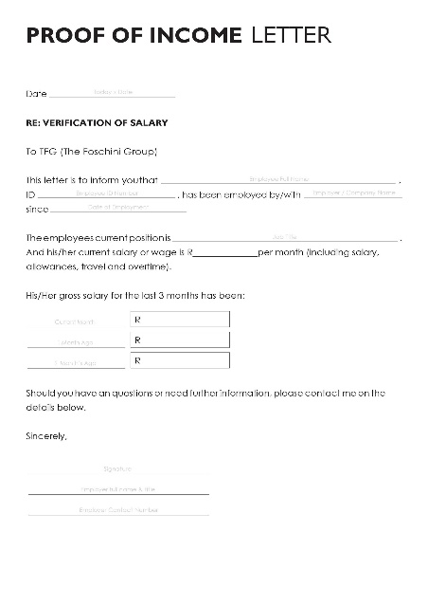

Written Evidence (cont.)
Acceptable written documentation for Assistance Programs and Other Source Categorical is an official letter from the program.
Acceptable written documentation for Other Source Categorical Eligibility Programs is an official letter, notice, or list
AGENCY LETTERHEAD
Notes:
Written evidence is primary source of income verification including TANF, FDPIR, Other Source Categorical Eligibility Programs, and foster child households. Written evidence is most often pay stubs from employers, award letters from welfare departments or governmental agencies.
Written evidence needs to have the name of the household member, amount of income received, frequency and the date received (so a pay stub without a date is not acceptable). The SFA may request this information from the FNS TANF FDPIR agency, but still must notify the parent.
Acceptable written evidence for children who are receiving benefits from an Assistance Program is a official letter or notice indicating that the child or any household member is receiving benefits from that program; for example, a notice of eligibility. For Other Source Categorical Eligibility Programs, an official letter, notice or list from the appropriate State agency; from a social services agency or court system for foster children; or for Head Start/Even Start enrollees, from the office or coordinator for those programs. The verifying official should examine the document provided to ensure that the child for whom the application was made is part of a household currently participating in any of these programs noted above or is a foster child. Electronic Benefit Transfer (EBT) cards cannot be used to confirm eligibility in SNAP and therefore cannot be used for categorical eligibility purposes.
A document from an assistance program that does not specify the certification period is not adequate for documentation. For example, the FNS identification card is not acceptable because it usually does not have an expiration date. Acceptable FNS TANF FDPIR would have the child’s name listed EBT CARD IS NOT SUFFICIENT.
A household that does not have satisfactory documentation from the assistance office, State or local agency for other source categorical eligibility may request a signed, dated letter from these offices verifying that the child is part of a household currently receiving their benefits.

Slide 45
Collateral Contacts
A person who is outside of the household
The household’s circumstances or confirmation of a households’ income
Agencies, and Religious or Civic Organizations
Collateral contacts should only be contacted when the household is unable to provide information.
Notes:
A collateral contact is a person outside of the household who is knowledgeable about the household’s circumstances and can confirm a household’s income participation in Assistance Programs or Other Source Categorical Eligibility Program sources. employers, social service agencies, migrant workers’ agencies, and religious or civic organizations. The verifying official should request a collateral contact only in cases when the household has not been able to provide adequate written evidence.
The verifying official must give the household the opportunity to designate the collateral contact. However, the verifying official may select a collateral contact if the household fails to designate one or designates one who is unacceptable to the verifying official. In either case, no contact may be made without first notifying the household and obtaining its permission.
All collateral contacts may be written or oral and must be documented, dated, and initialed. The LEA will examine any written information provided by the collateral contact or evaluate any oral information. If the collateral contact is unwilling or unable to provide the requested information, the LEA must contact the household to complete the verification process.

Slide 46

Agency Records
A household’s eligibility may be confirmed through the use of information maintained by other government agencies to which the State agency, SFA, or school has legal access.
Notes:
A household’s eligibility may be confirmed through the use of information maintained by other government agencies to which the State agency, LEA, or school has legal access.
Such records are State records, and the release of information maintained by State employment offices is governed by State law.

Slide 47
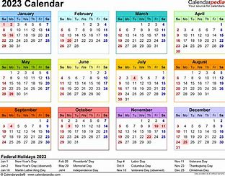
Acceptable timeframe
Acceptable documentation of income or receipt of assistance from any of the stated sources
Provided for any point in time between the month prior to application and the time the household is required to provide income documentation.
Notes:
Acceptable documentation of income or receipt of assistance from any of the above sources may be provided for any point in time between the month prior to application and the time the household is required to provide income documentation. So basically if an application was submitted on the first day of School, August 24, then July 24 - November 16 income or other source categorical documentation may be accepted.

Slide 48

When a Household Provides Pay Stubs
If the household is paid weekly, one pay stub is sufficient
If the pay stub includes overtime, the determining official should work with the household to determine whether the overtime is received in other pay periods.
Notes:
WHEN A HOUSEHOLD PROVIDES PAY STUBS
If a weekly pay stub is representative of what the household normally receives each week, one pay stub is sufficient.
If the household submits a pay stub that includes overtime, the determining official should work with the household to determine whether the overtime for the month being verified is representative of overtime received in other months. If the overtime is a one-time or sporadic source of income, income should be calculated based on the regular monthly income without overtime.

Slide 49

No Income
Zero income?
How are living expenses met?
May request additional written documentation or collateral contacts.
Notes:
If a household is selected for regular verification or verification for cause and the application indicates zero income, the LEA must request an explanation of how living expenses are met and may request additional written documentation or collateral contacts.

Slide 50
Direct
Verification

Slide 51
Direct Verification
Direct Verification (DV) is using records from public agencies to verify income or program participation.
In North Carolina, the DV process is in the DCV system
Conducted prior to sending out verification selection letters to the household.
Notes:
If information obtained through direct verification of an application for meal benefits indicates a child is participating in an eligible Assistance Program, no additional verification is required. The eligibility status of the child (or children) listed on the application is considered verified [7 CFR 245.6a(g)(2)].

Slide 52
When is Verification considered complete for DV Applications?
Application Selected for Verification | What do we do now?
Original Determination – Free meal benefits In DV System – Free meal benefits Exact match (free application/free in DV) | Verification is complete
Original Determination – Reduced benefits In DV System – Free benefits | Verification is complete once the status letter is sent to household within three days.
Original Determination – Free meal benefits In DV System – Reduced meal benefits | Verification must be completed through regular verification activities
Notes:
Application selected for verification is verified through in the SNTS, and is an exact match (free app/free in DV or Reduced app/reduced in DV) verification is complete and no letters are sent to the household
Application selected was originally determined as Reduced benefits but is in the DV system as Free benefits then verification is complete when the change of status letter is sent to the household within 3 days

Slide 53
Continuing The
Verification
Process

Slide 54

Follow Up Required? Yes!
The SFA must make a follow-up attempt:
√ No response from household
√ Insufficient evidence from household
√ No designated collateral contacts or
√ Collateral contacts unable or unwilling to provide requested information
Notes:
To continue the verification process subsequent to household notification, the LEA must either determine:
• If the household has submitted adequate information to complete its individual verification activity; or
• If follow-up with the household is needed.
The SFA must make at least one follow up attempt to contact the household that does not adequately respond to the verification request.
Helpful Hints: Documentation for the second attempt must be maintained (in writing, email, or by telephone with supporting documentation of who made the call, who the person was that was contacted and the date. The SFA may deem it necessary to make additional attempts to lower the non-response rate). Ensure that adequate language assistance is provided and that failure to respond to the request will result in a termination of benefits.
The LEA must make a follow-up attempt when the household:
• Does not respond to the request for verification;
• Submits insufficient or obsolete written evidence;
• Does not designate collateral contacts; and
• Collateral contacts are unable or unwilling to provide the requested evidence.

Slide 55

Follow Up Attempt:
The household responds and provides all needed evidence, verification is considered complete for this household:
* Inform household there is no change in benefits;
* Notify household that its benefits will be increased OR
* Send notice of adverse action.
Notes:
If, after at least one follow-up attempt:
• Household responds and provides all needed evidence, verification is considered complete for this household:
o If there is no change in benefits;
o When household is notified that its benefits will be increased;
o When notice of adverse action is sent.
• Household does not respond, verification is considered complete for this household:
o When notice of adverse action is sent.
• LEA is unable to continue its verification activities because the household fails to provide adequate written evidence or knowledgeable collateral contacts, verification is considered complete for this household:
o When the notice of adverse action is sent.

Slide 56
Follow Up Attempt:
The SFA is unable to continue its verification activities because the household fails to provide adequate written evidence or knowledgeable collateral contacts, verification is considered complete for this household:
* When the notice of adverse action is sent.
Notes:
If, after at least one follow-up attempt:
• Household responds and provides all needed evidence, verification is considered complete for this household:
o If there is no change in benefits;
o When household is notified that its benefits will be increased;
o When notice of adverse action is sent.
• Household does not respond, verification is considered complete for this household:
o When notice of adverse action is sent.
• LEA is unable to continue its verification activities because the household fails to provide adequate written evidence or knowledgeable collateral contacts, verification is considered complete for this household:
o When the notice of adverse action is sent.

Slide 57
When is Verification considered complete?
Demonstration of Completion | Follow Up Action, If Required
The household submits adequate evidence of income or categorical eligibility | Verification is complete
The household submits adequate evidence of income which indicates that the child(ren) should receive a greater or lesser level of benefits | Verification is complete when the adverse action is sent OR the household is notified that its benefits will be increased or decreased
Notes:
The following demonstrates how an LEA determines whether or not the household adequately responded and whether follow-up is required.
• The household submits either adequate written evidence or collateral contact confirms income or categorical eligibility:
o Verification is considered complete for this household;

Slide 58
When is Verification considered complete?
Demonstration of Completion | Follow Up Action, If Required
The household indicates that it no longer wishes to received free or reduced price meals | Verification is complete when the notice of adverse action is sent
The application provides case numbers and it is determined that no household member is receiving benefits from an Assistance Program | Verification is complete when the notice of adverse action is sent
Notes:
The following demonstrates how an LEA determines whether or not the household adequately responded and whether follow-up is required.
• The household indicates they do not want or need the free or reduced priced benefits or it is determine that no one in the household is receiving benefits from an Assistance Program. Verification is considered complete for this household;

Slide 59
Effective Time of the Change
HIGHER BENEFITS Effective immediately and implemented no later than THREE operating days and household is notified.
LOWER BENEFITS - TEN calendar days adverse action notice
Notes:
HIGHER BENEFITS (status is moved from reduced to free, paid/denied to free, paid/denied to reduced)
Immediately and implemented no later than 3
operating days and household is notified.
LOWER BENEFITS (status from free to reduced or paid/denied, or reduced to paid/denied), 10 calendar day adverse action notice (may be sent via postal service or email address of a parent/guardian…NOT by phone).

Slide 60

Notice of Adverse Action
NOTICE
The first day of the advance notice period is the day the notice is sent. The notice must advise the household of the following:
• Change in benefits;
• Reasons for the change;
• Instructions on how to appeal;
• That the household may reapply for benefits
Notes:
Adverse action letter sent to households reducing or terminating benefits must be given10 calendar days’ written notice. (If a family responds on 11/15 and the benefit is lower, then you have to give the family 10 days notice.)
The notice of adverse action may be sent via the postal service or to the email address of a parent/guardian. The LEA cannot notify the household of adverse action by phone.
The first day of the advance notice period is the day the notice is sent. The notice must advise the household of the following:
• Change in benefits;
• Reasons for the change;
• That an appeal must be filed within the 10 calendar days advance notice period to ensure continued benefits while awaiting a hearing and decision;
• Instructions on how to appeal;
• That the household may reapply for benefits at any time during the school year; and
• Households that were terminated because no member was receiving benefits from an Assistance Program may submit an application containing household names and income information and provide written evidence of current household income.

Slide 61
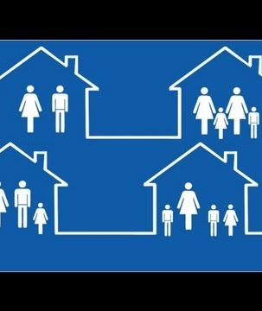
Households that Reapply for Program Benefits
Households with a reduction or termination in benefits may reapply during the school year.
(NOTICE: These are not considered new applications…but the original application not verified by November 15 is null.)
Notes:
Households affected by a reduction or termination of benefits may reapply for benefits at any time during the school year. However, if benefits to a household have been terminated and the household reapplies in the same school year, the household is required to submit income documentation or proof of participation in Assistance Programs at the time of reapplication. These are not considered new applications.

Slide 62

Recordkeeping at SFA Level
The SFA should maintain:
*The Verification Plan
* The approved Verification Selection Method
* The Verification Sample Pool & Size
* Documentation of Replaced Files
* The Confirmation
Notes:
Documentation must be kept by the LEA to demonstrate compliance with the verification requirements when LEAs are reviewed by State or Federal reviewers including documentation concerning any appeals. LEAs must maintain a description of their verification efforts. The description must include a summary of the verification efforts including the selection process; the total number of applications on file on October 1 and the percentage or number of applications that are/will be verified by November 15. The LEA must also be able to demonstrate compliance with the confirmation review requirement and provision of a no-cost telephone number for assistance in the verification process.
The SFA should maintain:
The Verification Plan
The Approved Verification Selection Method
The Verification Sample Pool
The Verification Sample Size
The Replaced files (if applicable, not to exceed 5%)
The Confirmation signatures on the applications (copies of the applications are preferred)
The Selection Letters
The Second attempt (whether written or verbal)
The Verification Results letter.
The Verification Summary Report

Slide 63

Individual Applications Recordkeeping
For each application verified the SFA must retain either:
Copies of all relevant correspondence between the households selected for verification and the SFA;
One of the following for all documentation used to
verify eligibility:
      All documents submitted by the household or reproductions of those documents; or
      In cases where the actual documents or photocopies cannot be kept, the verifying official must make a written record of the documents
Notes:
Copies of all relevant correspondence between the households selected for verification and the LEA;
• One of the following for all documentation used to verify eligibility:
All documents submitted by the household or reproductions of those documents; or
In cases where the actual documents or photocopies cannot be kept, the verifying official must make a written record of the documents submitted by the household including the type of document, e.g., wage stubs or a letter from an employer, income shown on the document, time period of the income, and the date of the document and any changes in eligibility as a result of verification procedures, the reasons for the changes, and the date the change was made.

Slide 64
Individual Applications Recordkeeping
Document the reason for the change, the date the household was notified, if necessary, and the date it became effective; and
If applicable, records of follow-up attempts and results. LEAs should also record:
  Any additional information necessary to show the efforts made by the LEA to meet the verification requirements;
  Title and signature of the verifying official; and
  Criteria for replacing applications for verification.
Notes:
Copies of all relevant correspondence between the households selected for verification and the LEA;
• One of the following for all documentation used to verify eligibility:
All documents submitted by the household or reproductions of those documents; or
In cases where the actual documents or photocopies cannot be kept, the verifying official must make a written record of the documents submitted by the household including the type of document, e.g., wage stubs or a letter from an employer, income shown on the document, time period of the income, and the date of the document and any changes in eligibility as a result of verification procedures, the reasons for the changes, and the date the change was made.

Slide 65

Verification and Extended Benefits
Refer to USDA Policy Memo SP51-2014 on Extending Categorical Eligibility to Additional Children in a Household.
Remember that extending benefits has to be documented by the SFA.
Notes:
After trying this methods of matching and if a student resides in a household which received FNS or TANF the benefits may be extended…please refer to USDA policy Memo USDA Policy Memo SP51-2014
Remember it is the responsibility of the SFA to have documentation to support extended benefits.

Slide 66
What is Verification for Cause?
The SFA has an obligation to verify all questionable applications which is known as Verification for cause.
Once the verification information is requested the verification process must be completed.
Notes:
So what is verification for cause: Regulations at 7 CFR 245.6a(c)(7) require LEAs to verify any questionable application including, on a case-by-case basis, verifying any application for cause when the LEA is aware of additional income or persons in the household.
Verification “for cause” is done in addition to the required sample size. An SFA may do verification for cause at any point in time during the school year.
The SFA has an obligation to verify all questionable applications (verification for cause). This process cannot delay the approval of the application (if the application is complete), once the determination is made, the SFA may begin verification.
To verify an approved application for cause a verification letter explaining that the household must submit verification of eligibility information with the application for continued eligibility must be sent to the household and this may be done at the same time the notification letter is sent to the household.
If the household does not respond by the date set by the SFA, an adverse letter must be sent.
Once the verification information is requested the verification process must be completed. In other words the SFA may not just elect to change their mind and not complete the process.

Slide 67
Verification Reporting
(FNS 742)
Students directly certified as Medicaid Free must be included in reporting
Student data cannot include the Medicaid Reduced students
Section 3 - Include the number of students directly certified with Medicaid for Free meals (along with other direct certifications.
Section 4 must only include counts of students certified for Free and Reduced via an application.
Notes:
If a child is directly certified as MF (Medicaid Free) on the direct certification list, the child (and all applicable children in the household) must be included in the Verification Collection Report (FNS 742).
• For Verification, the student data cannot include the Medicaid Reduced (MR) students.
• In Section 3, follow the current FNS-742 instructions for all questions. In 3-3, include the number of students directly certified with Medicaid for Free meals (along with other direct certifications for FREE with programs other than SNAP). Do not include the counts of students directly certified with Medicaid for reduced price in any count in Section 3.
• Section 4 must only include counts of students certified for Free and Reduced via an application. Do not include the counts of any students directly certified with any program (including Medicaid) for Free or Reduced-price meals.

Slide 68
Verification Reporting
(FNS 742)
“Verification for cause” must be recorded on the Verification Report in the School Nutrition Technology System (SNTS).
*DO NOT add to the number in the verification sample size.
Notes:
Verification for cause” must be recorded on the Verification Report in the SNTS.
*Remember the number of applications recorded as verification for cause is NOT added to the number in the verification sample size.
SEE PAGE 99 in the Eligibility Manual for School Meals for additional information on Verification for Cause.

Slide 69


Special Cases - School District Employees
SFAs can conduct verification for cause when known or available information indicates school district employees may have misrepresented their incomes.
USDA recommends consultation with the SFA’s legal counsel to address integrity concerns
Notes:
Verification for cause must not be used to automatically verify the households of all school district employees whose children are certified for free or reduced price meals. However, from among the list of children approved for free or reduced price meals, an LEA could identify children of school district employees and use available LEA salary information available to them to identify questionable applications and then conduct verification for cause on those questionable applications.
LEAs can use verification for cause to review approved applications for free or reduced price meals when known or available information indicates school district employees may have misrepresented their incomes on their applications to receive free or reduced price meals for their children. We would recommend that an LEA consult with legal counsel in establishing the parameters of verification for cause for school district employees.
USDA supports use of verification for cause where appropriate as a method for SFAs to address integrity concerns.

Slide 70

Common Misunderstandings

Slide 71

Common Misunderstandings
The verification process did not begin or end on time (October 2, November 15)
SFA uses the incorrect verification method.
SFA does not understand the sample size
Notes:
As stated earlier in the presentation, the following will be a list of items that seem to be findings that require corrective action during reviews conducted by the State Agency.
The verification process did not begin on October 2.
The verification process did not end by November 15.
Remember in order to avoid Corrective action a letter to the state agency requesting an extension must be in place prior to the start date or ending date.
SFA uses the incorrect verification method as determined by the State Agency.
SFA does not understand the Sample size, or finds that the verification software language is not consistent with USDA and the incorrect method is selected.

Slide 72

Common Misunderstandings
The software did not select the correct number of applications for the sample size.
Verification software is not compliant.
The sample size was not rounded up therefore there are not enough applications verified
Notes:
:
The software did not select the correct number of applications for the sample size. (The system did not round up)…or the manual mathematical calculation was incorrect.
It is the responsibility of the SFA authority to ensure that verification software is compliant.
The sample size was not round up therefore there are not enough applications verified…remember USDA requires that the exact number selected be verified…not more, not less!

Slide 73
Common Misunderstandings
The confirmation process did not take place
An application was pulled for Directly Certified student.
Only one attempt made to collect the verification information.
Notes:
It is a requirement that all applications selected for verification be confirmed as correct before sending letters to the selected households.
Most verification fiscal action errors found would not have happened if truly confirmation had taken place.
The confirmation process did not take place and errors were on the applications pulled for verification
Remember that we have spoken all along about the applications as being approved applications. If a student was Directly Certified but the family submitted a Free and Reduced Application (with all members that were in the DC file), then this application should be placed in an inactive file and is NOT considered a part of the verification sample size.
Only one attempt made to collect the verification information.

Slide 74

Common Misunderstandings
Documentation was not maintained for the second attempt.
A student withdraws during the verification process the process cannot be completed
Households that reapply must provide another application with current income or proof of FNS.
Notes:
Documentation was not maintained for the second attempt.
A student withdraws during the verification process the process cannot be completed and another similar application should be selected in its place.
Households that reapply must provide another application with current income or proof of FNS. This is for all households that were denied or were selected for verification but did not respond by the November 15 deadline.

Slide 75


Common Misunderstandings
Proper and accurate record keeping is not available (i.e. selection letters are not in the verification file)
I have a copy somewhere
Notes:
And finally, it is important to have all have and maintain all documentation of the verification activities. As mentioned previously some software programs only generate letters with the date the letter is printed so please make a copy and place in the files. If you don’t do that, there is no way for the reviewer, to have actual proof of the date the letter was mailed because if you went into the eligibility software for the reviewer it would generate a letter on the date it is being asked for…letters must have date between October 1 and November 15. The importance of sufficient and accurate documentation maintained at the SFA level cannot be stressed enough.

Slide 76

Thank you for participating in the Verification Webinar.
Notes:
Thank you for reviewing this Verification webinar. We hope the information has been helpful as you prepare for Verification season.

Slide 77
Questions?
Reminder: Your Area Consultant should always be your first line of communication or
Jacquelyn McGowan, Compliance Specialist jacquelyn.mcgowan@dpi.nc.gov or call 984-236-2909
Notes:
If you should have questions pertaining to verification, please let us know. Your first contact is your Area Consultant and you may contact me. My contact information is on this slide. Again, thank you for participating in the continuing education opportunity. Have a great day.

Slide 78
In accordance with federal civil rights law and U.S. Department of Agriculture (USDA) civil rights regulations and policies, this institution is prohibited from discriminating on the basis of race, color, national origin, sex (including gender identity and sexual orientation), disability, age, or reprisal or retaliation for prior civil rights activity.
Program information may be made available in languages other than English. Persons with disabilities who require alternative means of communication to obtain program information (e.g., Braille, large print, audiotape, American Sign Language), should contact the responsible state or local agency that administers the program or USDA’s TARGET Center at (202) 720-2600 (voice and TTY) or contact USDA through the Federal Relay Service at (800) 877-8339.
To file a program discrimination complaint, a Complainant should complete a Form AD-3027, USDA Program Discrimination Complaint Form which can be obtained online at: https://www.usda.gov/sites/default/files/documents/ad-3027.pdf , from any USDA office, by calling (866) 632-9992, or by writing a letter addressed to USDA. The letter must contain the complainant’s name, address, telephone number, and a written description of the alleged discriminatory action in sufficient detail to inform the Assistant Secretary for Civil Rights (ASCR) about the nature and date of an alleged civil rights violation. The completed AD-3027 form or letter must be submitted to USDA by:
mail:
U.S. Department of Agriculture
Office of the Assistant Secretary for Civil Rights
1400 Independence Avenue, SW
Washington, D.C. 20250-9410; or
fax: (833) 256-1665 or (202) 690-7442; or
email: Program.Intake@usda.gov
This institution is an equal opportunity provider.
12/09/2022
Notes:
This is the USDA Non-Discrimination Statement

