Slide 1
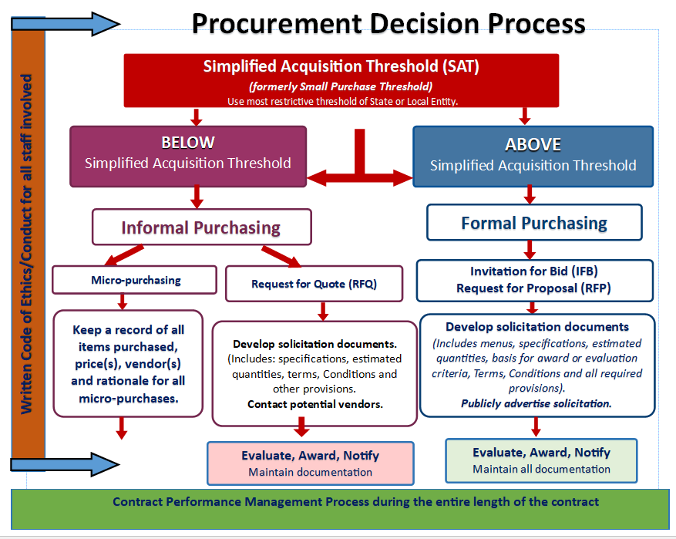
purchasing procedures
Notes:
Next we will discuss purchasing procedures.
You may be familiar with this slide. This document is an excellent decision-making guide when deciding what type of procurement process you may need to use.
Referenced here is the micro-purchasing process.
A micro-purchase is a purchase of supplies or services using simplified acquisition procedures, in which the aggregate amount does not exceed the micro-purchase threshold of $10,000.
When utilizing micro-purchasing, ensure the use of a micro-purchase log and retain proper documentation.

Slide 2
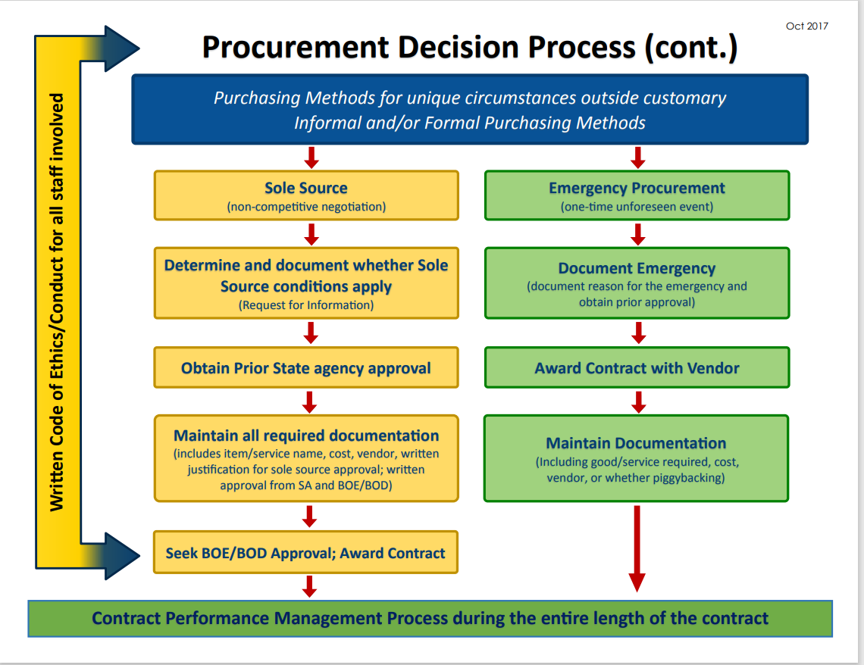
Notes:
On this slide, you see the Emergency Purchase process detailed.
If it is necessary to make a one-time emergency procurement as a result of a serious, unforeseen event that requires an immediate response in order to obtain goods or services to continue meal service, protect students, personnel or SFA resources, for other purposes that support program accountability and integrity, an emergency purchase shall be made and a log of such purchases will be maintained by the School Nutrition Director.
Emergency noncompetitive procurement methods are a standing flexibility and do not require a waiver.
Remember to utilize the Emergency Purchase Log and retain your procurement documentation

