Slide 1

Determining Eligibility of
Free and reduced-price meal applications
SY 2025-2026
North Carolina Department of public instruction
office of School nutrition
Notes:
Good morning. I am Dana Edwards, Program Analyst for the Office of School Nutrition. Thank you for joining us today to discuss eligibility determination of free and reduced-price meal applications. This webinar is being recorded and is designed to assist the Eligibility Determination Official to process free and reduced-price school meal applications. If you are an SFA that does not process Free and Reduced Applications (100% CEP district/SMP without applications/RCCIs without day students) then you are not required to participate in this webinar.
We will not be taking questions during this presentation; however, if there are questions, please refer to the Eligibility Manual, email me or reach out to your Service Area Consultant.
Also, CEUs will be issued for your participation in this webinar. A QR code will be provided at the end of the presentation for your access the evaluation and generate your certificate.
Please note that the words SFA and LEA are used interchangeably throughout the presentation. So, let’s get started…

Slide 2
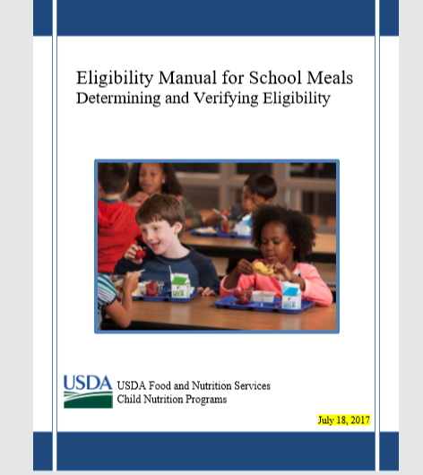
REFERENCES FOR ELIGIBILITY DETERMINATION:
Current Income Eligibility Guidelines
Eligibility Manual for School Meals, Determining and Verifying Eligibility (July 2017) (EMSM)
Notes:
The two resource references to use when Determining Eligibility is the current income eligibility guidelines which are released by the US government annually AND the most current Eligibility Manual for School Meals, released on July 18, 2017.
Both of these website are linked here for you to find on our NCDPI website.
This is a great resource and so we recommend that you keep a copy close by whether it is the electronic version or a hard copy.

Slide 3

Statutory and Regulatory Authority
Statutory authority for the Child Nutrition Programs includes:
    Richard B. Russell National School Lunch Act (NSLA)
    Child Nutrition Act of 1966 (CNA)
Regulatory authority is found in the Code of Federal Regulations (CFR):
  7 CFRCFR Part 210,
  7 Part 215,
  7 CFR Part 220,
  7 CFR Part 225,
  7 CFR Part 226,
  7 CFR Part 245
Notes:
As with all Federal Programs we have a foundation of laws or statutory authority that we reference. For the School Nutrition Programs it includes the Richard B. Russell National School Lunch Act (NSLA) and the Child Nutrition Act of 1966 (CNA).
Regulatory authority is found, as follows, in the Code of Federal Regulations (CFR):
7 CFR Part 210, National School Lunch Program (NSLP)
7 CFR Part 215, Special Milk Program for Children (SMP)
7 CFR Part 220, School Breakfast Program (SBP)
7 CFR Part 225, Summer Food Service Program (SFSP)
7 CFR Part 226, Child and Adult Care Food Program (CACFP)
7 CFR Part 245, Determining Eligibility for Free and Reduced Price Meals and Free Milk in Schools

Slide 4

Policy Statement
Media Release
Application Packet
Notes:
The Free and Reduced Price Policy Statement is included in the annual written agreement.
The Media Release is sent out by NCDPI on behalf of the SFA to Media sources in NC and contains information that replicates the letter to the households. In addition to the required notification at the beginning of the year, LEAS are encouraged to also share information about the availability of school meals in routine contacts throughout the school year.
The application packets are approved in our office annually. These approved forms are to be used for that specific school year. They will be reviewed during Technical Assistance visits and Administrative Reviews.

Slide 5
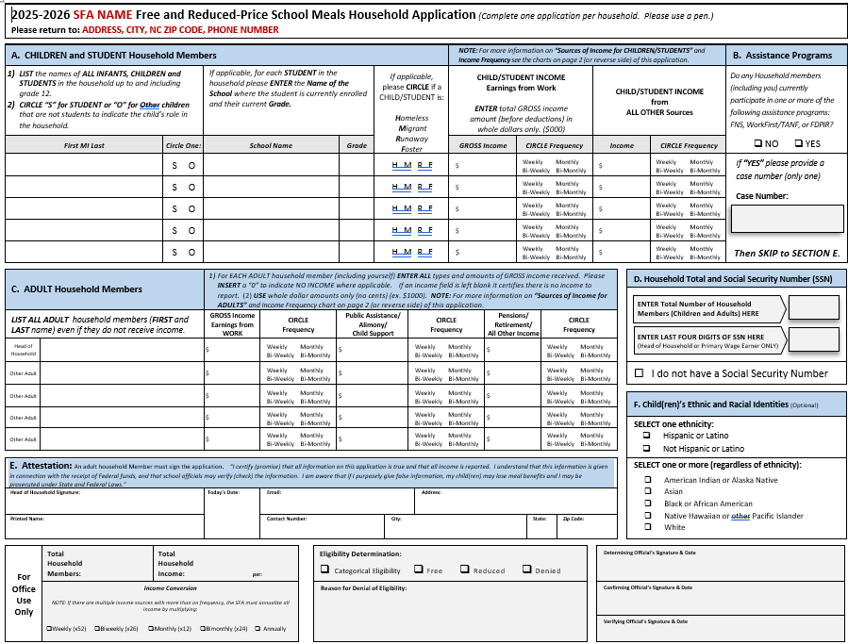
Free and Reduced-Price Meal Application Packet
Make free/reduced price meal letters and applications available to each enrolled student;
Only ONE HOUSEHOLD Application required per family.
APPLICATIONS MUST BE:
  Clear and simple in design
    Conform to federal requirements
      Approved by the State Agency
Notes:
The packet includes the actual F&R application with instructions on the form, the letter to the household which contains Q&As , DC notification letters, the notification of benefits letter, the verification selection letter and the verification response letters and lastly the optional forms that allows information to be shared with other programs.
As an SFA that receives federal funding, the SFA must make F&R meal benefits available to every enrolled children in your district/school in accordance with the statutory and regulatory requirements of the National School Meals Program. How you facilitate that process is up to your SFA (each SFA determines how this process happens. Some examples would be sending it home in the back to school packet at the beginning of the year, or ensuring the youngest student in the household has the application and if electronic applications are used remember you need a notice telling parents how to apply with an application because all households may not have access to a computer).
Other reminders:
Only ONE HOUSEHOLD Application required per Family. Families may NOT be required/and or mandated to complete an application if they decline to do so (many times we hear of classes having rewards for seeing who can complete all the documents in the packet sent home to the households, and many households know that they would not quality for benefits so we cannot ask them to submit an application if they do not wish to do so.
The APPLICATIONS MUST BE:
Clear and simple in design
Conform to federal requirements
And as stated earlier all must be Approved by the State Agency
REMEMBER …no-charge telephone number to the SFA must be available for parents to contact the SN Office

Slide 6
Letters: General Information
When Can I Distribute Letters and Applications?
No earlier than the beginning of the school year (Year Round School – June)
When can households apply?
A household may apply for benefits at any time during the school year.
When is an application not necessary?
No application is necessary if the household was notified by the SFA that all children have been directly certified.
Letters: General Information
Notes:
The f/r applications or letters cannot be distributed any earlier than the beginning of the new school year. This would normally be somewhere from the first of July to the middle of July for most schools in NC. For SFAs that have year-round school, you may distribute the application in June. F/R applications can NOT be sent home OR processed prior to the beginning of the new school year! Of course, you must wait until you have received the updated eligibility guidelines to process applications.
A household may apply for benefits at any time during the school year.
Each household must be informed about the Free and Reduced Price School Meals application. The letter must state that a household may apply for benefits at any time during the school year and that no application is necessary if the household was notified by the SFA that all children have been directly certified (this type of household should have received a State Agency approved Direct Certification letter). The DC letter also informs the household if they are not sure that all of the children in the household have been directly certified and how to contact the school or SFA with questions.

Slide 7
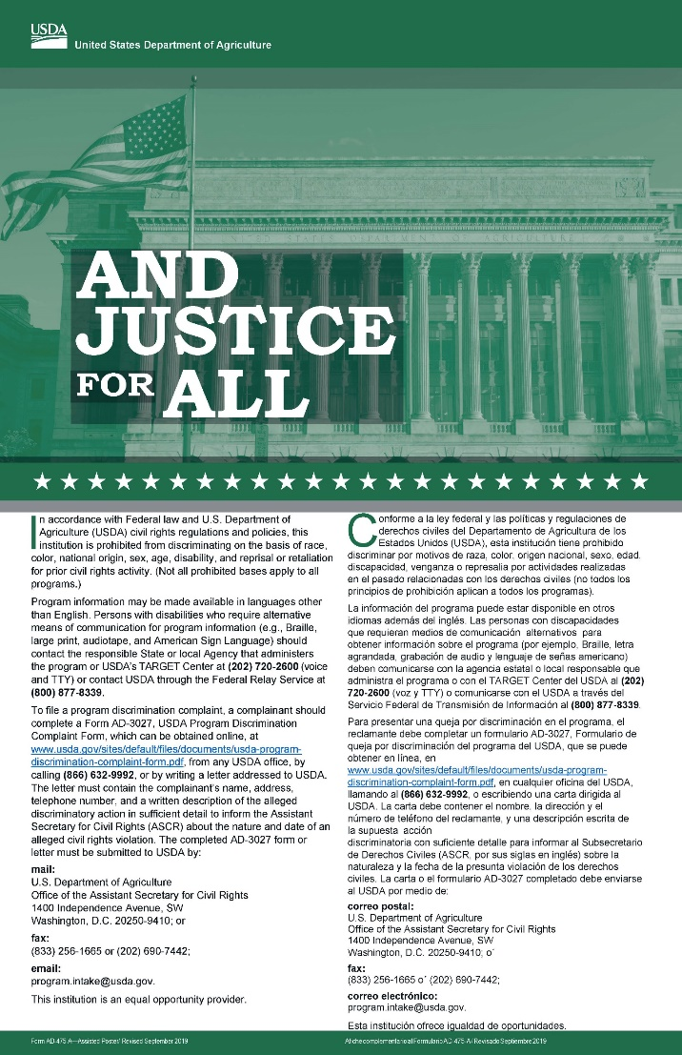
The letter to the household:
This is the most current
non-discrimination statement provided by USDA as of May 2025.
Notes:
The letter must contain the correct nondiscrimination statement which was published in May 2025. A link is provided to the USDA website.
This is the most current poster and unfortunately, we have not received any new posters in our office to distribute.

Slide 8

Foreign Language Translation Applications
Non-English letters and applications must be available when a significant number of the population needs info in a language other than English.
Translated School Meal Applications can be found on the USDA website.
Notes:
SFAs are encouraged to be familiar with the languages that are spoken within your districts and schools. USDA provides an “I Speak” survey to help identify limited English proficient (LEP) families and their language needs…refer to the USDA website noted above.
Non-English letters and applications must be available when a significant number of the population needs info in a language other than English. USDA has not defined “significant number” therefore you must use your professional judgment as to when to use foreign language translation applications. There are a number of non-English translation free/reduced applications on the FNS websites for your use.
You may use the help of your LEP/ESL translators in assisting with meal benefits application and to provide the necessary services to parents who are unable to read or have limited literacy skills. Families should not be expected to rely on family members to translate or provide interpreting services. Please use your best most reliable resource available

Slide 9
Electronic and Scanned Applications
The SFA may also scan paper applications. When using electronic and scanned applications:
  All disclosure restrictions must be met
  Electronic Transaction requirements SP 10-2007
  The system should include a statement explaining how to obtain a paper application
  The process for scanning applications must meet all requirements.
Notes:
In addition to paper applications, the SFA may make available and accept applications electronically. The SFA may also scan paper applications. When using electronic and scanned applications:
• All disclosure restrictions must be met, and acceptance of the application and electronic signatures must conform with FNS policy. See SP 10-2007, SFSP 06-2007, CACFP 07-2007: Update on Electronic Transactions in the Child Nutrition Programs,
Website is linked to this slide.
• If the SFA uses an electronic system as one of their application processes, the letter to households must inform the household how to access the system in order to apply for benefits. It must also explain that the household still has the option to submit a paper application and must indicate how the household may obtain and submit a paper application.
• The process for scanning applications must meet all requirements.

Slide 10
Electronic and Scanned Applications:
The system must include a question or data field to indicate a child’s Head Start, Migrant, Runaway, Foster, or Homeless status.
The system may ask for a student identification number, household address, school, grade or a child’s birth date.
The SFA is encouraged to amend the electronic application to reflect the FNS prototype application.
Notes:
When using electronic applications:
• The system must include a question or data field to indicate a child’s Head Start, migrant, runaway, foster, or homeless status.
• The system may ask for a student identification number, household address, child’s school grade or the child’s birth date. However, the household must be informed that these data fields are not required
The SFA is encouraged to amend the electronic application to reflect the FNS prototype application.
If modifications are made, the system must be able to recognize and accept whole dollar amounts.

Slide 11

Disclaimer:
USDA, FNS or the State Agency does not evaluate, recommend, approve, or endorse any software used for certification or verification purposes. There are no Federal specifications for software vendors.
Notes:
Please note the USDA, FNS or the State agency do not evaluate, recommend, approve, or endorse any software used for certification or verification purposes. There are no Federal specifications for software vendors. SFAs are responsible for assuring that any automated certification and verification processes meet all regulatory requirements and policies, including the calculation of income frequencies, and that the software used is performing correctly and meets all requirements.

Slide 12
Processing applications

Slide 13

F&R Applications - Processing Timeframe
Applications for the new school year should be processed IMMEDIATELY
What is the effective date of student eligibility?
The date the complete application is submitted and date stamped as received OR
The date the parent submits the application.
The SFA must not delay approval of applications if the household fails to provide any information that is not required.
The determining official must sign or initial and date each application or cover page for a batch of applications.
Computer system may capture original date of approval and basis of determination, however, still need manual signature, electronic signature of cover sheet for all batches.
Notes:
Once you receive new f/r applications for the new school year, you must process the applications IMMEDIATELY, but no later than 10 operating days. We recommend that you date-stamp each application as it is received into your office to document when the application is received.
REMEMBER…applications are processed at “face value”…meaning you may accept the information on the application as true and complete and process without further data (the key word is COMPLETE, the application MUST be complete…if missing data, you should contact the family to obtain missing data). If you have reason to suspect the information submitted on the application is inaccurate, you may VERIFY for CAUSE after the application has been processed. You may begin the process to verify for cause on the same date you determine eligibility. The SFA must not delay approval of applications if the household fails to provide any information that is not required
The determining official must sign or initial and date each application or sign or initial and date a cover sheet attached to a batch of applications – page 56 of EGM. Recording the information is dependent upon the LEA’s application method:
Prototype application may include area to capture data – sign and date on actual form or record at top of page or in margin
Notation should be made to the electronic file
Computer system may capture the original date of approval and basis for determination and update changes throughout the year – still need to have a means of capturing determining official signature/initials through manual signature, electronic means or via a cover sheet for batches of applications.

Slide 14
What is a complete application?
Income Application:
  Names of ALL household members;
  Last four digits of SS# of adult signing the application OR indication of no SS#;
  Income identified by each household member, $0, or if left blank it is an indication of none;
  Adult signature.
Notes:
An application for free or reduced price benefits cannot be approved unless complete eligibility information is submitted, as indicated on the application and in the instructions.
A complete Income Applications:
Names of ALL household members;
Last four digits of SS# of adult signing the application OR indication of no SS#;
Income identified by each household member, $0, or if left blank it is an indication of none;
Adult signature.

Slide 15

Incomplete Applications
If an application is missing REQUIRED information…
You may contact the household by phone or in writing,
document the details of the contact, date and initial
the entry.
Exception: If application is missing adult signature, then it
MUST be returned to the household.
***Every reasonable effort should be made to obtain missing information or clear up inconsistencies prior to denying an application.
Notes:
Once you receive f/r applications and determine that they are complete w/ all required items, you must process them as quickly as possible to approve or deny eligibility. If the application is incomplete, you may contact the family by phone or in writing to obtain the missing information. Document the details of the contact directly on the application, date of contact, initials of person making the contact, to whom you are speaking with (should be the adult household member, preferably the one that signed the application and then process the application.
This may be done for all missing information except the adult signature…may call and ask the adult to come by your office to sign or send the application back. Every reasonable effort should be made to obtain the missing information.

Slide 16

Extending Benefits
Extending
Categorical eligibility for free benefits is extended to all children in a household when the application lists a valid Assistance Program’s case number for any household member.
Notes:
Assistance Programs:
Categorical eligibility for free benefits is extended to all children in a household when the application lists a valid Assistance Program’s case number for any household member. This does not apply to other source categorical applications (for example if one student is a migrant student and others are not the eligibility does not carry forward. Remember it is the responsibility of the Determining official to become familiar with the county case numbers. EBT card numbers (generally 16 digits) are not acceptable case numbers.

Slide 17
The Basis of Eligibility
Notes:
So now that we have re-capped the letter to the households and some general application information let’s continue with the Basis of Eligibility.
In this section, you will find information to determine:
• Household composition when making an income eligibility determination,
• Household reportable income and income exclusions when making an income eligibility determination,
• Categorical eligibility based on participation in Assistance Programs, and
• Categorical eligibility through an Other Source Categorical Eligibility designation.

Slide 18
Reimbursement
In order to claim Federal reimbursement for student meals, the SFA must have EITHER:
an eligible Income application or Categorical Eligible application;
a list of Directly Certified students, Migrant, Homeless, or Runaway students; a list of federally-funded Head Start students;
check Foster Child(ren);
Notes:
In order to claim Federal reimbursement for student meals, the SFA must have EITHER:
an eligible Income application or Categorical Eligible application; or
a list of Directly Certified students; or (this is the state match)
a list of Migrant, Homeless, or Runaway Students;
a list of federally-funded Head Start Students; or
Check Foster Child(ren); or
an emergency application filed on behalf of the student…this would be by the principal in hardship household situations.
NOTE….NC PreK does not use the same federal guidelines to qualify their students so either the student would need to be DC, homeless, migrant, runaway, federally funded headstart, foster child or the household would need to complete an income application.

Slide 19
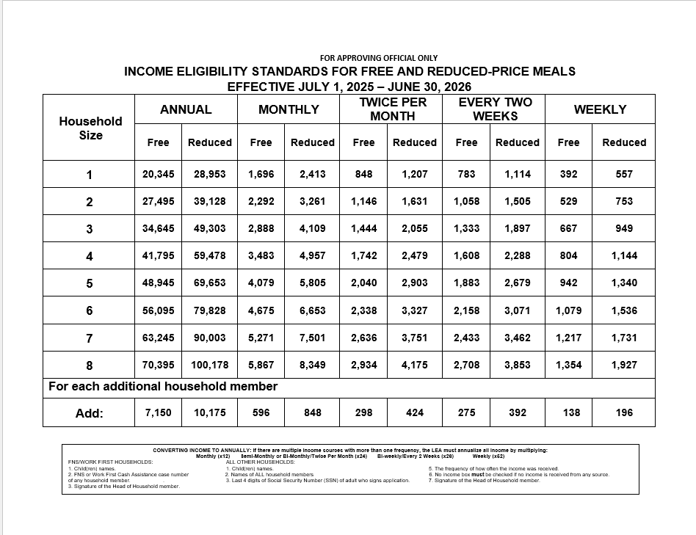
Determining Eligibility Based on Income Applications
Compare the household size and the total household GROSS income to the applicable Income Eligibility Guidelines (IEGs).
Notes:
Two factors determine income eligibility: household size and household income.
household size on the left of the chart
Follow across to the income frequency and amount for the household members
If there are multiple income frequencies within the household, convert the all income to annual
If there are 2 incomes and both are monthly, you can add both monthly together and use the monthly column (this does not need to be converted to annual income)
To establish that a household meets income eligibility requirements for benefits, determining officials must compare the household size and the total household GROSS income to the applicable IEGs.

Slide 20

Household Composition
Economic Unit - a group of related or unrelated individuals who are not residents of an institution or boarding house but who are living as one economic unit.
Notes:
Household composition for the purpose of making an eligibility determination for free and reduced priced benefits is based on an economic unit. An economic unit is a group of related or unrelated individuals who are not residents of an institution or boarding house but who are living as one economic unit, and whose members share housing, significant income, and expenses.
Generally, individuals residing in the same house are an economic unit. However, more than one economic unit may reside together in the same house. Separate economic units in the same house are characterized by prorating expenses and by economic independence from one another.

Slide 21
Household Compositions
Child Residing In An Institution/RCCI | A child who is a resident of a non-participating institution and attends a participating school during the week, or a child who resides in a participating RCCI, is considered a household of one
Child Away At School | A child who is temporarily away at school (e.g., attending boarding school or college) is included as a member of the household.
Adopted Child | An adopted child for whom a household has accepted legal responsibility is considered to be a member of the household.
Child Attending An Institution/RCCI | A child who attends, but does not reside, in an institution is considered a member of the household in which the child is a resident.
Notes:
Let’s review these household compositions:
A child who is a resident of a non-participating institution and attends a participating school during the week or a child who resides in a participating RCCI is considered a household of one.
A child, including a foreign exchange student, who is attending away temporarily, participating in boarding school who applies for meal benefits is also considered a member of the parent’s or guardian’s household. Eligibility is determined based on the family’s size and income. They are not considered to be a household of one
An adopted child for whom a household has accepted legal responsibility is considered to be a member of the household. If the household receives assistance payments or a subsidy for the adoption, the assistance payments or subsidy are included as income.
A child who attends, but does not reside in an institution or RCCI is considered a member of the household in which the child is a resident.

Slide 22
Household Compositions
Child Living With One Parent, Relative or Friend | In the case where a child resides with one parent or a relative, the child is considered to be a member of the household.
Families With Joint Custody | When joint custody has been awarded and the child physically changes residence, the child is considered part of the household where the child resides.
Foreign Exchange Student | A foreign exchange student is considered to be a member of the household (the “host household”) in which the foreign exchange student resides.
Foster Child | A foster child is a child whose care and placement is the responsibility of an agency that administers a State plan
Notes:
When joint custody has been awarded and the child physically changes residence, the child is considered part of the household where the child resides. If both guardians apply for benefits for the child, in the same LEA, but the eligibility status is different, the greater benefit level is used. For example, if one caretaker’s situation results in eligibility for free meals but the other caretaker’s application is denied, the child would receive free meals regardless of which parent had custody at the time.
However, one of the caretakers may elect not to have the child receive free or reduced price meal benefits while residing with them. When the child is residing with this caretaker and the caretaker pays for the meals, the child’s meals must be claimed at the paid rate.
A foreign exchange student is considered to be a member of the household (the “host household”) in which the foreign exchange student resides.
A foster child is a child whose care and placement is the responsibility of an agency that administers a State plan under part B or E of title IV of the Social Security Act, or a child who is formally placed with a relative or other caretaker household by a court or State child welfare agency. Whether placed by the State child welfare agency or a court, in order for a child to be considered categorically eligible for free meals, the State must retain legal custody of the child. Once the child is legally adopted, they are not considered foster.
For purposes of eligibility for School Nutrition Programs, a foster child is considered a member of the foster parents’ household if the child is placed through a formal arrangement by a court or State child welfare agency.
A foster child is categorically eligible for free meals and may be included as a member of the foster family if the foster family chooses to also apply for benefits for other children. Including children in foster care as household members may help other children in the household qualify for benefits.
If a foster family is not eligible for free or reduced price meal benefits, it does not prevent a foster child from receiving benefits.

Slide 23
Determining household income
Notes:
So now that we have determined who lives in the household we need to determine what is considered income for the purpose of the free and reduced application process.

Slide 24

Determining Reportable Income
Income is any money (Before Deductions) received on a recurring basis, including earnings, pensions, and child or spousal support.
Gross Earned Income means all money earned before such deductions as income taxes, employee’s Social Security taxes, insurance premiums, and bonds.
Current income means the gross income received by a household, before deductions, for the current month
Notes:
Households must report current GROSS income on a free and reduced price application.
• Income is any money (before deductions) received on a recurring basis, including earnings, pensions, and child or spousal support, unless an income source is specifically excluded by law for the Child Nutrition Programs (and we will address those under income exclusions).
• Gross earned income means all money earned before such deductions as income taxes, employee’s Social Security taxes, insurance premiums, and bonds.
• Current income means the gross income received by a household, before deductions, for the current month, or the amount projected for the first month for which the application is filled out, or for the month prior to application. If this income is higher or lower than usual and does not fairly or accurately represent the household’s actual circumstances, the household may, in conjunction with determining officials, project its annual rate of income based on the guidelines on special situations.

Slide 25

Each Household Must Provide:
Total amount of current gross income.
Report in whole dollars only.
Income earned or received by
adults and enrolled students
must be identified with the
individual who received it
and the source.
Each household member who does not have income should also be identified.
*When no income is provided for any of the adult household members, the application is still considered complete.
Notes:
Each household must provide the total amount of current gross income.
The prototype application requires that all income figures be reported in whole dollars only.
Income earned or received by adults and enrolled students in NC must be identified with the individual who received it, and the source (such as wages, or Social Security.
Each household member who does not have income should also be identified. Household members must be asked to report their status as “zero income” earners.

Slide 26

Determining Household Income
(By Category and Description)
Notes:
Now, we are going to discuss determining household reportable income by category and description

Slide 27
Income Eligibility
Weekly | X 52
Bi-Weekly Income (every 2 weeks) | X 26
Semi-Monthly (twice a month) | X 24
Monthly (once a month) | X 12
The SFA compares household size and income to the current Income Eligibility Guidelines
Notes:
As mentioned earlier based on the income eligibility chart there are two factors to determine income eligibility: household size and household income. The Eligibility Manual for School Meals provides specific guidance in these two areas. USDA provides updated income eligibility guidance each year based on current poverty rates.
Households may have different incomes from different sources. If all income is submitted in the same frequency (say all monthly you just compare that to the monthly IEG).
If multiple incomes are listed on the application with more than one frequency, i.e. one income receive weekly, one income receive bi-weekly, one income receive monthly, the LEA must annualize the income by multiplying weekly income by 52, bi-weekly income by 26, semi-monthly by 24 and monthly by 12. Remember, do not round values that result from each conversion. Instead, add all converted income together, and compare the total to the annual eligibility chart for the appropriate h/h size to determine eligibility.

Slide 28
Earnings From Work:
Wages, salaries, tips;
Net income from self-owned business including farms;
Strike benefits, unemployment compensation, and worker’s compensation; and
Military basic pay and cash bonuses and allowances for off-base housing, food, and clothing
Notes:
So what are some of the Earnings from Work to be reported
Wages, salaries, tips, commissions, and cash bonuses;
• Net income from self-owned business including farms;
• Strike benefits, unemployment compensation, and worker’s compensation; and
• Military basic pay, cash bonuses and allowances for off-base housing, food, and clothing (excluding combat pay, Family Substance Supplemental Allowance, and privatized housing allowances).

Slide 29
Other Income:
Unemployment benefits Worker’s compensation Supplemental Security Income (SSI) Regular cash assistance from State or local govt Alimony payments Child support payments Veteran’s benefits Adoption assistance payments Pensions
Notes:
Unemployment benefits;
• Worker’s compensation;
• Supplemental Security Income (SSI);
• Regular cash assistance from State or local government;
• Alimony payments;
• Child support payments;
• Veteran’s benefits;
• Pensions;
Types of incomes that are excluded: Check page 30 of the Eligibility Manual for School Meals. Unless a source of income is specifically listed as excluded by the Social Security Act or Appendix to Subpart K, it should be included as income on the household application.
ALL INCOME must be reported in the increment it is received.

Slide 30

Determining Household Income
(Special Situations)
Notes:
Now let’s look at how the household needs to report income

Slide 31
Special Situations
Seasonal Workers | The household may project its annual rate of income and report this amount as its current income.
Self-Employed | May use last year’s income as a basis to project their current year’s net income, unless their current net income provides a more accurate measure.
Foster Child’s Income | The foster child may be included as a household member and any personal income received by the foster child is reportable
Notes:
Certain workers, such as seasonal workers, experience income fluctuations throughout the year, meaning they earn more money in some months than in other months. For these workers, reporting the previous month’s income may distort the household’s actual financial circumstances. In these situations, the household may project its annual rate of income, and report this amount as its current income. If the prior year’s income provides an accurate reflection of the household’s current annual rate of income, the prior year may be used as a basis for the projected annual rate of income.
The LEA must determine the period of time any earnings are received for seasonal workers, as well as the amount and source. Seasonal workers with annual employment contracts, such as school employees, may choose to have their salaries paid over a shorter period of time. To treat these employees in the same manner as employees who choose to have their salaries paid over the full year, the LEA must determine the full amount of income available contractually on an annual basis, and convert all income sources to annual amounts.
Self-employed persons may use last year’s income as a basis to project their current year’s net income, unless their current net income provides a more accurate measure.
Self-employed persons are credited with net income rather than gross income. (refer the Eligibility Guidance Manual for School Meals page 27 and 28 for details on net income for self employment which includes deductive expenses, non-deductible expenses, gas receipts, and operating expenses.
If a household where a foster child resides applies for benefits for their non-foster children, the foster child may be included as a household member and any personal income received by the foster child is reportable. The foster child’s income can be from a part-time job held by the child, or from any funds provided to the child for the child’s personal use.

Slide 32
Special Situations
Income from Wages and Self Employment | Income must be listed separately
Income From Rental Property | For households with rental properties, income includes money from the rental of rooms, apartments, homes, etc
Military Benefits | For non-deployed service members, income includes benefits paid directly to the service member, such as food, clothing allowances and housing allowances.
Notes:
For a household with income from wages and self-employment, each amount must be listed separately. When a household experiences a business loss, income from wages must not be reduced by the amount of the business loss. If income from self-employment is negative, it is listed as zero.
For households with rental properties, income includes money derived from the rental of rooms, apartments, homes and other leases. The treatment of rental income would be similar to the treatment of self-employment income.
North Carolina has several Military Bases and cities. For non-deployed service members, income includes benefits paid directly to the service member, such as food, clothing allowances and housing allowances for households living off-base in the general commercial or private real estate market are considered income.
For deployed service members, income only includes that portion of a deployed service member’s income made available by them or on their behalf to the household will be counted as income to the household.

Slide 33
Special Situations
Alimony and Child Support | Any money received by a household in the form of alimony or child support.
Garnished Wages and Bankruptcy | In the case of garnished wages and income ordered to be used in a specified manner, the total gross income must be considered regardless of whatever portions are garnished or used to pay creditors.
Child’s Income | Infrequent earnings, such as income from occasional baby-sitting or mowing lawns, are not counted as income.
Notes:
Any money received by a household in the form of alimony or child support is considered income to the receiving household. Money paid by a household in the form of alimony or child support is not excluded as income for that household.
Infrequent earnings, such as income from occasional baby-sitting or mowing lawns, are not counted as income and should not be listed on the application.

Slide 34

Income Exclusions
Notes:
Let us now look at some income exclusions and please note the Eligibility Manual does not list all the income excluded from the eligibility determination but one thing is clear, unless a source of income is specifically listed as excluded by the Social Security Act or Appendix to Subpart K, it should be included as income on the household application.

Slide 35

Income Exclusions
Any cash income or value of benefits excluded by statute
Payments received from a foster care agency
Student financial assistance
Infrequent earnings received on an irregular basis, such as payment for occasional baby-sitting or yard work.
Notes:
Income not to be reported or counted as income in the determination of a household’s eligibility for free and reduced price meal benefits includes:
Any cash income or value of benefits excluded by statute, such as the value of benefits under FNS (SNAP or formerly food stamps) or FDPIR and some Federal educational benefits;
• Payments received from a foster care agency or court for the care of foster children;
• Student financial assistance provided for the costs of attendance at an educational institution, such as grants and scholarships awarded to meet educational expenses and not available to pay for meals;
• Loans, such as bank loans, since these funds are only temporarily available and must be repaid; and
• Infrequent earnings received on an irregular basis, such as payment for occasional baby-sitting or yard work.
Check page 30 of the Eligibility Manual for School Meals for additional information

Slide 36
Determining Categorical eligibility
Notes:
So now that we have determined who lives in the household we need to determine what is considered income for the purpose of the free and reduced application process.

Slide 37
Assistance Program Participants
A child that is a member of a household that receives benefits from an Assistance Program is categorically eligible for free meals or milk.
SFAs are required to use direct certification to identify children receiving benefits.
When using an application, SFAs must give households the opportunity to provide SNAP/FNS, Work First/TANF, or FDPIR case numbers or identifiers
Notes:
A child who is a member of a household that receives benefits from an Assistance Program (FNS, Work First/TANF, FDPIR is categorically eligible for free meals or milk) and the categorical eligibility of any household member in an Assistance Program conveys free meal benefits through the School Nutrition Programs to all children in that household.
SFAs are required to use direct certification to identify children receiving benefits.
Households receiving benefits under Assistance Programs and submitting a free and reduced price application must list a case number on the application. Determining officials must ensure that the Assistance Program’s case number or identifier listed on the application is consistent with the format used by the Assistance Program in that State. If the case number seems incorrect, the SFA should contact the household or the local Assistance Program to confirm the household’s eligibility or verify the application for cause. SFAs are encouraged to review the direct certification list to determine whether any of the applications with case numbers can be matched with children on the direct certification list:

Slide 38
Assistance Program Participants
(By Application)
When a household submits an application indicating an Assistance Program:
  Name of the applicable program
  Case Number
  The child must be given free meals.
  The SFA official should compare the applications with case numbers to the direct certification list
Notes:
When a household submits an application indicating an Assistance Program:
• The applicable programs must be indicated and the program case number must be recognized as belonging to an Assistance Program.
• The child must be given free meals.
• The LEA official should compare the applications with case numbers to the direct certification list to determine if any children listed on the application are on that list.
If yes, the eligibility determination must be switched to direct certification.
This type of applications should be kept in an inactive file.

Slide 39
Other Source Categorically Eligible Program Participants
Other Source Categorical Eligibility of one child does not convey free meal benefits to other children in the household.
SFA must confirm the child(ren)’s status before meal benefits can be provided.
Notes:
Similar to Assistance Programs, children designated as Other Source Categorically Eligible can be determined eligible for free meals through the application process. If the household of an Other Source Categorically Eligible child submits an application, the applicable programs must be indicated. Only the children designated on the application as participating in an Other Source Categorically Eligible Program may receive free meal benefits (in other words the other source categorical eligibility may not be extended). Other Source Categorical Eligibility of one child does not convey free meal benefits to other children in the household. • The LEA official must contact the Other Source Categorically Eligible agency liaison to confirm that the children are eligible for one of these programs. FNS recommends that LEAs confirm contact information for the agency liaisons and establish that relationship at the beginning of each school year.
If the household submits an application with income and also indicates Other Source Categorical Eligibility for one or more children, the LEA must confirm the children’s status before meal benefits can be provided. If a household submits an application indicating both income and Other Source Categorical Eligibility, and the LEA cannot confirm the children’s status, the LEA must process the application as an income application.
If Other Source Categorical Eligibility is documented for all children in the household, the determination based on income is overridden. However, if some children in the household are not determined Other Source Categorically Eligible, the income determination remains in effect for those children.

Slide 40
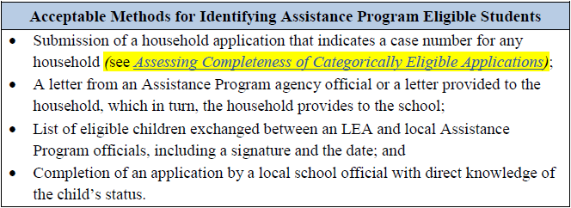
The Direct Certification Process
Notes:
Direct certification allows LEAs to certify children as eligible for free meal benefits using participant data from other means-tested programs (as permitted), eliminating the need for an application. The direct certification process uses information provided by State or local agencies administering Assistance Programs and Other Source Categorically Eligible Programs.
Eligibility for free meals is extended to all children in a household if any member of the household receives Assistance Program (FNS {SNAP} Work First/TANF, FDPIR. LEAs are encouraged to take appropriate steps to identify children who are part of a household receiving benefits, but were not identified through the direct certification process. For example, LEAs may review school district enrollment records or reference submitted meal benefit applications to find potential matches that were missed through the direct certification process.

Slide 41
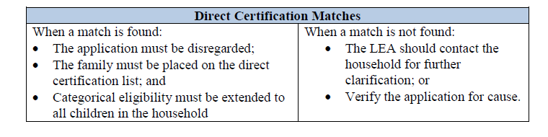
What do you do when…
Notes:
When we have an case number application submitted and it is a match
The application must be disregarded (NC suggests placing these in an inactive file)
The family must be placed on the DC list
Categorical eligibility must be extended to all children in the household
When a match is not found
The SFA should contact the household for further clarification or verify the application for cause.

Slide 42
Other Source Categorical Eligibility Descriptions
Notes:
Now let us look at in-depth information about Other Source Categorical Eligibility designations, which apply to migrant, runaway, homeless, and foster children. Children enrolled in Head Start or enrolled in an eligible pre-kindergarten program with eligibility criteria identical to or more stringent than Federal Head Start are also categorically eligible for free meals. (Again remember state funded programs do not use the same the income eligibility requirements therefore, free and reduced price school meal applications must be submitted for these students.

Slide 43
Other Source Categorical Eligibility
A household application indicating “Other Source Categorical Eligibility” for one or more children.
A form letter from an Other Source Categorically Eligible agency to the household, which in turn, the household provides to the school.
A signed and dated list of eligible children exchanged between the Other Source Categorically Eligible officials and the LEA. (example homeless)
A list of Other Source Categorically Eligible children compiled by the LEA and submitted to the determining official.
Completion of an application by a local school official with direct knowledge of the child’s status
Identifying Other Source Categorically Eligible
Notes:
The following are acceptable methods for identifying Other Source Categorically Eligible children:
• A household application indicating “Other Source Categorical Eligibility” for one or more children.
• A form letter from an Other Source Categorically Eligible agency to the household, which in turn, the household provides to the school.
• A signed and dated list of eligible children exchanged between the Other Source Categorically Eligible officials and the LEA. (example homeless)
• A list of Other Source Categorically Eligible children compiled by the LEA and submitted to the determining official.
• Completion of an application by a local school official with direct knowledge of the child’s status

Slide 44

Migrant Education Program - MEP
Acceptable documentation for MEP participation includes:
  List of names of participating children;
  Effective dates and the signature of a MEP official; or
  A letter from an MEP official or local educational liaison provided by the household, to the school which confirms the child currently participates in MEP.
Notes:
A child is considered other source categorically eligible based on the Migrant Education Program if the child is identified as meeting the definition of migrant in section 1309 of the Elementary and Secondary Education Act of 1965, 20 U.S.C. 6399, by the State, regional, or local MEP director, coordinator, or local educational liaison. The MEP provides services to children who have moved across school district lines, within the last three years, in order to accompany or join a parent or guardian who seeks or obtains temporary or seasonal work in agriculture or fishing. Minors who move with a spouse or by themselves to perform this work may also qualify.
Acceptable documentation for MEP participation includes:
• List of names of participating children;
• Effective dates and the signature of a MEP official; or
• A letter from an MEP official or local educational liaison provided by the household, to the school which confirms the child currently participates in MEP.

Slide 45
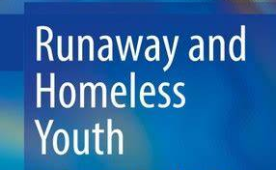
Runaway and Homeless-RHYA
Acceptable documentation for RHYA participation includes:
  List of names of participating children;
  Effective dates and the signature of an RHYA official; or
  A letter from a RHYA official or homeless liaison provided by the household to the school
Notes:
The Runaway and Homeless Youth Act was established by the Family and Youth Services Bureau of the US Department of Health and Human Services and provides temporary housing, transitional living, and street outreach programs for runaway, homeless, and human trafficked youth.
Acceptable documentation for RHYA participation includes:
• List of names of participating children with
• Effective dates and the signature of an RHYA official; or
• A letter from a RHYA official or homeless liaison provided by the household to the school, which confirms the child currently participates in an RHYA program.

Slide 46
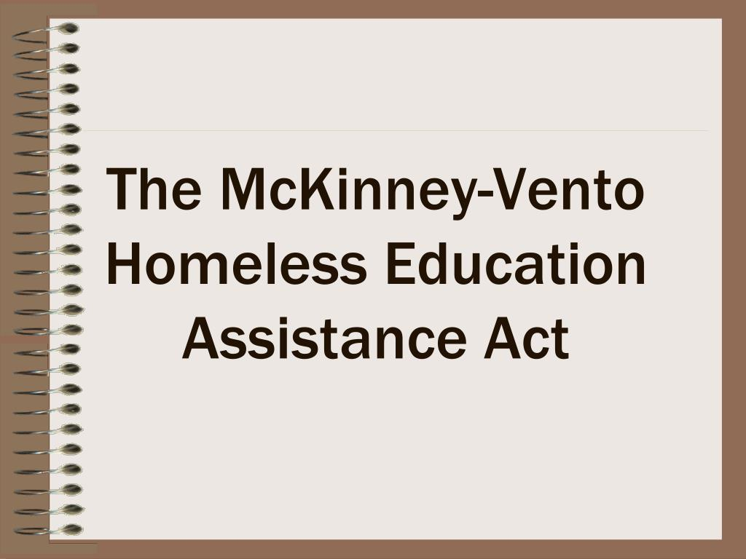
McKinney – Vento Homeless Assistance Act
A student is considered homeless if they are:
Lacking a fixed, regular and adequate nighttime residence
Identified as residing in a homeless shelter by an official of the shelter
Acceptable documentation obtained from LEA Homeless Liaison:
List of names of homeless children
Effective dates and signature of a homeless liaison
A letter from a homeless liaison provided by the household to the school
Notes:
The McKinney-Vento Homeless Assistance Act provides Federal money for homeless shelter programs and facilitates public school access for homeless children and youth.
According to the act, a student is considered homeless if they are identified as lacking a fixed, regular, and adequate nighttime residence by the LEA liaison, or if they are identified as residing in a homeless shelter by an official of the shelter. The circumstances that may qualify children as homeless include:
Sharing the housing of other persons due to loss of housing, economic hardship, or a similar reason.
• Living in motels, hotels, trailer parks, or camping grounds due to the lack of alternative adequate accommodations.
• Living in emergency shelters, transitional shelters, or hospitals due to abandonment.
• Awaiting foster care placement.
• Having a primary nighttime residence that is a public or private place not designed for or ordinarily used as a regular sleeping accommodation for human beings.
• Living in cars, parks, public spaces, abandoned buildings, substandard housing, bus or train stations, or similar settings.
• Living in any of the circumstances described above, due to migratory status
Acceptable documentation obtained from the LEA homeless liaison or officials of homeless shelters includes:
• List of names of homeless children;
• Effective dates and the signature of a homeless liaison; or
• A letter from a RHYA or homeless liaison provided by the household to the school, which confirms the child is currently homeless.

Slide 47
Homelessness Due to Disaster
Children determined to be homeless due to disaster are categorically eligible for free meals
Maintain their eligibility status for the entire year and up to 30 days in the next school year.
SP 46-2014, CACFP 12-2014, SFSP 18-2014: Disaster Response
Notes:
Children Experiencing Homelessness Due to a Disaster
Children determined to be homeless due to a disaster are categorically eligible for free meals in the CNPs. In this situation, the homeless liaison makes a determination of homelessness and provides to the LEA a list of all children determined homeless due to the disaster.
Children certified for free or reduced price meal benefits because of a disaster situation maintain their eligibility status for the entire school year and up to 30 days in the next school year [7 CFR 245.6(c)(1)]. For more information, see SP 46-2014, CACFP 12-2014, SFSP 18-2014: Disaster Response, http://www.fns.usda.gov/disaster-response-0.

Slide 48
Foster Children
A foster child is a child whose care and placement is the responsibility of a State or local welfare agency
A child may still be considered a foster child if placed with relatives provided the placement is made by the State or local foster care system or courts.
Notes:
A foster child is a child whose care and placement is the responsibility of a State or local welfare agency or who is placed by a court with a caretaker household. This applies only to foster children who are formally placed by the State welfare agency or court. It does not apply to informal arrangements, such as caretaker arrangements or to permanent guardianship placements, which may exist outside of or as a result of State or court based systems.
A child may still be considered a foster child if placed with relatives provided the placement is made by the State or local foster care system or courts. The State must retain legal custody of the child whether placed by a welfare agency or a court, in order for a child to be considered categorically eligible for free meals.
A foster family may include their foster child on the same household application that includes their non-foster children. This will streamline the application process and may help the foster family’s non-foster children qualify for free or reduced price benefits based on household size and income.

Slide 49
Foster Children
Acceptable documentation include:
An application that indicates the child’s status as a foster child An electronic or computer match directly to the SFA indicating the status of the child as a foster child without further application; • A letter from the State or local welfare agency or court confirming the child’s status as a foster child; A list of children in foster care from the welfare agency or court.
Notes:
Acceptable documentation for foster children includes:
• An electronic or computer match directly to the SFA indicating the status of the child as a foster child without further application;
• A letter from the State or local welfare agency or court confirming the child’s status as a foster child;
• Documents from the welfare agency or court stating that the courts have taken legal custody of a child who has been placed in the foster care system;
• A list of children in foster care from the welfare agency or court; or
• An application that indicates the child’s status as a foster child.
Remember: if an application is marked foster in NC it is taken at face value and is included in the pool of applications that may be selected for verification....then if the application is selected for verification then the household will have to prove the student is court appointed or a ward of the state.

Slide 50

Households That Fail to Apply
(Emergency Situations ONLY)
  When local officials complete an application for a student, the following conditions apply:
    The Application must contain:
    Documentation of the circumstance and the best known reason the child is eligible
    Child(ren)’s name(s), school(s), grade(s), home address, etc., and
    Signature of the school official completing the application.
    Names of household members, SS#
    Adult signature not needed
    Application is excluded from verification
    Household MUST be notified of eligibility
Notes:
When there are students in your school system that are “known to be eligible” but the family refuses to cooperate in the application process for whatever reason, someone in an official capacity who has knowledge of family’s economic need/situation may apply on behalf of the child/family. For example a principal may complete the application who has knowledge of the family situation. The application will cover all children in the family. Please remember that this situation is intended for EMERGENCY situations…it is for limited use. There should be extenuating circumstances that would prevent the family from completing the application for themselves, i.e. they are unable or won’t cooperate in completing the application. It is extremely important to remember that the household must be notified of the benefit.
When local officials complete an application for a student, the following conditions apply:
The Application must contain:
DOCUMENTATION of the circumstance and the best known reason the child is eligible, i.e. why official is applying for family, and
Child(ren)’s name(s), school(s), grade(s), home address, etc., and
Signature of the school official completing the application.
When local officials complete the f/r application on behalf of students, the names of all h/h members social security #’s and adult signatures are not required, however the official completing the application should sign the application as well as completely document the application. Also, these applications are not required to be verified, so make sure they are not in the verification sample. And lastly, even though the applications are being completed by the school official, the family must be notified that someone has applied for their child(ren) on their behalf, along with the eligibility status.

Slide 51
Establishing Eligibility
Notes:
Now let’s talk about establishing eligibility

Slide 52

Carryover of Previous Year’s Eligibility
Carryover of Previous Year’s Eligibility
A student’s eligibility from the previous school year carries over for up to 30 operating days into the new school year OR
Until a new eligibility determination is made, whichever comes first!
Does not delay processing applications, SFAs still have 10 days to process application once submitted.
Notes:
What is a Carryover?
It is time period for up to 30 operating days into the new school year in which eligibility from the previous year will continue within the same LEA.
When the carryover period ends, unless the household is notified that their children are directly certified or the household submits an application that is approved, the children must pay full price for school meals and the LEA is not required to send a reminder or a notice of expired eligibility.
This does not delay processing applications, SFAs still have 10 days to process application once submitted. For example, you have an application that you process on the first day of school and last year the student was DC (and you just happen to know this household) but through the application process this year the student is reduced…you may not delay notifying the household of the status once the application is processed it overrides the 30 operating days.
While not required to issue a notification about the carryover period, school officials are encouraged especially after a school year of all students receiving meals at no cost to the household – its important to clarify for families that the carryover will end after 30 operating days. School officials should inform affected families that they must submit a new application for meal benefits to re-establish their child’s eligibility before the end of the carryover period.

Slide 53
Carryover WITHIN an SFA
When a student moves to a new school, the SFA must carryover eligibility
Children with approved applications on file the previous year
Children who are newly enrolled in the LEA but reside in a household where another child (i.e. sibling) has an approved application
Children directly certified for free meal benefits the previous year
Notes:
Carryover of eligibility within an LEA is mandatory, whether a child is continuing in the same school or will attend a different school within the same LEA. The LEA may not have a carryover period of less than 30 operating days, unless a new eligibility determination is made. When a student moves to a new school within an LEA, the LEA must carry over eligibility for free or reduced price benefit for:
• Children with approved applications on file from the previous year;
• Children who are newly enrolled in the LEA, but who reside in a household where another child (e.g., a sibling) has an approved application on file from the previous year;
• Children directly certified for free meal benefits in the previous school year;
• Children who are newly enrolled in the LEA, but who reside in a household where another child (e.g., a sibling) was approved through direct certification with an Assistance Program in the previous year;

Slide 54
Carryover BETWEEN SFAs
The new SFA is encouraged to use the former SFA’s eligibility determination from the previous school year and carry over the child’s eligibility status.
The new SFA may accept the former SFA’s eligibility determination during the carryover period without incurring liability for the accuracy of the determination.
Carryover between SFAs is strongly encouraged so students’ access to school meals is not disrupted.
Notes:
When children move to a new LEA, either at the beginning of the new school year or during the summer months, the new LEA is encouraged to use the former LEA’s eligibility determination from the previous school year and carry over the child’s eligibility status. LEAs opting to do this can use the former LEA’s eligibility determination for up to 30 operating days, or until a new eligibility determination is made, whichever comes first. The new LEA may accept the former LEA’s eligibility determination during the carryover period without incurring liability for the accuracy of the determination. Carryover between LEAs is strongly encouraged so students’ access to school meals is not disrupted.

Slide 55
Carryover FROM CEP SCHOOL
At the State Agency’s discretion, children may carry over free meal eligibility from the provision school and be offered free reimbursable meals for up to 30 operating days or until a new eligibility determination is made for the current school year, whichever comes first.
Notes:
When children from schools participating in special provisions, including Community Eligibility Provision (CEP) move to a non-provision school within the same LEA, at the State agency’s discretion, children may carry over free meal eligibility from the provision school and be offered free reimbursable meals for up to 30 operating days or until a new eligibility determination is made for the current school year, whichever comes first. North Carolina is going to allow this.
So if a fifth grader last year was in a CEP school and they now attend a middle school that was not CEP then the status is free for 30 operating days or until an application is processed for a new determination

Slide 56
Transfer of Eligibility
Unlike carryover, which occurs at the start of a new school year, transfer of eligibility applies when a child transfers to another school during the school year.
When a child transfers to another school, the date of the transfer must be noted on the application and the point of service must be updated to include the new student’s information.
Notes:
Unlike carryover, which occurs at the start of a new school year, transfer of eligibility applies when a child transfers to another school during the school year.
When a child transfers to another school, the date of the transfer must be noted on the application and the point of service must be updated to include the new student’s information. If the SFA has an application on file and any change is made after the initial approval for the current school year, the determining officials must:
• Note the change;
• Write the date of the change on the application; and
• Implement the change by updating rosters or other methods used at point of sale, if necessary.

Slide 57
Transferring within an SFA
Non-Provision School | Non-Provision School
Eligibility for free and reduced price meal benefits for children from non-Provision and non-CEP schools must transfer to schools within the same SFA.
Provision 1, 2 or 3 or CEP School | Non-Provision Schools
A child transferring within the same SFA from a Provision 1, 2, 3 or CEP school to a non-Provision school must be given free reimbursable meals for up to 10 operating days or until a new eligibility determination is made, whichever comes first.
Notes:
The chart on this slide describes how schools should handle transfer eligibility for children transferring from schools using standard counting and claiming, and schools operating a special provision.
Transferring Within an SFA
Non-Provision Schools to Non-Provision Schools
Eligibility for free and reduced price meal benefits for children from non-Provision and non-CEP schools must transfer to schools within the same LEA [7 CFR 245.3(c)].
Provision 1, 2, or 3 or CEP Schools to Non-Provision Schools
A child transferring within the same SFA from a Provision 1, 2, 3 or CEP school to a non-Provision school must be given free reimbursable meals for up to 10 operating days or until a new eligibility determination is made, whichever comes first. State agencies have discretion to allow SFAs to provide free reimbursable meals for up to 30 operating days or until a new eligibility determination is made, whichever comes first [7 CFR 245.9(l)].

Slide 58
Transferring Between SFAs
Non-Provision School | Non-Provision School
Eligibility for free and reduced-price meal benefits for children from non-Provision schools may transfer from the former SFA to the new SFA. The new school will not incur liability for the accuracy of the former determination
Provision 1, 2 or 3 or CEP School | Non-Provision Schools
Effective July 2019, SFAs must provide free reimbursable meals for 10 operating days for a child who transfers to a different SFA from a Provision 1, 2, 3, or CEP school to a non-Provision school in another SFA.
Notes:
Transferring Between LEAs
When a student transfers to a new LEA, the new LEA is permitted to accept the eligibility determination from the student’s former SFA. SFAs and schools are strongly encouraged to accept the former SFA’s eligibility determination to ease the new student’s transition and ensure there is no break in the student’s meal access. The new SFA should retain written documentation of the eligibility determination made by the former SFA. An email from the former SFA stating the eligibility status is sufficient.
Non-Provision Schools to Non-Provision Schools
Eligibility for free and reduced price meal benefits for children from non-Provision schools may transfer from the former SFA to the new SFA. The new school will not incur liability for the accuracy of the former determination [While accepting an eligibility determination from another SFA is not required, it is a best practice and may ease the student’s transition to the new school by ensuring there is no break in meal service.
Provision 1, 2, or 3 or the CEP Schools to Non-Provision Schools
State agencies have discretion to allow SFAs to provide free reimbursable meals for up to 30 operating days or until a new eligibility determination is made, whichever comes first. Effective July 1, 2019, SFAs must provide free reimbursable meals for 10 operating days for a child who transfers from a Provision 1, 2, or 3 or CEP school to a non-Provision school in another SFA.

Slide 59
Independent Review of Applications

Slide 60
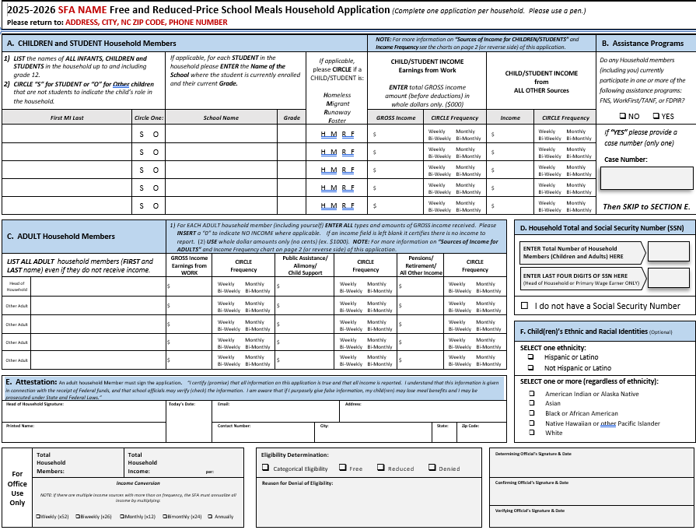
Independent Review of Applications
The second review must be conducted by an independent individual or entity that did not make the original eligibility determination.
The second review must determine whether the application is complete.
Notes:
In NC all SFAs are required to conduct a second review or independent review of applications.
The second review must be conducted by an independent individual or entity that did not make the original eligibility determination. This individual or entity is not required to be an employee of the LEA, but must be trained on how to make application determinations.
A second review of applications requires a re-evaluation of the eligibility determination made by the original determining official, based on the information provided by the household on the application. The second review must determine whether the application is complete with:
• Signature of an adult household member;
• Last four digits of a Social Security Number (or an indication of “none”) for non-categorical applications;
• Names of all household members, including the children for whom the application is made; and
• Income amount received by each household member, identified by the individual who receives it, for income applications.
The second review also must confirm that the application was correctly approved based on current income eligibility information, as applicable, and that the master list or roster of children’s names correctly records their eligibility.
In addition, the second review of applications must be done before the household is notified of eligibility and must not result in the delay of an eligibility determination. SFAs conducting a second review of applications must still notify households of the child’s eligibility determination within 10 operating days of receiving the application. See SP 44-2014, Questions and Answers Related to the Independent Review of Applications, http://www.fns.usda.gov/qas-related-independent-review-applications.

Slide 61
Approved Applications

Slide 62
Approved Applications
Households must be notified, either in writing or verbally, of their eligibility status as approved for free or reduced-price benefits.
Determining officials must record the eligibility determination
Recording this information will depend on the LEA’s application method
Notes:
Households must be notified, either in writing or verbally, of their eligibility status as approved for free or reduced price benefits. The preferred method in NC is in writing (confidentiality is a must). The LEA may e-mail the notification of the household’s approval for meal benefits to the adult household member who signed the application.
Determining officials must record the eligibility determination as follows:
• Indicate approval date;
• Indicate the level of benefit for which each child is
approved (if levels are different); and
• Sign or initial the application.
The determining official must sign/initial and date each application, or sign/initial and date a cover sheet attached to a group of applications.
Recording this information will depend on the LEA’s application method:
• The prototype application may be modified to collect this information, or it can be recorded in the margins or on a separate piece of paper attached to the application.
• A computer system can be used to capture the original date of approval, the basis for the determination (the household size and income used), and update the status of applications to account for transfers, withdrawals, terminations, and other changes. A notation should be made to an electronic file.
Children are eligible for free or reduced price meal benefits on the date their eligibility is determined; however, flexibility exists to allow SFAs to move the effective date of eligibility back under certain circumstances. An SFA electing to exercise this flexibility must notify its State agency and you did that as a part of the Annual Agreement process by completing the Effective Date of Free or Reduced Price School Meals Family Application Eligibility Determination form

Slide 63

Denied Applications
If a household provides an incomplete application or does not meet the eligibility criteria for free or reduced priced benefits, the application must be denied.
The notification must advise the household of the reason for denial of benefits
Notes:
If a household provides an incomplete application or does not meet the eligibility criteria for free or reduced priced benefits, the application must be denied. Households with children who are denied benefits must be provided with written notification of the denial. The written notification of denial can be provided by mail or e-mail again NC prefers mail, to the adult household member who signed the application. The “notification” page of an online system does not meet this requirement. LEAs that use automated telephone information systems must also give written notification of denial.
The notification must advise the household of:
• Reason for denial of benefits;
• Right to appeal;
• Instructions on how to appeal; and
• Ability to reapply for free and reduced price
benefits at any time during the school year.

Slide 64
Denied Applications
Determining officials must record the eligibility determination and notification in an easily referenced format that includes the:
  Denial date;
  Reason for denial;
  Date the denial notice was sent; and
  Signature or initials of the determining official (may be electronic, where applicable).
Notes:
In addition the Determining officials must record the eligibility determination and notification in an easily referenced format that includes the:
Denial date;
Reason for denial;
Date the denial notice was sent; and
Signature or initials of the determining official (may be electronic, where applicable).
An electronic copy of the notification letter is sufficient so long as it is maintained in a manner that SA reviewers may access.
A notice of denial may not be provided if the household fails to reapply during the carryover period because no eligibility determination was made during the current school year and there is no right to appeal a discontinuation of benefits based on the expiration of the carryover period.

Slide 65

Notice of Adverse Action
All currently certified households for whom benefits are to be reduced or terminated must be given 10 calendar days’ written notice
The first day of the advance notice period is the day the notice is sent.
The SFA cannot notify the household of adverse action by phone only.
A notice of adverse action must advise the household of the following:
  Change in benefits;
  An appeal must be filed within the 10 calendar days advance notice period to ensure continued benefits while awaiting a hearing and decision;
  The household may reapply for benefits at any time during the school year
Notes:
Reminder
All currently certified households for whom benefits are to be reduced or terminated must be given 10 calendar days’ written notice of the change prior to the date the change will go into effect. The first day of the advance notice period is the day the notice is sent. The notice of adverse action may be sent via the postal service or to the e-mail address of the parent or guardian. The LEA cannot notify the household of adverse action by phone only. Best practice is always written notification.
SFAs are encouraged to remind families of the end of the carryover period, but may not send a notice of adverse action as this would confer the right to appeal.

Slide 66

Appeals and Hearing Procedures
A household may appeal either the denial of benefits or the level of benefits
The household may also request a conference with an appropriate LEA or school food service official prior to a formal hearing.
Notes:
A household may appeal either the denial of benefits or the level of benefits for which it has been approved. The household may also request a conference with an appropriate LEA or school food service official prior to a formal hearing. When a household requests an appeal, the hearing procedures outlined in the LEA’s free and reduced price policy statement and in Program regulations must be followed, and the hearing official must be an individual who is not connected with the approval or verification process.

Slide 67

Appeals and Hearing Procedures
Publicly announce method of oral or written request for hearing
Examine documents and records presented to support the decision under appeal
Be held reasonable and responsive, adequate time and place of hearing
Decision made by the hearing official
Notes:
At 7 CFR 245.7, Federal regulations state that hearing procedures must be followed as listed in the Eligibility Manual on page 57.
• Provide the family and LEA a simple, publicly announced method to make an oral or written request for a hearing;
• an opportunity to be assisted or represented by an attorney or other person;
• an opportunity to examine, prior to and during the hearing, any documents and records presented to support the decision under appeal;
• Be held with reasonable promptness and convenience, and that adequate notice shall be given as to the time and place of the hearing;
• an opportunity to present oral or documentary evidence and arguments supporting a position without undue interference;
• an opportunity to question or refute any testimony or other evidence and to confront and cross-examine any adverse witnesses; and
• Be conducted and the decision made by a hearing official who did not participate in making the decision under appeal or in any previously held conference.

Slide 68
Benefits During An Appeal
When a household does not request an appeal during the 10 calendar day advance notice period, benefits must be reduced or terminated no later than 10 operating days after the notice period. If the hearing official rules that benefits must be reduced, the actual reduction or termination of benefits must take place no later than 10 operating days after the hearing official’s decision.
Notes:
When a household appeals a reduction or termination of benefits within the 10 calendar day advance notice period, the SFA must continue to provide the benefits for which the child was originally approved, until a final determination is made. The SFA may continue to claim reimbursement at that level during this period.
When a household does not request an appeal during the 10 calendar day advance notice period, benefits must be reduced or terminated no later than 10 operating days after the notice period. If the hearing official rules that benefits must be reduced, the actual reduction or termination of benefits must take place no later than 10 operating days after the hearing official’s decision.
Households affected by a reduction or termination of benefits may reapply for benefits at any time during the school year. However, if benefits to a household have been terminated because of failure to complete the verification or verification for cause processs and the household reapplies in the same school year, the household is required to submit income documentation or proof of participation in Assistance Programs at the time of reapplication. These are not considered new applications.

Slide 69

Determining Eligibility
Special Situations

Slide 70
Applications - Different Eligibility Types
In households with a variety of Other Source Categorically Eligible sources, children must receive free benefits, even if the other children listed on the application are determined ineligible or eligible for reduced price benefits.
Notes:
SFAs must have a method in place to process applications from mixed-status households (households where some children are Other Source Categorically Eligible and some children are not). These applications may result in different eligibility statuses for different children in a single household.
In mixed-status households, Other Source Categorically Eligible children must receive free benefits, even if the other children listed on the application are determined ineligible or eligible for reduced price benefits.
A complete mixed-status application must provide:
• Names of all household members;
• Amount, source, and frequency of current income for each household member;
• An indication of the program source of Other Source Categorical Eligibility status;
• Signature of an adult household member; and
• Last four digits of the Social Security Number of the household’s primary wage earner or another adult household member, or an indication that no adult household member has a Social Security Number.

Slide 71

Applications - Residents of RCCIs
Each child residing in an RCCI is considered a household of one. The documentation sheet must be signed by an appropriate official and include:
  Child’s name
  Income received by the child,
  Date of birth,
  Date of admission/release
  Official’s title
Notes:
Each child residing in an RCCI is considered a household of one. An application is completed for each child unless the RCCI uses an eligibility documentation sheet for all children residing in the RCCI. The documentation sheet must be signed by an appropriate official and include:
• Child’s name
• Personal income received by the child,
• Child’s date of birth,
• Date of admission,
• Date of release,
• Official’s title, and
• Official’s contact information.
Children attending but not residing in an RCCI (commonly referred to as day students) are considered members of their household. Their eligibility is determined using a household application or through direct certification.

Slide 72
Determining eligibility for categorically eligible applications

Slide 73
Eligibility (Case Numbers)
The determining official must assure that the Assistance Program case number or other identifier, consistent with the identifiers used for the program in that State, are valid. Determining officials need to be familiar with the format of valid case numbers or other identifiers.
Note: Only the case number may be used to determine eligibility. For example, the electronic benefit transfer (EBT) card number used by SNAP may not be used to establish categorical eligibility.
Notes:
The determining official must assure that the Assistance Program case number or other identifier, consistent with the identifiers used for the program in that State, are valid. Determining officials need to be familiar with the format of valid case numbers or other identifiers. If the case number seems incorrect, the LEA should contact the household or the Assistance Program to confirm the household’s eligibility. Note: Only the case number may be used to determine eligibility. For example, the electronic benefit transfer (EBT) card number used by SNAP may not be used to establish categorical eligibility.
LEAs are encouraged to review the direct certification list to determine whether any of the applications with case numbers can be matched with children on the list. If a match is found, the application is disregarded and all children in the household are categorically eligible for free meals through the direct certification process. When a match is not found, the LEA should contact the household for further clarification. If the LEA still considers the application to be questionable, the determining official should verify the application for cause.

Slide 74
Eligibility (Other Source Categorical)
Unlike categorical eligibility under Assistance Programs, which extends eligibility to all children in the household, Other Source Categorical Eligibility must be determined individually for each child.
(Foster children, however, do not require confirmation of eligibility status prior to receiving benefits).
Notes:
Unlike categorical eligibility under Assistance Programs, which extends eligibility to all children in the household, Other Source Categorical Eligibility must be determined individually for each child. When an LEA receives an application with any of the Other Source Categorical Eligibility categories checked, an appropriate program official must confirm the status for each child, either through direct contact with the agency or by a list of names provided by the agency, prior to providing benefits. (Foster children, however, do not require confirmation of eligibility status prior to receiving benefits).

Slide 75
Records Retention
Notes:
This section provides guidance on direct certification for Assistance Programs. Other Source Categorically Eligible children, such as homeless children identified by the LEA’s homeless liaison, are processed using procedures similar to direct certification.
Direct certification is the process under which LEAs certify children who are members of households receiving assistance under the Assistance Programs, including SNAP, TANF, and FDPIR, as eligible for free benefits, without further application, based on information provided by the State or local agencies administering those programs.
Eligibility for free meals is extended to all children in a household if any member has been identified through the direct certification process as eligible for benefits under the Assistance Programs. These children are also considered directly certified. LEAs are encouraged to take appropriate steps to identify these children who are part of the family but were not identified through direct certification through available means, such as the use of school district enrollment records.
During the carryover period, categorical eligibility status is extended to any newly enrolled children who are members of a household with one or more members who were directly certified under Assistance Programs.

Slide 76
Applications
All free and reduced-price applications must be kept on file for a minimum of three years after the final claim is submitted.
Any application that was disregarded because all children in the household were determined categorically eligible through direct certification must be retained.
Applications may be maintained at the school, the SFA, or another central location.
Notes:
All free and reduced price applications, including applications from households denied benefits, must be kept on file for a minimum of three years after the final claim is submitted for the fiscal year to which they pertain. Additional documentation, such as notices of adverse action, must also be retained if these show changes made to eligibility status during the school year.
Any application that was disregarded because all children in the household were determined categorically eligible through direct certification must be retained and the date of disregard must be documented.
Applications may be maintained at the school, the SFA, or another central location. Additionally, a list of eligible children by type must be maintained at the school. If an SFA maintains applications at a central location, applications must be readily retrievable by school.

Slide 77
Applications
Applications may be maintained at the school, the LEA, or another central location. Additionally, a list of eligible children by type must be maintained at the school. The LEA must ensure that:
Changes in eligibility status are accurately and promptly recorded
Adequate documentation for these transfers or changes is retained with the applications for 3 years.
Files must be kept longer if they are required by an audit; such files must be retained until resolution of the issues raised by the audit.
Notes:
Applications may be maintained at the school, the LEA, or another central location. Additionally, a list of eligible children by type must be maintained at the school. If an LEA maintains applications at a central location, applications must be readily retrievable by school. The LEA must ensure that:
• Any changes in eligibility status and transfers in and out of the school are accurately and promptly recorded on each school’s list; and
• That adequate documentation for these transfers or changes is retained with the applications for 3 years.
Files must be kept longer if they are required by an audit; such files must be retained until resolution of the issues raised by the audit.

Slide 78
CEP Retention
Retain records used in the development of the Identified Student Percentage (ISP) during the entire period the CEP is in effect.
Retain for three years after submission of the final claim for reimbursement.
Notes:
CEP Retention: SFAs and schools operating CEP must retain records used in the development of the Identified Student Percentage (ISP) during the entire period the CEP is in effect. This includes records for the initial approval year and all records from the year any updates are made to the ISP.
All CEP records must be retained for three years after submission of the final claim for reimbursement. Records must continue to be retained if any audit findings from the period during which the records were in use remain outstanding. In any such case, records must be retained until all issues raised by the audit have been fully resolved.

Slide 79

Direct Certification Documents
LEAs must keep documentation for direct certification on file for a minimum of three years
Documentation may be maintained either at the school or at a central location. A list of eligible children must be maintained at the school.
Notes:
LEAs must keep documentation for direct certification on file for a minimum of three years after submission of the final claim for reimbursement for the fiscal year to which the records apply. Documentation must be kept longer if it is required by an audit. If audit findings have not been resolved, the applications must be retained as long as required for resolution of the issues raised by the audit.
Documentation may be maintained either at the school or at a central location. A list of eligible children must be maintained at the school. If an LEA maintains documentation at a central location, children’s categorical eligibility status must be readily retrievable by school. The LEA must ensure that any changes and transfers in and out of the school are accurately and promptly reflected on each school’s list.

Slide 80

CONFIDENTIALITY
  BEWARE…You can be fined up to $1000 or imprisoned for 1 year, or both, for publishing, divulging, disclosing, or making known in any manner or extent not authorized by Federal law, any eligibility information.
Notes:
Last but not least…Just because a program is approved to receive free/reduced elig. Information doesn’t authorize the release of the f/r information. There must still be a “need to know” the f/r information prior to the release of the info to the authorized program. This section is covered in the Confidentiality and Disclosure section of the Eligibility Manual for School Meals.
Prior to releasing any F/R eligibility information, Memorandum of Agreement (MOA) must be obtained. The State Agency enters into MOAs for the LEAs so if you have a question about an MOA reach out to your Service Area Consultant and we can let you know if one is in place.
An MOA is not required for Federal, State or Local agencies evaluating or reviewing the Child Nutrition Program, i.e. local auditors, SN Consultants, or Comptroller General, since these activities are part of the routine operations of the SNP.
BE AWARE…You can be fined up to $1000 or imprisoned for 1 year, or both, for publishing, divulging, disclosing, or making known in any manner or extent not authorized by Federal law, any eligibility information.

Slide 81
Nondiscrimination Statement
In accordance with Federal civil rights law and U.S. Department of Agriculture (USDA) civil rights regulations and policies, the USDA, its Agencies, offices, and employees, and institutions participating in or administering USDA programs are prohibited from discriminating based on race, color, national origin, religion, sex, disability, age, marital status, family/parental status, income derived from a public assistance program, political beliefs, or reprisal or retaliation for prior civil rights activity, in any program or activity conducted or funded by USDA (not all bases apply to all programs). Remedies and complaint filing deadlines vary by program or incident.
Persons with disabilities who require alternative means of communication for program information (e.g., Braille, large print, audiotape, American Sign Language, etc.) should contact the State or local Agency that administers the program or contact USDA through the Telecommunications Relay Service at 711 (voice and TTY). Additionally, program information may be made available in languages other than English.
To file a program discrimination complaint, complete the USDA Program Discrimination Complaint Form, AD-3027, found online at How to File a Program Discrimination Complaint and at any USDA office or write a letter addressed to USDA and provide in the letter all of the information requested in the form. To request a copy of the complaint form, call (866) 632-9992. Submit your completed form or letter to USDA by: (1) mail: U.S. Department of Agriculture, Office of the Assistant Secretary for Civil Rights, 1400 Independence Avenue, SW, Mail Stop 9410, Washington, D.C. 20250-9410; (2) fax: (202) 690-7442; or (3) email: program.intake@usda.gov.
USDA is an equal opportunity provider, employer, and lender.
Notes:
This is the correct nondiscrimination statement as April 2025.

Slide 82

How did we do? Share your feedback!
Open camera app on phone or device
Point camera at QR code to the right → (and hold still!)
Tap on URL that appears on screen
Complete survey that opens in your device’s web browser
Make sure to hit “Submit” at the end!
Notes:
URL: https://forms.gle/fUiVmhPVSBp3CyQG7

Slide 83

Thank You for joining us today!
Questions:
Please contact your Service Area Consultant
or
Dana Edwards
Dana.Edwards@dpi.nc.gov

