Slide 1
Texture Modified Diets: Preparing Pureed and Mechanical Soft Foods
Cord Gentry
UNCG Graduate Student
Speech-Language Pathology
Master’s Project, Spring 2012
USDA is an equal opportunity provider and employer.

Slide 2
Pureed Diet (Level 1)
Foods should be pureed into a smooth form or “mashed potato-like” consistency.
No chunks of food present
Homogenous in color and texture
Requires no chewing or bolus control
Food should pass through a 1 mm mesh screen
No water separation

Slide 3
“Thick-It” Mixing directions
Pureed Meats
The mixing of Thick-It Original or Concentrated Thick-It 2 with pureed beef and chicken will vary depending on the fluidity of the puree. We suggest adding 2 ½ teaspoons to 1 tablespoon of Thick-It Original or 1 ¼ - 1 ½ teaspoons of Extra Strength Thick-It 2 to 4 oz. of beef or chicken puree. Enhance the flavor with beef, chicken or vegetable dry seasonings if desired.
Pureed Fruits
Pureed Fruits: Mix 1 tablespoon of Thick-It Original or ½ tablespoon of Concentrated Thick-It 2 with 4 oz. pureed fruit like applesauce, apricots, peaches or pears for a firm consistency. To enhance the flavor, add a dash of cinnamon or allspice in combination with either 1/8 teaspoon lemon juice or ½-1 teaspoon sugar or sweetener
Pureed Vegetables
4 ounces of pureed carrots, green beans, wax beans, peas, tomatoes and winter squash can achieve the desired consistency with 1 tablespoon of Thick-It Original or ½ tablespoon Concentrated Thick-It 2. Flavor with your favorite seasonings to make them taste more like the comfort foods you enjoy.

Slide 4
Pureed Hamburger

Slide 5
Pureed Carrots

Slide 6
Pureed Green Beans

Slide 7
Pureed Lasagna

Slide 8
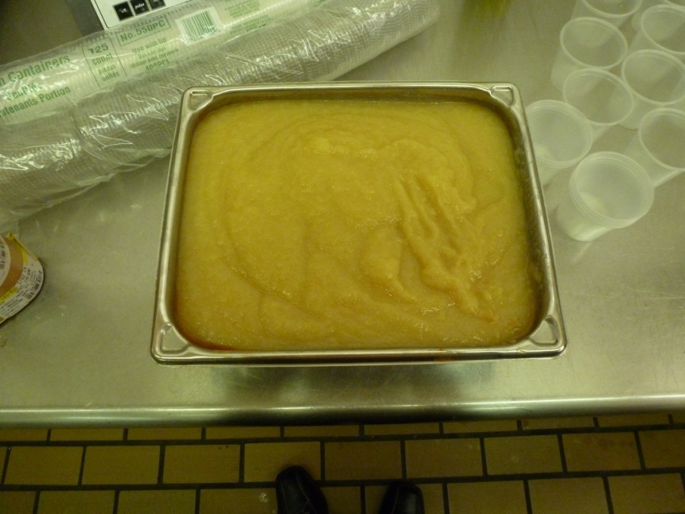
Puree vs. Regular
Students with modified diets are served applesauce- this is the pureed version of the apple cobbler dessert.
Apple cobbler preparation: Students on regular diets are served this for dessert.

Slide 9
Mechanically Altered Diet (Level 2)
Foods are moist and soft and formed easily into a bolus
Meats are minced/ground to no larger than ¼ inch pieces
Moist and cohesive with no water separation
Food should pass through a 6 mm mesh screen
Closely resemble minced/ground food texture.

Slide 10
Mechanical Soft Hamburger

Slide 11
Mechanical Soft Carrots

Slide 12
Mechanical Soft Green beans

Slide 13
Mechanical Soft Lasagna

Slide 14
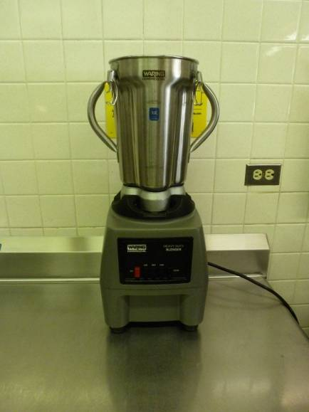
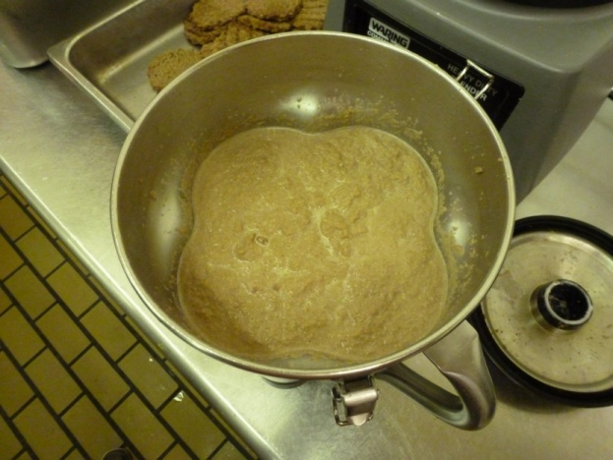
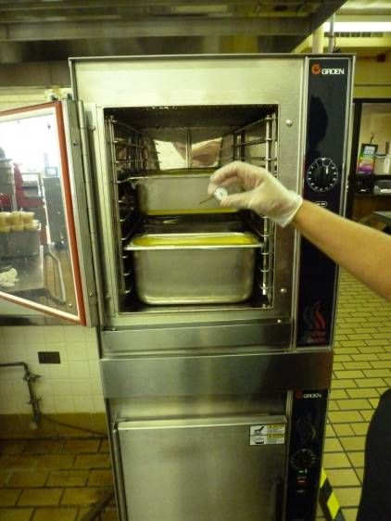
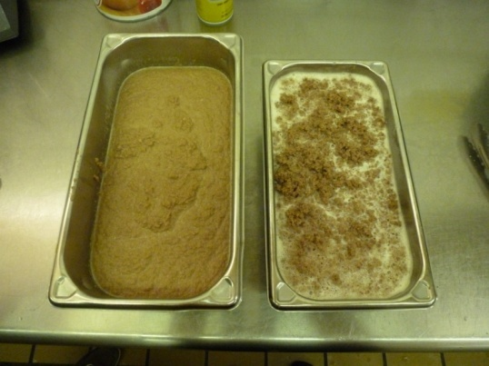
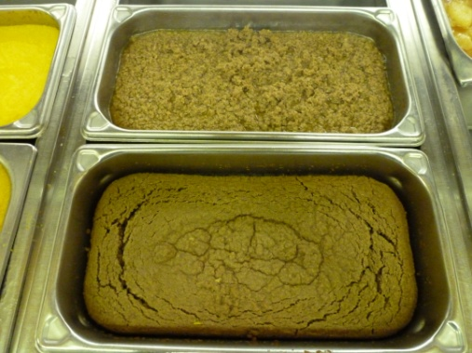
Food Processor Steps
Add meat to food processor
Fill water to top of food
Pulse (mechanical soft); Run on high (puree)
Check consistency
Finish cooking
Check consistency

Slide 15
Instant Food Thickener
Add one pack (6.5g) to 4 fl. oz of liquid and stir for 15 seconds. Allow 1-4 minutes to reach optimal thickness. Adjust amounts as needed for prescribed viscosity.

Slide 16
Regular and Modified Foods Ready to Serve

Slide 17
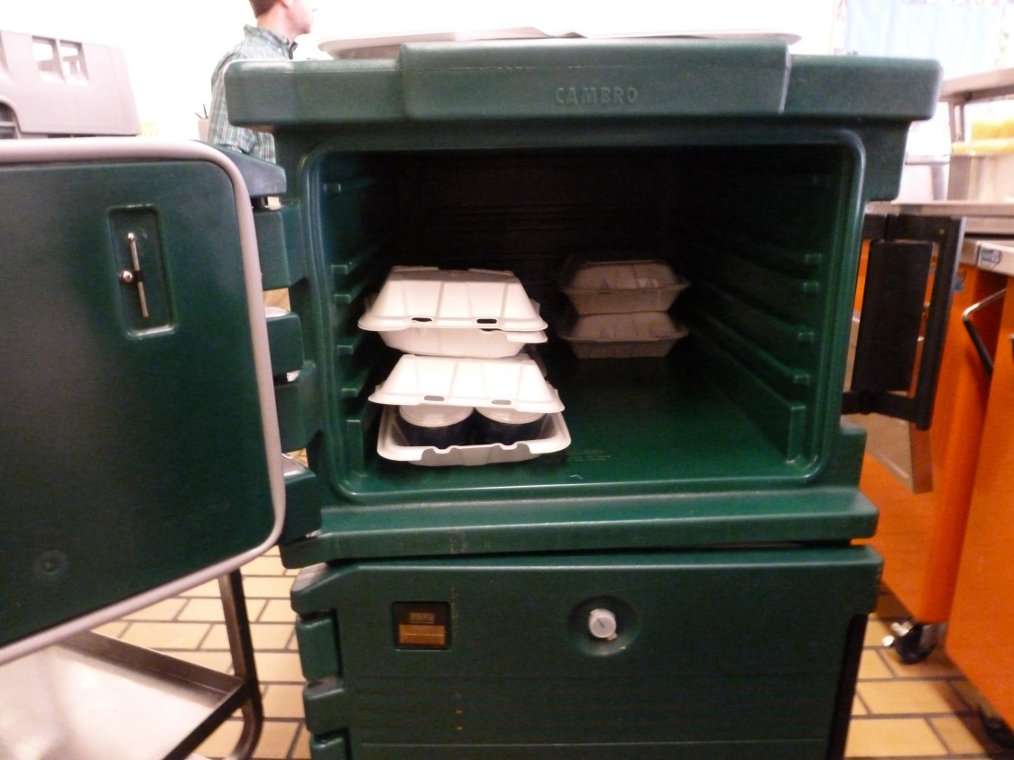
The Serving Process
Notes:
Use small individual cups to send to classrooms. Feeding is done primarily by the OT’s.

Slide 18
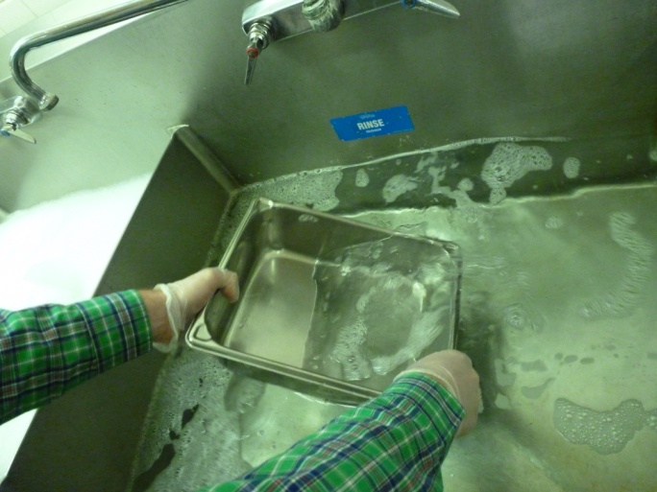
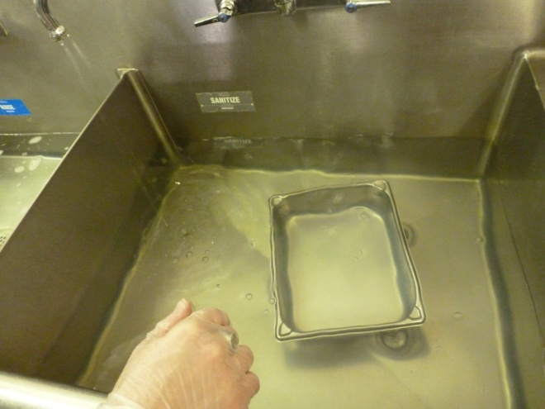
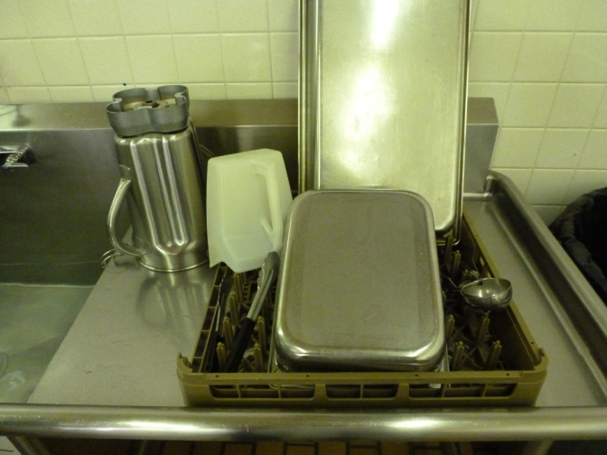
Sanitation
2. Rinse
1. Wash
3. Sanitize
4. Air dry

Slide 19
References
Dahl, .W. J. (2008). Modified Texture Food Production: A Manual for Patient Care Facilities, 2nd Edition. Dietitians of Canada.
Wake Forest Baptist Health
Gateway Education Center
http://childnutrition.ncpublicschools.gov/front-page/information-resources/special-diet-food-allergies

Slide 20
The Complete Experience

Slide 21
The U.S Department of Agriculture (USDA) prohibits discrimination against its customers, employees, and applicants for employment on the bases of race, color, national origin, age, disability, sex, gender identity, religion, reprisal, and where applicable, political beliefs, marital status, familial or parental status, sexual orientation, or if all or part of an individual's income is derived from any public assistance program, or protected genetic information in employment or in any program or activity conducted or funded by the Department. (Not all prohibited bases will apply to all programs and/or employment activities.)
If you wish to file a Civil Rights program complaint of discrimination, complete the USDA Program Discrimination Complaint Form, found at http://www.ascr.usda.gov/complaint_filing_cust.html or at any USDA office, or call 866.632.9992 to request the form. You may also write a letter containing all of the information requested in the form. Send your completed complaint form or letter to us by mail at U.S. Department of Agriculture, Director, Office of Adjudication, 1400 Independence Avenue, S.W., Washington, D.C. 20250-9410, by fax 202.690.7442 or email at program.intake@usda.gov.
Individuals who are deaf, hard of hearing or have speech disabilities may contact USDA through the Federal Relay Service at (800) 877.8339; or (800) 845.6136 (in Spanish).
USDA is an equal opportunity provider and employer.

