Slide 1

Civil Rights for School Nutrition Programs
2023
Why we do what we do!
Notes:
Civil Rights for School Nutrition Makeup Webinar

Slide 2
Overview and Objectives
Assurances
Authorities
Protected Bases
Public Notification
Complaint Procedures
Racial and Ethnic Collection
Language Assistance
Compliance Reviews
Objective: To understand and implement Civil Rights expectations and requirements.
Notes:
The goal is to provide a clear understanding of civil rights and the requirements the United States Department of Agriculture (USDA), State Agency and the School Food Authorities have for those organizations participating in School Nutrition Programs. What are Civil Rights? They are the nonpolitical rights of a citizen; the rights of personal liberty guaranteed to U.S. citizens by the 13th and 14th Amendments to the U.S. Constitution and Acts of Congress.
After reviewing the information, you will be able to:
Define civil rights in the School Meals Programs;
Identify required compliance areas; and
Implement the civil rights requirements in the School Meals Program.

Slide 3
Civil Rights Education includes:
Data collection and use
Public Notification
Complaints
Compliance and noncompliance
Accommodation
Resolving conflict
Notes:
All staff should receive training on all aspects of Civil Rights Compliance including but not be limited to:
Collection and use of data;
Effective public notification systems,
Complaint procedures,
Compliance review techniques,
Resolution of noncompliance,
Requirements for reasonable accommodation of persons with disabilities,
Requirements for language assistance,
Conflict resolution

Slide 4

Why Civil Rights Training?
Civil Rights Training required for all individuals involved in all levels of administration.
Notes:
Why Civil Rights Training? Training is required so that individuals involved in all levels of administration of programs that receive Federal financial assistance understand Federal laws, regulations, instructions, policies and other guidance.
This is an annual training requirement.

Slide 5
Civil Rights Training
State agencies are responsible for training subrecipient agencies on an annual basis.
Subrecipient agencies are responsible for training their local sites, including “frontline staff” who interact with applicants or participants on an annual basis.
New employees before participating in Program activities
Notes:
State agencies are responsible for training subrecipient agencies on an annual basis.
➢Subrecipient agencies are responsible for training their local sites, including “frontline staff” who interact with
applicants or participants on an annual basis.
➢New employees before participating in Program activities
➢Volunteers must receive training appropriate to their roles and responsibilities
All staff should receive training on all aspects of Civil Rights
compliance, including:
➢ Collection and use of data;
➢ Effective public notification systems;
➢ Complaint procedures;
➢ Compliance review techniques;
➢ Resolution of noncompliance;
➢ Requirements for reasonable accommodation of persons
with disabilities;
➢ Requirements for language assistance;
➢ Conflict resolution and customer service.

Slide 6
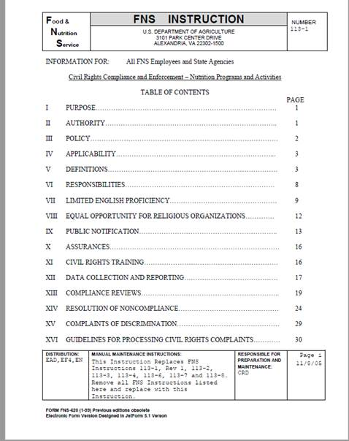
Applicability
Food and Nutrition (FNS) Instruction 113-1 is applicable to all programs and activities of a recipient of Federal financial assistance, regardless of those programs and activities being Federally-funded in part or whole.
https://fns-prod.azureedge.us/sites/default/files/resource-files/FNS-113-1.pdf
Notes:
This Instruction applies to all programs and activities for any school, district, facility that is receiving federal funds whether they are funded partially or completely. The Civil Rights Food and Nutrition Service (FNS) Instruction 113-1 was issued Nov. 8, 2005. The purpose of the Instruction was to establish and communicate policy and provide guidance and direction to the USDA FNS and it’s recipients and customers, and ensure compliance with and enforcement of the prohibition against discrimination in all FNS programs and activities whether funded wholly or in part. For source documentation, it is recommended you bookmark the FNS Instruction or if you have the capability, print it. It can be accessed at the website above.

Slide 7
Assurances
A Civil Rights Assurance must be incorporated in all agreements between State and local agencies and their subrecipients.
See FNS Instruction 113-1, Appendix B and form FNS-74 for Program-specific assurance language
Notes:
To qualify for Federal financial assistance, the program application must be accompanied by a written assurance that the program or facility will operate in compliance with the Civil Rights laws and will implement nondiscrimination regulations.  A civil rights assurance must be incorporated in all agreements between State and local agencies and their subrecipients.
For Program-specific assurance language, See FNS Instruction 113-1, Appendix B and FNS-74 form. Also, SFAs that contract with Food Service Management Companies (FSMC) to provide food service to students are responsible for ensuring that their FSMCs are in compliance with CR requirements. The assurances are binding on the program applicant and its successors, transferees, and assignees, as long as they receive assistance or retain possession of any assistance from USDA

Slide 8
Legal Authorities - Civil Rights
Title VI of the Civil Rights Act of 1964
• Race, Color, and National Origin
Civil Rights Restoration Act of 1987
• Clarifies the scope of the Civil Rights Act of 1964
Section 504 of the Rehabilitation Act of 1973 & Americans w/Disabilities Act of 1990 (ADA); ADA Amendments Act of 2008.
• Disability
Notes:
Title 6 of the Civil Rights Act of 1964 prohibits discrimination on the basis of race, color, or national origin in Federally Assisted Programs.
No one in the United States shall, on the grounds of race, color, or national origin be excluded from participation in, be denied the benefits of, or be subjected to discrimination under any program or activity receiving Federal Financial Assistance.
The Civil Rights Restoration Act of 1987 was issued to ensure nondiscrimination in all federal programs whether the programs for federally funded or not.

Slide 9

Legal Authorities – Civil Rights
The Age Discrimination Act of 1975 - Age
Title IX of the Education Amendments of 1972 - Sex
7 CFR Parts 15, 15a and 15b Nondiscrimination, Education, Disability
Executive Order 13166 – Improving Access to Services for Persons with Limited English Proficiency" (August 11, 2000)
USDA LEP Policy Guidance (79 Fed. Reg. No. 229. Friday, November 28, 2014)
Notes:
The Age Discrimination Act of 1975 ensures that no person in the United States shall, on the basis of age, be excluded from participation in, be denied the benefits of, or be subjected to discrimination under any program or activity receiving Federal financial assistance.
Title 9 of the Education Amendments of 1972 is designed to eliminate discrimination on the basis of sex in any education program or activity receiving Federal financial assistance, whether or not such a program or activity is offered or sponsored by an educational institution as defined by the legislation.
Additional information regarding legal authorities as it relates to disability is found at 7 CFR Parts 15, 15a and 15b. Also Limited English Proficiency guidance is found in Executive Order 13166 and the USDA LEP Policy Guidance document.

Slide 10

Definition of Disability
A person who has a physical or mental impairment which substantially limits one or more major life activities*, has a record of such an impairment, or is regarded as having such an impairment.
Notes:
On September 25, 2008, President George W. Bush signed the Americans with Disabilities Act Amendments Act of 2008 ("ADA Amendments Act" or "Act"). The Act emphasizes that the definition of disability should be construed in favor of broad coverage of individuals to the maximum extent permitted by the terms of the ADA.
This is a very broad and encompassing definition!

Slide 11
Disability and Major Life Activity
Major life activity means functions such as
  Caring for oneself
  Performing manual tasks
  Walking
  Seeing
  Hearing
  Speaking
  Breathing
  Learning
  Working
Notes:
This is a very broad and encompassing definition!
*functions of the immune system, normal cell growth, digestive, bowel, bladder, neurological, brain, respiratory, circulatory, cardiovascular, endocrine, and reproductive functions.

Slide 12
Equal Opportunity for Religious Organizations
Ensures equality for participation of faith-based organizations and other community organizations in USDA programs.
Notes:
Faith-based organizations have equal opportunity for participation in USDA programs. 7 CFR Part 16 notes and ensures a level playing field of faith based organizations and other community organizations in USDA programs. This can also be accomplished by clarifying that faith-based organizations can use space in their facilities to provide USDA-funded service without removing religious art, icons, scriptures, or other religious symbols; and ensure that no organization that receives direct financial assistance from the USDA can discriminate against a program beneficiary, on the basis of religion or religious belief.
It allows a religious organization that participates in USDA programs to retain its independence and continue to carryout its mission, provided that direct USDA funds do not support any inherently religious activities such as worship, religious instruction, or evangelizing, recruitment, etc

Slide 13
What is Discrimination?
Different treatment which makes a distinction of one person or a group of persons from others; either intentionally, by neglect, or by the actions or lack of actions, based on six protected bases.
Notes:
Review this definition of discrimination and the following page will take a look closer at each of the six protected bases in the School Meals Program.

Slide 14
Six Protected Bases of Discrimination
School Nutrition Programs
Race
Color
National Origin
Age
Sex (including gender identity and sexual orientation)
Disability
Notes:
In the food and nutrition programs, there are six (eight) protected bases or classes. FNS’s Civil Rights Division will update the Non-discrimination Statement and the And Justice for All posters to include gender identity
and sexual orientation as protected bases.
On May 5 CRD 01-2022 This memorandum clarifies prohibitions against discrimination based on sex in all FNS programs to includes a prohibition on discrimination on the basis of gender identity and sexual orientation and it provides guidance on processing discrimination complaints. Bostock vs Clayton County (US Supreme Court Case June 2020)
As a result, the AJFA posters will be updated and the NDS will be updated to reflect the addition of gender identity and sexual orientation. Additional information is forthcoming and when it is shared we will make sure to pass it on. We do have to share this information within 90 days and I believe that Victoria is working on a write up for the SN update.

Slide 15
Required Public Notification System
Must inform applicants, participants, and potentially eligible persons of:
  program availability
  program rights and responsibilities
  the policy of nondiscrimination
  the procedure for filing a complaint
Notes:
So let’s talk about how we make the public aware of our services and programs
We must have a public notification system. The purpose of this system is to inform applicants, participants, and potentially eligible persons of:
Program availability,
Program responsibilities,
Our non-discrimination policy, and
How to file a complaint
School Food Authorities must:
Make program information available to the public upon request
Prominently display the “And Justice for All” poster
Inform potentially eligible persons, applicants, participants and grassroots organizations of programs or changes in programs
Convey the message of equal opportunity in all photos and other graphics that are used to provide program or program-related information
Provide appropriate information in alternative formats for persons with disabilities and in the appropriate language(s) for LEP persons

Slide 16
3 Elements of Public Notification
Program Availability - Inform applicants, participants, and potentially eligible persons of their program rights and responsibilities and the steps necessary for participation.
Complaint Information - Advise applicants and participants at the service delivery point of their right to file a complaint, how to file a complaint, and the complaint procedures.
Nondiscrimination Statement - Must be included on all information, materials, and resources used to inform the public about FNS programs.
Notes:
Three levels of Public Notification – The first is Program Availability
Inform applicants, participants, and potentially eligible persons of their program rights and responsibilities and the steps necessary for participation.
All information materials and sources, including Web sites, used by FNS, State agencies, local agencies, or other sub-recipients (like your school) to inform the public about FNS programs must contain a nondiscrimination statement. The statement is not required to be included on every page of the program Web site. At a minimum the nondiscrimination statement or a link to it must be included on the home page of the program information. At a minimum, the Nondiscrimination
Statement should be on:
▪ Application Form(s)
▪ Notification of Eligibility or Ineligibility
▪ Notice of Adverse Action Form
▪ Program (Home) Web Page
▪ Public Information, including program literature

Slide 17
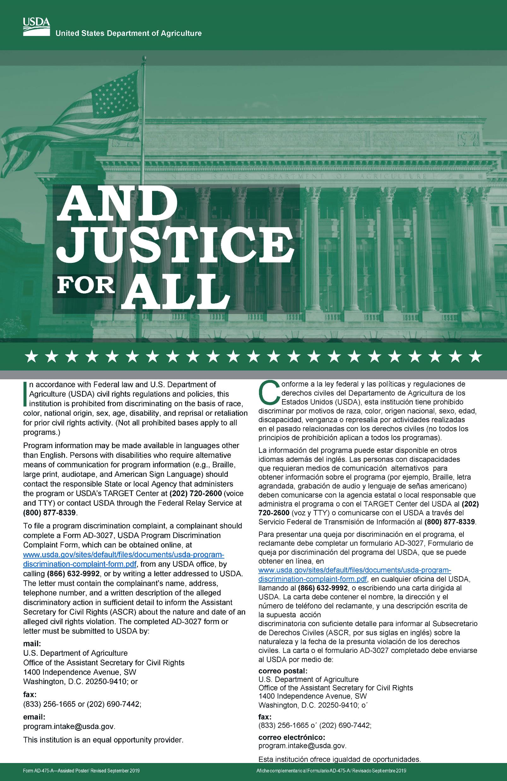
Methods of Public Notification
Display the Poster!
AD-475A
This is the required version
Notes:
Our first line of public notification is displaying the poster. Prominently display the “And Justice for All” poster. Make sure you have the most recent AJFA poster.
Prominently display the “And Justice for All” poster.
If you need copies of the poster, please download and print from the USDA website at:
http://www.fns.usda.gov/cr/and-justice-all-posters
Or contact the State Agency so that we can send them out to you.
We are still awaiting the new posters so if you submitted an order to us, we have it and are waiting. If you have not submitted a request for new posters, please send an email to Jacquelyn McGowan.

Slide 18
Nondiscrimination Statement
In accordance with federal civil rights law and U.S. Department of Agriculture (USDA) civil rights regulations and policies, this institution is prohibited from discriminating on the basis of race, color, national origin, sex (including gender identity and sexual orientation), disability, age, or reprisal or retaliation for prior civil rights activity.
Program information may be made available in languages other than English. Persons with disabilities who require alternative means of communication to obtain program information (e.g., Braille, large print, audiotape, American Sign Language), should contact the responsible state or local agency that administers the program or USDA’s TARGET Center at (202) 720-2600 (voice and TTY) or contact USDA through the Federal Relay Service at (800) 877-8339.
To file a program discrimination complaint, a Complainant should complete a Form AD-3027, USDA Program Discrimination Complaint Form which can be obtained online at: https://www.usda.gov/sites/default/files/documents/ad-3027.pdf , from any USDA office, by calling (866) 632-9992, or by writing a letter addressed to USDA. The letter must contain the complainant’s name, address, telephone number, and a written description of the alleged discriminatory action in sufficient detail to inform the Assistant Secretary for Civil Rights (ASCR) about the nature and date of an alleged civil rights violation. The completed AD-3027 form or letter must be submitted to USDA by:
mail:
U.S. Department of Agriculture
Office of the Assistant Secretary for Civil Rights
1400 Independence Avenue, SW
Washington, D.C. 20250-9410; or
fax:
(833) 256-1665 or (202) 690-7442; or
email:
Program.Intake@usda.gov
This institution is an equal opportunity provider.
Notes:
This is the text for the entire Civil Rights Policy statement. It should be used in it’s entirety on your website and on documents printed for your program.
Please note the nondiscrimination statement must be in the exact format as shown on the USDA website.
All documents, pamphlets, websites, etc. should be updated with the 2022 NDS as
follows:
1. Websites must be updated within 90 days of the date of the memorandum (May 2022)
2. Documents, pamphlets, brochures, etc., using 2015 NDS language must be updated when current supply on hand is exhausted or by September 30, 2023.
3. All new printing must use the 2022 NDS

Slide 19
Which Version Should I Use?
Include entire statement when space permits
Use shortened version in *special circumstances only where space is limited:
“The USDA is an equal opportunity
provider.”
For electronic communications use the statement on the previous slide.
Notes:
“The USDA is an equal opportunity provider” is the shortened version of the nondiscrimination statement. At a minimum, the Nondiscrimination
Statement should be on:
▪ Application Form(s)
▪ Notification of Eligibility or Ineligibility
▪ Notice of Adverse Action Form
▪ Program (Home) Web Page
▪ Public Information, including program literature

Slide 20

Discrimination Complaints
Must adhere to timeframes
File complaint within 180 days of discriminatory action
May be written, verbal, or anonymous
Form is provided but not required
Notes:
All complaints alleging discrimination on the basis of race, color, national original, age, sex or disability either written or verbal must be processed within the timeframes.
Right to File: Any person or representative alleging discrimination based on a prohibited basis has the right to file a complaint within 180 days of discriminatory action; Only the Secretary of Agriculture may extend this time under special circumstances
complaints may be written or verbal as well as anonymous;
the use of a form cannot be provided as a prerequisite for acceptance of a complaint; however, there is a prototype form in the 113-1 Instruction.
The USDA Discrimination Complaint Forms can be accessed at:
English - http://www.ocio.usda.gov/sites/default/files/docs/2012/Com plain_combined_6_8_12.pdf
Spanish - http://www.ocio.usda.gov/sites/default/files/docs/2012/Span ish_Form_508_Compliant_6_8_12_0.pdf

Slide 21

Discrimination Complaints
Request key information
SA forwards complaints to CRO
Complainant receives a letter of acknowledgement
Age discrimination complaints are referred to Federal Mediation and Conciliation Service (FMCS) within 10 days
Attempt resolution quickly at the lowest possible level
If finding(s), execute corrective action
Notes:
Complaints should include:
Name, address, and phone number of the complainant
The location and name of the organization or office
The nature of the incident or action
The names, titles, and business addresses of persons who may have knowledge of the discriminatory action
The date(s) during which the alleged discriminatory actions occurred
The basis for the alleged discrimination.
When there are complaints of discrimination, they are forwarded by the State Agency to the Civil Rights Office for processing.
In response to the complaint, a letter of acknowledgement is sent to the complainant;
age discrimination complaints are referred to Federal Mediation & Conciliation Service (FMCS) within 10 days for mediation;
the parties are encouraged to resolve the issue at the lowest possible level, as expeditiously as possible; and
if finding(s), corrective action is required.

Slide 22

Racial and Ethnic Data Collection and Reporting
Must obtain data by race and ethnic category on potentially eligible participants in area
Establish and maintain data collection systems
Ask for identification of racial categories that apply
Self-reported data is preferred
Notes:
State agencies, local agencies and other subrecipients are required to obtain data by race and ethnic category on potentially eligible populations, applicants, and participants in their service area.
Systems for collecting actual racial and ethnic data must be established and maintained for FNS programs with the exception of certain Food Distribution Programs listed in Appendix C.
Ask all program applicants and participants to identify all racial categories that apply listed on the free & reduced application (per the Office of Management and Budget guidance).
Self-identification is the preferred method of obtaining data.
Race/Ethnicity Data Collection Two Question Format
Ethnicity (must select one of the following)
Hispanic or Latino
Not Hispanic or Latino
Race (one or more of the following)
American Indian or Alaskan Native
Asian
Black or African American
Native Hawaiian or Other Pacific Islander
White

Slide 23
Collecting and Reporting Participation Data
Make
provisions for self identification when data is collected by on-line methods
Collect
and keep data as specified in the program regulations, instructions, and policies.
Retain
records for current year and 3 previous
Restrict
data access to authorized personnel only.
Submit
as requested to Food and Nutrition Service (FNS)
Notes:
In instances where racial/ethnic data is collected via online, provisions must be made for applicants/ participants to self-identify. The ability to verify this data by some manner of signing a printout, etc., must be available.
Data must be collected/retained by the service delivery point for each program as specified in the program regulations, instructions, and policies.
Records must be maintained for 3 years + current yr.
Make sure only the appropriate authorized individuals have access to the data
Submitted, as requested to FNS

Slide 24

Limited English Proficiency
Individuals who do not speak English as their primary language and who have a limited ability to read, speak, write, or understand English should be provided access to federally funded programs.
Notes:
In August of 2000, Enforcement of Title VI of the Civil Rights Act of 1964 was issued. It stated that individuals with Limited English Proficiency (LEP) or in other words individuals who do not speak English as their primary language and who have a limited ability to read, speak, write, or understand English) could not be discriminated against because of the language barrier.
It is important that School Nutrition Programs provide outreach in other language.

Slide 25

Limited English Proficiency (LEP)
Must take reasonable steps to ensure meaningful access to programs and activities by persons with limited English proficiency.
Notes:
Recipients of Federal financial assistance have a responsibility to take reasonable steps to assure meaningful access to the information and services they provide based on the following factors: 1) number or proportion of LEP persons eligible to be served by the program; 2) frequency with which LEP individuals come in contact with the program; 3) nature and importance of the program to people’s lives; 4) resources available to recipients and cost. Explore the most cost effective means of delivering language serves to LEP recipients.
Language services:
Applicants and participants cannot be asked to bring their own interpreters
Children should not be used as interpreters
Use qualified, competent language resources
Examples of language services:
Bilingual staff
Telephone interpreter lines
Oral interpretation services
Written language services
Community organizations and volunteers

Slide 26

Limited English Proficiency
Free & Reduced Application templates are available in many languages on the USDA website https://www.fns.usda.gov/school-meals/translated-applications
Notes:
Free & Reduced Application templates are available in many languages on the USDA website https://www.fns.usda.gov/school-meals/translated-applications

Slide 27
Compliance Reviews
State agencies review local agencies.
Local agencies review sub-recipients.
3 types of Reviews
Pre-Award
Post-Award
Special Review
Must report findings
Notes:
State agencies review local agencies.
Local agencies review sub-recipients.
There are three types of reviews - Pre-award Reviews
Post-award Reviews
“For Cause” Reviews
State agency must report significant findings to the reviewed entity and FNS.

Slide 28
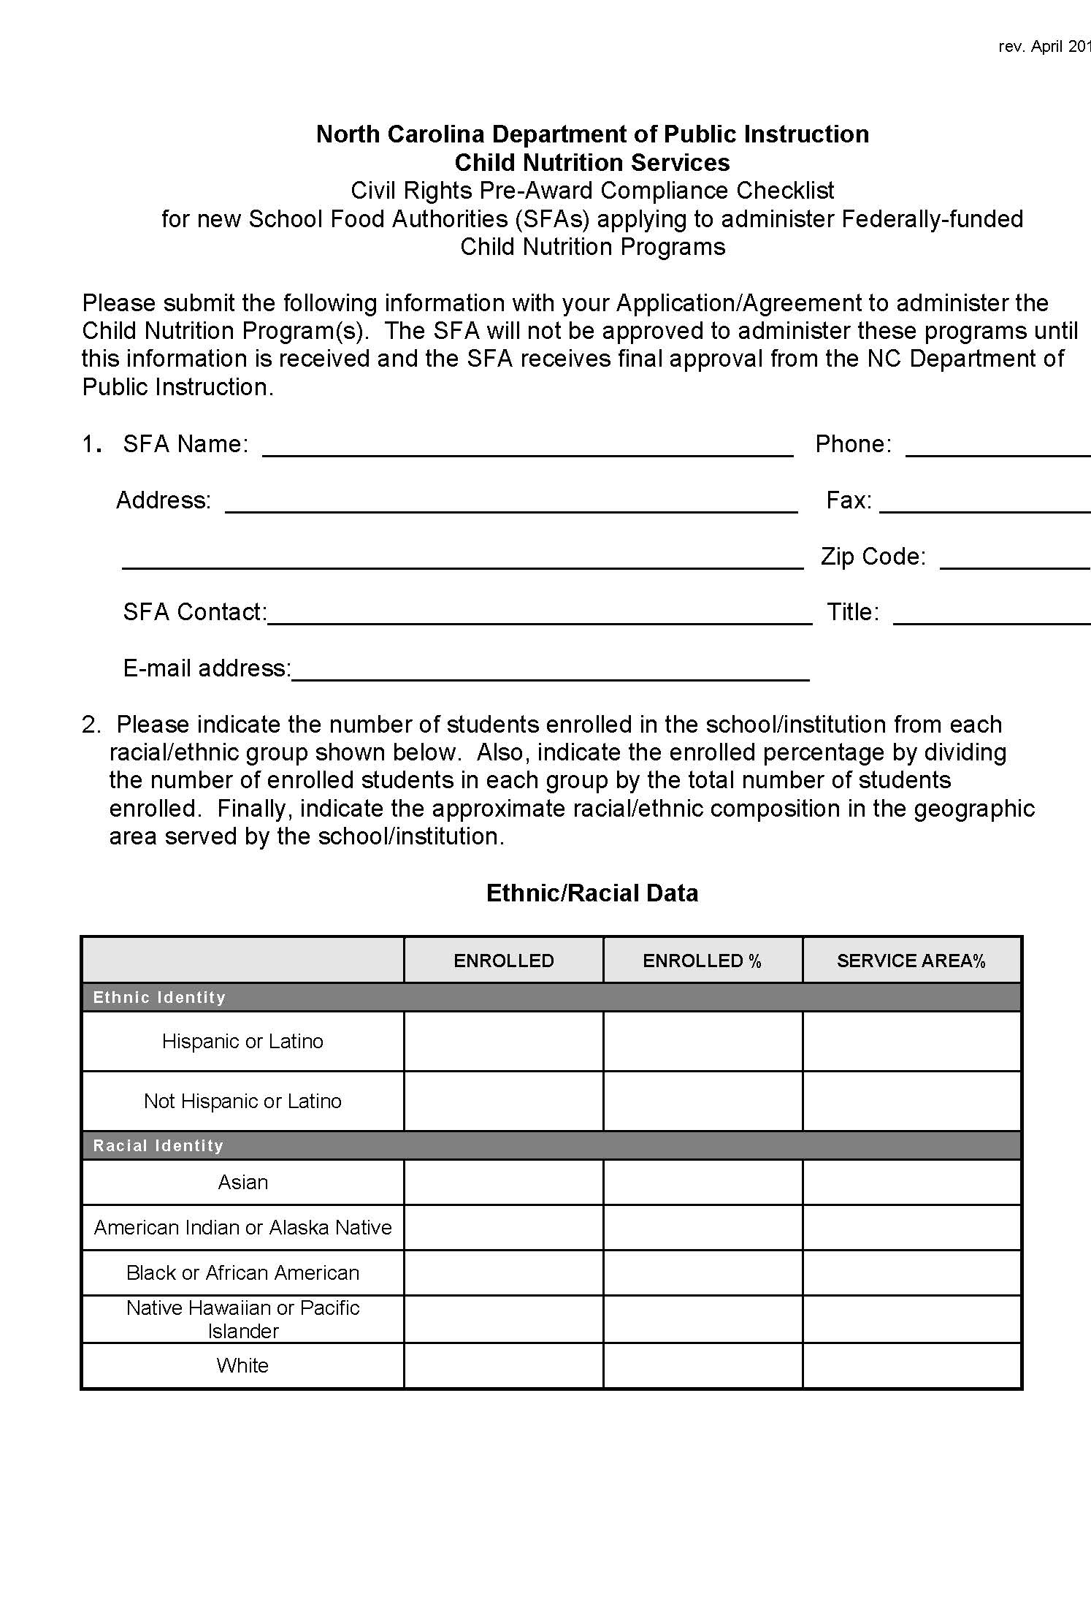
Pre-Award Requirement
Conducted when SFA’s are being considered to operate a School Nutrition Program
Notes:
When SFA’s are being considered to operate a School Nutrition Program, a Civil Rights Pre-Award is conducted by the State Agency to determine if an SFA is in compliance with Civil Rights requirement prior to approval

Slide 29
Post-Award Requirement
Administrative Review selection may be based on one of the following concerns:
Unusual fluctuation in racial/ethnic participation
Number of discrimination complaints
Reported information
Unresolved findings
Notes:
A post award review is normally done during Administrative reviews and can be triggered by any of the following concerns:
an unusual fluctuation in participation of racial or ethnic groups in a service area,
the number of complaints filed,
information from grassroots and advocacy groups, individuals and State officials, and
unresolved findings from previous civil rights reviews.
FNS and State agencies conduct routine compliance reviews as identified by FNS Instruction 113-1 and program-specific regulations and policies. The Civil Rights compliance areas are assessed and some sample post-award review questions are included below.
Do printed materials contain the nondiscrimination statement?
Is the And Justice For All poster displayed appropriately?
Are program informational materials available to all?
Is data on race and ethnicity collected and retained appropriately?
How are applicants and participants advised of their right to file a civil rights complaint of discrimination?
Have there been any civil rights complaints?
Are reasonable modifications and accommodations appropriately made for people with disabilities?
Is there ongoing civil rights education for staff?

Slide 30

Post-Award Requirement
State Agency (SA) evaluates:
Equal opportunity to participate;
Case records coded properly
Posters displayed as required
Appropriate use of nondiscrimination statement
Notes:
What does the SA look at when onsite for a post award review?
eligible persons and households have an equal opportunity to participate;
case records are coded by race or ethnic origin;
Offices/cafeterias are displaying the “And Justice for All” poster in a prominent location;
Correct nondiscrimination statement being used;

Slide 31
Post-Award Requirement
Availability of program information
Data maintained for three years
Complaint processing
Education
Notes:
Additional areas reviewed are:
availability of program information to eligible persons, program applicants and participants;
racial and ethnic data collection, and maintained for 3 years;
complaint processing; and
Continuing education for all employees is conducted and records maintained.

Slide 32
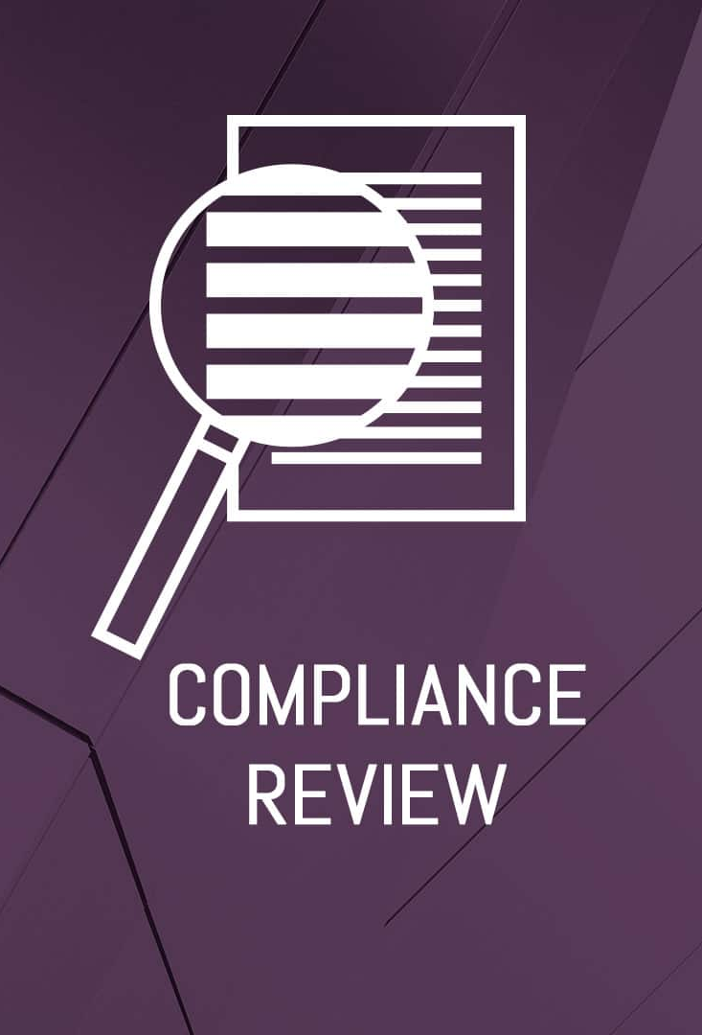
Compliance Reviews “For Cause”
Conducted upon:
Indication of benefits not extended properly
Documentation of complaint patterns
Report of alleged noncompliance
Notes:
There are times when the SA must conduct Compliance Reviews “for cause”.
Program participation data indicates a particular group in a specific area is not benefiting from a FNS program;
patterns of complaints of discrimination have been documented.
reports of alleged noncompliance made by the media, grassroots organizations, or advocacy groups that need to be resolved;
reports of alleged noncompliance made by other agencies, such as Dept. of Education (DOE) and Health & Human Services (HHS), need to be resolved;

Slide 33

Non-compliance Definition
A factual finding that any civil rights requirement, as provided by law, regulation, policy, instruction, or guidelines, is not being adhered to by a State agency, local agency, or other sub-recipient.
Notes:
Noncompliance is a finding based on facts that any civil rights requirement, as provided by law, policy, instruction, or guidelines, is not being adhered to by a State agency, local agency, or other sub-recipient.

Slide 34
What are examples of noncompliance?
Denying program benefits or services on protected class basis
Providing services or benefits in a disparate manner
Improper selection of advisory members based on protected class
Selecting program sites in a way that denies access to benefits based on protected class
Over-verification of categorically eligible participants
Notes:
Here are some examples of non-compliant practices:
Denying an individual or household the opportunity to apply for program benefits or services on the basis of a protected class
Providing FNS program services or benefits in a dissimilar manner on the basis of a protected class (except for a disability accommodation).
Selecting members for planning and advisory bodies in such a way as to exclude persons from membership on the basis of a protected class.
Selecting FNS program sites or facilities in a manner that denies an individual access to FNS program benefits, assistance, or services on the basis of a protected class.
Over-verification of Categorical Eligible.

Slide 35
Noncompliance may result from:
Management Evaluation or Civil Rights Compliance Review
Special Review
Investigation
AR or other local level review
Notes:
Non-compliance may result form a variety of situations. Compliance Reviews may be scheduled or unscheduled:
To follow-up on previous findings of noncompliance;
To investigate reports of noncompliance by other agencies, media, or grassroots organizations;
May be specific to an incident or policy;
History of statistical underrepresentation of particular group(s);
Pattern of complaints of discrimination.

Slide 36

Noncompliance
Noncompliance is effective on date of the written notice
Seek voluntary compliance at the lowest possible level.
Notes:
Effective date of the finding of noncompliance is the date of the written notice to the State agency, local agency, or other subrecipient.
What happens once noncompliance is determined?
Steps must be taken immediately to obtain voluntary compliance at the lowest possible level.

Slide 37

Questions??
Notes:
This concludes the presentation on Civil Rights. I hope that this session has provided useful information or served as a refresher of what you already know.

Slide 38
Non-Discrimination Statement
In accordance with federal civil rights law and U.S. Department of Agriculture (USDA) civil rights regulations and policies, this institution is prohibited from discriminating on the basis of race, color, national origin, sex (including gender identity and sexual orientation), disability, age, or reprisal or retaliation for prior civil rights activity.
Program information may be made available in languages other than English. Persons with disabilities who require alternative means of communication to obtain program information (e.g., Braille, large print, audiotape, American Sign Language), should contact the responsible state or local agency that administers the program or USDA’s TARGET Center at (202) 720-2600 (voice and TTY) or contact USDA through the Federal Relay Service at (800) 877-8339.
To file a program discrimination complaint, a Complainant should complete a Form AD-3027, USDA Program Discrimination Complaint Form which can be obtained online at: https://www.usda.gov/sites/default/files/documents/ad-3027.pdf , from any USDA office, by calling (866) 632-9992, or by writing a letter addressed to USDA. The letter must contain the complainant’s name, address, telephone number, and a written description of the alleged discriminatory action in sufficient detail to inform the Assistant Secretary for Civil Rights (ASCR) about the nature and date of an alleged civil rights violation. The completed AD-3027 form or letter must be submitted to USDA by:
mail:
U.S. Department of Agriculture
Office of the Assistant Secretary for Civil Rights
1400 Independence Avenue, SW
Washington, D.C. 20250-9410; or
fax:
(833) 256-1665 or (202) 690-7442; or
email:
Program.Intake@usda.gov
This institution is an equal opportunity provider.
Notes:
This concludes the presentation on Civil Rights. I hope that this session has provided useful information or served as a refresher for what you already know.

