Slide 1
Fall 2025
Policy Updates
NCDPI Office of School Nutrition
October 27-31, 2025
Notes:
Good morning and welcome to our Fall 2025 Policy Updates meeting!
Policy Updates meetings are a series of regional meetings across the state that aim to provide important state and federal program information, opportunities for discussion and conversation, and a chance to meet and network with your colleagues and State agency staff.
Let’s get started!

Slide 2
Agenda Overview
NCDPI OSN Updates
  NCDPI Strategic Plan
  What we are working on
Procurement updates
  NCPA
  Procurement Plan
Federal guidance and policy
  SP 17-2025
  SP18-2025
  Meal Pattern Final Rule reminders
  Buy American reminders
  Smart Snacks and competitive foods updates
  Digital accessibility reminders
Monitoring and compliance updates
  Onsite review/Self Assessment updates
Verification updates
Outreach and promotion updates
Professional development updates
Notes:
[Note to presenter: consultants may need to change order if they shift things around]
This is an overview of our agenda for today. We will be covering the following topics [read major bullet points on the slide].
We are happy to provide copies of the agenda should you need one for your records. We will also make a copy available on our website.

Slide 3
Objectives
Review and analyze key policy, procedural and other program administration priorities
Review various resources to support program implementation and oversight
Discuss best practices and challenges for operating School Nutrition Programs in North Carolina
Notes:
Today, we will:
review and analyze key policy, procedural and other program administration priorities,
review various resources to support program implementation and oversight, and
discuss best practices and challenges for operating School Nutrition Programs in North Carolina.

Slide 4

Introductions
Your name
Your SFA
Your role
How long you’ve been working in school nutrition
What you did before school nutrition
Anything else you’d like to share!
Get to know each other!
Notes:
Let’s get to know each other a bit better!
Instructor/facilitators introduce themselves (name, title, service area if applicable)
At your tables, share:
Your name
Your school
Your role
How long you have been in school nutrition
Your background (what did you do before school nutrition?)
And anything else you want to share about yourself
[Note to Presenter: Have tablemates introduce each other. Give tables 5 minutes to talk amongst themselves.]

Slide 5
Updates from NCDPI
Notes:
Let’s start off with some updates from our agency.

Slide 6
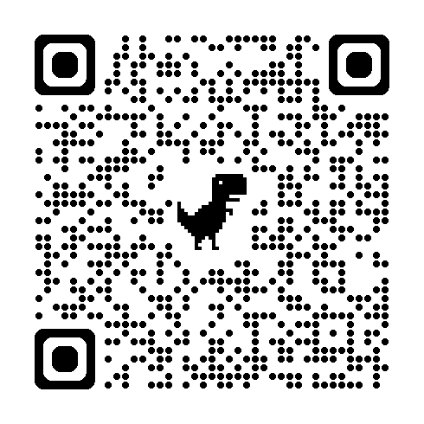
NCDPI Strategic Plan
2025-2030
Achieving Educational Excellence
https://www.dpi.nc.gov/about-dpi/state-superintendent-public-instruction/achieving-educational-excellence
Notes:
NCDPI and the NC State Board of Education (NCSBE) have developed a bold strategic five-year plan, Achieving Educational Excellence, to position North Carolina's public schools as the best in the United States by 2030. It is the first joint plan between the NC State Board of Education and the State Superintendent, Mo Green.
Achieving Educational Excellence is the vision for this strategic plan. This vision has three main components: high academic achievement, character development and making North Carolina public schools the best in the United States of America.
Let’s take a closer look at the plan together. Scan the QR code or visit the link shown to follow along and learn more about the Achieving Excellence strategic plan and educational regional visits on the NCDPI website.

Slide 7
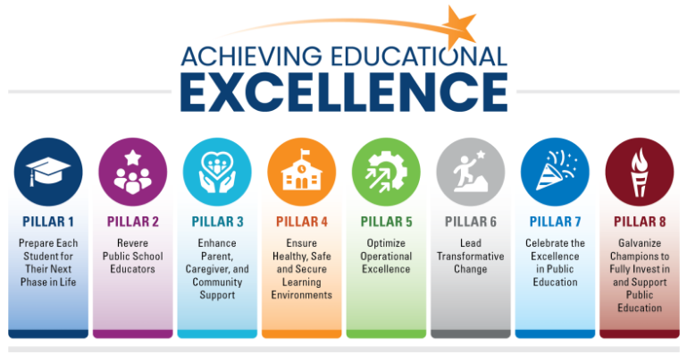
Achieving Excellence Pillars
Pillar 1: Prepare Each Student for Their Next Phase in Life
Pillar 2: Revere Public School Educators
Pillar 3: Enhance Parent, Caregiver and Community Support
Pillar 4: Ensure Healthy, Safe and Secure Learning Environments
Pillar 5: Optimize Operational Excellence
Pillar 6: Lead Transformative Change
Pillar 7: Celebrate the Excellence in Public Education
Pillar 8: Galvanize Champions to Fully Invest in and Support Public Education
Notes:
Realization of these goals rests upon successful actions across eight pillars, outlined in this graphic.
Pillar 1: Prepare Each Student for Their Next Phase in Life – this pillar is aimed at expanding rigorous pathways, dual enrollment and character development
Pillar 2: Revere Public School Educators – this pillar supports competitive compensation and career advancement opportunities
Pillar 3: Enhance Parent, Caregiver and Community Support – this pillar is focused on strengthening family engagement and partnerships
Pillar 4: Ensure Healthy, Safe and Secure Learning Environments – this pillar identifies the need for physical and emotional safety with mental health support
Pillar 5: Optimize Operational Excellence – this pillar targets modernizing systems and eliminating administrative burdens
Pillar 6: Lead Transformative Change – this pillar focuses on research-driven innovation and accountability reform
Pillar 7: Celebrate the Excellence in Public Education – this pillar supports comprehensive messaging to highlight successes
Pillar 8: Galvanize Champions to Fully Invest in and Support Public Education – this last pillar focuses on building coalitions for increased investment and pride in our schools
Each pillar is necessary, and together they share the weight of preparing the future of our state with excellence.

Slide 8

2030 NCDPI Strategic Plan Goals
Achieve:
  92% 4-year graduation rate (currently 86.9%)
  ACT composite score of 20 (currently 18.5)
  30% AP participation among 10-12th graders (currently 21.5%)
  41% Career Technical Education (CTE) participation among all K-12 students (currently 36.1%)
  89% of school-aged children enrolled in public schools
Lead the Southeast in educator compensation
Obtain national leadership in reading and math scores
Increase the number of schools recognized as both State and National Schools of Character
Learn more and get involved: https://www.dpi.nc.gov/about-dpi/state-superintendent-public-instruction/achieving-educational-excellence
Notes:
The Achieving Excellence strategic plan has identified several key goals to achieve by 2030:
A 92% four-year graduation rate (currently 86.9%),
An ACT composite score of 20 (currently 18.5),
30% AP participation among 10th-12th graders (currently 21.5%),
41% Career Technical Education (CTE) participation among all K-12 students (currently 36.1%),
89% of school-aged children enrolled in public schools,
Leading the Southeast in educator compensation,
And national leadership in National Association for Educational Preparedness (NAEP) reading and math scores.
The plan also emphasizes character development, with goals to significantly increase schools recognized as National Schools of Character and implement service-learning efforts and comprehensive character education programs statewide.
To learn more and get involved, such as by registering for and attending a public forum virtually or in-person, visit the page linked here or scan the QR code.

Slide 9
Office of School Nutrition Updates
Learn what we are doing to better support you!
Notes:
Now that we’ve gotten to know you, we’d like to share a bit about what the NCDPI Office of School Nutrition is doing behind the scenes to better support you and your programs.

Slide 10

Welcome, Tikiyha (Ty) Ancrum!
Summer Nutrition Compliance Consultant
Lead Consultant for Summer Nutrition Program trainings and program materials
10+ years of nutrition experience within Federal Child Nutrition Programs and Nationwide Member Food Banks
A mother of many but primarily 3 children (one son, two daughters). Extreme couponer (yes, she stockpiles) and loves playing Wordle
Notes:
Now for some exciting news from our Office of School Nutrition!
Please join us in welcoming the first new addition to our team since the spring – Tikiyha [Presenter Note: pronounced “tie – key – yah”] Ancrum. Tikiyha goes by “Ty” and is our new Summer Nutrition Compliance Consultant. As part of the small but mighty Summer Nutrition Team, Ty will be serving as the lead consultant for Summer Nutrition Program trainings and program materials.
Ty comes to us with 16 years of nutrition experience within Federal Child Nutrition Programs and Nationwide Member Food Banks. She previously worked as a Nutrition Health Educator for the Georgia Department of Early Care and Learning. Ty developed and acquired a $25,000 USDA Farm to School Grant for training within CACFP and SFSP. During Summer 2013, she worked as SFSP Supervisor for Food Bank CENC, managing over 90 SFSP sites and serving over 4000 children and over 130,000 breakfast/lunch meals in one summer. She worked with the 2nd largest nonprofit for meals served in NC.
Ty is a mother of many but primarily 3 children (one son and two daughters). She is graduate of North Carolina Central University and Meredith College. She is an extreme couponer and loves playing Wordle.

Slide 11

Welcome, Steven “Daved" Roberts!
School Nutrition Consultant, Service Area 7
App State graduate – degrees in accounting, music education
Prior work experience in accounting and music education
Started in SN as Davidson County SN Finance Coordinator
Nov 2019 – Davidson County SN Director
Notes:
We would also like to welcome the newest member of our school nutrition programs consultant team – Steven “Daved” Roberts. He goes by Daved, which is pronounced “David” and will be the school nutrition consultant for service area 7, which includes Alamance, Caswell, Guilford, Randolph, Rockingham, Orange, and Person Counties.
Daved graduated from Appalachian State University with a degree in accounting and music education. He has worked with an accounting firm and taught music education before finding his passion in School Nutrition. Daved started working for Davidson County Schools as the School Nutrition Financial Coordinator where he supervised all accounting functions within the school nutrition department, including purchasing, procurement, accounts payable and receivable and budget management. In November 2019, Daved became the School Nutrition Director of Davidson County School.
Daved is a strong advocate for school nutrition and passionate about serving and mentoring other school nutrition professionals for the benefit of North Carolina’s children. We are fortunate to have him on our team!

Slide 12

Welcome, Chris Pond!
Data and Program Analysis Section’s Business Systems Analyst
3 years at DPI, 10+ years at SAS
Father of 2 and a Golden, Husband of 1
Avid baseball fan, bowler and pumpkin carver.
Happy Halloween!

Slide 13
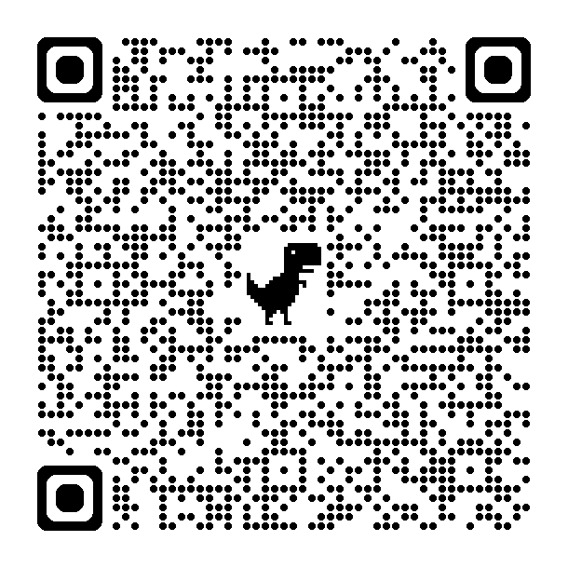

Changes Ahead
Transitioning to Canvas
  Learning management system
  One-stop shop repository of information
  NCDPI OSN website update
Developing new resources and continuing education
  Financial management
  Charter school/new sponsor focused
Refining internal procedures
  Reviewing and revising how we do things internally
Learn more about the NCDPI OSN Canvas Portal →
Notes:
We are devoting significant time and resources this year to help improve how we operate internally, as well the guidance and continuing education we provide to you, with the goal of better serving you and your teams.
Like clearing a path and laying the foundation for a new road or building, we are working diligently behind the scenes to re-launch our learning management system, Canvas. Some of you may remember using Canvas for earlier continuing education courses (such as R.A.C.E. Online offerings for Summer Nutrition Programs). We are working to update our course offerings on this portal and ultimately make it our information repository by spring 2026. We envision Canvas as your one-stop shop for taking continuing education courses or modules and downloading guidance and resources instead of needing to go to our website or SNTS. There will still be items stored for use in the document library in SNTS and these items and many of our resources will still remain on our website, but we hope that migrating all materials to Canvas will make it easier for you to find the information you need quickly. A big thank you to Donna Knight as she is working diligently to migrate and organize all of these materials for you.
The NCDPI Office of School Nutrition website was recently updated to assist you with finding information more quickly and easily. We hope you will take a look at the updated website.
We are also partnering with experts on financial management and operating Charter School SN programs to develop and streamline resources for your program operations. Financial management is one of the most requested topic areas for guidance and continuing education, so we are focusing on developing a training program and robust resources as one of our first priorities. In addition, we recognize that we need improved resources for our growing population of charter school SFAs that are relevant, practical, and consistent. We are also focusing our efforts this year on revising resources and creating new ones that are unique to operating school nutrition programs in charter schools.
Last but certainly not least – we recognize that we have an opportunity to review and revise our internal procedures. Our goal is to determine the most efficient and effective ways to serve you, while staying in compliance with USDA and state level regulations. We want to make sure that we are doing it the best way, not just “the way we’ve always done it”. As a result, guidance may start changing as we dig into all facets of these programs, so we appreciate your patience as we revise and strengthen our internal procedures.

Slide 14
Procurement
NC Procurement Alliance Update
Procurement Basics and Reminders
Procurement Plan Updates
Notes:
This part of our meeting will share some procurement-related updates, including upcoming changes to our procurement plan templates, advertising requirements, and local food procurement strategies.

Slide 15
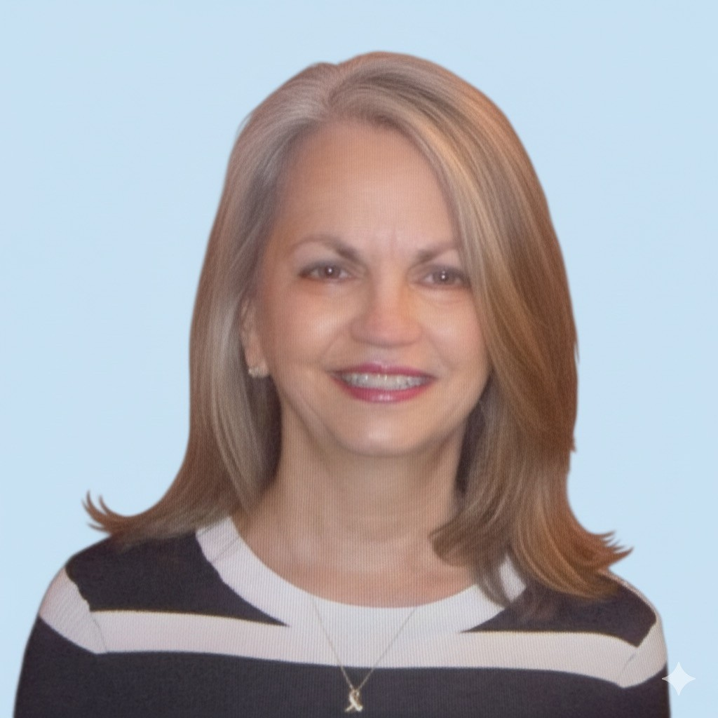
NC Procurement Alliance Team Updates
Welcome to Ginny Spencer!
Last position with Bake Crafters Food Company
30 years experience in K-12 ranging from industry to USDA
Married to Mike (JTM), her son Ryan is a collegiate dancer, and 2 rescue pups
Notes:
In addition to Ty and Daved, we would also like to welcome our newest NCPA Consultant Ginny Spencer, who will be joining Cindy Hobbs. Ginny comes to us with extensive knowledge of the K-12 food landscape and the world of commodity processing. She most recently held the position of Director of Sales for the Southeastern US at Bake Crafters Food Company and has been in involved in the world of K-12 schools for over 30 years. She will bring the industry perspective to the NCPA to help us make decisions while keeping in mind the various stakeholders involved in the K-12 procurement process.
Ginny is married to her husband Mike and has a son, Ryan, who is a collegiate dancer. She also has two rescue pups.
Please join us in welcoming Ginny to the NC Procurement Alliance team!

Slide 16

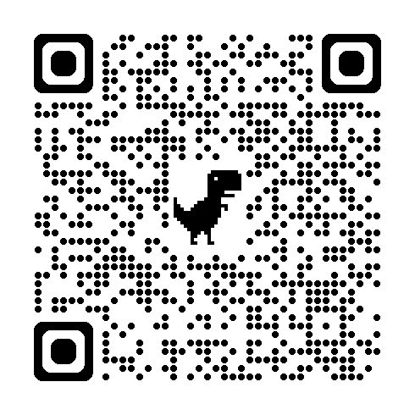
Interested in Learning More about the NCPA?
Collective purchasing
High-quality and reasonably priced
Food, supplies, equipment
Learn more about NCPA on our website: https://www.dpi.nc.gov/districts-schools/district-operations/school-nutrition/procurement-alliance
Notes:
As a reminder, The NC Procurement Alliance is essential for leveraging the collective purchasing power of member school districts for measurable, cost-effective results – essentially, providing districts with quality products at lower prices. The NCPA works in a voluntary partnership to procure high quality, reasonably priced foods, supplies, small equipment and large equipment that will enhance the health, well-being and academic success of students enrolled in North Carolina’s traditional public schools.
If you are a charter school or a district that is not a member of the NCPA, but you are interested to learn more, please scan the QR code on this screen or visit the website linked above.

Slide 17
Procurement Basics and Reminders
Adapted from Maine Department of Education, Procurement 101
Notes:
Next, we’ll spend some time reviewing some procurement basics for you to consider as you start thinking about your procurement activities for the school year.
Some of the information we are sharing today has been adapted from the Maine Department of Education’s procurement training.

Slide 18
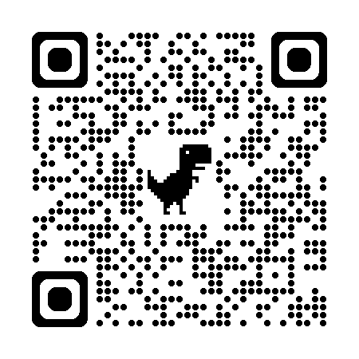

Federal Procurement Regulations
https://www.ecfr.gov
2 CFR 200
  All programs receiving federal funds
7 CFR 225.17 - SFSP
7 CFR 210.21 - NSLP/SBP
7 CFR 220.16 - NSLP/SBP
2 CFR 400.2 - Conflict of Interest
Notes:
As a reminder, here are the federal procurement regulations that we all must follow when conducting any procurement activity.
[Read through slide]
If you are interested in reviewing these and other federal regulations related to school nutrition, you can scan the QR code to review the Code of Federal Regulations online.

Slide 19

Free and Open Competition
Vendors are on a level playing field
  Equal opportunity to compete for your business
  Spending federal dollars, need to be impartial
Give vendors adequate time to respond
Don't be overly restrictive by:
  Specifying brand name
  Requiring unnecessary experience
  Placing unreasonable requirements for the procurement activity
Notes:
When any program that receives federal funds is procuring any item, we want to ensure that all vendors are on a level playing field. That means that every vendor has an equal opportunity to compete for your business because when you are spending federal dollars, you need to be impartial. In order to remain impartial, you must allow free and open competition.
You must give your vendors adequate time to respond. There is no federal guidance on what is an adequate time to respond, so use your best judgement when developing your quote to determine what adequate time to respond means for what you want to procure.
Try not to be overly restrictive. If you specify a brand name, then you need to provide an approved substitute. If you only specify brand names, you are not ensuring this procurement process is allowing for free and open competition. Avoid requiring an unnecessary amount of experience. An example of that would be requiring a vendor to be in business for 20 years.
An example of placing an unreasonable requirement for the procurement activity would be requiring the vendor to deliver only during the hours of 9am-10am.

Slide 20
4 Key Principles of Procurement
Buy American Provision
Regulations
Full & Open Competition
Responsive & Responsible Vendors
Notes:
There are 4 key principles of procurement that you will need keep in mind through every procurement activity and decision.
The Buy American Provision
Procurement regulations
Full and open competition
Responsive and responsible vendors
Let’s start with the Buy American provision.

Slide 21

Buy American Provision
Required for all procurement solicitations for food
Purchase, to the maximum extent possible:
  Unprocessed agricultural commodities (food) grown in the US
  Processed food products that contain over 51% agricultural commodities grown in the US and processed in the US
Notes:
The Buy American Provision requires SFAs operating all school and summer nutrition programs to purchase, to the maximum extent possible, both of the following types:
unprocessed agricultural commodities grown in the US and
processed food products that contain over 51% agricultural commodities that are both grown and processed in the US
If you are writing a specification for a food item, you must include the Buy American provision in your terms and conditions. We talk about that again later.
Image: https://commons.wikimedia.org/wiki/File:US_Flag_Backlit.jpg

Slide 22
Micro-Purchasing Process
Determine micro-purchase threshold via board policy for your SFA or use Federal threshold of $15,000 if no board policy
Determine if the total amount of the purchases of goods/services does not exceed the micro-purchasing threshold
Ensure competition by distributing purchase transactions equitably among qualified sources where the price is reasonable 2 CFR 200.320(a)(1)(ii)
Determine micro-purchase threshold via board policy for your SFA or use Federal threshold of $15,000 if no board policy
Determine if the total amount of the purchases of goods/services does not exceed the micro-purchasing threshold
Ensure competition by distributing purchase transactions equitably among qualified sources where the price is reasonable 2 CFR 200.320(a)(1)(ii)
Notes:
First, let's talk about micro-purchasing. The first thing you need to do is figure out if your local board of education has a micro-purchase threshold limit below $15,000. You will need to review your local board policies to answer that question or reach out to your business office. If you do not have a local board policy that outlines a micro-purchase threshold, then you will use the federal micro-purchase threshold of $15,000. We know there is a provision allowing for the micro-purchasing threshold to be increased to $50,000, if approved annually by the state agency (NCDPI). Our office is in the process of gathering data from other states to determine how they manage this annual certification process. Our office plans to communicate the updated annual certification process of the $50,000 micro-purchasing threshold increase for approval for the 2026-2027 school year.
You can purchase items with this purchasing method if the total amount of the good or service does not exceed the micro-purchasing threshold.
Ensuring competition by distributing purchase transactions equity means that if you are buying local apples, you buy them from Farmer 1 first, then Farmer 2, Farmer 3, etc. Keep in mind, completing a small purchase quote may give you better pricing then spreading around your micro-purchases.
If there are multiple places that offer equipment repair, spread those repairs around equitably to different vendors in your area.

Slide 23
Micro-Purchasing Process - Rules
Rules to follow:
  Aggregate (total) dollar amount of the purchase may not exceed threshold set by local board of education or federal threshold by transaction
  Should distribute equally among qualified vendors/suppliers
  2 CFR 200.320(a)(1)(ii): Price comparisons may not be needed if the program operator "considers the price to be reasonable based on research, experience, purchase history or other information and maintains documents to support its conclusion"
  Invoices/receipts of the micro-purchase must be maintained and filed with the micro-purchase log as documentation of the purchase
Notes:
Here are some rules to follow with micro-purchasing.
Again a reminder, the total dollar amount of the purchase may not exceed the threshold you determine is appropriate for your SFA. Whether that be the local board policy threshold or the federal threshold. Since the micro-purchase threshold changed, we will begin updating the micro-purchase log and let you know when it is ready via the SN Update.
You need to "share the wealth" and evenly award micro-purchases to responsible and responsive vendors.
Per USDA, micro-purchases may be awarded without soliciting competitive price or rate quotations, if the program operator considers the price to be reasonable based on research, experience, purchase history or other information and maintains documents to support its conclusion.
You need to keep all invoices and receipts of each micro-purchase and file them with your SFAs micro-purchase log as the documentation of that purchase. We recommend a new micro-purchase log every school year (July 1-June 30).

Slide 24
Small Purchase Process Steps
Draft solicitation
1
Contact at least 2-3 vendors (by phone or email)
2
Document all responses/ requests
3
Compare & evaluate quotes
4
Monitor contract
5
Notes:
When doing small purchase procurement, you will need to follow each of these steps.
Develop a draft solicitation
Contact at least 2-3 vendors by phone or email
Document all responses and/or requests
Compare and evaluate quotes, and
Monitor the final contract.
Let’s explore each of these steps in more detail.

Slide 25
Step 1: Draft Solicitation – Specifications for Food
Written specifications describe what you need
How to write a specification using the following information if procuring food:
  Name of the product
  Description of the product
  Case Pack and Weight
  Main Ingredient(s)
  Minimum & maximum size and pieces (if applicable)
Notes:
To develop a solicitation, you must write the product specifications and the terms and conditions of the quote. This process ensures that all potential vendors receive the exact same information. First, let's start with what information needs to be included when you write a specification for food.
[Read through slide]

Slide 26
Step 1: Draft Solicitation – Food (continued)
Write a specification using the following information if procuring food:
  Unit (each, case, etc)
  Quality indicators (grade A, extra fancy, U.S. No 1, USDA Prime, etc)
  Prohibited ingredients (if applicable)
Specification Reminders for procuring food:
  Brand name or approved equivalent to allow for open competition
  Buy American provision must be included
Notes:
[Read through slide]
This may not be an exhaustive list. You may think of something that we have not thought of that can be added to a specification.
You can use the Buy American provision from your formal procurement terms and conditions as long as it complies with the most recent Buy American provision found at SP38-2017 Compliance and Enforcement of the Buy American Provision in the NSLP.

Slide 27
Step 1: Draft Solicitation - Equipment
Write a specification using the following information if procuring equipment:
  Name of the piece of equipment
    Commercial Reach-In Refrigerator, Commercial Convection Oven, Combination Oven, Commercial Steamer
  Description of features needed in the piece of equipment
    Materials used in construction of the equipment
    Food safety considerations
  Technical Specifications
    Dimensions
    Certifications
    Energy type (Electrical, Natural Gas, Propane/LP Gas)
    Other technical requirement(s)
Notes:
Now let's review the information needed to write a specification for equipment.
[Read through slide]
Same as the previous slide, this may not be an exhaustive list. You may think of something that we have not thought of that can be added to an equipment specification.

Slide 28
Step 1: Draft Solicitation – Terms & Conditions
What to include when writing terms and conditions
  How the quote needs to be submitted (via email, fax, phone, etc) and when
  How the quote will be awarded
    Lowest price by line item, total price of all items in the quote
    How long the quote is valid for (week, month, quarter)
  Delivery Requirements
    Required delivery hours, if needed
    Special transportation requirements (e.g. refrigerated/frozen delivery truck)
  Buy American provision (if procuring food items) & other regulatory requirements
  Termination conditions for noncompliance (e.g. not delivering specified item(s)
  Proof of liability insurance & GAP certification (if needed)
Notes:
We know this slide is very wordy, but you having this information on one slide is important.
After you write the specifications for the item you would like to purchase using small purchase procurement, you will then need to write the terms and conditions for the quoter to follow if they are awarded the quote.
[Read through slide]
Again, not an exhaustive list, but should serve as a blueprint to help you write your terms and conditions.

Slide 29
Step 2: Contact Potential Vendors
Contact as many vendors as you can
  Send quotes to the number of vendors as indicated in your approved procurement plan
  3 quotes is best practice but 2-3 quotes is required
  NCDPI considers a non-response as a response with documentation that the SFA reached out to the vendor
How to find potential vendors:
  Web search
  Contact manufacturer/broker
  Within district
  Fellow school nutrition administrators
Notes:
The number of potential vendors you contact should be outlined in your Procurement Plan. If your Procurement Plan states you will contact three (3) vendors in your Informal Purchasing, then you should be contacting three vendors at a minimum. Three quotes is not required, but it is best practice. NCDPI considers a non-response as a response with documentation that the SFA reached out to the vendor.
[Read through how to find potential vendors from slide]

Slide 30
Step 3: Documentation
If verbal quote, write down relevant information on small purchase quote sheet
Document the following on the small purchase quote sheet:
  Written specifications including a detailed description
  Vendor/company name
  Contact info for person providing the quote to the SFA
  Source of quote (telephone, email)
  Date
  Price
Notes:
If providing a verbal quote, you must read the specifications to the vendor and document the date/time the conversation took place on the document your SFA uses to document small purchase quotes.
[Read through slide]

Slide 31
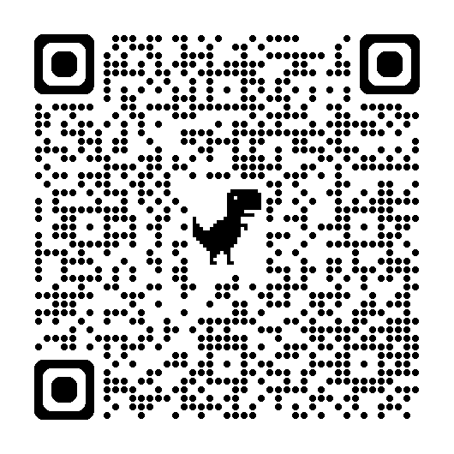
Resources for Writing a Solicitation
Resources for food specifications:
  Food Buying Guide
  Choice Plus Reference Guide
  Urban Food Alliance K-12 Specification Guide
  USDA Grades and Standards
  USDA Foods in Schools Product Information Sheets
Resources for equipment specifications:
  Commercial Equipment Wholesaler
  Manufacturer websites
https://www.dpi.nc.gov/districts-schools/district-operations/school-nutrition/information-resources-subject/procurement
Notes:
Here are some resources to help you write specifications.
[Read through slide]
All of the resources are linked, so when you receive this slide deck, you will have these references for you to use when writing your specifications. NCPA members have access to a bid spreadsheet that lists hundreds of food product specifications to help in writing a specification. NCPA also has provided specifications for many pieces of large equipment.
The QR code on the screen will take you to the NCDPI Procurement webpage. We are in the process of putting the links shown here on this page, so if they aren’t there yet, know that we are working on it and they will be soon. In the meantime, feel free to do an internet search for these at your convenience.
[Use Procurement Slides Facilitation Guide doc for facilitation guidance]

Slide 32
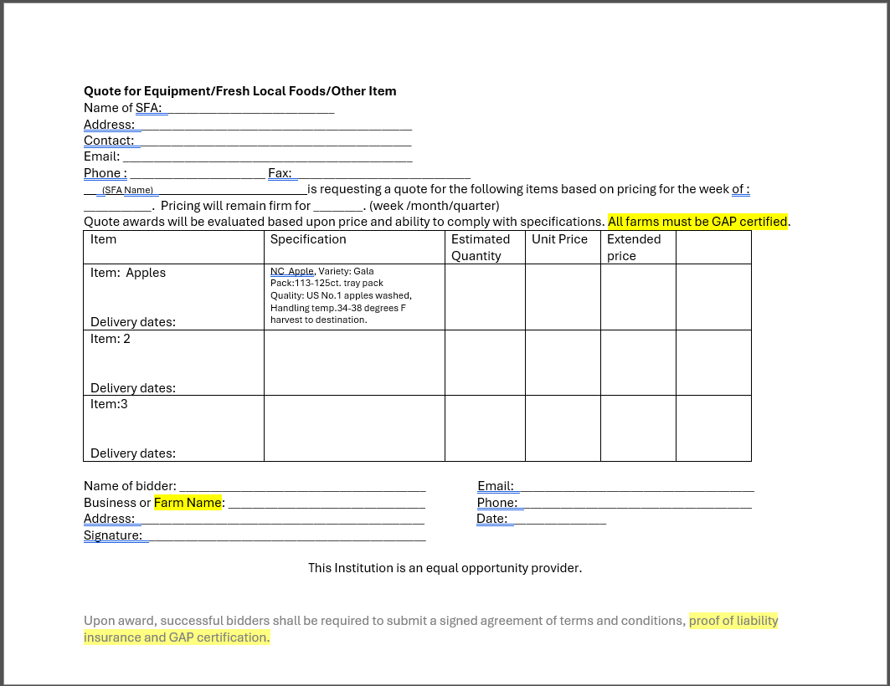
Example of Small Purchase Quote Sheet
Notes:
Cindy Marion developed this quote sheet to use for the purchasing of local foods, but it can also be used for any small purchase. Once this quote sheet is finalized with instructions, we will post it on our website and send the location of where to find this quote sheet via the SN Update. Items highlighted in yellow can be added or removed, depending on the type of item you are trying to procure. You may also use any document already used in your SFA.

Slide 33
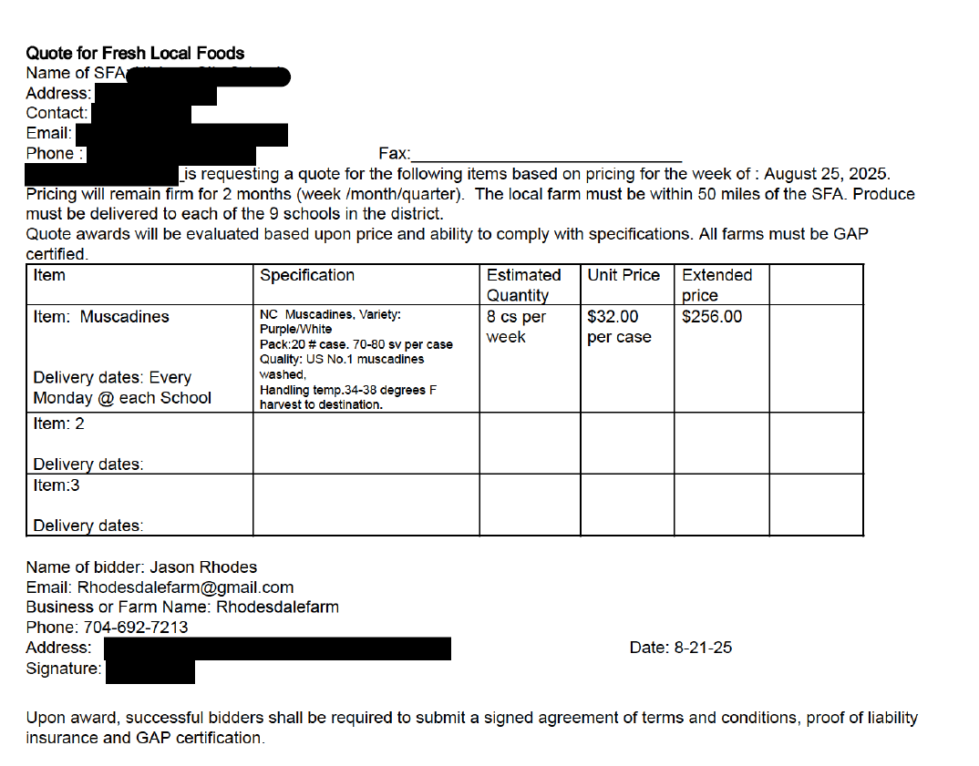
Example of a Completed Small Purchase Quote Sheet
Notes:
Here is an example of a completed small quote sheet for a local food purchase.

Slide 34

Step 4: Compare & Evaluate Quotes
Vendor must meet all deadlines and requests for information AND be capable of executing the quote
  "Responsive & responsible bidder"
Compare "'apples to apples"
  Usage/case size/price
  Delivery charges
Determine winning vendor
  Lowest price, responsive & responsible
Notes:
The vendor must meet all deadlines and requests for information and be capable of executing the quote. If the vendor can meet those requirements, the vendor would be considered a responsive and responsible bidder.
Being Responsive means that the bidder complied with all the terms and conditions, met the deadline you provided, responded to all requests, and made sure the items quoted meet your specifications.
Being a Responsible bidder means you feel they are capable of performing under the contract because they have the technical expertise, management capability, and financial resources to perform the work successfully for your SFA.
You want to make sure that you are comparing "apples to apples" which means that you are able to compare the same usage provided by you, with the same case size you specified to make sure the pricing between vendors is comparable. You will also want to add in any delivery charges from the vendor.
To determine the winning vendor, remove quotes from the pool of quotes if the bidder is not responsive (they did not submit the quote by the date indicated, did not respond, or did not provide a quote based on the specifications you provided) or responsible. We are now going to do an activity to help you think through whether a vendor would be considered responsive and/or responsible.
[Use Procurement Slides Facilitation Guide doc for facilitation guidance]

Slide 35
Examples of Written Specifications
Description of Product: Ground Beef Patties, 80% lean, 20% fat, frozen
Case Pack/Wt: Not to exceed a 20 pound case
Min & Max Size: Each patty must be a 4oz individually portioned ground beef patty
Quality: USDA Choice
Product must be grown/raised in North Carolina
Description of Product: Commercial Convection Steamer
Description: Double steamer with separate cooking departments with separate controls and steam shut off switch when door opens, 12 plan capacity, stainless steel exterior and cooking compartments, electric (120V, 60 Hz, 1-phase), NSF listed
Dimensions: 65" (h) x 33" (d) x 24" (w)
Notes:
These are two very brief (that would fit on one slide) examples of some written specifications for both food and equipment. You would need to add more details to these specifications since they are not comprehensive.
[Read through slide]

Slide 36

Step 5: Award the Quote
Notify the vendor that won the quote/contract
Discuss next steps (invoicing, delivery, etc.)
Notify those that did not win the quote
Save all your documentation!
  Hard copy in one file with all documents, and/or
  Digital shared cloud-based storage option
Notes:
Once you have compared your quotes, you will need to award the quote based on the method you indicated in your quote solicitation. You will need to notify the vendor that was awarded the quote and notify the vendors that were not awarded the quote. All vendors can be notified via email or phone. An email notification provides you with the documentation of the award and non-award, and would be considered a best practice to help maintain documentation surrounding this quote.
Discuss the next steps with the vendor about invoicing, delivery, etc.
Save all communication, quotes, small purchasing quote sheet, and all other documents related to the solicitation of this quote together in one file so it's readily available should that information be needed to provide to the NCDPI for technical assistance or an administrative review. You may also store this information digitally, but it would be best practice to store this information on a shared cloud-based storage drive like a shared google drive or shared microsoft onedrive and not on an individual's cloud-based storage drive to allow easy access to all within the SFA that may need to reference this information.

Slide 37

Step 6: Monitor the Contract
Is the vendor performing as agreed to in the quote solicitation?
  Correct item(s)
  Agreed upon pricing
  Buy American (if purchasing food items)
Notes:
After the quote is awarded, the work of the quote is not over. Now you must monitor the contract the quote created by ensuring you are receiving the correct items as specified in the quote specification. Is the pricing invoiced the agreed upon pricing? Is the vendor overall executing what they said they would in the quote? If not, you may need to refer back to the terms and conditions you wrote about how you can terminate the small purchase quote with the vendor for noncompliance.

Slide 38
Micro-Purchase vs. Small Purchase
Situation | Micro-Purchase vs. Small Purchase
One-time purchase
Shop from different vendors to "share the wealth"
Buy repeatedly from the same vendor
Lowest price
Micro-purchase might be best
Micro-purchase
Small purchase
Small purchase
Notes:
Now we’re going to do a short activity to show a few examples of different procurement situations you may encounter in your operations.
In small groups or at your tables, review each of these brief situation descriptions and determine the best type of procurement – micro-purchase or small purchase.
[Pause for about 2 minutes for discussion among groups.]
Let’s review the answers.
[Presenter Note – ANIMATION SLIDE. Go over each example. Click once for each answer to appear on the screen; they go in order from top to bottom]
Now let's dig into some procurement scenarios for you to work through at your tables.
[Use Procurement Slides Facilitation Guide doc for facilitation guidance]

Slide 39
How to Use the State Term Contract
Can be used for micro-purchasing
  Remember that micro-purchasing requires you to spread around your purchases to different vendors
Can be used as one of the 2-3 quotes for small purchasing
  Can document the price of the item *if* it meets the specification
CAN NOT be used in place of obtaining quotes for small purchasing
CAN NOT be used in place of any formal procurement
Notes:
While we are not covering formal procurement today, as it is currently interpreted, programs using federal funds may not use the state term contract as their sole procurement method. Federal procurement methods must be adhered to at all times when using federal funds.

Slide 40
Iran Divestment Act
Federal Iran Divestment Act passed by Congress on June 24, 2010.
NC’s Iran Divestment Act signed into law in 2015 and updated in 2021.
In July 2017, elimination of certification requirement that vendors not on list.
Governmental entities, including districts and charter schools, are still prohibited from contracting with entities on the list.
NC State Treasurer’s Office maintains list of entities with which NC government purchasers cannot contract.
Notes:
[Review first two bullets about history of Act on slide.]
In July 2017, Governor Roy Cooper signed legislation that eliminated the certification requirement, with the change taking effect on October 1, 2017.
The actual prohibition against contracting with entities on the Final Divestment List remains in effect but a formal certification that a vendor is not on the list is no longer required.
Instead of collecting certifications, North Carolina government purchasers must now proactively check the list maintained by the State Treasurer before awarding a contract. This includes school districts and charter schools. The Treasurer's office updates the list annually.
Most of the companies on the State Treasurer’s list are Chinese-owned petroleum companies and there are only a few.

Slide 41
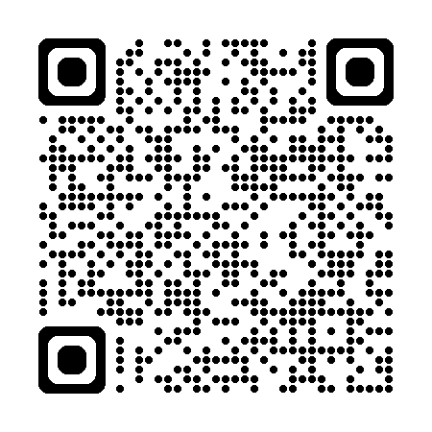
Iran Divestment Act – Requirements
Check the State Treasurer’s Divestment and Do-Not-Contract Rules
Retain a copy of the list and before awarding a contract, ensure the prospective vendor is not on the list
List is updated annually at the end of the year
Check the State Treasurer’s Divestment and Do-Not-Contract Rules
List is updated annually at the end of the year
Retain a copy of the list and before awarding a contract, ensure the prospective vendor is not on the list
https://www.nctreasurer.gov/about/transparency/divestment-and-do-not-contract-rules
Notes:
The key questions are what are what are your responsibilities in procurement, what documentation do you need to retain and what is the State agency required to do in terms of monitoring and providing technical assistance?
As School Food Authorities, you will need to check the State Treasurer’s Divestment and Do-Not-Contract Rules | NC Treasurer before awarding a contract to ensure the vendor is not on the list. You can access the list through the QR code or link on this slide. Retain a copy of the list of prohibited vendors from the State Treasurer’s website every year as documentation and keep it with your procurement documents and contracts for easy reference.
As the link between the USDA and our SFAs, we, as the State agency must ensure you are managing the nutrition programs according to federal and state requirements, including the Iran Divestment Act.
We will ask if you have reviewed the Treasurer’s list before your procurement to ensure no vendors were on the list and ask whether you have retained a copy of the list.
Remember federal record retention requirements still apply and you will need to retain your documentation for three years plus the current year and longer if the base contract has been renewed for more than three years.
Are there any questions about your responsibilities in ensuring compliance with the Iran Divestment Act?

Slide 42
Procurement Plan Updates
Changes to Iran Divestment Plan
Change in bid solicitations (newspaper vs. eVP)
Updated micro-purchase threshold to $15,000
Does include the new non-discrimination statement
  Do not use this updated non-discrimination statement on any other school nutrition materials—wait for guidance from NCDPI
Needs to be updated before the 2026-2027 school year
Notes:
Remember that when our team conducts an AR in your SFA, we review your procurement plan in detail to make sure you are following the steps outlined in the procurement plan for your SFA. The information provided throughout this procurement training is meant as a guide to assist you with your procurement, but you must follow the most restrictive procurement requirements, and your local board of education may have requirements that are more restrictive than the federal requirements.
We made changes to the Iran Divestment Plan to update the language to the current language.
We added the option to use eVP to advertise your bid solicitations. You are welcome to continue placing bid solicitations in the newspaper if you choose.
We updated the micro-purchase threshold to $15,000 throughout this document. The change in the micro-purchase threshold may require you to change board policy at your SFA to allow for the micro-purchase threshold increase to $15,000, if the micro-purchase threshold in your district is in board policy. You will need to either check with your business office or investigate this board policy yourself to figure out how to approach this new micro-purchase threshold in your procurement plan.
We decided to include the new non-discrimination statement despite not receiving any guidance from USDA about the new statement. We didn’t want some of you to start the process of updating your procurement plan and then the NDS changes. We hope we will receive guidance soon to communicate with you about the new non-discrimination statement, but as of right now, only the F/R application materials approved by NCDPI for school year 2025-2026 and this updated procurement plan should have the updated NDS. The old NDS still applies to all other documents.
Lastly, we would like for you to update your procurement plans by the 2026-2027 school year. This may not give you enough time if you need to change board policy to increase the micro-purchase threshold. If you think you will not be able to update your procurement plan by the 2026-2027 school year due to a needed change in board policy, please contact your service area consultant.

Slide 43
Tips for a Successful Procurement Plan
Customize and Complete All Highlighted Fields
Keep Roles and Responsibilities Clear
Align Thresholds and Methods
Strengthen Documentation Practices
Emphasize Ethics and Conflict-of-Interest Controls
Review and Update Annually
Train, Communicate, and Reinforce
Notes:
Customize and Complete All Fill-In Fields
Replace all placeholders (e.g., “Title of Person,” “Name of SFA,” “record SAT here”) before board approval.
Include completed attachments (A, B, C) — these are critical for review and audit readiness.
Keep Roles and Responsibilities Clear
Assign specific staff titles to every function (advertising, documentation, oversight, etc.).
Best Practice--Designate at least one backup person for each major procurement role.
Review job descriptions to ensure procurement duties align with written responsibilities.
Align Thresholds and Methods
Clearly state your simplified acquisition threshold (SAT) and micro-purchase limit in dollar amounts.
Cross-check these against the current Local, State and Federal thresholds (N.C. $90,000 / Federal $250,000 / Micro $15,000 (new as of Oct 1 , 2025).
Document rationale for any board-approved lower thresholds.
Strengthen Documentation Practices
Maintain a central procurement file containing:
The Procurement Checklist (Attachment C) is a great way to ensure that the procurement process is complete.
Bid tabulations, evaluation rubrics, cost analyses
Award/non-award letters, advertisements, and board minutes
Best Practice---Keep files organized by fiscal year and procurement type for easy access during reviews.
Emphasize Ethics and Conflict-of-Interest Controls
Ensure Attachment A (Code of Ethics) is complete and board-approved.
Annual staff acknowledgment of the ethics policy.
Suggestion----Add an internal monitoring step to verify compliance with gift/gratuity limits
Review and Update Annually
Conduct an annual procurement plan review—the template already calls for this but make it part of your year-end checklist.
Train, Communicate, and Reinforce
Provide annual procurement training for school nutrition and finance staff (Requirement of USDA-Published August 23, 2023)
Use real-world examples of allowable/unallowable practices during training.

Slide 44
Activity:
Vendor and Supply Chain Discussion
Notes:
Now we’re going to do a discussion activity about your vendor and supply chain challenges and successes.

Slide 45

Team up for school nutrition success
What vendor or supplier challenges have you experienced this year?
  (e.g., delivery delays, product substitutions, inconsistent quality, limited competition)
What factors do you believe contribute to these challenges?
  (e.g., supply chain shortages, poor communication, unclear specifications, staffing issues)
How have these challenges affected your program operations or compliance? If so, how?
What strategies or practices have helped you manage or reduce vendor issues?
What support do you need from the State Agency to address vendor challenges?
Notes:
Vendor and supplier relationships are critical to ensuring reliable food delivery, quality products, and cost-effective purchasing. Today, we’ll explore what’s working and what’s not in your districts.
[Note to presenter: Use Procurement Slides Facilitation Guide and follow instructions for this activity.]

Slide 46
Lunch and Networking
Enjoy your meal! Make a new friend!
Notes:
Now it’s time for lunch!
Also use this as an opportunity to network with other SFAs, especially ones that may be new to you!

Slide 47
Federal Guidance and Policy
SP 17-2025: Reimbursement for Off-Site Meal Consumption
SP 18-2025: Guidance on Fees for Electronic Payment Services in School Meal Programs
USDA Final Rule: Meal Patterns Consistent with the 2020-25 DGAs (reminders)
Buy American (reminders)
Notes:
Let’s review some recent policy memos, share some reminders about new rules that have taken effect, and those that are coming up in the next year or two.

Slide 48
SP 17-2025: Reimbursement for Off-Site Meal Consumption
Meals Reimbursed
  Serving site participating in NSLP/SBP
  Off-site activities must occur during typical meal time(s)
  Students who would normally be on site for the regularly scheduled meal service but are participating in an off-site school function or extracurricular activity and will return back to school that day
    e.g. field trips, work study, dual credit college courses, etc.
Meals NOT Reimbursed
  Students who are off site at the end of the school day if that falls outside of the typical lunch period.
  Meals taken off site by students due to early dismissal since there will be no meal service that day.
  Meals served by a non-participating or ineligible school or site
  More than one meal per type per student per day
Notes:
USDA Policy Memo SP 17-2025 provides guidance on reimbursement for off-site meal consumption. This is important for any of you interested or currently providing meals to students that may be consumed off-site.
According to this policy memo, children who attend an NSLP/SBP participating school but leave for part of the day to participate in school functions or extracurricular activities may be provided meals to be consumed off site. This could include, but is not limited to, off-site functions such as field trips, dual credit classes at a local college, work study, extracurricular activities, or release time religious education programs.
SFAs may only provide meals if the off-site function occurs during typical meal times in accordance with 7 CFR 210.10(l)(1) and 7 CFR 220.8(l)(1).
For example, a SFA may not provide meals to students who are off site at the end of the school day if that falls outside of the typical lunch period. Additionally, SFAs may not provide meals to all students to be taken off site due to early dismissal since there will be no meal service that day. Instead, this clarification applies only to individual students or groups of students who would normally be on site for the regularly scheduled meal service but are participating in an off-site school function or extracurricular activity and will return back to school.
If children attend a work-study program at a non-participating or ineligible school or site, meals provided by the work-study program to the children are not eligible for Federal reimbursement. However, as explained above, these students may be provided with reimbursable meals from their home-base school to take with them to the work-study program. In the event that children attend another NSLP/SBP participating school for work-study, either the home-base or work-study school may serve the children and claim the meals, but the schools should coordinate to ensure that the student receives only one breakfast and one lunch per day. For example, if the student’s home-base school provides the student lunch to take to the work-study site, the student should not receive another lunch at the work-study site.

Slide 49

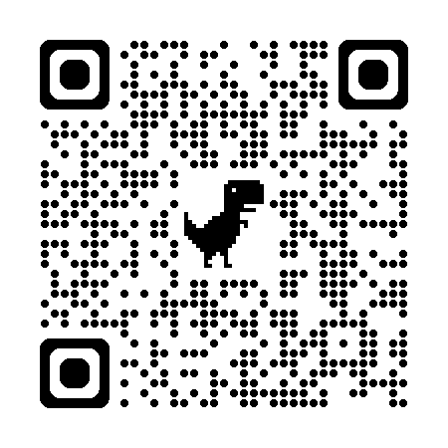
SP 17-2025: Reimbursement for
Off-Site Meal Consumption (continued)
Additional considerations
  Meals provided at the discretion of the school/SFA
  Must meet the meal pattern requirements
  Subject to especially stringent sanitary and precautionary measures to avoid contamination and spoilage
  Handling free and reduced applications and eligibility determination records
https://www.fns.usda.gov/schoolmeals/reimbursement-offsite-meal-consumption
Notes:
Schools have the option to provide meals for children who will be off site during the breakfast or lunch period, since SFAs are only required to make meals available to students who are present during the meal service period.
Meals taken off site must meet the meal pattern requirements and should be subject to especially stringent sanitary and precautionary measures to avoid contamination and spoilage.
Students applying for free or reduced price meals should do so through their home-base school since that school would be more familiar with their individual circumstances. If the work-study school is serving and claiming the meals, it should obtain, for its records, a copy of the eligibility determination (i.e., free and reduced price meal application or direct certification documentation) for students. In all cases, care must be taken to ensure that accurate detailed records are maintained, including meal counts for free, reduced price, and paid categories.
Next, we’ll review another recent USDA Policy Memo.

Slide 50
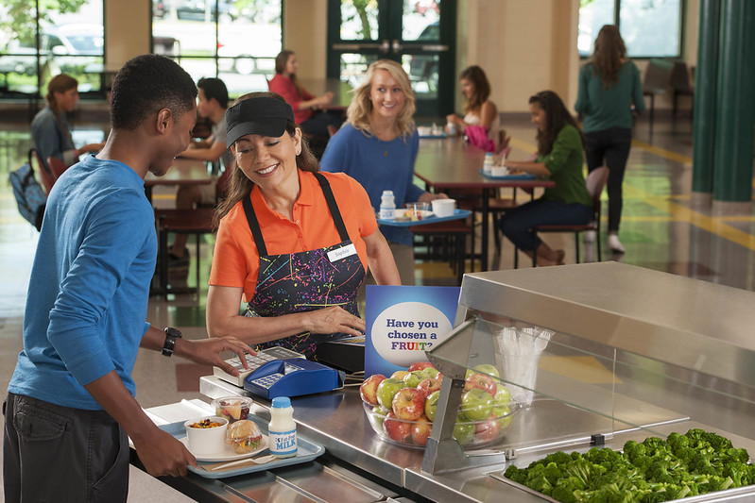
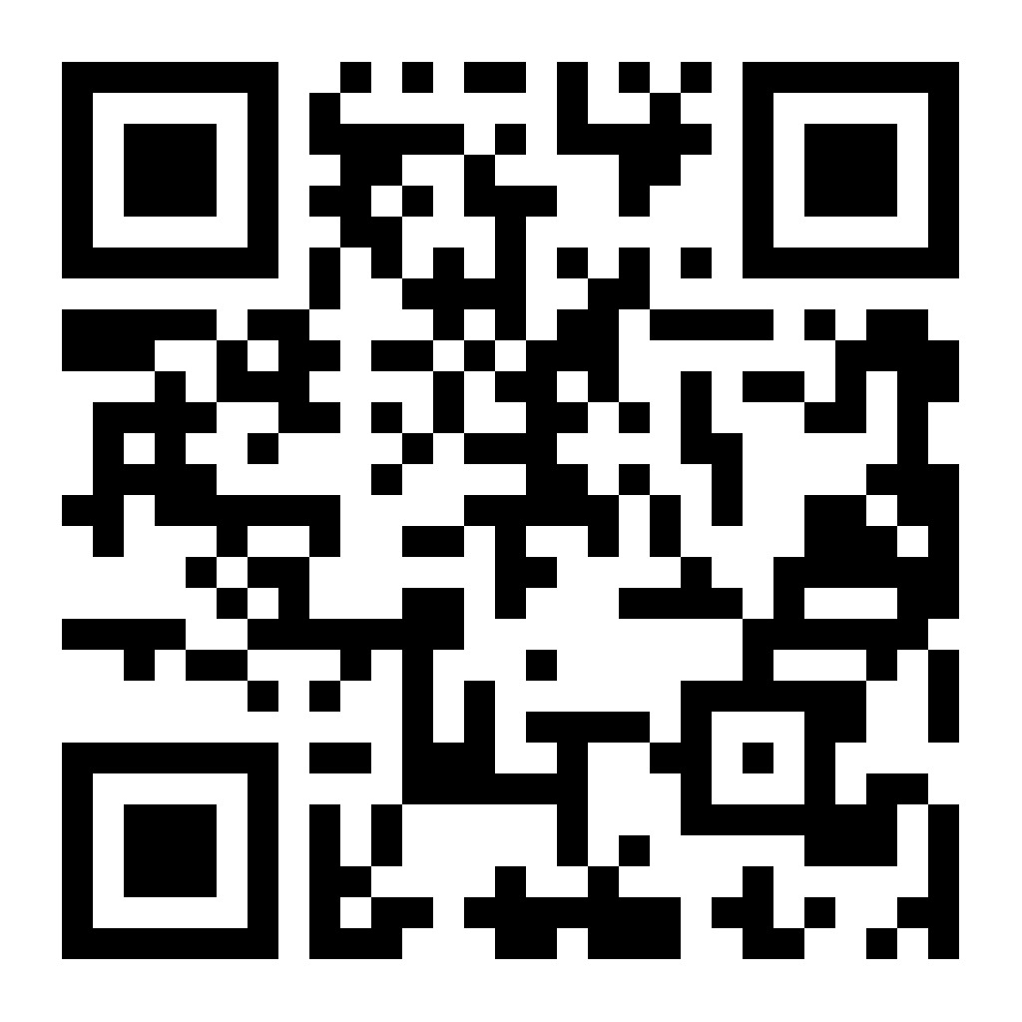
SP 18-2025: Fees for Electronic Payment Services in SMP
Published July 11, 2025
Requirements and Best Practices
More information available at:
https://www.fns.usda.gov/schoolmeals/guidance-fees-electronic-payment-services
Notes:
On July 11, 2025, the USDA updated rules for schools that let parents/guardians pay for their student’s school meals using an online payment system.
Some online payment systems charge electronic payment fees when parents/guardians add money to their student’s meal account using online payment systems.
The important requirements to be aware of are:
1. Schools can charge fees for electronic services (like online payments) to add money to student meal accounts. However, this is only allowed if the school also offers a free and easily accessible way for parents/guardians to add money to these accounts, like sending cash or checks to their student’s school.
2. Schools must clearly tell families all the ways they can pay for their students’ meals and any electronic payment fees that might apply to pay for their students’ meals if the parents/guardians choose to utilize an online payment system.
3. The information about how to provide payment to a student’s meal account should be shared on the school website, in emails, on menus, and when your student’s account is running low on funds.
Other noteworthy items to consider:
1. It’s a good idea for schools to try not to charge any electronic payment fees to place money on a student’s meal account.
2. If there are electronic payment fees, paying with a bank account usually costs less than using a credit card. You can check with your software provider to ask if this type of electronic payment is allowable in their system.
Schools can also use special funds or donations to help cover electronic payment fees. Covering the cost of electronic payment fees for parents/guardians to use an online payment system is an allowable cost to the nonprofit school food service account.
3. Schools can also use special funds or donations to help cover electronic payment fees. Covering the cost of electronic payment fees for parents/guardians to use an online payment system is an allowable cost to the nonprofit school food service account.
More details on SP 18-2025 is provided online at the link or QR code available on the bottom of the slide.
Next, we will spend some time reviewing a few reminders and clarifications on the guidance we provided last spring on the USDA Final Rule on Meal Patterns Consistent with the 2020-2025 Dietary Guidelines for Americans.

Slide 51
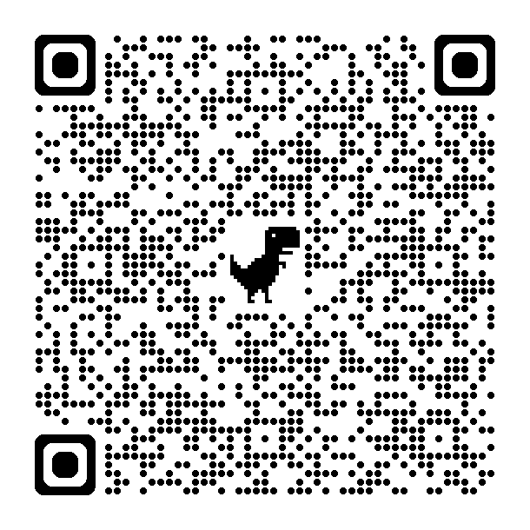
USDA Child Nutrition Final Rule:
Meal Patterns Consistent with the 2020-25 DGAs
Released April 2024
https://www.dpi.nc.gov/districts-schools/district-operations/school-nutrition/information-resources-subject/menu-planning-production-school-meals#MealPatterns-6870
Notes:
Now we will take a few minutes to share review some key changes in meal pattern guidance and clarify some of the regulations. For more information and resources about the Final Rule, please visit our website by following the URL or QR code shown on this slide.

Slide 52
Meal Pattern Final Rule – In Effect Now
July 1, 2025 (already in effect)
  Added sugars (product-based) – cereal, yogurt, milk, fluid milk substitute exception
  Flavored milk
  Whole grain rich weekly minimum
  M/MA at breakfast flexibility
  Substituting vegetables for grains and indigenous foods (tribal communities) flexibility
  Substituting vegetables for fruits at breakfast – subgroups flexibility
  Nuts and seeds flexibility
  Beans, peas, and lentils as M/MA flexibility
  Bean dip exemption – Smart Snacks and competitive foods
  ASSP meal pattern updates
Notes:
This list summarizes the general areas impacted by the new Meal Pattern Final Rule that are currently in effect as of July 1, 2025.
[Read through slide]
You should have already made changes where necessary to ensure you’re in compliance with the updated regulations for this school year. We reviewed the changes in detail during our last Policy Updates meeting in the spring.

Slide 53
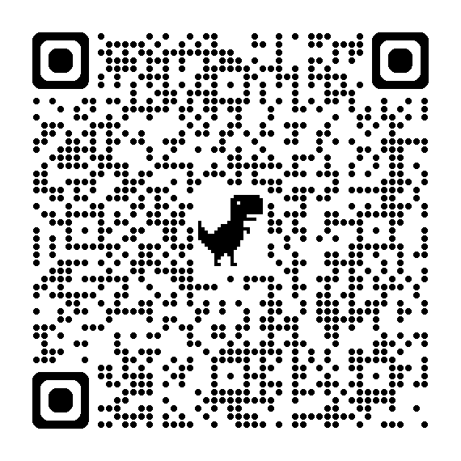
Meal Pattern Final Rule – Starting SY 27-28
July 1, 2027 (later, but start planning now!)
  Added sugars – weekly limit
  Average weekly sodium limit reduction
Review our resource on the Final Rule:
https://www.dpi.nc.gov/documents/schoolnutrition/summaryfinal-rule-meal-patternsconsistent-w2020-25-dietary-guidelines-americans/download
Notes:
There are some additional changes coming up in school year 2027-2028 that you’ll want to start preparing for now. These include a weekly limit for added sugars and an average weekly sodium limit reduction.
Again, we strongly encourage you to start planning for these changes now. We also plan to provide training on this topic at the spring policy updates, tentatively held in the last week of April (April 27-May 1).
To review a summary of the Final Rule regulations, please visit our website using the link shown on the screen or by scanning the QR code.

Slide 54
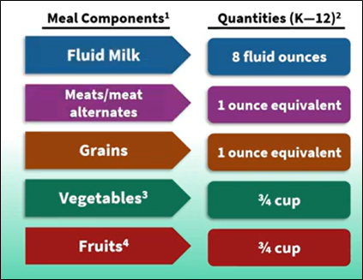
NSLP Afterschool Snack Program [UPDATED]
Implementation Date: July 1, 2025
Must serve 2 out of the 5 components
No more than half of the weekly fruit and vegetable offerings in NSLP snacks can be juice
Added sugar requirements for all snacks apply
  No more than 6 grams of added sugars per 1 oz dry cereal
  No more than 12 grams of added sugars per 6 oz yogurt
Grain-based desserts do NOT count towards the grain requirement
Milk can be flavored or unflavored, skim or 1%
Notes:
You may recognize this slide from the spring Policy Updates meeting. We have updated it with additional clarification related the sugar requirements for snacks served in the NSLP Afterschool Snack Program.
Specifically, cereal can have no more than 6 grams of added sugars per dry ounce. Yogurt can have no more than 12 grams of added sugars per 6 ounces. The updated language is indicated by the blue arrow.

Slide 55
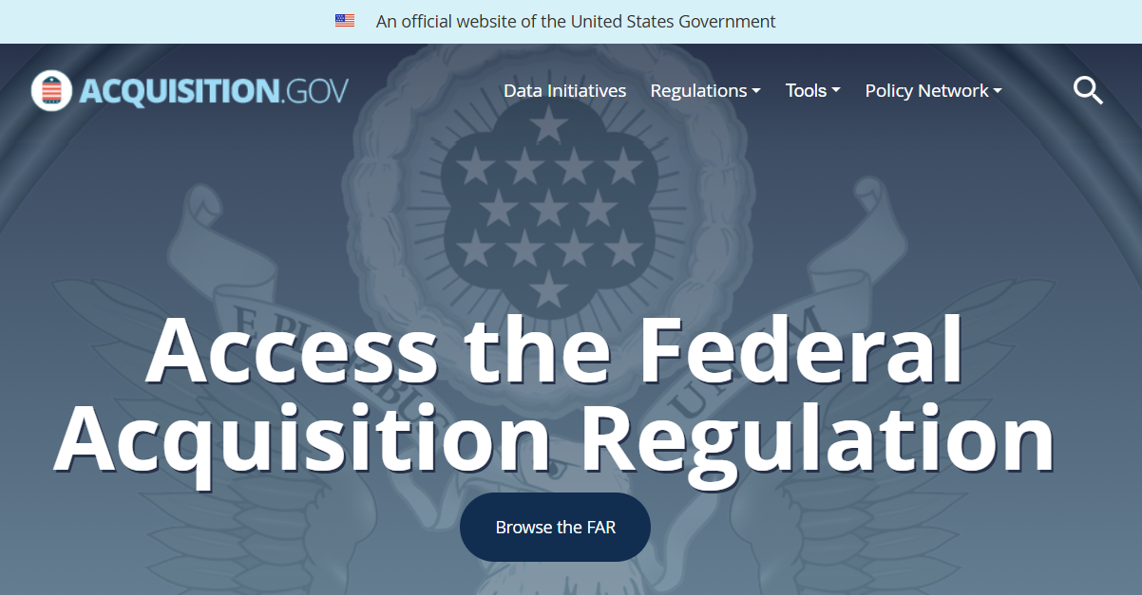
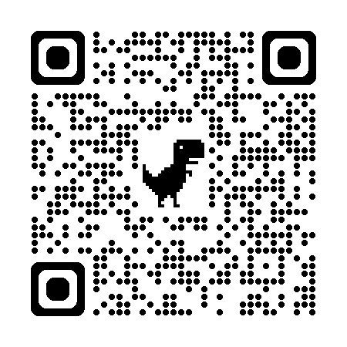
Buy American in Meal Pattern Final Rule – SBP, NSLP
Implementation Date: July 1, 2025
Reasons why an SFA may purchase non-domestic foods:
  Competitive bids reveal the cost of the US product is significantly higher
    SFA chooses what is considered "significantly higher"
  FAR 25.104 Nonavailable Articles List
    Bananas
    Canned mandarin oranges
    Canned grapefruit sections
    Canned pineapple
    Bulk herbs and spices
    Olive oil
https://www.acquisition.gov/far/25.104?searchTerms=nonavailable%20articles
Notes:
Here is a reminder of the Buy American provision in the final rule that requires nondomestic food items to not exceed 10% of the total commercial food purchases. This final rule was implemented in July 1, 2025. There are a few reasons why SFAs may not purchase a nondomestic product. The first reason is that competitive bids reveal that the cost of the US product is significantly higher than the domestic product. You will need to document the cost difference. Another reason why you may choose a nondomestic product is if it's included in the FAR 25.104 Nonavailable articles list. We have listed the most common items found on school nutrition menus that are also on the FARS list.
Scan the QR code or visit the URL on the screen to review the FAR 25.104 Nonavailable Articles List.

Slide 56
Buy American – Non-Domestic Food Cap
Implementation Date: July 1, 2025
  10% cap on total commercial food costs for the entire school year on non-domestic food items
Implementation Date: July 1, 2028
  8% cap on total commercial food costs for the entire school year on non-domestic food items
Implementation Date: July 1, 2031
  5% cap on total commercial food costs for the entire school year on non-domestic food items
Notes:
Here is a reminder of the timeline for the non-domestic cap changes. Currently, if you have not submitted an accommodation (which we will cover again in just a few minutes), then you need to be documenting that you have not spent more than 10% of your total commercial food costs for the entire school year on nondomestic food items. That changes to 8% on July 1, 2028, and 5% on July 1, 2031. We have received limited guidance from USDA on how to determine this non-domestic cap. NCDPI requested additional information about the documentation process for both the SFA and state agency in August. USDA has not provided a response.

Slide 57

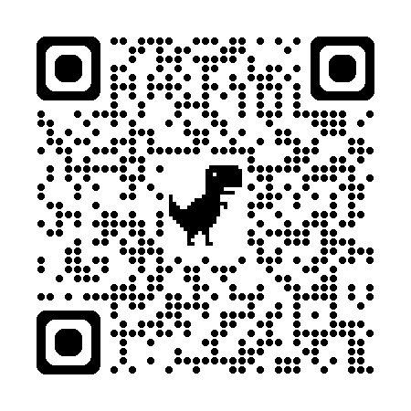
Buy American – Documentation Required
Must document all exceptions in Buy American except if the item is found in FAR 25.104
  Food items purchased and listed in FAR 25.104 must count towards the non-domestic cap
Documentation will be reviewed during the AR process
USDA tracking tool
https://www.fns.usda.gov/cn/buy-american-provisions
Notes:
Image: PowerPoint Stock Photos
All we know so far is that we must document all exceptions in the Buy American final rule provision. This includes only exceptions based on price of the nondomestic vs domestic item since the items found on the FAR 25.104 list are already exempt. However, the items on the FAR list MUST COUNT towards the non-domestic cap.
The documentation for the exceptions identified by the SFA due to cost and the documentation of the FAR 25.104 list will be reviewed during the AR process. For the 2025-2026 school year, if the SFA does not meet the 10% non-domestic cap and does not have an accommodation in place, the corrective action will be to complete the accommodation process. There is also a USDA tracking tool available on their website to help. The QR code will take you to that tool within the final rule guidance.

Slide 58
Buy American – Additional Final Rules
The Buy American provision should be included in all procurement procedures
Definition of "substantially"
  Substantially using agriculture commodities that are produced in the United States means over 51% of a food product must consist of agricultural commodities that were grown domestically
Farmed Fish must be harvested within the US
Wild caught fish must be harvested within the Exclusive Economic Zone of the US by a US flagged vessel
Notes:
The Buy American provision should be included in all procurement procedures, as it normally would. The Buy American final rule did define "substantially using agriculture commodities" as food items that are produced in the US and over 51% of a food product must consist of agricultural commodities that were grown domestically. The definition of "American" for farmed fish means that the fish were harvested within the US. And the definition of "American" for wild caught fish means that the fish must have been harvested within the Exclusive Economic Zone of the US by a US flagged vessel. Your food supplier is aware and should be knowledgeable about these definitions.

Slide 59

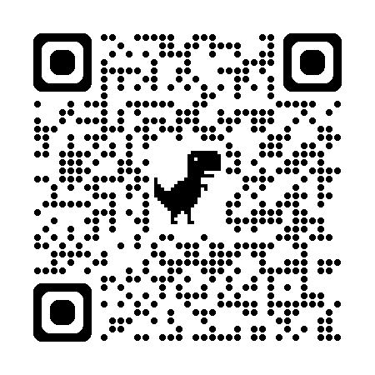
Buy American – Accommodation Process
Received by the state agency on February 20, 2025
Memo Code: SP 09-2025
Temporary relief for SFAs that demonstrate they cannot meet the thresholds for non-domestic food purchases
https://www.fns.usda.gov/schoolmeals/buy-american-accomodation
Notes:
Starting July 1, 2025, unless the school food authority has completed an accommodation request for this requirement from NCDPI, no more than 10% of commercial food purchases can be nondomestic including items found on the FARS 25.104 list. This includes all commercial food purchases but does not include any USDA food items that are not processed (eg. USDA foods not diverted for further processing). NCDPI is still waiting for further guidance from USDA regarding food items diverted for further processing and whether those items must be counted as nondomestic or domestic.
NCDPI has enacted the accommodation process as outlined by USDA. Scan the QR code or visit the URL on the screen to review USDA Policy Memo SP 09-2025.

Slide 60
Buy American Accommodation Process for SY 2025-2026 (SP09-2025)
Temporary relief for demonstrating inability to meet non-domestic thresholds (10% cap)
A temporary accommodation for the threshold requirement is only available for non-domestic purchases that qualify under one or more of the regulatory exceptions (cost and/or availability)
Application/form to complete (SFA Accommodation Plan SY 2025-2026)
Notes:
(Speaker notes below from https://www.fns.usda.gov/schoolmeals/buy-american-accommodation)
The accommodation process provides the state agency the ability to approve temporary relief for school food authorities (SFAs) that demonstrate they cannot meet the thresholds for non-domestic food purchases established in 7 CFR 210.21(d)(5) and 7 CFR 220.16(d)(5).
The USDA FNS is aware that there are concerns about certain products which are integral to school meals menus and the program’s nutrition standards that may be difficult to procure domestically. These products include cereals and fruit juices as well as popular fruits and vegetables. The availability of these foods provides students familiar options they enjoy both at school and home and support an exceptional level of customer service in the school meal programs.
The accommodation will allow SFAs to exceed the 10 percent threshold. A temporary accommodation for the threshold requirement is only available for non-domestic purchases that qualify under one or more of the regulatory exceptions (cost and availability). Let's walk you through the accomodation process if you haven't completed it already.

Slide 61
Buy American Process Form Questions (part 1)
Please select all categories of food that require an accommodation from the threshold requirement (i.e., exceeding the 10%):
  Fruit
  Vegetables
  Fruit/Vegetable juices
  Cereals
  Other (please specify)
Notes:
First, select ALL food categories for which you are requesting an accommodation for the 10% threshold requirement.

Slide 62
Buy American Process Form Questions (part 2)
Please select all that apply for reasons for the accommodation from the threshold requirement:
  Timing of procurement cycle
  Student preference/anticipated participation impacts
  Items that help meet meal standards
  Items that facilitate meal service models (e.g. grab n’ go, Breakfast in the Classroom)
  Other, please describe
Please briefly describe the anticipated timeline to make modifications to meet the Buy American requirements (this could include timing of calculating the baseline percentage of non-domestic food purchases (or include the baseline percentage if available), obtaining documentation, and balancing the accommodation and exception process with making menu changes).
Notes:
Next, select ALL reasons for needing an accommodation(s).
Last, briefly describe the anticipated timeline you’ll need to meet the Buy American requirements. This could include:
timing of calculating the baseline percentage of non-domestic food purchases (or include the baseline percentage if available),
obtaining documentation, and
balancing the accommodation and exception process with making menu changes.
Your distributors should be providing documentation to support the timeline and response to the last question, which we will talk about next.

Slide 63
SY 2025-2026 Buy American Accommodation Process for NC
STEP 1: Obtain a velocity report from your SFA’s primary food and produce distributor(s).
STEP 2: Complete the Microsoft Form, which will be sent to you by your Service Area Consultant. Upload your velocity report to the Microsoft Form.
Notes:
The process for requesting Buy American Accommodations for School Year 2025-2026 in North Carolina will consist of two primary steps:
Step 1 will be to obtain a velocity report from your primary food and produce producer.
The next step – Step 2 – will be to complete a Microsoft Form on the next screen via the QR code and upload your velocity report as part of completing this online form.
If you have any questions about this process and obtaining your velocity report, please contact your School Nutrition service area consultant.

Slide 64
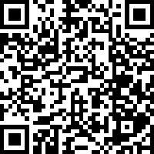
SY 2025-2026 Buy American Accommodation Process - Survey
https://ncdpi.az1.qualtrics.com/jfe/form/SV_dd1ZSRuQdPjh6AK
Notes:
If you have not already done so, please complete the Buy American Accommodation Process survey for this school year unless you have determined you meet the 10% non-domestic threshold. This will be reviewed as part of the Administrative Review process.

Slide 65
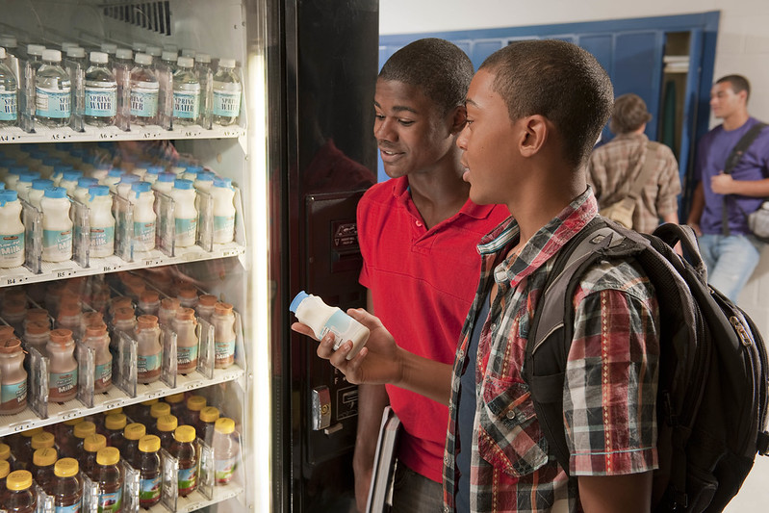
Smart Snacks/Competitive Foods Findings
Previous Practice
Findings labeled as “Competitive Foods”
Fiscal action for violations
New Practice
No regulatory changes
Findings labeled as “Smart Snacks” violations
Technical assistance and corrective action for violations
  Fiscal action removed
Notes:
There are some updates regarding competitive foods. Previously, the term “competitive foods” was used when foods or beverages were sold to students during the school day, from 12:01am to the end of the last lunch period.
When such findings occurred, fiscal action was taken against the school site, not the SFA.
Under the new state agency practice, regulatory requirements have not changed, all previous regulations still apply. The only changes are in the terminology and the approach to corrective action.
Going forward, instead of referring to “competitive foods findings,” the term Smart Snack violations will be used. Importantly, with Smart Snack violations, fiscal action will no longer be applied. However...... (go to the next slide)

Slide 66
Smart Snacks/Competitive Foods Findings (continued)
Fiscal action will no longer be applied to Smart Snacks (competitive foods) violations.
However, repeat violations could result in the withholding of claim reimbursements.
Notes:
Although, fiscal action will no longer be applied to smart snack/competitive foods findings, repeat violations could result in the withholding of claim reimbursements.

Slide 67
What is Digital Accessibility?
Design and development of digital content, applications, and services that are usable by all people, including those with disabilities
Ensures that websites, mobile apps, electronic documents, and other digital tools are accessible to individuals who may use assistive technologies such as screen readers, magnifiers, or alternative input devices
Notes:
Digital accessibility refers to the design and development of digital content, applications, and services that are usable by all people, including those with disabilities.
It ensures that websites, mobile apps, electronic documents, and other digital tools are accessible to individuals who may use assistive technologies such as screen readers, magnifiers, or alternative input devices.

Slide 68
Why is Digital Accessibility Important?
Equal Access:
  Promotes inclusivity through equal access to info and services for people with disabilities
  Ensures everyone can participate fully in the digital world
Compliance:
  Required by Title II of the Americans with Disabilities Act and Section 504 of the Rehabilitation Act to provide equal access to services, activities, and programs for state and local governments, including K-12 public schools
    Public entities with a total population > 50,000: Compliance start date: April 24, 2026
    Public entities with a total population < 50,000: Compliance start date: April 26, 2027
    North Carolina PSU Compliance Start Dates
Enhanced User Experience:
  Leads to improved usability for all users, not just those with disabilities
Notes:
Equal Access: Digital accessibility promotes inclusivity by providing equal access to information and services for people with disabilities. It ensures that everyone can participate fully in the digital world.
Compliance: Title II of the Americans with Disabilities Act and Section 504 of the Rehabilitation Act require that state and local governments, including K-12 public schools, provide equal access to services, activities, and programs.
Compliance Dates:
Public entities with a total population > 50,000: Compliance start date: April 24, 2026
Public entities with a total population < 50,000: Compliance start date: April 26, 2027
Note: The link to compliance start dates for North Carolina Public School Units is included on the slide.
Enhanced User Experience: Accessible design often leads to improved usability for all users, not just those with disabilities. For example, features like captions, alt text, and clear navigation can benefit everyone.

Slide 69
Who is Responsible for Digital Accessibility?
Everyone involved in the creation, management, procurement and maintenance of digital content (web content/pages, documents, multimedia, software applications, online forms) holds responsibility for ensuring digital accessibility
Collaborative effort that requires awareness and commitment from all stakeholders to make digital environments inclusive
Notes:
Everyone involved in the creation, management, procurement and maintenance of digital content holds responsibility for ensuring accessibility. This includes web developers, designers, content creators, project managers, and educators. It is a collaborative effort that requires awareness and commitment from all stakeholders to make digital environments inclusive.

Slide 70
What Accessibility Resources are Available?
NCDPI Digital Accessibility Dashboard – Regulations, Resources and Training
Resources/Webinar Series for Public School Units
Resources/Webinar Series for Vendors
Digital Accessibility Community of Practice (CoP)
  Brief professional learning spotlight followed by collaborative discussion and strategy sharing
  First Wednesday of each month, 1-2 PM
Digital Accessibility CoLab
  Open space for collaborative problem solving and TA for accessibility challenges
  Third Wednesday of each month, 9-10:30 AM
Notes:
Donna Murray, Digital Accessibility Specialist with NCDPI, has created a Digital Accessibility Dashboard with information about the regulations and requirements, resources and training. It is tailored to whether you are new to accessibility, have knowledge or experience and/or are in charge of accessibility for your district.
The dashboard includes resources and a webinar series for public school units.
It also includes resources and a webinar series for vendors. Remember: vendors that School Nutrition Programs work with for online menus, newsletters, social media, etc. must provides materials that are digitally accessible.
Links to the Digital Accessibility Dashboard is included on the slide. You can bookmark these links. Also, a quick internet search for NCDPI Digital Accessibility Dashboard will get you to the correct site.
Two ongoing, interactive co-learning opportunities are available monthly.
The Digital Accessibility Community of Practice is open to State and Local Government and Education Agency staff. The Community of Practice sessions offer a brief professional learning spotlight followed by a collaborative discussion and strategy sharing. It occurs the first Wednesday of each month, 1-2 pm.
The Digital Accessibility CoLab is an open space for collaborative problem solving and TA for accessibility challenges. It occurs the third Wednesday of each month, 9-10:30 am.
Links to access/sign up for both are offered on the slide.

Slide 71
Monitoring and Compliance
Onsite Review and Self-Assessment update
Notes:
Now we’ll review a few short monitoring and compliance updates and reminders.

Slide 72

On-Site Reviews Due Date
(for Traditional Public Schools and RCCIs)
February 1st On-site Reviews due for traditional public schools and RCCI’s (7 CFR 210.8(a)(1))and (7 CFR 220.11(d)(1))
Each school operating the NLSP and 50% of schools operating in the SBP (7 CFR 210.18(h))
  Each school approved to participate in the SBP must be reviewed at least once every two years.
Corrective Action Plan > 45 day follow up
Extensions for the due date will NOT be granted per FNS guidance.
Notes:
On-site reviews for traditional public schools and RCCIs are due annually on February 1. On-site reviews must be conducted for each school operating NSLP and 50% of schools operating SBP. However, don’t forget that each school approved to operate SBP still must be reviewed at least once every two years. This means if you don’t review them this year, you’ll need to review them next year.
This is an important change – extensions for the February 1 due date WILL NOT BE GRANTED. This is a requirement per USDA FNS guidance. Plan ahead to complete all on-site reviews well before the due date. [Presenter note – repeat this again!] It is essential to start conducting your reviews NOW and not wait until shortly before these reports are due to be completed. This also allows for time to correct areas where refinement is needed.
Corrective action plans or CAPs are due within 45 days of the follow up.

Slide 73



Self-Assessment Reviews Due Dates
(for Charter and Non-Public Schools)
November 1st & April 1st Two (2) Self Assessments due for charter and non-public schools
Corrective Action Plan > 45 day follow up
Extensions for the due date will NOT be granted per FNS guidance.
Notes:
Charter and non-public schools have slightly different monitoring requirements.
Charter and non-public schools must complete two self-assessment reviews that are due on November 1 and April 1st annually. Like for traditional schools and RCCIs, extensions for these two due dates WILL NOT BE GRANTED. This is a requirement per USDA FNS guidance. Plan ahead to complete all on-site reviews well before the due date. [Presenter note – repeat this again!] It is essential to start conducting your reviews NOW and not wait until shortly before these reports are due to be completed. This also allows for time to correct areas where refinement is needed.
Corrective action plans or CAPs are also due within 45 days of the follow up for the self-assessment reviews.

Slide 74
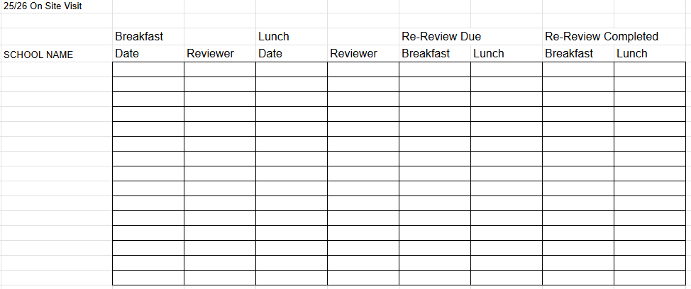
Sample Form – Onsite Review/Self Assessment Tracking
Form developed by Stokes County School Nutrition
Notes:
This shows a sample form developed by Stokes County School Nutrition for tracking completion of onsite reviews. It could also be used for tracking completion of self-assessments. Utilizing a tool to track required monitoring is a best practice.
Additional columns can be added for notes, Corrective Action Plan (CAP) follow up due dates, and whether a Corrective Action Plan is needed. As a reminder, Corrective Action Plans must be completed within 45 calendar days. A column to indicate if no Corrective Action Plan is needed may be added to help keep up with compliance especially for SFAs that have multiple school sites to review and monitor.

Slide 75
Verification
Updates for School Year 2025-2026
Notes:
Next, we will share some updates and reminders for verification for school year 2025-2026.

Slide 76
Verification Dates for 2025-2026
1 Oct.
Verification begins
17 Nov.
Verification ends
*November 15 falls on the weekend
18 Nov.
Verification Collection Report opens in the SN Technology System (SNTS)
Begin tracking households not responding
Verification survey sent to SFAs -complete by November 27
8 Dec.
Final day to complete Verification Collection Report in SNTS
16 Feb.
Tracking ends for households that did not respond initially
19 Feb.
Survey open to report the non-response changes
1 Oct.
  Verification begins
17 Nov.
  Verification ends
    *November 15 falls on the weekend
18 Nov.
  Verification Collection Report opens in the SN Technology System (SNTS)
    Begin tracking households not responding
    Verification survey sent to SFAs -complete by November 27
8 Dec.
  Final day to complete Verification Collection Report in SNTS
16 Feb.
  Tracking ends for households that did not respond initially
19 Feb.
  Survey open to report the non-response changes
Notes:
These are your important verification dates for 2025-2026. They are also posted on our website.
Wednesday, October 1, 2025 (Verification Begins)
Monday, November 17, 2025 (Verification ends – November 15 falls on the weekend this year, so we move to Monday following the 15th)
Tuesday, November 18, 2025 (Survey starts and the Verification Collection Report is opened to SFAs) Verification Report is required to be completed by all SFAs.
Monday, December 8, 2025 (The Verification Collection Report is closed to SFAs)
Monday, February 16, 2026 (Date to end the tracking for those who responded after verification)
Thursday, February 19, 2026 (Report due to State Agency on the number that did not respond to verification until after the period ended through February 16, 2026)

Slide 77
Online Verification Report Opens
On Tuesday, November 18, 2025:
Online Verification Collection Report opens in SNTS
AND
Online survey sent to SFAs for reporting to State Agency that verification has been completed
October 1 - Verification begins
November 17 - Verification ends
November 18 - Online Verification Collection Report opens AND online survey to SFAs
October 1 - Verification begins
November 17 - Verification ends
November 18 - Online Verification Collection Report opens AND online survey to SFAs
Notes:
Verification ends on November 17 this year, since the 15th falls on a weekend.
Two things will happen on Tuesday, November 18:
• a brief online survey will be sent only to determine if the verification process has been completed
•November 18 is also the date the Verification Collection Report is opened to all SFAs. Since the process is so fresh on your mind, we encourage you to complete this report immediately after the closing deadline.

Slide 78
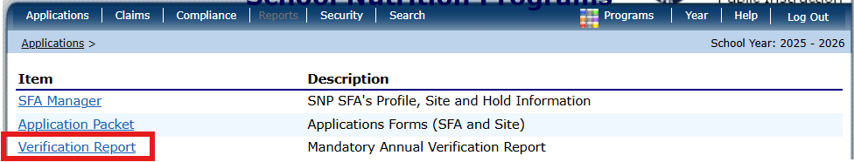
Verification Collection Report (FNS 742)
Students directly certified as Medicaid Free must be included in reporting
Student data cannot include the Medicaid Reduced students
Section 3 – Include the number of students directly certified with Medicaid for Free Meals (along with other direct certifications).
Section 4 - must only include counts of students certified for Free and Reduced via an application
Students directly certified as Medicaid Free must be included in reporting
Student data cannot include the Medicaid Reduced students
Section 3 – Include the number of students directly certified with Medicaid for Free Meals (along with other direct certifications).
Section 4 - must only include counts of students certified for Free and Reduced via an application
REQUIRED FOR ALL SFAS
Notes:
The verification collection report must be completed in SNTS by ALL SFAs regardless if they are not collecting Free and Reduced applications and conducting verification. Instructions for completing this report will be sent in the group email sent to all.
To complete the report, here are a few reminders:
If a child is directly certified as Medicaid Free (MF) on the direct certification list, the child (and all applicable children in the household) must be included in the Verification Collection Report.
•For this report, the student data cannot include the Medicaid Reduced (MR) students.
•In Section 3, follow the current instructions for all questions. In 3-3, include the number of students directly certified with Medicaid for Free meals (along with other direct certifications for FREE with programs other than SNAP). Do not include the counts of students directly certified with Medicaid for reduced price in any count in Section 3.
•Section 4 must only include counts of students certified for Free and Reduced via an application. Do not include the counts of any students directly certified with any program (including Medicaid) for Free or Reduced-price meals.
For SFAs fully operating CEP complete:
•Section 1 – list total number of schools and students
•2-3: enter the number of sites operating CEP and students at those sites
•Check the box in 3-1
•Check the box in 5-1 that you are exempt from verification
•Save the report at the bottom and the Verification Collection Report is complete.
•

Slide 79
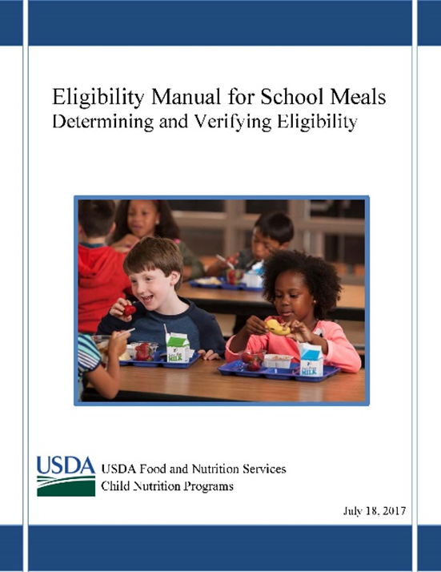
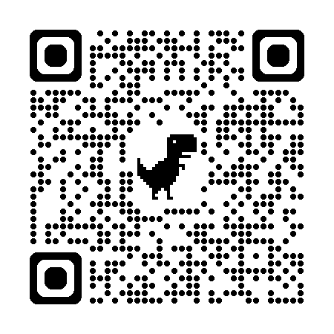
Recordkeeping
The SFA should maintain:
The Verification Plan
The approved verification selection method
The verification sample pool & sample size
Documentation of replaced files
The confirmation signatures or copies of applications
Selection letters
Second attempts made
Verification results letter and summary report
Refer to the USDA Eligibility Manual for additional guidance
Notes:
Documentation must be kept by the LEA to demonstrate compliance with the verification requirements when LEAs are reviewed by State or Federal reviewers including documentation concerning any appeals. LEAs must maintain a description of their verification efforts. The description must include a summary of the verification efforts including the selection process; the total number of applications on file on October 1 and the percentage or number of applications that are/will be verified by November 17. The LEA must also be able to demonstrate compliance with the confirmation review requirement and provision of a no-cost telephone number for assistance in the verification process.
The SFA should maintain:
The Verification Plan
The Approved Verification Selection Method
The Verification Sample Pool
The Verification Sample Size
The Replaced files (if applicable, not to exceed 5%)
The Confirmation signatures on the applications (copies of the applications are preferred)
The Selection Letters
The Second attempt (whether written or verbal)
The Verification Results letter.
The Verification Summary Report
Refer to the USDA Eligibility Manual for additional guidance. The most current version is from July 2017.

Slide 80

Verification questions?
Contact your Service Area Consultant or
Dana Edwards
Program Analyst dana.edwards@dpi.nc.gov
Notes:
If you should have questions pertaining to verification, please let us know. Your first contact is your Service Area Consultant, and you may contact Dana Edwards, Program Analyst that handles verification in the Raleigh office.

Slide 81
Outreach and Promotion Updates
Farm to School, NSLW, and NC Junior Chef
Outreach and Promotion Activity
Healthy Meal Incentive Awards
School Nutrition Update Newsletter
Notes:
Now we’ll share updates from our Outreach and Promotion section, including updates about Farm to School, National School Lunch week, NC Junior Chef, and the USDA Health Meals Incentive Awards. We will also discuss an updated plan for issuing the School Nutrition Update newsletter.
Get your thinking caps ready too, for a short activity and discussion around promoting your school nutrition program.

Slide 82
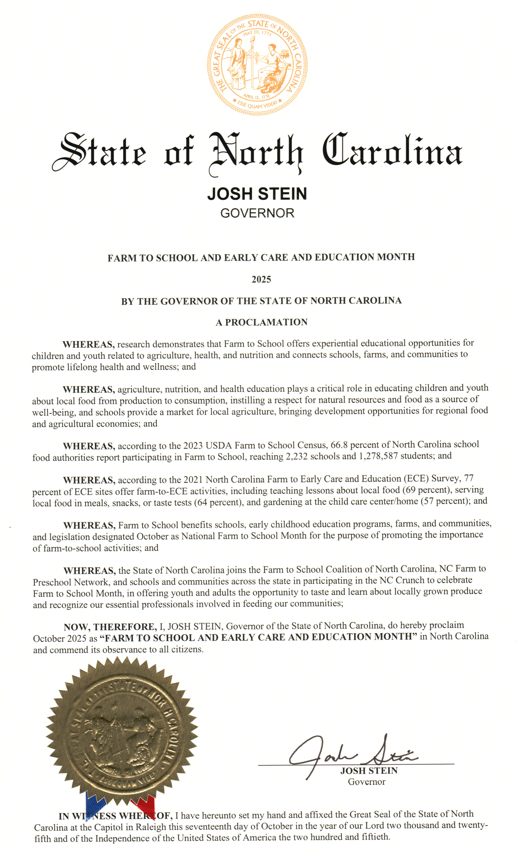

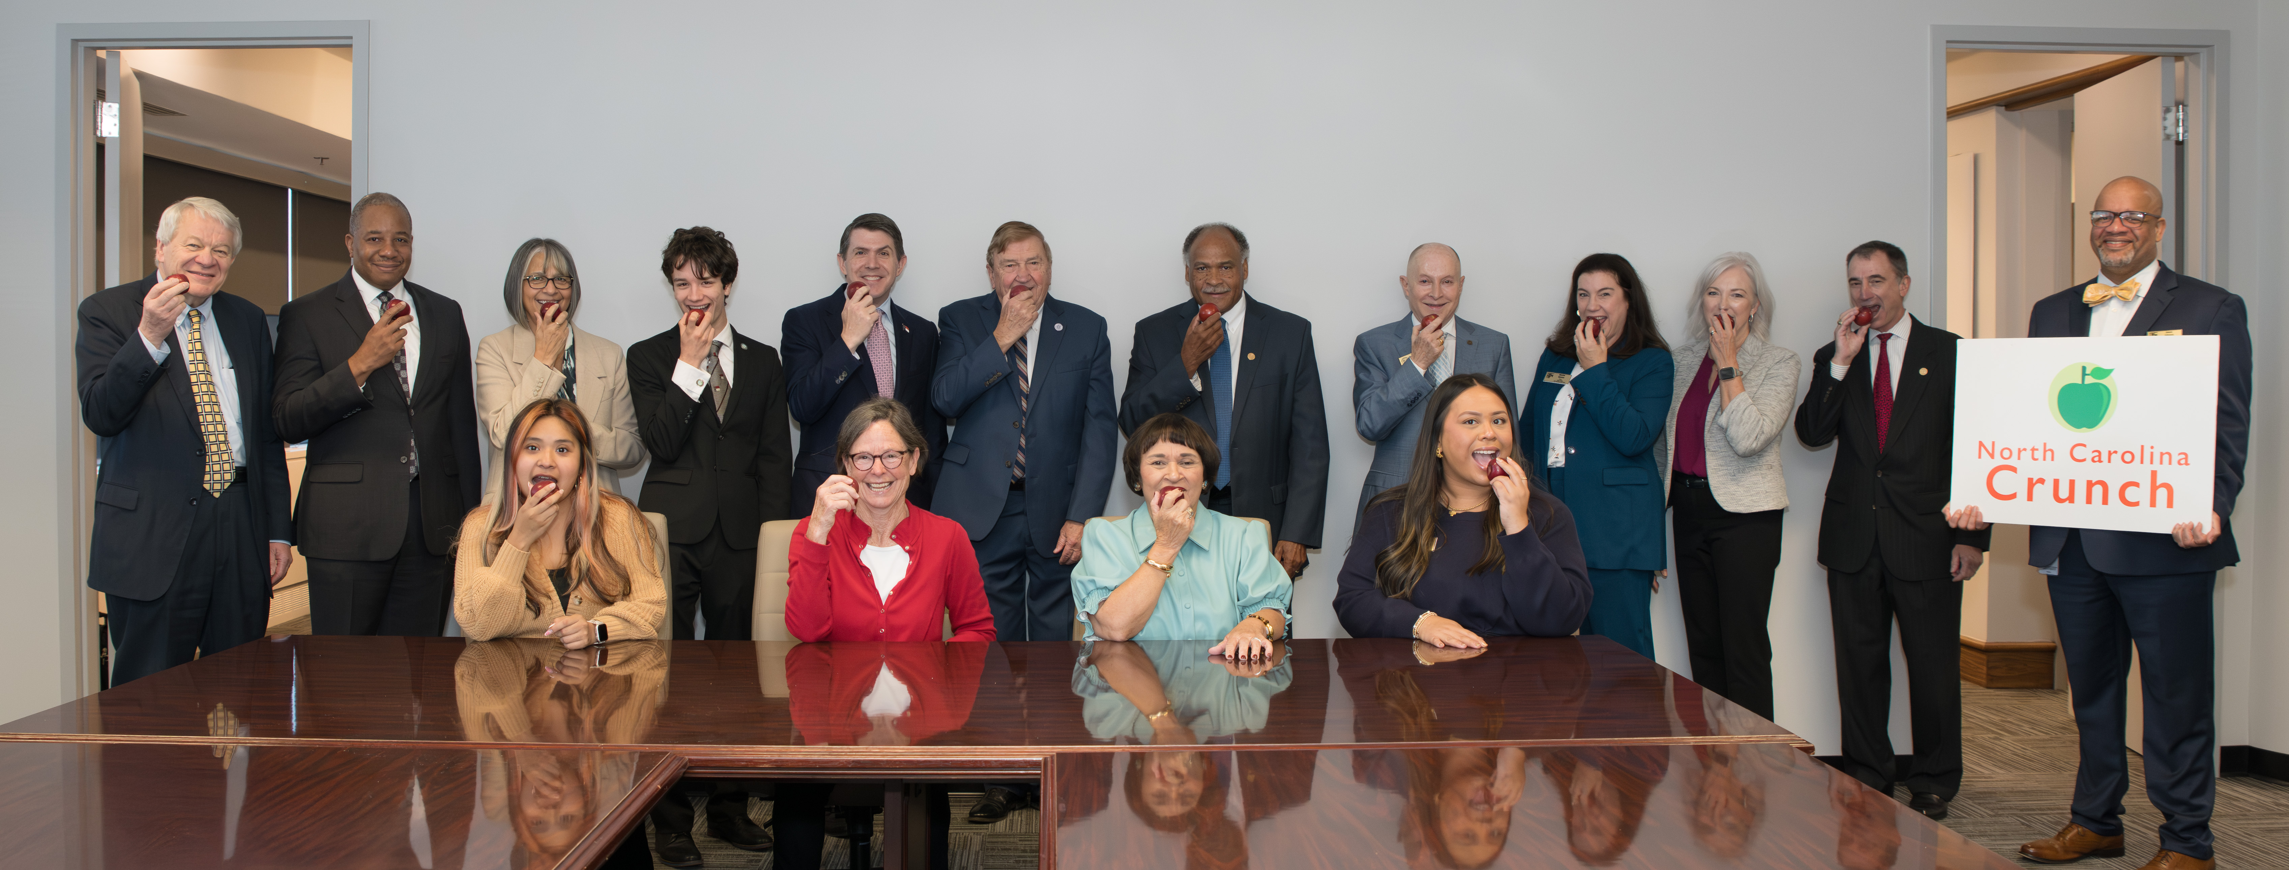
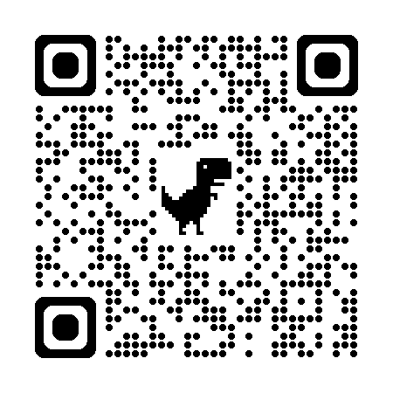
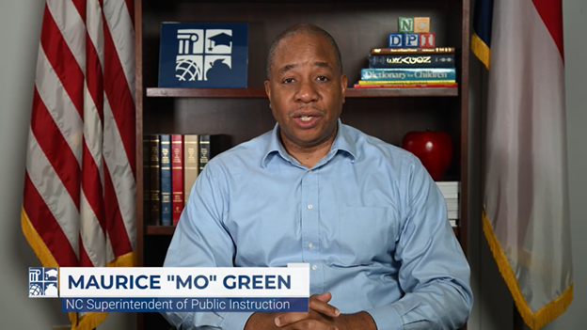
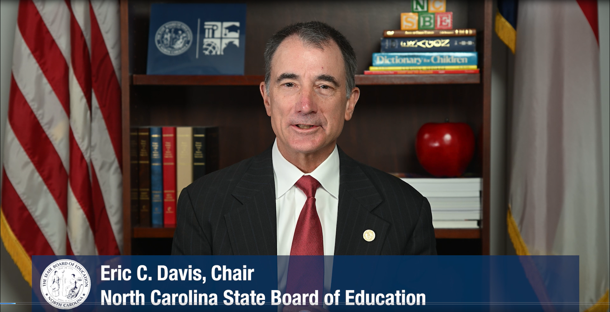
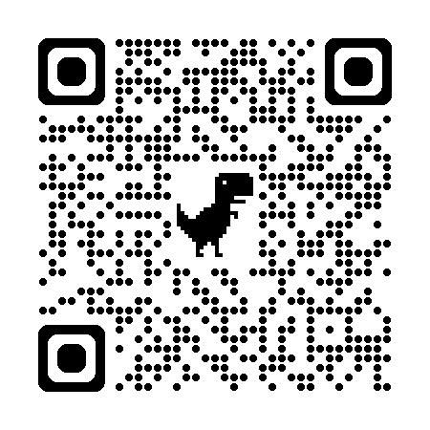
NSLW/Farm to School Month
Promotes the benefits of school lunch with National School Lunch Week, #NSLW 2025 – Taste the World: Your School Lunch Passport
Highlights local food procurement, school gardens and education with Farm to School Month
Learn more and find resources:
https://schoolnutrition.org
https://farmtoschool.org
Notes:
The second full week in October is National School Lunch Week. The 2025 theme was Taste the World: Your School Lunch Passport. Schools across the state enjoyed exploring a variety of foods and flavors from around the globe. More info and resources are available at schoolnutrition.org. You can also plan ahead for next year and look toward National School Breakfast Week.
Congress designated October as Farm to School Month. In North Carolina, the event is celebrated as Farm to School and Early Care and Education Month. NC Governor Stein issued a proclamation. The event is an opportunity to celebrate food education, school gardens and lunch trays filled with healthy, local ingredients in addition to all those involved in feeding our youth, families and communities. More info and resources are available at farmtoschool.org.
To recognize both National School Lunch Week and Farm to School Month and show their support for school meals and farm to school, State Superintendent Green and NC State Board of Education Chair Davis recorded video messages encouraging everyone to enjoy school meals, taste and enjoy NC-grown produce for the NC Crunch, celebrate National School Lunch Week and Farm to School Month and recognize our School Nutrition and Farm to School professionals. The NC State Board of Education also took a NC Crunch photo during their October meeting. In addition, farm to school has been highlighted through school and farm visits as part of the Achieving Educational Excellence strategic plan tour.

Slide 83

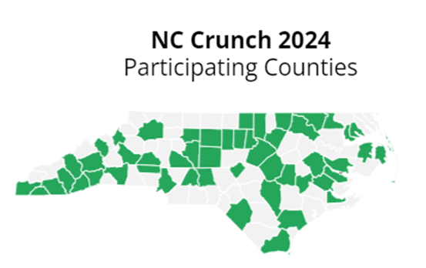



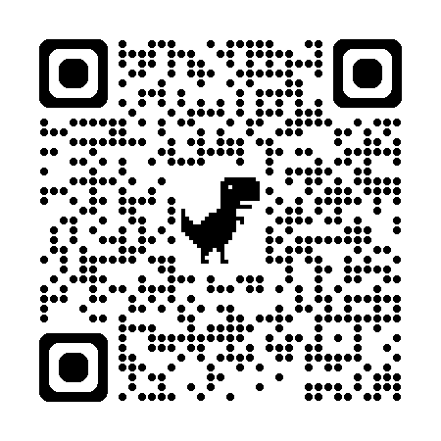
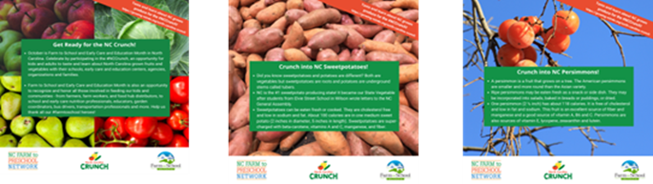
#NCCrunch
Thank a NC Farmer Day
November 6, 2025
https://www.ncfarmerappreciation.com
Encourages youth and adults to taste and learn about North Carolina grown produce for Farm to School Month
Promotes farm to school
Recognizes all those involved in producing, transporting, serving, preparing, teaching about, and promoting locally grown foods
Offers strategies, resources, templates, graphics and more
Help reach all 100 NC counties!
Learn more, register and access free resources:
https://growing-minds.org/north-carolina-crunch/
Share #NCCrunch photos and activities.
Tag @NCSchoolMeals.
Notes:
North Carolina celebrates Farm to School and Early Care and Education Month through the NC Crunch. Youth and adults and encouraged to taste and learn about NC-grown fruits and vegetables with their schools, early care and education sites, agencies, organizations, families and communities.
The event is an opportunity to increase awareness and engagement with farm to school, highlighting the importance of agriculture, nutrition and local food.
It is also an opportunity to recognize all those involved in producing, transporting, serving, preparing, teaching about, and promoting locally grown foods
The goal is to reach all 100 counties with NC Crunch participation. If you are planning to or have already offered NC-grown fruits and vegetables through school meals or snacks or NC Crunch activities, please complete the sign-up to share how many sites and people you plan to reach or did reach and where. The sign-up is available at https://growing-minds.org/north-carolina-crunch/. A quick internet search for NC Crunch will also get you to the info. The sign-up takses 5 minutes or less. Once you complete the questionnaire, you gain access to a free guide with tips and resources, the logo, sticker template, signage, flyer, social media graphics and more.
Share your photos and activities on social media using the hashtag #NCCrunch. Don't forget to tag @NCSchoolMeals.
Please know that "Thank a NC Farmer Day" is coming up November 6. This annual recognition event was established last year by the NC General Assembly. More info and resources are available at ncfarmerappreciation.com.

Slide 84
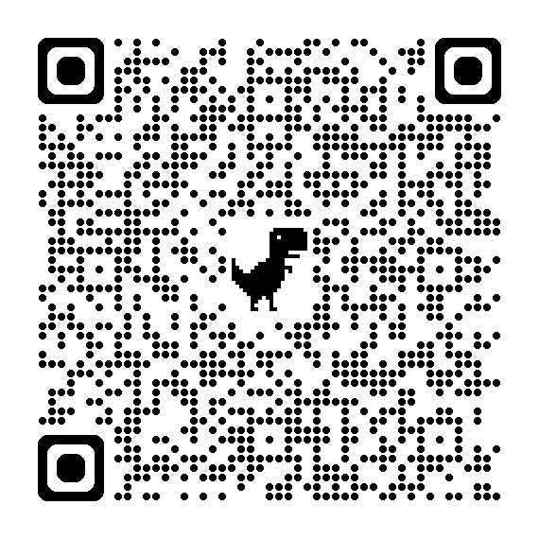


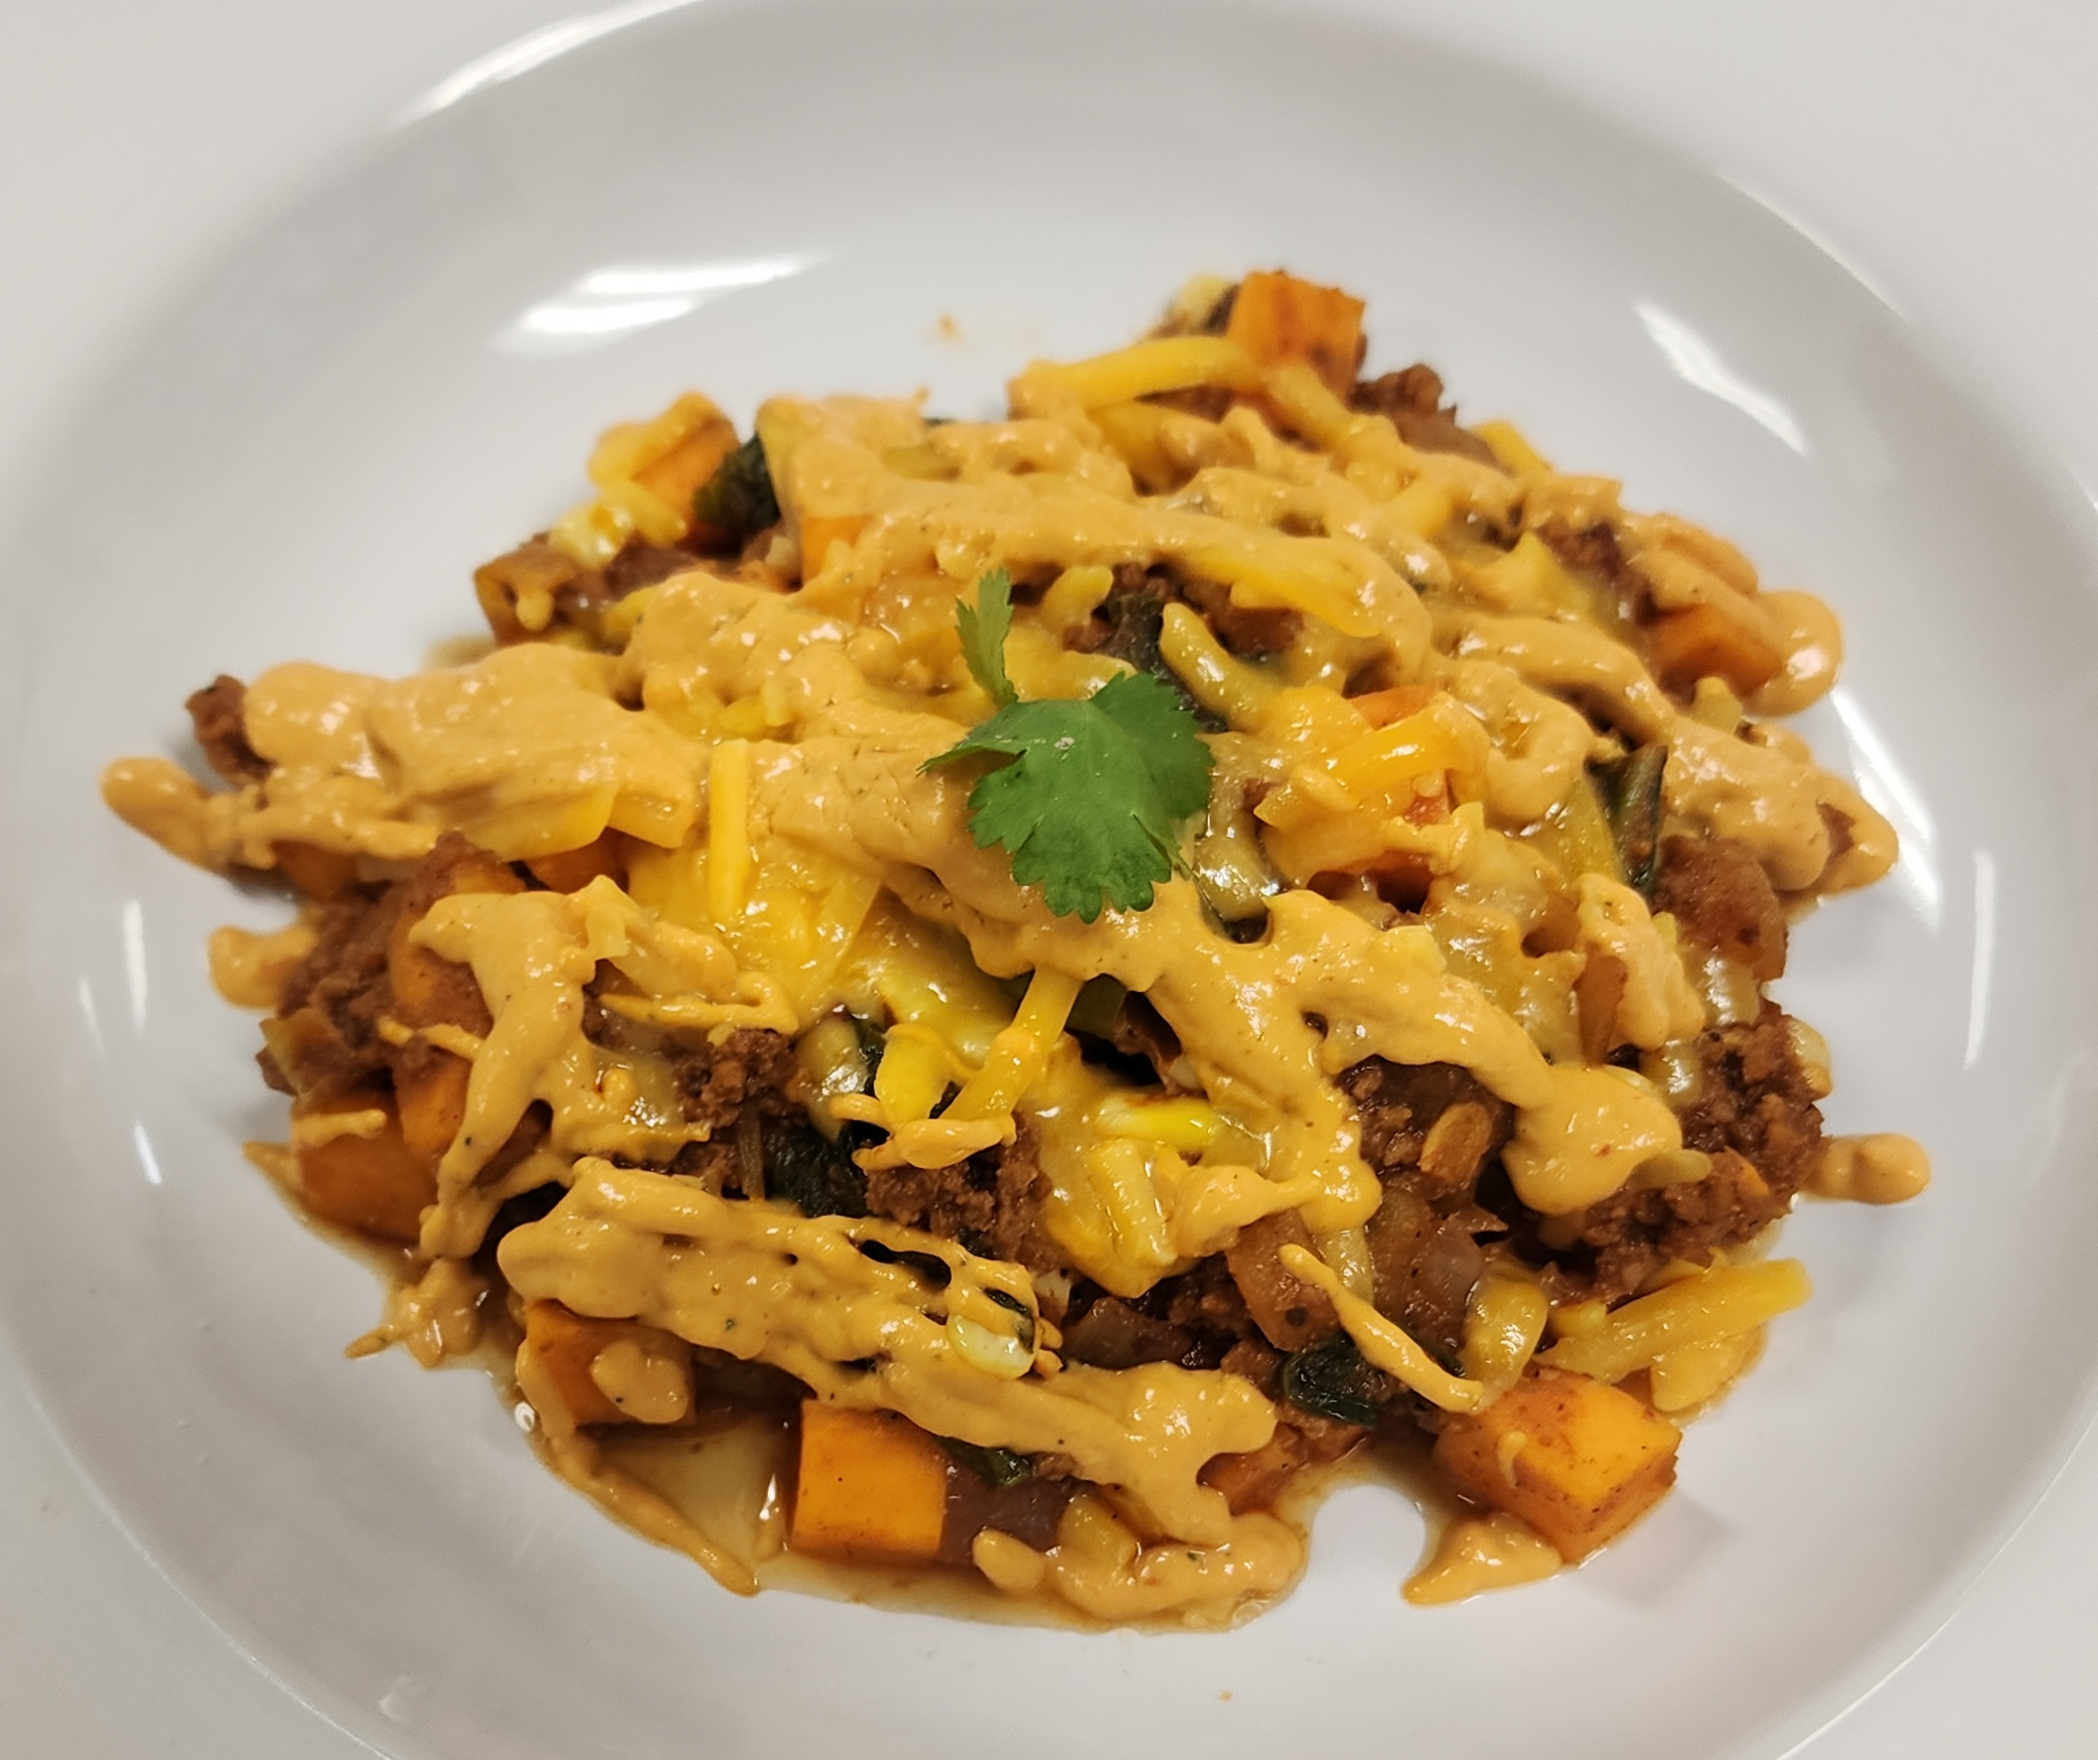
2025-26 #NCJrChef Competition
High school students work with teachers and local School Nutrition Program to create school lunch recipes
Date | Action Step
11/6 by 4:30 pm | Teams submit application with recipe, nutrient and cost analysis, recipe photo
11/20 | Finalist teams notified
12/18 by 4:30 pm | Finalist teams submit application with recipe, nutrient and cost analysis, recipe photo, workplan and video of team preparing and plating recipe
2/2 or 3 | Evaluators conduct live virtual interviews, prep and taste recipes
2/6 | Finalist teams recognized and results announced in virtual ceremony
2/9 | State 1st place teams submit materials for Southeast Jr. Chef Competition
4/23-24 | 1st place teams represent states in Southeast Jr. Chef Competition
Learn more: https://go.ncdpi.gov/ncjrchef
Notes:
Through the NC Jr. Chef Competition, teams of 2-4 high school students work with their teachers and local School Nutrition Program to create a school lunch recipe that adheres to National School Lunch Program regulations, includes at least two North Carolina-grown and one USDA Foods item and appeals to students. The recipe must include 3 components: Meat/Meat Alternate (2 oz eq), Grain (2 oz eq), and a Fruit or Vegetable (½ cup). Teams should conduct taste tests and incorporate the feedback into their recipe.
The timeline of action steps for the 2025-26 NC Jr. Chef Competition is on the screen. Alabama will be hosting the Southeast Jr. Chef Competition and had established earlier regional deadlines that North Carolina must adhere to which has moved up our timeline. The first deadline for teams is November 6. Teams must submit their application with recipe, recipe photo, nutrient and costs analysis and completed and signed permission forms via the online submission form.
Student members of the top three teams at the state and regional level are offered scholarships to Sullivan University.
We are working to scale up and incorporate the NC Jr. Chef recipes into the NC K-12 Culinary Institute.
The timeline, materials and more info are all available on the NCDPI, Office of School Nutrition website. The URL, go.ncdpi.gov/ncjrchef, is listed on the slide. A quick internet search for NC Jr. Chef Competition will also get you to the info.

Slide 85
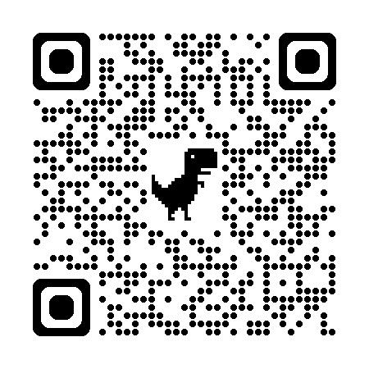
FY 2026 Farm to School Grant Program
Funds innovative farm to school projects ranging from $100,000 to $500,000 for a total of up to $18 million
Improve access to local foods in CNP sites through comprehensive farm to school programming that includes local sourcing and agriculture education
Eligible entities: State agencies, Indian Tribal organizations, Child Nutrition Program operators, Local agencies, Agricultural producers, Groups of agricultural producers, Non-profit orgs
Apply by December 5
Learn more: https://www.fns.usda.gov/grant/f2s/fy26
Notes:
The Patrick Leahy Farm to School Grant Program, authorized in the Richard B. Russell National School Lunch Act (NSLA) (42 USC 1751 et seq.), is designed to increase the availability of local foods in Child Nutrition Program (CNP) operations and connect students to the sources of their food through education, taste tests, school gardens, field trips, and local food sourcing for meals. Grants can be used to launch new farm to Child Nutrition Programs or expand existing efforts. The objective of the fiscal year (FY) 2026 Farm to School Grant is to improve access to local foods in eligible sites through comprehensive programming that includes local sourcing and agricultural education efforts.
This competitive grant will fund innovative farm to school projects ranging from $100,000 to $500,000 for a total of up to $18 million.
Eligible entities include:
State agencies
Indian Tribal organizations
Child Nutrition Program operators*
Local agencies*
Agricultural producers*
Groups of agricultural producers*
Non-profit organizations*
All non-profit organizations must include their 501(c)(3) determination letter issued by the Internal Revenue Service.
For additional information, please see the Patrick Leahy Farm to School Grant Program website. A link to the grant info is included on the slide. You can also search for USDA Farm to School Grant and find the grant materials and info.

Slide 86
Outreach and Promotion Activity
Celebrating and promoting school nutrition
Notes:
Next, we’re going to do a short activity around outreach and promotion efforts.

Slide 87

How Do You Promote SN Programs?
Celebrations and activities:
  Farm to School Month
  NC Crunch
  National School Lunch Week
  National School Breakfast Week
Educational enrichment:
  Storybooks, activity guides, posters
  Ag Mags, lesson plans
  NC Jr. Chef
Notes:
Presenter note: Have the group pair share or table or group discuss:
How they have celebrated 1) Farm to School Month, 2) the NC Crunch and 3) National School Lunch Week
How they plan to celebrate National School Breakfast Week
If/how they have engaged students with educational resources (farm to school storybooks, activity guides, posters, Ag Mags, lesson plans)
If/how they have engaged students with the NC Jr. Chef Competition (do they have interest from their schools this year, in year's past, have they promoted, etc.)?
[Presenter note: suggest 5 min for sharing in pair/share, 10 minutes if whole table. For share-out, suggest at least 10 minutes for sharing ideas. Currently, the estimate is about 20 min in the agenda total for this activity).

Slide 88


Healthy Meal Incentive (HMI) Awards
Purpose
  Recognize exceptional programs
  Spotlight innovation
  Capture and share best practices
Categories
  Innovation
  Trailblazer
Notes:
The U.S. Department of Agriculture (USDA) partnered with Action for Healthy Kids (AFHK) to create the Healthy Meals Incentives (HMI) initiative. Through the initiative, award opportunities have been offered to recognize exceptional School Nutrition Programs, spotlight innovation, and capture and share best practices.
SFAs were eligible to apply for the Recognition Awards if they participated in the National School Lunch Program (NSLP) and/or School Breakfast Program (SBP).
Seven awards were available in two categories: Trailblazer and Innovation.
To learn about all the ins-and-outs of each recognition award, you can access a one-pager and more information on the healthymealsincentives.org website.

Slide 89

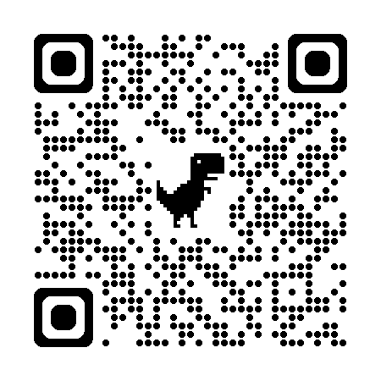
14 North Carolina HMI Awardees
Breakfast Trailblazer
  Catawba County Schools
Innovation in the Preparation of School Meals
  Craven County Schools
  Elizabeth-City Pasquotank Public Schools
  Elkin City Schools
  Graham County Schools
  Hoke County Schools
  Yadkin County Schools
Small and/or Rural Lunch Trailblazer
  Beaufort County Schools
Innovation in Nutrition Education
  Bertie County Schools
  Buncombe County Schools
  Haywood County Schools
  Jackson County Schools
  New Hanover County Schools
  Pitt County Schools
Learn more: https://www.dpi.nc.gov/news/press-releases
Notes:
North Carolina has 14 Healthy Meal Incentives Awardees. The awardees are listed on the screen.
NCDPI recently issued a press release recognizing the awardees. A link to the release is included on the slide.
USDA and Action for Healthy Kids are planning to recognize the awardees during a virtual HMI Summit in November.

Slide 90

7 NC Turnip the Beet Awardees
Gold
  Boys and Girls Club of Wake County
  Halifax County Schools
Silver
  Catawba County Schools
  Food Bank of Central and Eastern North Carolina
  YMCA of Southeastern North Carolina
Bronze
  Beaufort County Schools
  Elizabeth-City Pasquotank Public Schools
Recognizes SUN Meal Programs that go above and beyond to:
  offer appealing and nutritious meals
  incorporate locally grown foods
  engage students in educational enrichment
Learn more:
https://www.dpi.nc.gov/news/press-releases
Notes:
USDA launched the Turnip the Beet Awards to recognize Summer Nutrition Programs that go above and beyond to offer high quality meals that are appetizing, appealing and nutritious to children, incorporate fresh, locally grown foods into meals and snacks, and engage students in educational enrichment.
Awards are available at the gold, silver and bronze level.
Seven NC Summer Nutrition Programs recently received Turnip the Beet Awards for outstanding achievements with Summer 2024 operation. A link to the NCDPI press release is included on the slide.

Slide 91
Submit Content for SN Update E-letters
Support SN Update publish goal of 2nd and 4th full week of each month
Submit content (job postings, shoutouts, etc.) by Monday of the prior week
Send a brief ready-for-print article (250 words or less); job postings should have a description and active link open to the public or a local contact
Obtain permission to share any photos of students, staff, families, etc.
Email to School Nutrition Consultant, include SN Update in subject line
Note: Submissions not received by the deadline will be held until the next issue
Notes:
If you would like to submit a request to add information to a School Nutrition Update e-newsletter, such as available job postings or highlights from your district or school, please follow the process show.
You’ll need to send a brief, ready-for-print, article of no more than 250 words to your School Nutrition Consultant by the MONDAY prior to the week of the issue. SN Updates issues are sent on the 2nd and 4th weeks of each month, except during the summer where they may be sent less frequently. In the email, please reference the School Nutrition or SN Update in the subject line.
Make sure to get any permissions to use photos that include students, staff, families, or others.
If your submission is not received by the deadline, it will be held until the next issue. If it will no longer be relevant by the next issue (such as a deadline or event date), please follow up with your consultant to let them know.

Slide 92

Not getting SN Updates?
Check ALL email folders (inbox, junk/spam)
  Sender is ”SchoolNutritionNews” (NCPublicSchools@public.govdelivery.com)
If still not receiving, contact Donna Knight (donna.knight@dpi.nc.gov) and copy your School Nutrition Consultant
Notes:
If you or someone on your team is not receiving our regular School Nutrition Updates emails, please follow these steps:
Check all email folds, including inbox subfolders, and also any junk or spam folders, to make sure any emails are not being sent into these folders.
Contact Donna Knight to request to be added to the listserv, and copy your School Nutrition Consultant.
Note that there are several different types of listservs. If you are not a school nutrition director or administrator, you may not receive all emails, as some are sent only to school nutrition directors or administrators, which is why you may not be receiving those specific emails. School Nutrition Updates e-newsletters are sent to a broader audience.

Slide 93
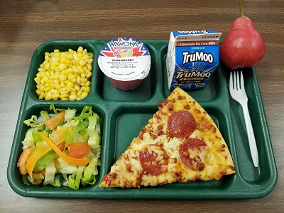
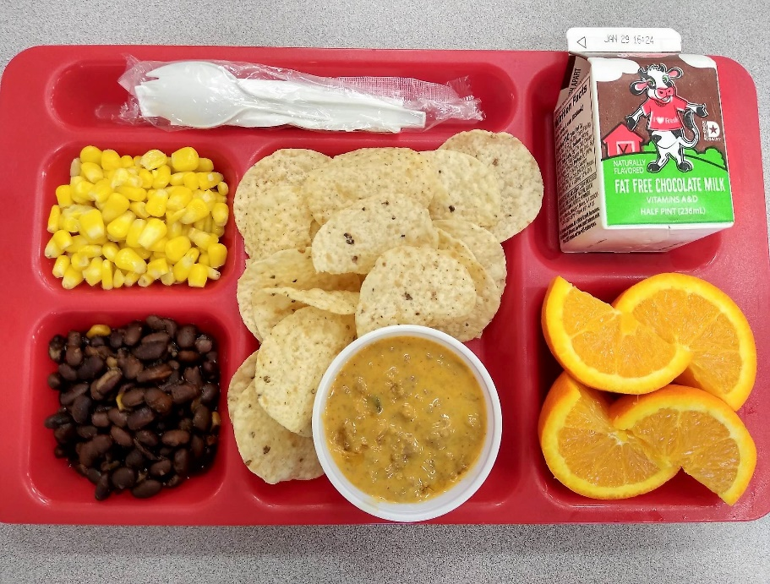
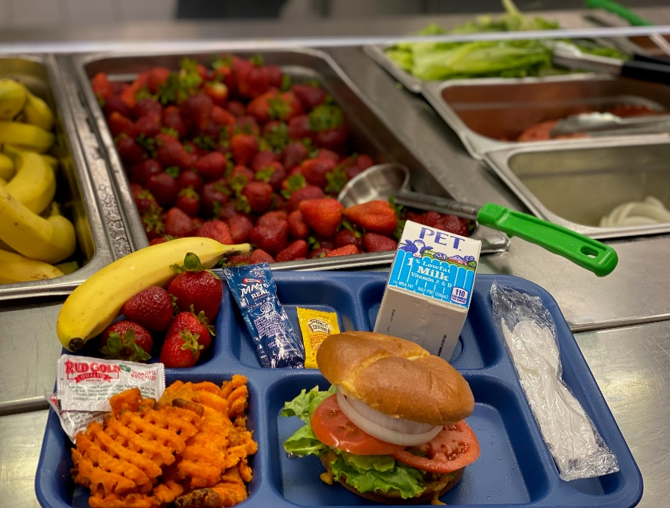
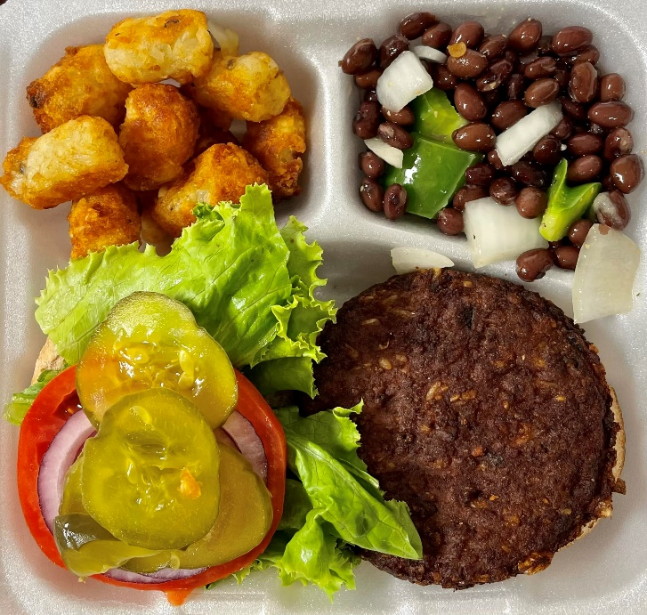
Connect With Us!
Office of School Nutrition website, go.ncdpi.gov/ncschoolmeals
School Nutrition (SN) Update e-letter
School Nutrition News emails (important, time-sensitive messages) – for SN Directors and Administrators
Policy Updates
Social Media
  @NCSchoolMeals (Facebook, X, Instagram)
  @Ray4NCKids (Facebook, X, Instagram)
    #NourishNCKids #NCK12CulinaryInstitute
    #NCSchoolMeals #NCSchoolNutritionHeroes
    #NCSummerMeals #NCJrChef
Notes:
Please check our the Office of School Nutrition website for the latest information and resources. The quick link to access the website is on the screen, go.ncdpi.gov/ncschoolmeals.
The SN Update eletter shares programmatic updates, shoutouts, grant and job opportunities, educational resources and continuing education opportunities.
The Office of School Nutrition sends out School Nutrition News emails for important, time sensitive messages.
Policy Updates offers an opportunity to review pertinent regulations, share policy updates, provide professional development, learn from others and ask questions.
We encourage you to connect with us on social media for the latest news, resources, and success stories to share out. Please tag @NCSchoolMeals and/or @Ray4NCKids with your posts sharing school and summer meals photos, educational, promotional and outreach activities.
Please share photos of school and summer meals with us. You can send photos to Tracey Bates, School Nutrition Promotion Specialist, tracey.bates@dpi.nc.gov. On the screen, you see some great examples from SFAs across the state. We would love to feature photos of beautiful school and summer meals from every SFA.

Slide 94
Professional Development and Continuing Education Updates
NC K-12 Culinary Institute On-Demand
NCDPI OSN Continuing Education Opportunities
Notes:
We know back to school training is coming up quickly, so we want to take an opportunity to talk about program training requirements and resources. We’ll share resources for recommended training topics, USDA Professional Standards annual training requirements, tips for documenting training hours completed, upcoming continuing education opportunities from our office, and end with a discussion about your needs related to back to school training.

Slide 95

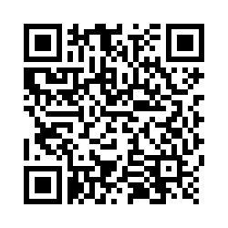
NC K-12 Culinary Institute On-Demand
New online portal for on-demand learning
From the developer of the NC K-12 Culinary Institute (summer workshops)
Features an online community for sharing ideas and successes, asking questions, and supporting each other
Earn credits towards USDA Professional Standards annual training requirements
Sign up to be in the first group to experience this new learning opportunity! →
https://ncdpi.az1.qualtrics.com/jfe/form/SV_cA90Up7ZIKlsGrA
Notes:
We are exited to announce the brand-new North Carolina K-12 Culinary Institute online training platform!
This training platform will provide you with access to self-paced courses focusing on the core concepts of the NC K-12 Culinary Institute program. You will earn training hours that count toward USDA Professional Standards requirements while strengthening your culinary and leadership skills.
You will also be able to become part of an online community where you can ask questions, share ideas, and highlight your successes with others enrolled in the on-demand courses.
We are currently enrolling our first cohort of directors and managers now through Tuesday November 4. This first group will get an exclusive look at on-demand courses designed for NC Chef Ambassadors. We plan to ultimately open the courses and online community to North Carolina school nutrition professionals across all levels. This smaller more specific group will allow us to pilot test some of its features before opening it up to all.
Don’t miss your chance—next enrollment won’t open until 2026! School Nutrition Administrators, Directors, and any managers in the room should scan the QR code and complete the sign up form to reserve your spots today! Directors – sign up any managers that you’re interested in participating, or send them the link to sign up.

Slide 96
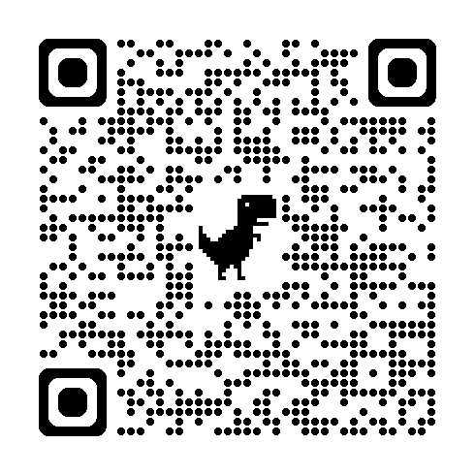
Other Upcoming PD/CE Opportunities
Opportunities | Registration and Information
SummerPalooza: November 18, 2025 – Hickory November 20, 2025 – Raleigh November 21, 2025 - Greenville | See next slide
Unique Mealtime Needs workshops: December 11, 2025 – Hickory December 18, 2025 – Raleigh | Register using QR code → For more info, see the October SN Update
Save the Date – Spring 2026 Policy Updates Week of April 27, 2026; locations TBD | Registration not yet open; check our website and SN Updates for new info.
2026 SNA-NC Annual Conference Pre-Conference workshops (NCDPI) – June 22-23, 2026 Conference (SNA-NC) – June 24-25, 2026 | Register for the conference through SNA-NC. Registration for pre-conference workshops not yet open; check our website and SN Updates for new info.
SummerPalooza:
  November 18, 2025 – Hickory
  November 20, 2025 – Raleigh
  November 21, 2025 - Greenville
  See next slide for registration and information
Unique Mealtime Needs workshops:
  December 11, 2025 – Hickory
  December 18, 2025 – Raleigh
  Register using QR code on the screen
  For more info, see the October SN Update
Save the Date – Spring 2026 Policy Updates
  Week of April 27, 2026; locations TBD
  Registration not yet open; check our website and SN Updates for new info.
2026 SNA-NC Annual Conference
  Pre-Conference workshops (NCDPI) – June 22-23, 2026
  Conference (SNA-NC) – June 24-25, 2026
  Register for the conference through SNA-NC.
  Registration for pre-conference workshops not yet open; check our website and SN Updates for new info.
Notes:
This chart highlights some other important upcoming professional development and continuing education opportunities. SummerPalooza, which we will review next, is coming up next month.
We will have two opportunities to take the Unique Mealtime Needs workshop in December before the holidays.
Please also save the date for the following:
Spring Policy Updates the week of April 27, 2026, and
The 2026 SNA-NC Annual Conference, where we’ll be organizing several pre-conference workshops the Monday and Tuesday prior to the conference
We’ll continue to share important registration information and details for our professional development and continuing education opportunities through the regular SN Updates, so make sure you are reviewing each issue!

Slide 97

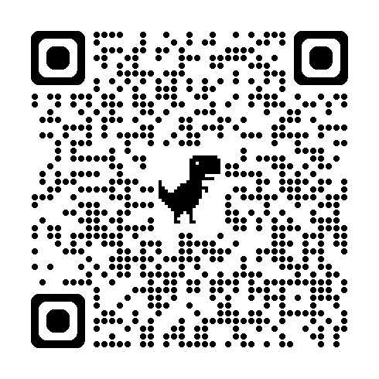
SummerPalooza! 2026
Register by 11/6
Agenda
  9:15-10 am: Choice of optional session
      Summer 101 OR
      SFSP Meal Crediting and Recipes
  10:15-11 am: Choice of optional session
      Intro to Non-congregate OR
      Non-congregate Best Practices
  11:15 am-12 pm: Lunch
  12-4 pm: SummerPalooza! Summit
Dates and Locations
  Tues, Nov 18 (Hickory)
  Thurs, Nov 20 (Raleigh)
  Fri, Nov 21 (Greenville)
Learn more and register: https://forms.gle/HAT1PXFkA5i6U9GT6
Notes:
If you have attended in the past, SummerPalooza needs no introduction. The Summer Nutrition Team, with Carolina Hunger Initiative, is hosting SummerPalooza in three locations in November. Everyone attending needs to register for their preferred location by Nov 6 (QR code on screen). This year, SummerPalooza! will begin at 12 so that in-person continuing education sessions can be offered in the morning. We hope you will find at least one of the morning sessions to be a good fit however they are not required to attend. Registering at the link or QR code registers you for the SummerPalooza event starting at 12 AND for any morning continuing education sessions plus a lunchtime meal if you so choose.

Slide 98
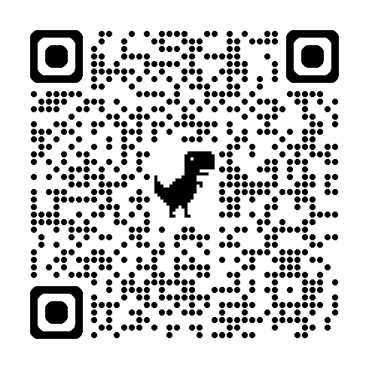
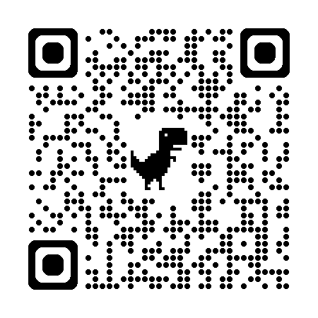
PD/CD Updates – Food Safety
Safe Plates for Food Managers course interest form
  Planning tentative course in winter 2026
  https://forms.gle/JkYCaDzbcBp9w3W56
Crisis Communication pilot workshop
  Help us create this course by sharing your thoughts
  https://forms.gle/WwszJsPMuSYLJdB37
Notes:
We are also tentatively planning two workshop opportunities focusing on food safety and HACCP.
This year, we are planning to offer an opportunity to take the Safe Plates for Food Managers course and exam again during January or February. If you or any of your staff are needing to get or renew their Certified Food Protection Manager certification and would like to be considered for a workshop near your area, please complete a brief form using the top QR code shown on the screen to help us select a date and location.
We will NOT be planning an opportunity this summer as an SNA-NC Pre-conference session, we have done in years past, due to low attendance.
However, instead of an SNA-NC pre-conference workshop to take Safe Plates for Food Managers, we are exploring the opportunity to develop and pilot test a new workshop to help School Nutrition Directors and Administrators, their central office team, and other school administrators develop a crisis communication plan specifically related to food and beverage issues. We will work with food safety experts at NC State to help us develop and deliver the course. Please share your thoughts on this potential opportunity by answering a few quick questions using the bottom QR code shown on the screen.

Slide 99
Non-Discrimination Statement (updated July 2025)
In accordance with federal civil rights law and U.S. Department of Agriculture (USDA) civil rights regulations and policies, this institution is prohibited from discriminating on the basis of race, color, national origin, sex, disability, age, or reprisal or retaliation for prior civil rights activity.
Program information may be made available in languages other than English. Persons with disabilities who require alternative means of communication to obtain program information (e.g., Braille, large print, audiotape, American Sign Language), should contact the responsible state or local agency that administers the program or USDA’s TARGET Center at (202) 720-2600 (voice and TTY) or contact USDA through the Federal Relay Service at (800) 877-8339.
To file a program discrimination complaint, a Complainant should complete a Form AD-3027, USDA Program Discrimination Complaint Form which can be obtained online at: Program Discrimination Complaint Form English [409.6 kb], Program Discrimination Complaint Form Spanish [389.3 kB] and from any USDA office, by calling (866) 632-9992, or by writing a letter addressed to USDA. The letter must contain the complainant’s name, address, telephone number, and a written description of the alleged discriminatory action in sufficient detail to inform the Assistant Secretary for Civil Rights (ASCR) about the nature and date of an alleged civil rights violation. The completed AD-3027 form or letter must be submitted to USDA by:
mail:
U.S. Department of Agriculture
Office of the Assistant Secretary for Civil Rights
1400 Independence Avenue, SW
Washington, D.C. 20250-9410; or
fax:
(833) 256-1665 or (202) 690-7442; or
email:
Program.Intake@usda.gov
This institution is an equal opportunity provider.
Notes:
Updated July 2025

Slide 100
Questions?
Thank you!
Notes:
[Consultants – please insert your contact information on this slide in the space provided (name, service area, email, phone)]

Slide 101
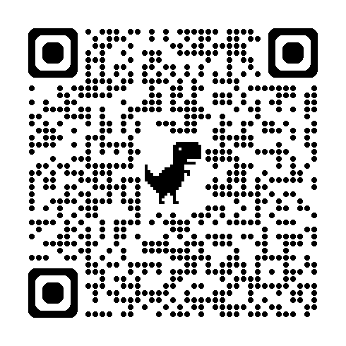
How did we do? Share your feedback!
Open camera app on phone or device
Point camera at QR code to the right → (and hold still!)
Tap on URL that appears on screen
Complete survey that opens in your device’s web browser
Make sure to hit “Submit” at the end!
Notes:
Fall 2025 Policy Updates evaluation
Link to complete will also be sent with certificate via email within about a week after attending.
Link to evaluation:
https://forms.gle/DmL1i3znpqjeQ7z27

