Slide 1

Maximizing Customer Appeal
Making the USDA Meal Patterns Work
USDA is an equal opportunity provider and employer.
Notes:
Creating exciting menus for your customers takes time, effort, and creativity. Let’s discuss some important concepts to consider when using the USDA Meal Patterns and incorporating student favorites to keep the menus exciting…..

Slide 2


Certification: required yet flexible!
Notes:
Certification of menus for new School Food Authorities (SFAs) is required in order to demonstrate the capability of planning menus that meet USDA’s stringent criteria. An additional 6 cents per student meal reimbursement is available to those SFAs who achieve certification. SFAs are not required to offer only the menu used to achieve certification. Menus will change with the seasons, with new products that become available, with changing customer preferences, and even staff and equipment changes. There is no requirement that only a “certified” menu may be offered; however, all menus must meet the daily/weekly meal pattern and dietary specifications requirements for components.
Twice yearly analysis of menus requires that SFAs analyze one week’s menu for breakfast and lunch for each grade group meal pattern used. It is a best practice to always carefully evaluate and analyze planned menus to make sure they meet USDA requirements; however, it is not a requirement that only those analyzed menus submitted to the State Agency in October and March can be served to students.
Do not be “chained” by the notion that only Certified Menus or those submitted for Twice Yearly Analysis of Menus prevents creativity and variety in menu offerings. Once the menu planner demonstrates proficiency in planning menus that meet requirements, additional menus may be planned that also meet the requirements. By paying attention to customer responses to the offered menu items, the menu planner can practice menu planning magic to offer exciting dining choices that keep customers coming back for more!

Slide 3

Customers like Variety
Cycle Menus have many Advantages
What are They?
Cycle Menus can have Disadvantages
Name Some……..
Notes:
We often use cycle menus for a variety of reasons. Let’s explore some advantages and disadvantages:
A Cycle Menu’s advantages include those that relate to:
Food Purchasing
Recipe Development
Production Record entries
Employee ease of preparation
Serving line set-up
Efficiency in Kitchen
Disadvantages: If a cycle menu stays around too long, customers become tired of the offerings, predict with accuracy what is offered each day, become bored with the menu, and begin to complain. Cycle menus that are for too short a period of time (Example: 2 weeks) quickly become predictable and customers may lose interest. Even employees may become bored without new and frequent challenges. So, let’s look at the meal components and explore some options for adding variety and keeping menus interesting. We will start with the meats and meat alternates…..

Slide 4

Meats & Meat Alternates
Notes:
Aa variety of appealing, nutritious, and affordable main dishes are key to participation and program viability. Are you maximizing the options?

Slide 5
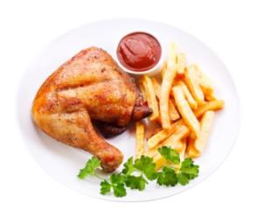
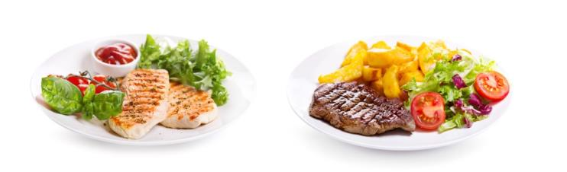
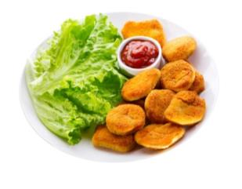
Meats/Meat Alternates: Tips to
Remember…
Minimum requirements for each grade group
No maximums enforced
Adhere to the nutrient targets
Credit M/MA to nearest ¼ ounce equivalent
Notes:
First, let’s review a few important points about this component and its crediting:
Each grade group has minimum and maximum oz eq of the meats/meat alternates component; however, the maximum limits are no longer enforced. So you may offer more oz eq at any grade group as long as the dietary standards do not exceed the limits for calories, saturated fat, and sodium. This component is credited to the nearest ¼ oz eq – remember to round down!

Slide 6

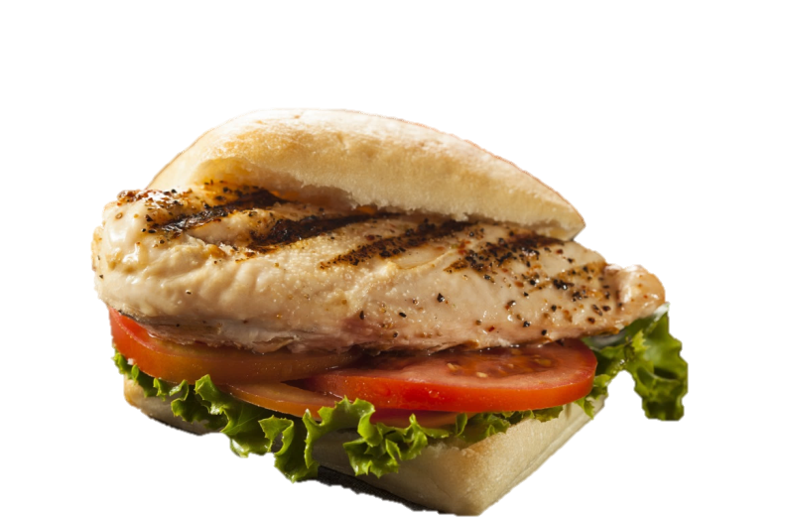
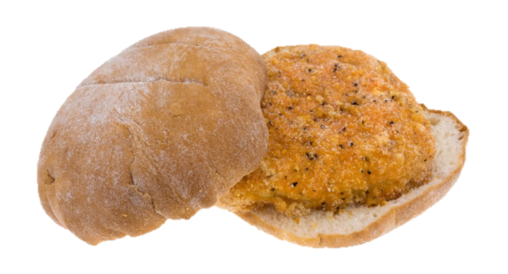

Meats/Meat Alternates on the Menu
Consider higher quality products
Use occasionally to increase participation
Notes:
One of the easiest ways to reduce plate cost is to procure and offer less expensive entrée items. Many times, the cheaper items are of lesser quality, and this may have a negative impact on participation. Consider offering some higher quality, popular entrée items occasionally to increase student satisfaction and participation.

Slide 7

Meats/Meat Alternates: Offer Popular Items Often!
Offer popular menu items daily
Sell a la carte all week
Notes:
Entrée items that do not meet Smart Snack standards may only be sold the day they are offered as part of the reimbursable meal and the following day. Some popular menu items, such as peanut butter and jelly sandwiches, routinely exceed the 350 calorie limit which limits your ability to sell them a la carte. By offering items like this daily, menu selections increase, more variety is offered, and the items may be sold a la carte all week. Check your nutrient targets for calories, saturated fat, and sodium to make sure it fits!

Slide 8
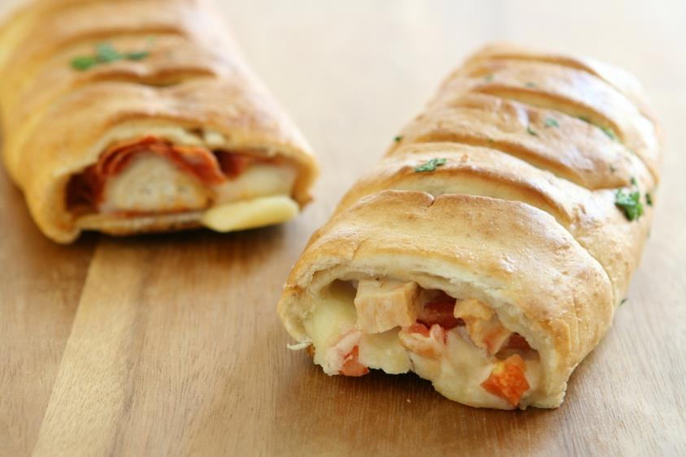

What’s for Lunch?
Chicken Pot-Pie Pockets
Pizza Stromboli
Notes:
We know that when kids ask “What’s for Lunch” that they are usually referring to the entrée!
Here’s two old menu items for lunch with a new twist!
1. Chicken pot pie pockets versus Chicken pot pie
2. Pizza Stromboli versus Stromboli

Slide 9
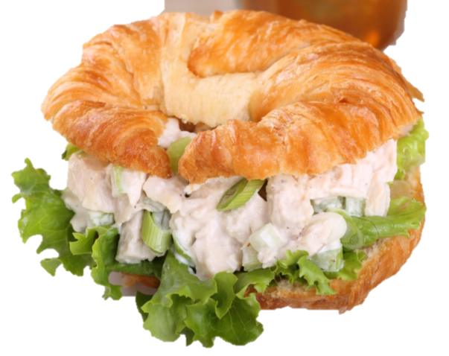

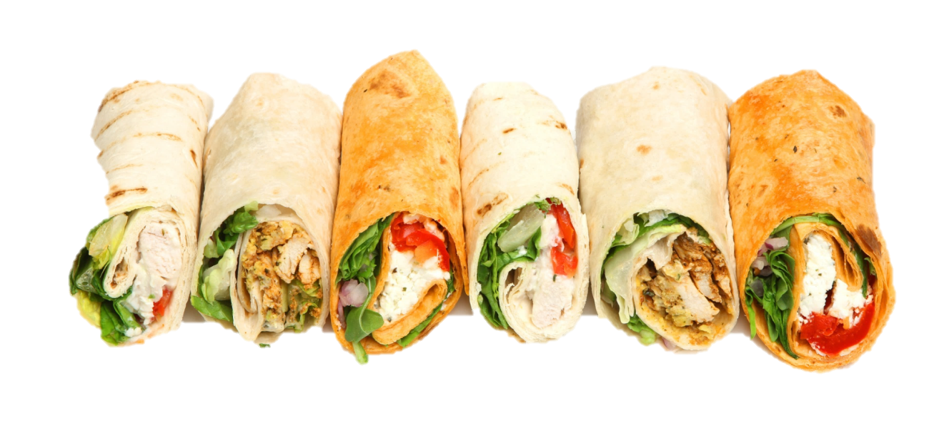
The Sandwich – an all time favorite!
Notes:
Sandwiches-using a variety of bread (grain) choices, variety of sandwich trimmings, and a myriad of ways to present sandwiches with added trimmings adds to the appeal!

Slide 10
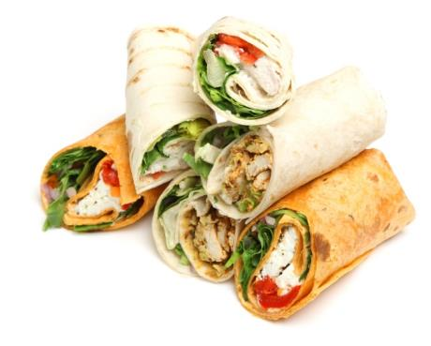


Set up a Deli Bar!
Offer sub buns, tortillas, and assorted breads
Provide sliced ham, turkey, and cheese
Top with jalapeno or banana peppers, lettuce, tomato, onions, olives, pickles
Remember the condiments – oil and vinegar, herb sprinkle, mayo, and mustard!
Notes:
Given that sandwiches are an all time favorite, turn a serving line into a build a sandwich deli bar. Allow students to select bread, meat and cheese, and toppings for a freshly made to order hand-held entrée!

Slide 11
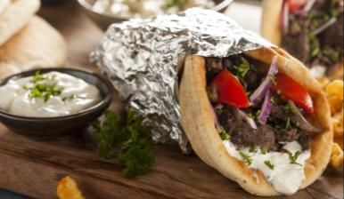
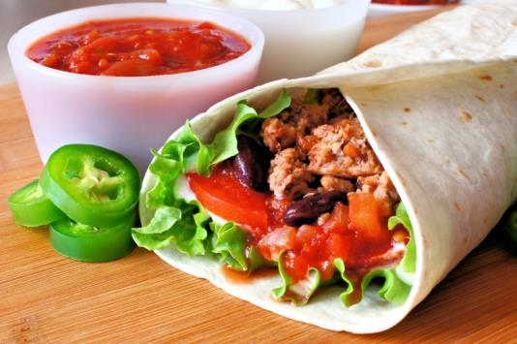

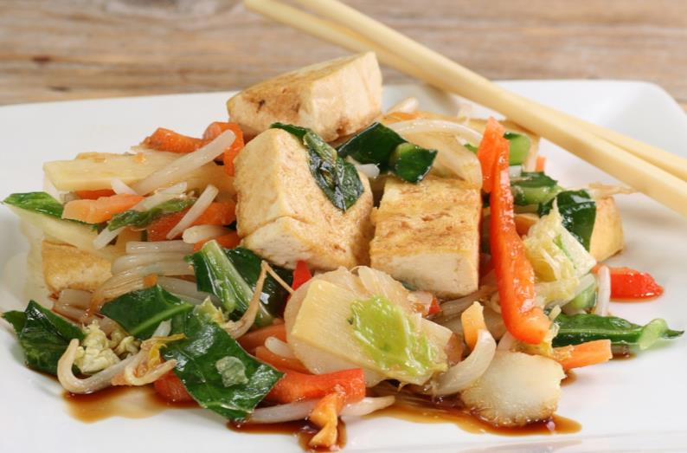
Include Ethnic Favorites
Notes:
Be sure to include ethnic dishes regularly – Italian, Oriental, Mexican, Greek, and regional American foods are always popular!

Slide 12
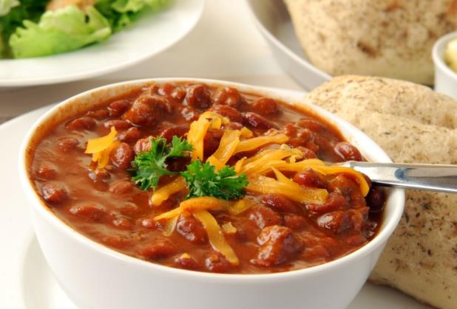
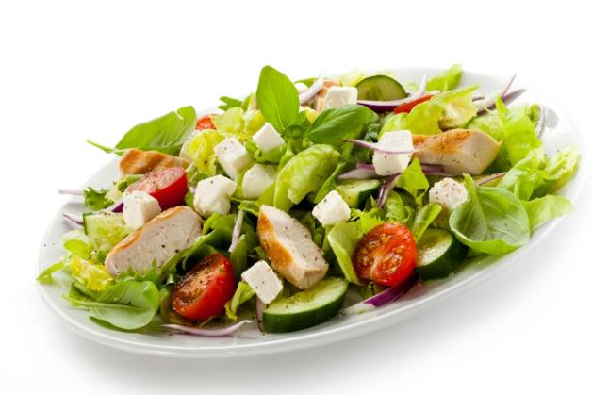
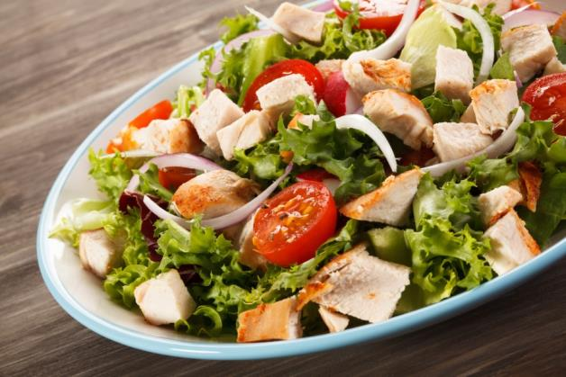
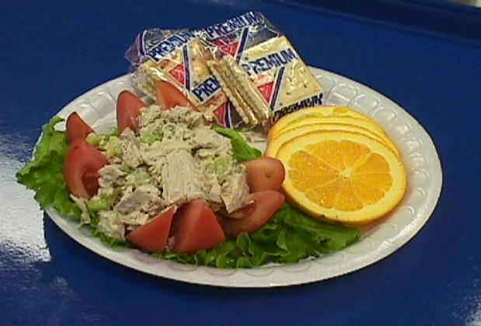
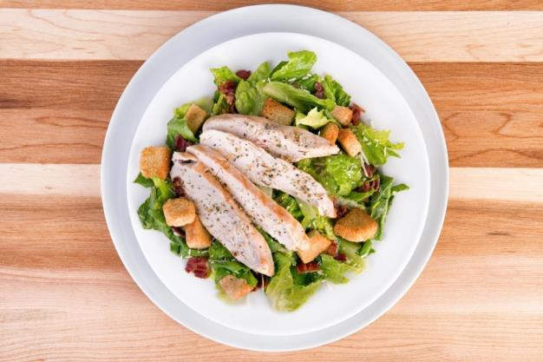
Seasonal Entrée Soups and Salads
Notes:
A hearty bowl of chili-using both ground beef and dried beans to count towards the meats/meat alternates or dried bean/legumes vegetable subgroup. Remember – one portion of legumes may not count for both M/MA and vegetable in the same meal. Be sure to yield test the recipe to determine the correct portion utensil to use for correct crediting!
And, in the spring, add crisp, cool entrée salads such as: Chicken Caesar Salad, Greek Salads, Grilled Chicken Salad, Stuffed Tomatoes, and more…

Slide 13

Grains
Notes:
Grains are an important component at both breakfast and lunch – and they are an important part of marketing the main dish. Let’s review the difference in 100% whole grain and whole grain-rich to be sure we are selecting grains that will be most acceptable to students…..

Slide 14

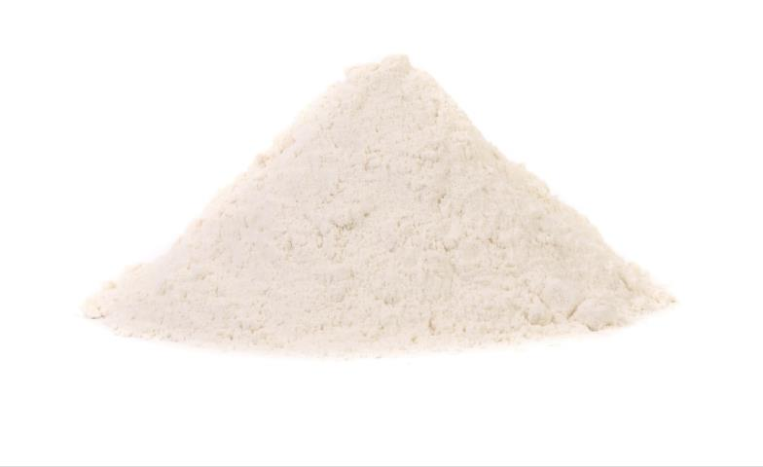
Whole Grain-Rich Criteria
Grain weight of product: at least 50% whole grain and remaining grains are enriched
A serving = portion size requirements
Read labels on grain products carefully
Notes:
Grain products do not have to contain 100% whole grain or 100% whole grain meal and/or flour to be used. Many breads, buns, rolls, and other grain items can be allowable as long as at least 50% of the grain weight of the product is from a whole grain (may be red whole wheat, white whole wheat, oats, barley, or other variety of whole grain) and the remainder of the grains are enriched. These products (containing at least 50% whole grain with the remaining grains being enriched) are referred to as whole grain-rich (WGR) and may be used for all the grain offerings. Even so, there may be some products that are still not fully acceptable as WGR and SFAs may apply for a waiver – we will discuss this more in a few minutes!
Since students at some schools report a dislike for “brown” colored bread products, look at alternatives. Some white wheat bread products may qualify. Some light-brown grain products may qualify. Request accurate and current product information from the vendor regarding ingredients and grain content. If labels do not provide adequate information, you may need to request that the manufacturer complete a Product Formulation Statement (PFS). The PFS may be downloaded from http://www.fns.usda.gov/cnlabeling/food-manufacturersindustry
Refer to the updated grains section of the Food Buying Guide and the Exhibit A attached to USDA Memorandum SP 30-2012.
Note to presenter: White whole wheat flour is it is simply WHOLE flour – including the bran, germ and endosperm – made from hard WHITE spring wheat. White wheat does not contain the strongly-flavored phenolic compounds that are in red wheat. This gives white wheat a milder flavor, and also means that products made with white wheat require less added sweetener to attain the same level of perceived sweetness.
The “brown” or regular 100% whole wheat flour is derived by grinding or mashing the whole grain of RED wheat.
Reference: http://wholegrainscouncil.org/whole-grains-101/whole-white-wheat-faq

Slide 15

Grains on the Menu
Whole grain-rich waiver available if needed
Taste Tests
Nutrition education
Nutrition promotion
Notes:
Request the WG waiver for items that are student favorites in non-WG form. (Ex: biscuits, crackers, pastry sheets for cobblers/pot pies, hushpuppies, bread slices for grilled cheese sandwiches, hot dog bun, hamburger bun, ravioli, breading for meats). If you have received permission to use the WG waiver for specific grain products, half of the grains offered during the school week still must meet the whole-grain rich criteria.
Continue to offer whole grain-rich options for foods that are accepted well by students. Introduce additional whole grain-rich items carefully and provide taste tests and nutrition education to help students become familiar and more accepting of these products. Nutrition promotion is a newly required goal of all local school wellness policies. Focus on promoting whole-grain offerings as healthy and tasty choices.

Slide 16

There are no “Caps” on Grains
Minimum grains for each grade group
No maximums enforced
Pay attention to Calories, Sodium, and Saturated Fat
Notes:
The meal patterns include weekly ranges (minimum and maximum levels) for the grains component to help schools plan and offer age-appropriate and well-balanced meals. USDA has provided flexibility in measuring compliance with the weekly grains ranges by relaxing the maximum limits or caps on the oz eq of grains; therefore, menu planners may plan menus that exceed the daily and weekly oz eq of grains as long as the dietary specifications are within the regulatory limits for calories, saturated fat, and sodium. Schools that exceed the weekly maximum limit for grains are considered compliant for certification and monitoring purposes, provided that the weekly dietary specifications are met. Only the daily and weekly minimum quantities are enforced.
Sometimes additional grains are needed to meet the calorie requirements, especially for meals offered using the 9-12 age/grade group meal pattern.
Remember, however, that half of all grains served still must be WGR if your SFA has been approved for the waiver.

Slide 17
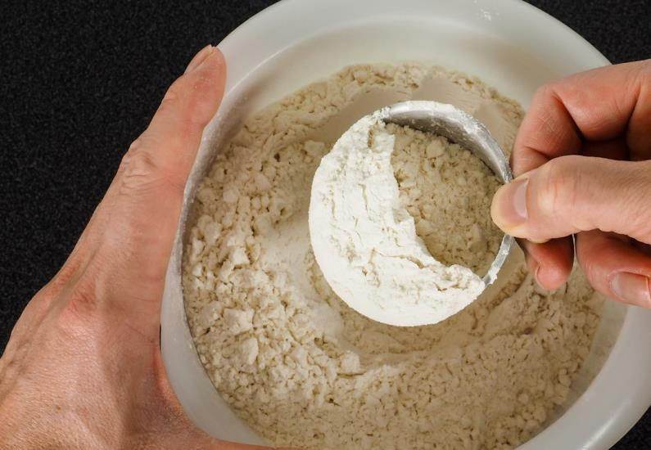
Grains: Small amounts don’t count!
Less than ¼ oz eq not creditable
Are included in nutrient analysis
Notes:
Grains offered in amounts less than 0.25 oz eq are never included in the calculation of daily and weekly grain offerings and would be considered “extra”; however, these extra amounts would need to be included when evaluating the weekly dietary specifications. For products from the revised Exhibit A in Groups A to G, this means that there should not be more than 3.99 grams of non-creditable grain per portion. For products from Group H, this means that there should not be more than 6.99 grams of non-creditable grain.
Note to Presenter: Provide examples -- small amount of bread crumbs or cracker crumbs in meatloaf (each portion contains less than .25 oz eq grain); topping on a casserole-type dish, flour used as minimal ingredient for thickening, other?

Slide 18
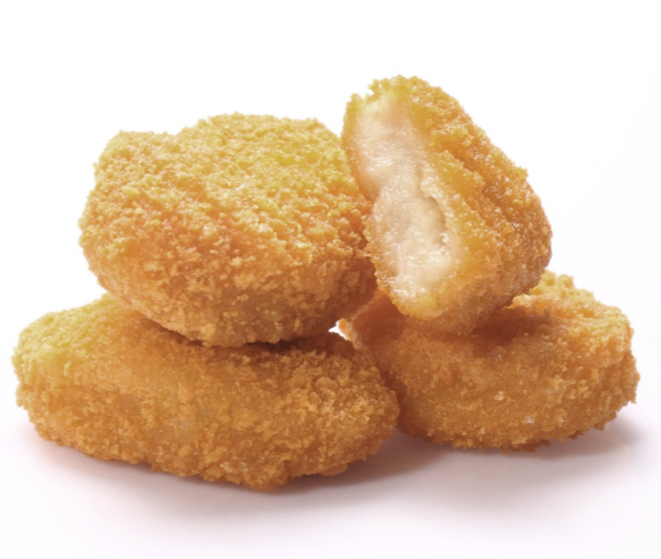
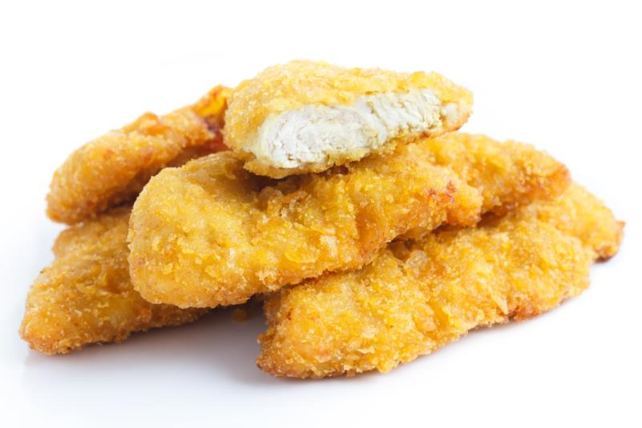
How about Breading?
May be WGR and Creditable
May be Non-WGR and non-creditable
May be included in WGR waiver
Must be included in Nutrient Analysis
Notes:
Combination foods, such as breaded items, are not required to contain WG if not counted toward the grain component; however, if the menu planner decides to count the breading, the menu item must contain at least 0.25 ounce equivalent grains in order to credit toward meal pattern requirements.
All breading on meat items, such as chicken nuggets or corn dog nuggets, does not have to be WG. These items can be included in the WG waiver request. Another option is not to count the non-WG breading toward the grain requirement; it must be included in the nutritional analysis and will count toward the calories, sodium and other nutrient standards for the week.

Slide 19
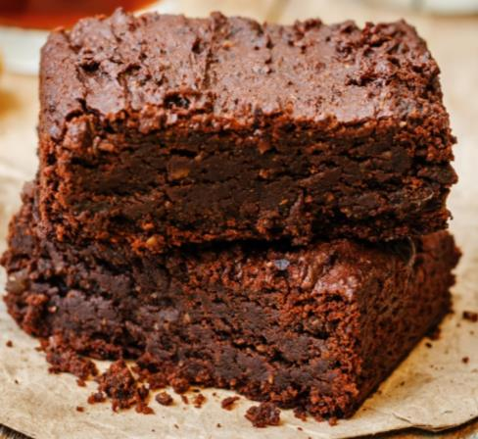

Grain Based Desserts
2 oz eq of grains may be offered in Grain-Based Dessert Items per week
  Offer in two 1 oz eq servings
  Offer in four ½ oz eq servings
Notes:
The 2 oz eq per week limit on grain-based desserts is still in effect so up to 2 oz eq grains per week for lunch may be offered in a grain-based dessert. It is important to remember -- if a grain-based dessert is made from non-creditable grains, it still counts toward the 2 oz eq per weekly limit.
The allowance for grains in grain-based desserts can be divided over the course of the week. For example: if you offer 1/2 oz eq of grain based desserts 4 times per week, the 2 oz eq grain-based dessert will not be exceeded.

Slide 20

Fruits

Slide 21

Fruits: Pretty and Plentiful!
Breakfast
  Offer ½ cup fruit and ½ cup juice daily
  Bundle fruit with the entrée to create a reimbursable meal
Lunch
  Offer a variety!

Slide 22
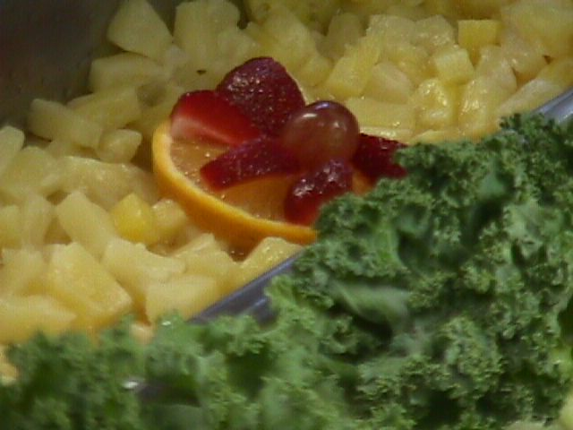
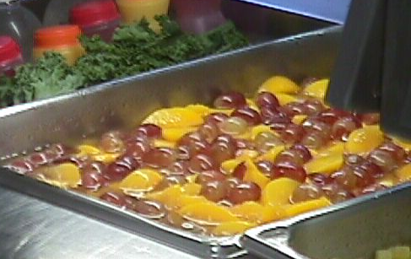
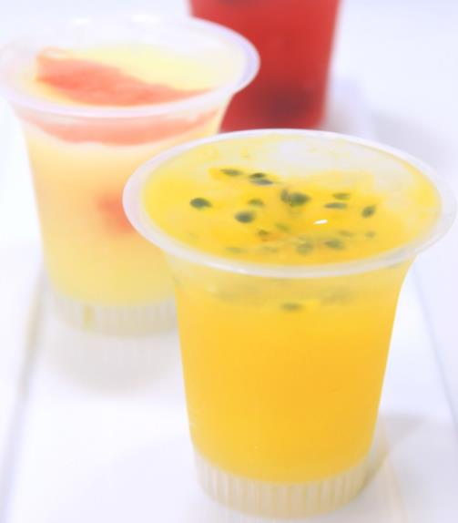

Canned Fruit
Garnish with fresh fruit
  Kiwi, strawberry, or orange slice
  blueberries, grapes, raspberries, blackberries
Add a dollop of yogurt or whipped topping
    Add fruit to gelatin

Slide 23
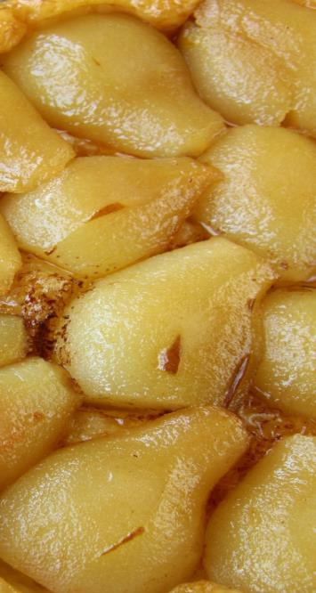
Cooked Fruit
2 oz grain based desserts per week
    Crumble, crisp, cobbler
Non-grain based desserts
    Can be offered daily if calories available
    Consider spiced apples, peaches, or pears

Slide 24
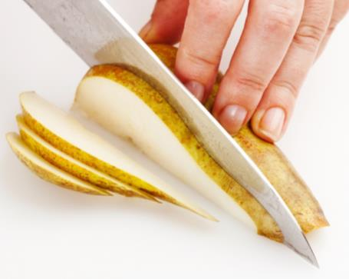
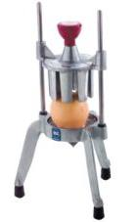
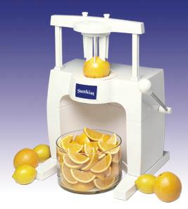
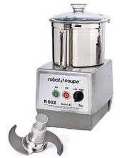
Fresh Fruit
Cut it!
  Knife/cutting board
  Sectionizer, robot coupe
  Use lemon juice, other citrus juice, or pineapple juice to prevent browning
Notes:
Fresh Fruit-a variety of fresh fruit served whole and cut will add some variety to the menu; however, cut fresh fruit can be a welcome change for elementary students with loose or missing teeth! And older students on the move will welcome the convenience of cut fruit.

Slide 25
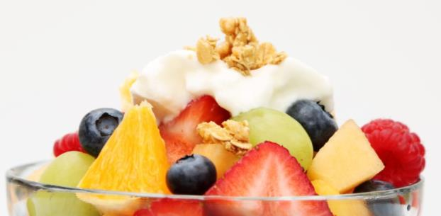

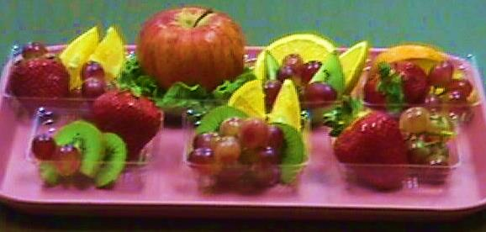
Fresh Fruit: Play with it
Dip it!
  Serve fresh fruit with a flavored yogurt dip
    or dip apple halves in dry gelatin
Color It!
  Mix two to three different color fruits
  Garnish fresh fruit with a slice of a different color

Slide 26

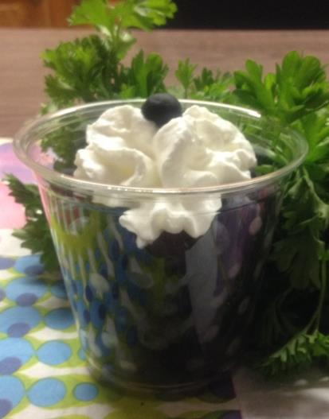
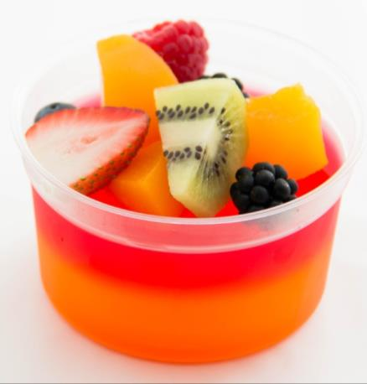
Fresh Fruit: Play with it
Kebob it!
  Skewer fruit chunks on coffee stirring sticks
Make blueberry dots
Top gelatin with it!

Slide 27
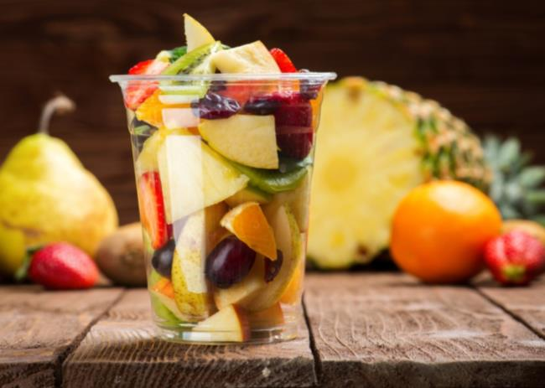
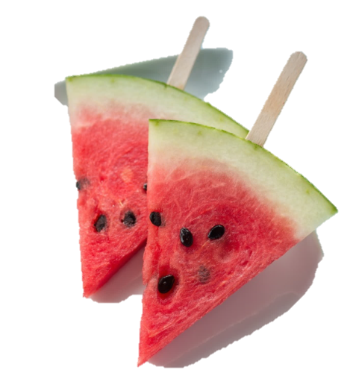
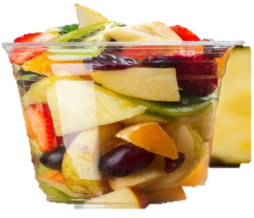

Fresh Fruit: Promote it!
Notes:
Adding a fruit basket with a variety to the serving line will make the line very attractive. Offer cut fruit in cups for easy service – a tall cup is easy to select and hold while a squat cup does not tilt over readily – students will enjoy both!
Make melon pops by inserting tongue depressors into wedges cut to provide ½ cup of fruit.

Slide 28
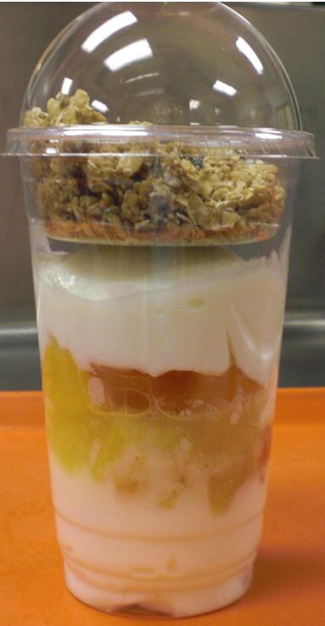

Fruit Parfaits
Layer yogurt, granola, and fresh or canned fruit in attractive cups

Slide 29
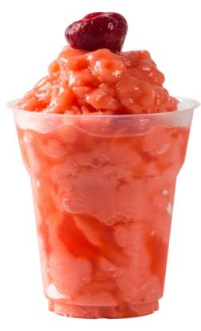

Smoothies and Frozen Fruit Juice or Puree
    Use at breakfast and lunch
    Offer within the 50% juice allowance
    Reference: USDA Memorandum SP 10-2014 (v.3)
Notes:
With their increasing popularity in school meals and snacks, USDA has altered the crediting regulations for smoothies. Policy Memo SP 36-2012 allowed Milk and fruit to be creditable in smoothies. Recent Policy Memo SP 10-2014(.3) extends crediting for yogurt as a meat/meat alternate at breakfast or lunch and at snacks. (The addition of yogurt to a smoothie does not serve as a substitution for fluid milk and milk varieties need to continue to be offered separately.) Even vegetables in smoothies are now creditable also. See above Policy Memos for further details.

Slide 30

Vegetables

Slide 31
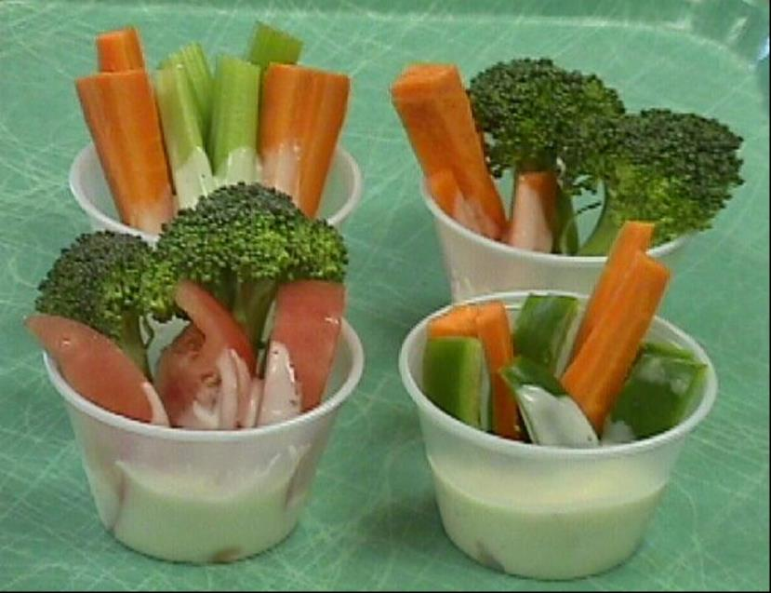
Red Orange Veggie Challenge
Combine for interest
  Cucumber and tomato salad
  grape tomatoes and green pepper slices w/ranch
  Garden salad w/ ¼ cup carrots or tomatoes
  Baby carrots and celery w/ranch
  Sweet and white potato fries
Notes:
Getting the 1st ½ cup for k-8 and the second serving for grades 9-12 into the menu is pretty easy; its including the extra ¼ cup to reach the required ¾ cup and 1 ¼ cup that gets very repetitious!
Rather than always adding a full ½ cup serving, combine the required ¼ cup red orange veggie into another menu item like…
Cucumber and tomato salad
grape tomatoes and green pepper slices w/ranch
Tossed/Garden salad w/ ¼ c carrots or tomatoes
Baby carrots and celery w/ranch
Veggie cups that include red pepper strips, carrots, or tomatoes along with broccoli, green pepper strips, celery sticks, squash sticks, or other raw “dipping” vegetables.
Mixing sweet potato fries half and half with the white potato version.

Slide 32
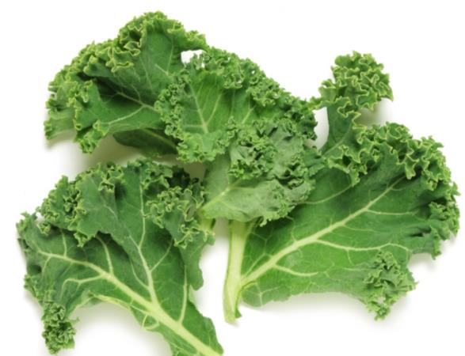
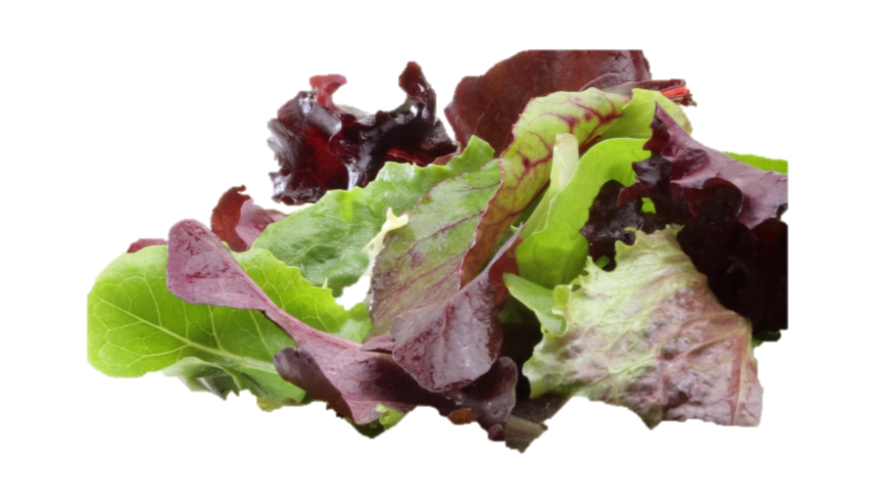
Dark Green Veggies: Use Variety
Mesclun - a fancy French word for spring mix!
  an alternate salad choice
  Affordable
Baby kale
  Tasty in salad
  Readily available in salad
      mixes
Notes:
Did you know? Mesclun is just a fancy French word for spring mix!
Both students and adults love spring mix as an alternate salad choice. Its really compact in the bag, so a 1 cup portion (approx. 2 oz wt) is easy to fluff into a serving bowl and not as expensive as you may think – you could get about 8 portions per pound!*
Baby kale is pretty tasty in salad and becoming readily available in salad mixes
*Note to presenter – green leaf lettuce FBG factor was used to estimate yield for mesclun since spring mix data is not provided. Calculations were done as follows using the 66% yield factor since spring mix is normally purchased trimmed and ready to serve:
18.8 lb X .66 = 12.4 lb EP; therefore, each portion would be just under 2 oz wt. (12.4 lb X 16 oz / 100 = 1.98 oz per portion)

Slide 33
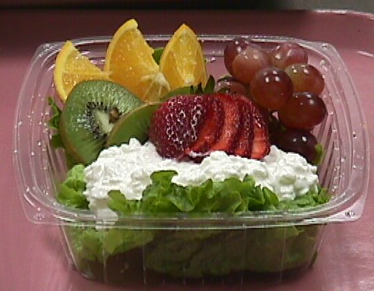
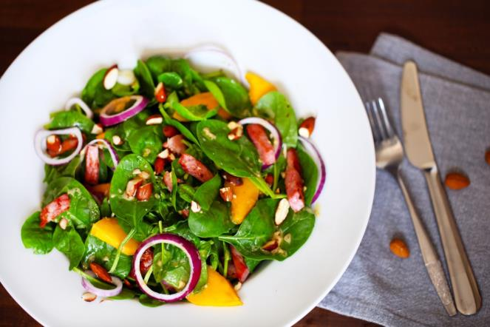
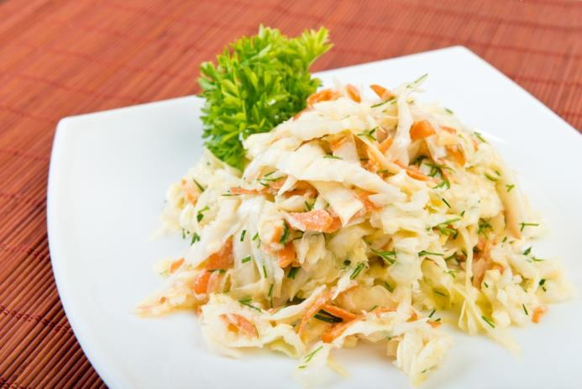
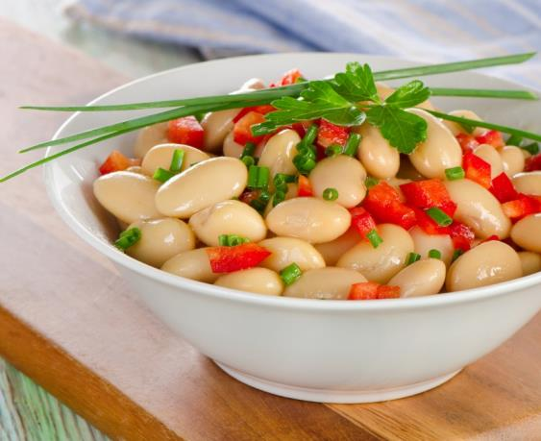
Try new salads
Notes:
Salads are popular and add variety to the menu. Add different salads often. Consider using a pre-cut salad mix that has a color variety with lettuce that qualifies as a dark green vegetable. Carrots, spinach, broccoli, cherry and/or grape tomatoes are also a great plus to add to vegetable salads for a pop of color – if enough of these ingredients are included in the recipe(s), these can also count towards the vegetable subgroups. Jazz up Cole slaw with chunks of pineapple or mango or coarsely chopped cilantro or try a white bean salad. And, of course, Chef’s salads are always popular.
For fruit, granola and yogurt are great additions to garnish or pair the fruit with served in clear or colored containers!

Slide 34
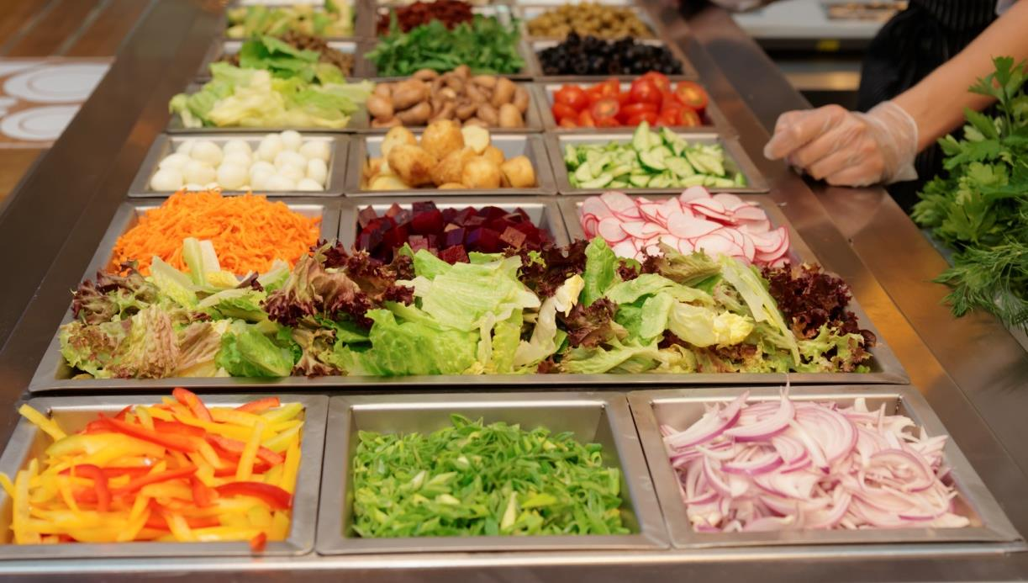
Consider a Garden Bar
Notes:
Garden Bars may be an option for increasing vegetable selections and acceptance for the reimbursable meal when placed prior to the point of service. USDA has provided guidance for bars that are placed after the point of service.
It is important to weigh potential increased participation against the cost, food waste, and food safety concerns to make a good decision about this type of vegetable service.

Slide 35


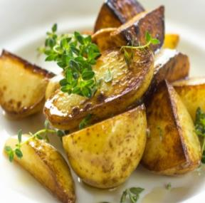


Veggies: Bring Back Mr. Potato!
Serve white potatoes more frequently
Prepare in a variety of ways –scalloped, mashed, roasted, baked, stuffed, salad…
To avoid competing choices and availability to all subgroups, consider allowing unlimited vegetable selections.
Notes:
Maximize your ability to serve white potatoes and draw students in to the cafeteria for their favorite vegetable. The meal pattern is intended to increase the variety of vegetables in the school menu; however, a school could offer the same vegetable every day provided the weekly menu meets all other meal requirements, including all vegetable subgroups in at least the minimum amounts over the week, and meets the dietary specifications, AND if students are not required to choose between competing subgroups. Allowing unlimited vegetable servings avoids any potential conflict with competing vegetable choices for the menu planner.

Slide 36

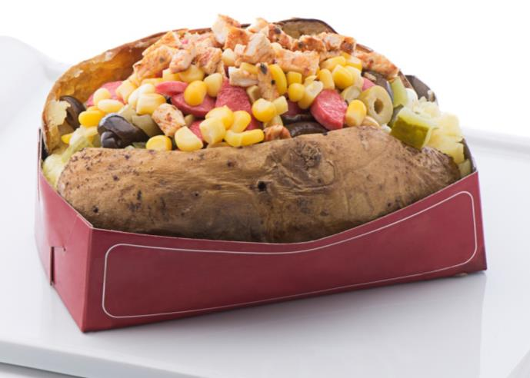
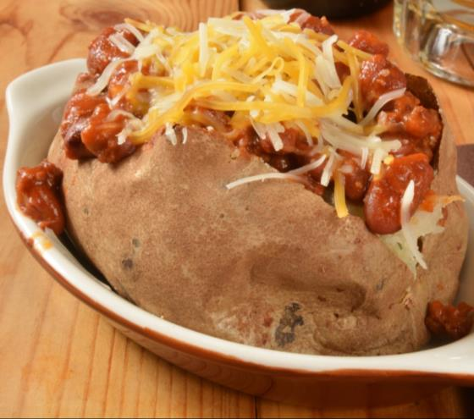



Try a Potato Bar!
Notes:
A Potato Bar! Offer margarine and/or sour cream (trans-fat free, of course) or even use vegetables and herbs for added variety and flavor! Use sweet and white potatoes for variations – even consider the purple sweet potatoes! Add meats and cheeses to transform the popular vegetable into a main dish. A sprinkle of parsley of another type of garnish can also be used if desired!
Change it up with a bowl of mashed potatoes or baked chunks, wedges, or fries – white or sweet!

Slide 37

Vegetables – give credit
If offering only 1 entrée, the vegetables in the entrée may be counted towards the vegetable subgroups if at least 1/8 cup.
  Example: A slice of pizza made with sweet potato crust may possibly credit towards the red/orange vegetable if there is at least ⅛ cup per serving of identifiable vegetable in the menu item
If offering multiple entrees, avoid counting vegetable contributions, so as not to limit availability to all subgroups over the course of the week.
Notes:
Credit vegetables when possible and not confusing to cashier and students. For example, if offering only 1 entrée, the vegetables in the entrée may be counted towards the vegetable subgroups if offered in greater than 1/8 cup servings. Think of it like this - A slice of pizza, served as the only entrée of the day, made with sweet potato crust may possibly credit as red/orange vegetable if there is visible 1/8 cup veggies in the sauce or on the pizza. You may only count this towards the vegetable subgroup if there are no other entrees to choose from. Every student must have the opportunity to select the vegetable subgroups offered, so if there are competing entrees, then this would not be possible unless sufficient red orange vegetables were offered again on another day.
For instance, if a chef salad made with romaine lettuce is one entrée that is offered along with a chicken sandwich entrée item and black bean taco entrée item, then the lettuce on the chef salad may be counted as a vegetable at point of sale, but this may not be the weekly offering as a dark green veggie since all students did not have the opportunity select this vegetable. Other dark green choices would have to be offered to all students at another time during the week. The student selecting the chef salad must be allowed to take the other vegetables offered if they desire so as to have the opportunity to take all vegetable subgroup offerings.
While you want to give credit when credit is due, please remember to keep it simple for the menu planner, employees, and students!

Slide 38


Vegetables – Juices and Smoothies
Many types of vegetable juices available
Offer a smoothie bar
Remember the 50% limitation on juice and puree
Notes:
Other ideas for increasing vegetable variety in menu planning include: offering vegetable juice and making vegetable smoothies. If you offer a smoothie bar, consider having dark green and re/orange selections such as spinach, kale, tomato, or carrots to add to the smoothie.
Remember that no more than ½ of the fruits/vegetables offered in a week may be from full-strength juice or puree.

Slide 39

Vegetables – get creative
Give vegetables creative names
Display the age-appropriate names on a poster or menu board outside the cafeteria
Zucchini Surfboards
Mummified Potatoes
Superman Spinach
Notes:
Think about the ages of the students you are serving, look for topics and characters that may appeal to them. Is there a new movie, game or popular toy you after which you could name your food? Kids like zombies, super heroes, games, and apps. You may even have a contest for the students to submit fun names for the foods you offer.

Slide 40




Vegetables – Promote and Teach
Give stickers for trying new foods or choosing extra vegetables
Check out free or low cost sources: Team Nutrition and others
Notes:
Younger students love stickers! You may want to offer a sticker with the choice of a fruit or veggie or give stickers to students when they try new food items.
Team Nutrition may have stickers available at no cost, or you may purchase from nutrition teaching tool suppliers such as NASCO or even order from Amazon.

Slide 41






Vegetables: Food for Fun
Notes:
You could team up with the art teacher or culinary class to ask for help with creative veggie displays. You could have the students prepare fun foods like these or even have a contest where students submit entries!

Slide 42

Milk
Notes:
Yes, all meals must still offer fluid milk in fat-free flavored and up to 1% fat unflavored varieties; however, …

Slide 43

Milk: Use in Smoothies!
Notes:
… as of July 2012, USDA allowed milk contained in fruit smoothies prepared in-house to be credited. While smoothies may provide the milk component, fluid milk must still be offered.
What are some safe, creative or appealing ways to offer milk to students of different grade groups?

Slide 44

breakfast
Notes:
We have all heard that breakfast is the most important meal of the day…and students need nutritious food to learn! Now that we have looked at all of the meal components used at breakfast and lunch, let’s look at some breakfast menu planning specifics: We will start by reviewing the breakfast meal pattern….

Slide 45
Breakfast Meal Pattern
    K-5
    6-8
    9-12
Flexibility in menu planning at breakfast
    All three grade group requirements overlap at breakfast
    A single K-12 menu can be used for all groups
Notes:
There are 3 grade groups that may be used to plan the menus: k-5, 6-8, and 9-12. The breakfast component requirements for the three grade groups overlap so a single menu could be used for all.
A meal pattern defines the required components that must be included on the day’s menu. The components included in a meal pattern are in the minimum amounts. For example, a K-12 Breakfast meal pattern could be met by offering the following menu: Dry cereal (1 oz eq), Fruit (4 oz juice and 1/2 cup sliced peaches), and 8 oz Milk in at least two varieties (1% low fat unflavored, Fat Free flavored); however, the meal pattern does not have to limit the menu planner to just these choices. The Breakfast meal pattern can be met by numerous other menu options and combinations. After the first 1 oz eq of daily grain is offered, a meats/meat alternates item may be substituted for part of the daily grain offering to meet the total weekly grain requirement.

Slide 46



Customers like choices
Daily Breakfast Meal Pattern
Milk | 1 cup
Fruit | 1 cup
Grain | At least 1 oz eq
Notes:
Meal patterns tell us the minimum amounts of each component that must be offered at a meal but do not limit the number of choices that can be offered. Customers of all ages like to have choices. Choices should be carefully considered to include foods that have student-appeal.
Create a breakfast menu that includes at least four (4) different items for a reimbursable meal. How many possible reimbursable meals could a student select from these items? Then create another breakfast menu that offers at least 6 different items that will make a reimbursable meal using the choices. How many possible reimbursable meals could a student select from these items?
Note: Offering choices of a meal component is not the same as offer vs. serve (OVS). OVS means that students may decline certain components. Choices mean that students may select the reimbursable meal (with or without OVS) from a variety of menu items.

Slide 47

What’s for Breakfast??!!
New ideas
Easy to prepare
Improved appeal
Increased participation
Notes:
What are some menu options that could be a good change and easily prepared for your breakfast program? Remember that presentation and merchandising of each and every menu item is part of a good customer service and will help with improved food appeal and increased participation.
Let’s take a look at some ideas that may work for providing some variety and excitement to the breakfast menus…..

Slide 48



Meats/Meat Alternates on the Breakfast Menu
Count eggs, meat, cheese, etc. as grain substitute!
Notes:
To simplify crediting and reduce confusion among prep staff, consider crediting all m/ma as substitutes for grain at breakfast. Maximum limits for grains are not enforced so counting the m/ma as a grain substitute will not have a negative impact on meal pattern compliance. Substitution of a M/MA for a grain option can be used once the menu planner has included a 1 oz eq of grain daily. Use this substitution option to include student favorites such as chicken biscuits, egg and cheese on English Muffins, sausage biscuits, cheesy grits, etc.
The key to best understanding of the meal components is consistency in menu planning – in other words, always use the substitution option, or always count the M/MA as extra food – the menu planner makes that choice!

Slide 49
Vegetables…at Breakfast? Yes!
Offer 2 cups of dark green, red/orange, legume or other veggie subgroups over the week; then count potato items towards the fruit component
Easily plan ½ cup veggies for 4 days a week by offering
    ½ cup of sliced tomatoes or grape tomatoes.
    Sliced or grilled green peppers, red peppers, spinach, or salsa when offering eggs
    Tomato juice or other 100% red/orange juice blend
Incorporate any leftover veggies at lunch
Notes:
Consider adding vegetables to breakfast!
Veggies can count towards the required 1 cup daily of fruit.
According to USDA Memorandum SP10-2012, Questions and Answers, the first two cups of vegetable substitutions for fruit at breakfast must be from the dark green, red/orange, legumes, or other vegetables before starchy vegetables can be served as a creditable offering; however, the vegetables do not have to be offered in any particular order during the week. Vegetable juice blends (with or without fruit juice) contribute to the “additional” vegetable subgroup and are subject to the 50% juice limit per week.

Slide 50



Vegetable ideas for breakfast
Sweet Potato Smoothie or Soufflé
Sweet Potato or Pumpkin and “chunky” carrot muffins
“Extra” hash browns or potato rounds
Notes:
Go on the wild side and offer a chilled sweet potato smoothie or soufflé made with ½ cup sweet potatoes and 4 ounces of yogurt (crediting for 1 oz eq M/MA) as a breakfast entrée which could be served chilled that no cooking would be required for those early meals. Offer graham crackers for the daily grain requirement and ½ cup juice to round out the 4 items needed for an offer vs. serve menu. Serve any leftover smoothie as an a la carte item at lunch.
Muffins made with mashed sweet potatoes or pumpkin and diced carrots may count as a grain and vegetable provided each muffin contains at least 1/8 cup of recognizable pieces of vegetable (in this case, diced carrots).
Sweet Potato Biscuits may also be offered but will not count as a vegetable unless the biscuit also contains at least 1/8 cup of recognizable, creditable vegetables. Since this is unlikely, sweet potato biscuits may be a nice change for a new grain item but not usable as a creditable red/orange vegetable. Reference: SP 10-2012 v. 9 – “ pureed foods such as fruits or vegetables may contribute to meal pattern requirements, provided that the dish that contains them also provides an adequate amount of recognizable, creditable fruits or vegetables.”
Offer hash browns or potato rounds as an extra food that does not contribute to meal if the weekly 2 cups of non-starchy vegetables have not been included in the menu; however, remember to include in the weekly nutrient standards.

Slide 51


Try Tomato Pizazz from Carteret County!
#10 can diced tomatoes
1 ½ Tbsp sugar
1 Tbsp lemon juice
1 tsp salt
2 Tbsp Worcestershire sauce
¾ tsp crushed red pepper
1 cup water
Blend all ingredients leaving a few small bits of tomato and enjoy this red orange vegetable with a celery stick!
Notes:
Carteret County School Nutrition Staff shared this recipe (excerpt from the complete instructions are on the screen) that has proven a popular red/orange offering at breakfast! Add a celery stick for a bit of color and extra veggie contribution if you like.

Slide 52

Vermont Maple Apple French Toast
http://www.vtfeed.org/materials/new-school-cuisine-cookbook
Notes:
Vermont Baked Maple Apple French Toast sounds and looks tasty. Find it here: Maple Apple French Toast, Windham-Raymond RSU #14, Maine. Recipe from Vermont FEED, New School Cuisine Cookbook (http://www.vtfeed.org/materials/new-school-cuisine-cookbook).
Available Resources- Blog Name: School Meals That Rock; Blog URL: http://schoolmealsthatrock.org

Slide 53


Banana Roll Ups or Ham and Cheese Muffins
Notes:
Here are some unique, and student- appealing breakfast or “breakfast for lunch” menu items:
Peanut butter and banana roll-ups and ham and cheese muffins.
Consider using other nut or seed butters, such as hazelnut or sunflower, for the roll ups and add drained, cooked sausage instead of ham to the muffin mix.
Would you serve these foods to your students? I know, I would!

Slide 54



Cinnamon Rolls and Pastries
Notes:
Include Cinnamon Rolls, other pastries, and cinnamon biscuits -- familiar, popular, and well-liked breakfast menu items that students enjoy eating any day. And, leftovers can be sold as a la carte for lunch on the same day and the next day to generate additional revenues.

Slide 55

Pre-Kindergarten Meals
Notes:
The Pre-K Meal Pattern may be better suited for the Pre-K students since they require less calories than school-aged students. If offering pre-K students the same meals as school aged students by following the K-5 meal pattern may provide extra calories that are not needed by this age group.

Slide 56

Lets Talk Pre-k
Benefits of Pre-K Meal Pattern:
  More appropriate serving sizes, calories and nutrients for age group
  Fruit and vegetable food components combined for smaller portions
  Smaller M/MA portions
  Less waste and lower food cost
The Pre-K meal pattern is available in 7 CFR 210.10
Notes:
Some benefits of using the specific Pre-K meal pattern include:
More appropriate portions and nutrients for the age group
Smaller portions reduce waste and food cost
Meal pattern combines the fruit and vegetable components – can serve ¼ cup of each
M/MA portion is smaller
List the smaller portion sizes separately on the production record to fully account for these meals.

Slide 57
Pre-K Meal Pattern
Daily Lunch Meal Pattern Ages 3 and 4
Milk | 1 cup
Fruit/Vegetable | 1/2 cup total
Meats/Meat Alternates | 1 ½ oz eq
Grain* | 1 serving daily *8 servings per week
Notes:
You may consider following the Pre-K meal pattern when serving this group of students.
Please see 7 CFR 210.10 or the “old” food buying guide for the complete meal pattern for Pre-K which is summarized on the slide (and below) for the preschool ages 3 and 4:
Milk – 6 fl oz minimum
Fruit/Vegetable - Can serve ¼ cup each of fruit and veggie, or 2 (1/4 cup) servings of fruit or 2 (1/4 cup) servings of vegetable
Meats/Meat Alternates – 1 ½ oz eq
Grains – 1 serving per day and 8 servings per week

Slide 58

Create interesting Meals
Notes:
Increase flavor and appeal for recipes and menu items - let’s explore some ways….

Slide 59

Flavors, Flavors, Flavors!
Use seasonings with less or no salt
Make your own blends
Experiment with new flavors
Reduce sodium gradually
Use salt in moderation
Notes:
Often the first thing that comes to most peoples minds when someone says seasonings is salt! It is true - there is salt in many of the seasoning blends available; however, there are many ways to enhance flavors without adding excessive salt:
Try making your own blends without adding salt or by adding only minimal amounts.
Buy low sodium or no salt blends.
Experiment with new flavor combinations and reduce sodium gradually.
And, use salt when needed – just use in moderation!

Slide 60

Flavor the vegetables!
Italian (basil, marjoram, oregano, garlic powder, thyme)
Cajun (paprika, garlic powder, black pepper, cayenne, oregano, thyme)
Rosemary
Mexican (cumin, chili powder, garlic powder, cayenne, paprika
Notes:
Here is a list of some great seasoning blends for vegetables and get amazing flavor without the salt.
Italian blends are made of several herbs and spices and go great on green beans or any type of mixed vegetables.
Cajun blends can give a kick to any vegetable and it especially goes great on fries and potato chunks.
Rosemary is a herb that can give an extra flavor boost to roasted white or sweet potato chunks.
Remember the Mexican and/or taco seasoning that goes great in refried, black or pinto beans!

Slide 61

For the Meat
  Cajun (paprika, garlic powder, black pepper, cayenne, oregano, thyme)
  Jamaican Jerk (onion powder, thyme, all spice, cinnamon, cayenne)
  Mexican (cumin, chili powder, garlic powder, cayenne, paprika
Notes:
Some great seasoning for meat are Cajun, Jamaican Jerk and Mexican. You can use the Cajun and Jerk on 8 piece chicken or season a grilled chicken breast and have a Cajun or Jamaican jerk chicken sandwich.
Mexican seasonings can be used to season ground beef for tacos or chicken for fajitas.
There are endless possibilities for herb blends or by themselves on entrées or vegetables!

Slide 62


Other Seasonings and Flavors
Offer vinaigrette dressings
Offer light dressings
Use butter, trans-fat free margarine, or oil in moderation when cooking vegetables
Offer a variety of condiments
Notes:
Offer a variety of reduced fat/fat free margarine, salad dressings, and/or sour cream in individual portions or bulk dispensers to add appeal to the menu. Consider placing these items strategically on the serving line near appropriate items to help market the menu!

Slide 63



Make a “shaker” bar!
Notes:
Maybe set up a “shaker bar” with lots of selections! Consider bottles of herb mixes and other flavors – Italian seasoning, Parmesan Cheese, crushed chili peppers, lemon pepper, and other popular herbs.

Slide 64





Serving Line Appeal – Eat your colors!
Use colorful or clear clam shells, boats, deli paper
Give items descriptive names
Vary cutting or presentation methods
Display pans neatly
Garnish the food
Notes:
Keep it colorful, neat, and appealing!
Offer Fresh Fruit tray or vegetable tray with ranch dressing (presents well with a beautiful color arrangement in a clear container)! Educational message for the students: Eat your colors!

Slide 65



Garnish Attractively
Use simple techniques
With produce on hand
Notes:
Also don’t forget to garnish the serving line and/or select dishes and menu items! A true meal appeal for enhancing the appetite!
Garnishes enhance our foods by:
adding color
adding contrast
adding visual appeal
Garnishes can be simple like cucumber or orange slices, lemon twists, strawberry fans, carrot ribbons, or a sprig of fresh herb such as parsley or cilantro. The items shown are fairly easy to do and are done with items readily available for most SN Programs! Remember, customers eat with their eyes - If it looks good, it will taste better!

Slide 66

Decorate the line: Food for Art
Have food art contests
Make a display for the top of the serving line
Notes:
You may not have the time to make every serving of food look like an animal or house or character, but you could take a couple of minutes and prepare a food art display – not for consumption of course!

Slide 67



Pleasing the students
Let students taste
Create flyers and colorful marketing
Use difference flavors
Find out what students want

Slide 68

Resources
Notes:
There are many free resources that will provide menu and recipe ideas. Let’s take a look at a few….
(Note to presenter: determine how extensively to show the videos and links depending on the time available.)

Slide 69
Resources
School Lunches That Rock
Recipe for Healthy Kids Cookbook: Cookbook for Schools
Michigan’s School Day Just Got Healthier
Notes:
Note to presenter: Select one of the links and briefly discuss the content. Right click on one of the resources listed and click on Open Hyperlink.
School Lunches That Rock link will take you to Pinterest where Dayle Hayes is showcasing school lunches.
Recipe for Healthy Kids Cookbook link will provide tasty food items with their standardized recipes and pictures. The recipes are organized based on components.

Slide 70
Resources
Michigan Team Nutrition’s Meeting the Challenge Recipe Book
Recipes are hyperlinked to YouTube - Chef is demonstrating the preparation of each food item
Standardized recipes
Notes:
All recipes in this cookbook are hyperlinked to YouTube, demonstrating the preparation of each recipe in the school kitchen by a chef.
The standardized recipes are listed for each menu item.
Note to presenter: Right click on the link, scroll down and click on “Open Hyperlink” and watch chef preparing one of the recipes.

Slide 71

Resources
http://whatscooking.fns.usda.gov/
Notes:
Another great resource providing a variety of menu items with standardized recipes – things like Eggritos, Mediterranean Quinoa Salad, and Green Bean and Rice Casserole.
Note to presenter: This slide is hyperlinked to “What’s Cooking, USDA Mixing Bowl’s” website. Right click anywhere on the picture then choose “open hyperlink” and you are taken to the website. Click on Recipes, large quantity, and USDA standardized information. From USDA standardized information, use the dropdown arrow and check mark the box indicating “Yes, this recipe has been standardized by USDA”. You will note the USDA recipes alphabetically listed with their recipes.

Slide 72
Resources
http://healthymeals.nal.usda.gov/recipes/recipes-school-food-service
http://www.fns.usda.gov/tn/recipes-healthy-kids-cookbook-child-care-centers-0
http://www.nfsmi.org/Templates/TemplateDefault.aspx?qs=cElEPTEwMiZpc01ncj10cnVl
Food Service Company Websites
Notes:
Note to Presenter: click on any of these links, and choose Open Hyperlink to immediately open them.

Slide 73
Resources
Anatomy of a standardized recipe: Finding & Creating School Recipes for Success with USDA Foods
Presenters: Dayle Hayes and Malissa Marsden
https://www.youtube.com/watch?v=MOnnby-mFKE&feature=youtu.be
Notes:
Let’s watch a few minutes of a YouTube presentation by Malissa Marsden and Dayle Hayes. Malissa provides an overview of how to create and modify standardized recipes, and Dayle shares a variety of available resources from agricultural boards, social media, and school nutrition programs.
Note to presenter: Right click on the URL (hyperlinked to YouTube presentation) then choose “open hyperlink” and show a few minutes of the presentation and move to the next slide. Please make sure internet connection is available.

Slide 74

In Summary…Make the Meal Pattern Work for Students!
Bring back or keep favorite foods
Introduce new items
Provide a variety
Merchandise well and provide great customer service
Notes:
Identify the types of foods students want to eat.
Plan menus to offer a wide variety of popular and well-liked foods;
Reintroduce some of the old favorite foods.
And, lastly, merchandise meals very well and always provide great customer service! Consider displaying a sample plate so students can see what's offered that day or use newly-popular electronic menu boards to promote the meal selections.

Slide 75

Questions?

Slide 76

The U.S Department of Agriculture (USDA) prohibits discrimination against its customers, employees, and applicants for employment on the bases of race, color, national origin, age, disability, sex, gender identity, religion, reprisal, and where applicable, political beliefs, marital status, familial or parental status, sexual orientation, or if all or part of an individual's income is derived from any public assistance program, or protected genetic information in employment or in any program or activity conducted or funded by the Department. (Not all prohibited bases will apply to all programs and/or employment activities.)
If you wish to file a Civil Rights program complaint of discrimination, complete the USDA Program Discrimination Complaint Form, found at http://www.ascr.usda.gov/complaint_filing_cust.html or at any USDA office, or call 866.632.9992 to request the form. You may also write a letter containing all of the information requested in the form. Send your completed complaint form or letter to us by mail at U.S. Department of Agriculture, Director, Office of Adjudication, 1400 Independence Avenue, S.W., Washington, D.C. 20250-9410, by fax 202.690.7442 or email at program.intake@usda.gov.
Individuals who are deaf, hard of hearing or have speech disabilities may contact USDA through the Federal Relay Service at (800) 877.8339; or (800) 845.6136 (in Spanish).
USDA is an equal opportunity provider and employer.

