Slide 1
Completing the Transported Meals Daily Meal Production Record
North Carolina Department of Public Instruction
School Nutrition Services
Revised July 2015
USDA is an equal opportunity provider and employer.
Notes:
Welcome Participants and distribute copies of sample delivery tickets and production records (use your own accurately completed samples or refer to the School Nutrition website at http://childnutrition.ncpublicschools.gov/information-resources/menu-planning-production/meal-production-records).
Briefly describe what participants will learn today:
What is a production record and delivery ticket
Why production records must be used
Who uses what information on the document
Procedures for proper completion and retention of the document
How to avoid common mistakes and errors
The Transported Meal Production Record is a required record for the National School Lunch and School Breakfast Programs. There are separate production records for Breakfast and Lunch due to the different meal components in the breakfast and lunch meal patterns. The information is to be recorded daily and kept in the school’s food service area. The production record is a management tool that will provide information for planning, producing and serving daily school meals. It is a legal document used to determine nutritional adequacy, assess food safety practices and support the claim for reimbursable meals. All forms other than the DPI prototype forms discussed in this presentation must be approved in writing by the State Agency prior to use.

Slide 2
Documentation
Delivery Tickets
Production Records
Notes:
When to use Transported Meal Production Record and Meal Delivery Ticket
Depending on the operation, there are two tools that can be used to document reimbursable meals at sites receiving transported reimbursable meals: the Transported Meal Production Record and Meal Delivery Ticket. The Transported Meal Production Record provides documentation for reimbursable meals served at a facility with limited on-site food preparation facilities and where meals are brought in (catered/transported) from an outside production site. The Delivery Ticket is designed to be used by the production kitchen to document the food prepared and delivered to the serving site.
Discuss the options with your School Nutrition Consultant to determine which works best for your operation. Ultimately the School Food Authority (SFA) is responsible for assuring that production records are completed; however, the catering contract may include language that also defines the caterer’s responsibility. Although each situation is unique, the production record instructions describe two options often used for recording meal service and production for SFAs receiving transported meals. You should review these options and determine the best solution for your site.
Copies of these documents are provided on the School Nutrition website at: http://childnutrition.ncpublicschools.gov/information-resources/menu-planning-production/meal-production-records
Look underneath the Transported Meals heading to locate.

Slide 3
Delivery Tickets for meals from a vendor
Notes:
Now, let’s review when it may be a good practice to use a delivery ticket:
When A School Receives Catered Reimbursable Meals from a Vendor:
The Transported Meal Production Record, when used alone, may be partially pre-filled by the SFA or the caterer; it is important that the SFA and caterer work together to determine who is responsible for documentation with both parties agreeing on the procedure to use. If the production records starts with the caterer, it may travel daily with the food from the catering operation to the school, where final information is recorded on the day of service. In this case, the caterer records the Menu in section (1) and Food Items in (6), contribution to the meal pattern in column (7), the portion size in column (8), the number of portions ordered (9a) and the amount of bulk food provided in column (9b) in units of pounds, # 10 cans or “each” for each menu item. At the school, the Transported Production Record would be completed by the School Nutrition administrator, starting with Section 1: Time and Temperature of delivery. The SFA would record the number of portions received (9c) and the number of portions served to students(10a), adults (10b) and a la carte portions served (10c). The SFA would record the number of portions leftover (11a) and their temperature or the time that meal service ended and leftovers were discarded (11b). The Transported Meal Production Record would need to be signed by the SN administrator and caterer and filed daily by the SFA. NOTE: Manually add a line for the second signature if this method is chosen. It is recommended that the caterer keep a copy of the completed production record for his/her records.
If using the Transported Meal Production Record and the Meal Delivery Ticket, the SFA will be responsible for ensuring all necessary documentation is captured on either the Transported Production Record or the Meal Delivery Ticket. The caterer will complete the Meal Delivery Ticket and the SFA will complete the remaining required documentation on the Transported Production Record. (Refer to the Transported/catered Production Record and Meal Delivery Ticket documents at http://childnutrition.ncpublicschools.gov/information-resources/menu-planning-production/meal-production-records). Sections of the production record that can be pre-filled ahead of the day of service include section 2 School Name, 3 Planned Reimbursable Meals, column 6 Food Items, and column 9a Number of Portions Ordered. Upon delivery of the food, record the Time and Temperature of foods that are time-temperature controlled for safety (TCS) in section 1 and the number of portions received in 9c. After meal service, record the number of portions served to students (10a) and adults (10b), a la carte portions served (10c) and leftover information (11a and 11b). The caterer will complete the Meal Delivery Ticket documenting the *Menu, *Meal Pattern Contribution, *Portion size, *Quantity of food prepared in units of pounds, #10 cans (or other can size as appropriate) or “each”. The caterer will record time of preparation of the food and temperature for TCS foods, time of delivery and temperature of food upon delivery. Information from the Meal Delivery Ticket can be transferred to the Transported Meal Production Record; however, it is recommended that the Meal Delivery Ticket be stapled to the Transported Meal Production Record daily to avoid duplication. The Delivery Ticket should accompany the meal, be signed by the caterer and the SN administrator and be attached to the Transported Meal Production Record and filed by the SFA. The caterer should keep a copy of the Meal Delivery Ticket for his/her records.

Slide 4
Transporting from a School to another Site
Notes:
When a school’s central kitchen or nearby school site is catering to another site where meals are claimed for reimbursement, both the Daily Meal Production Record (note: this is the production record used at the production kitchen) and Transported Meal Production Plan can be used to document reimbursable meals for proper claiming. If meals are claimed at the catered site (i.e. Early College), then a Transported Meal Production Record should be completed daily for that site. If the school is catering a non-school site (i.e. day care facility that is paying the SFA for the meals) where meals are not claimed for reimbursement by the School Nutrition Program, then the Daily Meal Production Record at the production kitchen along with the Meal Delivery Ticket furnished to the site would be sufficient.
The manager/employees would record information about the catered food provided to both types of locations mentioned in the previous two paragraphs on the Daily Meal Production Record used at the production kitchen in this manner:
Column 11(c): Include the number of servings planned to offer at the catered site in the Total Servings Planned to Offer
Column (15): Include the number of servings of each menu item that were served at the catered site as Non-reimbursable servings at the production kitchen
Section (4): Record the number of Catered Meals for that day.
Recording the information above correctly will ensure that both the production kitchen and catered sites have sufficient information to document that reimbursable meals were provided and the reimbursement claim may be sufficiently supported.

Slide 5
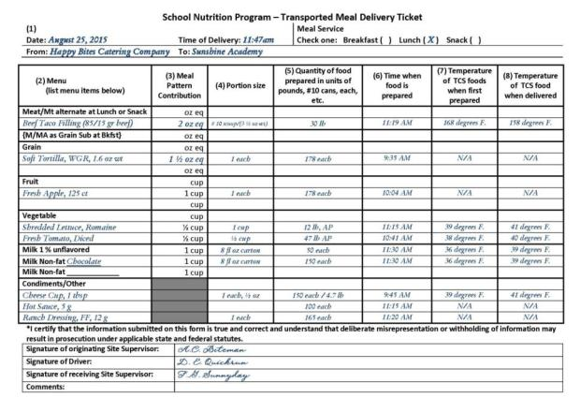
Completing the Delivery Ticket
Notes:
Now, let’s look briefly at the delivery ticket information to learn more if your school needs to use this option in combination with the daily production record. If you are not using the delivery ticket, you may skip these slides and go directly to information about completing the daily production record on slide # ?????.

Slide 6
Notes:
Refer to the delivery ticket sample already distributed as we review each section….

Slide 7
1
Notes:
Section 1: Enter the date and time of the delivery. Indicate the type of meal service for these menu items by placing a mark beside of breakfast, lunch, or snack. Enter the name of the establishment from which the foods originate and the name of the school or establishment receiving the foods.

Slide 8
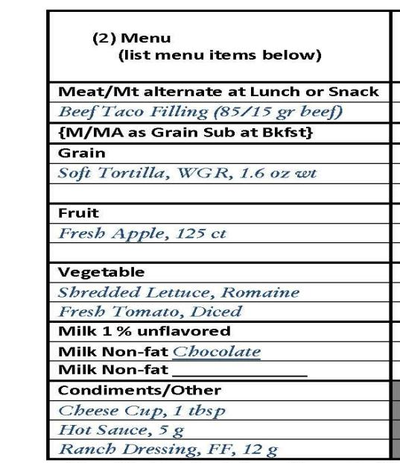
2
Notes:
Section 2: List the menu items in the appropriate meal component section. Be as specific as possible with the description of ingredients -- For example, indicate if the item was fresh, frozen, canned, the fat content, precut, flavor of fat-free milk provided, weight or size, etc.

Slide 9
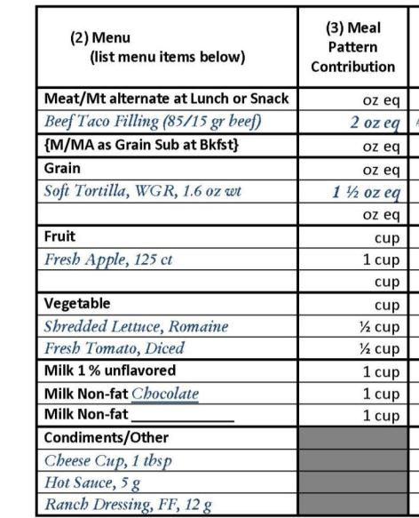
3
Enter the meal component crediting information here.
Notes:
Section 3: Indicate the amount of meal component contribution provided by the menu items. Be sure to refer to the meal pattern for the grade group of students being served breakfast, lunch, or snack for adequate component amounts for reimbursable meals. For example, carrots may contribute ½ cup, ¾ cup etc. A hamburger bun may contribute 1.5 oz eq, 2 oz eq, or another amount, depending on the weight of the bun. Five chicken nuggets may contribute 2 oz eq, 2.5 oz eq or another amount, depending on documentation from the processor. It is very important that accurate crediting numbers, based on reliable information, are used in this column.

Slide 10
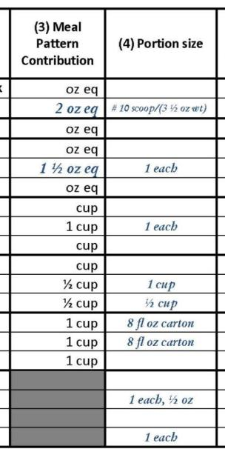
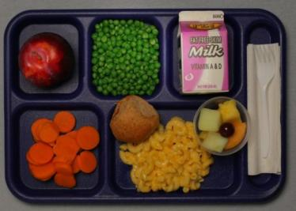
4
Enter the portion size of each meal component in column 4.
Notes:
Section 4: Indicate the portion size of the menu item to be served. Remember that portion size and meal component contribution is not always the same. For example, the portion size of spaghetti sauce may be 1 cup and it provides 2 oz eq of meats/meat alternates component; the portion size of baked beans may be 2/3 cup and it provides ½ cup of vegetable component; or the portion size of cheesy breadsticks may be 3 each and they provide 1 oz eq of grain and 2 oz eq of meats/meat alternates.
Think of portion size as the amount you expect to see on a plate or tray! Accurate standardized recipes should indicate both the portion size AND the meal pattern contribution.

Slide 11
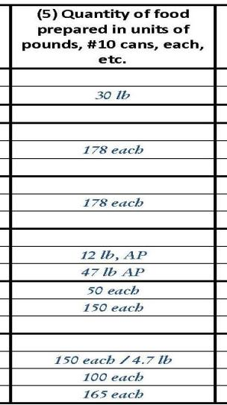
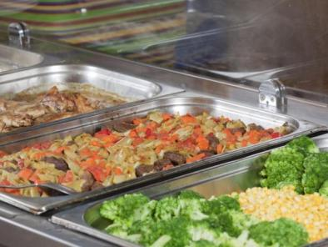
5
Provide the total amount of food prepared and delivered in column 5. Do no use “servings” in this column – be specific!
Notes:
Section 5: Indicate the total amount of the food prepared and delivered to the site. Use purchase units as listed in the USDA Food Buying Guide and as indicated on your accurate standardized recipes for placing creditable food items into production. This information should be entered as pounds or ounce weight (e.g. 13 lb cheese or 40 lb ground beef), number of cans with the can size specified (e.g. four #10 cans, twelve #303 cans, etc.), each (e.g. 100 each pizza slices, or 100 each chicken patties, or 100 each 110 count oranges), or a volume measure such as gallon or quart (e.g. 1 gallon fat-free ranch dressing). Do not use “cases” since the weight or number of servings in the case may vary.)

Slide 12
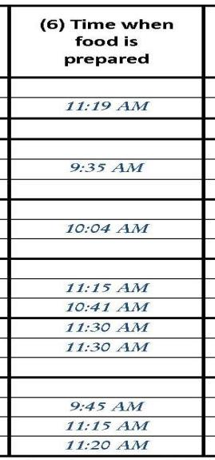
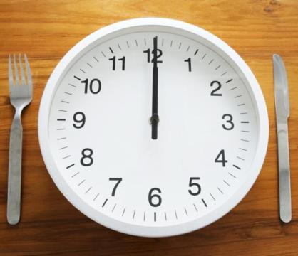
6
Indicate the times that preparation is completed for the various menu items
Notes:
Section 6: Write in the time that the food preparation is completed. This time will likely be different for various menu items.

Slide 13
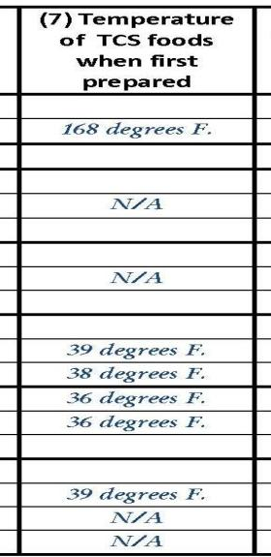
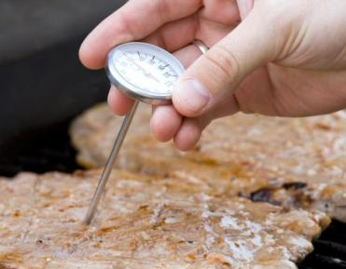
7
Indicate the temperature for each TCS food when preparation or cooking is completed.
Notes:
Section 7: Measure the temperature of time-temperature controlled for safety (TCS) foods when the cooking or preparation is completed at the time noted in section 6. Write the measured temperature of the first pan or batch of food prepared in this section; if multiple pans or batches are prepared, measure the temperature of each to make sure that final temperatures are in compliance with safe food handling practices. Refer to the North Carolina Food Code and/or the HACCP Plan templates in Part 1: Safe Food Handling for proper cooking and preparation instructions (http://childnutrition.ncpublicschools.gov/information-resources/menu-planning-production/information-resources/haccp-food-safety ).

Slide 14
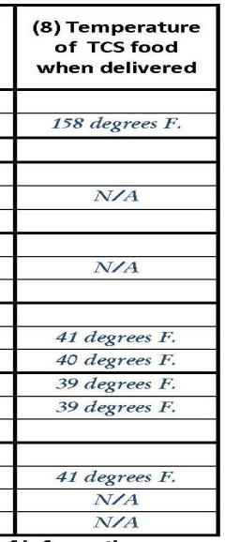
8
Indicate the temperature for each TCS food when the delivery arrives at your school. Accept only safe food!
X
Notes:
Section 8: When the food is delivered to the receiving site, a representative of the School Food Authority or receiving faciltiy should measure the temperature of each of the TCS foods to ensure that they are being delivered within the safe range of 41 degrees F. or below for cold foods or 135 degrees F. or above for hot foods. This temperature should be taken by using a properly calibrated, clean and sanitized thermometer. Do not accept and serve TCS foods that are not at a safe temperature when delivered since you have no way of knowing how long they have been in the temperature danger zone. (See Criteria for Accepting or Rejecting Food in the HACCP Plan for Transported Meals, Part 2: Safe Food Handling.)

Slide 15
Signatures Required!
Notes:
Bottom of Delivery Ticket: Obtain required signatures to validate the information on the Delivery Ticket. File the Delivery Ticket with the Daily Meal Production Record when the menu items are being used as part of reimbursable meals or snacks. Enter comments as needed about this delivery – you might use this space to note items that were not acceptable quality, short, or our of a safe temperature range.
And another quick note to remember -- The Delivery Ticket must be filed and kept for 3 years plus the current school year. If production records are also used, it should be stapled to the corresponding meal’s production record. It is recommended that a copy of the Delivery Ticket be kept on file by a caterer and the receiving site.
Now, let’s move to the daily production record….

Slide 16
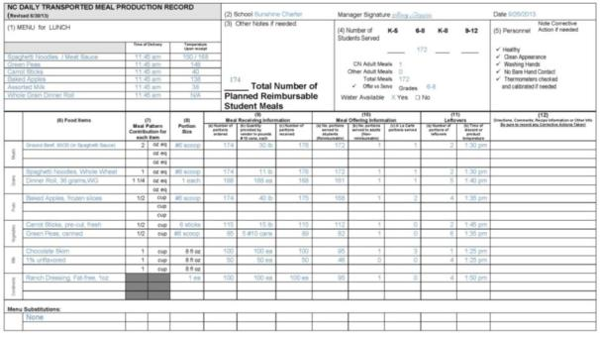
COMPLETING THE NC DAILY MEAL PRODUCTION RECORDS
Notes:
Now, let’s look specifically at the transported meal production record. You may refer to the samples already distributed as we discuss each section.
The production records supports the USDA Meal Pattern; a menu that follows the meal patterns and contains information consistent with standardized recipes for each item on the menu. Information for all reimbursable meals must be supported by a Production Record. (Refer to the example already distributed.)
In this example, the data can be entered at three different time periods:

Slide 17
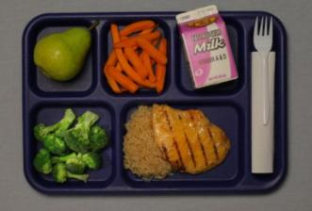
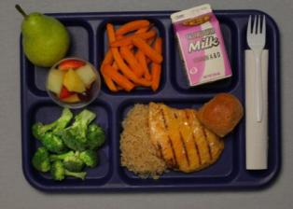
Now, Let’s look at the LUNCH Production Record….
Notes:
The Daily Meal Production Plan is a required record for the National School Lunch and Breakfast Program. The information is to be recorded daily and kept in the facility’s food service area. The two major sections, Meal Receiving and Meal Offering, allow the form to be a management tool, determine nutritional adequacy, assess food safety practices, and support the claim for reimbursable meals.
All forms other than the DPI prototype production record must be approved in writing by the State Agency prior to use. The form must be completed thoroughly and accurately daily to support the student meal reimbursement claim. All items required as part of the HACCP Plan are printed in italics in these instructions and must be completed daily.

Slide 18
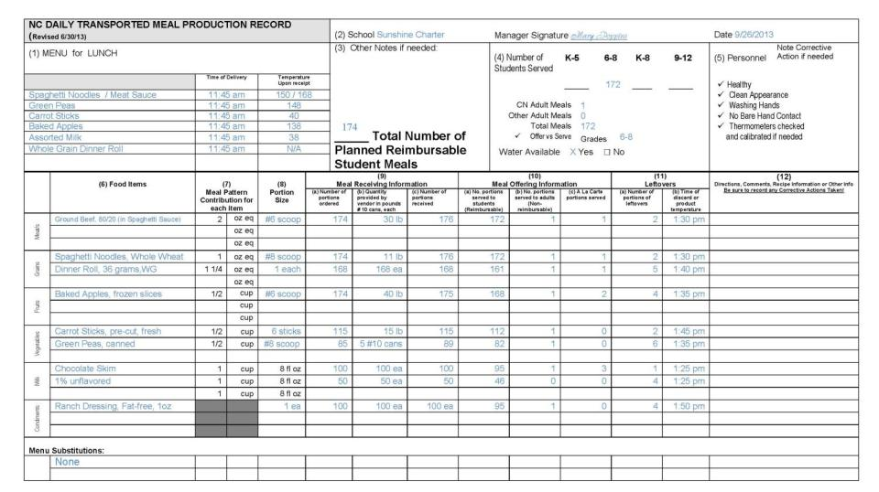
Notes:
Look at the sample document provided for Lunch. There are separate documents for breakfast and lunch because the meal pattern components are now different for those meals. We will first review the lunch document seen on this slide and then move to the breakfast production record later in the presentation. With the exception of the meal components, the documents and instructions are very similar.
We strongly encourage you to use this approved prototype as it captures the required information for compliance with the Administrative Review and HACCP.
If you choose to use alternate form(s), you must submit to DPI for prior approval. Even when using alternate form(s), all of the information on the NC Daily Meal Production plan, including the HACCP monitoring and instructions, must be included in your documentation.

Slide 19
The production record is …
A tool for planning the menu items to order
A source of information about food quantities for use in the nutrition analysis
A record of foods received, offered, served, and leftover to support the reimbursement claim
A source of information for forecasting future production needs
Notes:
Each of these are USDA record keeping requirements to document nutritional adequacy and proper types and amounts of available foods to support the meal reimbursement claim.

Slide 20
Why use this tool?
USDA requires menu and food production records to support meal reimbursement and HACCP monitoring
It documents that requirements for meal components are met and adequate amounts and required portion sizes are provided
Notes:
Emphasize that this is a USDA requirement!

Slide 21
Who needs it?
Managers use it to plan and order food, communicate with employees, document food production and service, and track inventory usage
Employees use it to learn the daily menu items, find out the amounts to serve, and record amounts leftover for each meal
SN Administrators, Supervisors, and SA Consultants use it to verify compliance with USDA regulations.
Notes:
Explain that many people use information on the production record in various ways.
Managers use it to control food ordering and service in an efficient way.
Place the production record in the food service area so employees can refer to it for complete serving information.
Schools participate in several types of observations and reviews – periodic program visits from the director or supervisor, annual SN program reviews, Technical Assistant Reviews by the State Agency (SA) consultants, Administrative Reviews by a SN team of consultants. All of these reviews must verify compliance with USDA regulations.

Slide 22
Managers must …
Use the record as a plan before ordering food
Verify that employees provide accurate information at the end of the day of service to document amounts served and leftover
Assure that the record is completed accurately on the day the meal is served to prevent data being “made up” later
Notes:
The HACCP monitoring should be completed during and after service to verify safe high quality food.
The meal receiving information should be completed. If the delivery ticket is used, it may be attached to the production record for reference about the amounts of food prepared by the caterer.
The meal offering and leftover sections should be completed after the meal to document the quantity of food served. Remember that the production record should record what was really planned and actually occurred for that meal.

Slide 23
Learn how to correctly complete NC Daily Meal Production Plan by reviewing the document and instructions at least every year
Recognize that complete and accurate records is a basic job requirement for every Manager
Periodically check for completion and accuracy without waiting until a contact from the State Agency
Notes:
The Daily Meal Production Record is required meal documentation for School Food Authorities (SFAs) participating in the National School Lunch, School Breakfast Program, and After School Snack Programs. The information is to be recorded daily and used in the school’s food service area.

Slide 24
It’s REQUIRED !!!
Lack of complete and current production records can result in withholding and/or reclaiming federal funds
Notes:
Through and accurate daily production records are required for the school to be eligible for meal reimbursement.

Slide 25
How long do you keep records?
Keep for the current school year plus the past three years.
Turn into the central office or file in the food service area according to your facility’s procedure
Notes:
USDA requires that records are kept safely and entirely for 3 years. Store the records clearly labeled in a secure place.

Slide 26
Common Problems and Errors
Records are incomplete or missing.
Number of menu items or food quantities offered is not plausible when compared to the number of meals.
HACCP monitoring is not complete
Inaccurate/inadequate information to document components and/or reimbursable meals
Notes:
This slides shows common production record problems and errors observed during Technical Assistance Reviews and Administrative Reviews.

Slide 27
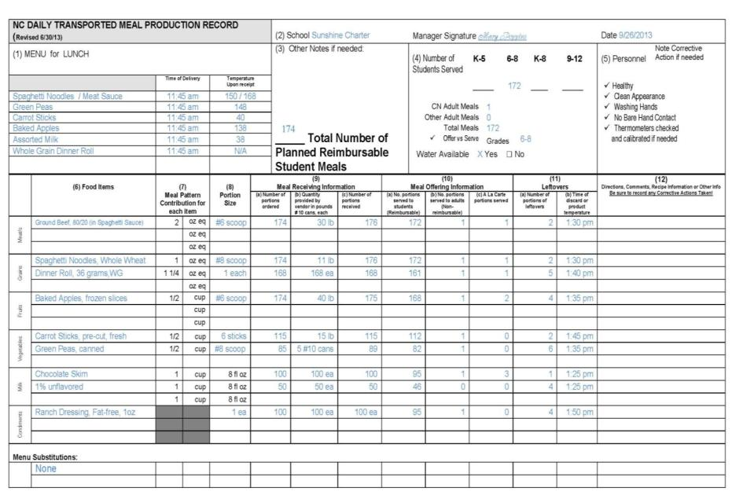
Notes:
Let’s look at a sample of a completed lunch menu production record for a day. Refer to it when maintaining this form; or call your SN director to discuss local procedures.
The Daily Meal Production Plan is a required record for the National School Lunch and Breakfast Programs. (A production record is also required for the after school snack program and there is another form for that use that allows the manager to complete one page per week.) The information is to be recorded daily and kept in the school’s foodservice area. The two major sections, Meal Preparation and Meal Offering, allow the form to be a management tool, determine nutritional adequacy, and assess food safety practices.
Even when using alternate form(s), all of the information on the N.C. Daily Meal Production plan, including the HACCP monitoring and instructions, must be included in your documentation.
The Transported Meal Production Record, when used alone, may be partially pre-filled by the SFA or the caterer; it is important that the SFA and caterer work together to determine who is responsible for documentation with both parties agreeing on the procedure to use. If the production records starts with the caterer, it may travel daily with the food from the catering operation to the school, where final information is recorded on the day of service.
Alternately, the production record may be used in conjunction with the delivery ticket discussed previously in this presentation.

Slide 28
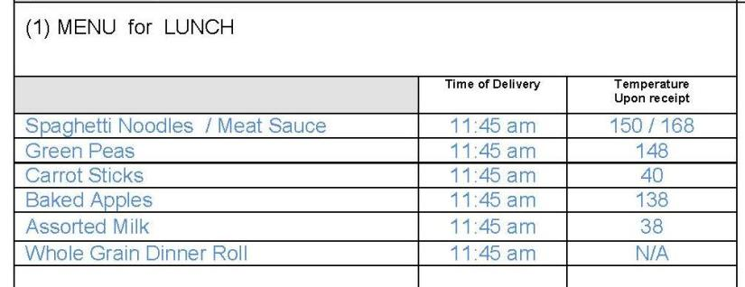
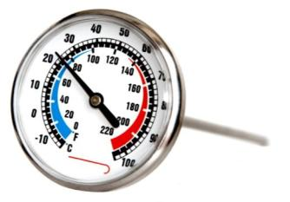
1
Notes:
(1) MENU -- Enter menu planned for the day. List any additions to the menu or substitutions from the planned menu.
The following information needs to be completed only for menu items that are Time-Temperature Controlled for Safety (TCS ) foods– see Menu Summary information in HACCP Part 5: Menus and Recipes. Be sure employees are using a properly calibrated thermometer.
MENU -- Enter menu planned for the day. Record any substitutions made in the planned menu also. The following information must be completed for menu items that are time- temperature controlled for safety (TCS). The temperature of all TCS foods will be checked using a calibrated thermometer upon receipt of the catered foods at the serving site and recorded along with the time of the delivery. If meals are individually pre-plated, select representative meal(s), measure and record the temperature of each time-temperature controlled for safety (TCS) food along with the time of the delivery.
Time of delivery – Record the time the food was received from the food production site at the serving site.
Temperature upon receipt – Upon receipt of the food at the serving site, check the actual product temperature of the food with a properly calibrated thermometer. Measure the temperature of the food before the food is offered to students. If a cold food is not at 41˚F or colder and hot food is not at 135˚ F or hotter it should not be accepted from the food production site or served. The time and temperatures recorded in this column should be recorded for all time-temperature controlled for safety foods (TCS) accepted and served to students.
If Time as a Public Health Control Procedures (TPHC) are being implemented as a food safety control, follow the written procedure included in the HACCP Plan for documenting time when removed from holding and discard times. Foods subject to TPHC must be discarded by the end of the time specified in the written procedure. File copies of all approved TPHC procedures in the HACCP plan in Part 5: Menus and Recipes.

Slide 29
Signature … Required when info is verified!
2
Notes:
School, Manager, and Date
Enter name of the school, manager signature, and date of meal service. The signature indicates that the manager or person in charge has fully reviewed the meal planning, production and service and is satisfied with the accuracy of the information. If the caterer is completing any section(s) of the record, add a line for the caterer to sign daily as well.

Slide 30
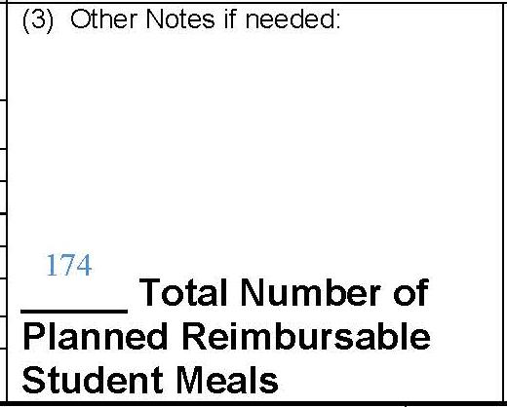
3
Notes:
Total Number of Planned Reimbursable Student Meals
Record the total number of student meals planned at the time you complete column 9a and prior to ordering food. The amounts of food planned for student reimbursable meals must be consistent with the number of reimbursable meals planned in section 3. For example, if you are planning 335 reimbursable student meals, you cannot plan more than this number of total entrees or milks; likewise, you could not plan more than 670 servings of vegetables and fruits if students are only allowed to take two servings. You may plan less than these amounts if students participate in offer vs. serve and often decline some menu items.

Slide 31
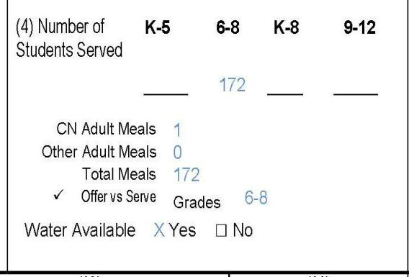
4
Notes:
Number of Students Served
After meal service, record the total number of students served, indicating the meal pattern used such as K-5, 6-8. K-8 or 9-12. Indicate the number of CN (Child Nutrition) meals served (if any), Other Adult Meals purchased, adding all columns to determine the Total Meals served. Check if students participate in Offer vs Serve and indicate grade levels implementing Offer vs Serve. Check that water is available without restriction and at no charge at meal service.

Slide 32
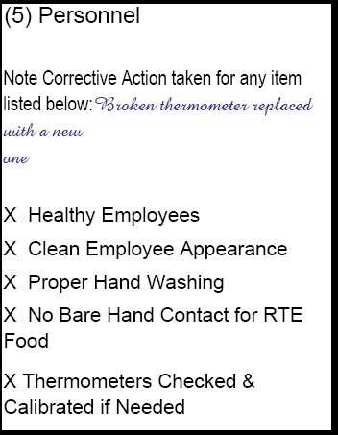
5
Notes:
Personnel – These five items support your daily HACCP Plan. Each should be checked if in place. Note any corrective action taken if you were unable to check that all were in place.
Healthy – Are all employees who are handling and serving foods healthy? If an individual is sick, she/he should not be handling exposed food, single-use articles, cleaned and sanitized dishware and equipment, and clean linens.
Clean Appearance – Are employees properly dressed according to the food safety standards outlined in 2-4: Prerequisite Programs?
Washing hands – Are employees properly washing their hands with warm water, soap, and drying?
No Bare Hand Contact – Employees should not be handling cooked or ready-to-eat foods with their bare hands. They should use tongs, utensils, deli tissue, or single-use gloves.
Thermometers checked and calibrated if needed -- Thermocouples do not require calibration; if using one, make a notation of N/A.

Slide 33
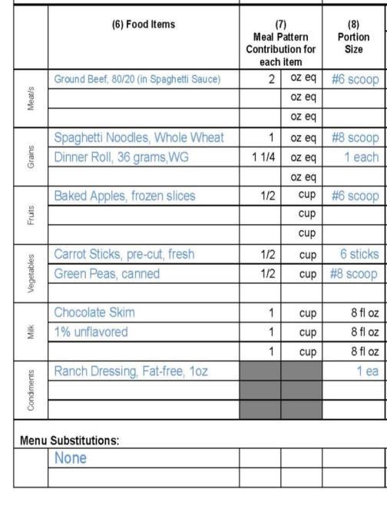
6, 7, & 8
Notes:
Food Items
From the menu items written in Section 1, list by meal component, the foods to be served. Meal components are different for breakfast and lunch, requiring the use of different production records for each meal. Lunch components include Meats, Grains, Fruits, Vegetables and Milk.
Include descriptive information about each product to assure an accurate nutrient analysis. For example: reduced fat, fat-free, diced, sliced, fresh, frozen, identify whole wheat products as WW and whole grain products as WG. Specify the various milk choices the same way that you list any other menu item. Milk cannot be “recycled”; once it leaves the line on a student’s tray it cannot be returned for service to others. The milk might become contaminated while on the student’s tray and so could potentially become a source of illness for the student to whom the milk is re-served.
Menu Substitutions: Items added on the day of service would be considered a menu substitution since the original planned amounts would be adjusted to accommodate this last minute addition. If any menu items are substituted on the day of meal service, draw a line through the menu item that will not be served and list the substituted menu item in this section; complete columns 7-12 for the menu substitution.
Meal Pattern Contribution
Enter the amount of meal pattern contribution for each menu item using the units provided. (i.e. 2 oz. meat/meat alternate, 1 ounce equivalent of grain, ½ c. fruit, ½ cup vegetable, 1 cup milk). Remember that the Meal Pattern Contribution may be different than the actual weight or measure of the Portion Size (for example, 5 chicken nuggets may contribute 2 oz. of meat/meat alternate to the food based meal pattern but their total weight may be more than 2 oz. The actual portion size listed in column 8 would be 5 nuggets)
Portion Size
Enter the actual portion size of each menu item. (portion size is the amount of food served on the tray/plate). The portion size must be in “measurable” units such as each, cup, ounce, etc. Verify the Portion Size by measuring or weighing the menu item; if the Portion Size is inadequate, contact your caterer.

Slide 34
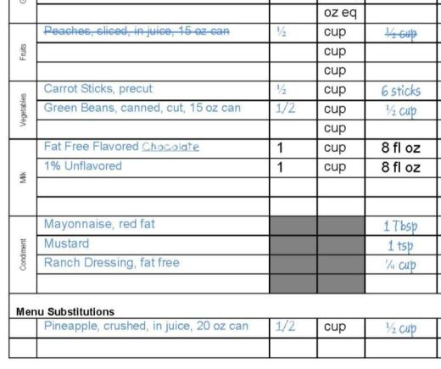
6, 7, & 8
Continued….
Notes:
This is the bottom portion of the page showing columns 6, 7, and 8. You will note that a line is drawn through the peaches and pineapple is entered at the bottom of the page underneath the Menu Substitutions heading. All substitutions must be documented daily.

Slide 35
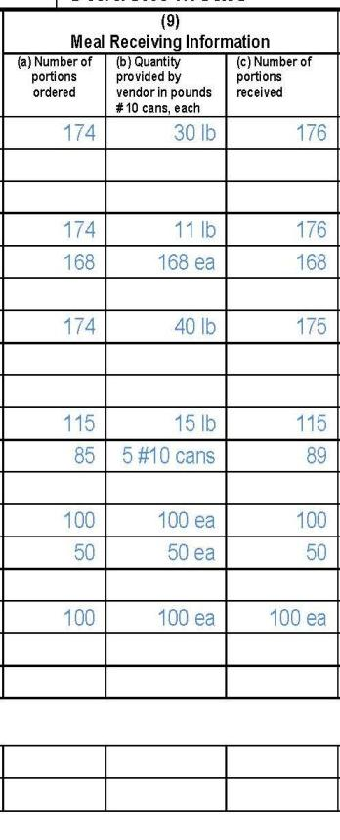
9a
Enter the number of portions ordered for each menu item.
Plan before you order food to control costs! Use previous records to forecast accurately.
Notes:
Meal Receiving Information
Number of portions ordered- Enter the number of portions (servings) ordered for each menu item.

Slide 36
Process of Determining Number of Portions Needed
Number of Portions to Plan
Past Production Records
Notes:
You should refer to past production records for receiving, serving, and leftover information to assist with future menu orders. Careful ordering will help control meal costs.
Let’s look at the next slide and see how this information becomes a cycle….

Slide 37
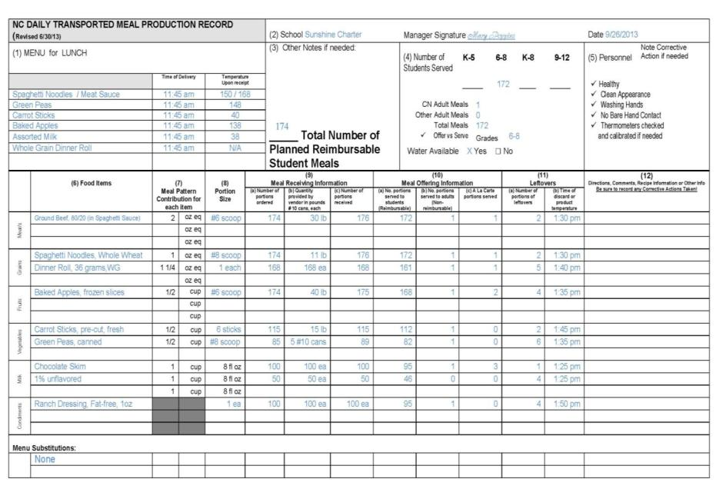
Notes:
Use historical production information as a guide for future planning. Planning amounts will not always exactly match production amounts; however, it should be close if student enrollment remains fairly constant. If there are excessive leftovers, investigate the cause and adjust planned amounts accordingly for future menus.

Slide 38
Common Errors with Production Record Planning
All information for foods planned to offer is not completed.
Amounts of planned foods are inconsistent with the number of planned meals.
Milk and condiments are not planned.
Notes:
This slide shows some common mistakes made when planning for meal service. Be sure to accurately plan all menu items and condiments so that all items needed for the menu may be ordered in sufficient amounts.

Slide 39
9b
Provide the total amount of food prepared and delivered in column 9b. Do no use “servings” in this column – be specific!
Notes:
Meal Receiving Information
Quantity provided by Vendor in pounds, #10 cans, or each- The caterer must provide the bulk quantity of the amounts of each menu item prepared and delivered for the meal. For example, 5 #10 cans of peas, 30 lb of ground beef for spaghetti, 15 lb of carrots sticks, 150 each chicken patties. Recording number of servings or portions is not sufficient to show that the amount of food was adequate for the meal pattern requirements. If a delivery ticket is used along with the production record, this information would already be recorded on that document and may be attached to the daily production record.
Number of portions received- Enter the number of portions (servings) received from the caterer for each menu item.

Slide 40
9c
Enter the number of portions actually received for each menu item.
Notes:
Meal Receiving Information
Number of portions received- Enter the number of portions (servings) received from the caterer for each menu item.
You will want to check to see that the number of portions are consistent with the total quantities indicated in column 9b by referring to the USDA Food Buying Guide, manufacturer product formulation statements, or CN labels.

Slide 41
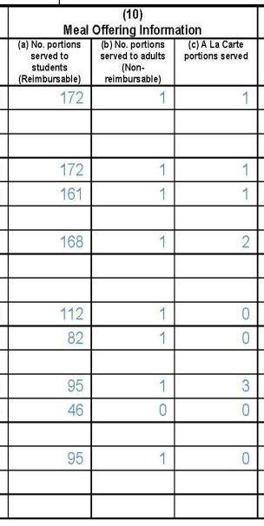
10a
Enter the number of portions served to students for the reimbursable meal.
Notes:
Meal Offering Information
No. portions Served to Students (Reimbursable)- Record the number of portions (servings) served to students as part of reimbursable meals.

Slide 42
10b
Enter the number of portions served to adults.
Notes:
Meal Offering Information
No. portions Served to Adults (Non-reimbursable)-Record the number of portions (servings) of each menu item served for adult-priced meals or served to adults, including CN employees.

Slide 43
10c
Enter the number of portions sold that were not part of the reimbursable meals or adult meals.
Notes:
Meal Offering Information
A la Carte Portions Served- Enter the number of servings of each menu item that were sold that were not part of a complete reimbursable meal. This information is recorded only if your organization sells servings of foods to adults or students that are not part of a reimbursable meal. An example of this would include a student buying an extra piece of pizza or a carton of milk or a teacher purchasing an entree.

Slide 44
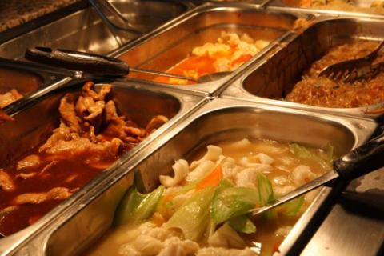
11a
Enter actual number of portions of each menu/food item left after all meals have been served.
Notes:
Leftovers
Number of Portions of Leftovers- Enter actual portions of each menu/food item left after all meals have been served, regardless of preserving or discarding the food.

Slide 45
11b
Enter the time foods are discarded at the end of meal service.
Notes:
Leftovers
All leftover TCS foods must be discarded at the end of meal service. No catered foods can be saved for service at a later time. Exception: individually packaged, unused non-TCS foods (i.e. pop tarts, cereal bars, muffins, individually sealed pre-cupped canned fruits, individually packaged 100% fruit juice, etc.) and unserved cartons of milk that have been temperature controlled, will be safely monitored and maintained at proper temperature, and are deemed safe to be used the following day.
Time of Discard or Product Temperature- All Time-Temperature Controlled for Safety (TCS) foods must be held for service at safe and appropriate temperatures. It is expected that catered food will be held in appropriate methods to maintain safe temperatures prior to service and that food temperatures are regularly checked with a properly calibrated thermometer. Catered food should never be allowed to be held for service longer than 4 hours. At the end of meal service, record in this column either:
The time meal service ends if all food items are to be discarded or
The temperature of each TCS menu item, prior to discarding the food. If any menu items, such as unserved temperature controlled cartons of milk, are routinely saved for re-service, the temperature of the food must be recorded in column (11b) at the end of the meal.

Slide 46
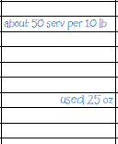
12
Write instructions or comments here.
Notes:
Directions, Comments, Recipe Numbers or Corrective Actions Taken
Write in special directions, food preparation and serving notes, comments, recipe numbers or recipe information, leftovers (individually packaged items only) or other information relative to the menu production for the day’s menu or notes for another day.

Slide 47
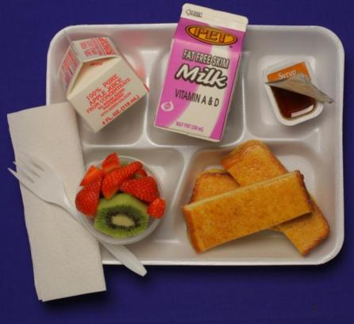
Now, Let’s look at the BREAKFAST Production Record….
Notes:
The breakfast meal pattern has changed and so has the production record! The breakfast meal service is recorded on a separate document in order to capture the breakfast component crediting for Grains, Fruit, and Milk along with an indication of M/MA used as a substitute for grain or “other” item.

Slide 48
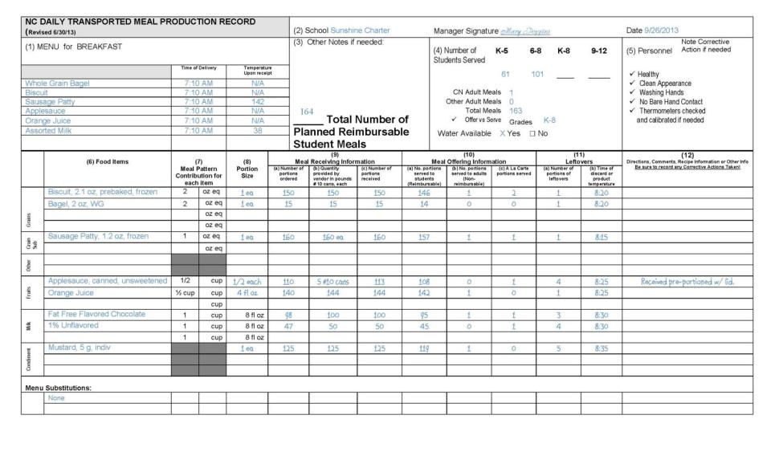
Notes:
As just mentioned, there is a separate production record for Breakfast because the meal pattern components are different for those meals. Breakfast meals no longer contain a meats/meat alternates component. We strongly encourage you to use this approved prototype as it captures the required information for compliance with the Administrative Review and HACCP.
As with the lunch production record, if you choose to use alternate form(s), you must submit to DPI for prior approval. Even when using alternate form(s), all of the information on the NC Daily Meal Production plan, including the HACCP monitoring and instructions, must be included in your documentation.

Slide 49
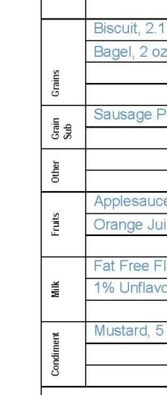
Changes to the meal components
Notes:
The breakfast production record is the same as the lunch production record with the exception of the sections used to document the meal pattern component contribution crediting. The breakfast production record indicates the meal components of grain, fruit, milk along with substitute for grains and other. The breakfast meal pattern no longer contains meats/meat alternates. Under certain circumstances, M/MA may credit as a substitute for grains so refer to current USDA guidance about the breakfast meal pattern. Alternately, M/MA may be used as an “other” menu item which does not provide component crediting of any type. The menu planner must make this determination before the menu is planned, offered, or served.

Slide 50
Questions?
Notes:
Please contact your School Nutrition Administrator or regional School Nutrition Specialist or Consultant with questions.

Slide 51
The U.S Department of Agriculture (USDA) prohibits discrimination against its customers, employees, and applicants for employment on the bases of race, color, national origin, age, disability, sex, gender identity, religion, reprisal, and where applicable, political beliefs, marital status, familial or parental status, sexual orientation, or if all or part of an individual's income is derived from any public assistance program, or protected genetic information in employment or in any program or activity conducted or funded by the Department. (Not all prohibited bases will apply to all programs and/or employment activities.)
If you wish to file a Civil Rights program complaint of discrimination, complete the USDA Program Discrimination Complaint Form, found at http://www.ascr.usda.gov/complaint_filing_cust.html or at any USDA office, or call 866.632.9992 to request the form. You may also write a letter containing all of the information requested in the form. Send your completed complaint form or letter to us by mail at U.S. Department of Agriculture, Director, Office of Adjudication, 1400 Independence Avenue, S.W., Washington, D.C. 20250-9410, by fax 202.690.7442 or email at program.intake@usda.gov.
Individuals who are deaf, hard of hearing or have speech disabilities may contact USDA through the Federal Relay Service at (800) 877.8339; or (800) 845.6136 (in Spanish).
USDA is an equal opportunity provider and employer.

