Slide 1
Completing the Homestyle Kitchen Daily Meal Production Record
North Carolina Department of Public Instruction
School Nutrition Services
Revised July 2015
USDA is an equal opportunity provider and employer.
Notes:
Welcome Participants and distribute copies of sample production records (use your own accurately completed samples or refer to the School Nutrition website at http://childnutrition.ncpublicschools.gov/information-resources/menu-planning-production/meal-production-records). Briefly describe what participants will learn today:
What is a production record
Why production records must be used
Who uses what information on the document
Procedures for proper completion and retention of the document
How to avoid common mistakes and errors

Slide 2
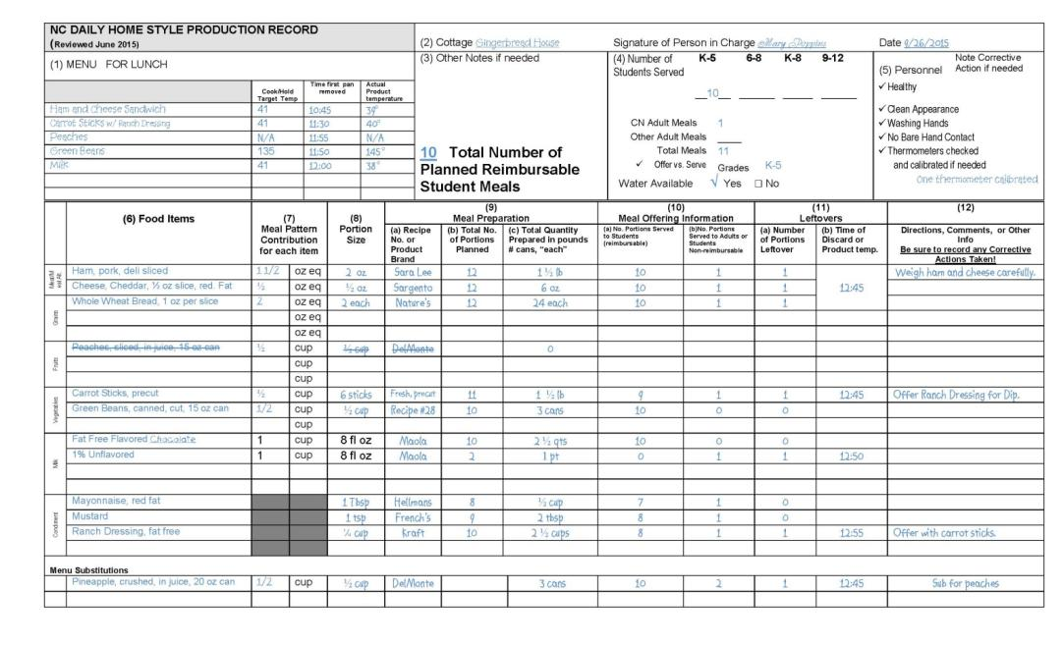
COMPLETING THE NC DAILY MEAL PRODUCTION RECORDS
Notes:
The production records supports the USDA Meal Pattern; a menu that follows the meal patterns and contains information consistent with standardized recipes for each item on the menu. Information for all reimbursable meals must be supported by a Production Record. (Refer to the example already distributed.)
In this example, the data can be entered at three different time periods:
The basic MENU information, recipe number, recipe name, meal component contribution, and portion size is often supplied by the central office before distribution to the school.
The information for the number of portions planned is computed by the kitchen facility manager/employee in advance of the meal before ordering food.
The total quantity prepared, number of portions served to students and adults, and leftover information is completed by the facility manager/employee the day the meal is prepared and served. All items required as part of your HACCP Plan are italicized in the instructions and must be completed daily

Slide 3
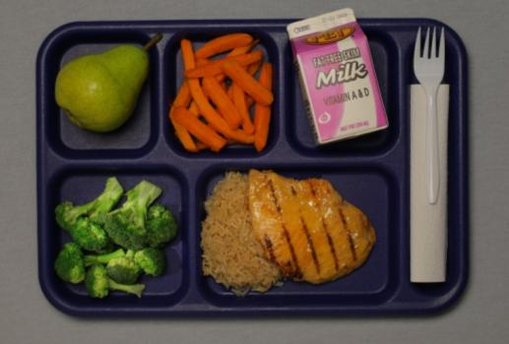
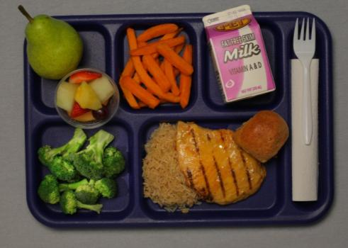
Now, Let’s look at the LUNCH Production Record….
Notes:
The Daily Meal Production Plan is a required record for the National School Lunch and Breakfast Program. The information is to be recorded daily and kept in the facility’s food preparation and service area. The two major sections, Meal Preparation and Meal Offering, allow the form to be a management tool, determine nutritional adequacy, assess food safety practices, and support the claim for reimbursable meals.
All forms other than the DPI prototype production record must be approved in writing by the State Agency prior to use. The form must be completed thoroughly and accurately daily to support the student meal reimbursement claim. All items required as part of the HACCP Plan are printed in italics in these instructions and must be completed daily.
It is recommended that sections 1 (Menu items and target temperatures), 3, 6, 7, 8, 9a, and 9b be completed at least 1-2 weeks ahead of the day of actual meal service to allow the production record to be used as a tool for ordering/purchasing food. This information may be prepared or partially completed by the central office menu planner prior to distribution to managers; doing so may increase accuracy and ensure that all required meal components, including the vegetable subgroups are included. Other sections must be completed on the day of meal service.
Examples are provided for completed menu records for a day. Refer to them when maintaining this form. School Nutrition (SN) Administrators should contact the State Agency (SA) consultants for technical assistance. Managers should contact the School Nutrition Administrator to discuss local procedures. In this example, the data can be entered at three different time periods: the basic menu information supplied by the central office, the PLANNING section information provided by the manager in advance of the meal, and the TODAY’S PRODUCTION/SERVICE columns completed the day the meal is prepared and served. All items required as part of your HACCP Plan are printed in italics in these instructions and must be completed daily.

Slide 4
Notes:
Look at the sample document provided for Lunch. There are separate documents for breakfast and lunch because the meal pattern components are now different for those meals. We will first review the lunch document seen on this slide and then move to the breakfast production record later in the presentation. With the exception of the meal components, the documents and instructions are very similar.
We strongly encourage you to use this approved prototype as it captures the required information for compliance with the Administrative Review and HACCP.
If you choose to use alternate form(s), you must submit to DPI for prior approval. Even when using alternate form(s), all of the information on the NC Daily Meal Production plan, including the HACCP monitoring and instructions, must be included in your documentation.

Slide 5
The production record is …
A tool for planning the foods to order and prepare
A source of information about food quantities for use in the nutrition analysis
A record of foods prepared, offered, served, and leftover to support the reimbursement claim
A source of information for forecasting future production needs
Notes:
Each of these are USDA record keeping requirements to document nutritional adequacy and proper types and amounts of available foods to support the meal reimbursement claim.
The production record can also function as a task assignment for employees by highlighting assigned tasks in various colors for employees or writing their names beside of the menu item when more than one person works in the kitchen.

Slide 6
Why use this tool?
USDA requires menu and food production records to support meal reimbursement and HACCP monitoring
It documents that requirements for meal components are met and adequate amounts and required portion sizes are provided
Notes:
Emphasize that this is a USDA requirement!

Slide 7
Who needs it?
Managers use it to plan and order food, communicate with employees, document food production and service, and track inventory usage
Employees use it to learn the daily menu items, find out the amounts to prepare, and record amounts leftover for each meal
SN Administrators, Supervisors, and SA Consultants use it to verify compliance with USDA regulations.
Notes:
Explain that many people use information on the production record in various ways.
Managers use it to control high quality food production and service in an efficient way.
Place the production record in the kitchen along with the recipes for the day so employees can refer to it for complete production information.
Schools participate in several types of observations and reviews – periodic program visits from the director or supervisor, annual SN program reviews, Technical Assistant Reviews by the State Agency (SA) consultants, Administrative Reviews by a SN team of consultants. All of these reviews must verify compliance with USDA regulations.

Slide 8
Managers must …
Use the record as a plan before ordering food
Verify that employees provide accurate information at the end of the day of service to document amounts prepared and leftover
Assure that the record is completed accurately on the day the meal is served to prevent data being “made up” later
Notes:
The planning section must be completed before the meal is served to accurately order food. Some of this information (such as sections/columns 1, 6, 7, 8, 9a, and 9b) may be prepared or partially completed by the School Nutrition central office staff prior to distribution to facility staff in the homestyle kitchens. In other facilities, the manager may complete all of the information.
The HACCP monitoring should be completed during and after service to verify safe high quality food.
The meal offering and leftover sections should be completed after the meal to document the quantity of food served. Remember that the production record should record what was really planned and actually occurred for that meal.

Slide 9
Learn how to correctly complete NC Daily Meal Production Plan by reviewing the document and instructions at least every year
Recognize that complete and accurate records is a basic job requirement for every Manager
Periodically check for completion and accuracy without waiting until a contact from the State Agency
Notes:
The Daily Meal Production Record is required meal documentation for School Food Authorities (SFAs) participating in the National School Lunch, School Breakfast Program, and After School Snack Programs. The information is to be recorded daily and used in the school’s food preparation and service area. The two major sections, Planning and Production, allow the form to be a management tool, determine nutritional adequacy, and assess food safety practices.
All forms other than the DPI prototype forms must approved in writing by the State Agency prior to use.

Slide 10
It’s REQUIRED !!!
Lack of complete and current production records can result in withholding and/or reclaiming federal funds
Notes:
Through and accurate daily production records are required for the school to be eligible for meal reimbursement.

Slide 11
How long do you keep records?
Keep for the current school year plus the past three years.
Turn into the central office or file at the kitchen according to your facility’s procedure
Notes:
USDA requires that records are kept safely and entirely for 3 years. Store the records clearly labeled in a secure place.

Slide 12
Common Problems and Errors
Records are incomplete or missing.
Planned number of menu items is not plausible when compared to the number of planned meals.
HACCP monitoring is not complete
Inaccurate/inadequate information to document components and/or reimbursable meals
Notes:
This slides shows common production record problems and errors observed during Technical Assistance Reviews and Administrative Reviews.

Slide 13
Notes:
◉ Note to Leader – Distribute a sample of the production record and instructions for completing the form to use as reference during the workshop.
Let’s look at a sample of a completed lunch menu production record for a day. Refer to it when maintaining this form; or call your SN director to discuss local procedures.
The Daily Meal Production Plan is a required record for the National School Lunch and Breakfast Programs. (A production record is also required for the after school snack program and there is another form for that use that allows the manager to complete one page per week.) The information is to be recorded daily and kept in the school’s food preparation and service area. The two major sections, Meal Preparation and Meal Offering, allow the form to be a management tool, determine nutritional adequacy, and assess food safety practices.
All forms other than the N.C. Department of Public Instruction (NCDPI) prototype forms must approved in writing by the State Agency prior to use.
Even when using alternate form(s), all of the information on the N.C. Daily Meal Production plan, including the HACCP monitoring and instructions, must be included in your documentation.
Schools are encouraged to use the approved prototype as it captures the required information for compliance with the Administrative Review and HACCP.

Slide 14
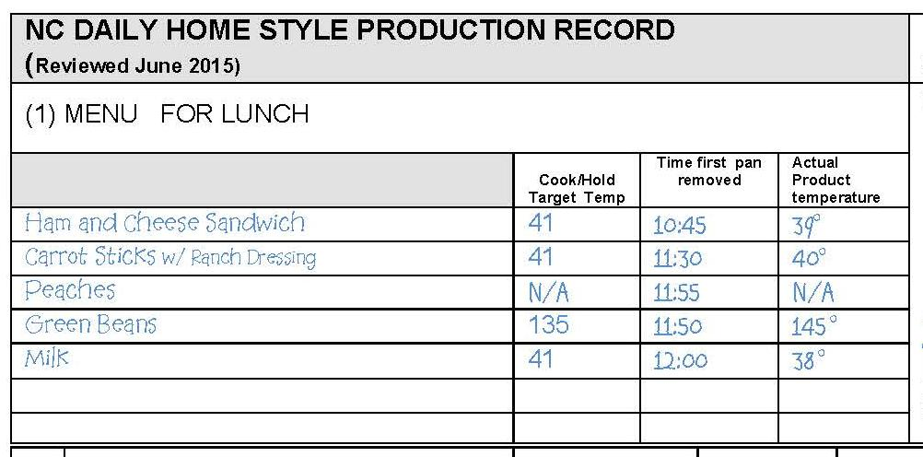
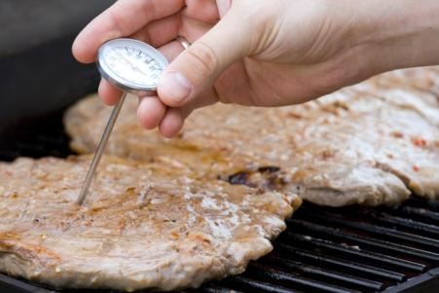
1
Notes:
(1) MENU -- Enter menu planned for the day. List any additions to the menu or substitutions from the planned menu.
The following information needs to be completed only for menu items that are Time-Temperature Controlled for Safety (TCS ) foods– see Menu Summary information in HACCP Part 5: Menus and Recipes. Temperatures are only recorded for the first pan or batch of each menu item. The temperature of all remaining pans will be checked for doneness or the temperature will be checked before the item is removed from the refrigerator but not recorded on the Production Plan. Be sure employees are using a properly calibrated thermometer.
Cook Target Temperature – Record the safe cooking or preparation temperature for each TCS menu item (see HACCP Part 1: Safe Food Handling Procedures).
Time First Pan Removed – Record the time that the first pan of TCS food was removed from the oven or in the case of cold food when preparation was completed.
Food Temperature once cooked/prepared – Check the actual food temperature with a properly calibrated thermometer. If the food does not meet the cook target temperature, continue cooking until it does. Do not record this temperature because the corrective action is to continue to cook the item to the proper temperature before service. Do not put food on the serving line until it is safe to eat. In summary, the temperatures recorded in this column should be the end cooking temperatures for menu items that have reached the cook target temperature or the temperature of uncooked foods when preparation is completed. If the temperature is not at 41 degrees or below for a TCS cold food, chill the food to this temperature within 2 hours in order to serve it safely.
If Time as a Public Health Control Procedures (TPHC) are being implemented as a food safety control, follow the written procedure included in the HACCP Plan for documenting time when removed from holding and discard times. Foods subject to TPHC must be discarded by the end of the time specified in the written procedure. File copies of all approved TPHC procedures in the HACCP plan in Part 5: Menus and Recipes.

Slide 15
Signature … Required when info is verified!
2
Notes:
(2) Cottage, Manager Signature, and Date
Enter name of the cottage, manager signature, and date of meal service. The signature indicates that the manager or person in charge has fully reviewed the meal planning, production and service and is satisfied with the accuracy of the information.

Slide 16
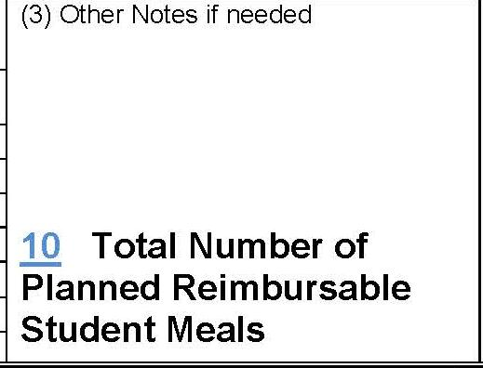
3
Notes:
(3)Total Number of Planned Reimbursable Student Meals
Record the total number of planned reimbursable student meals. This will be the number of column 9b minus the planned number of adult meals.
You may also use this section to record notes about today’s meal service that may explain any unusual or irregular circumstances (e.g. several students gone on a field trip or out sick, incorrect food deliveries requiring extensive substitutions, etc.)

Slide 17
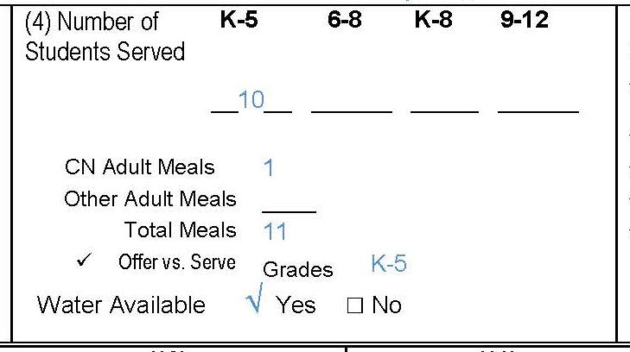
4
Notes:
(4)Number of Students Served
After meal service record the total number of students served, indicating the meal pattern used such as K-5, 6-8. K-8 or 9-12. Indicate the number of CN (Child Nutrition) meals (if any), Other Adult Meals served (if any), adding all columns to determine the Total Meals served. Check if students participate in Offer vs Serve and indicate grade levels implementing Offer vs Serve.
Verify that drinking water is available to all students without restriction.

Slide 18
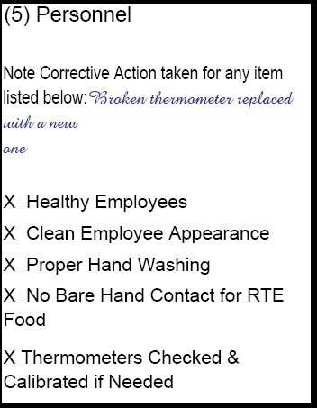
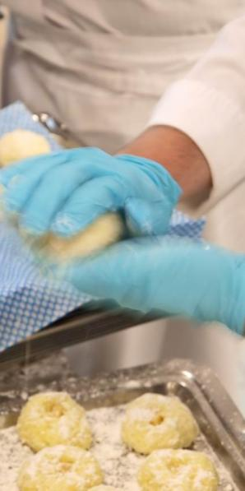
5
Notes:
(5) Personnel – These five items support your daily HACCP Plan. Each should be checked if in place. Note any corrective action taken if you were unable to check that all were in place.
Healthy – Are all employees who are handling and serving foods healthy? If an individual is sick, she/he should not be handling exposed food, single-use articles, cleaned and sanitized dishware and equipment, and clean linens. Refer to the HACCP Plan Part 1: Prerequisite Programs, Appendix A for more information about employee health and when to exclude or restrict employees from food handling duties.
Clean appearance – Are employees properly dressed according to the food safety standards outlined in Part 1: Prerequisite Programs?
Washing hands – Are employees properly washing their hands with warm water, soap, and drying?
No bare hand contact – Employees should not be handling cooked or ready-to-eat foods with their bare hands. They should use tongs, utensils, deli tissue, or single-use gloves.
Thermometers checked and calibrated (if needed) – Are thermometers checked for accuracy daily and calibrated if needed? Calibration is the process of verifying the accuracy of a thermometer. Thermocouples do not require calibration; if using one, make a notation of N/A.

Slide 19
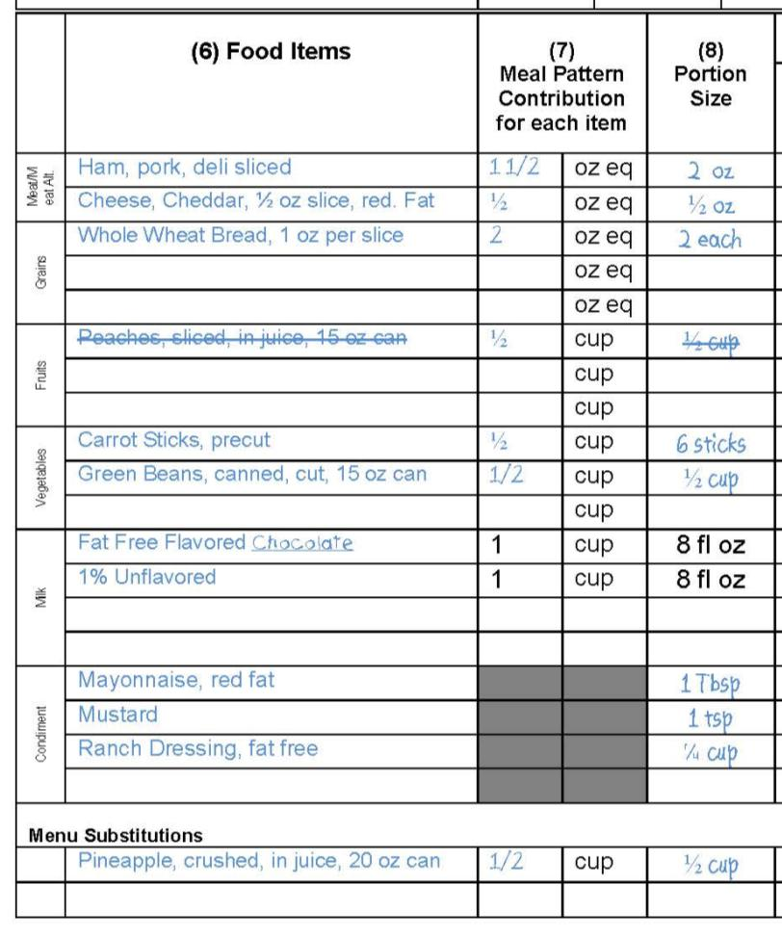
6, 7, & 8
Notes:
MENU PLANNING
(6) Food Items
From the menu items written in Section 1, separate them by meal component, in column 6. Include descriptive information about each product to assure an accurate nutrient analysis (i.e. sweetened, reduced fat, fat-free, diced, sliced, fresh, frozen, etc.) Identify whole wheat products with WW and whole grain-rich products with WGR. Please note that fruit and vegetables are now separate components and need to be documented individually on the production record. Meal components are different for breakfast and for lunch, requiring the use of different production records for each meal. Remember to list the various milk choices the same way that you list any other menu item. Include condiments with the serving size (for example” ketchup, 9 gram packet” or “ketchup, 2 Tbsp.” and description of dressings, such as: ”ranch, fat free or French, reduced fat”, etc.)
Menu Substitution: Items added on the day of service would be considered a menu substitution since the original planned amounts would be adjusted to accommodate this last minute addition. If any menu items are substituted on the day of meal service, draw a line through the menu item that will not be served and list the substituted menu item in this section; Complete columns 7-12 for the menu substitutions.
(7) Meal Pattern Contribution
Enter the amount of meal pattern contribution for each menu item using the units provided. (i.e. 2 oz. meat/meat alternate, 1 ounce equivalent of grain, ½ c. fruit, ½ cup vegetable, 1 cup milk). Remember that the Meal Pattern Contribution may be different than the actual weight or measure of the Portion Size (for example, 5 chicken nuggets may contribute 2 oz. of meat/meat alternate to the food based meal pattern but their total weight may be more than 2 oz. The actual portion size listed in column 8 would be 5 nuggets). Meal Pattern Contribution should be included on each standardized recipe and can be determined from the USDA Food Buying Guide, product labels, and product spec sheets.
Breakfast components include Grains, Fruits, and Milk. There is no requirement to offer Meats/Meat Alternates (m/ma); however, m/ma may be included in the breakfast menu in two ways: 1) as a Grain Substitute once the minimum daily grain requirement is met or 2) as an “other” food that does not credit toward any component.
(8) Portion Size
Enter the actual portion size of each menu item (portion size is the amount of food expected to be on the tray/plate). Remember that the portion size must be in “measurable” units such as each, cup, ounce, etc. This information can be obtained from the USDA FOOD BUYING GUIDE, Child Nutrition labels, USDA food fact sheets, or recipes.
Remember that meal pattern contribution and portion size are not always the same; refer to your accurate standardized quantity recipe for more information; standardized recipes should indicate both the portion size AND the meal pattern contribution.

Slide 20
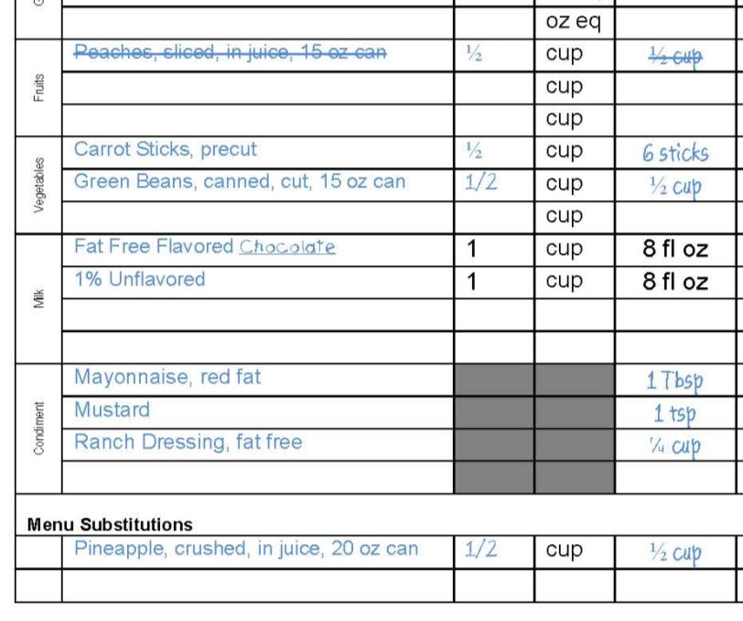
6, 7, & 8
Continued….
Notes:
This is the bottom portion of the page showing columns 6, 7, and 8. You will note that a line is drawn through the peaches and pineapple is entered at the bottom of the page underneath the Menu Substitutions heading. All substitutions must be documented daily.

Slide 21
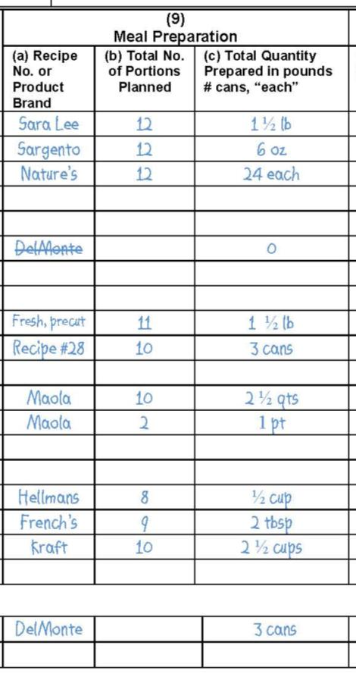
9a
Enter the recipe number for each menu item.
Notes:
(9) Meal Preparation Information
(a) Recipe Number or Product Brand
Enter the recipe number for each menu item. Remember every item on your menu must have a standardized recipe. (If a menu item consists of one ingredient, you may record the product brand in this column). See HACCP Part 5: Menus and Recipes for how to organize recipes.

Slide 22
9b
Enter the number of servings of each menu item planned for student reimbursable meals and any adults who may be eating.
Notes:
(9) Meal Preparation Information
(b) Total Number of Portions Planned
Enter the number of servings of each menu item planned for student reimbursable meals and any adults who may be eating. Include planned servings of condiments, milk, as well as all other menu items. If Offer vs Serve is not used, you would plan for each student reimbursable meal to include all components. If using Offer vs Serve, planning should be based on what is usually selected by students in your facilities. Remember to plan reasonable amounts of menu items to avoid excessive leftovers.

Slide 23
Plan before you order food to control inventory! Use previous records to forecast accurately.
Notes:
Accurate forecasting/planning is key to inventory control and meeting the meal pattern and components! Planning section of production record must be completed before the day of service to facilitate proper ordering and assure that adequate ingredients will be available on the day of service.

Slide 24
Common Errors with Production Record Planning
All information for foods planned to offer is not completed.
Amounts of planned foods are inconsistent with the number of planned meals.
Milk and condiments are not planned.
Notes:
This slide shows some common mistakes made when planning for meal service. Be sure to accurately plan all menu items and condiments so that all items needed for the menu may be ordered in sufficient amounts.

Slide 25
Process of Determining Number of Portions Needed
Number of Portions to Plan
Past Production Records
Notes:
Refer to past production information to plan/forecast for future menus. Let’s look at the next slide and see how this information becomes a cycle….

Slide 26
Notes:
Use historical production information as a guide for future planning. Planning amounts will not always exactly match production amounts; however, it should be close if student enrollment remains fairly constant. If there are excessive leftovers, investigate the cause and adjust planned amounts accordingly for future menus.

Slide 27
9c
Record amounts of food prepared or available for today’s menu. Use measurable units like pounds, ounces, each, #10 can, etc. Do not record in cases because that does not indicate an exact amount of the food item.
Notes:
(9) Meal Preparation Information
(c) Total Quantity Prepared (in pounds, # cans, or “each”)
The total quantity of food actually prepared for the meal must be recorded in order to show that the amount of food was adequate for the meal pattern requirements. Enter the bulk quantity of the amounts of each menu item prepared for the meal. For example, 1 #2.5 can of peas, 4 lb. of ground beef for spaghetti, 3 lb. of carrots, 12 “each” for chicken patties. Since food comes in various can sizes, be sure to record the can size used (see Food Buying Guide Introduction for information on can sizes).

Slide 28
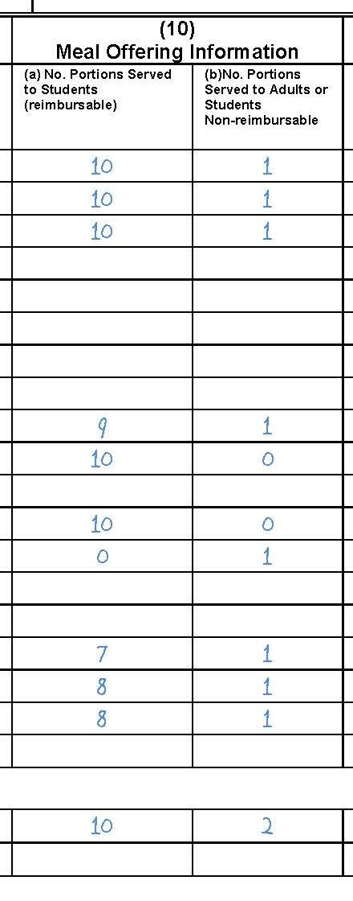
10
Enter actual number of portions served.
Notes:
(10) Meal Offering Information
(a)No. portions Served to Students (Reimbursable)
Record the number of portions (servings) actually served to students as part of reimbursable meals.
(b) No. portions Served to Adults (Non-reimbursable)
Record the number of portions (servings) of each menu item actually served for adult meals.

Slide 29
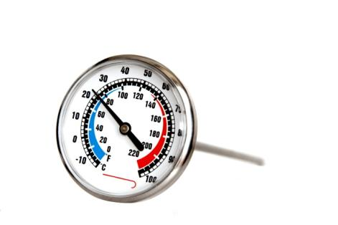
11
Enter actual number of portions of each menu/food item left after all meals have been served.
Notes:
(11) Leftovers
(a)Number of Portions Leftover
Enter actual number of portions of each menu/food item left after all meals have been served, regardless of preserving or discarding the food.
(b) Time of Discard or Product Temperature
All Time-Temperature Controlled for Safety (TCS) foods must be discarded and cannot be saved and reserved as leftovers. All self-service food or food served family-style must be discarded at the end of the meal also. At the end of meal service, record in this column either:
The time meal service ends if all food items are to be discarded or
The temperature of each TCS menu item, prior to discarding the food. If any menu items, such as cartons of milk, are routinely saved for re-service, the temperature of the food must be recorded in column (11b) at the end of the meal. All TCS items must remain at proper temperatures – refer to the HACCP Plan for information about proper hot and cold holding temperatures.

Slide 30
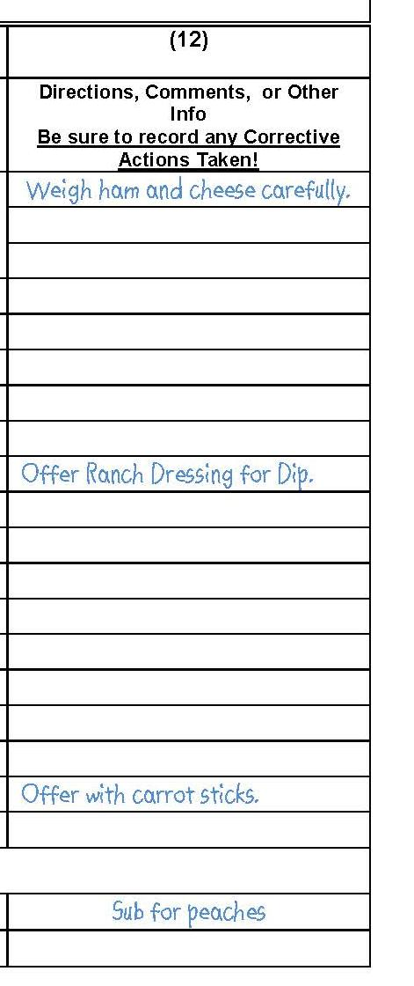
12
Write instructions or comments here.
Notes:
(12) Directions, Comments, or Corrective Actions Taken
Write in special directions, food preparation and serving notes, comments, recipe information or other information relative to the menu production for the day’s menu or notes for another day.

Slide 31
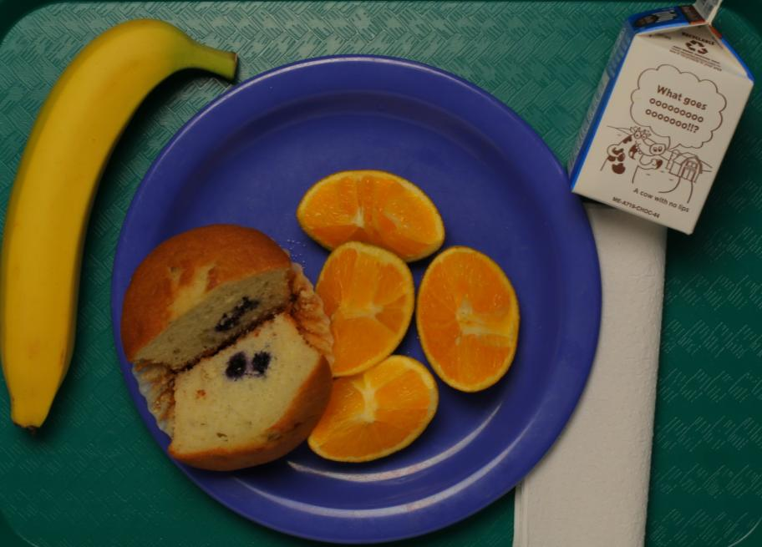
Now, Let’s look at the BREAKFAST Production Record….
Notes:
The breakfast meal pattern has changed and so has the production record! The breakfast meal service is recorded on a separate document in order to capture the breakfast component crediting for Grains, Fruit, and Milk along with an indication of M/MA used as a substitute for grain or “other” item.

Slide 32
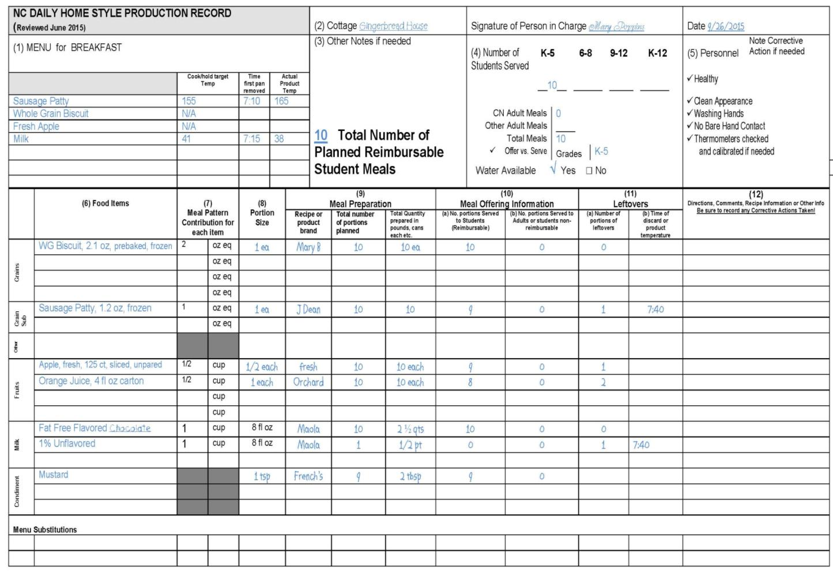
Notes:
As just mentioned, there is a separate production record for Breakfast because the meal pattern components are different for those meals. Breakfast meals no longer contain a meats/meat alternates component. We strongly encourage you to use this approved prototype as it captures the required information for compliance with the Administrative Review and HACCP.
As with the lunch production record, if you choose to use alternate form(s), you must submit to DPI for prior approval. Even when using alternate form(s), all of the information on the NC Daily Meal Production plan, including the HACCP monitoring and instructions, must be included in your documentation.

Slide 33
Changes to the meal components
Notes:
The breakfast production record is the same as the lunch production record with the exception of the sections used to document the meal pattern component contribution crediting. The breakfast production record indicates the meal components of grain, fruit, milk along with substitute for grains and other. The breakfast meal pattern no longer contains meats/meat alternates. Under certain circumstances, M/MA may credit as a substitute for grains so refer to current USDA guidance about the breakfast meal pattern. Alternately, M/MA may be used as an “other” menu item which does not provide component crediting of any type. The menu planner must make this determination before the menu is planned, offered, or served.

Slide 34
Questions?
Notes:
Please contact your School Nutrition Administrator or regional School Nutrition Specialist or Consultant with questions.

Slide 35
The U.S Department of Agriculture (USDA) prohibits discrimination against its customers, employees, and applicants for employment on the bases of race, color, national origin, age, disability, sex, gender identity, religion, reprisal, and where applicable, political beliefs, marital status, familial or parental status, sexual orientation, or if all or part of an individual's income is derived from any public assistance program, or protected genetic information in employment or in any program or activity conducted or funded by the Department. (Not all prohibited bases will apply to all programs and/or employment activities.)
If you wish to file a Civil Rights program complaint of discrimination, complete the USDA Program Discrimination Complaint Form, found at http://www.ascr.usda.gov/complaint_filing_cust.html or at any USDA office, or call 866.632.9992 to request the form. You may also write a letter containing all of the information requested in the form. Send your completed complaint form or letter to us by mail at U.S. Department of Agriculture, Director, Office of Adjudication, 1400 Independence Avenue, S.W., Washington, D.C. 20250-9410, by fax 202.690.7442 or email at program.intake@usda.gov.
Individuals who are deaf, hard of hearing or have speech disabilities may contact USDA through the Federal Relay Service at (800) 877.8339; or (800) 845.6136 (in Spanish).
USDA is an equal opportunity provider and employer.

