Slide 1
Completing the Commercial Kitchen Daily Meal Production Record
North Carolina Department of Public Instruction
School Nutrition Services
Revised July 2015
USDA is an equal opportunity provider and employer.
Notes:
Welcome Participants and briefly describe what they will learn today.

Slide 2
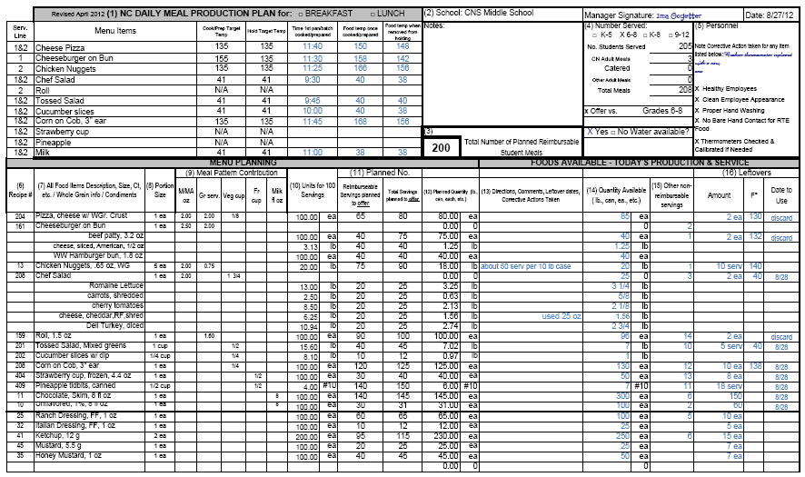
COMPLETING THE NC DAILY MEAL PRODUCTION RECORDS
Notes:
Distribute a sample of the breakfast and lunch commercial kitchen production records and instructions for completing the form for use as reference during the workshop.
The production records supports the USDA Meal Pattern; a menu that follows the meal patterns and contains information consistent with standardized recipes for each item on the menu. Information for all reimbursable meals must be supported by a Production Record. (Refer to the example already distributed.)
In this example, the data can be entered at three different time periods:
The basic MENU information, recipe number, recipe name, meal component contribution, and units for 100 servings is often supplied by the central office before distribution to the school.
The PLANNING section information is computed by the manager in advance of the meal before ordering food.
The PRODUCTION/SERVICE information is completed the day the meal is prepared and served. All items required as part of your HACCP Plan are italicized in the instructions and must be completed daily

Slide 3
Now, Let’s look at the LUNCH Production Record….
Notes:
The Daily Meal Production Plan is a required record for the National School Lunch and Breakfast Program. The information is to be recorded daily and kept in the school’s food preparation and service area. The two major sections, Planning and Production, allow the form to be a management tool, determine nutritional adequacy, assess food safety practices, and support the claim for reimbursable meals.
All forms other than the DPI prototype must be approved in writing by the State Agency prior to use. Sections/Columns 1, 6, 7, 8, 9and 10 may be prepared or partially completed by the central office menu planner prior to distribution to managers; doing so may increase accuracy and ensure that all required meal components, including the vegetable subgroups are included. Note: the manager may need to complete the serving line information in section 1 if the information is not known by the menu planner.
Examples are provided for completed menu records for a day. Refer to them when maintaining this form. School Nutrition (SN) Administrators should contact the State Agency (SA) consultants for technical assistance. Managers should contact the School Nutrition Administrator to discuss local procedures. In this example, the data can be entered at three different time periods: the basic menu information supplied by the central office, the PLANNING section information provided by the manager in advance of the meal, and the TODAY’S PRODUCTION/SERVICE columns completed the day the meal is prepared and served. All items required as part of your HACCP Plan are printed in italics in these instructions and must be completed daily.

Slide 4
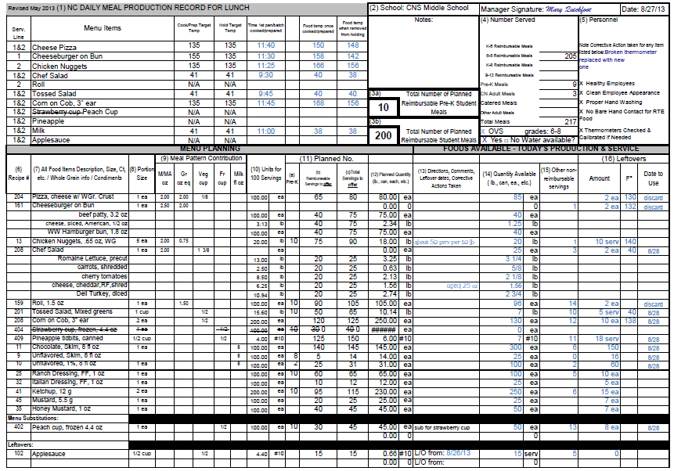
Notes:
Look at the sample document provided for Lunch. This lunch production record is an Excel version with embedded formulas that automatically determine the amount of food to prepare once the planned number of meals is entered by the Manager. This year, there are separate worksheets for breakfast and lunch because the meal pattern components are now different for those meals. We will first review the lunch document seen on this slide and then move to the breakfast production record later in the presentation. With the exception of the meal components, the documents and instructions are very similar.
We strongly encourage you to use this approved prototype as it captures the required information for compliance with the Administrative Review and HACCP.
If you choose to use alternate form(s), you must submit to DPI for prior approval. Even when using alternate form(s), all of the information on the NC Daily Meal Production plan, including the HACCP monitoring and instructions, must be included in your documentation.

Slide 5
The production record is …
A tool for planning the foods to order and prepare
A source of information about quantities planned to offer for use in the nutrition analysis
A record of foods prepared and offered for service to customers
A record of amounts of food served and leftover
A source of information for forecasting future production needs
Notes:
Explain that each of these are USDA record keeping requirements to document nutritional adequacy and proper types and amounts of available foods.
The production record can also function as a task assignment for employees by highlighting assigned tasks in various colors for employees or writing their names beside of the menu item.

Slide 6
Why use this tool?
USDA requires menu and food production records to support meal reimbursement and HACCP monitoring
It documents that requirements for meal components are met and adequate amounts and required serving sizes are provided
Notes:
Emphasize that this is a USDA requirement!

Slide 7
Who needs it?
Managers use it to plan and order food, communicate with employees, document food production and service, and track inventory usage
Employees use it to learn the daily menu items, find out the amounts to prepare, and record amounts leftover for each meal
SN Administrators, Supervisors, and SA Consultants use it to verify compliance with USDA regulations.
Notes:
Explain that many people use information on the production record in various ways.
Managers use it to control high quality food production and service in an efficient way.
Place the production record in the kitchen along with the recipes for the day so employees can refer to it for complete production information.
Schools participate in several types of observations and reviews – periodic program visits from the director or supervisor, annual SN program reviews, Technical Assistant Reviews by the State Agency (SA) consultants, Administrative Reviews by a SN team of consultants. All of these reviews must verify compliance with USDA regulations.

Slide 8
Managers must …
Use the record as a plan before ordering food
Verify that employees provide accurate information at the end of the day of service to document amounts prepared and leftover
Assure that the record is completed accurately on the day the meal is served to
prevent data being “made up” later
Notes:
The planning section must be completed before the meal is served to accurately order food. Some of this information (such as sections/columns 1, 6, 7, 8, 9, and 10) may be prepared or partially completed by the School Nutrition central office staff prior to distribution to managers. In other districts, the manager may complete all of the information.
The HACCP monitoring should be completed during and after service to verify safe high quality food.
The production and service section should be completed after the meal to document the quantity of food served. Remember that the production record should record what was really planned and actually occurred for that meal.

Slide 9
Learn how to correctly complete NC Daily Meal Production Plan by reviewing the document and instructions at least every year
Recognize that complete and accurate records is a basic job requirement for every Manager
Periodically check for completion and accuracy without waiting until a contact from the State Agency
Notes:
The Daily Meal Production Record is required meal documentation for School Food Authorities (SFAs) participating in the National School Lunch, School Breakfast Program, and After School Snack Programs. The information is to be recorded daily and used in the school’s food preparation and service area. The two major sections, Planning and Production, allow the form to be a management tool, determine nutritional adequacy, and assess food safety practices.
All forms other than the DPI prototype forms must approved in writing by the State Agency prior to use.

Slide 10
It’s REQUIRED !!!
Lack of complete and current production records can result in withholding and/or reclaiming federal funds
Notes:
Through and accurate daily production records are required for the school to be eligible for meal reimbursement.

Slide 11
How long do you keep records?
Keep for the current school year plus the past three years.
Turn into the central office or file at the school according to your district’s procedure
Notes:
USDA requires that records are kept safely and entirely for 3 years. Store the records clearly labeled in a secure place.

Slide 12
Common Problems and Errors
Records are incomplete or missing.
Planned number of menu items is not plausible when compared to the number of planned meals.
HACCP monitoring is not complete
Inaccurate/inadequate information to document components and/or reimbursable meals

Slide 13
Notes:
◉ Note to Leader – Distribute a sample of the production record and instructions for completing the form to use as reference during the workshop.
Let’s look at a sample of a completed lunch menu production record for a day. Refer to it when maintaining this form; or call your SN director to discuss local procedures.
The Daily Meal Production Plan is a required record for the National School Lunch and Breakfast Programs. (A production record is also required for the after school snack program and there is another form for that use that allows the manager to complete one page per week.) The information is to be recorded daily and kept in the school’s food preparation and service area. The two major sections, Planning and Production, allow the form to be a management tool, determine nutritional adequacy, and assess food safety practices.
All forms other than the N.C. Department of Public Instruction (NCDPI) prototype forms must approved in writing by the State Agency prior to use.
Even when using alternate form(s), all of the information on the N.C. Daily Meal Production plan, including the HACCP monitoring and instructions, must be included in your documentation.
Schools are encouraged to use the approved prototype as it captures the required information for compliance with the Administrative Review and HACCP.

Slide 14
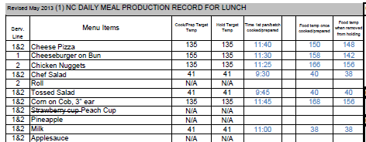
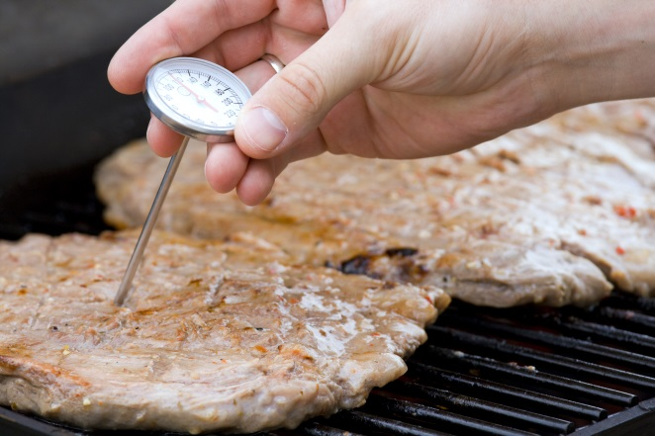
1
Notes:
(1) MENU -- Enter all items offered for the day’s reimbursable menu. This includes food item choices such as additions, leftovers, substitutions, etc. A second page has been added for schools that have extensive menus and/or a la carte items that are time-temperature controlled for safety (TCS) foods and not available as part of the reimbursable meal. An additional production record could also be used.
The USDA Meal Pattern requires that all components, including vegetable sub-groups, are offered on all serving lines dispensing reimbursable meals. Therefore, it is necessary for schools to document the food items available on each separate serving line when different. Use the column to the left of the menu section to write in the serving line for each menu item that is offered differently for each line. If all multiple serving lines contain exactly the same food items OR if the school has only one line, this information is not required.
The following information only needs to be completed for menu items that are potentially hazardous (PH) or TCS foods– see Menu Summary information in HACCP Part 5: Menus and Recipes. Temperatures are only recorded for the first pan or batch of each menu item. The temperature of all remaining pans will be checked for doneness or the temperature will be checked before the item is removed from the refrigerator but not recorded on the Production Plan. Be sure employees are using a properly calibrated thermometer.
Cook Target Temperature – Record the safe cooking or preparation temperature for each TCS menu item (see HACCP Part 1: Safe Food Handling Procedures).
Hold Target Temperature – Record the safe holding temperature for each TCS menu item (see HACCP Part 1: Safe Food Handling Procedures).
Time First Pan Removed – Record the time that the first pan of TCS food was removed from the oven or in the case of cold food when preparation was completed.
Food Temperature once cooked/prepared – Check the actual food temperature with a properly calibrated thermometer. If the food does not meet the cook target temperature, continue cooking until it does. Do not record this temperature because the corrective action is to continue to cook the item to the proper temperature before service. Food should never be placed in holding or on the serving line
until it is safe to eat. In summary, the temperatures recorded in this column should be the end cooking
temperatures for menu items that have reached the cook target temperature or the temperature of uncooked foods when preparation is completed. If the temperature is not at 41 degrees or below for a PH cold food, chill the food to this temperature within 2 hours in order to serve it safely.
Food Temperature when removed from Cold/Hot Holding– Measure the actual temperature of the food when it is removed from the cold holding/cooler or hot holding cabinet and before it is placed on the serving line. If a cold food is not at 41ºF or colder, it can be safely cooled down if one knows that it has not been in the temperature danger zone for more than four hours. If not known, then throw it out. Record the amount of food thrown out in column (13) Directions, Comments, Corrective Actions Taken. Only record the temperature of the first pan of cold food placed on the serving line; measure the temperature of each subsequent pan. All pans of cold TCS food should always be at 41ºF or colder before placement on the serving line. Measure the temperature of hot foods when removed from hot holding and before placement on the steam table or serving line. If the food is not at 135ºF or hotter, you must reheat to 165ºF before placement on the serving line. Record this in column (13) Directions, Comments, Corrective Actions Taken.
If Time as a Public Health Control (TPHC) procedures are being implemented as a food safety control for TCS foods (instead of temperature), follow the written procedure for documenting time when removed from holding and/or discard times. Foods subject to TPHC must be discarded by the end of the time specified in the approved TPHC procedure. File copies of all approved TPHC procedures in the HACCP plan in Part 5: Menus and Recipes.
Remember that food temperatures of all TCS foods, including a la carte items must be tracked at three times:
1) preparing cold foods or cooking
2) holding, and
3) leftover temperatures. The only exception is for foods held according to written Time as a Public Health Control (TPHC) procedures; leftover temperatures are not required for these foods; however, the TPHC procedures and record keeping must be followed exactly as written; Failure to follow exactly will result in an Environmental Health violation.

Slide 15
Signature … Required when info is verified!
2
Notes:
(2) School, Manager, and date -- Enter name of the school and date of meal service. The signature indicates that the manager or person in charge has fully reviewed the meal planning, production, and service and is satisfied with the accuracy of the information. The document should be signed at the end of the day of meal service when all information is complete and verified.

Slide 16
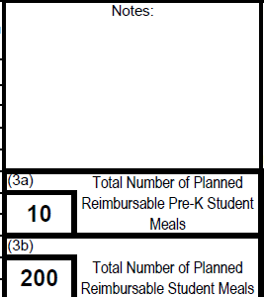
3
Notes:
(3) Total Planned Reimbursable Student Meals – In 3(a), record the total number of Pre-K meals planned. In 3(b) record the total number of reimbursable student meals (not including Pre-K meals) planned to offer at the time you complete column 11 and 12 prior to ordering food. You should use previous production record information for similar menus to determine the estimated number of reimbursable meals and the potential amount of each menu item to offer. Plan and offer enough food so that students may have adequate quantities to select reimbursable meals but not amounts that are inconsistent with past production records that result in excessive leftovers. If students participate in Offer vs. Serve (OVS), it is not reasonable to plan a serving of every menu item, including milk, for each student. Remember to refer to past production record columns 14, 15, and 16 for accurate planning and forecasting!
For schools utilizing more than one menu planning grade group at each school (i.e. grades Pre-K and grades K-5, or k-5 and grades 6-8, or grades 6-8 and grades 9-12), you must plan the menu items for each grade group separately. Note: the Pre-K column (a) may be "re-named" if you need to use it to record K-5 and then use column (b) to record grades 6-8. Work with the SA consultants to achieve accurate production record recording in these special situations.
You may also use the section above the planned meals to record important notes about the day’s meal service.

Slide 17
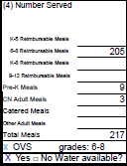
4
Notes:
(4) Number Served -- After meal service record the total number of student meals served by grade level(s) using same menu planning grade group (i.e. grades K-5, grades 6-8, grades 9-12, etc.). Also include the number or Pre-K meals, Eligible SN Adult meals, catered or transported meals, and other adult priced meals , noting the total meals served. Check if students participate in Offer vs. Serve (OVS) and indicate grade levels implementing OVS.
For schools utilizing more than one menu planning grade group on the same production record at each school (i.e. grades k-5 and grades 6-8, or grades 6-8 and grades 9-12), record a separate number served from each grade group used for menu planning.
Verify that drinking water is available to all students without restriction. Refer to USDA Memorandum SP28-2011.

Slide 18
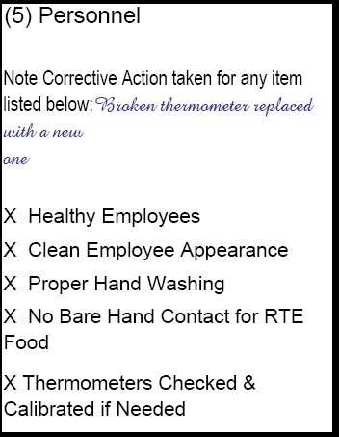
5
Notes:
(5) Personnel – These five items support your HACCP Plan and must be monitored daily. Each should be checked if in place. Note any corrective action taken if you were unable to check that all were in place.
Healthy – Are all employees healthy? If an individual is sick, he/she should not be handling exposed food, single-use articles, cleaned and sanitized dishware and equipment, and clean linens. Refer to the HACCP Plan Part 1: Prerequisite Programs, Appendix A for more information about employee health and when to exclude or restrict employees from food handling duties.
Clean appearance – Are employees properly dressed according to the food safety standards outlined in Part 1: Prerequisite Programs?
Washing hands – Are workers properly washing their hands with warm water, soap, and drying?
No bare hand contact – Are employees handling ready to eat food with no bare hand contact? Employees should not be handling cooked or ready-to-eat foods with bare hands; They should use tongs, utensils, deli tissue, or single-use gloves.
Thermometers checked and calibrated (if needed) – Are all thermometers checked for accuracy daily and calibrated if needed? Calibration is the process of verifying the accuracy of a thermometer. Thermocouples do not require calibration and so if using one, make a notation of N/A. Refer to the HACCP plan Part 1: Safe Food Handling Requirements or the HACCP continuing education materials on the SN website for complete instructions about properly calibrating thermometers.
(5) Personnel – These five items support your HACCP Plan and must be monitored daily. Each should be checked if in place. Note any corrective action taken if you were unable to check that all were in place.
Healthy – Are all employees healthy? If an individual is sick, he/she should not be handling exposed food, single-use articles, cleaned and sanitized dishware and equipment, and clean linens. Refer to the HACCP Plan Part 1: Prerequisite Programs, Appendix A for more information about employee health and when to exclude or restrict employees from food handling duties.
Clean appearance – Are employees properly dressed according to the food safety standards outlined in Part 1: Prerequisite Programs?
Washing hands – Are workers properly washing their hands with warm water, soap, and drying?
No bare hand contact – Are employees handling ready to eat food with no bare hand contact? Employees should not be handling cooked or ready-to-eat foods with bare hands; They should use tongs, utensils, deli tissue, or single-use gloves.
Thermometers checked and calibrated (if needed) – Are all thermometers checked for accuracy daily and calibrated if needed? Calibration is the process of verifying the accuracy of a thermometer. Thermocouples do not require calibration and so if using one, make a notation of N/A. Refer to the HACCP plan Part 1: Safe Food Handling Requirements or the HACCP continuing education materials on the SN website for complete instructions about properly calibrating thermometers.

Slide 19
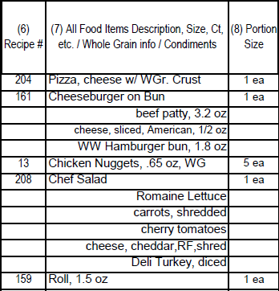
6, 7, & 8
Notes:
MENU PLANNING
(6) Recipe Number
Record the recipe number of the standardized recipe that must be used for preparing every menu item. Remember, all menu items must have accurate standardized quantity recipes filed in the HACCP recipe binder or available in a readily accessible electronic database, and also used for conducting the menu analysis when required.
(7) Food Items
From all of the offered menu items written in Section 1, list the foods to be planned, prepared, and served as part of the reimbursable meal. Refer also to the standardized recipe for more information. Also, if the same food items are offered in different portion sizes for a Pre-K menu, use a separate line and list the item again with corresponding portion size and component contribution. Remember to list the various milk choices, condiments, and any other foods (such as desserts) the same way that you plan for any other menu item offered as part of the reimbursable meal. Indicate if any of the grains offered are WHOLE WHEAT or WHOLE GRAIN by using "WW" or "WG" in the recipe or food item description.
List all menu additions in this section the same as for the regularly planned menu items as these menu additions should be planned prior to ordering food. Items added on the day of service would be considered a menu substitution since the original planned amounts would be adjusted to accommodate this last minute addition. If additional menu items are added at the last minute, it would be reasonable to reduce the original planned quantity similar to a complete or partial substitution.
List the flavors and fat levels of milk planned for service in your school(s) (i.e. 1% unflavored, skim/FF chocolate, 1% Lactose Free unflavored, skim/FF unflavored, etc.) Milk (or any other menu item) cannot be “recycled”; once it leaves the line on a student’s tray, it cannot be returned for service to others. The milk or other food might become intentionally or unintentionally contaminated and so could potentially become a source of illness for others.
(8) Portion Size
Portion size is the amount that one would expect to see on a plate or tray. Portion size is NOT always the same as the meal pattern contribution. For example, the portion size of a corn dog may be 1 each; however, the meal pattern contribution could be 2 oz Meat/Meat Alternate (M/MA) and 2 grain (Gr) servings. The portion size of a cheeseburger may be 1 each and the M/MA contribution could be 2 ½ oz
M/MA and 1.75 Gr servings. The portion size of a tossed romaine/spinach salad could be 1 cup and provide ½ cup vegetable (V) component contribution. The portion size of crackers, 4/pk may be 2 each and provide 1 Gr serving. Accurate standardized recipes should indicate both the portion size AND the meal pattern contribution. MENU PLANNING
(6) Recipe Number
Record the recipe number of the standardized recipe that must be used for preparing every menu item. Remember, all menu items must have accurate standardized quantity recipes filed in the HACCP recipe binder 1 or available in a readily accessible electronic database, and also used for conducting the menu analysis when required.
(7) Food Items
From all of the offered menu items written in Section 1, list the foods to be planned, prepared, and served as part of the reimbursable meal. Refer also to the standardized recipe for more information. Also, if the same food items are offered in different portion sizes for a Pre-K menu, use a separate line and list the item again with corresponding portion size and component contribution. Remember to list the various milk choices, condiments, and any other foods (such as desserts) the same way that you plan for any other menu item offered as part of the reimbursable meal. Indicate if any of the grains offered are WHOLE WHEAT or WHOLE GRAIN by using "WW" or "WG" in the recipe or food item description.
List all menu additions in this section the same as for the regularly planned menu items as these menu additions should be planned prior to ordering food. Items added on the day of service would be considered a menu substitution since the original planned amounts would be adjusted to accommodate this last minute addition. If additional menu items are added at the last minute, it would be reasonable to reduce the original planned quantity similar to a complete or partial substitution.
List the flavors and fat levels of milk planned for service in your school(s) (i.e. 1% unflavored, skim/FF chocolate, 1% Lactose Free unflavored, skim/FF unflavored, etc.) Milk (or any other menu item) cannot be “recycled”; once it leaves the line on a student’s tray, it cannot be returned for service to others. The milk or other food might become intentionally or unintentionally contaminated and so could potentially become a source of illness for others.
(8) Portion Size
Portion size is the amount that one would expect to see on a plate or tray. Portion size is NOT always the same as the meal pattern contribution. For example, the portion size of a corn dog may be 1 each; however, the meal pattern contribution could be 2 oz Meat/Meat Alternate (M/MA) and 2 grain (Gr) servings. The portion size of a cheeseburger may be 1 each and the M/MA contribution could be 2 ½ oz
M/MA and 1.75 Gr servings. The portion size of a tossed romaine/spinach salad could be 1 cup and provide ½ cup vegetable (V) component contribution. The portion size of crackers, 4/pk may be 2 each and provide 1 Gr serving. Accurate standardized recipes should indicate both the portion size AND the meal pattern contribution.

Slide 20
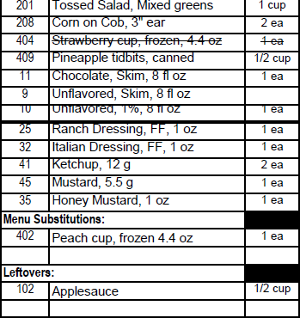
6, 7, & 8
Continued….
Notes:
This is the bottom portion of the page showing columns 6, 7, and 8. You will note that a line is drawn through the strawberry cup and Peach Cup is entered at the bottom of the page underneath the Menu Substitutions heading. All substitutions must be documented daily. In addition, all leftovers that will be re-served must be added to the production record on the day they are offered.

Slide 21
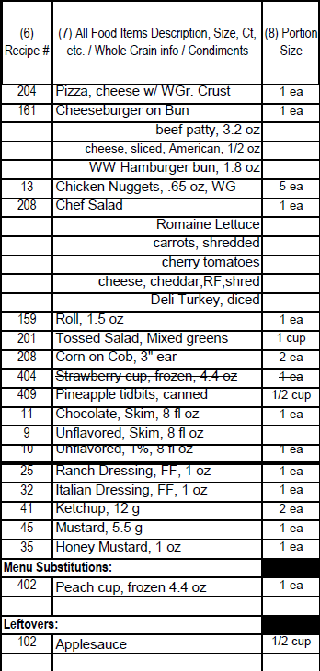
9
Notes:
(9) Meal Pattern Contribution
Enter the amount of meal pattern contribution for each menu item (i.e. 2 oz. M/MA, ½ c. vegetable, 1 cup fruit (F), 1½ grain oz eq, 8 fl oz milk (M)). Remember that meal pattern contribution and portion size are not always the same; refer to your accurate standardized quantity recipe for more information; standardized recipes should indicate both the portion size AND the meal pattern contribution.

Slide 22
10
Notes:
(10) Units for 100 Servings
Enter the number of purchase units required for 100 servings. This information should be based on and calculated from the accurately yield tested standardized quantity recipe used at the school. The recipe should be yield tested and written to reflect at least the minimum amount of ingredient(s) required for component crediting from the USDA FOOD BUYING GUIDE, SN labels, USDA food fact sheets, signed USDA Product Formulation Statements, or signed manufacturer’s statements on company letterhead; these are considered approved sources of information. The information in column 10 should be consistent with the accurate standardized recipe yield information.
For example, if the yield tested, standardized recipe states that it takes 5 lb of a creditable ingredient or food item to produce 23 portions, then the units for 100 servings would be 21.74 lb for that item. (This is calculated as 5 lb/23 portions X 100 portions = 21.74 lb)

Slide 23
11
Plan before you order food to control inventory! Use previous records to forecast accurately.
Notes:
(11) Servings to Offer
IMPORTANT NOTE ABOUT UPDATING THE PRE-PLANNED AMOUNTS ON THE DAY OF MEAL SERVICE:
Previously, menu substitutions made on the day of service and leftover menu items were not included in the servings to offer column 11. However, USDA now requires that the menu analysis is conducted based on the menu items offered. Therefore, you must adjust the number of servings offered when the original menu items and amounts planned differ from the menu items and number of servings offered. These adjustments should be made in the columns (11) before meal service on the day the menu is offered. Remember that the amounts to offer for reimbursable meals must be reasonable when compared to the number of meals planned for the day. It is important to remember that leftovers are listed on the production record; however, they are not included in the nutrient analysis since they would have already been analyzed on the day of original service.
Remember, you are using the “servings to offer” for two things in section 11 of the production record - 1) preplanned two or more weeks out before ordering food, and then 2) possible subsequent adjustments on the day of service to show the number of servings that will be offered to students.
Prior to ordering food, enter the number of servings planned to offer for each meal component for Pre-K students in 11(a), other Student Reimbursable meals in 11(b) and Total meals (Pre-K, student reimbursable plus a la carte and adult meal servings) in 11(c). Remember to plan the various milk choices and condiments for students and record the same as for any other menu item. The milk planning information should be recorded at the time you plan the remainder of the menu items and before ordering food.
For schools utilizing more than one menu planning grade group at each school (i.e. grades Pre-K and grades K-5, or k-5 and grades 6-8, or grades 6-8 and grades 9-12), you must plan the menu items for each grade group separately. Note: the Pre-K column (a) may be "re-named" if you need to use it to record planning for K-5 and then use column (b) to record planning for grades 6-8. Work with the SA consultants to achieve accurate production record recording in these special situations.
Remember that the amounts of food planned to offer for student reimbursable meals must be reasonable when compared with the number of reimbursable meals planned in section 3. For example, if you are planning 335 reimbursable student meals, you cannot plan more than this number of total entrees or milks; likewise, you could not plan more than 335 servings of fruits if students are only allowed to take one serving. You would plan less than these amounts if students participate in OVS and often decline some menu items.
Remember to plan to offer reasonable amounts of menu items to avoid excessive leftovers using past production record information for accurately forecasting numbers of servings needed.
NOTE: If items that are sold only as a la carte are included in column 7, DO NOT COMPLETE THE REIMBURSIBLE SERVINGS TO OFFER COLUMN; instead include information only for TOTAL SERVINGS TO OFFER since students would not select these items as part of the reimbursable meal. (In other words, enter “zero” for student reimbursable servings to offer for a la carte only menu items.) Alternately, use page 2 of the production record to list these a la carte only items.
Menu items substituted must be included on the Production Record and should be listed in the areas designated at the bottom of the page on the day of meal service. Complete the information for all columns, including the servings to offer column. If the production record has items already planned and you will not serve those items, mark one line through that item and record "zero" in column 14, Quantity Available.
Menu items served as Leftovers must also be listed. List the food items, portion size, meal pattern contribution, number of servings to offer and date of original service (columns 7, 8, 9, 11 & 13). Include the leftover quantity available, amount of non-reimbursable servings, and the required information about leftovers (columns 14-16). Leftovers are included on the production record; however, the leftover menu items are included in the nutrient analysis only on the day of original service. For example, 200 servings of tossed salad are offered on Monday, and 20 servings are leftover. The 20 leftover salad servings are offered Tuesday. The nutrient analysis should be conducted on the menu as offered: Monday’s offerings should reflect 200 servings of salad, even though 20 leftover servings were offered on Tuesday. The Dietary Specifications requirements are weekly requirements, and the nutrient analysis would still reflect that 200 servings of salad were offered over the week, even if some leftovers were offered on subsequent days. It is important NOT to enter 200 servings of salad Monday, and 20 servings of salad Tuesday because this would result in double counting the menu item.
Additions made prior to ordering food are treated the same as any other planned menu item as the manager is planning to order and serve it. Additions made at the last minute on the day of service would be treated as a partial or full substitution. For example, the manager realizes that bananas need to be added because there is an abundance in stock or peaches are insufficient to provide the amount needed so an additional fruit is added to substitute for the shortage. Either way, the planning for the day will need to be adjusted to reflect the amounts to offer. However, if the manager knew in advance that bananas would be planned and served, the original planning would reflect this so there would be no need to indicate that it was a substitution on the day of service.

Slide 24
Common Errors with Production Record Planning
All information for foods planned to offer is not completed.
Amounts of planned servings are inconsistent with the number of planned meals.
Milk and condiments are not planned.
Servings to Offer are not adjusted to accommodate planning and service of substitutions and leftovers.
Notes:
Accurate forecasting/planning is key to inventory control! Planning section of production record must be completed before the day of service to assure that adequate ingredients will be available on the day of service.
The Servings to Offer column 11a and 11b must be adjusted prior to daily meal service to accommodate planning and service of substitutions and/or leftovers. This is an important change from previous practice!

Slide 25
There is a correlation!
Notes:
Total number of planned meals must be consistent with the number of servings of meal components needed to assure that there will be enough food ordered to serve reimbursable meals.
For example, if a school is planning 335 meals, the manager may plan 275 servings of chicken nuggets with wheat roll and 60 servings of tuna salad sandwich, 160 servings of mashed potatoes, 53 servings of green peas (from 3#10 cans), 190 servings of peaches (from 4 #10 cans), 90 servings of steamed rice, 100 skim chocolate milk, 25 skim strawberry milk, 20 servings of unflavored skim milk and 55 servings of 1% unflavored milk. Remember to include planned quantities of condiments such as 75 servings of chicken gravy, 50 pkg of BBQ sauce, 110 pkg ketchup, and 10 pkg honey mustard sauce, etc.
Remember that all varieties of milk and condiments must be planned just as any other menu item.
In the example above, when planning for 335student reimbursable meals, it would not be accurate to plan 325 servings of chicken nuggets with roll and 75 servings of tuna salad for students. However, these planned amounts may be accurate for the total planned amounts since the manager would add additional amounts in the TOTAL column to compute the Total Planned Quantity in column 10 which is the food order for that day (minus, of course, any excess stock already on hand when the order is actually placed!)

Slide 26
Process of Determining Number of Servings for Weighted Analysis
Number of Servings to Offer
Past Production Records
Notes:
Refer to past production information to plan/forecast for future menus.

Slide 27
Notes:
Use historical production information as a guide for future planning. Planning amounts will not always exactly match production amounts (especially if effective batch cooking methods are used); however, it should be close. If there are excessive leftovers, investigate the cause and adjust planned amounts accordingly for future menus.

Slide 28
12
Information initially generated in this column becomes your food order for this day’s menu!
After adjusting for substitutions and leftovers on the day of service, this column becomes the amounts of food to be offered for the daily menu.
Notes:
(12) Planned Quantity (lb, Can, each)
The purpose of the information in this column is to create an accurate food order and communicate to employees the expected amount of food to prepare and offer for service. Use purchase units as listed in the USDA Food Buying Guide and as indicated on your accurate standardized recipes for placing creditable food items into production (i.e. each, pounds, #10 cans, etc. as indicated in column 10.) This revised Excel spreadsheet will transfer the purchase units as listed in column 10 automatically when correct information is entered into the computer. This spreadsheet also contains formulas that will make the calculations automatically for the planned quantity required to prepare the number of servings indicated in the Total section of column 11. For example: it will take 36.2 lbs. of French Fries, Crinkle Cut to serve 200 (3/4 cup) portions – 18.6 X (200/100) = 36.2 lbs.; it will take 3 #10 cans of Green Beans to serve 65 (1/2 cup) portions - 4.6 X (65/100) = 3 #10 cans. Follow the quantities on the standardized quantity recipe which should be based on minimum quantities from the FBG, USDA Food Fact Sheets, SN Labels, signed manufacturer’s statements on company letterhead, or your own documented in-house yield data results; Refer to the FBG page I-3 for more information about yield testing.

Slide 29
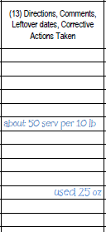
13
Notes:
FOODS AVAILABLE – TODAY’S PRODUCTION AND SERVICE
(13) Directions, Comments, Leftover dates, Corrective Actions Taken
Write in special directions, comments, the original date of preparation for leftover menu items offered for today’s service, or other information relative to the menu production for the day’s menu or for advance preparation for another day. You may include such directions as type of pack, descriptive terms, brand names, code numbers of food, special garnishes, reminders to pull items from freezer to thaw for another day, etc.
If food items have been thrown out due to improper handling, note that information here. If leftovers are re-served, note the original date of production in column 13.

Slide 30
14
Record amounts of food prepared or available for today’s menu. Use measurable units like pounds, ounces, each, #10 can, etc. Do not record in cases because we will not know an exact amount of the food item.
Notes:
(14) Quantity Available (lb, can, each, etc.)
Enter total quantity of each meal component/food item actually prepared for the entire day’s meal service. Use purchase units as listed in the USDA Food Buying Guide or production units indicated on accurate quantity recipes (i.e. pounds, #10 cans, each, etc.) for newly prepared foods.
Examples include:
Record the total quantity of canned fruits and vegetables as #10 cans. Record the weight of cheese, deli meats, precooked and raw meats such as diced chicken and ground beef or bulk, frozen fruits and vegetable in lbs or ounces. Record individual items such as whole, fresh fruit, chicken patties, or rolls as each because they can be counted. Effective standardized quantity recipes should make use of these
standard purchase units and provide accurate yield data for the number of portions expected. Use of accurate recipes for all menu items should be standard practice and provide clear guidance for all persons reviewing the production record and meal service data.
There may be some instances where providing the number of portions in addition to the purchase unit could be helpful in determining sufficient portion sizes – for example if #10 cans of fruit are pre-portioned into individual cups, the employee could count the number of cups and record in addition to the number of cans used. If a casserole item (such as baked spaghetti, lasagna, or chicken pot pie) is prepared, the employee could indicate in column 13 the number of pans prepared; one could then reference the recipe to easily determine the number of portions prepared for the day’s meal service.
Include foods left over from previous days’ meal service, as well as additional food opened or prepared. If serving leftover products, indicate the number of portions or amount available for today’s menu. Leftover foods may be recorded in number of servings (i.e. 15 servings of lasagna, 20 servings of green beans, 4 chef salads, 2 sub sandwiches) since the purchase unit would be recorded on the production record for the original day of service.
The State Agency (SA) does not require calculating and recording the number of portions for every menu item in this column; requiring this would be at the discretion of the School Nutrition (SN) Administrator.
The Production Record is the official document to monitor, record, and substantiate the reimbursable meals claimed. The production record should be used as an internal control to monitor and confirm that adequate foods are prepared and served to substantiate the reimbursable claim. If the SN Administrator is concerned about accurate documentation of correct amounts of foods being prepared, served, and recorded for reimbursable meals, consider teaching SN managers to calculate the expected number of portions from the amounts prepared daily and make a comparison to the amount of a la carte servings (column 15), leftovers (column 16), and reimbursable meals served (section 4). The SN Administrator should contact the SA Consultants if additional technical assistance is needed.

Slide 31
15
Record all food that is not served as a part of students’ reimbursable meals. This includes adult meals, a la carte, and items selected as part of SN employee meals.
Notes:
(15) Other non-reimbursable servings
Enter the number of portions served for any non-reimbursable item, including a la carte sales, adult priced meals, eligible SN Adult meals, and catered meals, etc. This information is often available from a computer-generated report from Point of Sale (POS) information.

Slide 32
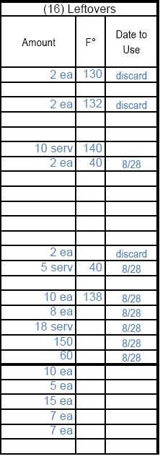
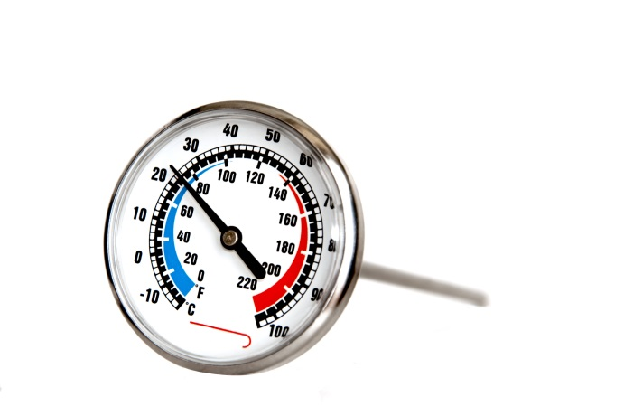
16
Use all leftover foods within 72 hours for maximum quality and safety.
Notes:
(16) Leftovers
Amount -- Enter actual portions of each menu/food item left after all meals and non-reimbursable items have been served. You should always record all leftovers (temperatures of TCS foods and amounts of all food) even if you are discarding the products.
^{oF} – Measure the temperature of the food (if it is a TCS food.) If the temperature of the food is not 41ºF or colder or 135ºF or hotter, then it cannot be used as a leftover. If the temperature is 41ºF or colder or 135ºF or hotter, then it can be used as a leftover so record the date to use the item – which can be up to three days from today’s date. Record the temperature of all leftover foods even if you plan to discard them; this information is necessary to give a clear picture of the way the foods were handled during the entire meal service. Refer to the HACCP plan for proper cooling procedures and the cooling log for recording the cool down times and temperatures.
If TILT procedures are followed according to EH approval, temperature of these foods do not have to be recorded on the production record at the end of service. Foods subject to TILT must be discarded by the end of the time specified in the written TILT procedure.
Date to Use By – Date marking of TCS foods that are prepared in the operation is required. While the Food Code allows foodservice operators to keep potentially hazardous foods for seven days, School Nutrition has established a higher standard. All leftover foods must be used within three days from the date of production. Record the date – up to three days from today’s date. The food must also to be labeled with the name of the item and clearly indicated date to use or discard date. Since leftovers can be used on any day during the three day period, you may indicate the date planned to include the leftover in the menu OR you may record the date that is three days out and use it on any menu within the three day period. Remember to discard all leftovers that remain in the cooler or freezer past the third day from original preparation. Note: Leftovers may NOT be frozen for use beyond 3 days; Leftovers and Pre-prepared foods are not the same. Refer to the HACCP plan Part 5: Menus and Recipes for more information about proper preparation and storage of Pre-prepared foods.
Remember that food temperatures of ALL TCS foods, including a la carte items must be tracked – cooking/preparation, holding, and leftover temperatures.

Slide 33
How do I record substitutions or leftovers on the day that they are served?
Enter the item(s) in section 1 so that you can track time and temperature.
Enter item information in the appropriate section of columns 6, 7, 8, 9, 10, and 11.
For leftovers, note the date of the original production in column 13. - i.e. L/O from 4/24
Write the amount offered for today’s meal in column 14.
Indicate a la carte sales/usage in column 15 and leftover information (if any!!) in column 16.
Notes:
List the food items, portion size, meal pattern contribution, and date of original service (columns 6, 7, 8, 9, 10, 11, and 13). Include the substitution or leftover quantity available, amount of non-reimbursable servings, and the required information about leftovers (columns 14-16).
IMPORTANT REMINDER – Adjust the Servings to Offer column 11 to reflect the substitution and leftover amounts added to the menu. Remember, you may need to reduce the originally planned amounts of some items so that the total number of meal components offered for reimbursable meals is plausible when compared to the total number of meals planned to offer in section 3.

Slide 34
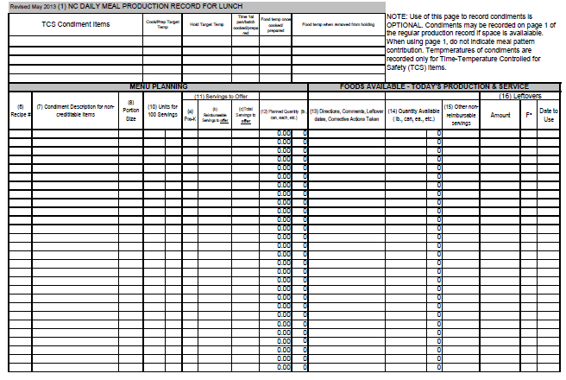
Optional Condiment Page
Notes:
Click on the tab at the bottom of the excel worksheet to locate the optional condiment tab. Use this additional page as needed when there is insufficient space on the first page of the production record to include all condiments offered and served.

Slide 35
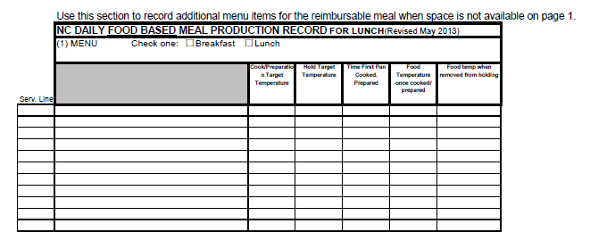
Extra space on page 2!
Notes:
The optional page 2 contains additional space to record additional menu items for the reimbursable meal when adequate space is not available on page 1, section 1.

Slide 36
A Reminder - Food Temperatures must be tracked for all time-temperature controlled for safety (TCS) foods - including a la carte!
For your convenience, we have added a HACCP a la carte section to page 2 that may be used for this purpose ….
Notes:
Remember that food temperatures of ALL TCS foods, including a la carte items must be tracked – cooking/preparation, holding, and leftover temperatures.
The only exception is for foods held according to written Time in Lieu of Temperature (TILT) procedures; leftover temperatures are not required for these foods; however, the TILT procedures and record keeping must be followed exactly as written; Failure to follow exactly will result in an Environmental Health violation.

Slide 37
Reminder…
An optional separate page for condiments
Column 11 must be adjusted prior to daily meal service to reflect the number of servings to offer to students. This adjustment to the number of reimbursable meals and menu items is required so that an accurate nutrient analysis can be conducted on the meals OFFERED to students. Previously the menu analysis was conducted on the items PLANNED and was adjusted only if the menu changed more than 2 weeks prior to being served.
Notes:
The production record contains a few enhancements and changes for this year.
An optional page for recording condiments is added.
Column 11 must be adjusted prior to daily meal service to reflect the number of servings to offer to students. This adjustment to the number of reimbursable meals and menu items is required so that an accurate nutrient analysis can be conducted on the meals OFFERED to students. Previously the menu analysis was conducted on the items PLANNED and was adjusted only if the menu changed more than 2 weeks prior to being served. USDA now requires the analysis on the OFFERED menu.

Slide 38
Adjusting for the OFFERED Menu:
Notes:
The red arrows point to the column 11 for number of reimbursable serving to offer and to the number of planned meals. Prior to daily meal service, adjust these numbers to reflect reasonable amounts of servings and meals that will be offered that day (Remember, USDA considers offered amounts as the amounts that will be prepared). Take in consideration any menu substitutions and/or leftovers offered that may impact the integrity of the nutritional analysis. Leftovers are not included in the nutrient analysis as they were already offered on the original day of service; however, they must be listed on the production records on the day(s) that they are re-served if they are offered as part of a reimbursable meal and/or TCS food temperature must be monitored.

Slide 39
Notes:
Note to Presenter: Consider opening the excel spreadsheet and demonstrating the way the spreadsheet calculates the amounts of food needed for the day’s meal service.
The red arrows point to the planned quantity column 12, and the quantity prepared column 14. When properly completing the information in units for 100 servings (based on ingredient amounts in the accurate standardized recipes) and the total planning information, column 12 will calculate automatically; the units of measure or weight will also transfer automatically to column 14 as a reminder to employees of the way to record the amounts of foods used for today’s meal service.

Slide 40
Click the icon below to demonstrate the production record spreadsheet
Notes:
Note to presenter: you must save the excel production record file to the same file location as the PPT presentation and check to make sure that the link works.

Slide 41
Now, Let’s look at the BREAKFAST Production Record….
Notes:
The breakfast meal pattern has changed and so has the production record! The breakfast meal service is recorded on a separate document in order to capture the breakfast component crediting for Grains, Fruit, and Milk along with an indication of M/MA used as a substitute for grain or “other” item.

Slide 42
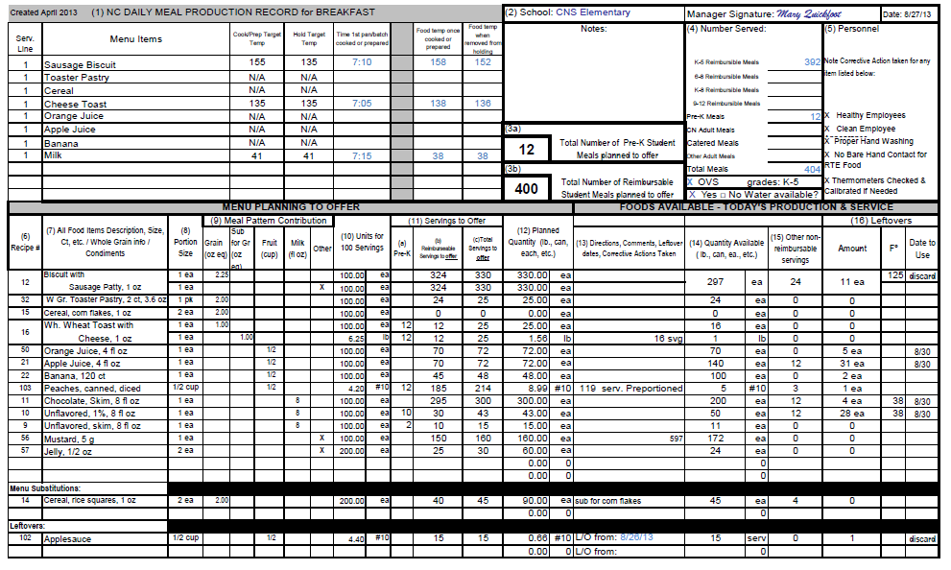
Notes:
As just mentioned, there is a separate production record for Breakfast because the meal pattern components are different for those meals. Breakfast meals no longer contain meats/meat alternates component. The BREAKFAST production record is also an Excel version with embedded formulas that automatically determine the amount of food to prepare once the planned number of meals is entered by the Manager.
We strongly encourage you to use this approved prototype as it captures the required information for compliance with the Administrative Review and HACCP.
As with the lunch production record, if you choose to use alternate form(s), you must submit to DPI for prior approval. Even when using alternate form(s), all of the information on the NC Daily Meal Production plan, including the HACCP monitoring and instructions, must be included in your documentation.

Slide 43
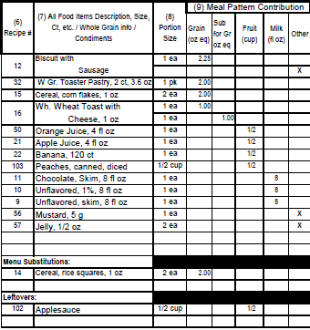
Changes to the meal components
Notes:
The breakfast production record is the same as the lunch production record with the exception of the sections used to document the meal pattern component contribution crediting. The breakfast production record indicates the meal components of grain, fruit, milk along with substitute for grains and other. The breakfast meal pattern no longer contains meats/meat alternates. Under certain circumstances, M/MA may credit as a substitute for grains so refer to current USDA guidance about the breakfast meal pattern. Alternately, M/MA may be used as an “other” menu item which does not provide component crediting of any type. The menu planner must make this determination before the menu is planned, offered, or served.

Slide 44
(9) Meal Pattern Contribution
Grain (oz eq) | Sub for Gr (oz eq) | Fruit (cup) | Milk (fl oz) | Other
Notes:
Here is a close up graphic showing the section with the new component crediting on the breakfast production record. All other information, including documentation of leftovers and menu substitutions are consistent with the lunch production record.
Refer to the worksheet tab for instructions at the bottom of the excel workbook for more detailed information about proper completion of the document.

Slide 45
Questions?
Notes:
Please contact your School Nutrition Administrator or regional School Nutrition Specialist or Consultant with questions.

Slide 46
The U.S Department of Agriculture (USDA) prohibits discrimination against its customers, employees, and applicants for employment on the bases of race, color, national origin, age, disability, sex, gender identity, religion, reprisal, and where applicable, political beliefs, marital status, familial or parental status, sexual orientation, or if all or part of an individual's income is derived from any public assistance program, or protected genetic information in employment or in any program or activity conducted or funded by the Department. (Not all prohibited bases will apply to all programs and/or employment activities.)
If you wish to file a Civil Rights program complaint of discrimination, complete the USDA Program Discrimination Complaint Form, found at http://www.ascr.usda.gov/complaint_filing_cust.html or at any USDA office, or call 866.632.9992 to request the form. You may also write a letter containing all of the information requested in the form. Send your completed complaint form or letter to us by mail at U.S. Department of Agriculture, Director, Office of Adjudication, 1400 Independence Avenue, S.W., Washington, D.C. 20250-9410, by fax 202.690.7442 or email at program.intake@usda.gov.
Individuals who are deaf, hard of hearing or have speech disabilities may contact USDA through the Federal Relay Service at (800) 877.8339; or (800) 845.6136 (in Spanish).
USDA is an equal opportunity provider and employer.

