Slide 1
Competitive Sale and Smart Snacks rules
What you need to know about Smart Snacks!
August 2014
USDA is an equal opportunity provider and employer.
Notes:
Let’s look at the rules that govern what and when certain foods and beverages can be sold at school.

Slide 2
What are competitive foods?
All food and beverages sold to students on the school campus during the school day, other than reimbursable meals.
Notes:
First, let’s look at the definition of a Competitive food: Competitive food is defined as all food and beverages sold to students on the School campus during the School day, other than those meals reimbursable under programs authorized by the National School Lunch Act and the School Nutrition Act (which would include the lunch and breakfast programs).

Slide 3
Healthy Hunger-Free Kids Act 2010
Provided USDA authority to establish nutrition standards for all foods and beverages sold outside of the Federal School Nutrition programs in schools.
Specifies nutrition standards for all foods sold:
outside the school meal programs;
on the school campus; and
at any time during the school day.
Notes:
Now, how are competitive foods regulated? Section 208 of the Healthy, Hunger-Free Kids Act of 2010 provided the Secretary of Agriculture with the authority to establish nutrition standards for all foods and beverages sold outside of the Federal School Nutrition programs in schools. And, these foods are the competitive foods as we defined in the previous slide.
The law specifies that the nutrition standards shall apply to all foods sold (a) outside the school meal programs; (b) on the school campus; and (c) at any time during the school day.
It does not apply to foods and beverages brought from home by students for meals (in personal lunchboxes) OR snacks or foods and beverages for birthday parties and other celebrations. (USDA intends that these situations will be addressed through the SFA’s Local Wellness Policy.)

Slide 4
In addition…..
Standards must be consistent with most recent Dietary Guidelines for Americans (DGA)
Standards represent minimum requirements
SFA’s and schools may establish more restrictive standards
Notes:
In addition, the competitive foods served must meet specific standards which we will discuss in more detail a bit later.

Slide 5
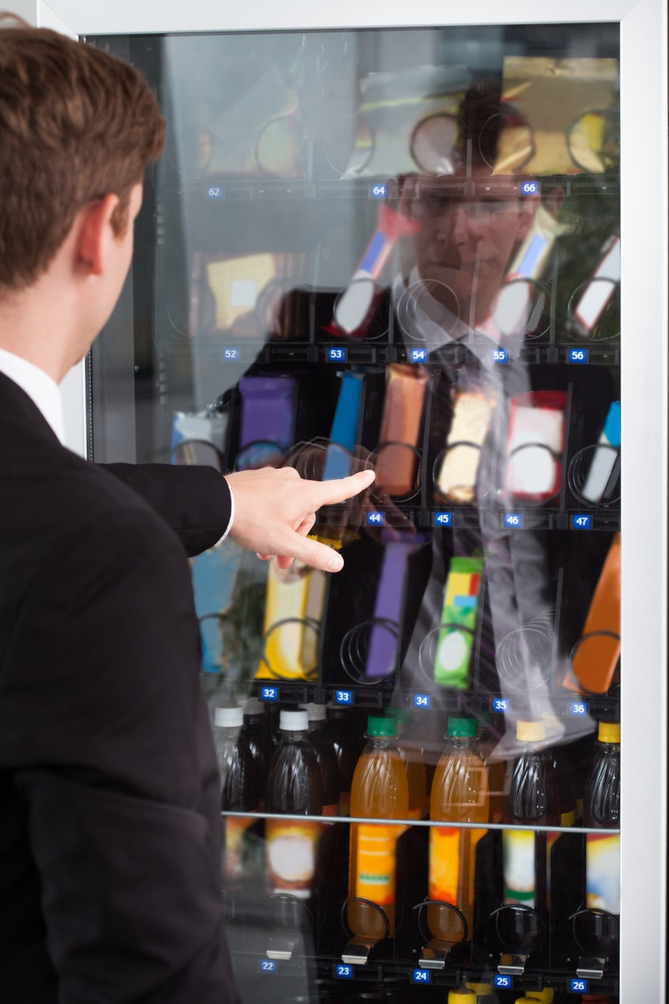
Smart Snacks Rule Applies to:
A la carte foods sold in the cafeteria
School stores
Snack bars
Vending machines
Any other venues
Notes:
The Smart Snacks Standards for All Foods Sold in Schools rule is often referred to as the Smart Snacks Rule for short. This rule is an interim final rule which means that it is in effect but has not been published in its final form at this time. However, effective July 1, 2014, schools are expected to implement the requirements. This rule applies to all competitive foods – for example, foods and beverages sold a la carte in the cafeteria, in school stores, at snack bars, from vending machines or any other venues that sell food to students on the school campus during the school day. In other words, these standards apply to all areas of the school campus accessible to students during the school day where competitive foods are sold. This would not include areas for the exclusive use of the faculty and staff, such as teacher’s lounges, as long as students do not have access during the school day.
Now, on another note, NC has some strict competitive food rules that do not allow foods and beverages to be sold during the school day except by the school nutrition program so we will talk more about this later.

Slide 6
What is the school day?
From midnight to 30 minutes after the end of the official school day.
Notes:
The competitive food standards apply during the school day. With the many activities, programs and schedules established by schools, it is not possible to specify in regulations a precise time for the start of the school day; therefore, this rule defines that the sale of competitive food to students be prohibited from the midnight before, to 30 minutes after the end of the official school day, or what may be considered the instructional day. For example, if a school dismissed each day at 3:00, then the standards would apply from midnight that day until 3:30 pm, 30 minutes after dismissal.
Specifying the period of midnight before ensures that the competitive food standards would apply to foods sold in the morning, including the School Breakfast Program meal service.
While USDA’s authority does not extend beyond the school day, States or local school districts have the discretion to apply these standards during afterschool, evening and weekend activities on campus, should they wish to do so by addressing these situations in the LWP.

Slide 7
Standards for Smart Snacks Foods
Apply to all grade levels
Include general standards and specific nutrient standards
Apply to:
Entrees
Sides
Snacks
Beverages
Provide exemptions for some foods
Notes:
As we begin to look a specific standards, remember that the nutrition standards for foods sold in schools are the same for all grades of students.
The rule contains both general standards and specific nutrient standards as well as exemptions from certain nutrient standards for some specific foods that are considered to be foods to encourage. We will discuss these exemptions after we go through the basic requirements.
Competitive foods are classified as one of the following:
Entrees
Sides
Snacks
Beverages
Each classification has some specific requirements so let’s begin to look more closely at each beginning with the entrees, sides and snacks first.

Slide 8
Definition of Competitive Food Entrée
A combination food of meats/meat alternates and whole grain rich food
A combination food of vegetable or fruit and meats/meat alternates
A meats/meat alternates item
Some exceptions from entrée classification
Notes:
Let’s take a moment to discuss the definition of an Entrée that is sold as a competitive food before we look further.
Entrée item is defined in this rule as either a combination food of meat and grains, of fruit or vegetables and meat, or a meats/meat alternates item served alone.
Some meat alternates, such as yogurt, cheese, nuts, seeds and nut butters, are excluded from the definition of entrée because they are typically snack items and would not be appropriate if offered in entrée sized portions.
In addition the interim final rule now also excludes meat snack items such as dried meat jerky and meat sticks from being considered to be an entrée, similar to the exclusion of the meat alternates mentioned above.
Our next slide will talk more about combination foods…..

Slide 9
Smart Snack Foods other than Entrées
Sides
Snacks
Notes:
Food items that do not qualify as an entrée are considered sides or snacks. These foods must meet some general and specific nutrient standards.

Slide 10
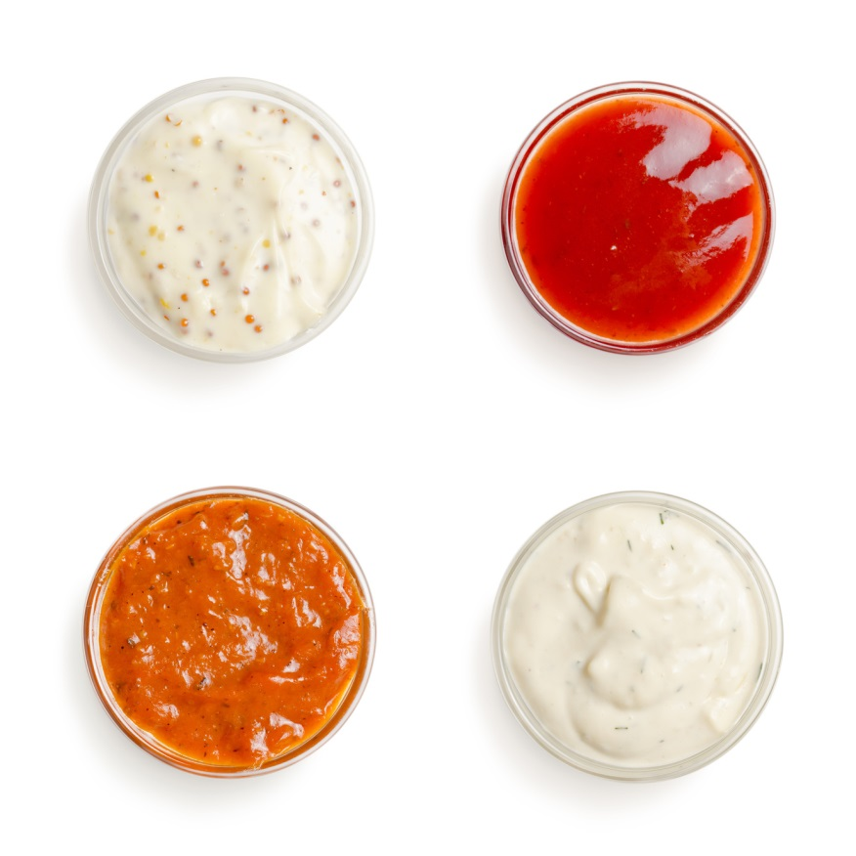
Accompaniments
Must be included in nutrient profile as a part of item served
Examples include:
Ketchup or mayonnaise for sandwiches Salad dressings
Margarine or jelly on toast
Cream cheese on bagels.
Notes:
Accompaniments and condiment items commonly served with foods, such as butter, salad dressing, cream cheese, jelly, syrup etc. can add a significant amount of calories, fat, sugar, and sodium to a diet.
The interim final rule continues to require that accompaniments be included in the nutrient profile as a part of the entrée or side item served and meet all of the nutrient standards.
However, this rule does not require pre-portioning of accompaniments. Instead the school can determine the average portion of the accompaniments used and add the nutrients to the profile of the food item the accompaniment is served with. This is similar to the approach schools have used for nutrient analysis of meals.

Slide 11
Smart Snack Foods General Standards
Whole grain-rich product
Fruit, vegetable, dairy, or protein as first ingredient
Combination food containing at least ¼ cup of fruit and/or vegetable
Contain 10% DV of one of the nutrients of public health concern (calcium, potassium, vitamin D or fiber) until July 1, 2016.
Notes:
All competitive foods, other than reimbursable meal offerings, must meet at least one of these four criteria:
Allowable grain products must include 50% or more whole grains by weight or have whole grains as the first ingredient.
If the item is not a whole grain-rich food, an allowable competitive food may be an item that has, as its first ingredient, one of the non-grain major food groups as defined in the 2010 Dietary Guidelines for Americans. This means that the first ingredient must be a fruit, vegetable, dairy product or protein (meat, beans, poultry, etc.). If water is the first ingredient, the second ingredient must consist of an item that belongs to one of these food groups or be a whole grain-rich item.
Allowable competitive foods also include combination foods that contain at least ¼ cup of a fruit and/or a vegetable. The interim final rule defines combination foods as those products that contain two or more foods from the five primary food groups from the DGA’s including the fruit, vegetable, dairy, protein or grain groups. Examples of combination foods that meet this criterion would include yogurt and fruit, cheese and crackers, hummus and vegetables, and fruit cobbler with whole grain-rich crusts.
The 10% provision is what we once knew as the Foods of Minimal Value (FMNV) rule…which will be phased out by July 1 , 2016.

Slide 12
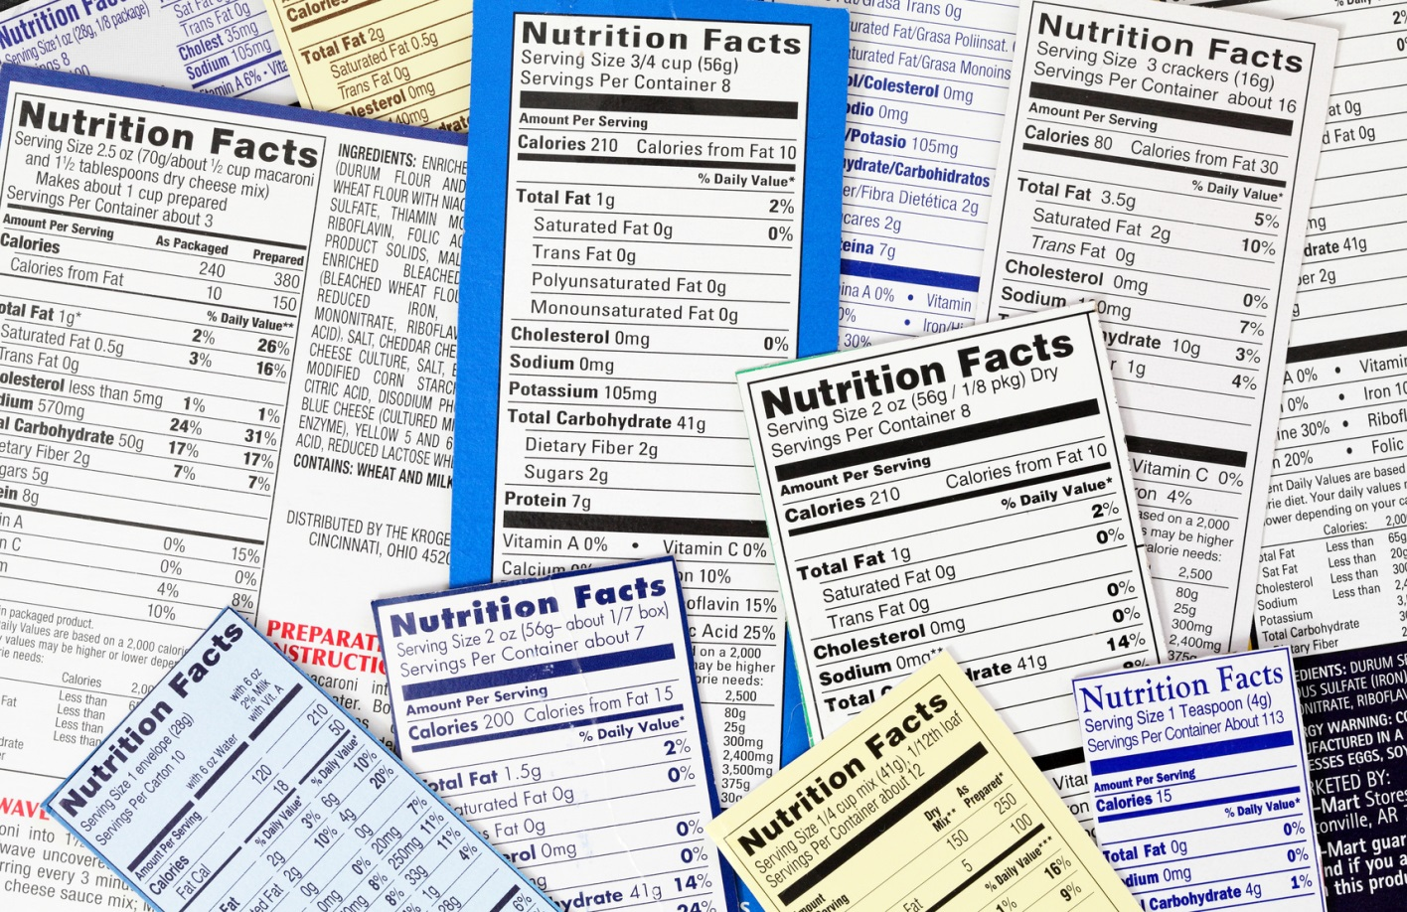
Smart Snack Nutrient Standards
Limits on:
Calories
Sodium
Fats
Sugar
Notes:
After determining that a competitive food meets one of the four criteria just discussed, you must look more closely at some of the specific nutrients. The Smart Snack Rule sets limits on calories, sodium, fat, and sugar. We will look at the limits for each of these nutrients for entrees, and sides/snacks.

Slide 13
Calories in Smart Snack Foods
Entrée items
< 350 calories
Snack and side items
< 200 calories
Notes:
The caloric content of snack items must be less than 200 and entrée items must be less than 350 calories. Therefore, you may see some changes in the types of a la carte snacks, sandwiches, pizza, tenders, etc. that are sold next year and beyond.

Slide 14
Sodium in Smart Snack Foods
Entrée items
< 480 mg
Snack and side items:
< 230 mg beginning July 1, 2014
< 200 mg beginning July 1, 2016
Notes:
The rule includes two sodium standards, one standard for items considered to be entrees and another standard for snack and side items.
The sodium limit for entrées that do not qualify under the NSLP/SBP exemption is no more than 480 mg sodium per item as served. SO…if an entrée is served other than on the day of service or the next day…it cannot contain more than 480 mg Na.
The interim final rule sets an initial limit for sodium at 230 mg for snacks and side dishes as packaged or served for the first two years of implementation of the standards. Sodium intake is an important health issue that must be addressed, however we recognize that making sodium changes is a process that will take time because of the need to reformulate or develop new products as well as time for children to adapt to new flavor profiles in foods.
Beginning July 1, 2016, the sodium limit for snacks and side dishes is reduced to 200 mg per item.
In addition, the allowable sodium level of snacks will be reduced to less than 200 mg on July 1, 2016.

Slide 15
Fats in Smart Snack Foods
Total fat: < 35% of calories
Saturated fat: < 10% of calories
Trans fat: zero grams
Some foods are exempt from fat standards
Notes:
Under the interim final rule, foods are required to contain no more than 35% of total calories from fat per item as packaged or served. Saturated Fat is limited to less than 10% of calories and all foods must have Zero grams of trans fat per portion as packaged. Trans fat is identified on the product label, which, for an eligible food, will say zero on a per portion basis.
There are some exemptions to the total fat limit for certain foods including reduced fat cheese; part-skim mozarella cheese, nuts and seeds and nut/seed butters; products consisting of only dried fruit with nuts and/or seeds with no added nutritive sweeteners or fat; and seafood with no added fat. These exemptions would not extend to combination foods that contain these exempt foods packaged together with other foods, such as peanut butter and crackers or trail mix.
The rule exempts some products from the saturated fat standard too. Products such as reduced fat cheese, part skim mozzarella cheese can be sold. And because nuts and seeds contain healthier fats, the rule also allows the sale of nuts and seeds and nut/seed butters.

Slide 16
Sugar in Smart Snacks Foods
< 35% of product weight from total sugars
Some foods are exempt
Notes:
≤ 35% of weight from total sugars per item. Some foods are exempt from the total sugars limit:
Fresh, frozen and canned fruits are exempt from all of the nutrition standards. This rule expands the dried fruit exemptions from the sugar requirement to certain dried fruits with added nutritive sweeteners where such sweeteners are required for processing and palatability, such as dried cranberries, tart cherries and blueberries. Dried fruit with only nuts/seeds (no added nutritive sweeteners or fat) added are also exempt from the sugar limits of less than 35% by product weight.

Slide 17
NSLP/SBP Entrée Competitive Food Exemption
Entrée exemption for the day of service and the next school day after original service
Does not apply to side dishes
Notes:
USDA paid special attention to ensuring that the nutrition standards for all foods sold to children complement or align with the updated school meal requirements.
To help achieve this, the interim final rule provides an exception or exemption from the Smart Snacks Rule for entrée items that are part of the reimbursable meal but also made available for a la carte purchase. This entrée exemption is available only on the day the item is served as part of a reimbursable meal and on the day after. This approach supports the concept of school meals as being healthful, while providing flexibility to use leftovers.
The interim final rule requires that competitive foods side dishes that are sold a la carte always meet all applicable competitive food standards.

Slide 18
Fruits and Vegetables Competitive Foods Exemptions
Fresh, frozen and canned fruit packed in water, 100 percent juice, light syrup or extra light syrup
Fresh, frozen and canned vegetables with no added ingredients except water
Canned vegetables with small amount of sugar for processing
Notes:
Fruits and vegetables are nutrient dense, and most children do not consume the recommended amount of fruits or vegetables. To be consistent with both the Dietary Guidelines and the Institute Of Medicine’s recommendations, the interim final rule includes an exemption to the standards for certain fruits and vegetables.
These are:
Fresh, frozen and canned fruit packed in water, 100 percent juice, light syrup or extra light syrup;
Fresh, frozen and canned vegetables with no added ingredients except water; or
Canned vegetables that contain a small amount of sugar for processing purposes in order to maintain the quality and structure of the vegetable (like green peas).

Slide 19
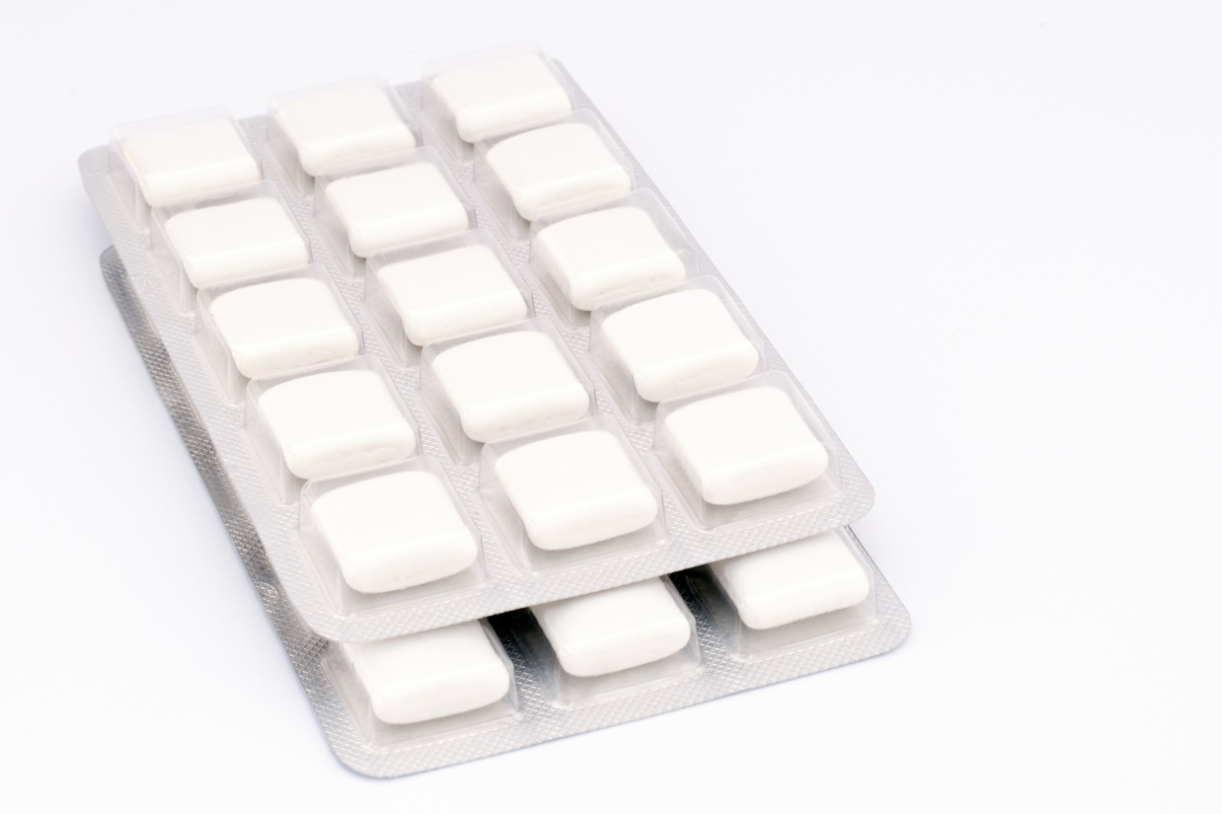
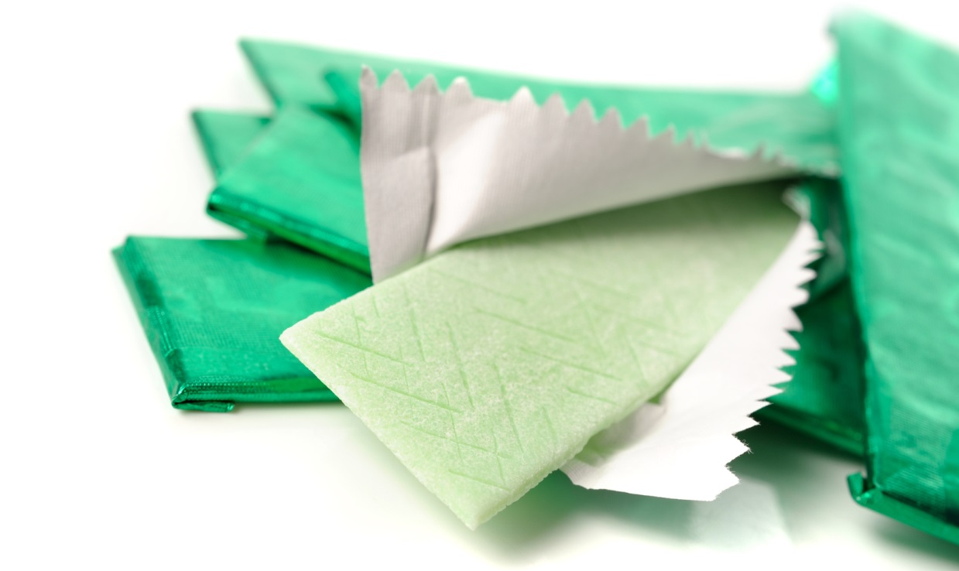
Chewing Gum Exemption
Sugar-free chewing gum may be sold as a competitive food item.
Notes:
The interim final rule allows the sale of sugar-free chewing gum; however, schools may choose not to allow the sale of sugar-free gum. it was recommended that USDA provide an exemption from the competitive food standards for sugar-free chewing gum because it has a proven impact on dental and oral health. Clinical studies have shown that chewing sugarless gum for 20 minutes following meals can help prevent tooth decay.

Slide 20
Smart Snack Beverage Standards
Vary by grade level
Identify specific types of beverages allowed
Limit the portion size
Allow caffeine only at high school
Notes:
Now, let’s turn our attention to beverages. The standards for beverages are structured a little differently than the standards for foods. The standards for beverages vary by grade level and they specifically identify the types and maximum portion sizes of beverages allowed.
At elementary and middle schools, foods and beverages must be caffeine-free, except for trace amounts of naturally- occurring caffeine substances.

Slide 21
Smart Snack Beverages Allowed
Water
Plain and any portion
Milk
100% Juice or juice diluted with water
8 fluid ounces in elementary
12 fluid ounces in middle and high
Notes:
Allowable beverages for all grade levels include water, milk and juice in serving sizes appropriate for age and grade levels.
Plain water may be sold to all students without limits on size. This includes the addition of plain carbonated water with no added ingredients. While some bottled waters have added minerals, including fluoride and others, for taste and this is acceptable, but no other additives, no natural or other flavors or sweeteners are allowed for carbonated water sold to students in elementary or middle schools.
Unflavored low fat milk and Unflavored or flavored non fat milk may be sold in up to 8 ounce servings in elementary school and up to 12 ounces for middle and high school students. This standard also includes nutritionally equivalent non-dairy milk substitutes for students who do not tolerate regular cows milk as permitted in the school meal programs.
100% fruit and/or vegetable juice may be sold.
The rule now allows the addition of 100% juice diluted with water which may be sold in these age-appropriate portion sizes. Diluted juice provides a lower calorie and nutritious option. These products could be carbonated or not carbonated, but they must not include any added sweeteners or other additives, only 100 percent juice and water. For elementary schools, the maximum serving size for juice is 8 ounces, and for middle and high schools, the maximum serving size is 12 ounces.

Slide 22
High School Other Smart Snack Beverages
Calorie-free flavored water, with or without carbonation
Up to 20 fluid ounces
Other “calorie-free” beverages
less than 5 calories per 8 fluid ounces
up to 10 calories per 20 fluid ounces
Notes:
In recognition of the wide range of beverages available to high school students in the broader marketplace and the increased independence these older students have in making consumer choices, the rule provides additional beverage choices for high school students. Therefore, the following beverages are allowed in high schools:
Calorie-free, flavored and/or unflavored water, with or without carbonation (≤20 fl. oz);
Other calorie free beverages with
<5 calories per 8 fluid ounces or;
<10 calories per 20 fluid ounces.
Such products may include flavored waters, carbonated or uncarbonated waters, enhanced waters, vitamin/nutrient waters or other similar beverages.

Slide 23
High School Other Smart Snack Beverages
Lower Calorie Beverages
Maximum Serving Size 12 fluid ounces
Up to 60 calories per 12 fluid ounces
Up to 40 calories per 8 fluid ounces
Notes:
For other beverages available in high school, the interim final rule includes low calorie beverages up to 60 calories per 12 ounces or up to 40 calories per 8 ounces which may be served in a maximum serving size of 12 ounces. There are many options available in the current marketplace that meet these standards at this time, such as lower calorie sports drinks, lower calorie tea/lemonade beverages, etc.

Slide 24
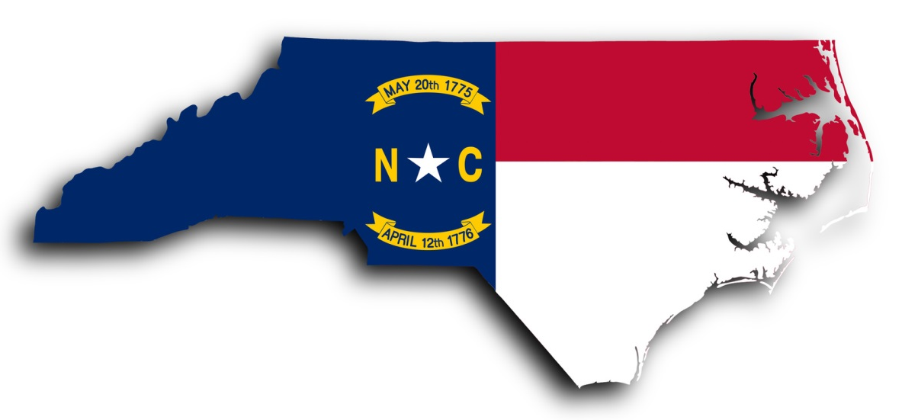
And now…Current NC Rules
No food or beverage may be sold to students on campus in competition with the school nutrition program between the hours of 12:01 AM until the cafeteria closes for the day.
Notes:
NCDPI State Board of Education Policy16 NCAC 6H.004 , which carries the same weight of law, says that Competitive food sales of extra food items in the cafeteria or its general environs must be on a nonprofit basis. Nonprofit basis” means that the SFA deposits income from the sale of such food items into the account of the school’s nonprofit lunch and breakfast programs and uses the income solely for these programs.
In other words, no food or beverage (regardless of its nutrient content) may be sold in competition with the school nutrition program between the hours of 12:01 AM until the cafeteria closes for the day.
This means that there can be no fundraising activities of food or beverage sales in North Carolina Schools until the cafeteria closes unless the sales occur by the school nutrition program.

Slide 25
Fundraisers
Exemptions for fundraisers will not be granted
Can conduct non-food and beverage fundraisers during school
Food and beverage fundraisers after cafeteria closes must comply with Smart Snacks nutrition standards.
Notes:
The interim Smart Snacks Rule makes a provision for SFAs to request exemptions from the Smart Snack nutrition standards for occasional fundraisers. However, the State Board of Education (SBE) in our state has not granted exemptions for fundraisers.
As previously stated, to be in compliance with the SBE policy on competitive foods and beverages, fund-raising activities that involve the sale of foods and/or beverages to students may not occur from 12:01 AM until the cafeteria closes for the day. If foods and/or beverages are sold as fund-raisers from the time the cafeteria closes for the day through 30 minutes after the dismissal bell rings, they must comply with the Smart Snacks nutrition standards. Fund-raisers that are conducted outside the protected time period of 12:01 AM through 30 minutes after the dismissal bell rings, are not required to comply with Smart Snacks nutrition standards, but are subject to the requirements of the LEA’s local wellness policy.

Slide 26
Competitive Foods Violations
The State Agency has the authority to reclaim or withhold Federal funds for reimbursable school meals on each day the school is in violation of the SBE Policy and/or may withhold federal reimbursement until compliance is obtained.
Notes:
SFAs in violation of the competitive foods rule are subject to corrective action plans to ensure ongoing compliance. The State Agency has the authority to reclaim or withhold Federal funds for reimbursable school meals on each day the school is in violation of the SBE Policy and/or may withhold federal reimbursement until compliance is obtained.

Slide 27
Bottom Line in NC…
All revenues from the sale of foods and/or beverages sold to students until the established lunch period ends must accrue to the non-profit School Nutrition Program.
Failure to comply will mean loss of federal School Nutrition funds.
Notes:
Even with the Smart Snacks rules in place, there can be no food or beverage sales at school until after the end of the lunch period unless they are sold through the school nutrition program.

Slide 28
What happens after lunch?
School districts may:
Extend the existing NC Competitive Foods Rule to 30 minutes after the school day ends.
Allow School Nutrition Services to control all food and beverage sales
Purchase qualifying snacks and beverages from School Nutrition
Control their own sales of foods and beverages after the lunch period
Notes:
The Smart Snack Rule requirements continue until 30 minutes after school is dismissed. So what happens in NC after lunch is over? There are 4 options for compliance in our state and each local BOE makes the decision about the options available.
School districts may:
Extend the existing NC Competitive Foods rule to 30 minutes after the school day ends. No competitive food sales would be allowed at any time during the day continuing until 30 minutes after school.
Allow School Nutrition Services to control all food and beverage sales after lunch is over and receive the proceeds of the sales. All vending and other sales would become the responsibility of School Nutrition Program.
Purchase qualifying snacks and beverages from School Nutrition and sell after lunch is over. The school would also be purchasing the expertise of the School Nutrition Administrator to ensure that all products meet the Smart Snack requirements and would keep appropriate labels. The School Nutrition Administrator would determine the appropriate mark-up and procedures for the sales.
Control their own sales of foods and beverages after the lunch period, keep all required nutrient and sales documentation, and be subject to frequent and unannounced reviews for compliance. This option would not involve School Nutrition Services for product review or record keeping and could become burdensome for the school administration.

Slide 29
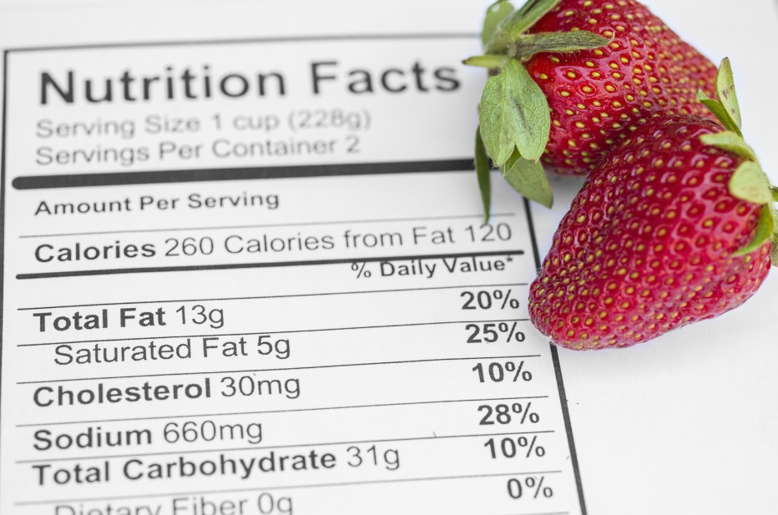
Questions about Competitive Foods and Smart Snacks?
Notes:
School Nutrition Consultants, Specialists, and local SN Administrators are available to answer questions about competitive foods and Smart Snacks.

Slide 30
The U.S Department of Agriculture (USDA) prohibits discrimination against its customers, employees, and applicants for employment on the bases of race, color, national origin, age, disability, sex, gender identity, religion, reprisal, and where applicable, political beliefs, marital status, familial or parental status, sexual orientation, or if all or part of an individual's income is derived from any public assistance program, or protected genetic information in employment or in any program or activity conducted or funded by the Department. (Not all prohibited bases will apply to all programs and/or employment activities.)
If you wish to file a Civil Rights program complaint of discrimination, complete the USDA Program Discrimination Complaint Form, found at http://www.ascr.usda.gov/complaint_filing_cust.html or at any USDA office, or call 866.632.9992 to request the form. You may also write a letter containing all of the information requested in the form. Send your completed complaint form or letter to us by mail at U.S. Department of Agriculture, Director, Office of Adjudication, 1400 Independence Avenue, S.W., Washington, D.C. 20250-9410, by fax 202.690.7442 or email at program.intake@usda.gov.
Individuals who are deaf, hard of hearing or have speech disabilities may contact USDA through the Federal Relay Service at (800) 877.8339; or (800) 845.6136 (in Spanish).
USDA is an equal opportunity provider and employer.

