Slide 1
Civil Rights for School Nutrition Programs
Presented to School Nutrition Managers and Employees
North Carolina Department of Public Instruction
School Nutrition and District Operations Division
Revised August 2020
Notes:
(Notes to presenter:
Introduce yourself, inform of any housekeeping rules for the learning session, and briefly tell about what the participant will learn. Remember to keep documentation of this employee continuing education on file. The documentation should include the title "Civil Rights Continuing Education“, date of continuing education session, and a roster of those attending the learning session.)
During this presentation we will learn about civil rights – what are civil rights and how these rights impact the service you provide to students and families participating in the School Nutrition programs.

Slide 2
What are civil rights?
Civil rights are the nonpolitical rights of a citizen; the rights of personal liberty guaranteed to U.S. citizens by the 13th and 14th Amendments to the U.S. Constitution and Acts of Congress.
Notes:
Civil rights are the nonpolitical rights of a citizen. They are the rights of personal liberty guaranteed to U.S. citizens by the 13th and 14th Amendments to the U.S. Constitution and Acts of Congress.

Slide 3
Civil Rights Education
All people involved in administering programs receiving federal financial assistance must understand civil rights laws, regulations, procedures and directives.
Education about civil rights must be provided to all employees every year.
Notes:
Continuing Education is required so that people involved in all levels of administration of programs that receive federal financial assistance understand civil rights laws, regulations, procedures and directives.
State agencies are responsible for educating the School Nutrition administrator of the School Food Authority (SFA) annually.
The SFA is responsible for educating their managers and staff who interact with applicants or participants annually.

Slide 4
FNS Instruction 113-1 Civil Rights Compliance and Enforcement - Nutrition Programs and Activities
Provides guidance to prohibit discrimination in Food and Nutrition Service (FNS) programs.
Notes:
The Civil Rights Instruction Food and Nutrition Service (FNS) 113-1 was issued Nov. 8, 2005. The purpose of the Instruction is to establish and convey policy and provide guidance and direction to the USDA Food & Nutrition Service and it’s recipients and customers, and ensure compliance with and enforcement of the prohibition against discrimination in all FNS nutrition programs and activities, whether federally funded in whole or not.

Slide 5
What is a Protected Class?
Any person or group of people who have characteristics for which discrimination is prohibited based on a law, regulation, or executive order.
Protected classes for the School Nutrition (SN) Programs are race, color, national origin, age, sex, and disability.
Notes:
A protected class is any person or group of people who have characteristics for which discrimination is prohibited based on a law, regulation, or executive order.

Slide 6
Race, Color, National Origin
Title VI of the Civil Rights Act of 1964 states “no person in the United States shall be discriminated against on the grounds of race, color or national origin, be excluded from participation in, be denied the benefits of, or be subjected to discrimination under any program or activity.”
Notes:
The Civil Rights Act of 1964 was a product of the growing demands of the early sixties, launched by the Federal government as a response against racial discrimination.
Title VI of the Civil Rights Act of 1964 prohibits discrimination on the basis of race, color, or national origin in Federally Assisted Programs.
No one in the United States shall, on the grounds of race, color, or national origin be excluded from participation in, be denied the benefits of, or be subjected to discrimination under any program or activity receiving Federal Financial Assistance. The Civil Rights Restoration Act of 1987 was issued to ensure nondiscrimination in all federal programs whether the programs for federally funded or not.
Discrimination Examples:
Race/Color: Treating or speaking to a child differently (using slang for example) or in a friendlier manner because of race or color.
National Origin: Assuming a student doesn’t eat a particular food because of their national origin (example, assuming students of middle eastern decent do not eat pork). All customers need to be offered the same food choices. They have the option to choose what they want to eat.

Slide 7
Age
The Age Discrimination Act of 1975 provides:
No person in the United States shall, on the basis of age, be excluded from participation in, be denied the benefits of, or be subjected to discrimination under, any program or activity receiving Federal financial assistance.
Notes:
The Age Discrimination Act of 1975 ensures that no person in the United States shall, on the basis of age, be excluded from participation in, be denied the benefits of, or be subjected to discrimination under any program or activity receiving Federal financial assistance.
Discrimination Example: Even if a child is younger, they need to be offered the same portion size as other students. For example, you can’t give a ¼ cup serving of a food item to a younger child just because they are younger, if you are offering ½ cup servings to the rest of the students according to the same meal pattern.

Slide 8
Sex (Gender)
Title IX of the Education Amendments of 1972 states:
No person in the United States shall, on the basis of sex, be excluded from the participation in, be denied the benefits of, or be subjected to discrimination under any educational program or activity receiving Federal financial assistance.
Notes:
Title IX of the Education Amendments of 1972 is designed to eliminate discrimination on the basis of sex in any education program or activity receiving Federal financial assistance, whether or not such a program or activity is offered or sponsored by an educational institution as defined by the legislation.
Discrimination Example: You shouldn’t offer smaller food portions to girls compared to boys. Just because girls are physically smaller, they might participate in sports and need similar calories to those of boys their age. The same size portion should be offered to each student.

Slide 9
Handicap or Disability
Section 504 of the Rehabilitation Act of 1973 added disability to Title VI.
Title II and Title III of the Americans with Disabilities Act of 1990 extended the requirements to all services, programs and activities of State and local governments and prohibits discrimination based on disability in other public services.
Notes:
Section 504 of the Rehabilitation Act of 1973 prohibits discrimination on the basis of handicaps in programs and activities receiving or benefiting from Federal financial assistance.
The Americans with Disabilities Act, (ADA) took effect on January 26, 1992, and prohibits discrimination on the basis of a disability.
The Americans with Disabilities Act enables an individual with a disability to enjoy equal opportunity in employment and services
The manager/assistants must work with the school and children that are disabled or mentally challenged. They need to be offered the same choices and serving sizes as the other students unless they have a properly completed and signed Medical Statement on file and require special accommodations.

Slide 10
Language Assistance
Serve people with limited English proficiency (LEP)
Outreach in other languages is important
Must take reasonable steps to provide access to people with LEP
Notes:
In August of 2000, Enforcement of Title VI of the Civil Rights Act of 1964 was issued. It stated that person with Limited English Proficiency (LEP) (individuals are ones who do not speak English as their primary language and who have a limited ability to read, speak, write, or understand English) could not be discriminated against because of the language barrier.
Outreach in other languages is important.
Recipients of Federal financial assistance have a responsibility to take reasonable steps to assure meaningful access to the information and services they provide based on the following factors: 1) number or proportion of LEP persons eligible to be served by the program; 2) frequency with which LEP individuals come in contact with the program; 3) nature and importance of the program to people’s lives; 4) resources available to recipients and cost. Explore the most cost effective means of delivering language serves to LEP recipients.

Slide 11
3 Elements of Public Notification
1. Program Availability
Inform applicants, participants, and potentially eligible persons of their program rights and responsibilities and the steps necessary for participation.
Notes:
Program Availability
Inform applicants, participants, and potentially eligible persons of their program rights and responsibilities and the steps necessary for participation.

Slide 12
3 Elements of Public Notification
2. Complaint Information
Advise applicants and participants at the service delivery point of their right to file a complaint, how to file a complaint, and the complaint procedures.
Notes:
Complaint Information
Advise applicants and participants at the service delivery point of their right to file a complaint, how to file a complaint, and the complaint procedures.

Slide 13
3 Elements of Public Notification
3. Nondiscrimination Statement
Must be included on all information, materials and sources, used to inform the public about FNS programs.
Notes:
Nondiscrimination Statement
All information materials and sources, including Web sites, used by FNS, State agencies, local agencies, or other sub-recipients (like your school) need to inform the public about FNS programs they operate. These materials and sources must contain the nondiscrimination statement. The statement is not required to be included on every page of the program Web site. At a minimum the nondiscrimination statement or a link to it must be included on the home page of the program information.

Slide 14
Nondiscrimination Statement
In accordance with Federal civil rights law and U.S. Department of Agriculture (USDA) civil rights regulations and policies, the USDA, its Agencies, offices, and employees, and institutions participating in or administering USDA programs are prohibited from discriminating based on race,
color, national origin, sex, disability, age, or reprisal or retaliation for prior civil rights activity in any program or activity conducted or funded by USDA.
Persons with disabilities who require alternative means of communication for program information (e.g. Braille, large print, audiotape, American Sign Language, etc.), should contact the Agency (State or local) where they applied for benefits. Individuals who are deaf, hard of hearing or have speech disabilities may contact USDA through the Federal Relay Service at (800) 877-8339. Additionally, program information may be made available in languages other than English.
To file a program complaint of discrimination, complete the USDA Program Discrimination Complaint Form, (AD-3027) found online at: How to File a Complaint, and at any USDA office, or write a letter addressed to USDA and provide in the letter all of the information requested in the form. To request a copy of the complaint form, call (866) 632-9992. Submit your completed form or letter to USDA by:
(1) mail: U.S. Department of Agriculture
Office of the Assistant Secretary for Civil Rights
1400 Independence Avenue, SW
Washington, D.C. 20250-9410;
(2) fax: (202) 690-7442; or
(3) email: program.intake@usda.gov.
This institution is an equal opportunity provider.
Notes:
This is the text for the entire Civil Rights Policy statement. It should be used in it’s entirety on your website and on documents printed for your program.
Retrieved August 20, 2020
http://childnutrition.ncpublicschools.gov/information-resources/civil-rights/usda-non-discrimination-statement

Slide 15
When to use which version of the Nondiscrimination Statement?
Include entire statement when space permits
Use shortened version where space is limited:
“The USDA is an equal opportunity provider and employer.”
For electronic communications use the statement on the previous slide.
Notes:
“The USDA is an equal opportunity provider and employer” is the shortened version of the nondiscrimination statement. This part of the statement can be substituted on a menu or other document where space is limited.

Slide 16
Required Public Notification
Must inform applicants, participants, and potentially eligible persons of:
program availability
program rights and responsibilities
the policy of nondiscrimination
the procedure for filing a complaint
Notes:
All FNS assistance programs must include a public notification system.
The purpose of this system is to inform applicants, participants, and potentially eligible persons of:
program availability,
program rights and responsibilities,
the policy of nondiscrimination, and
the procedure for filing a complaint.

Slide 17
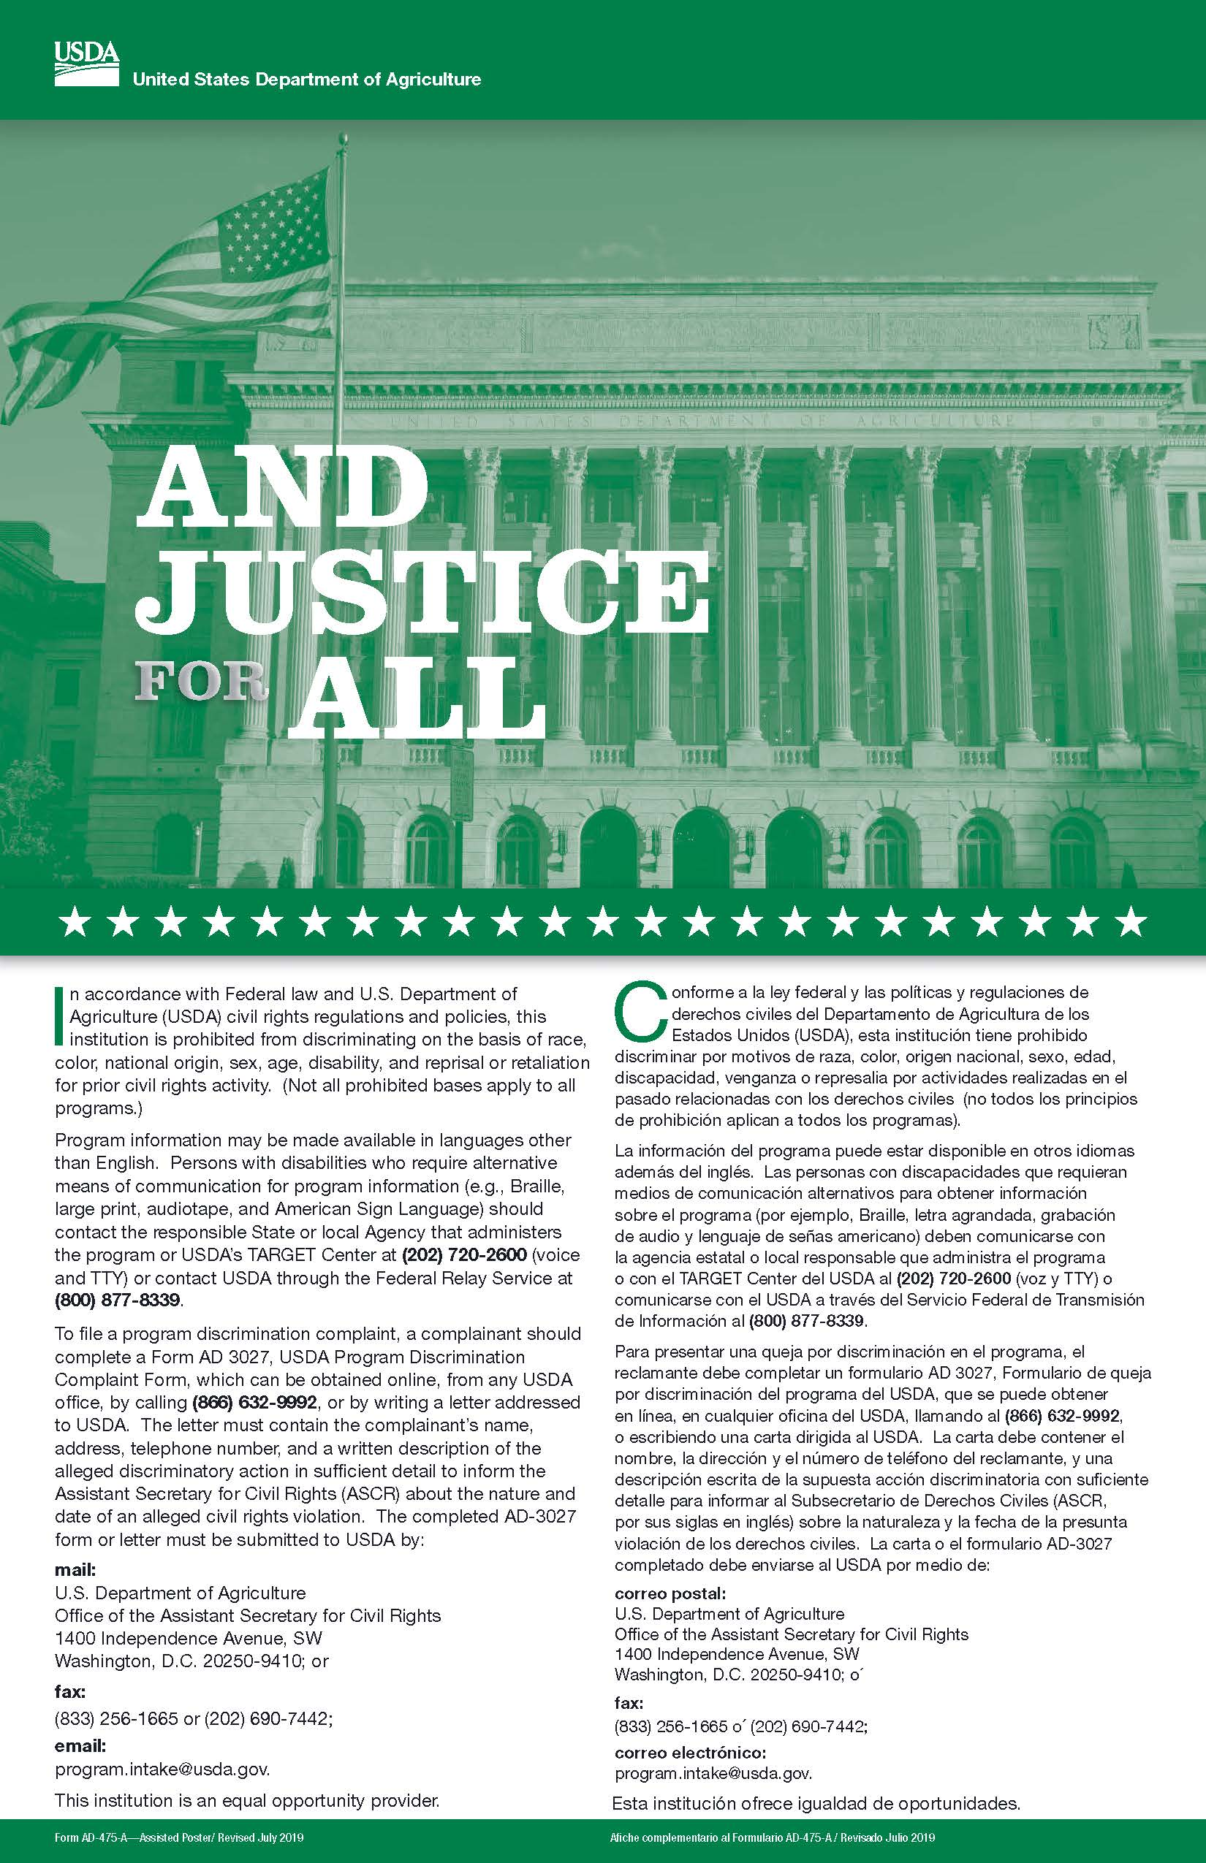
Methods of Public Notification
Display the Poster!
Notes:
Prominently display the “And Justice for All” poster.

Slide 18
Public Notification
Inform about programs and changes
Provide appropriate format for persons with disabilities.
Include statement on all materials
Consistently convey the message of equal opportunity
Notes:
The public notification process should:
Inform potentially eligible persons, applicants, participants and grassroots organizations of programs or changes in programs.
Provide appropriate information in alternative formats for persons with disabilities.
Include the required nondiscrimination statement on all appropriate FNS and agency publications, Web sites, posters and informational materials.
Convey the message of equal opportunity in all photos and other graphics that are used to provide program or program-related information.

Slide 19
What to do if a complaint is made:
Notify the School Nutrition Administrator immediately
Provide forms for written complaints OR
Take detailed notes of oral complaints
Notes:
Verbal or Oral Complaints - In the event a complainant makes the allegations verbally or through a telephone conversation and refuses or is not inclined to place such allegations in writing, the person to whom the allegations are made will write up the elements of the complaint for the complainant. Verbal complaints must be accepted and forwarded immediately upon receipt.
Written Complaints - Written complaints must be accepted and forwarded immediately upon receipt.

Slide 20
Information needed:
Complainant’s name, address, and phone number
Location where discrimination occurred
Nature of the incident
Basis for the claim (i.e. race, age, disability, etc.)
Names of witnesses
Date(s) when action(s) occurred
Notes:
For written, verbal, or anonymous complaints, it is necessary that the information obtained be sufficient to determine the identity of the agency or individual toward whom the complaint is directed, and to indicate the possibility of a violation. Only the federal representatives may reject a complaint on the basis of lack of merit. Every effort should be made to have the complainant provide the information about the alleged discriminatory action.

Slide 21
What are some examples of Civil Rights noncompliance?
Denying the opportunity to apply for program benefits based on a protected class.
Giving student eligibility information to anyone without receiving permission from the SN Administrator.
Notes:
Example: All students should receive an application for free/reduced meals regardless of where they live or their nationality.
Eligibility information must not be shared with anyone without getting permission from the SN Director due to confidentiality issues.

Slide 22
What are some examples of Civil Rights noncompliance?
Selecting members for planning and advisory committees in such a way as to exclude persons from membership on the basis of a protected class.
Overtly identifying a student based on a protected class.
Notes:
Be sure appropriate measures are taken to include members from all race, age and sex categories in any activities conducted by SN Services.
Example: Don’t have a student advisory committee made up of students from the same grade or sex. Ask a variety of students to participate.
Example: Don’t assume students who are “handicapped” are eligible for free meals.

Slide 23
Customer Service
Treat others as you want to be treated – with equality and kindness!
Notes:
Remember to treat all students with equality and kindness!

Slide 24
QUESTIONS?
http://childnutrition.ncpublicschools.gov/information-resources/civil-rights/civil-rights/information-resources/civil-rights
Notes:
This concludes the presentation on Civil Rights. We hope that this session has provided useful information. Please contact your School Nutrition Administrator or refer to the School Nutrition website if you have additional questions.

Slide 25
Nondiscrimination Statement
In accordance with Federal civil rights law and U.S. Department of Agriculture (USDA) civil rights regulations and policies, the USDA, its Agencies, offices, and employees, and institutions participating in or administering USDA programs are prohibited from discriminating based on race, color, national origin, sex, disability, age, or reprisal or retaliation for prior civil rights activity in any program or activity conducted or funded by USDA. Persons with disabilities who require alternative means of communication for program information (e.g. Braille, large print, audiotape, American Sign Language, etc.), should contact the Agency (State or local) where they applied for benefits. Individuals who are deaf, hard of hearing or have speech disabilities may contact USDA through the Federal Relay Service at (800) 877-8339. Additionally, program information may be made available in languages other than English.
To file a program complaint of discrimination, complete the USDA Program Discrimination Complaint Form, (AD-3027) found online at: How to File a Complaint, and at any USDA office, or write a letter addressed to USDA and provide in the letter all of the information requested in the form. To request a copy of the complaint form, call (866) 632-9992. Submit your completed form or letter to USDA by:
(1) mail: U.S. Department of Agriculture
Office of the Assistant Secretary for Civil Rights
1400 Independence Avenue, SW
Washington, D.C. 20250-9410;
(2) fax: (202) 690-7442; or
(3) email: program.intake@usda.gov.
This institution is an equal opportunity provider.
Notes:
Retrieved August 20, 2020
http://childnutrition.ncpublicschools.gov/information-resources/civil-rights/usda-non-discrimination-statement

