Slide 1
Annual Civil Rights Training shortened version
April 2024
Office of School Nutrition
Notes:
Please note that this training has been consolidated but will still cover all the required training components as outlined by USDA. However, keep in mind that when counting this towards your annual Professional Standards hours, you may only count 15 minutes for this Civil Rights training.

Slide 2
Civil Rights Education includes:
Data collection and use
Public Notification
Complaints
Compliance and noncompliance
Accommodation
Resolving conflict
Annual Civil Rights Training
Notes:
What are Civil Rights? They are the nonpolitical rights of a citizen; the rights of personal liberty guaranteed to U.S. citizens by the 13th and 14th Amendments to the U.S. Constitution and Acts of Congress.
All staff should receive training on all aspects of Civil Rights Compliance including but not be limited to:
Collection and use of data;
Effective public notification systems,
Complaint procedures,
Compliance review techniques,
Resolution of noncompliance,
Requirements for reasonable accommodation of persons with disabilities,
Requirements for language assistance
Conflict resolution, and
Customer service
The goal of Civil Rights training is to provide a clear understanding of civil rights and the requirements the United States Department of Agriculture (USDA), the State Agency, and the School Food Authorities have for those organizations participating in School Nutrition Programs.
State agencies are responsible for training subrecipient agencies on an annual basis. Subrecipient agencies are responsible for training their local sites, including “frontline staff” who interact with applicants or participants on an annual basis. New employees must receive Civil Rights training before participating in Program activities. Volunteers must receive training appropriate to their roles and responsibilities.
[Note to presenter: Source Document - www.fns.usda.gov/cr/fns-instruction-113-1 Please bookmark or save to your desktop]

Slide 3
Six Protected Bases of Discrimination
School Nutrition Programs
Race
Color
National Origin
Age
Sex (including gender identity and sexual orientation)
Disability
Notes:
In USDA’s Food and Nutrition Programs, there are six (eight) protected bases or classes. FNS’s Civil Rights Division will update the Non-discrimination Statement and the And Justice for All posters to include gender identity and sexual orientation as protected bases.
On May 5, USDA Policy Memorandum CRD 01-2022 was issued to clarify prohibitions against discrimination based on sex in all FNS programs to include a prohibition on discrimination on the basis of gender identity and sexual orientation. The memorandum provides further guidance on processing discrimination complaints.
As a result, the AJFA posters are being updated and the NDS will be updated to reflect the addition of gender identity and sexual orientation.
Additional information is forthcoming and when it is shared we will make sure to pass it on.
[Note to presenter: The court case leading to the updated memorandum is Bostock vs Clayton County (US Supreme Court Case June 2020)]

Slide 4
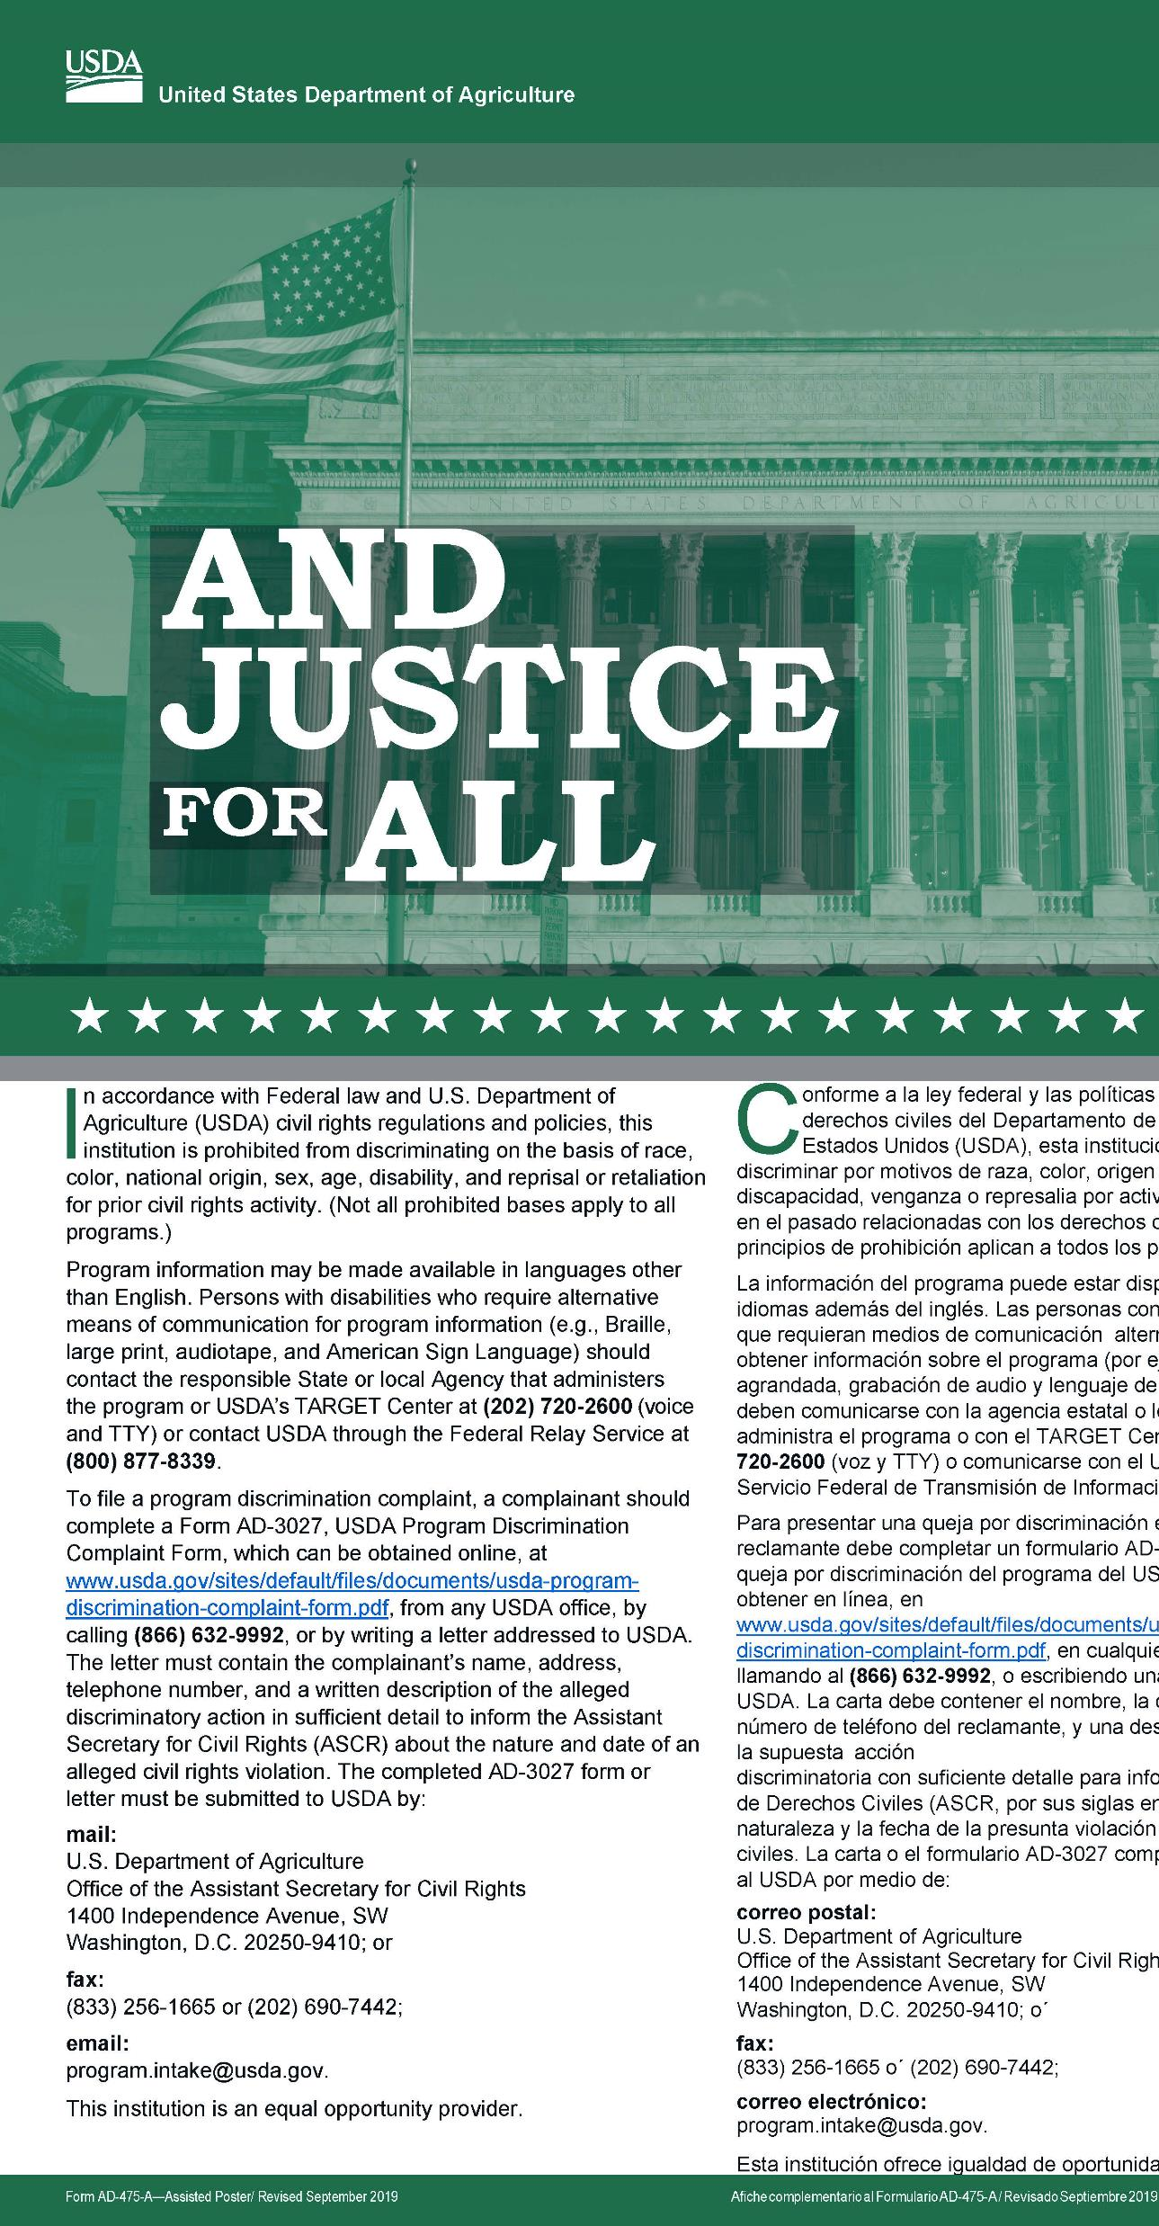
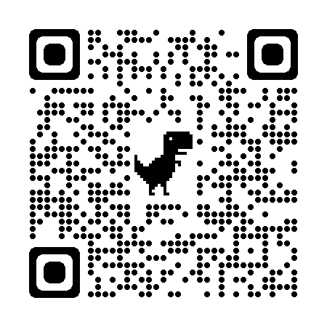
Methods of Public Notification
Display the Poster in a prominent location and visible to recipients of benefit!
AD-475A
This is the required version
https://www.fns.usda.gov/cr/and-justice-all-posters-guidance-and-translations
Notes:
Our first line of public notification is displaying the poster. Prominently display the “And Justice for All” poster and make sure it is visible to recipients of the benefit. It is important to make sure you have the most recent poster, since they are regularly updated.
The And Justice For All poster includes the entire Civil Rights Policy statement. It should be used in its entirety on your website and on documents printed for your program.
Please note the nondiscrimination statement must be in the exact format as shown on the USDA website.
If you need copies of the poster, please download and print from the USDA website as shown on the screen. You can also scan the QR code to go directly to the website on your mobile device. You can also contact the State Agency so that we can send them out to you. We are still awaiting the new posters so if you submitted an order to us, we have it and are waiting. If you have not submitted a request for new posters, please send an email to Jacquelyn McGowan.

Slide 5
Which Version Should I Use?
Include entire statement when space permits
Use shortened version in *special circumstances only where space is limited:
“The USDA is an equal opportunity provider.”
Please reference the last slide for the full non-discrimination statement.
Notes:
One question we get often is, “What version of the Non-discrimination Statement should I use?”
The entire statement should be used when space permits. However, in special circumstances only where space is limited, the shortened version can be used. This version states, “The USDA is an equal opportunity provider.”
At a minimum, the Non-discrimination Statement should be on:
Application Form(s),
Notification of Eligibility or Ineligibility,
Notice of Adverse Action Form,
Program (Home) Web Page, and
Public Information, including program literature.
The last slide of this presentation includes the full Non-discrimination Statement.

Slide 6

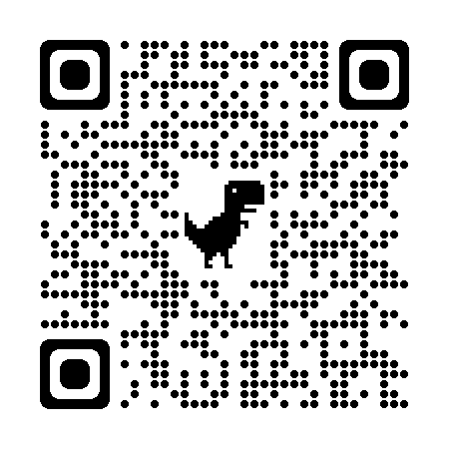
Discrimination Complaints
Must adhere to timeframes
File complaint within 180 days of discriminatory action
May be written, verbal, or anonymous
Form is provided but not required
https://www.usda.gov/oascr/filing-program-discrimination-complaint-usda-customer
Notes:
All complaints alleging discrimination on the basis of race, color, national original, age, sex, or disability, either written or verbal, must be processed within the timeframes.
Any person or representative alleging discrimination based on a prohibited basis has the right to file a complaint within 180 days of discriminatory action. Only the Secretary of Agriculture may extend this time under special circumstances.
Complaints may be written or verbal as well as anonymous.
The use of a form cannot be provided as a prerequisite for acceptance of a complaint; however, there is a prototype form in the 113-1 Instruction.
You can find the USDA Discrimination Complaint Forms, as well as information about filing a compliant, on USDA’s website. The form is available in both English and Spanish. Visit the website shown on the slide, or scan the QR code to access this website.

Slide 7

Discrimination Complaints
Request key information
SA forwards complaints to CRO
Complainant receives a letter of acknowledgement
Age discrimination complaints are referred to Federal Mediation and Conciliation Service (FMCS) within 10 days
Attempt resolution quickly at the lowest possible level
If finding(s), execute corrective action
Notes:
Complaints should include:
Name, address, and phone number of the complainant
The location and name of the organization or office
The nature of the incident or action
The names, titles, and business addresses of persons who may have knowledge of the discriminatory action
The date(s) during which the alleged discriminatory actions occurred, and
The basis for the alleged discrimination.
When there are complaints of discrimination, they are forwarded by the State Agency to the Civil Rights Office for processing. In response to the complaint, a letter of acknowledgement is sent to the complainant.
Age discrimination complaints are referred to Federal Mediation & Conciliation Service (FMCS) within 10 days for mediation. The parties are encouraged to resolve the issue at the lowest possible level, as expeditiously as possible. If there are finding(s), corrective action is required.

Slide 8

Racial and Ethnic Data Collection and Reporting
Must obtain data by race and ethnic category on potentially eligible participants in area
Establish and maintain data collection systems
Ask for identification of racial categories that apply
Self-reported data is preferred
Notes:
State agencies, local agencies, and other subrecipients are required to obtain data by race and ethnic category on potentially eligible populations, applicants, and participants in their service area.
Systems for collecting actual racial and ethnic data must be established and maintained for FNS programs, with the exception of certain Food Distribution Programs listed in Appendix C.
Ask all program applicants and participants to identify all racial categories that apply listed on the free & reduced application (per the Office of Management and Budget guidance).
Self-identification is the preferred method of obtaining data.
The Race and Ethnicity Data Collection Form has a two-question format. The first question is about ethnicity and asks participants to select either “Hispanic or Latino”, or “not Hispanic or Latino”. The second question asks participants to select one or more of the following racial categories which include American Indian or Alaskan Native, Asian, Black or African American, Native Hawaiian or Other Pacific Islander, or White.

Slide 9
Collecting and Reporting Participation Data
Make
provisions for self identification when data is collected by on-line methods
Collect
and keep data as specified in the program regulations, instructions, and policies.
Retain
records for current year and 3 previous
Restrict
data access to authorized personnel only.
Submit
as requested to Food and Nutrition Service (FNS)
Notes:
In instances where racial and ethnic data is collected online, provisions must be made for applicants or participants to self-identify. The ability to verify this data by some manner of signing a printout, etc., must be available.
Data must be collected and retained by the service delivery point for each program as specified in the program regulations, instructions, and policies.
Like all our documentation for this program, these records to be maintained for 3 years plus the current year, unless your local entity has more strict requirements for record storage and retention.
Make sure only the appropriate authorized individuals have access to the data.
Lastly, data and records must be submitted as requested to FNS.

Slide 10

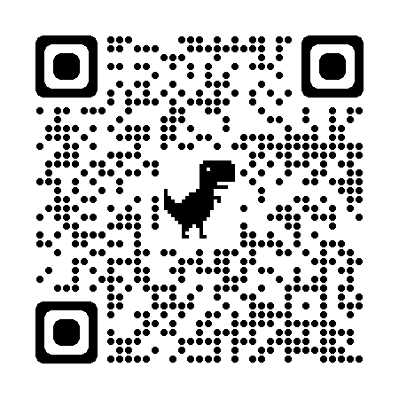
Limited English Proficiency
Individuals who do not speak English as their primary language and who have a limited ability to read, speak, write, or understand English should be provided access to federally funded programs.
www.fns.usda.gov/cn/translated-applications
Notes:
In August of 2000, Enforcement of Title VI (6) of the Civil Rights Act of 1964 was issued. It stated that individuals with Limited English Proficiency (LEP) could not be discriminated against because of the language barrier. Limited English Proficiency, or LEP, refers to individuals who do not speak English as their primary language and who have a limited ability to read, speak, write, or understand English.
It is important that School Nutrition Programs provide outreach in other language. Translated free and reduced applications are available from USDA on their website, which is shown on the slide. You can also access this website using the QR code shown here.

Slide 11

Questions??
Notes:
This concludes the presentation on Civil Rights. I hope that this session has provided useful information or served as a refresher of what you already know.
Are there any questions?

Slide 12
In accordance with federal civil rights law and U.S. Department of Agriculture (USDA) civil rights regulations and policies, this institution is prohibited from discriminating on the basis of race, color, national origin, sex (including gender identity and sexual orientation), disability, age, or reprisal or retaliation for prior civil rights activity.
Program information may be made available in languages other than English. Persons with disabilities who require alternative means of communication to obtain program information (e.g., Braille, large print, audiotape, American Sign Language), should contact the responsible state or local agency that administers the program or USDA’s TARGET Center at (202) 720-2600 (voice and TTY) or contact USDA through the Federal Relay Service at (800) 877-8339.
To file a program discrimination complaint, a Complainant should complete a Form AD-3027, USDA Program Discrimination Complaint Form which can be obtained online at: https://www.usda.gov/sites/default/files/documents/ad-3027.pdf, from any USDA office, by calling (866) 632-9992, or by writing a letter addressed to USDA. The letter must contain the complainant’s name, address, telephone number, and a written description of the alleged discriminatory action in sufficient detail to inform the Assistant Secretary for Civil Rights (ASCR) about the nature and date of an alleged civil rights violation. The completed AD-3027 form or letter must be submitted to USDA by:
mail:
U.S. Department of Agriculture
Office of the Assistant Secretary for Civil Rights
1400 Independence Avenue, SW
Washington, D.C. 20250-9410; or
fax:
(833) 256-1665 or (202) 690-7442; or
email:
Program.Intake@usda.gov
This institution is an equal opportunity provider.
Notes:
This is the most current Non-Discrimination Statement, which includes gender identity and sexual orientation in the first sentence.

