Slide 1

Office of School Nutrition
Supporting students’ health, well-being, academic and future success
We think nutrition because
students can’t think without it!
Community Eligibility Provision Webinar
March 15, 2023

Slide 2

Topics Covered in this Webinar
Basics of CEP
Eligibility Requirements
CEP Cycles
CEP in the SNTS
Tools to increase ISP and maximize claiming percentages

Slide 3
What is CEP?
Community eligibility allows high-need schools to offer breakfast and lunch to all students at no cost.
Removes the burden of processing free & reduced household applications
Uses Directly Certified/Categorically Eligible student data as of April 1st of the prior school year
Provision program that operates on a 4-Year Cycle

Slide 4
Eligibility Requirements to Elect CEP

Slide 5
Eligibility Criteria
Schools and LEAs with a minimum Identified Student Percentage (ISP; ≥ 40 percent) in the prior school year
Identified students are those certified for free meals without the use of household applications
Available to:
  All schools in an LEA
  A group of schools in an LEA
  An individual school in an LEA

Slide 6
Group Criteria for CEP Implementation
If the district-wide ISP is below 40%, partial
CEP is an appropriate option
  Group of schools
  Individual schools
The group of schools is weighted based on the enrollment of each school

Slide 7

Calculating ISP
ISP must be at least 40%

Slide 8

Identified Student Percentage (ISP)
Who are “Identified Students”?
  Children directly certified for free meals through data matching
    SNAP, TANF, or Food Distribution Program on Indian Reservations (FDPIR)
    Medicaid – FREE
    Includes Extended Eligible students
    Found in the SNTS Direct Certification system
  Children who are categorically eligible for free school meals because they are deemed:
    Homeless, migrant, runaway, enrolled in a federally funded Head Start program, or in foster care

Slide 9
Identified Student Percentage (ISP)
Who are “Enrolled Students”?
  Enrolled in a CEP participating school
  Attending a CEP school
  Has access to lunch and breakfast

Slide 10
Calculating Claim Reimbursements
Example:
  50% ISP x 1.6 = 80
  Therefore, 80% of the breakfasts and lunches would be reimbursed at the free reimbursement rate.
  The remaining 20% would be reimbursed at the paid rate.
What is the 1.6 multiplier?
  The 1.6 multiplier is regulated by the USDA.

Slide 11
Examples
ISP | (ISP multiplier) | Free | Paid
40% | x 1.6 | 64% | 36%
45% |  | 72% | 28%
50% |  | 80% | 20%
55% |  | 88% | 12%
60% |  | 96% | 4%
65% |  | 100% | 0%

Slide 12
Increasing ISP
Perform direct certification matches as often as possible
Extend eligibility to students living in the same household with other students who are directly certified
Connect with school support staff to identify any students who are newly homeless or have entered foster care
Connect with local organizations that do SNAP outreach to families

Slide 13
Documentation
& the 4-Year Cycle

Slide 14
Understanding the CEP Cycle
The ISP is established as of April 1st in the school year prior to implementing CEP, and can be used for four school years
Example:
  The SFA’s last Data Year cycle was established in April 2019, for Cycle Year SY 2019-2020.
  Their 4-Year cycle would run from SY 2019-2020 through SY 2022-2023
  The SFA will need to re-establish for SY 2023-2024 using data from April 2023
SFA’s are allowed to re-establish before the end of the 4-Year cycle (i.e. at year 2 or 3)

Slide 15
Changes to Grouping
Adjustments to existing groupings, addition or deletion, of schools will require that current data be used, and a new cycle begins.
Review your existing groups and carefully weigh the pros and cons to the change.

Slide 16
Opting out mid-year
USDA does allow an LEA to opt out of CEP during the school year.
Careful consideration and planning is needed
  Households will need to complete a household application
  Students will need to begin paying for meals if they do not qualify for free or reduced-price benefits
  Adjustments to the SFA and Site Applications
Any change to a school within a group, requires a recalculation of the ISP.

Slide 17
Grace Year
USDA does allow an LEA to opt for a Grace Year (5th Year) in certain circumstance given the following criteria is met:
  The district/group/school has an ISP of at least 30.00% - 39.99% ISP using current data
The 1.6 multiplier will be applied, and the NEW free/paid reimbursement percentage will be established. If the 40% threshold is not met the following year, CEP may not be an option

Slide 18
Source Documentation
Documentation may include:
  Direct certification lists
  Lists of homeless students
  Lists of migrant students
  Etc.
Each list should include confirmation of total enrollment numbers

Slide 19

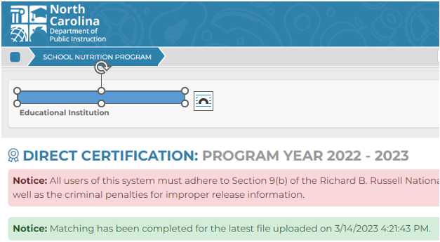
Direct Certification System

Slide 20
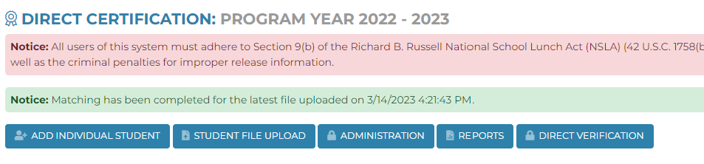
Direct Certification System

Slide 21
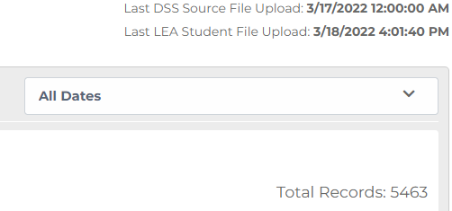
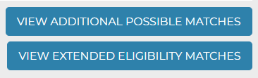
Direct Certification
Total Records count
Complete Direct Certification List
  Displays the first 10 students
  Export to view all matched students for the entire school year, or during a specific date range

Slide 22
School Nutrition Technology System (SNTS)
CEP Next Steps

Slide 23

Steps to Complete for CEP
Use the CEP Site Data Worksheet
Enter your numbers from the CEP Site Data Worksheet into the SNTS CEP Site List (as of April 3rd )
Complete the CEP Schedule, once you decide to do CEP and have started your SFA Application for SY 2023 - 2024

Slide 24
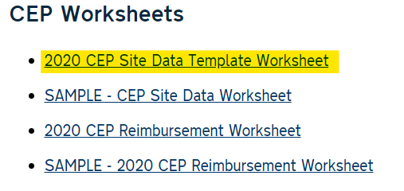
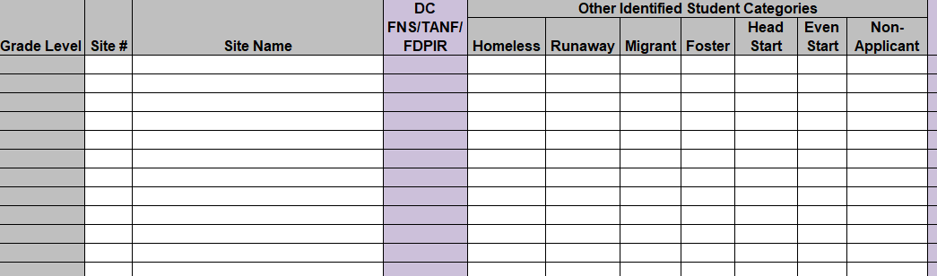
Go to the NCDPI School Nutrition Website:
Information and Resources by Subject
Determining Household Eligibility for School Meals
CEP

Slide 25
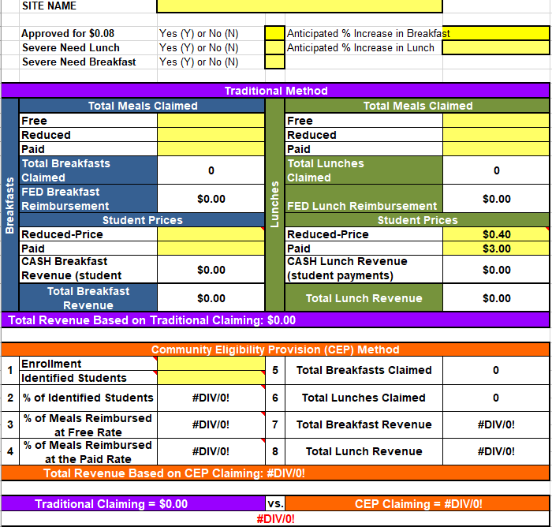

Slide 26
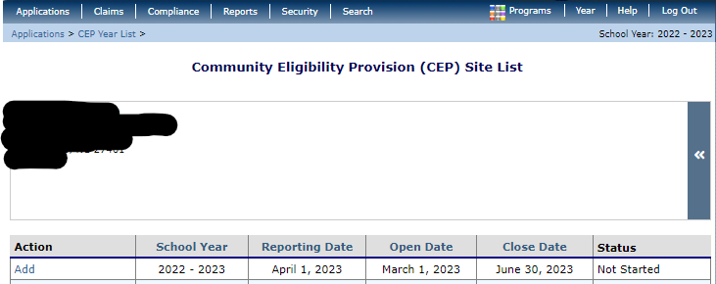
Completing the CEP Site List in SNTS
SNTS > Applications menu > Community Eligibility Provision
For SY 2022 - 2023

Slide 27
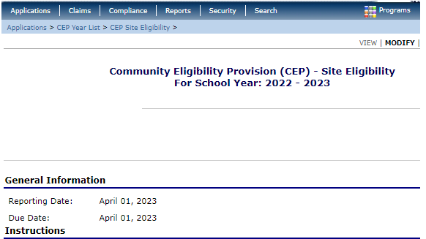
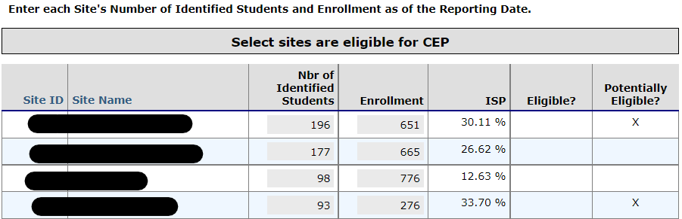
CEP Site List

Slide 28
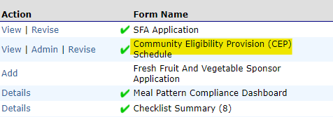
CEP Schedule
Ask any questions prior to revising/submitting your CEP Schedule
SNTS > Blue tile for SNP > Applications > Application Packet

Slide 29
Benefits of CEP

Slide 30

CEP Benefits Everyone!
Students
Parents
School staff
Administrators

Slide 31

Questions?
Thank you for attending this webinar!

Slide 32
Resources
USDA’s CEP Resource Center:
  https://www.fns.usda.gov/cn/community-eligibility-provision-resource-center
NCDPI School Nutrition:
  https://www.dpi.nc.gov/districts-schools/district-operations/school-nutrition/information-resources-subject/determining-household-eligibility-school-meals/community-eligibility-provision-cep
FRAC CEP webpage:
  https://frac.org/community-eligibility

Slide 33
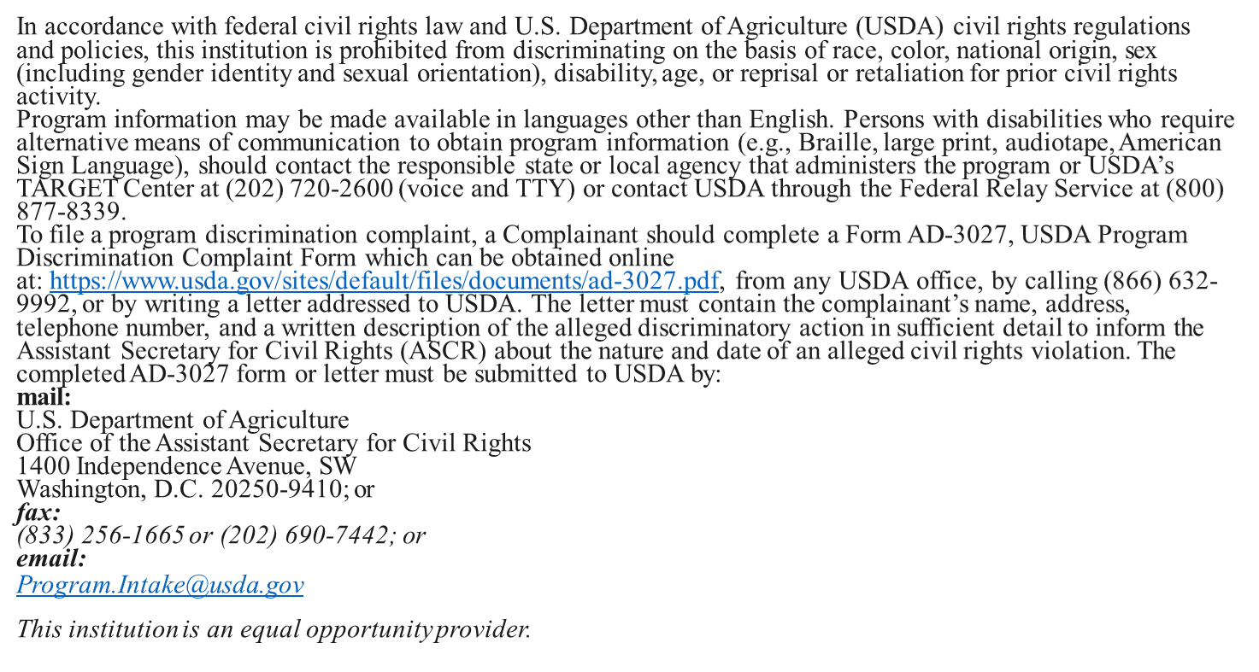
USDA Nondiscrimination Statement

