Slide 1
Child and Adult Care Food Program (CACFP) Pre-K Meal Pattern
North Carolina Department of Public Instruction
School Nutrition Services
August 2017
Notes:
There are many pre-kindergarten students enrolled in North Carolina Schools. These students eat breakfast and lunch meals at school and sometimes participate in other School Nutrition programs, such as the NSLP After-School Snack Program or the CACFP After School At-Risk Meals Program.
USDA recently announced changes to the CACFP meal patterns. CACFP stands for Child and Adult Care Food Program. These are the first changes that have been made in the CACFP meal patterns in over 30 years. These new revisions are bringing the CACFP meals more closely aligned to the changes that have already been made in the school nutrition program since the implementation of the Healthy, Hunger-Free Kids Act of 2010.
The CACFP Meal Pattern for Children will be required for all licensed childcare centers or homes as of October 1, 2017. All pre-k programs in which the students are enrolled in your schools or pre-k programs that are catered by your schools should be using this meal pattern as the basis for planning meals and snacks.

Slide 2
Overview of today’s webinar
Revisions to the CACFP Pre-K meal pattern must be implemented by October 1, 2017 per the USDA Final Rule
In N.C.- implement by the start of the 2017-18 school year
Today’s Objectives:
Explore the meal pattern changes by components
Discuss some strategies for smooth implementation
Explore optional best practices
Notes:
The final ruling requires that the revised CACFP meal pattern must be implemented no later than October 1, 2017. By providing you with technical assistance and continuing education on this meal pattern, we expect you should be able to implement it by the start of the 2017-18 school year.
In today’s webinar, we want to:
Explore the meal pattern changes by components;
Discuss some strategies for smooth implementation of the meal pattern;
Explore optional best practices – remember best practices are not required, but may be helpful as you implement the new meal pattern.

Slide 3
CACFP Pre-K Meal Patterns
Notes:
The recently updated CACFP meal patterns ensure children have access to healthy, balanced meals throughout the day.
While the new meal patterns are a significant change for day cares and other child-care institutions, as we said, the changes are intended to align more with meal patterns in the NSLP and SBP, so we are not impacted as much by the changes. We, in school nutrition programs, are already accustomed to very similar meal pattern requirements.

Slide 4
Major Changes to Pre-K Meal Pattern
Greater variety of vegetables and fruit
More whole grains
Less added sugar and saturated fat
Improved nutritional quality of all meals served
Notes:
The new meal pattern will provide a greater variety of vegetables and fruit, more whole grains, and reduce added sugar and saturated fat. The changes are based on the Dietary Guidelines for Americans, scientific recommendations from the National Academy of Medicine, and stakeholder input.

Slide 5
Breakfast for Ages 3-5
Three food components at breakfast
Milk, Fruit/Vegetable, Grain
Fruits and vegetables are combined at breakfast
May substitute M/MA for Grain 3 times per week
No OVS allowed for pre-k
Notes:
There are three components that must be provided as part of the reimbursable breakfast. Milk, fruit and/or vegetable, which are combined into one component at breakfast, and grain/bread are the required components for breakfast. Meat or meat alternate may be used in place of bread or grain up to three times per week.
Offer versus serve is not an option for Pre-K meals. The three required components must be provided for all reimbursable breakfasts.

Slide 6
CACFP Pre-K Breakfast Meal Pattern 2017-18
 | Ages 1-2 |  | Ages 3-5
 | Previous | Updated | Previous | Updated
Milk | ½ cup | ½ cup | ¾ cup | ¾ cup
Vegetables, Fruit or both | ¼ cup | ¼ cup | ½ cup | ½ cup
Grains | ½ serving | ½ oz eq | ½ serving | ½ oz eq
Notes:
Let’s look at the CACFP pre-K Breakfast Meal Pattern. Please look at the Ages 3-5 columns, because it is this age that is most often enrolled in schools.
This chart shows the previous meal pattern requirements and the updated requirements. As you can see, the chart doesn’t indicate many changes at Breakfast from the Previous meal pattern to the Updated meal pattern. The only easily recognizable change is in the Grain component where “serving” is now “ounce equivalents”. This language is in sync with the language we use in school meals and provides a way to determine more accurate serving sizes for grains.
Most pre-k students enrolled in public schools are in the age 3-5 group; however, there may be some that include 2 year-olds.
Notice there are three components at breakfast. All three components – Milk; Vegetables, Fruit or both; and Grains must be served for a reimbursable meal at breakfast. OVS is not an option at breakfast because young children need time to explore different and new flavors, textures, foods, etc. Thus they need the opportunity and encouragement to try many new foods.
Note: these serving sizes are the minimum amounts that must be provided; they are also age-appropriate for young children. Since milk is purchased by schools in 8 ounce cartons, most SFA’s will just continue to serve pre-k students with 8 ounce cartons of milk. However, serving 6 ounce servings is an option.

Slide 7
Lunch: 5 Food Components
Milk
Meat/Meat Alternates
Grains
Vegetable
Fruit
Minimum serving sizes for a reimbursable meal are included on the charts
Notes:
There are now 5 food components instead of 4. The five required meal components are: Milk, Meat/meat alternate, Grains, Fruits and Vegetables. Notice that the Fruits and Vegetables are two separate components at lunch. (not at breakfast)
All five components must be served at lunch. Offer v Serve is not an option for Pre-K students at the lunch meal. Like the breakfast meal, all required meal components must be served as part of a reimbursable lunch
Minimum serving sizes within each grade groups are included on the following chart.

Slide 8
CACFP Pre-K Lunch Meal Pattern 2017-18
 | Ages 1-2 |  | Ages 3-5
 | Previous | Updated | Previous | Updated
Milk | ½ cup | ½ cup | ¾ cup | ¾ cup
Meat and Meat Alternates | 1 oz | 1 oz | 1 ½ oz | 1 ½ oz
Vegetables | ¼ cup | 1/8 cup | ½ cup | ¼ cup
Fruit |  | 1/8 cup |  | ¼ cup
Grains | ½ serving | ½ oz eq | ½ serving | ½ oz eq
Notes:
Now look at the CACFP Pre-K meal pattern for lunch. Look at the Ages 3-5 columns, both the previous and updated meal pattern requirements.
The most notable changes are in the Fruit and Vegetable components. The previous pre-k meal pattern required ½ cup total of fruit and/or vegetables. The revised meal pattern will require ¼ cup of fruit and ¼ cup of vegetables. Thus the Fruit and Vegetable components have been separated at lunch. They are not separated at breakfast. There are five components at lunch: Milk, Meat and Meat Alternates, Vegetables, Fruit, and Grains.
Grains: note that oz eq will be used as the basis for portion size. Oz equivalents are determined the same way that they are in the NSLP and SBP.
The serving sizes are age-appropriate and are the minimum serving sizes that must be offered. OVS is not an option at lunch for pre-k students. Again the reason is that pre-k students need to be offered a variety of foods so that they will learn to enjoy a variety of flavors and textures. Exposure to a broad array of foods is considered appropriate for their nutrition education. (The only meal in which OVS may be allowed for pre-schoolers is at the At-Risk Afterschool Meals Program in which it is optional.)
Let’s take a look at each component in the pre-k meal pattern.

Slide 9
Milk
Only unflavored milk is allowed for ages 2-5
Skim or
1% milk fat
Notes:
Meal Components: We will now take a look at each individual meal component and review the guidelines, requirements and special considerations for each.
Fluid milk is the first of five components we will review.
Only unflavored milk may be served to Pre-K students. It can be skim or 1% milk fat. (this is required for children ages 2-5)
(Note: Breastmilk or commercial infant formula should be served to children from birth to 12 months. Whole milk should be served to children, ages 1 year through the end of 23 months. A one-month transition period is allowed to switch from whole milk to low-fat or fat-free milk when a child turns 2 years old)

Slide 10
Meat and Meat Alternates
Lean Meats, Fish Poultry | See Food Buying Guide and CN Labels
Tofu | 5 g protein per 2.2 oz or ¼ cup
Cheese | no “imitation” or cheese “product”
Eggs | 1 large = 2 oz eq
Beans/Peas (Legumes) | count as M/MA or Vegetable
Yogurt | with sugar restrictions
Nuts and Seeds | limit to 50% M/MA at lunch
Notes:
The M/MA component can include food items such as:
Lean meat, poultry, or fish; Eggs, dry beans/peas, yogurt, and nuts and seeds
Only commercially prepared firm and extra-firm tofu may be used as a meat alternate. Tofu serving sizes of 2.2 oz, by weight, or ¼ cup of tofu must contain at least 5 grams of protein will credit as 1 oz eq of meat alternate.
Cheese is credited according to the Food Buying Guide. Any cheese labeled “imitation” cheese or cheese “product” does not meet crediting requirements.
Eggs are a good source of protein and are inexpensive. One large egg provides 2 oz eq M/MA
Beans and peas may be used to meet the M/MA component or the Vegetable component for the meal. One serving of beans or peas may meet either the M/MA or Veg component. One serving of beans or peas may not meet both the MA and V component requirement.
Yogurt may also be used to meet the M/MA component requirement. 4 of yogurt credits as 1 oz eq of M/MA. Yogurt provided as part of a reimbursable meal or snack must contain no more than 23 grams of total sugar per 6 oz. Only commercially prepared yogurt may be served. Soy yogurt may be used as a dairy-free option.
Yogurt items that are not creditable as meat alternates include: frozen yogurt, drinkable yogurt, homemade yogurt, yogurt flavored products, yogurt bars or yogurt covered fruits and nuts.
Nuts and seeds contribute to the M/MA component but may only be used to meet up to 50% of the M/MA requirement. Nuts and seeds must be paired with another M/MA item.

Slide 11
Sugars in Yogurt Table
Serving Size Ounces | Sugars must not be more than
1 oz | 4 g
1.25 oz | 5 g
1.5 oz | 6 g
1.75 oz | 7 g
2 oz | 8 g
2.25 oz | 9 g
2.5 oz | 10 g
2.75 oz | 11 g
3 oz | 11 g
3.25 oz | 12 g
3.5 oz | 13 g
3.75 oz | 14 g
4 oz | 15 g
4.25 oz | 16 g
4.5 oz | 17 g
Serving Size Ounces | Sugars must not be more than
4.75 oz | 18 g
5 oz | 19 g
5.25 oz | 20 g
5.3 oz | 20 g
5.5 oz | 21 g
5.75 oz | 22 g
6 oz | 23 g
6.25 oz | 24 g
6.5 oz | 25 g
6.75 oz | 26 g
7 oz | 27 g
7.25 oz | 28 g
7.5 oz | 29 g
7.75 oz | 30 g
8 oz | 31 g
Notes:
Yogurt provided as part of a reimbursable meal or snack must contain no more than 23 grams of total sugar per 6 oz. Refer to this table to easily identify the allowable grams of sugar per ounce of yogurt . This will be posted on our website as “CACFP Choose Yogurts handout”.

Slide 12
Meat/Meat Alternates at Breakfast
May Substitute for grain at breakfast 3 times per week
1 oz eq of M/MA is equivalent to 1 oz eq Grain
Notes:
Meat components may be used to satisfy the entire grain component requirement at breakfast up to 3 times per week.
At breakfast, 1 ounce equivalent of M/MA is equivalent to 1 ounce equivalent of Grain.
For example, an egg, cheese stick or yogurt could be part of a reimbursable breakfast and credit as a meal alternate substitute for the Grain Component.

Slide 13
FRUIT
Combined with vegetables at breakfast only
Separate component at lunch
Juice
May be used at one meal or snack per day
Pasteurized
Full-strength
Notes:
At breakfast, vegetables and fruit are combined into one component. Fruit is a separate, individual component at lunch,
Fruit pieces or juice may be served at any meal or snack. Fruit juice must be pasteurized, 100% full strength juice. In North Carolina, juice may only be offered at one meal or snack each day and is limited to a _______ portion. Therefore it is very important that the school nutrition department and the pre-k supervisor communicate about this requirement and when to serve juice to pre-k students.
I can’t find any definitive answer to the question. I would say ½ cup at breakfast and at least ¼ cup at lunch. These are the amounts of fruit and vegetable required at these meals.

Slide 14
VEGETABLES
Vegetables
Combined with fruit at breakfast only
Separate component at lunch
May be used as a fruit substitute- 2 different veggies
Vegetable Juice
May be used at one meal or snack per day
Pasteurized
Full-strength
Notes:
As we’ve already stated, the fruit and vegetable components are combined into one component at breakfast.
Vegetables are required to be served at the lunch meal in at least the required minimum quantity for the age group. Vegetables may also be used as a substitute for the fruit component at lunch. If vegetables are used instead of fruit at lunch, two different vegetables must be served.
And, as with fruit juice, vegetable juice may be used to fulfill the entire vegetable component at one meal or snack per day.

Slide 15
Grains Overview
At least 1 serving of grains per day must be whole grain-rich
Breakfast cereals must contain no more than 6 grams of sugar per dry oz.
Grain-based desserts no longer credit towards the grain component
Use ounce equivalents (oz eq) to determine the amount of creditable grains starting October 1, 2019
Notes:
There are a few key changes to the grains component in the new CACFP meal pattern and they are:
One serving per day must be WG
B'fast cereals now have a limit on the grams of sugar allowed--- no > 6 gms per dry ounce
You cannot credit grain based desserts—those items identified on Exhibit A with a footnote number 3 or 4
CACFP will use the same grain equivalents we adopted in 2012, minus the recent change that lifted graham crackers and animal crackers as being designated as a grain based dessert. (USDA PM CACFP 16-2017). Starting October 1, 2019, ounce equivalents will be required for all day care operators using the pre-K meal pattern. In schools, we already are accustomed to using the new Exhibit A and ounce equivalences for grain.

Slide 16
Meals, Menus & Whole Grain-Rich
Each day, at least one meal or snack must include a whole grain-rich food
If only serving one meal, the grain must be whole grain-rich
If serving breakfast, lunch, & snack, choose which meal to serve the whole grain-rich food
Must document whole grain-rich foods on menu
Notes:
Now, lets apply this to menu planning. Every day, at least one meal or snack must contain a wg rich food. If you only serve your pre-k students one meal, then that meal must have a wg rich grain. If serving several meals/snack, then you can choose which meal will contain he wg rich food item.
You must identify on your menus, which items are whole grain. Good Examples are “Whole wheat” bread, “Whole grain-rich” English muffins. Remember if you use an acronyms, such as WW or WG, you must define what these mean somewhere on the menu as well.

Slide 17
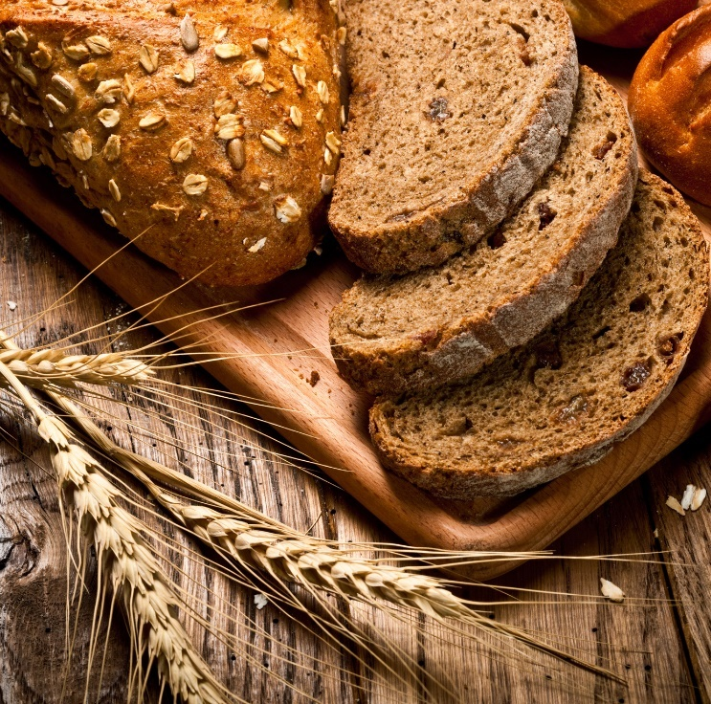
“Whole Grain-Rich foods contains 100% whole grains, or at least 50% whole grains, & the remaining grains in the food are enriched…”
Look for Whole grains as the primary ingredient(s) on the label
Next look for other grain ingredients to be enriched
Notes:
Let’s define what Whole Grain Rich Foods are and see if you can identify them. A WG rich food must contain at least 50% whole grains by weight or greater. It could be 51%,75% or even 100% whole grain, all would meet the definition of whole grain. The remaining grains Must Be enriched!
The ingredient labels list ingredients in descending order by weight. This means that the item that weighs the most is listed first, the ingredient weighing the second most is listed next, etc. and continues on until you get down to the last ingredient, which may be a spice or something that doesn’t weigh much.

Slide 18
Is this Whole Grain Rich? White Whole-Wheat Breadsticks
Ingredients: Whole-Wheat Flour, water, enriched unbleached wheat flour (wheat flour, malted barley flour, niacin, iron as ferrous sulfate, thiamine mononitrite, enzyme, riboflavin, folic acid), graham flour, sugar, wheat gluten.
YES! The first ingredient is whole grain and the remaining grains are enriched or whole grain
Notes:
Yes, first ingredient is a Whole grain, and the remaining grains are enriched

Slide 19
Multiple Whole-Grain Ingredients…?
What if a whole grain is not listed as the first ingredient for non-mixed dishes?
It may be Whole grain-rich if combined weight of whole grains is more than the weight of the other grains
Requires a CN Label or Product Formulation Statement
Look for FDA Approved Whole Grain Label Health Claims
How many Grams of Whole Grains are in a serving? Refer to Exhibit A: School Lunch and Breakfast Whole Grain Ounce Equivalency Requirements
Use the USDA Whole Grain Resource for the NSLP
and SBP https://www.fns.usda.gov/tn/whole-grain-resource-national-school-lunch-and-school-breakfast-programs-0
Notes:
What if the first ingredient is NOT identified as being a Whole grain, but other ingredients are? You would then need either a CN Label OR a Product Formulation Statement from the manufacturer to identify the amount of whole grain in the product.
Other ways to identify that a product is whole grain include an FDA approved Whole Grain Label claim, or determining the number of whole grains per serving: ≥8 grams of whole grain per NSLP/SBP oz eq per Exhibit A
Use the USDA Whole Grain Resource as your guide to determining if a product meets the whole grain rich requirement. It is a very handy and informative tool!
WG Stamps: By Source (WP:NFCC#4), Fair use, https://en.wikipedia.org/w/index.php?curid=48733414

Slide 20
Is this Whole Grain Rich? Light Multigrain Bread
Ingredients: Water, ENRICHED WHEAT FLOUR [flour, malted barley flour, reduced iron, niacin, thiamin mononitrate (vitamin b1), riboflavin (vitamin b2), folic acid], WHOLE-WHEAT FLOUR, WHOLE ROLLED OATS, sugar, wheat gluten, yeast, soybean oil, salt, calcium propionate (preservative), monoglycerides, datem and/or sodium stearoyl lactylate, calcium sulfate, citric acid, calcium carbonate, soy lecithin, whey, nonfat milk.
Product Formulation Statement:
enriched wheat flour (40% of grain weight)
whole-wheat flour (30% of grain weight)
whole oats (30% of grain weight)
YES! 60% whole grain, 40% enriched
Notes:
Can you see how you would need further information form the manufacturer in order to determine if this qualifies as whole grain?
The actual Product Formulation Statement form the Manufacturer reveals the weight of whole grains is 60%, therefore making the product whole grain.

Slide 21
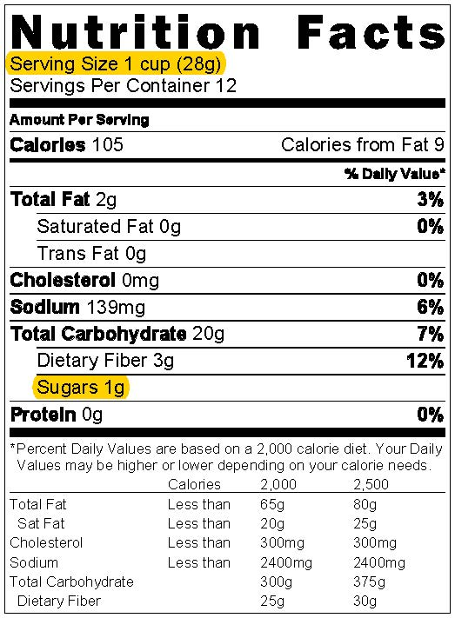
How to Calculate Breakfast Cereal No > than 6 grams of total sugar per dry oz or per 28.3 g
This equates to 21.2 grams of sugar per 100 grams of dry cereal
Threshold formula calculated as: 6 g sugar / 28.3 g per oz. = 0.212
Calculate the amount of sugar
$\frac{Sugars}{Serving Size }$ =$\frac{1 g}{28 g}$ = 0.036
Yes the cereal is creditable! 0.036 is less than 0.212
Notes:
Here is how to calculate the amount of sugar per ounce of dry cereal Steps
Find the Nutrition Facts Label
Find the Serving Size: 28 grams
Find the amount for Sugars: 1 gram
Divide the grams of sugar by the grams of the serving size if the resulting number is <.212, then it is ok to serve

Slide 22
Sugars in Cereal Table
Serving Size | Sugars
If the serving size is: | Sugars cannot be more than:
8-11 grams | 2 grams
12-16 grams | 3 grams
17-21 grams | 4 grams
22-25 grams | 5 grams
26-30 grams | 6 grams
31-35 grams | 7 grams
36-40 grams | 8 grams
41-44 grams | 9 grams
45-49 grams | 10 grams
50-54 grams | 11 grams
Serving Size | Sugars
If the serving size is: | Sugars cannot be more than:
55-58 grams | 12 grams
59-63 grams | 13 grams
64-68 grams | 14 grams
69-73 grams | 15 grams
74-77 grams | 16 grams
78-82 grams | 17 grams
83-87 grams | 18 grams
88-91 grams | 19 grams
92-96 grams | 20 grams
97-100 grams | 21 grams
Notes:
Or, You can use a chart like this…My Personal Preference! This will be on our website under the heading “CACFP Worksheet Cereal”

Slide 23
Grain-Based Desserts
Source of added sugars, saturated fats and empty calories
Increases risk of chronic illnesses
Not creditable towards the grain component
Notes:
Last, lets think about Grain based desserts. Desserts can easily be a source of empty calories, full of sugar and statured fats. (no wonder I love them!) Too much of a good thing can increase our risk of chronic diseases.
As an adult, we can monitor our individual caloric intake and balance our food choices to work in the occasional dessert. Our little ones cant. We want them to get the most nutrient dense food possible. As you know, they don't take much in at one time, and every bite counts!

Slide 24
Examples of Grain-Based Desserts
Breakfast bars
Brownies
Cakes
Cereal bars
Cookies
Doughnuts
Granola bars
Sweet crackers (graham & animal crackers)
Sweet piecrusts
Sweet rolls
Toaster pastries
Notes:
USDA Policy Memo June 30, 2017 CACFP Grain-Based Desserts in the CACFP, updated Exhibit A to include graham crackers and animal crackers as allowable grains, dropping their designation as a grain based dessert. This should provide relief by allowing a greater variety for the menu options.

Slide 25
Grain-Based Desserts & Special Occasions
Annual festival, birthday celebrations, end-of-year bash, or other special events
May be served as an additional item only
Notes:
If desserts are served for a special occasions, they must not contribute to the meal pattern, this would be above and beyond the required minimums for the meal service.

Slide 26
Other ways to serve healthy foods…
Deep Fat Frying may not be used to prepare meals on-site
May purchase from commercial manufacturer: pan-fried, flash-fried, par-fried (may not deep fry when re-heating)
Meal service types: pre-plated, family-style
Offer water to children throughout the school day
Notes:
The new regulations include the following measures to serve healthy meals.
Deep Fat Frying may not be used to prepare meals on-site
The following items can be purchased from commercial manufacturers: pan-fried, flash-fried, par-fried, however, it is not allowable to deep fry when re-heating these items.
Meal service types: pre-plated, family-style
Offer water to children throughout the school day; this becomes effective October 1, 2017 and replaces the current requirement to make potable water available to children throughout the school day. Offering water means asking the children if they would like to have water during the school day. Caregivers should not wait for children to request water. Young children may not realize they are thirsty and need hydration. Water is not part of the reimbursable meal and does not replace milk. Water must be offered during mealtimes and throughout the day. For more information – see USDA Policy Memo CACFP-20-2016 Water Availability in the CACFP.

Slide 27
Menu Planner Tips
1 grain per day must be whole grain
Grain based desserts not allowed; they do not credit (exception is graham-type crax)
No cereal > 6gms sugar per dry oz
Limit full strength juice to one serving per day
Unflavored milk only, 1% or skim
Vegetable can be used for entire fruit serving, must then be 2 different veggies served
Meat/Meat Alternate can replace entire grain at Breakfast up to 3 times per week
Notes:
In a Nutshell, here are key items to focus on as a menu planner- tips to following the new CACFP Meal Pattern
Review each:
1 grain per day must be whole grain
Grain based desserts not allowed; they do not credit. We have now have the exception to this rule – graham crackers are not considered a grain-based dessert and can be served and credited as a grain.
Do Not offer cereal with > 6gms sugar per dry oz
Limit full strength juice to one serving per day
Offer Unflavored milk only, 1% or skim
A Vegetable serving can be used for the entire fruit serving; if this is done, then 2 different veggies must be served
A serving of Meat/Meat Alternate can replace the entire grain serving at Breakfast up to 3 times per week

Slide 28
Tips, Continued
Identify whole grains on menu
No OVS - all components must be served
No deep fat frying (on-site)
Potable water must be offered throughout the day
Parents/guardians may not provide more than one component of meal
Combination vegetables count as one veggie
Combination of fruit & veggie count as either fruit or veggie, not both
Notes:
Tips continued……..
Identify whole grains on menu - easy to do on school menus because most grains are identified as whole-grain on the printed menus
No OVS - all components must be served
There can be no deep fat frying (on-site)
Potable water must be offered throughout the day to pre-schoolers
Parents/guardians may not provide more than one component of meal sent from home
Combination vegetables, such as broccoli/cauliflower/carrot combination, count as one veggie
Combination of fruit & veggie count as either a fruit or veggie, not both

Slide 29
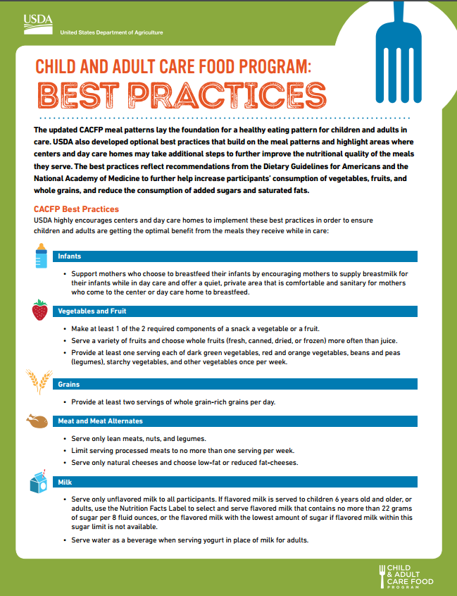
Notes:
There are optional best practices that build on the meal patterns and highlight areas where you may take additional steps to further improve the nutritional quality of the meals you serve. These best practices will help participants consume more FVs, whole grains and reduce added sugars and fats. These are listed on the Best Practices Handout from USDA pictured in this slide.

Slide 30
Best Practices...to be encouraged
Serve a variety of fruits; choose whole fruits more often than juice
Provide at least one serving from the vegetable subgroups per week
Serve at least two servings of WG-Rich grains per day
Limit processed meats to one serving per week
Notes:
While these Best Practices are not requirements, they are encouraged to serve healthy meals and snacks to pre-K children. These practices also move the program in the direction of NSLP and SBP regulations.
Serve a variety of fruits; choose whole fruits more often than juice
Provide at least one serving from the vegetable subgroups per week
Serve at least two servings of WG-Rich grains per day
Limit processed meats to one serving per week. Processed meats include meats that are salted, smoked, cured or have chemical preservatives added. Examples include bacon, bologna, luncheon meats.

Slide 31
More Best Practices!
Serve only low-fat, reduced-fat and natural cheeses
Serve only unflavored milk to all pre-school age groups
Incorporate seasonal and locally produced foods
Avoid serving non-creditable sources of added sugars
Notes:
More Best Practices
Serve only low-fat, reduced-fat and natural cheeses. Common examples include reduced fat string cheese, reduced fat cheddar cheese, and low-fat cottage cheese. Avoid the following by reading food labels: imitation cheese, cheese food or cheese products.
Serve only unflavored milk to all pre-school age groups. In N.C. this is a requirement.
Incorporate seasonal and locally produced foods
Avoid serving non-creditable sources of added sugars. This might include sweet toppings, sugar-sweetened beverages, or sweet ingredients mixed in with yogurt.

Slide 32
SP 37-2017 Flexibility for Co-Mingling
Flexibility for Co-Mingled Preschool Meals; Questions and Answers
Notes:
Flexibility for Co-Mingling SP 37-2017
USDA released a Policy Memo on June 30, 2017 that recognizes that some schools serve meals to preschoolers and grade K-5 students in the same service area at the same time. These co-mingled situations may create counting and claiming issues because it is challenging to determine during a meal service if a child is in preschool or K-5, and the meal patterns for each are slightly different. For example children may arrive on the same bus and enter the cafeteria for breakfast together. In this situation, it may be difficult for meal service staff to determine which children are in preschool or K-5.
FNS strongly encourages schools to find ways to serve grade-appropriate meals to preschoolers and K-5 students to best address their nutritional needs. Some best practices to avoid co-mingling situations include serving breakfast in the classroom or staggering the meal service time for preschoolers and K-5 students. However, when students are served in the same area, a single menu flexibility is allowed to reduce administrative burdens and ensure the integrity of the Programs. Therefore, schools that serve meals to preschoolers and K-5 students in the same service area at the same time may choose to follow the grade-appropriate meal patterns for each grade group, or serve the K-5 meal pattern underparts 7 CFR 210.10 and 220.8 to both grade groups.
During the transition time of school year 2017-18, State agencies must provide technical assistance in lieu of fiscal action when they observe violations related to the updated meal pattern requirements. (Reference: USDA Policy Memo SP 30-2017 )

Slide 33
Summary
Remember pre-k students are next year’s kindergarten students
Focus on providing healthy meals and snacks
Focus on teaching pre-k students to eat a variety of foods and build healthy eating habits
Notes:
SUMMARY
Remember pre-k students are next year’s kindergarten students
Focus on providing healthy meals and snacks
Focus on teaching pre-k students to eat a variety of foods and build healthy eating habits

Slide 34
In accordance with Federal civil rights law and U.S. Department of Agriculture (USDA) civil rights regulations and policies, the USDA, its Agencies, offices, and employees, and institutions participating in or administering USDA programs are prohibited from discriminating based on race, color, national origin, sex, disability, age, or reprisal or retaliation for prior civil rights activity in any program or activity conducted or funded by USDA.
Persons with disabilities who require alternative means of communication for program information (e.g. Braille, large print, audiotape, American Sign Language, etc.), should contact the Agency (State or local) where they applied for benefits. Individuals who are deaf, hard of hearing or have speech disabilities may contact USDA through the Federal Relay Service at (800) 877-8339. Additionally, program information may be made available in languages other than English.
To file a program complaint of discrimination, complete the USDA Program Discrimination Complaint Form, (AD-3027) found online at: http://www.ascr.usda.gov/complaint_filing_cust.html, and at any USDA office, or write a letter addressed to USDA and provide in the letter all of the information requested in the form. To request a copy of the complaint form, call (866) 632-9992. Submit your completed form or letter to USDA by:
(1) mail: U.S. Department of Agriculture Office of the Assistant Secretary for Civil Rights 1400 Independence Avenue, SW Washington, D.C. 20250-9410;
(2) fax: (202) 690-7442; or
(3) email: program.intake@usda.gov.
This institution is an equal opportunity provider
Retrieved 8/18/17 from:
https://childnutrition.ncpublicschools.gov/information-resources/civil-rights/usda-non-discrimination-statement

