Slide 1
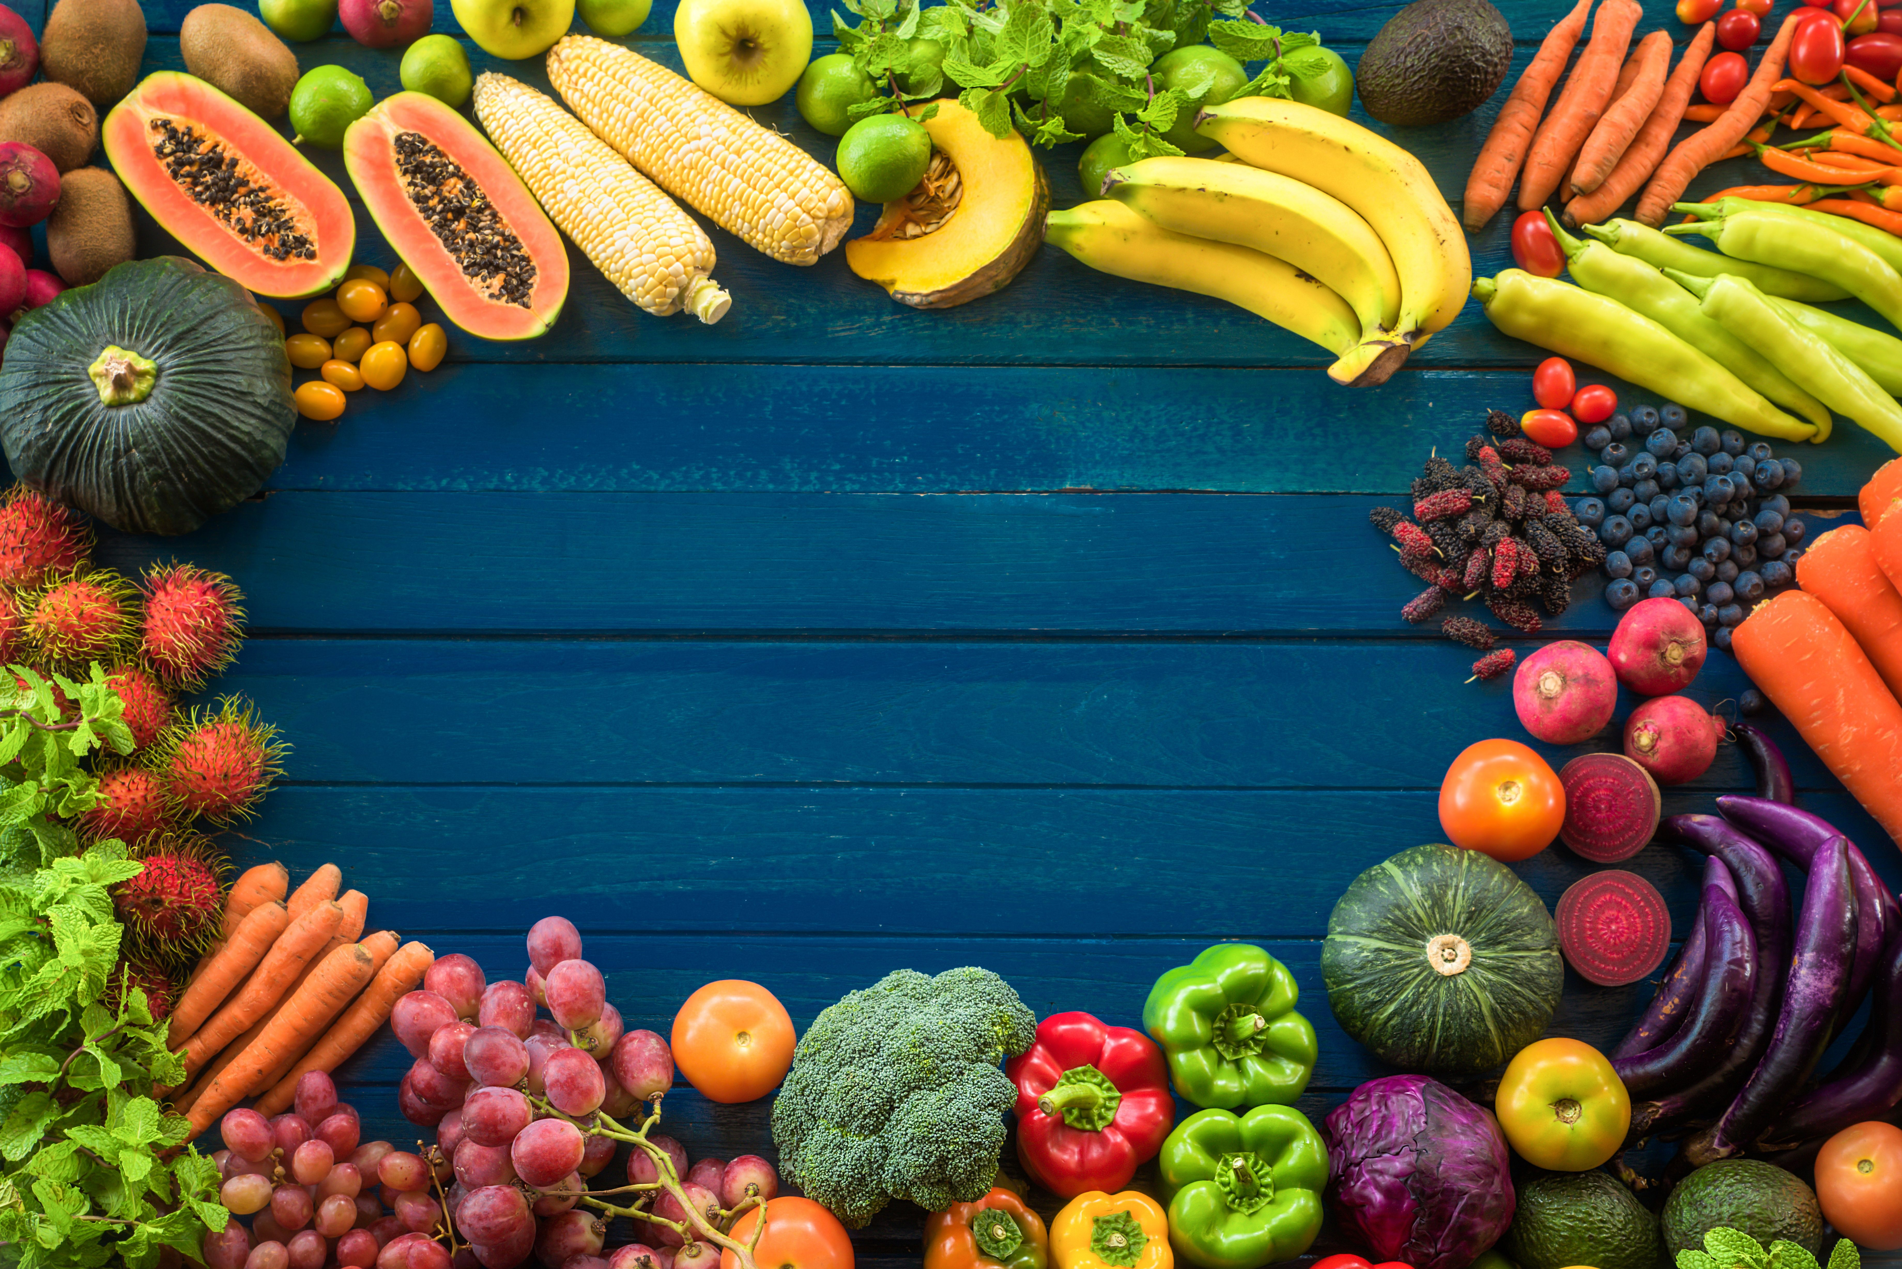
Fresh Fruit and Vegetable
Program (FFVP)
Annual Training 2025-2026
NC Department of Public Instruction
Office of School Nutrition

Slide 2
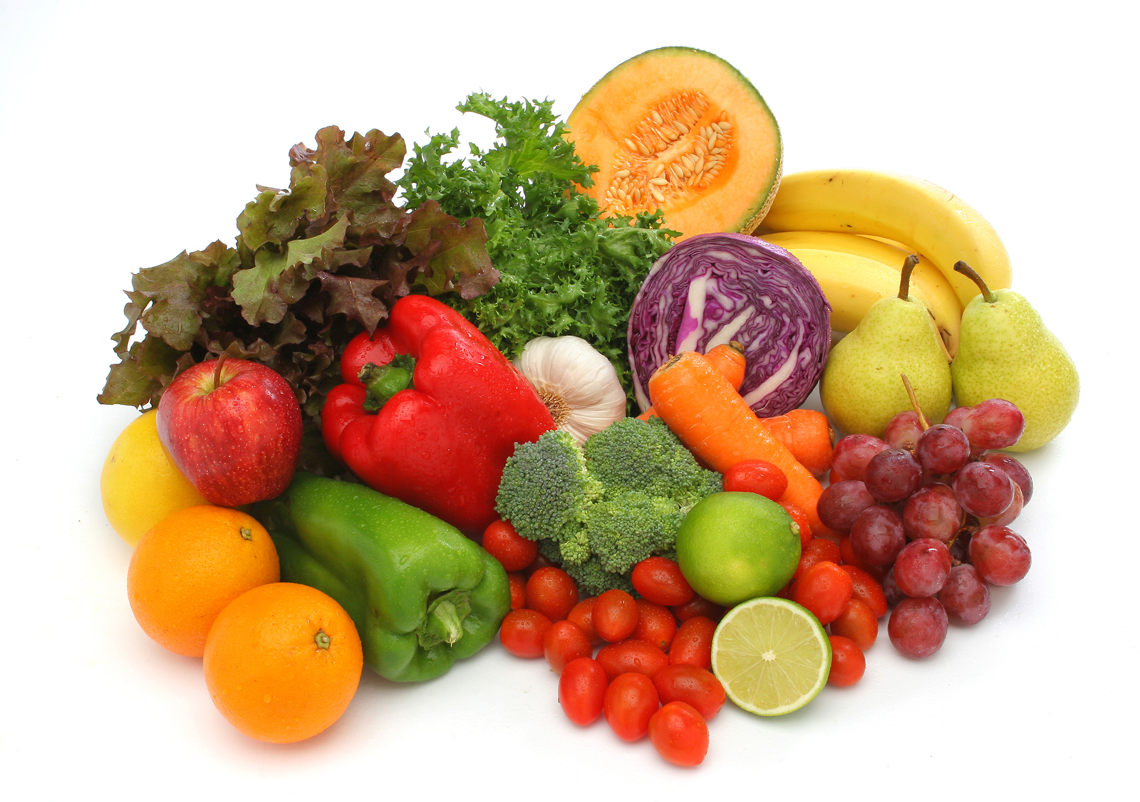
Welcome to the 2025-2026 FFVP Required Annual Continuing Education!
Program Requirements and Operation
Important Resources
FFVP Addendum and Allocations for 2025-2026 SY
Program Objectives/Requirements
Establishing Partnerships
Advertising and Marketing
Competitively Procuring
Allowable/Unallowable FFVP Purchases
Notes:
Welcome to the Required Annual Continuation Education Opportunity for the Fresh Fruit and Vegetable Program. My name is Jacquelyn McGowan and I am a Special Programs Consultant with the NC Department of Public Instruction, Office of School Nutrition. The USDA FFVP provides a variety of free fresh fruit and vegetable snacks to children at eligible elementary schools. Congratulations on being chosen to participate in the program this year!
The purpose of this training is to provide an overview of the program and to give guidance on the expectations this year. So, let’s get started. During this time, we will discuss Important Resources that will be helpful to manage this program, the FFVP Addendum and Allocations for the 2025-26, the objectives and requirements of this program, the importance of establishing partnerships, marketing, procurement and unallowable and allowable purchases.

Slide 3
Welcome to the 2025-2026 FFVP Required Annual Continuing Education!
Operating Procedures
FFVP Snacks and Labor
Civil Rights
Special Dietary Needs
Food Safety/Sanitation
Nutrition Education
Notes:
We will also go over operating procedures, FFVP snacks, claiming labor, civil rights requirements, special dietary needs, sanitation and the nutrition education component

Slide 4
Welcome to the 2025-2026 FFVP Required Annual Continuing Education!
Best Practices
FFVP Technical Assistance/Reviews
Financial Guidance
Access to the School Nutrition Technology System (SNTS)
FFVP Financial Accountability
FFVP Monthly Claims
FFVP Wrap Up
Questions?
Notes:
And then we will talk about best practices, technical assistance. We will wrap up with financial guidance and go over the Technology system, financial accountability, claims, and we’ll close with how to reach me if there are questions.

Slide 5
Program Requirements and Operation
Important Resources
USDA FFVP: Handbook for Schools
Fresh Fruit and Vegetable Program | Food and Nutrition Service (usda.gov)
Fresh Fruit & Vegetable Program (FFVP) *8/2025* | NC DPI
FFVP Addendum and Allocations
Notes:
There are several resources that will help you manage this program as you embark on this adventure this year. The USDA has created a Handbook for schools to utilize as a reference. It provides the history of the program, along with the goals, nutrition education and other important nuggets to have a successful program in your schools. Another resource is the USDA FFVP website which contains the fact sheets, policy memos, research and data. The last resource is our State Agency’s website that contains the list of approved schools, a link to the USDA Handbook, the application process, forms that may be helpful in your FFVP operation (like the number of days the FFVP Operates Weekly form) fact sheets and menu suggestions.
The addendum to the agreement was sent out via email on July 24 along with the allocations and then posted on the website shortly thereafter. If you have not submitted the addendum and budget forms which were due August 20, please send those to me as soon as possible. Also, as a practice I am sending email communications to the SN Administrator and the individual listed as the Reimbursement Official. If you have additional SN professionals who need to receive communications, let me know so I can add them to the list.

Slide 6
Program Requirements and Operation
Program Goals
Expand the variety of fruits and vegetables children experience
Increase children’s fruit and vegetable consumption
Make a difference in children’s diets to impact their health
Program Requirements
Must by trained annually
Maintain full and accurate records
Follow FFVP procedures
Submit a monthly claim
Notes:
Program Goals for the FFVP is to
Expand the variety of fruits and vegetables children experience
Increase children’s fruit and vegetable consumption
Make a difference in children’s diets to impact their health
Program Requirements
Must by trained annually
Maintain full and accurate records
Follow FFVP procedures
Submit a monthly claim

Slide 7
Program Requirements and Operation
Establishing Partnerships
Collaborate with State and Local affiliates
Encourage cooperation with Administrators, Teachers, School Nurses, PTA and Student Government
Look in unexpected places – local doctors, nurses, government officials to come in and speak to students
Notes:
Establish partnerships with state affiliates or on a local level with grocers, Health Departments, or extension service. State or national level partnerships can also be very helpful. Encourage cooperation with Administrators, Teachers, School Nurses, PTA and Student Government,
Look in unexpected places – local doctors, nurses, government officials, local businesses to come in and speak to students. If you need help finding community partners in your area let me know and I can offer some suggestions or help research contacts in your area.

Slide 8
Program Requirements and Operation
Advertising and Marketing
Plan a special event to introduce the program to students, staff, parents and the media
Promote to staff at a pre-planning meeting
Publicize through school or district social media
Procurement
Schools can order through DoD-Fresh (the Department of Defense FFVP
Buy produce from local farmers and grocery
Notes:
Advertising and Marketing – we suggest a special event to introduce program to students, staff, parents, and media.
• Promote to staff at district meeting, back to school training.
• Publicize through school or district media (website, social media avenues, school menu)
• Provide parents with information by setting up an FFVP table at Open House
• Organize a special event with special guests—high school students, cheerleaders, superintendent, mascots. Think outside the box to promote the program to students, parents and staff.
Another program requirement is related to procurement
FFVP schools must follow proper procurement procedures. Produce must always be graded and inspected according to existing local, State and Federal guidelines. Produce purchased with FFVP funds are meant to be used in the FFVP only. It cannot be used in the National School Lunch or School Breakfast Programs. When you are purchasing fresh produce, including produce from local vendors, proper procurement procedures must be followed.

Slide 9
Program Requirements and Operation
Allowable FFVP Purchases
“Fresh” fruits competitively priced
“Fresh” vegetables competitively priced
Pre-packaged, individual servings
Only reduced fat, fat free or lite condiments for fresh vegetable snacks only (Oper Costs)
Paper and plastic products used for serving FFVP snacks (Oper Costs)
Small equipment i.e. knives, cutting boards
Notes:
So let’s talk about Allowable/Unallowable FFVP Purchases
“Fresh” fruits competitively priced
“Fresh” vegetables competitively priced
Pre-packaged, individual servings of fresh fruit and vegetables
Only reduced fat, fat free or lite condiments for fresh vegetable snacks only
Paper and plastic products (napkins, paper boats, snack bags) used for serving FFVP snacks (Oper Costs)
Small equipment i.e. knives, cutting boards, colanders, food services gloves for prepping/serving FFVP (Oper Costs)
Food safe containers with a lid for distributing daily FFVP snacks (Oper Costs)

Slide 10
Program Requirements and Operation
Unallowable FFVP Purchases
No “flavor enhanced” fruits or vegetables like grapples
No dried fruit
No coconuts, ginger root, sprouts
No condiments of any kind for FFVP “fruit” snacks
No purchased juice.. not even 100% (unless it is made fresh at the FFVP school)
No frozen fruit bars
No fruit leather, fruit roll-ups, fruit chews
Notes:
Some of the Unallowable FFVP Purchases include
No “flavor enhanced” fruits or vegetables like grapples
No dried fruit
No coconuts, ginger root, sprouts, horseradish, garlic, herbs
No condiments of any kind for FFVP “fruit” snacks
No purchased juice.. not even 100% (unless it is made fresh at the FFVP school)
No frozen fruit bars
No fruit leather, fruit roll-ups, fruit chews, trail mix, granola bars, nutrition/energy bars
No fruit/vegetable baskets/trays for school office, nurses stations, teacher lounges
No nutrition education materials
No technological devices
No decorations, visual aids
If you have questions about a specific item, let me know

Slide 11
Program Requirements and Operation
Operating Procedures
Follow reporting and record keeping requirements
Complete and submit monthly claims
Equipment purchased with FFVP must be prorated among the programs.
Administrative cost are limited to 10% of your school’s total grant
Notes:
FFVP requires you to follow reporting and record keeping requirements that are similar to those for the National School Lunch Program. Complete and submit a monthly FFVP reimbursement claim in the SNTS. Please make sure you include comments or it will cause an error. Provide details in your comments so that we can read how your students are enjoying the FFVP snacks. You are responsible for ensuring that all claims are correct and appropriate. Equipment purchased with FFVP funds that will be used in other school feeding programs must be prorated among the programs. Administrative cost are limited to 10% of your school’s total grant. Do not exceed this amount.

Slide 12
Program Requirements and Operation
FFVP Snacks
No cost to students
Leftovers should be discarded
Menu suggestions on the website
Must be served on the school campus, during the school day, and separately from lunch or breakfast meals
FFVP Labor
Labor costs must be minimal
Documentation form on the website
Notes:
FFVP Snacks
No cost to students
Leftovers should be discarded (make sure there is a procedure in place for this). Ideally, the snacks should be returned to the cafeteria to be discarded so that you know that it is discarded and not going home with students or teachers.
Menu suggestions on the website
Must be served on the school campus, during the school day, and separately from lunch or breakfast meals
One goal of the FFVP is to expand the variety of fruits and vegetables your students consume. Try “sample sizes” to introduce new items and then adjust your ordering accordingly. To the extent possible, you should not limit the choices you offer. Find innovative and fun ways to encourage your students to try different foods
FFVP Labor
Labor costs must be minimal and reasonable.
Documentation form on the website. When I come out to observe the great things that you are doing at your schools, I may ask to see your timesheets so please keep them on file.

Slide 13
Program Requirements and Operation
The Best Time
Serve during the school day
Not during the NSLP or SBP meal periods
Multiple distribution times can be planned
The Best Place
Classrooms
In hallways
Centrally located kiosks
Notes:
As we continue to program requirements and operation,
The Best Time
Serve during the school day
Not during the NSLP or SBP meal periods
Multiple distribution times can be planned
Cannot be served during summer school sessions
The Best Place
Classrooms
In hallways
Centrally located kiosks
Through free vending machines
As part of nutrition education activities

Slide 14
Program Requirements and Operation
Civil Rights
Ensure that all staff involved in the FFVP have sufficient training to perform the tasks they perform
This includes, but is not limited to, the required civil rights training
Maintain documentation of the agenda and signed attendance roster
Special Dietary Needs
If a child’s disability prevents them from consuming fresh fruits and vegetables, the school must provide accommodations.
Notes:
Ensure that all staff involved in the FFVP have sufficient training to perform their tasks
This includes, but is not limited to, the required civil rights training
Maintain documentation of the agenda and signed attendance roster
If a child’s disability prevents them from consuming fresh fruits and vegetables as prepared, the school
must provide accommodations as they would for other school meals. Schools must consider how the
requirement may be applied in the operation of the FFVP. For example, in providing accommodations
for the FFVP, schools may have to modify texture. In doing so, schools should consider starting with
fresh items and avoid pureeing canned or frozen fruits and vegetables, including baby foods. In most
instances, fresh fruits can be pureed; we recognize that this is not always the case for vegetables. Fresh
vegetables should be used when feasible but may be cooked and then pureed when needed.

Slide 15
Program Requirements and Operation
Food Safety/Sanitation
Train School Nutrition Employees who prepare FFVP snacks
Establish procedures for receiving/storing
Wash hands using proper procedures
Wash, rinse, sanitize and air-dry all food contact surfaces
Label, date and refrigerate fresh cut items
Notes:
Train School Nutrition Employees who prepare FFVP snacks
Establish procedures for receiving/storing and discarding snacks
Wash hands using proper procedures
Wash, rinse, sanitize and air-dry all food contact surfaces
Label, date and refrigerate fresh cut items
Follow State and local public health requirements

Slide 16
Program Requirements and Operation
Nutrition Education
We strongly encourage schools to provide nutrition education as a component of the FFVP.
Resources on the website
Incorporate into daily curriculum
Request free materials from State, Local and Federal partners
Coloring sheets, crossword puzzles, etc
Notes:
We strongly encourage schools to provide nutrition education as a component of the FFVP.
It is part of helping schools create a healthier school environment.
Resources on the website
Incorporate into daily curriculum
Request free materials from State, Local and Federal partners
Coloring sheets, crossword puzzles, etc, brain games, fun facts, FFVP challenges – we are working on a portal to house all of these items for easy access.
Visit USDA Team Nutrition, MyPyramid.gov for more information about the FFVP
Have students to create fruit and vegetable posters to decorate classrooms and serving areas
Promote the FFVP on monthly menus that are sent to parents

Slide 17
Program Requirements and Operation
Best Practices
Keep a file that contains any policy memoranda, addendums, contact info for all participating schools, invoices, monthly claims
Anticipate the need for staff to prepare and deliver food
Coordinate efforts to inform principals, teachers, school staff, children, and parents about the Fresh Fruit and Vegetable Program
Respond to reports from custodians about trash
Notes:
Keep a file that contains any policy memoranda, addendums, contact info for all participating schools, invoices, monthly claims, purchase order information, vendors/local farmers.
Anticipate the need for staff to prepare and deliver food
Coordinate efforts to inform principals, teachers, school staff, children, and parents about the Fresh Fruit and Vegetable Program
Respond to reports from custodians about trash
Kiosks allow you to offer more choices and provide easy access. Consider staggering access to lessen confusion in hallways. Be sure to serve fruits and vegetables in a manner that can be handled easily.
Develop guidelines to remind children of good manners when they receive and eat their fruit and vegetable snacks, and to dispose of their trash. Setting policies on trash disposal and clean up will improve the fruit and vegetable service.
Monthly/quarterly poster contests to decorate serving line and classrooms.
•Mystery fruit or vegetable of the week.
•Small white board featuring fruit or vegetable of the day on the serving line.
•Staff dresses up as fruit or vegetable.
•AM/PM announcements.
•Include information about the FFVP every month in school newsletter.

Slide 18
Financial Guidance
Access to the School Nutrition Technology System (SNTS)
FFVP Financial Accountability
FFVP Monthly Claims
Questions?
Notes:
Financial Guidance – We’ve talked about the monthly claims several times thus far but now we are going to provide a little more detail on the claim submission process.

Slide 19
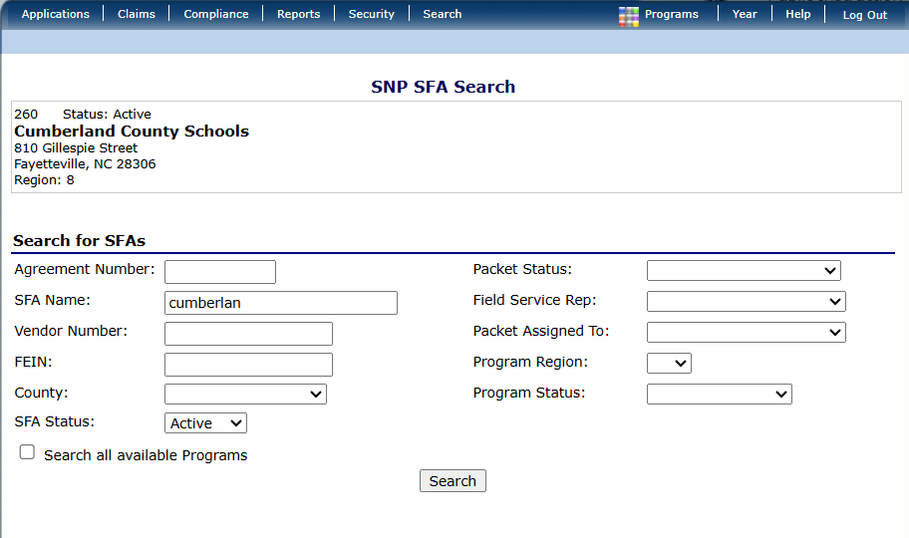

Financial Guidance
Notes:
Log into the SNTS and click on Claim and then FFVP. Must be submitted by the 15th of each month. If there is an extenuating circumstance and you need to submit it after the deadline, please contact me.

Slide 20
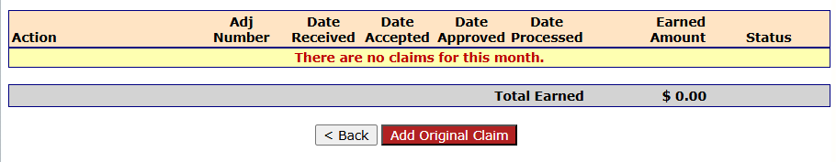
Financial Guidance
Notes:
Log into the SNTS and click on Claim and then FFVP. Add original claim. Enter the fresh fruit and fresh vegetables that was served during the month. Before you save the claim MAKE SURE YOU SUBMIT A COMMENT. Please indicate more than the students enjoyed the FFVP this month. For example, may be the students used the FFVP snack as part of a math lesson or science experiment, please share that in the comments. Must be submitted by the 15th of each month. If there is an extenuating circumstance and you need to submit it after the deadline, please contact me.

Slide 21
Financial Guidance
Financial Accountability
Receive funds based on an allocation of $50‐ $75 per student
Submit a monthly claim for reimbursement
Must operate the NSLP
May use no more than 10% of your school’s total grant for administrative costs
Receive reimbursement for the costs of purchasing, preparing, and serving fresh fruits and vegetables to children in your school
Notes:
As a part of the USDA requirement, the funds based on an allocation of $50‐ $75 per student. The last couple of years, we have increased the amount of the allocation to closer to $75/student therefore we are unable to transfer funds between schools as we get towards the end of the school year.
Submit a monthly claim for reimbursement
Must operate the NSLP
May use no more than 10% of your school’s total grant for administrative costs
Receive reimbursement for the costs of purchasing, preparing, and serving fresh fruits and vegetables to children in your school
Make sure you have established a monthly budget to assist you in tracking funds and entirely timely expenditures of program funds

Slide 22
Financial Guidance
Monthly Claims
Maintain accurate records at both district and school level
Review of all claims submitted for reimbursement
Majority of funds are used to purchase fresh produce
Labor costs and other non-food costs are minimal
Notes:
*Keep in mind that most of a school’s FFVP funds must go toward purchasing fresh fruits and vegetables.
*Reimbursement is based on actual allowable costs.
Must be submitted by the 15th of each month. If there is an extenuating circumstance and you need to submit it after the deadline, please contact me.
If you are claiming labor (which should be minimal), please maintain timesheets on site. It should have the name, date, time in and time out, FFVP tasks completed and the number of hours

Slide 23
Frequently Asked Questions
Question: Should schools develop a budget for the FFVP?
Answer: It is prudent for schools to develop a budget in order to assist in the timely expenditure of funds and FNS strongly encourages schools to do so.
Notes:
Question: Should schools develop a budget for the FFVP?
Answer: It is prudent for schools to develop a budget in order to assist in the timely expenditure of funds and FNS strongly encourages schools to do so. The budgets were due August 20 so if it has not been submitted, please do so as soon as possible.

Slide 24
Frequently Asked Questions
Question: Can schools bid FFVP, NSLP and SBP purchases together?
Answer: Yes. However, schools must be able to demonstrate which items are purchased for the FFVP
Notes:
Question: Can schools bid FFVP, NSLP and SBP purchases together?
Answer: Yes. However, schools must be able to demonstrate which items are purchased for the FFVP. Any items that are purchased with FFVP funds should be labeled as such in the storage rooms and refrigerated spaces.

Slide 25
Frequently Asked Questions
Question: May adults participate in the FFVP?
Answer: Teachers may participate under the following conditions: Only teachers who are directly responsible for serving the fruit or vegetable to their students in a classroom setting may partake of the fruit and/or vegetable.
Notes:
Question: May adults participate in the FFVP?
Answer: Teachers may participate if they are directly responsible for serving the fruit or vegetable to their students in a classroom setting. The FFVP is not available to the general teacher population and other adults in the school ▪ Teachers choosing to participate with their students are strongly encouraged to include a nutrition education component to enhance their positive role modeling. The most successful examples of this program that I’ve seen is when a teacher took five minutes to talk about the fruit or vegetable and the encourage the students to try it. The kids voted Love it, Like it, Try again later.

Slide 26
Frequently Asked Questions
Question: Who can participate in State agency provided FFVP training?
Answer: The training should be for those in the food service department directly responsible for the FFVP operations and may also include the principal or vice principal.
Notes:
Question: Who can participate in State agency provided FFVP training?
Answer: The training should be for those in the food service department directly responsible for the FFVP operations and may also include the principal or vice principal

Slide 27
Share Your Successes!
Keep copies of emails, letters, etc.
•Take pictures during the implementation of the program.
•Use the media.
•Incorporate the FFVP into your district/school wellness policy.
Share your stories and pictures with us!!
Notes:
Toot your own horn of your successes!
Keep copies of emails, letters, etc.
•Take pictures during the implementation of the program.
•Use the media.
•Incorporate the FFVP into your district/school wellness policy.
Share your stories and pictures with us!!

Slide 28


Slide 29
QUESTIONS?
If you have any questions, please contact me.
Jacquelyn McGowan, Special Programs Consultant - FFVP
Jacquelyn.mcgowan@dpi.nc.gov
(984) 236-2909

Slide 30
In accordance with Federal civil rights law and U.S. Department of Agriculture (USDA) civil rights regulations and policies, the USDA, its Agencies, offices, and employees, and institutions participating in or administering USDA programs are prohibited from discriminating based on race, color, national origin, sex, disability, age, or reprisal or retaliation for prior civil rights activity in any program or activity conducted or funded by USDA.
Persons with disabilities who require alternative means of communication for program information (e.g. Braille, large print, audiotape, American Sign Language, etc.), should contact the Agency (State or local) where they applied for benefits. Individuals who are deaf, hard of hearing or have speech disabilities may contact USDA through the Federal Relay Service at (800) 877-8339. Additionally, program information may be made available in languages other than English.
To file a program complaint of discrimination, complete the USDA Program Discrimination Complaint Form, (AD-3027) found online at: http://www.ascr.usda.gov/complaint_filing_cust.html and at any USDA office, or write a letter addressed to USDA and provide in the letter all of the information requested in the form. To request a copy of the complaint form, call (866) 632-9992. Submit your completed form or letter to USDA by:
(1) mail: U.S. Department of Agriculture
Office of the Assistant Secretary for Civil Rights
1400 Independence Avenue, SW
Washington, D.C. 20250-9410;
(2) fax: (202) 690-7442; or
(3) email: program.intake@usda.gov
This institution is an equal opportunity provider.

