Slide 1
Title I Preschool ESSA Local Coordination MOU Requirement Webinar NC Department of Public Instruction Office of Federal Programs and Office of Early Learning July 7, 2022
Notes:
Good Morning Everyone.. You have joined the Title I Preschool Every Student Succeeds Act Local Coordination MOU requirement introduction webinar. As you know, this Memorandum of Understanding requirement is between LEA’s (receiving Title I funds) and Head Start Programs. Thank you for your time today.

Slide 2
AGENDA
Welcome
ESSA MOU Legislation
ESSA Statutory Requirements
Agreement Example
CCIP Requirements
CCSSO Toolkit
Notes:
The agenda for today includes a brief Welcome. We will then move to the specific ESSA MOU Requirement and Statutory Requirements for LEA's. We will follow the requirement sections with an Agreement example and the CCIP location for which the Agreement MOU requirement must be uploaded. Lastly, is an inclusive Toolkit created by the Council of Chief State School Officers and The National Head Start Association. The toolkit is the main resource used for today's information session and is a deeper dive into the requirements and coordinated efforts between LEA's and Head Start Grantee's.

Slide 3
Office of Federal Programs and The Office of Early Learning
Jody Koon
Office of Federal Programs
Title I Preschool Consultant
Jody.Koon@dpi.nc.gov
Dr. Leslie Simmons
Office of Early Learning
Early Education Consultant
Leslie.Simmons@dpi.nc.gov

Slide 4
The “Elementary and Secondary Education Act” (ESEA), as amended in 2015 by the “Every Student Succeeds Act” (ESSA), requires local educational agencies (LEAs) receiving Title I funds to develop agreements with Head Start and other early childhood providers (if feasible) to increase coordination.
ESSA Legislation
SEC. 1119. [20 U.S.C. 6322] COORDINATION REQUIREMENTS
Notes:
The ESSA LEA/Head Start MOU requirement was created to increase coordination between LEA's receiving Title I funds and Head Start ( the oldest and largest federally funded early education program serving over one million children across the nation with preschool and family services). Thus, the coordination of the two programs to support young children and families became a priority at the national level. Of particular importance in the legislation is: that All LEA’s receiving Title I funds must have a Coordination agreement with Head Start whether the LEA is using Title I funds for preschool or not. It is often questioned as to Why all LEA's must have the agreement with Head Start if they do not serve preschool children? The first that comes to mind are the opportunities for a collaborative, well planned Transition process from Preschool into our public school kindergarten classrooms.

Slide 5
ESSA Legislation - An Opportunity
Better coordination between school districts and Head Start
Provides:
Higher-Quality Early Education Learning Experiences &
More Seamless Transition to Kindergarten
Notes:
The opportunities to develop preschool to kindergarten transition practices which support, and impact children, teachers, and families are numerous. This federal requirement further underscores the important opportunity for better coordination between school districts and Head Start including the broader community-based early childhood education preschool programs. The coordination goals are to create higher-quality learning programs and experiences for children; as well as a more seamless transition to kindergarten which, as we know, impacts children’s development and success in school. This legislation is designed to support Cross-Systems coordination to further promote best practices in early education.

Slide 6
Formal document of the coordinated efforts between the LEA and the Head Start program
ESSA Requirement
MOU
(Memorandum of Understanding)
Notes:
The provision requires that LEAs document the coordination through a written agreement between the LEA and Head Start Grantee. And, if feasible, with other early childhood programs. Therefor, the MOU is the formal document which meets the requirement.

Slide 7
The specific coordination activities (which must be included in the MOU) outlined in the legislation include:
ESSA’s Statutory Requirements
(for LEA Coordination with Head Start)
Notes:
Again, the following requirements applies categorically to Head Start programs because it is the country’s primary federally funded early childhood education program- with centers in communities across the country. In addition to Head Start, it is worth conversation, consideration and if feasible it is also required to have coordination agreements with the broader early childhood community. For purposes of this session we again are focusing on the ESSA requirements for LEA's with Head Start.

Slide 8
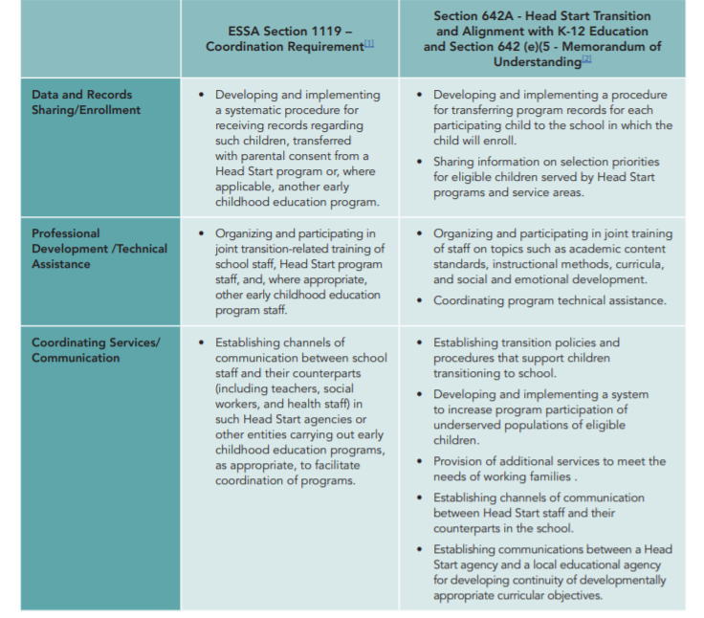
ESSA’s Statutory Requirements
Data & Records Sharing/Enrollment
Professional Development / Technical Assistance
Coordinating Services/Communication
Notes:
This slide is a snapshot of the specific statutory requirements to be included in the MOU. Notice in this table that there are three columns. The first column is the subject column. The second column lists the ESSA Section 1119 Coordination Requirements which are the requirements of the LEA’s. The third column lists the Section 642 federal requirements for Head Start. Head Start has had a requirement since 2007 to coordinate with LEA’s. However, often there are challenges when one entity has a statutory requirement, and the other does not. Thus, once again, an additional reason for the requirements of LEA’s for purposes of program alignment. Now- both federally funded programs are required to have an MOU with coordinated efforts to comply with the funding received from the federal government.
There are six primary required areas of coordination. On this slide: Data and Record Sharing-is described and ranges from coordinating and sharing information on preschool eligibility and priority and program coordination including sharing the information of preschool children transitioning from Head Start preschools into the LEA kindergarten program.
Secondly, Professional Development and Technical Assistance: The primary focus is a PD/TA system which coordinates professional development opportunities inclusive of teacher and program supports for high quality transition activities from Head Start preschool to the kindergarten school and classroom. as well as, the possibilities of having a joint system of support for all teachers and assistants in both public and non public early childhood programs. Thirdly, Communication: the emphasis again is a coordinated system within the community addressing communication which includes school staff, Head Start staff and other early childhood programs. As we see, this legislation is about opportunities to work together, learn together, serve the most children possible and again, transfer from one program to another what children know and are able to do from those that have been teaching them possibly since birth.

Slide 9
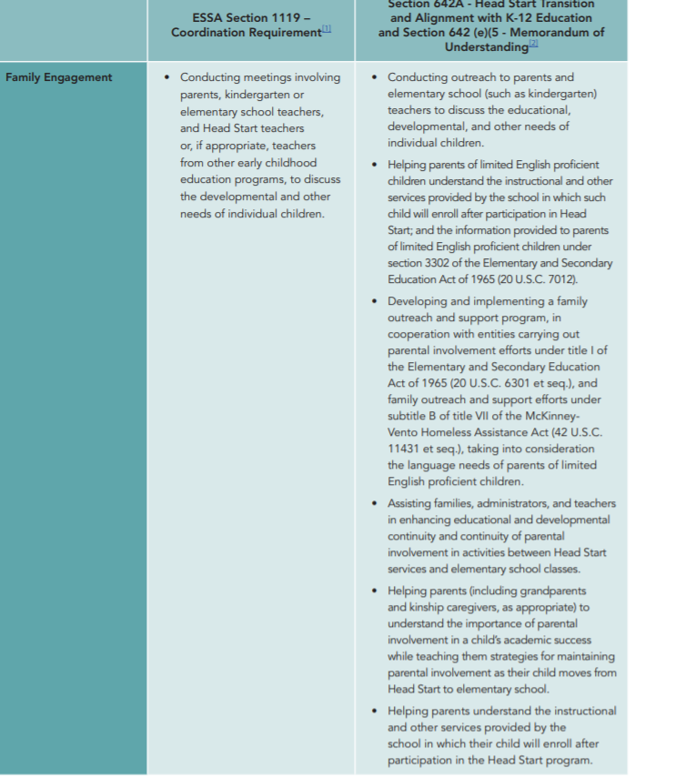
ESSA’s Statutory Requirement contd.
Family Engagement
Notes:
Family Engagement: We have all been working hard and know the importance of learning from families, planning with families, and including families in the education of their children. Working with Head Start programs, and other early childhood programs, on outreach efforts and engagement practices supports again a more coordinated system for families, children and programs which promotes the development, learning and success of all of our children in school.

Slide 10
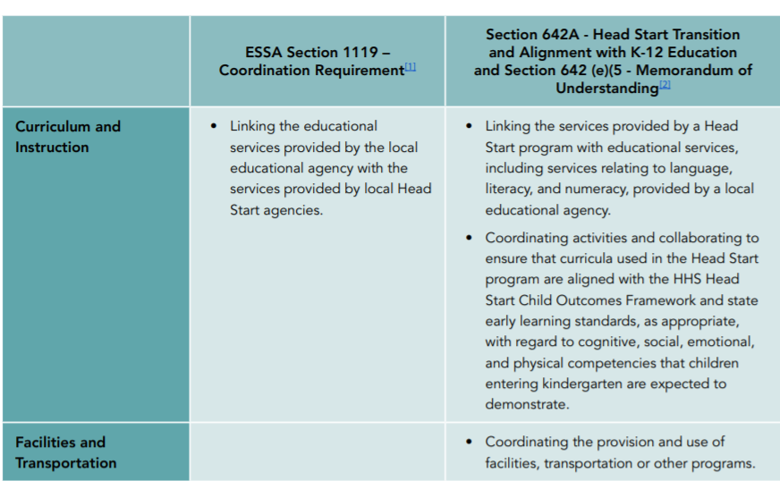
ESSA’s Statutory Requirement contd.
Curriculum & Instruction
Facilities & Transportation
Notes:
Curriculum and Instruction: Just as in our K-12 system PK-K standards, curricula, and assessment alignment is best practice in supporting and promoting learning. Currently, for example, in NC the majority of Head Start, state funded NCPK and Community based early education programs use a curricula called Creative Curriculum and an assessment called The Gold Assessment in preschool. Of which both align with the North Carolina Foundations of Early Learning and the Early Learning Inventory (Formally know as the KEA) which is required in all public Kindergarten classrooms within the first 60 days of school.
Facilities and Transportation: Here lies an additional opportunity- the opportunity to maximize resources. For example, many LEA’s across NC give in kind space to Head Start and NCPK programs to serve preschool children. As well, numerous LEA’s include preschool children in their bus transportation system to serve more eligible children in programs and schools. Many North Carolina communities are already working together across sectors on many of the coordination efforts listed in the requirements.

Slide 11
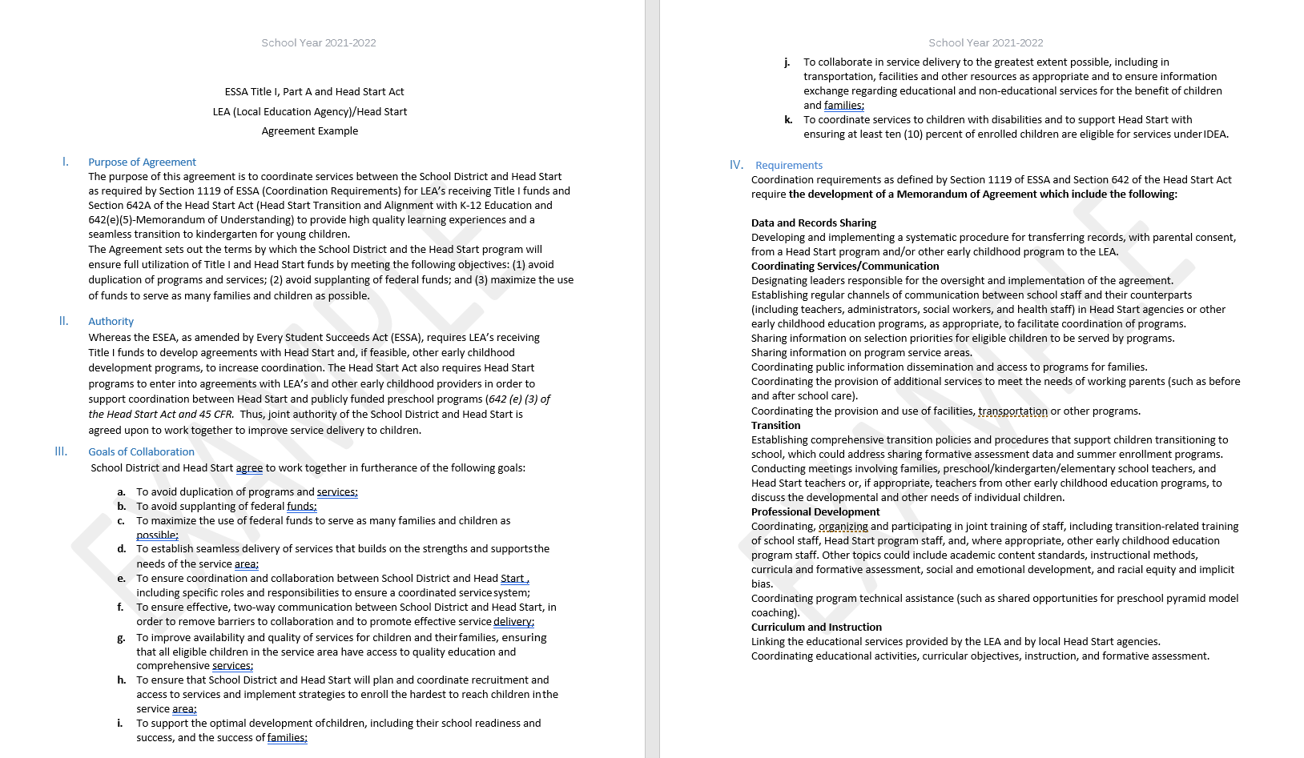
Agreement Example
I. Purpose of Agreement
II. Authority
III. Goals of Collaboration
IV. Requirements
Notes:
We have provided a visual example of an agreement LEA’s, Head Start and other community programs use to coordinate services. The example includes the parties creating and agreeing on the Purpose of the Agreement, which Agency has Authority in what areas of the agreement , What are the shared Goals for working together, and the Statutory Requirements discussed in the previous slides.

Slide 12
Agreement Example contd.
V. Program Description
Notes:
And, in this example- Program Descriptions which is a narrative of each of the programs that are party to the agreement. In this example, included is Head Start and Title I. This is a very basic example of an MOU. There are many more examples of MOU's in a resource we will discuss shortly.

Slide 13
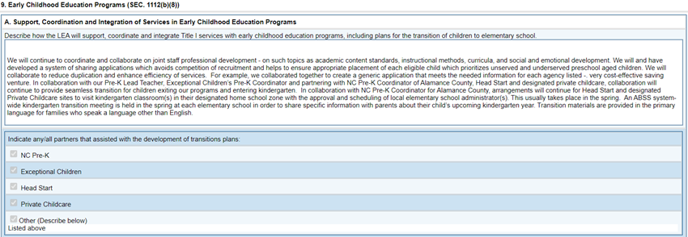
CCIP Documentation contd.
Documentation of Coordination Efforts
Notes:
This section of the Comprehensive Continuous Improvement Plan requires a description of how LEA’s will support, coordinate, and integrate Title I services with early education programs including a written plan for transition from preschool to kindergarten.

Slide 14
CCIP Documentation contd.
Documentation of MOU
Notes:
In this section of the CCIP- Coordination Requirements – is the location the MOU is uploaded. It is my experience that if the MOU does not meet the components discussed today the application is at risk of not being approved. In some cases we are finding MOU's with coordinated agreements between Head Start and Exceptional Children's programs outlining agreements and services for children with disabilities. These existing agreements are an opportunity to build upon to incorporate Title I and the requirements of ESSA 1119.

Slide 15
https://ccsso.org/sites/default/files/2018-02/Toolkit-New%20Early%20Childhood%20Coordination%20Requirements%20in%20the%20ESSA-for%20pr....pdf
Notes:
This is the toolkit resource mentioned earlier which was developed by the Council of Chief State School Officers and the National Head Start Association. The Toolkit includes all components required of LEA’s receiving Title I funds and Early Childhood Education ESSA requirements.
https://ccsso.org/sites/default/files/2018-02/Toolkit-New%20Early%20Childhood%20Coordination%20Requirements%20in%20the%20ESSA-for%20pr....pdf

Slide 16
Notes:
The toolkit is a 100 page document that at first glance may be overwhelming. I approached toolkit by using the table of contents and taking one section at a time to focus on that content for understanding. A few sections you may want to glance at are: Section Five: Alignment of ESSA 1119 Coordination Requirements and the Coordination Requirements of the Improving Head Start for School Readiness Act of 2007 (642A). This will give you the perspective of both federal program requirements. Appendix G: Gives you very detailed specific examples of MOU's. and Appendix H is helpful with Common Frequently Asked Questions. You will find in this toolkit that The MOU and Coordination Requirements within both ESSA and the Head Start Act are basics to a much broader vision within these two laws: They are a spring board to what most of the Toolkit offers which you will find in the remaining sections. They are Guidance sections on building a shared community wide system of support for early education. That remains the greatest opportunity within this body of work. Please know, the recorded webinar, powerpoint and support documents will be sent out on the Consolidated Federal Program Updates ListServ. At this time, I will turn it over to Tina and Alex for questions. Thank you again for participating today.

Slide 17
Thank you for participating in today’s session!
Questions?

