Slide 1
Guidelines for Cross-Program Consolidated Monitoring Process August 31, 2022 North Carolina Department of Public Instruction Office of Federal Programs

Slide 2
Office of Federal Program (OFP) Consolidated Staff
Leadership Team
Dr. LaTricia Townsend, Director
Tina Letchworth, Asst. Director
Alex Charles, Section Chief~ West
Melissa Eddy, Section Chief~ East
Program Administrators
Paul Perrotta
Jennifer Smith
Dr. Masa Kinsey-Shipp
Tim Dryman
Dr. Pauletta Thompson
Laura Popp
Shawna Andrews
Julie Hill
Talbot Troy
Support Staff
Anita Harris
Richard Trantham
Grace Velez-Diaz
Shana Fryer
Notes:
My name is Jennifer Smith;
Jen: The Office of Federal Programs supports over $560,000,000 in recurring federal funding grants provided to districts and schools each year. Additionally, since the start of the Coronavirus pandemic, our Office also oversees all of the Federal Elementary and Secondary School Emergency Relief funding. The primary role of the Office of Federal Programs is to provide grants administration, program monitoring, data collection and reporting.
Our staff listed here works vigilantly to facilitate the necessary technical assistance to ensure not only compliance but quality programs for all students in North Carolina.

Slide 3
Agenda
Guidelines for Cross-Program Consolidated Monitoring Process
Scope and Purpose of Monitoring
Sharing Documents for Review
Preparing for School Visits
Preparing for Stakeholder Interviews
Element Ratings and the Monitoring Report
2021 – 2025 Monitoring Cycle
Notes:
Jen: The purpose of today’s recorded presentation is to provide a high-level overview of our Office’s Cross-Program Monitoring Process (from start to finish). In reviewing this process we will discuss the scope and purpose of monitoring, how PSUs will share compliance documentation for review, how PSUs should develop a visit Agenda and prepare for our team’s on-site visit and interviews. Lastly, we will review the Monitoring Report which will provide a rating for each of the 22 Elements.
Today’s agenda does NOT review each of the Elements on the Monitoring Instrument tool; so if you are seeking additional information regarding the monitoring instrument tool itself, please refer to a separate recorded technical assistance webinar which provides a thorough walk through of that tool.

Slide 4
Scope and Purpose of Monitoring
Jennifer Smith, Program Administrator
Notes:
Jen:
I am going to begin today’s recorded presentation by reviewing the scope and purpose of the Cross-Program Consolidate monitoring events.

Slide 5
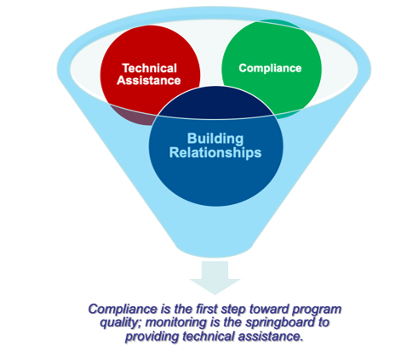
Purpose of Monitoring
Office of Federal Programs Monitoring Process
to ensure compliance with federal and state requirements,
to verify the implementation of descriptions included within the approved application, and
to identify areas that require additional support and technical assistance
Notes:
Jen: Federal and NC State policy requires that NCDPI, who serves as the State Education Agency (SEA) for grants authorized under the Every Students Succeeds Act (ESSA), monitors the quality and effectiveness of programs operating with the use of federal funds authorized under the law.
While our work is legislatively required, compliance monitoring is also the foundation of identifying areas the SEA can support improvement for local programs. Through cooperative assessment of the federal programs between the State and PSUs, the quality of services to students will be strengthened and improved. The OFP team utilizes monitoring events to answer questions, facilitate dialogue, and exchange ideas and information for program improvement while, at the same time, meeting all federal requirements.

Slide 6
Risk Assessment and Four-Year Cycle
Cross-Program Consolidated Monitoring Calendar is developed on a 4-Year Cycle (2021-2025)
Currently starting ‘Year 2’
What year your PSU is selected for a monitoring event is based on a risk assessment
Amount of Title I funds​
Years since last monitored​
Number of federal programs​
Number of findings​
Percentage of CSI Schools​
Years Federal Program Director and CFO has been in place
Notes:
Jen: Our SEA uses a Four-Year Monitoring Cycle for all PSUs receiving federal funds. A risk assessment analysis is used to determine what level and what year of monitoring within the four year cycle your PSU will receive a cross-program monitoring event.
The risk assessment includes six key components listed on this slide; Amount of your PSU’s Title I funds, how many years it has been since you were last monitored, how many federal program grants you receive, the number of compliance findings from your last monitoring event, the % of CSI-identified schools within your PSU, and the years your Fed. Prog. Director and CFO have been in place.
Each component receives a rubric score between 1 and 5 and then a weighting is applied that results in an indexed “score” for each PSU and charter school. PSUs are ranked from most risk to least risk. Charter schools are ranked separately.

Slide 7
Scope of Monitoring
Cross-Program Consolidated Monitoring Instrument
Programs Included in Consolidated Monitoring:
Title I Part A
Title I, Part C
Title I, Part D
Title ll, Part A
Title III, Part A
Title IV, Part A and
Title V, Part B
Notes:
Jen: The scope of monitoring depends on the grants in which the PSU participates. In addition, CPCM will consider the PSU’s participation in other programs addressed by ESSA, such as Title I pre-kindergarten, homeless education programs, Targeted School Improvement (TSI), Comprehensive School Improvement (CSI) and equitable services for private schools. Other ESSA grants and related programs which a PSU might participate in (Such as ESSER or IDEA grants) does not fall within the scope of the CPCM process.
The CPCM monitoring instrument can be found on the Office of Federal Programs webpage and is linked here.

Slide 8
Monitoring Event Timeline
PSUs notified of the Month of their monitoring event the Summer prior to the school-year
Official Notification Letter emailed to the PSU at least 30 days prior to the monitoring event
Required documentation will be due on the Thursday prior (at 5:00pm) to the scheduled onsite visit date
PSUs are notified of the schools that be visited (randomly selected; minimum of 4 Title I schools will be visited depending on the size of your PSU)
PSU should review the OFP’s Monitoring Instrument Video as resource
Lead Program Administrator will host a Pre-Monitoring Virtual Meeting for any questions
On-Site Visit on the Thursday of the PSU’s Monitoring Event Week
Reports will be issued within 30 days of the monitoring event
Notes:
Jen: Before we talk about the monitoring protocol in greater detail, I want to begin by sharing the timeline that is applicable to the cross-program monitoring event process. Read slide
**We will be diving into the monitoring report ratings later on in the slidedeck

Slide 9
Cross-Program Consolidated Monitoring Event Timeline
Notification Letter
Pre-Monitoring
Receive Report
Resolve Findings
Closing Letter
On-Site Visit and Interviews
Notes:
Jen; This is just a visual graphic showing the timeline of a Cross-Program Monitoring Timeline

Slide 10
Sharing Documents for Review
Jennifer Smith, Program Administrator
Notes:
Jen: OFP has organized key provisions of ESSA into 22 compliance elements for PSUs that form the basis of the CPCM process. The accompanying CPCM Monitoring Instrument describes the elements in detail and provides examples of the types of documentation PSUs will be asked to provide to OFP during the process. I am now going to review how each PSU will share electronic documentation for review during their CPCM event.

Slide 11
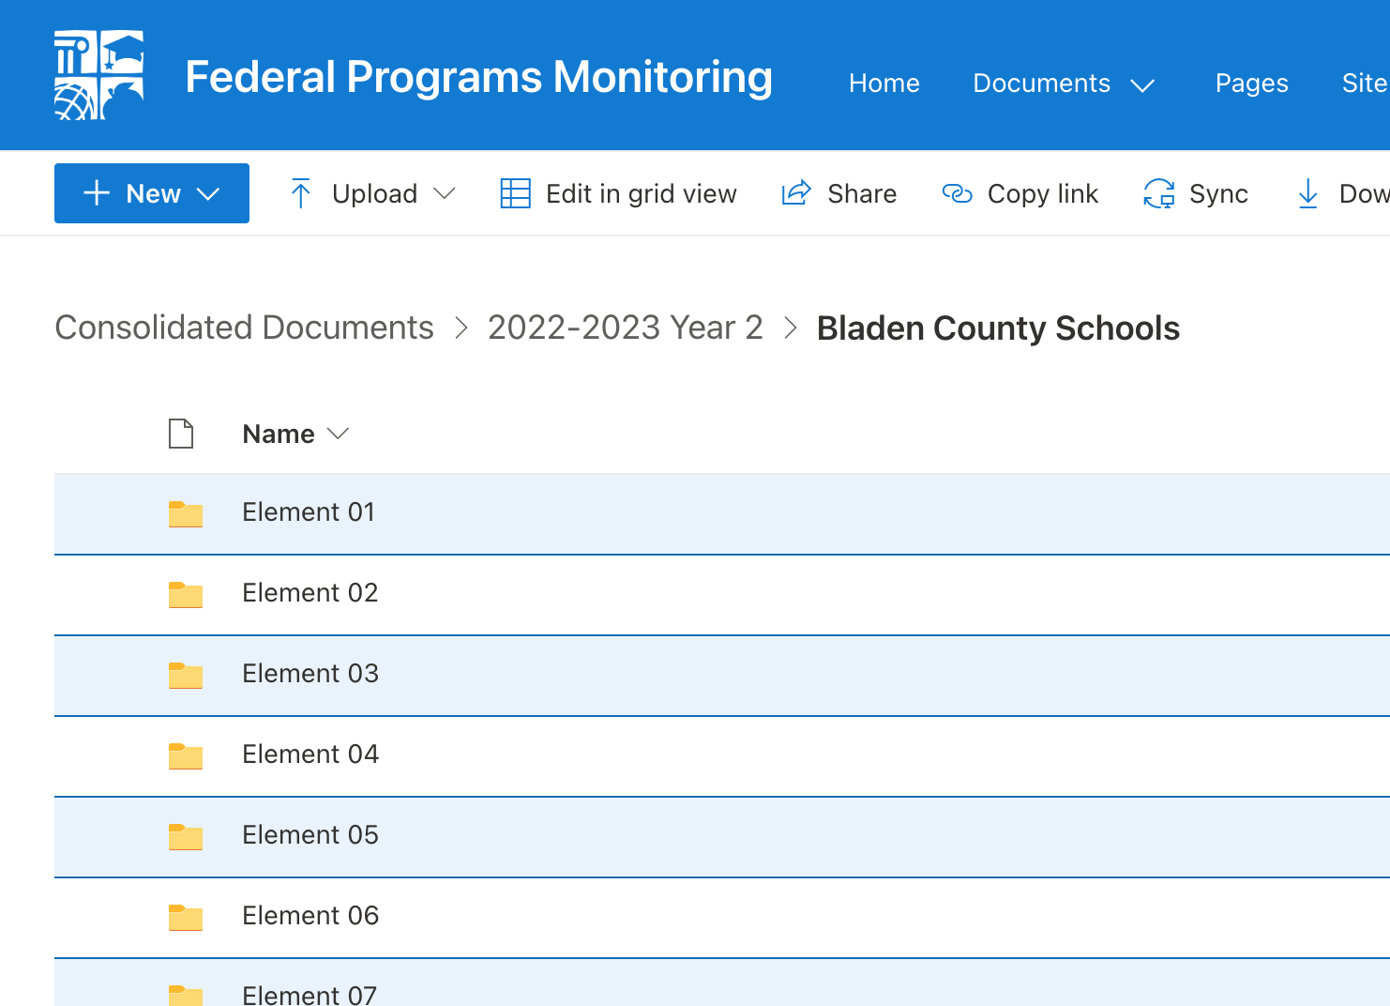
Electronic Submission
All documentation to support compliance *must* be submitted electronically through SharePoint
Access to the SharePoint folders will automatically be granted to the Superintendent (or Board Chair for Charters) and the Federal Program Director listed on Notification Letter
One SharePoint Folder for each of the 22 Elements
Notes:
Jen: The PSU is responsible for providing evidence of compliance with the statutes that are cited in the Monitoring Instrument Tool. Some of the elements or portions of elements will not apply to your PSU determined by which programs you participate. The lead PA will help identify those areas where the PSU will not be required to produce evidence.
The OFP has moved all documentation submission to the SharePoint platform. Access to your PSU’s SharePoint folders for the CPCM events are automatically provided to your Superintendent (or Board Chair for Charter Schools) and the PSU’s Federal Program Director.
Within your PSU’ SharePoint Folder, one Parent folder for each of the 22 Elements on the Monitoring Instrument have already been created.
If your PSU uses an external platform (e.g., Google Drive) to maintain documentation, OFP has created a video reference guide to show how to transfer documents into the SharePoint platform.

Slide 12
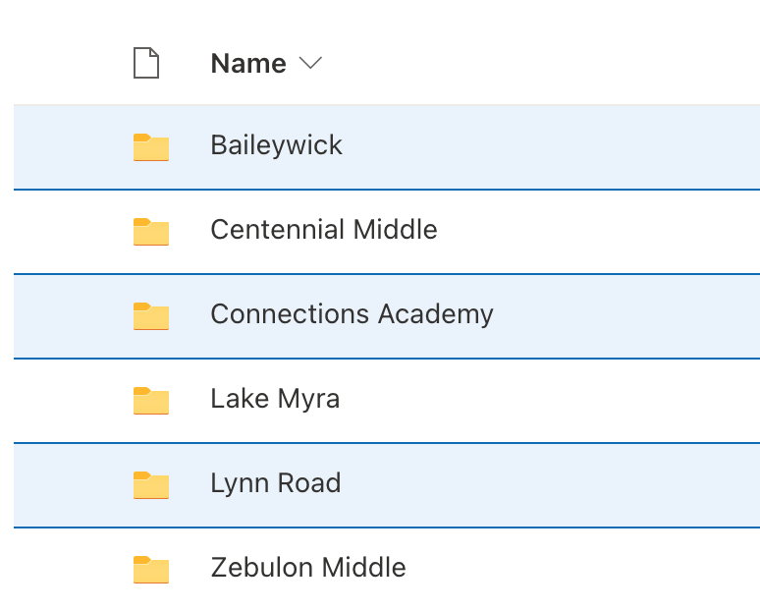
Electronic Submission
Some of the elements will require documents that come from the selected schools
Within each of those element folders, PSU staff should create subfolders named for those schools.
Subfolders for each selected Title I School within an Element
Notes:
Jen: Some of the Elements are rather large or require documents from each of the selected Title I schools that will be visit during the Monitoring Event; for those Elements where school-based documents are likely to be required this is indicated on the Monitoring Instrument column titled Supporting Documentation. Sample Supporting Documentation is divided into a ‘District’ heading for items applicable to the whole District, and ‘District Selected Schools’ and for ‘Charter/Lab’ Schools for further clarification.
We do ask that subfolders should be created within the 22 Element Parent Folders for ease of navigation and clarity for the PA reviewing your documentation.

Slide 13
General Guidelines for Documentation
Documentation of activities is usually not restricted to any one format. It can be a paper or electronic record of completed work such as meeting notes, survey examples and results, assessment results, reports, agreements, schedules, attendance records, work activity reports, supervisor approval of expenditures, etc.
Documentation should be maintained in an organized manner so it can be easily referenced when needed.
Generally, documentation should
identify the date of the activity (i.e. the event) or action (i.e. the advance notice);
identify the PSU or school, preferably using letterhead;
identify the purpose of the activity and/or agenda topics, the main input and/or action, and the results such as decision(s) made;
identify the names of participants in the activity and their role and/or group represented
Notes:
Jen: How each PSU maintains documentation of activities varies greatly across the state; it can be paper record, electronic records, photographs, meeting minutes, lesson plans, tutor records, schedules, written policies and procedures etc.
We encourage all PSUs to ensure documentation is maintained on a continual basis and filed in alignment to the Monitoring Tool to ease the burden of producing the documentation during your monitoring event.
For a few general guideline reminders: please ensure records are DATED and identifiable by your District or School; ensure documentation can demonstrate activities, actions, results, agenda topics, and all meetings identify the names of participants as well as their role or group represented. These simple tips ensure PA’s can easily understand your submitted files.

Slide 14
Compliance Documentation Best Practices
If one document satisfies more than one element, it should be uploaded into all applicable folders.
Only the most recent or current documents that demonstrate compliance are required.
Items may be provided in the following formats: PDFs, Word files, TXT files, Excel files, CSV files, PowerPoints, or JPEGs
PSU staff should not create documents (such as notes-to-file) that describe the PSU’s compliance with an element simply to have a document to provide for the monitoring event.
Clarifying information may be added onto an existing document in the form of an electronic “post-it” or comment (e.g., features available in Adobe or Word) or a handwritten note in the margin prior to scanning
There is no need to upload documentation for any elements that do not apply to the PSU.
Notes:
Jen: A few additional Compliance Documentation best practices are listed here:
-If one document satisfies more than one element, it should be uploaded into all applicable folders. This seems redundant but makes it easier for all parties to keep track of what has been shared and reviewed.
-Only the most recent or current docs should be submitted; we do not need files from years prior unless it is needed to support an activity that might not have occurred this year yet
-Please do not ‘create’ documents with narratives as ‘evidence’ simply to have something to upload
-Clarifying information can be added to an existing document if you believe it would provide clarifying context for the reviewer
- There is no need to upload documents for any element that do not apply to your district or school (those element parent folders can remain empty)

Slide 15
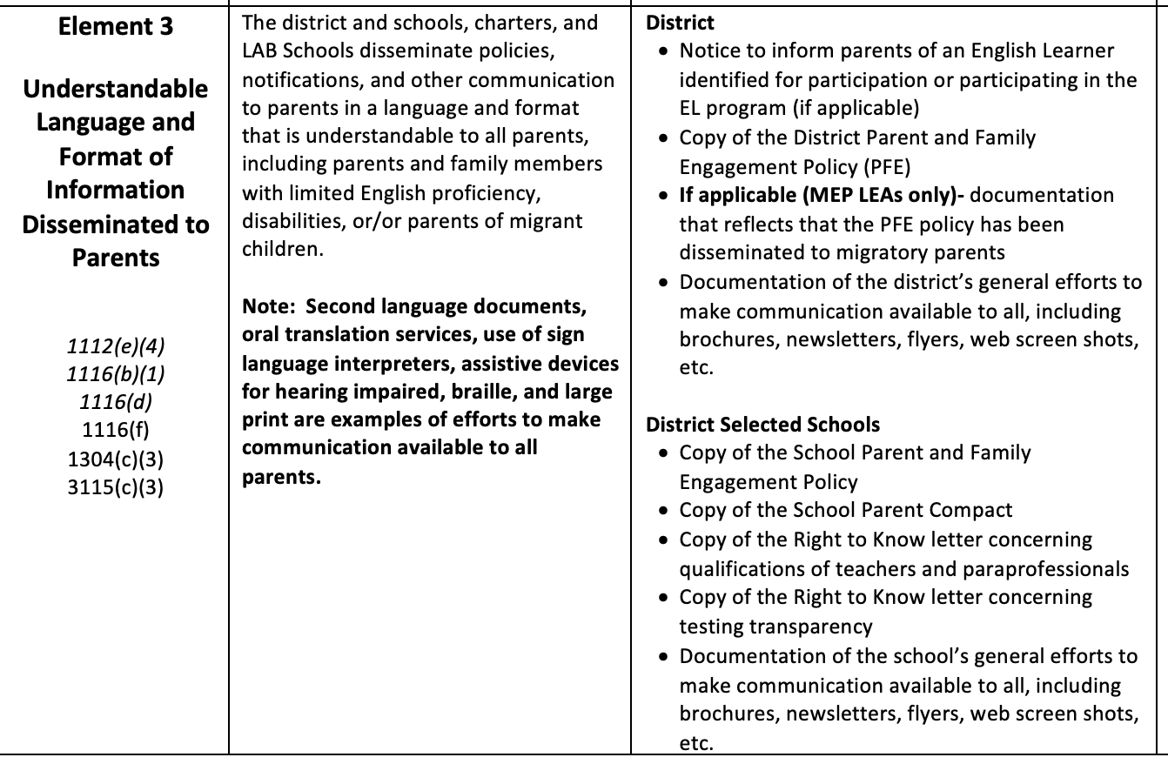
Using the Instrument as a Guide
Notes:
Jen

Slide 16
How Much Documentation is Required to Demonstrate Compliance?
The PSU is not required to provide an exhaustive set of a particular kind of document.
For example, to demonstrate a particular group has met 12 times during the year, the PSU may supply the artifacts related to one or two of those meetings, as long as those artifacts reflect what is described in the given element. Artifacts from all the other meetings would not be required.
However, to provide a more comprehensive view, a calendar or schedule showing the other meeting dates should be included.
The PA is available to answer questions about supplying sufficient documentation for a particular element.
Notes:
Jen: read slide

Slide 17
When is Electronic Documentation Due?
All documents must be available for review no later than 5:00 P.M. on the due date listed on page 1 of these guidelines (the Thursday prior to the date of the on-site visit!)
SharePoint file access will be locked after that date and time and no additional documentation will be accepted for upload.
IMPORTANT: The ratings of the applicable elements and the monitoring report will be based on documents that are submitted by the deadline; late documents will not be reviewed.
PSU staff should consult the PA with any questions about the documents needed for of the elements.
Notes:
Jen: read slide
I am now gong to turn over the presentation to my colleague Tim Dryman to review how to prepare for your school visits and interviews:

Slide 18
Preparing for School Visits
Tim Dryman, Program Administrator
Notes:
Tim: Hello everyone. We will now review the process for the pre-selected school visits.

Slide 19
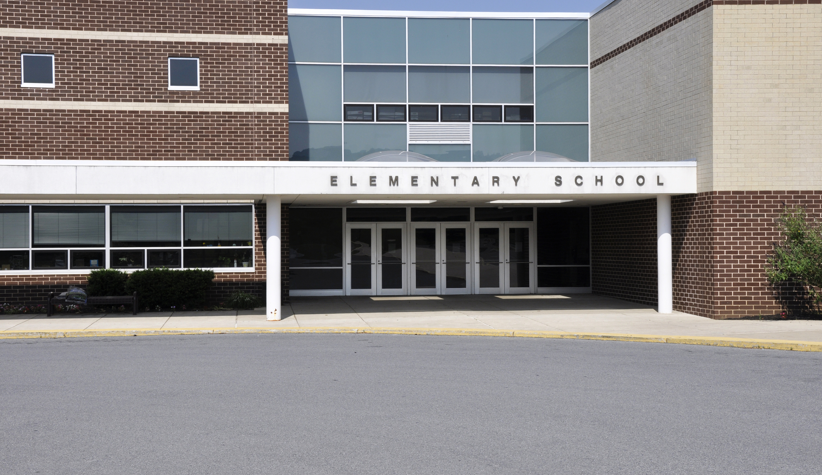
On-Site Visitation Procedures
A small team from OFP will visit each of the selected school(s) for about 40-45 minutes during the morning of the visitation date listed on the first page of your monitoring guidelines.
It is the expectation the OFP team will meet with each principal of the selected Title I school(s) for a few moments prior to touring the school and the principal will facilitate the school tour.
Notes:
Tim: The morning part of the day will include informal visits to the pre-selected schools. The walking tours of the schools will last approximately 40-45 minutes. They will include the visiting team from federal programs, the principal and any other school team member the principal would like to invite. The focus of the visit will be to see how Federal funds are being implemented at the school. This will include classrooms led by Title I funded teachers and tutors, and any initiatives funded by federal funds such as STEM labs, level libraries etc. These visits should not cause the school to alter their daily routine. For example, a schoolwide assembly that coincides with the visit should take place as planned.

Slide 20
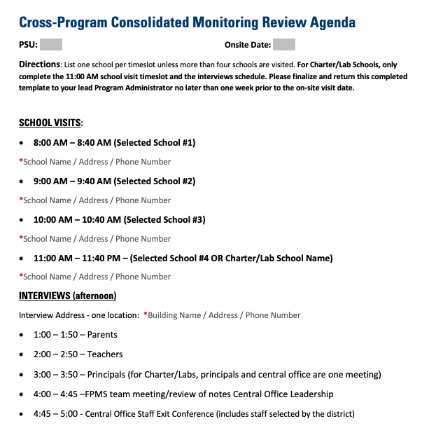
Developing the Visit Agenda
The schedule for the visits and interviews will be determined by the PSU, based on the locations and start times of the selected schools and the scheduling needs of the parents, teachers and principals.
However, ensure the last interview conducted is with Central Office staff/Leadership team
Notes:
Tim: Once the Title I Director is notified of the schools to be visited, they will begin to develop the agenda for the onsite visit. Based on the locations of the selected schools, the director will determine the best order in which to visit the selected schools that will minimize travel time between schools to maximize time at school sites. Please include the address of the location where the afternoon meetings will held. The meeting times for parents, teachers and principals are flexible and those meetings should be scheduled in a manner that works with the district's daily schedule. The only meeting that is not time flexible is the central office/leadership team meeting. It is best to keep this meeting as the last of the day to best summarize the observations of the day. Once the agenda has been finalized, please return the agenda to your Lead Program Administrator
For charters/labs: Your day will begin at 11 am with the school tour and follow with the designated afternoon schedule on the agenda. Similar to districts, the schedule will be flexible for parents, and teachers with the day ending with school leadership.
During the leadership meetings, the superintendent for districts or board chairs for charters/labs are not required to attend, but are welcome to attend.

Slide 21
School Visit(s) Reminders
Order the school visits in the most time efficient manner for all visits to be completed before afternoon interviews
During the Principal-led School Tour(s), focus on highlighting school initiatives funded by your Consolidated Federal Programs
Title I School-wide/Targeted Assistance Plan Components
Interventionist or Tutor Rooms; Title I Supplies/Equipment
Title II Reduced-sized classrooms; Lead Teachers or Instructional Coaches
Title III activities/resources/staff
Title IV funded activities, staffing, resources
If the PSU funds pre-k with Title I, the team will visit one or two pre-k classrooms to examine the on-site documents related to student selection and to briefly ask the pre-k teachers about the implementation of the pre-k program.
Notes:
Tim: Some additional information for the school visits. Take into consideration school locations, traffic, construction and other obstacles that would take away time at each school. An optional component of the visit: the selected school principal can prepare a brief, no more than five minute review of their School-wide Title I Plan. The visit should focus on how the school is utilizing their federal funds to address learning loss and closing achievement gaps. Highlights should include classrooms led by Title I funded teachers, TA's and tutors, STEM labs, level libraries etc. If the schools have Title I funded Pre-K classrooms, visiting one or two of those classrooms should be included during the tour.

Slide 22
Preparing for Stakeholder Interviews
Tim Dryman, Program Administrator
Notes:
Tim: We will now review the preparation for the afternoon stakeholder interviews.

Slide 23
Preparing for Stakeholder Interviews
A portion of the on-site visit agenda is dedicated to interviews with stakeholder groups
Interview segments last about 40-50 minutes
Due to time constraints, interviews should take place in the same location
Ensure the interview room location is private and includes appropriate computer equipment if some participants will be joining virtually
Notes:
Tim: A portion of the onsite visit will consist of stakeholder interviews. The purpose of the interviews are to see how knowledgeable stakeholders are about federal funds, their knowledge of how federal funds are used at their schools and what role do stakeholders play in the planning, development and implementation of those funds and their school plan. The director or charter representative should ensure that sign in sheets are available for each group. Each interview segment will take no longer than 50 minutes. These meetings are strictly confidential in the sense that no names are recorded as to who made statements about certain questions. Directors and charter representatives should reassure participants of that to allow for free flowing conversation. Ensure that one central location is designated for all visits and the selected room should be able to accommodate the largest group and technology is available for parents who may not be able to attend in person. Teachers, principals and leadership are required to attend in person. Charter leadership who may be located in another state, will be able to attend by video format.

Slide 24
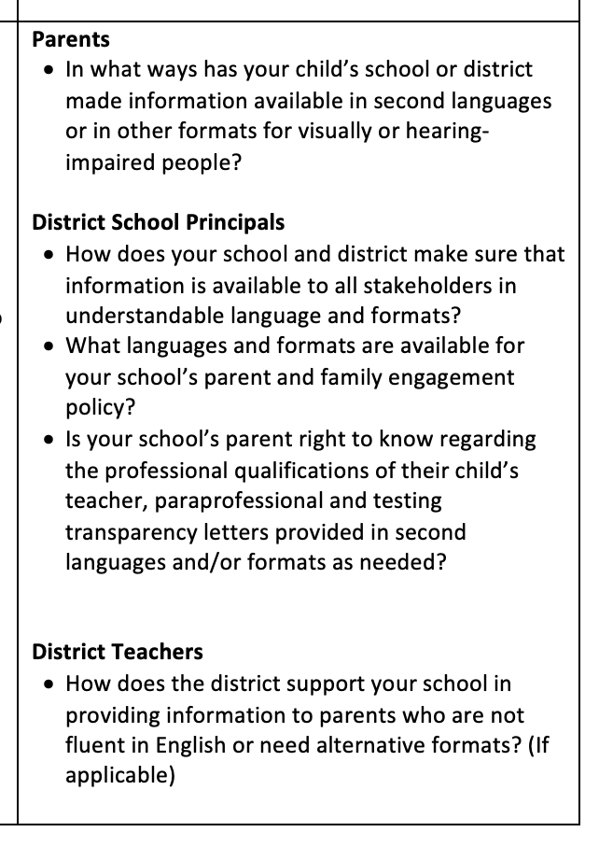
Preparing for Stakeholder Interviews
Stakeholder Interview Questions are standardized for consistency across the State and are provided on the Monitoring Instrument in the column titled Interview Questions
However, follow-up or expanded questions may be asked for further clarification as needed
PSUs may share the interview questions with participants prior to the monitoring visit, however interview participants should not respond to questions from a prepared script.
Notes:
Tim: When contacting stakeholders to participate in the meetings, please reassure stakeholders that this is a routine monitoring process that occurs once every few years and that the process focuses on PSU practices, not on schools or staff members. The interviews will be documented with notes and sign-in sheets, but none of the comments or discussion will be attributed to specific participants. You will see on the slide some examples of the types of questions that will be asked of each group. Please inform participants that anonymity is important to the process and that they should feel comfortable speaking freely to the federal program team. This is a true supportive process and should not be seen as an opportunity to catch any wrong doing.

Slide 25
Parent/Caregiver Interviews
Parent/Caregiver participants will be interviewed as one group with no others present, except for any interpreters required to facilitate participation of all attendees
Two to Four participants from each selected school are expected to attend
PSUs should invite additional parents from any of the PSU’s schools, if needed to ensure representation of families of students served with the applicable federal funds, such as English as a Second Language (ESL), migrant, homeless and pre-k students.
The parents in this group may not be employees of the school PSU, contracted service providers, or a member of the local board of education.
Notes:
Tim: For parent groups, there should be two to four parents per selected Title I school. The director is welcome to invite more parents from those schools and also invite parents from other Title I schools. Ensure translators are present if an EL parent is participating and requires a translator. Also ensure that virtual platform opportunities are available for those parents who may not be able to attend in person. The director should plan and coordinate face to face participation with parents as much as possible. Parents who are employees of the school or PSU, employees of companies who may be contracted by the school or PSU, or members of the local BOE should not be selected for participation. Parents who are members of the school leadership team, the PTO, or volunteer at the school will be allowed to participate.
Parents who lead or are a part of Parent Teacher organizations are allowed to participate in this interview group

Slide 26
Principal Interviews (PSUs Only)
Principal participants will be interviewed as one group with no others present
The principals of all selected schools are expected to attend and may bring other leadership staff from their buildings as they see fit.
Principals from non-Title I schools may be invited to support discussion of Title II, Title III, Title IV-A and Title I-C, as the PSU sees fit.
Principals from other Title I schools are also welcomed to attend, as the PSU sees fit.
Notes:
Tim: For the principal group, attendance is mandatory for the principals of the selected schools. The director is welcome to invite other Title I and non-Title I principals to speak to other federal funded programs such as Title II, III and IV A if their schedules allow participation.

Slide 27
Teacher Interviews
Teachers and others who work directly with students will be interviewed together in one group with no others present.
A variety of grade levels and teaching areas should be represented.
The group should include mostly classroom teachers but may also include resource teachers, interventionists, media specialists or counselors.
Not to be included are instructional coaches or facilitators, even those who serve only part-time in those roles. (These individuals may attend the principal or the PSU leadership team, if the PSU believes it would be beneficial.)
Notes:
Tim: The teacher group will consist of 2-4 teachers from each of the selected schools. The director is welcome to invite more teachers to participate. When selecting teachers, please ensure a wide spectrum of teachers from various grade levels, specials classes, media specialists, counselors, interventionists, EL and EC teachers. Please do not select teachers who serve as instructional coaches or facilitators. Please reach out to your lead program administrator prior to the onsite visit if you have questions about who could be included in the teacher group.

Slide 28
Central Office/Leadership Interviews & Exit Conference
This interview will include any central office/leadership staff necessary to discuss the requested documentation and the PSU’s implementation of all consolidated federal programs.
If the PSU operates an MEP Program, the migrant recruiter and migrant coordinator should be included in this part of the interview process.
It will be the last interview conducted, allowing the OFP team to tie up any loose ends that remain after the previous interviews.
The final portion of this interview will serve as an exit conference, providing an opportunity for OFP and PSU staff to share feedback about the monitoring process.
Notes:
Tim: For the central office/leadership group, any person who is involved in the development, planning, implementation and budgeting of consolidated Title funds at this level should be included in this group. The central office/leadership group will be scheduled for the end of the day. The purpose for this is to summarize discussions from the focus groups, school visit observations, and the logistics and procedures of the reporting process which will follow the onsite visit. This time will also be utilized for questions the group may have for the federal program team. Superintendents for districts and board chairs for charters and labs are not required to attend, but are highly welcome to participate. I will now turn it over to my colleague Paul Perrotta.

Slide 29
Element Ratings and the Monitoring Report
Paul Perrotta, Program Administrator
Notes:
Element Ratings and the Monitoring Report

Slide 30
Element Ratings
Based on the documentation, on-site observation and interview notes, OFP staff will analyze the PSU’s implementation of the consolidated federal programs and issue a rating for each of the applicable elements, using the following rubric:
Meets Requirement
Meets Requirement with Recommendation(s)
Finding(s)
An element will be considered not applicable if the PSU does not participate in the program(s) which form the basis of the element or if the pre-requisites stated in the element do not apply.
Notes:
Read here:
Element Ratings
There are three possible ratings that apply to each element. The ratings consist of: Meets Requirement, Meets Requirement with Recommendation, or a Finding.
Non-applicable, will be issued to any of the 22 elements not part of the PSUs monitoring event.

Slide 31
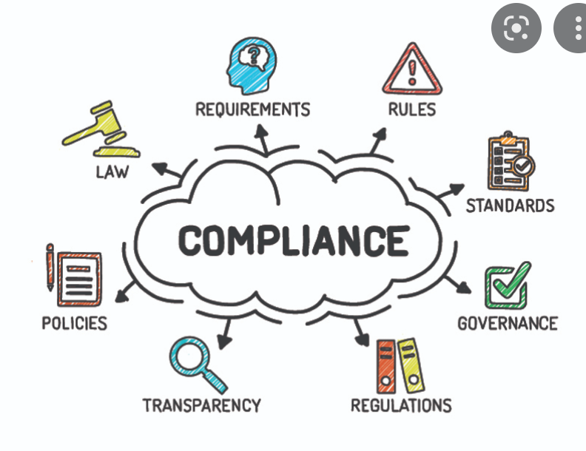
Meets Requirement
Compliance element is 100% met and supported by required evidence.
All required documents are provided and support compliance.
Interviews are consistent with documentation and indicate proper processes and implementation.
Compliance is consistent at the PSU level and throughout the schools.
Notes:
Read here:
"Meets Requirements" means compliance. Compliance often occurs when the documentation, observed practices, interviews, plans, and implemented activities align and verify evidence for compliance.
When Meeting Requirements and compliance, good job! And continue implementing those activities to sustain, improve, and impact student achievement.

Slide 32
Meets Requirement with Recommendation(s)
Basic compliance requirements are met.
Compliance and/or documentation could be strengthened with reasonable modifications.
Notes:
Read here:
Meets requirements with Recommendations also means compliance. However, in this case, the Office of Federal Programs has provided insight and recommendations for how compliance and programming may be strengthened.

Slide 33
Finding(s)
Evidence or lack of evidence shows compliance element has not been met.
Documentation is incomplete or lacking.
Interviews do not support documentation.
Interviews reveal a lack of understanding of processes or implementation.
Compliance is inconsistent at the PSU or school level.
Notes:
Read here:
Findings. Findings reveal that COMPLIANCE HAS NOT BEEN MET, and the PSU must take further action to comply.
Examples of findings include - incomplete documentation, such as an agenda without a date or the required participants, or hosting an event without fulfilling the essential purpose, or not implementing the necessary activities.
Inconsistency during interviews and with required practices can also result in a finding.
IF you have questions or need support about a finding, the PA who led the monitoring event can assist.

Slide 34
The Monitoring Report
OFP will issue a monitoring report by designating one of the three ratings for each of the applicable elements.
OFP is required to issue the report within 30 business days of the monitoring event.
For elements rated as Meets Requirements with Recommendations:
the report will include recommendations that require no further action on the part of the PSU.
Where a Finding is issued:
the report will describe the areas of non-compliance, the corrective actions required of the PSU and the deadlines by which those actions must be completed.
Notes:
READ here:
The Monitoring Report.
PSUs will receive the official Monitoring Report within 30 business days after the close of the monitoring event. The report will include a rating for every applicable element.
If a PSU receives a finding or several findings, corrective actions and new documentation uploads will be required by the PSU.
Such responses by the PSU are NOT Required for elements that Met Requirements and Met Requirements with Recommendations.

Slide 35
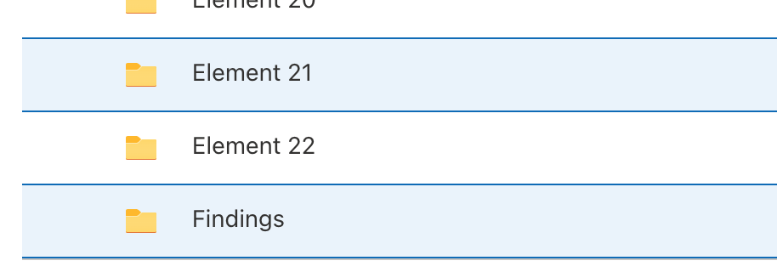
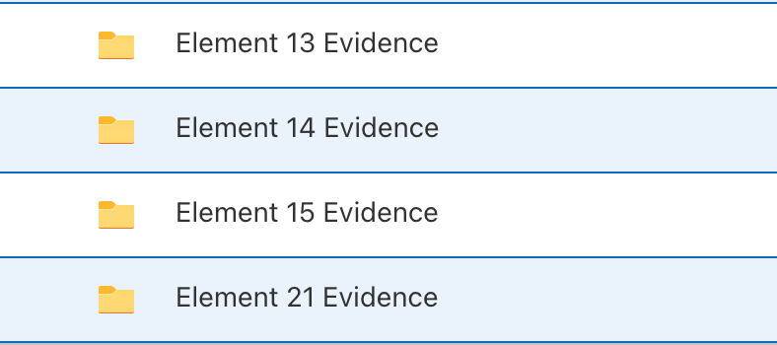
How to Respond to a Report with Findings?
The PSU must respond to each item marked as a Finding within thirty (30) business days of receiving of the report.
The Office of Federal Programs will provide a link to the PSU to access their Findings folder in SharePoint (see the blue star, the "Findings" folder can be found under Element 22).
The PSU will create subfolders by element for each finding and upload the required documentation and evidence to the applicable folder (see the example, Element 13,14,15, and 21)
The PSU should use the "Action Steps" information in the report narrative to assist with the corrective actions, documentation, and required activities.
Notes:
Read here, first:
How to Respond to Findings? As mentioned - PSUs will receive an Official Report within 30 business days after the monitoring event is completed.
Read the four bullets.

Slide 36
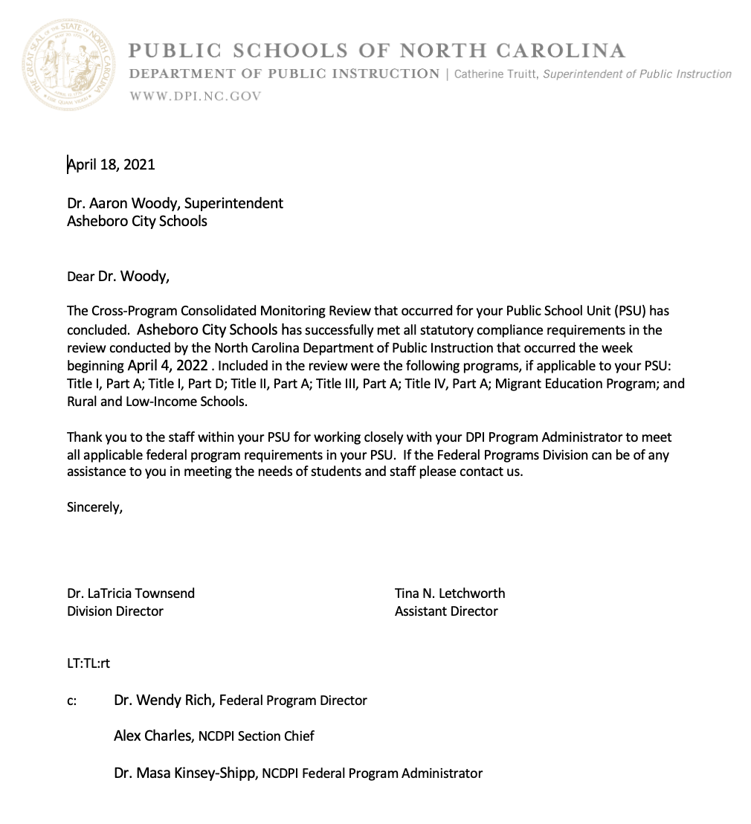
Closing Letters
After the findings are resolved, the PSU will receive an official letter to signify the closing of the monitoring process.
SAMPLE
Notes:
Read here - Closing Letters:
Findings must be resolved for compliance AND for next year's allotments and consolidated application of funds in CCIP.
Once the findings are resolved, the PSU will receive an official letter to signify statutory compliance and the closing of the monitoring process for the applicable 4-year cycle.

Slide 37
Video Resources – Required Viewing
Required Video #1:
Preparing for Your Upcoming Monitoring Visit - Monitoring Event Guidelines Presentation
Required Video #2:
CPCM Instrument Part 1: The Consolidated Program Elements (CPCM Elements 1-5)
Notes:
Did you know there are a series of videos that you can view to prepare for your monitoring event? There are two required videos for all PSUs preparing for a monitoring visit. The first required video is the Monitoring Guidelines video. This video provides an overview of the entire monitoring event from notification to closure. Also, all PSUs should watch Part 1 of the CPCM Monitoring Instrument series. This video provides general guidance related to documentation and a comprehensive review of the required Consolidated Elements – Elements 1-5 on the CPCM Instrument, which apply to all PSUs.

Slide 38
Video Resources – Optional Viewing
CPCM Instrument Part 2: Title I, Parts A & D (Elements 6-11)
CPCM Instrument Part 3: Title II, Part A – (Element 12)
CPCM Instrument Part 4:Title IV, Part A – (Element 13)
CPCM Instrument Part 5:Title III, Part A – (Elements 14-17)
CPCM Instrument Part 6: Title I, Part C- MEP (Elements 18-20)
CPCM Instrument Part 7:Title V, Part B – RLIS (Element 21)
CPCM Instrument Part 8:Title I, Part D – State Operated Programs (Element 22)
Notes:
Please be sure to view the optional videos for the Title programs in which your PSU participates. The required and optional videos will be hyperlinked to this presentation and posted on the Office of Federal Programs website.

Slide 39
We are here to support YOU!
​
Office of Federal Programs Leadership Team​
​
Dr. LaTricia Townsend, Director​
Tina Letchworth, Asst. Director​
Alex Charles, Section Chief~ West​
Melissa Eddy, Section Chief~ East
Consolidated Program Administrator Staff
Jennifer Smith
Paul Perrotta
Tim Dryman
Dr. Masa Kinsey-Shipp
Julie Hill
Shawna Andrews
Laura Popp
Talbot Troy
This Photo by Unknown author is licensed under CC BY-NC-ND.
Notes:
Thank you for viewing the video presentation on our Monitoring Guidelines Protocol. Please let us know if you have any questions.

