Slide 1

NC Center for Safer Schools
NC DPI
Bo Trumbo, Executive Director

Slide 2

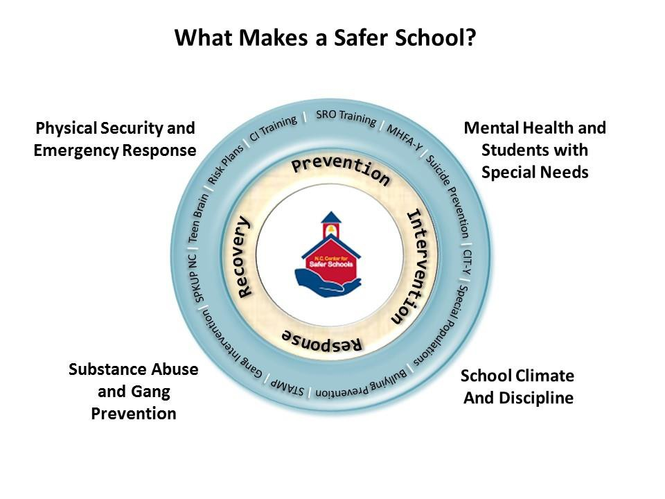

NC: A New Look At School Safety
Physical Security and Emergency Response
Critical Incident Response Training
SRO Training
School Risk Management System
Mental Health
Mental Health First Aid - Youth
School-Based Mental Health
Suicide Toolkit
School Climate & Discipline
Bullying & Cyberbullying
Anonymous Reporting for Students / SpkUp
Student Tutoring and Mentoring Program

Slide 3
SROs in Schools
Training
Sharing Information
Clear Expectations

Slide 4
WHAT IS NC DOING?
CRITICAL INCIDENT RESPONSE FOR SCHOOL FACULTY AND STAFF
This establishes a uniform response by schools all across the state.
Has ZERO impact on HOW law enforcement or first responders respond to critical incidents at the schools. Only changes what they may see once they are on-scene.

Slide 5
New Guiding Principals/Legislation
NC Schools need to have Threat Assessment Teams in place
  115C-105.60. Threat assessment teams.
School Resource Officers (SROs) need reporting and targeted required training
  115C-105.58 School resource officer reports.
  115C-105.59 School resource officer
System of accountability for schools to report on school safety initiatives
  115C-105.52A Facility vulnerability assessments
  115C-105.48 School safety definitions

Slide 6
New Guiding Principals/Legislation
Schools need to engage students in positive ways
  G.S. 115C-47 Peer- to- peer student support programs
School support staff need to be expanded and trained on mental health issues
  School Safety Grants Program SECTION 7.27
    Students in crisis
    Training to Increase School Safety
    Safety Equipment
    School mental health support personnel

Slide 7


Slide 8






  SS-ARS Framework
11_85
Crisis Center
Step 1: Submit
Youth or Adult (aka “Tipster”) submits a tip using the SS-ARS App, Website, or Telephone Hotline
Step 2: Process
Crisis Center triages, categorizes, and delivers the tip to the school team and/or dispatch
Step 3: Manage
School team and/or law enforcement assess the tip and intervene as needed
Sustained and Maintained
8

Slide 9

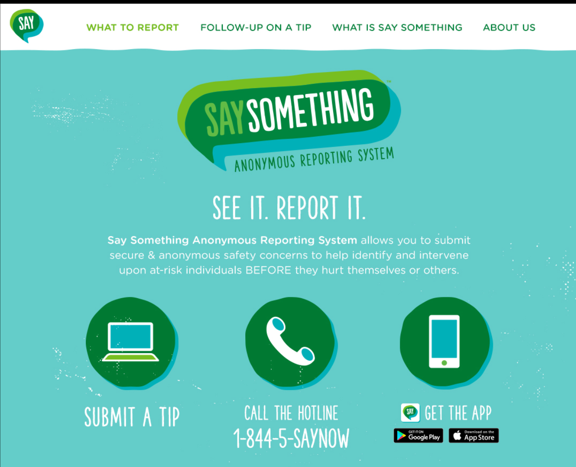

  Step 1: Tip Submission
11_85
Mobile
App
SaySomething.net
Website
24/7
Hotline
Step 1: Submit
Youth or Adult (aka “Tipster”) submits a tip using the SS-ARS App, Website, or Telephone Hotline
Every user MUST associate themselves with a school within the district in order to submit a tip
9

Slide 10
  Step 1: Sample Topics With Top 10 Ranking
11_85
Anger Issues (#7)
Animal Cruelty
Bullying / Cyber Bullying (#1)
Concern about an Adult
Cutting / Self-Harm (#2)
Depression / Anxiety (#5)
Domestic Violence / Child Abuse
Drug Use / Distribution (#4)
Eating Disorder
Gang Violence / Activity
Harassment / Intimidation
Hate Crime / Hate Speech
Hazing
Homeless / Runaway Student
Inappropriate Relationship
Intent to Harm Someone (#6)
Physical Abuse (#10)
Planned Fight / Assault (#8)
Planned School Attack
Reckless / Dangerous Behavior
Sexual Assault / Rape
Sexual Exploitation / Abuse
Sexual Harassment
Sharing Inappropriate Photos (#9)
Social Isolation / Withdrawal
Substance Abuse
Suicide / Suicide Ideation (#3)
Theft
Toxic / Abusive Relationship
Vandalism
Verbal Abuse
Weapon(s)
10

Slide 11
  Step 2: Tip Categorization
11_85
Tip classifications are also FLUID
~50% of life safety submitted tips are “down-graded” to non-life safety
~10% of non-life safety tips are “up-graded” to life safety
Re-categorizations are due to counselor triage and assessment, tipster submits new/updated information, and/or collaboration with the school team
Life Safety
Non-Life Safety
11

Slide 12
Reporting Rates
3-6% of students trained will submit a tip once on average during school year … Note: you will have a higher rate of tips in the first 30 days due to students just being trained and latent tips
Approximately 18-25% will be Life Safety Tips of which 10-15% will be very serious
Summer impact is average 88% of regular week over 9 week period
Hoax or false claims are less than ½ of 1% -- with most being in-actionable submissions such as “clowns have red hair”
12

Slide 13
  Step 3: Tip Disposition
11_85
School Team assesses, intervenes, and takes protective action per their respective policy, laws and procedures
Law enforcement involved on ALL life safety tips, especially outside of school hours. School can invite law enforcement in at any time for non-life safety tips.
School Team closes out tip documenting / dispositioning what actions were taken
Step 3: Manage
School team and/or law enforcement assess the tip and intervene as needed
13

