Slide 1
PowerTeacher Pro
for School Administrators

Slide 2
The purpose of this presentation is for School Administrators to gain perspective on the implementation and roll out of PowerTeacher Pro.
It is useful to understand how the application is set up at the district level as well as what is seen and used at the individual school level.
School Administrators in this case might not be the persons handling the administrative duties of setting up PowerTeacher Gradebook.
So, it is important to know what principals, assistant-principals and other school administrators can access and utilize in PowerTeacher Pro.

Slide 3
AGENDA
AGENDA
Standards Grading cont’d
View Imported Standards
View Configuring Standards Grade Preferences
View Configured Display Settings
Viewing at the School Level
Sections (gradebook type)
District Categories for Teachers
Traditional Grading Calcs & Prefs
Viewing a Teacher’s Gradebook
Current Year & Previous Years
Migrating PTG Data to PTPro
View Grade Scales
View PowerTeacher Pro (PTPro) District Setup / Settings
Default Gradebook Type
District Created Categories
Traditional Grading
View Traditional Grade Calculation Formulas
View Traditional Grade Preferences
Standards Grading
District Use of Standards

Slide 4
AGENDA
Standards Grading cont’d
View Imported Standards
View Configuring Standards Grade Preferences
View Configured Display Settings
Viewing at the School Level
Sections (gradebook type)
District Categories for Teachers
Traditional Grading Calcs & Prefs
Viewing a Teacher’s Gradebook
Current Year & Previous Years
Migrating PTG Data to PTPro
View Grade Scales
View PowerTeacher Pro (PTPro) District Setup / Settings
Default Gradebook Type
District Created Categories
Traditional Grading
View Traditional Grade Calculation Formulas
View Traditional Grade Preferences
Standards Grading
District Use of Standards

Slide 5
Viewing Grade Scales
Navigate: LEA > Grading: Grade Scales
Notes:
Navigate to LEA (under Setup)>Under Grading heading
PowerTeacher Pro Settings (will come back to later)
Go to Grade Scales
can districts copy DPI's NC10-pt scale to then create numeric scale for Elem, Mid, & High - so district can then create different "special Codes scales" for each level. OR is DPI pushing out the only Special codes for Districts to use?

Slide 6
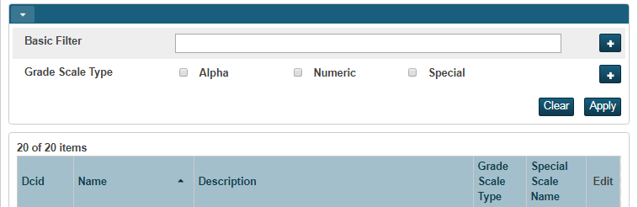
Viewing Grade Scales
Notes:
GRADING> -grade scales -
One big change - all previous versions had one type : Alpha Scale - problem is with that grade scale - they had extra items/codes like W withdraw, INC incomplete, WP, WF etc. The problem is that they assume a 0 (zero) grade value. When teachers assigned a 0 (zero) grade value the system was confused as to which grade/or code to assign.
PTPro now also has numeric scale AND special codes scale - Special codes scale is to be attached to your main scale such as Numeric
Class creates a Grade Scale for Traditional Grades
Does this scale use special codes? Can’t add yet because we need to still create a special codes scale (generate table for) and then come back and attach it here
Choose starting number of colors: most colors is 5 (if more grade items - more than one item can have the same color)
-DCID number is on left (internal ID number) for standards

Slide 7
Alpha Grade Scale
Notes:
Add description as needed
-teacher gradebook values (if the item is checked, then yes the teacher can use this scale to grade)
-In High School you SHOULD NOT mark with the grade value
Gradebook Cutoff% & Values - read VERTICALLY
Cutoff % - teachers give grades in gradebook as percentages
Values = teachers give alpha grades in gradebook A, B, F, etc - tells the system if I give a student a C calculate it as 75 (problematic for secondary schools)
-color level is set by users -- they assist in identifying student levels quickly

Slide 8
Numeric Grade Scale
As long as people are still using the Java based gradebook (PTG), Conversions need to be set up (Standards)
If using PTPro and are moving from standards to traditional grading, Conversions need to be set up.
Notes:
Set descriptions
-as long as ppl are using Java, we do need the conversion set up
-in Pro if they are going from standards to traditional, we will still need a conversion set up.
All existing conversion scales have automatically been converted to grade scales with the upgrade to PS 10.x

Slide 9
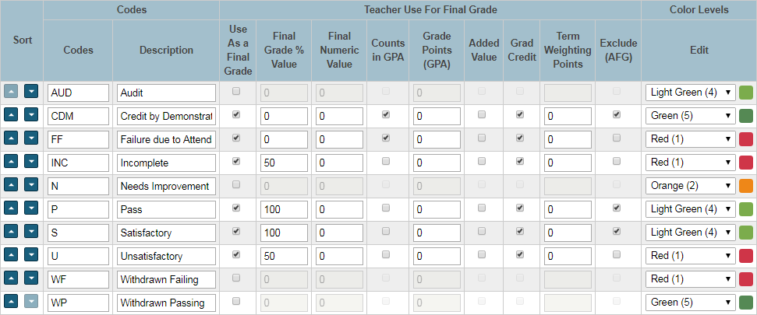
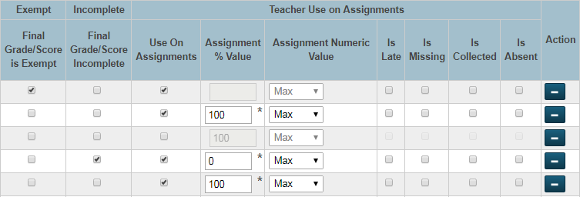
Special Codes Scale
Notes:
After generating the table, this is the next step
-can sort into order
-can add description
-Don't just add tag (late, missing, etc) unless you are giving it a value - PTPro works on values
-Enter a Final Grade Values for those codes used for Final Grade
-On numeric scale - you do not have to enter a final numeric value but it won't hurt if you do, ... check as need -->does it count in GPA? using Added value? Grad Credit?
-ex: withdraw is not in use on assignments so you will uncheck it.
-not handed in would be missing
-normally don’t change grading scale during the school year

Slide 10
Apply Special Codes Scale to the Regular Scale

Slide 11
AGENDA
AGENDA
Standards Grading cont’d
View Imported Standards
View Configuring Standards Grade Preferences
View Configured Display Settings
Viewing at the School Level
Sections (gradebook type)
District Categories for Teachers
Traditional Grading Calcs & Prefs
Viewing a Teacher’s Gradebook
Current Year & Previous Years
Migrating PTG Data to PTPro
View Grade Scales
View PowerTeacher Pro (PTPro) District Setup / Settings
Default Gradebook Type
District Created Categories
Traditional Grading
View Traditional Grade Calculation Formulas
View Traditional Grade Preferences
Standards Grading
District Use of Standards

Slide 12
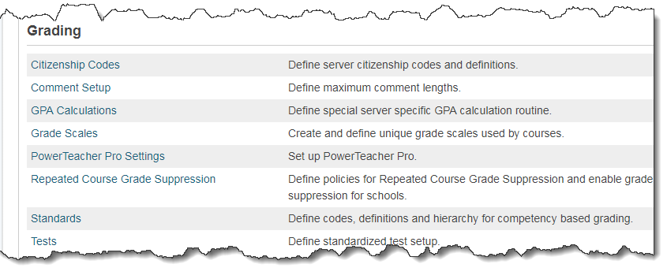
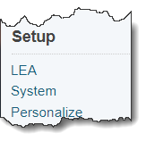
Notes:
District > Power Teacher Pro Settings ….
Gradebook Setup -- Default Gradebook Type (talk more about it at the school level later)
District Settings --- School can trump District , and Teachers can trump both School and District ---- is Okay.
Click on a School to open info ----

Slide 13
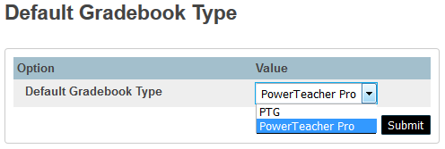
PowerTeacher Pro Settings
CAUTION!: Set this to PTG if you still have teachers in both gradebook types
Notes:
-will default to PTG in 10 - in SECTIONS table (WILL TALK MORE ABOUT THIS AT THE SCHOOL LEVEL→ In course sections)
-In PS10x - There is a New field in Sections Table called GradebookType
-Setting this will force any NEWLY created sections to use this default gradebook type.
-Existing sections will have to have the new field in the Sections table modified to the gradebook each section is going to use.
-Can be done in Mass using DDA Sections Table : GradebookType
PTG = 1
PowerTeacher Pro = 2
Submit

Slide 14
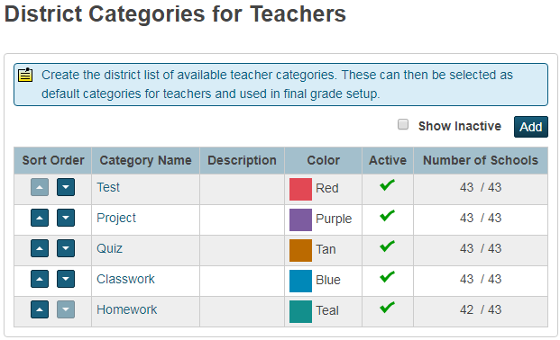
View District Categories
Navigate: LEA > PowerTeacher Pro Settings > District Categories for Teachers
Schools can:
View the district created categories
Manage district categories to turn them on/off
Schools CANNOT change properties of the district categories.
In PTPro, teachers see a house next to the district created categories.
Do not have to ‘push’ all categories to all schools
Notes:
Schools can view the district created categories
They can NOT change anything about these however, they can ‘uncheck’ one or more of them and not use them.
They can manage categories to turn them on/off
Go BACK to District -- PowerTeacher Pro Settings -- District Categories for Teachers

Slide 15
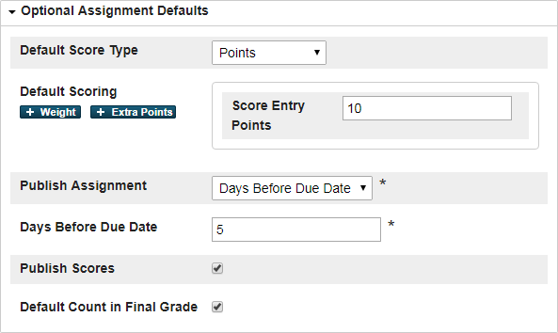
View District Category Optional Defaults

Slide 16
Calculation Method for Categories
i.e. Q1 = (Tests (40%) + Quiz (20%) + Homework (20%) + Classwork (20%))
Also pushing out calculation methods using the categories
?
District pushing out categories
?
Yes
Yes
No
Notify teachers that district categories AND the calculations so they will use those categories.
No
School will make categories.
Notify teachers that district categories are not included in calculation methods.
Notes:
Districts don’t have to push out categories - District decision
If district deletes category, then it becomes a teacher category therefore a teacher can modify
If pushing out a calculation method for Categories - you have to push out categories and notify teachers
Problem - if district pushes out a calculation for classwork but then the teacher creates a category call daily work and uses it instead, then teacher’s category is NOT included in the calculation - that is why teacher’s must be notified if District is setting up calculation methods on categories.

Slide 17
AGENDA
AGENDA
Standards Grading cont’d
View Imported Standards
View Configuring Standards Grade Preferences
View Configured Display Settings
Viewing at the School Level
Sections (gradebook type)
District Categories for Teachers
Traditional Grading Calcs & Prefs
Viewing a Teacher’s Gradebook
Current Year & Previous Years
Migrating PTG Data to PTPro
View Grade Scales
View PowerTeacher Pro (PTPro) District Setup / Settings
Default Gradebook Type
District Created Categories
Traditional Grading
View Traditional Grade Calculation Formulas
View Traditional Grade Preferences
Standards Grading
District Use of Standards

Slide 18
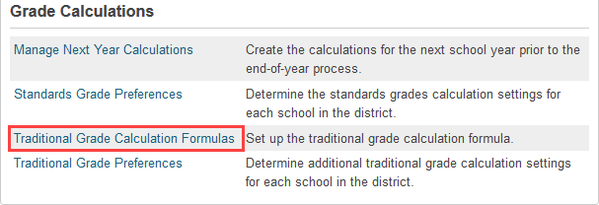
View Traditional Grade Calculation Formulas
Navigate: LEA > Grading: PowerTeacher Pro Settings > Gradebook Calculations: Traditional Grade Calculation Formulas
Currently Formulas are only pushed to Entire School
Notes:
NC has mandated formulas
Future - can push out formula to Departments, individual courses and grade levels (not in v11)
NOTE: NC mandates the NC 10-Point Scale as the only scale available for high schools - as far as GPA calculations go.

Slide 19
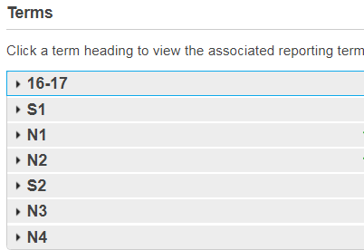
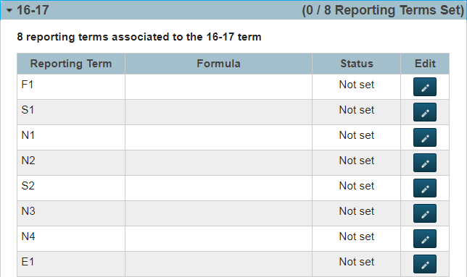
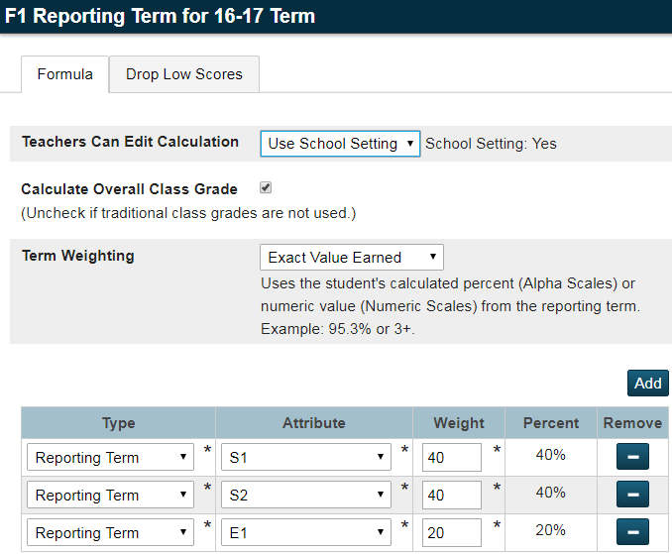
Year long classes
Year long classes
Semester classes that meet just S1
Click the Pencil to the right
Nine week classes that meet just N1
Yr long class - S1 grade calc
Yr long class - 1st 9 week calc
Notes:
-can see the reporting terms in this scheduling term
-click edit to edit terms
If nothing is set up for the formula, it will default to total points
-add additional types for ex:
Can lock down by term level - ie - District can lock down final grade term to calculate S1 & S2, and also not lock down quarter terms - with Categories
Teachers Can Edit Calculation - Don’t forget about the drop down options
Standards attribute can have MEAN - it is appropriate here
New options - if you want to use them - you must go to LEA and set it at the course
Specific Weighting
Specific Sum
Weighting Categories - PTPRo will recalculate accordingly if a teacher does not use one of the categories set up (such as Project). (In NC some districts do mandate that all categories be used)
-fill the options but DO NOT submit --- go to ‘Drop Low Scores’ tab

Slide 20
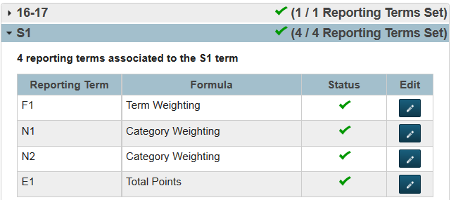
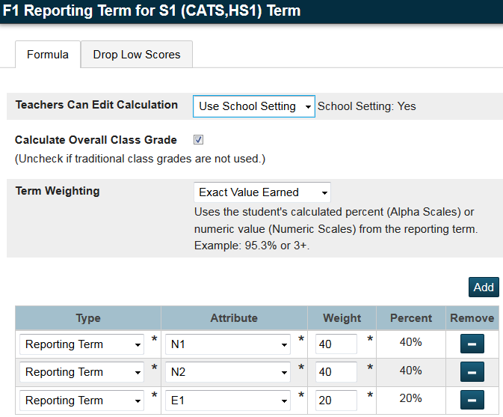
Semester 1 Classes Calculations
Notes:
-when adding schools you may have to override the current formula
-leave the calculate overall class grades checked
-setting up Term weighting - the Term Weighting Drop Down - has Exact Value Earned - use that UNLESS you are an IB school then use Term Weighting Points

Slide 21
Allow Teachers to Drop Low Scores
Notes:
Here do standards in the quarter
-can set up the “drop the lowest scores” It is not recommended to set this up at the beginning of the term. Advise teachers this is optional to set up at the end of the term, then recalculate the gradebook grades.
-can lock if teachers do not edit “drop low scores”

Slide 22
Viewing Traditional Grade Preferences
Navigate: District > Grading: PowerTeacher Pro Settings > Grade Calculations: Traditional Grade Preferences
Allows you to see all the schools settings at a quick glance
Notes:
Click high school name

Slide 23
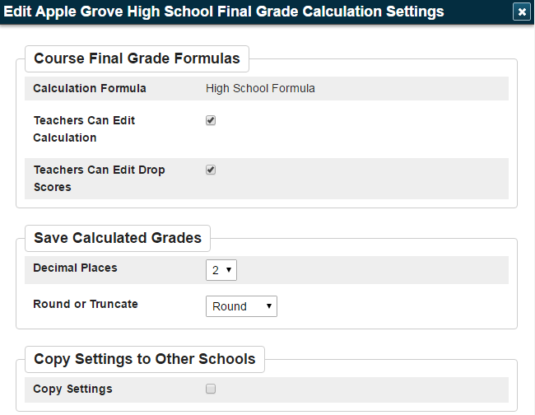
Setting up Traditional Grade Preferences
After clicking on a school link ----
These are the preference options that can be edited
Notes:
General “preference” for traditional grade calculations for a specific school

Slide 24
AGENDA
AGENDA
Standards Grading cont’d
View Imported Standards
View Configuring Standards Grade Preferences
View Configured Display Settings
Viewing at the School Level
Sections (gradebook type)
District Categories for Teachers
Traditional Grading Calcs & Prefs
Viewing a Teacher’s Gradebook
Current Year & Previous Years
Migrating PTG Data to PTPro
View Grade Scales
View PowerTeacher Pro (PTPro) District Setup / Settings
Default Gradebook Type
District Created Categories
Traditional Grading
View Traditional Grade Calculation Formulas
View Traditional Grade Preferences
Standards Grading
District Use of Standards
Notes:
When we went to PS10 - Standards automatically went to the new version

Slide 25
District Importing of Standards
Just because the District imports Standards does NOT mean every school has to use them
Standards can NOT be edited (as per DPI Curriculum and Instruction)
Behavioral type standards are the only additional standards that can be created and used by individual district and/or school - but they have to be added in their own ‘domain’ (not in other content area standards)
-----------------------------------
Districts wanting to begin using Standards:
A long initial process beginning with much discussion with curriculum - at school and district levels
DPI curriculum is always available for assistance as needed
Importing of the Standards is the result of roll-out decisions

Slide 26
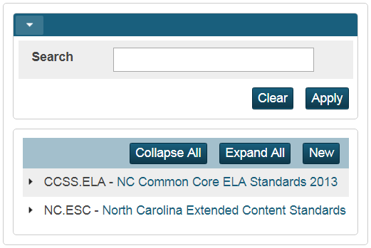
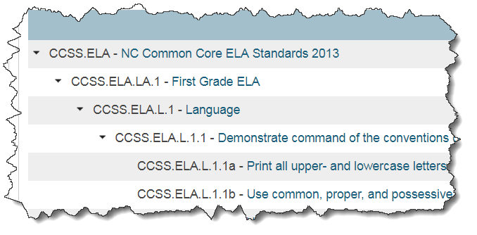
Viewing Imported Standards
Navigation: LEA > Under Grading > Standards > List Standards
Click the ‘triangle’ to open the hierarchy

Slide 27
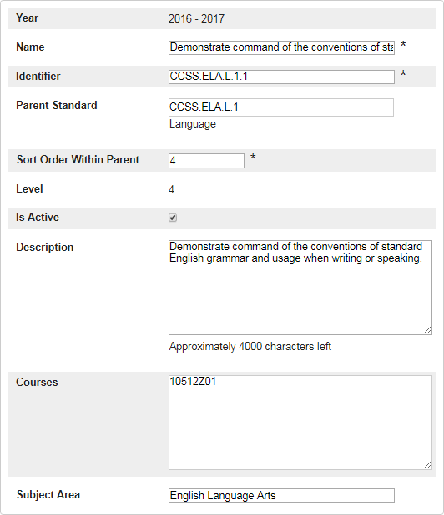
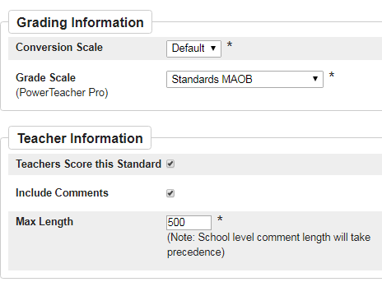
Viewing Imported Standards
Navigation: LEA > Under Grading >
Standards > List Standards
Click the Name (which is a link) to open definition of the standard

Slide 28
Sort Order Within Parent / Level
Navigation: LEA > Under Grading >
Standards > List Standards
Sort order 2
Sort order 3
Sort order 5
This sort order works with the option ‘Auto-calculate’ which rolls up the lower level standards into the upper level standards (using whichever metric is chosen by district).
A decision must be made by the district as to what level standard wants to be displayed on the North Carolina Standards Based Report Card.
If nothing is auto-calculated, then the teachers MUST ensure a grade is entered into the level standard that will be printed on the report card.

Slide 29
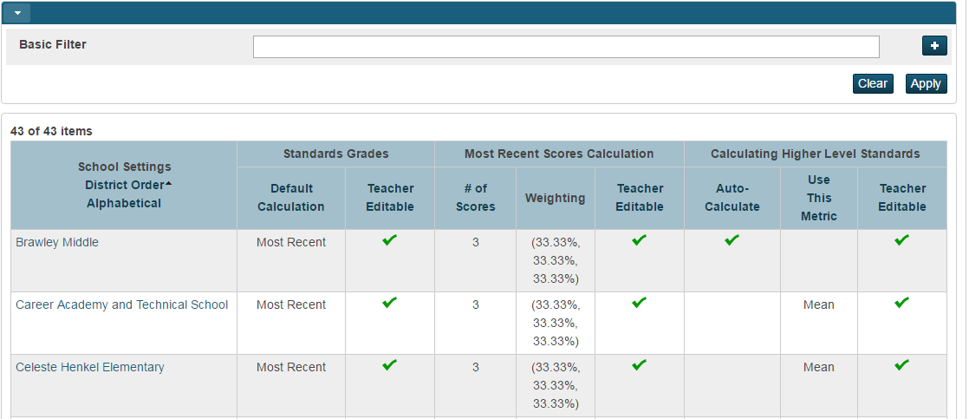
Viewing Standards Grade Preferences
Navigate: District > Under Grading: PowerTeacher Pro Settings > Under Gradebook Calculations: Standards Grade Preferences
Allows you to see all the schools settings at a quick glance
Notes:
Click on elementary School name

Slide 30
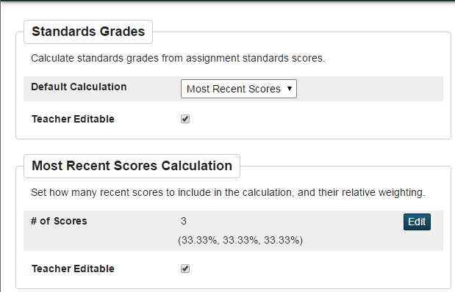
View Standards Grade Pref cont’d
Most Recent Scores: Student learning culminated over time
Mean: Average of the scores
Median: Throw out high and low scores
Mode: Most frequently occurring score
Weighted: High-point assignments count more
Highest: Best for performance assessments
None: No default - a case-by-case method
Notes:
Should NOT have the ‘Mean’ as the default calculation at the highest level of Standard which means take the ‘average’ of the assignment standard scores (the top portion of this page) … using the average is not the concept of Standards Based Grading.
It’s okay however to have the ‘mean’ of the lower level standards calculate up to the higher standards (the bottom portion of this page)

Slide 31
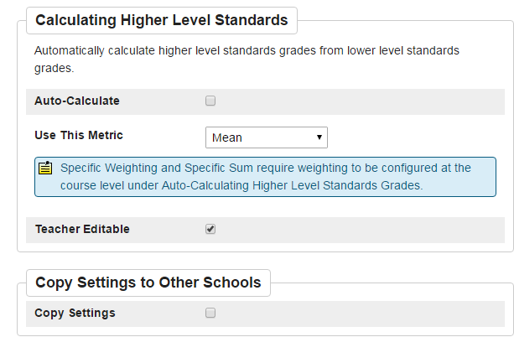
View Standards Grade Pref cont’d
Have the ability to auto-calculate higher level standards grades from lower level standards grades. Otherwise, teachers’ use their professional judgement and enter a grade for the higher level standard based on looking at lower level standards.
Note: PowerSchool determines which parent standards are auto-calculated based on the course records (see next slide)
Notes:
Should NOT have the ‘Mean’ as the default calculation at the highest level of Standard which means take the ‘average’ of the assignment standard scores (the top portion of this page)
It’s okay however to have the ‘mean’ of the lower level standards calculate up to the higher standards

Slide 32
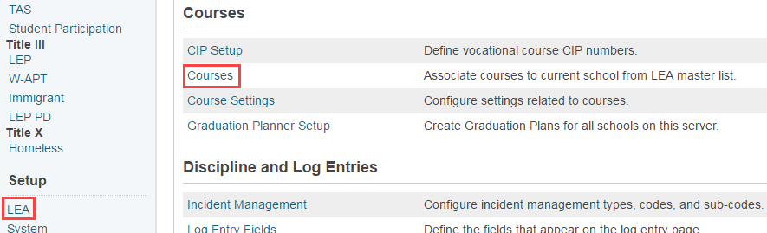
View District Standards at the Course Level
Navigate: LEA > Courses
Search for and select a course and click ‘District - Standards’ tab
Notes:
Go back to District setup → Courses → Filter Course Name by ‘NC Math 1’
Select a NC Math course that has Standards attached

Slide 33
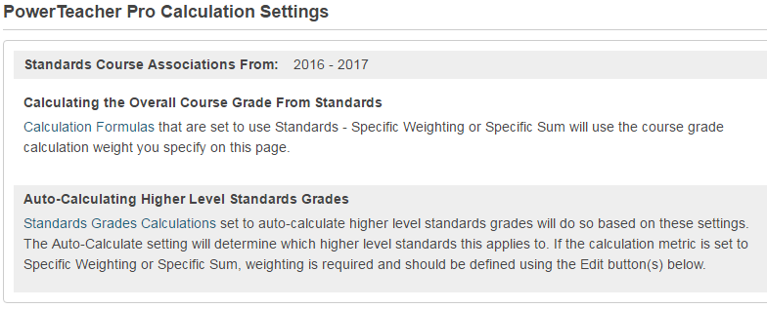
District-Standards Tab- Two Sections
Section 1
Notes:
Can set up district standards (a lot of work)
-will ‘auto calculate” if a higher level is needed
-can edit

Slide 34
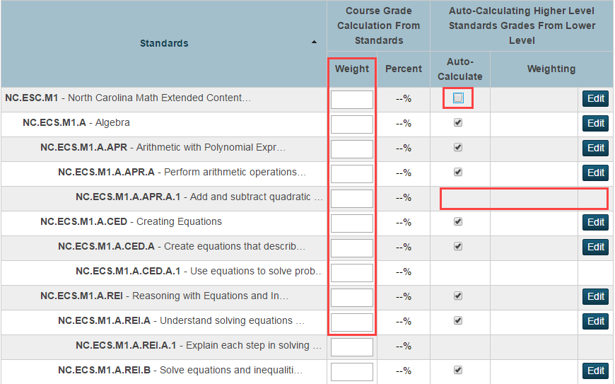
Section 2
Only use the weights if the metric chosen is ‘Specific Weighting’ or ‘Specific Sum’
Notes:
Point out how to read the fields on the screen (i.e. the auto-calculate, the Weighting etc…),
and why there are not Auto-Calc and Weighting for some standards [because they are the ‘children’ and have nothing rolled up to them … they are the ‘smallest entity standard’
When editing, the scores will adjust
-can add weights to standards

Slide 35
AGENDA
AGENDA
Standards Grading cont’d
View Imported Standards
View Configuring Standards Grade Preferences
View Configured Display Settings
Viewing at the School Level
Sections (gradebook type)
District Categories for Teachers
Traditional Grading Calcs & Prefs
Viewing a Teacher’s Gradebook
Current Year & Previous Years
Migrating PTG Data to PTPro
View Grade Scales
View PowerTeacher Pro (PTPro) District Setup / Settings
Default Gradebook Type
District Created Categories
Traditional Grading
View Traditional Grade Calculation Formulas
View Traditional Grade Preferences
Standards Grading
District Use of Standards

Slide 36
View Configured Display Settings
Navigate: District > Grading: PowerTeacher Pro Settings > Display Settings
Notes:
Similar to PT Admin
School can trump District , and Teachers can trump both School and District ---- is Okay.
Click School name

Slide 37
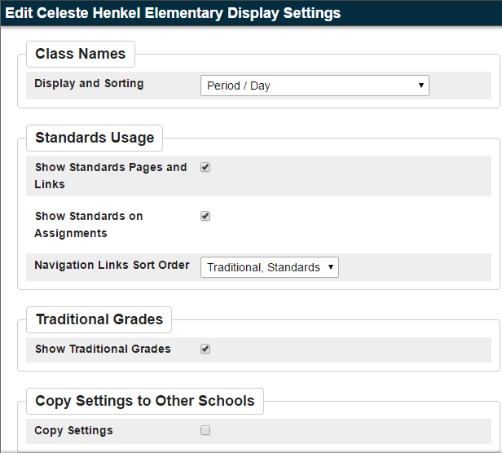
View Configured Display Settings cont’d
Teachers can change these display settings

Slide 38
Let’s go to School ….
… level, and look at Sections and PowerTeacher Pro Settings
Notes:
Switch to School>School Setup>Grading: PowerTeacher Pro Settings
Display Settings (schools can change display settings and work with the district categories….YES my school uses this category however cannot modify name, color, description)

Slide 39
AGENDA
Standards Grading cont’d
View Imported Standards
View Configuring Standards Grade Preferences
View Configured Display Settings
Viewing at the School Level
Sections (gradebook type)
District Categories for Teachers
Traditional Grading Calcs & Prefs
Viewing a Teacher’s Gradebook
Current Year & Previous Years
Migrating PTG Data to PTPro
View Grade Scales
View PowerTeacher Pro (PTPro) District Setup / Settings
Default Gradebook Type
District Created Categories
Traditional Grading
View Traditional Grade Calculation Formulas
View Traditional Grade Preferences
Standards Grading
District Use of Standards

Slide 40
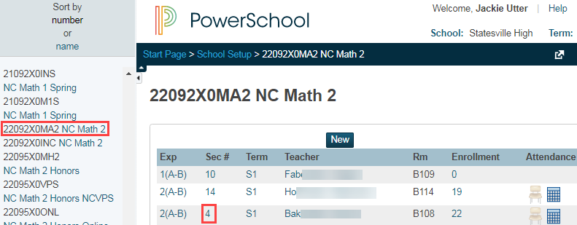
View ‘Gradebook Type’ field at the Section Level
Navigate: School: Setup > School > Scheduling: Sections > Course > Click a section to open it up
Notes:
-School..sections..pick section..

Slide 41
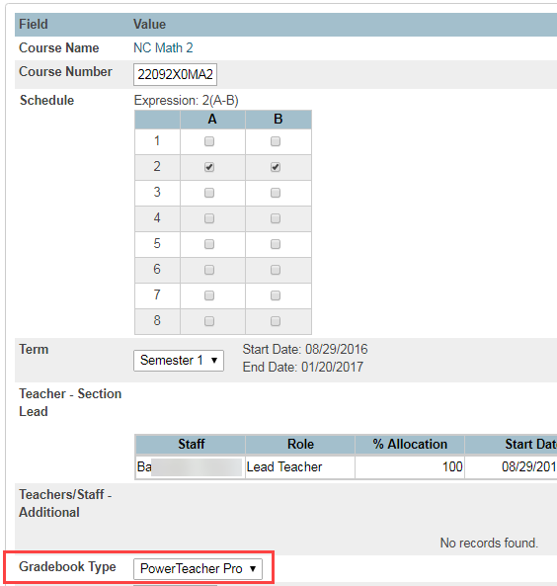
Section record opened
Choice of ‘PowerTeacher Pro’ or ‘PTG’ (old PowerTeacher Gradebook)
Once you go Pro - there is no going back!
Not required to have all sections in the school migrate to PTPro at one time ....
Notes:
Change gradebook type
-one you go Pro, CANNOT go back to PTG
-migration can only happen once and only migrates 1 year of information - the rest stay in PTG
-must have assignments in the year
-PTP needs to be blank (teachers can only be in 1 grade book at a time)
-in DDA you can update all sections at 1 time

Slide 42
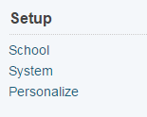
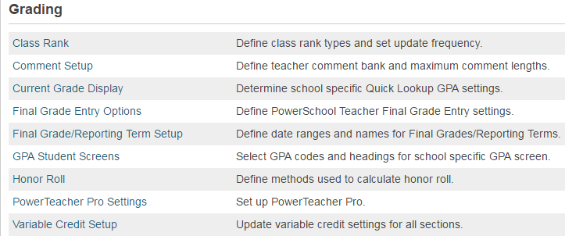
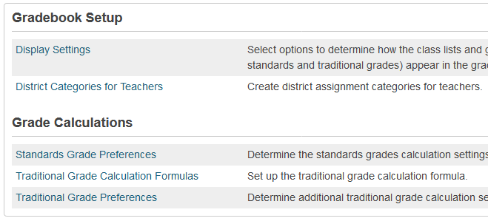
View District Categories for Teachers
Navigate: Change to School: Setup > School > Grading > PowerTeacher Pro Settings

Slide 43
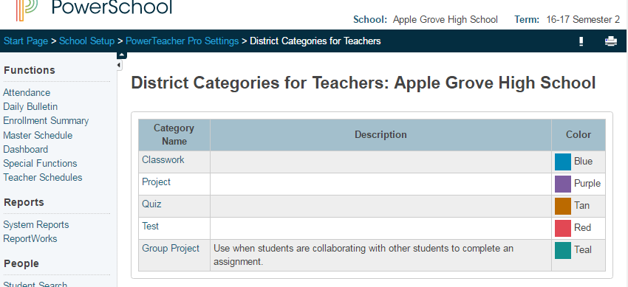
View District Categories for Teachers
Navigate: Change to School level: School > Under Grading > PowerTeacher Pro Settings > Under Gradebook Setup> District Categories for Teachers
Notes:
District level pushes out the categories. Teachers can create a category however IF this district has pushed out categories, they should use the district categories to be included in final grade calculation. Meaning a teacher is not to use their own test category if the district has a test category.

Slide 44
Traditional Grade Calculation Formulas
Navigate: Change to School level: School > Under Grading > PowerTeacher Pro Settings > Under Grade Calculations> Traditional Grade Calculation Formulas

Slide 45
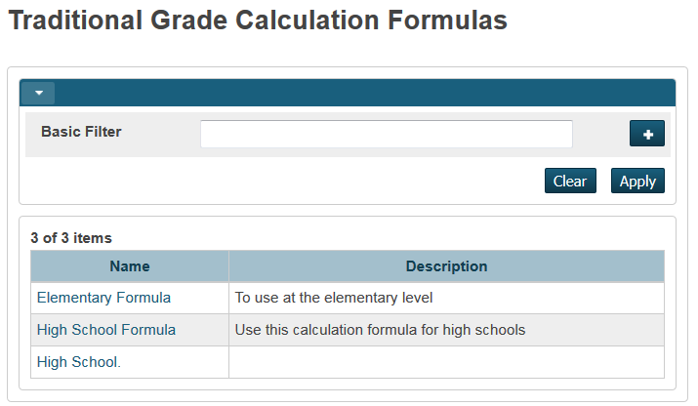
Traditional Grade Calculation Formulas cont’d
View a formula created at the district level.
What does a school see?
What can a school change?
What can a school NOT change?
Notes:
School, gradebook, PTP settings
Open a High School formula

Slide 46
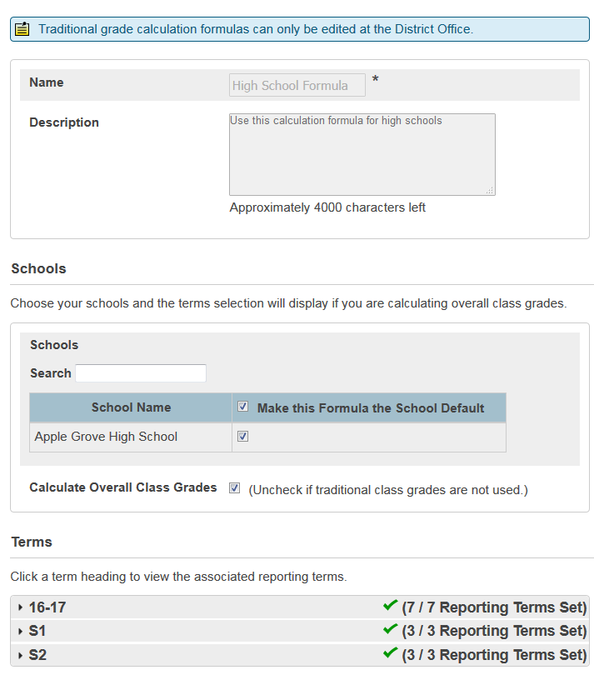
Viewing High School Formula
What’s editable?
Nothing!
(if it is locked down by the district)
A local decision!

Slide 47
Traditional Grade Preferences
Navigate: Change to School level: Setup > School > Grading > PowerTeacher Pro Settings > Grade Calculations: Traditional Grade Preferences

Slide 48
Traditional Grade Preferences

Slide 49
AGENDA
Standards Grading cont’d
View Imported Standards
View Configuring Standards Grade Preferences
View Configured Display Settings
Viewing at the School Level
Sections (gradebook type)
District Categories for Teachers
Traditional Grading Calcs & Prefs
Viewing a Teacher’s Gradebook
Current Year & Previous Years
Migrating PTG Data to PTPro
View Grade Scales
View PowerTeacher Pro (PTPro) District Setup / Settings
Default Gradebook Type
District Created Categories
Traditional Grading
View Traditional Grade Calculation Formulas
View Traditional Grade Preferences
Standards Grading
District Use of Standards

Slide 50
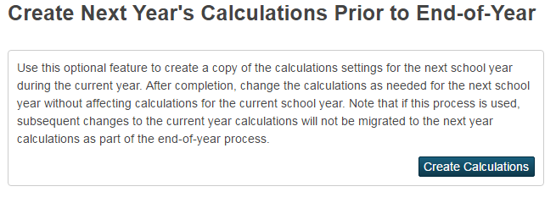
Managing Next Year’s Calculations
Similar to getting next year’s schedule ready while in current year - can get next year’s calculation settings ready for next year while in current year (next year ‘Years and Terms’ must have already been created
Will not have any effect on current calculations
In a “bubble” to protect current year calculations
Good time for discussion of ‘lessons learned’ from current year calculations!

Slide 51
Administrators Viewing Teachers PTPro Gradebook Current Year and Previous Years
PowerTeacher Pro
VIEW ONLY
And
Migrating Data

Slide 52
Viewing a Teachers’ PowerTeacher Pro Gradebook
A ‘security role’ must be created
This role must be assigned to your account in PowerSchool (for all schools that you require PTPro view access)
2 ways to get into PTPro with view only permissions
From Teacher Schedules
Navigate to ‘Teacher Schedules’
Click on a teacher name (a link to their classes page)
Click ‘PowerTeacher Pro’ button
From Teacher Record
On the Start page, click the ‘Staff’ tab
Search for and open a teacher record
On the left navigation bar, click ‘PowerTeacher Pro’
Notes:
Teacher will EVENTUALLY see some type of notification / alert if Admin has been in PTPro

Slide 53
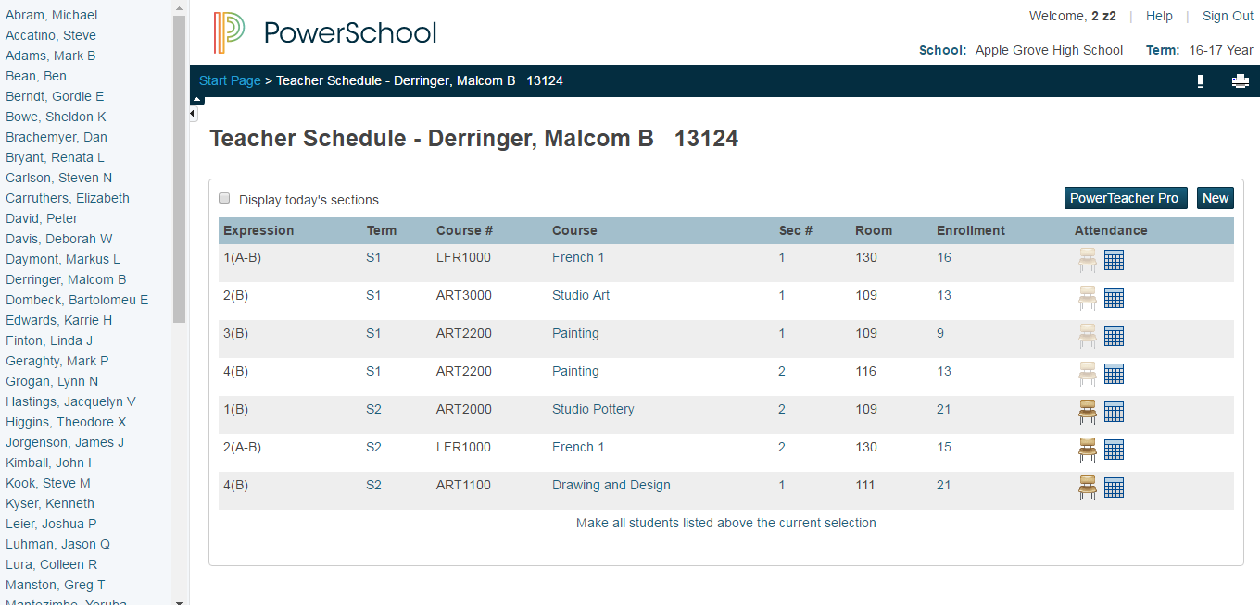
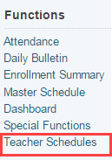
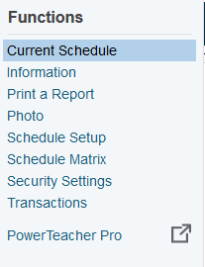
Both Methods for Finding PTPro View Links
or
Navigate: Change to School Level > Start Page > Teacher Schedules > Select a Teacher> Click PowerTeacher Pro to launch gradebook
Navigate: Change to School Level > Start Page > Staff tab > Search for and open a staff record > Under Functions - Click PowerTeacher Pro to launch gradebook
Notes:
Note: pop-up windows will open - they are html and not constricted to pop-up blockers

Slide 54
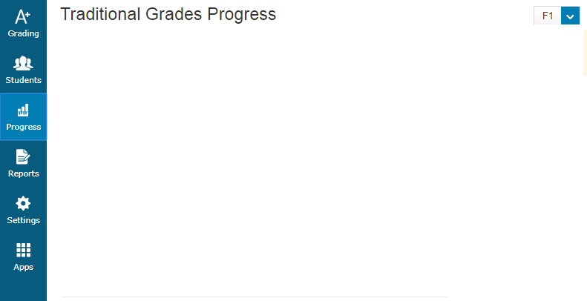
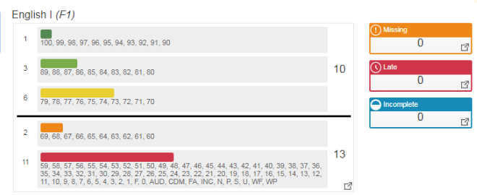
What’s New to See Inside a PTPro Gradebook
The Progress Charm ! Traditional Grades Distribution by Class
Nbr students passing vs failing
Click to see details
Nbr students in each grade range

Slide 55
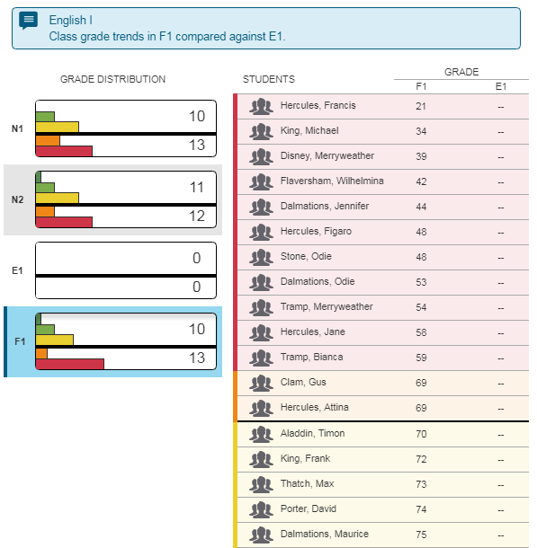
What’s New to See Inside a PTPro Gradebook
The Progress Charm ! Traditional Grades Distribution by Class

Slide 56
What’s New to See Inside a PTPro Gradebook
The Progress Charm ! Traditional Grades Distribution by Class

Slide 57
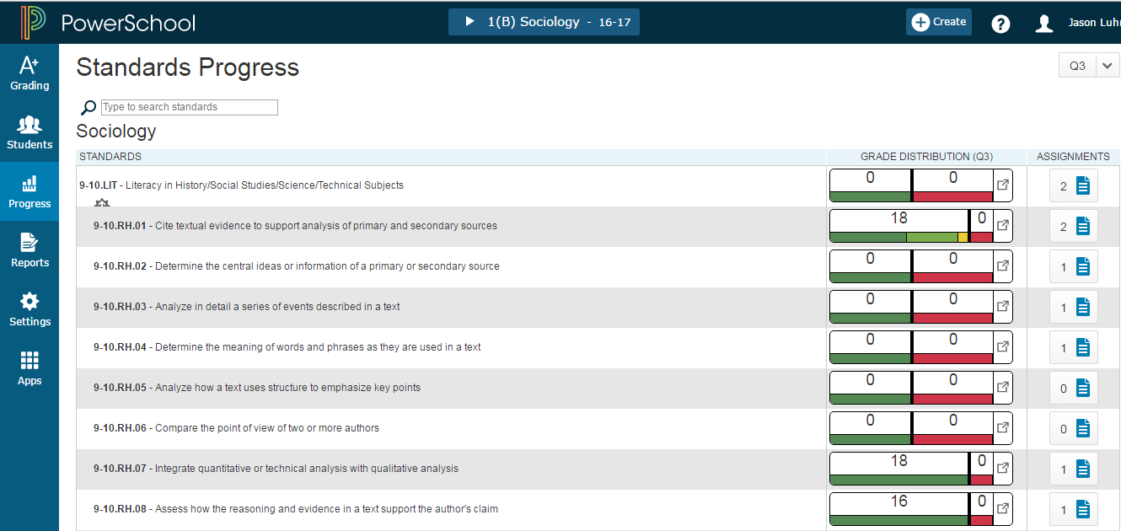
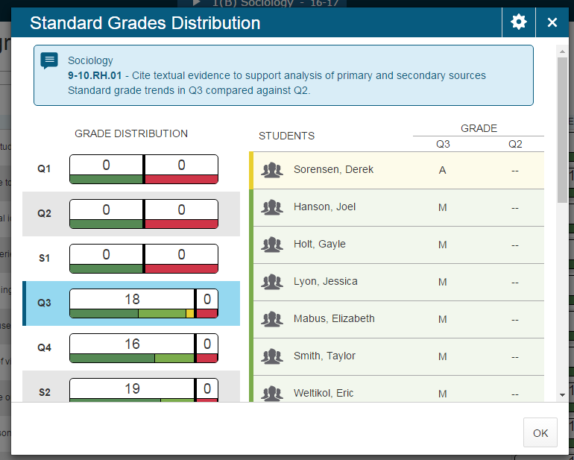
What’s New to See Inside a PTPro Gradebook
The Progress Charm ! Standards Grades Distribution for a Class

Slide 58
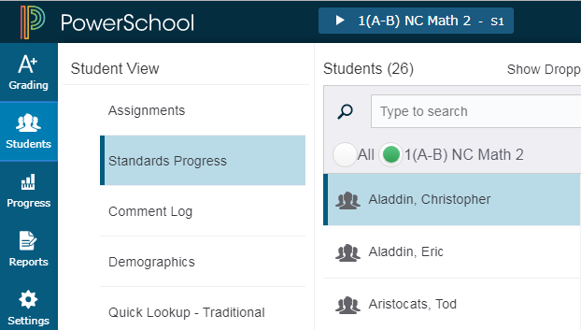
Standards Progress for a Student
Click Nbr of Assignments to see details
Professional Judgement Indicator

Slide 59
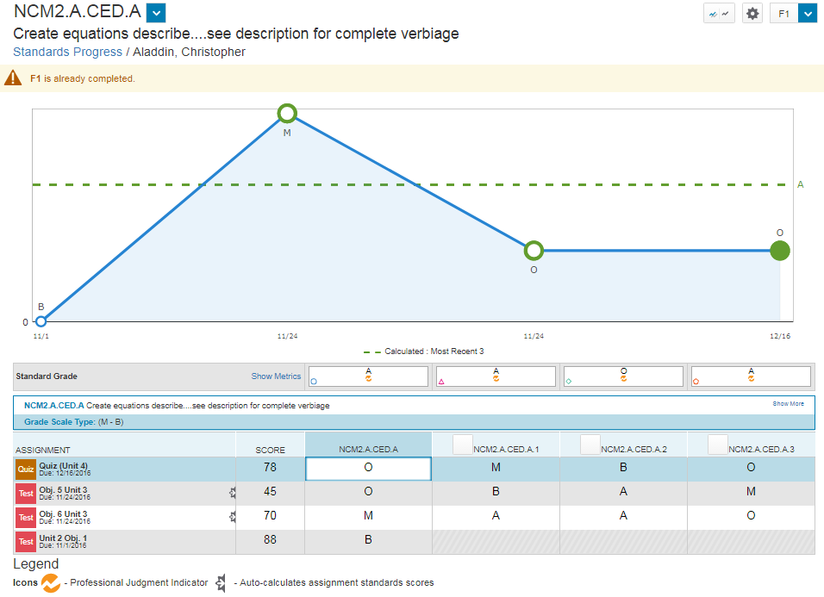
Standards Progress for a Student

Slide 60
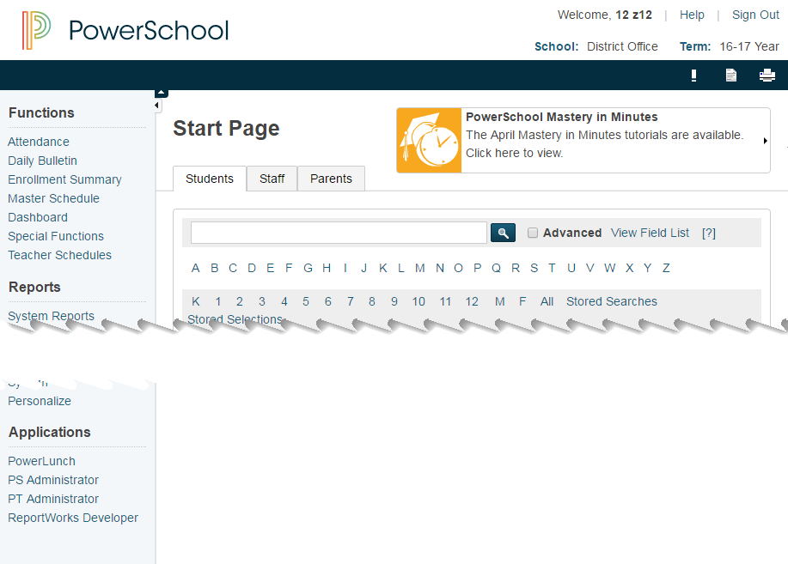
Viewing Previous Years’ PTG Gradebook Data
Goes to Java-based Gradebook (PTG)
In view only mode
Notes:
PT Administrator (Navigation blue bar - side bar) goes to Java gradebook …. This will not go away [for viewing old gradebook information]
District, Under Grading goes to PTPro Settings

Slide 61
AGENDA
Standards Grading cont’d
View Imported Standards
View Configuring Standards Grade Preferences
View Configured Display Settings
Viewing at the School Level
Sections (gradebook type)
District Categories for Teachers
Traditional Grading Calcs & Prefs
Viewing a Teacher’s Gradebook
Current Year & Previous Years
Migrating PTG Data to PTPro
View Grade Scales
View PowerTeacher Pro (PTPro) District Setup / Settings
Default Gradebook Type
District Created Categories
Traditional Grading
View Traditional Grade Calculation Formulas
View Traditional Grade Preferences
Standards Grading
District Use of Standards

Slide 62
Data Migration
Only ONE year of PTG data can be migrated to PowerTeacher Pro
However, District(s) can decide to not allow ANY PTG data migrated - essentially, starting from a clean slate
Certain conditions need to be met in order
to successfully migrate assignment data into PTPro
The GradebookType field is set to Powerteacher Pro for section(s) for the current year
No assignments exist in PowerTeacher Pro
At least one assignment must exist in PTG for current year
If the above conditions are met, the first time a teacher launches PTPro, a Migrate Data to PowerTeacher Pro screen appears
Notes:
*Final grade calculations DO NOT migrate
Section readiness report coming this summer.

Slide 63
Migration - What Data is NOT Migrated
Custom grade scales
Score codes
Calculation settings
Content Links
Teacher-defined student fields
NOTE: If a co-teacher launches PTPro before the lead teacher, all classes in which the co-teacher can edit will be migrated.

