Slide 1
PowerTeacher Pro Training
Admins
PPT: http://bit.ly/NCDPI_PTP_Admin

Slide 2
Welcome and Introductions
NCDPI - Home Base Professional Learning Team
Cami Narron cami.narron@dpi.nc.gov
Tiffany Kinney Tiffany.kinney@dpi.nc.gov
Jackie Utter Jacqueline.Utter@dpi.nc.gov
PowerSchool/Homebase Business & Function
Doris Kitts doris.kitts@dpi.nc.gov

Slide 3
AGENDA
Creating Grade Scales
Setting Up PowerTeacher Pro
Setting PowerTeacher Pro as the Default Gradebook
Setting Up District Grading Preferences
Creating District Categories for Teachers
Creating Traditional Grade Calculation Formulas
Setting Up Traditional Grade Preferences
Setting Up District Grading Preferences
Configuring Standards Grade Preferences
Configuring Display Settings
School Level
PowerTeacher Pro Settings
District Categories for Teachers
Standards Grade Preferences
Traditional Grade Calcs & Prefs
District Level
Managing Next Year’s Calculations

Slide 4
AGENDA
Creating Grade Scales
Setting Up PowerTeacher Pro
Setting PowerTeacher Pro as the Default Gradebook
Setting Up District Grading Preferences
Creating District Categories for Teachers
Creating Traditional Grade Calculation Formulas
Setting Up Traditional Grade Preferences
Setting Up District Grading Preferences
Configuring Standards Grade Preferences
Configuring Display Settings
School Level
PowerTeacher Pro Settings
District Categories for Teachers
Standards Grade Preferences
Traditional Grade Calcs & Prefs
District Level
Managing Next Year’s Calculations

Slide 5
Creating Grade Scales
Navigate: LEA > Grading: Grade Scales
Notes:
Navigate to LEA (under Setup)>Under Grading heading
PowerTeacher Pro Settings (will come back to later)
Go to Grade Scales
can districts copy DPI's NC10-pt scale to then create numeric scale for Elem, Mid, & High - so district can then create different "special Codes scales" for each level. OR is DPI pushing out the only Special codes for Districts to use?

Slide 6
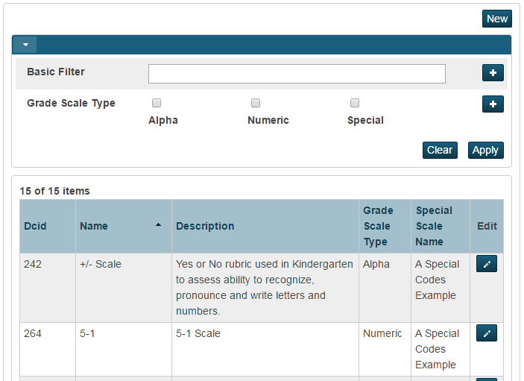
Grade Scales
Notes:
GRADING> -grade scales -
One big change - all previous versions had one type : Alpha Scale - problem is with that grade scale - they had extra items/codes like W withdraw, INC incomplete, WP, WF etc. The problem is that they assume a 0 (zero) grade value. When teachers assigned a 0 (zero) grade value the system was confused as to which grade/or code to assign.
PTPro now also has numeric scale AND special codes scale - Special codes scale is to be attached to your main scale such as Numeric
Class creates a Grade Scale for Traditional Grades
Does this scale use special codes? Can’t add yet because we need to still create a special codes scale (generate table for) and then come back and attach it here
Choose starting number of colors: most colors is 5 (if more grade items - more than one item can have the same color)
-DCID number is on left (internal ID number) for standards
-click “New”

Slide 7
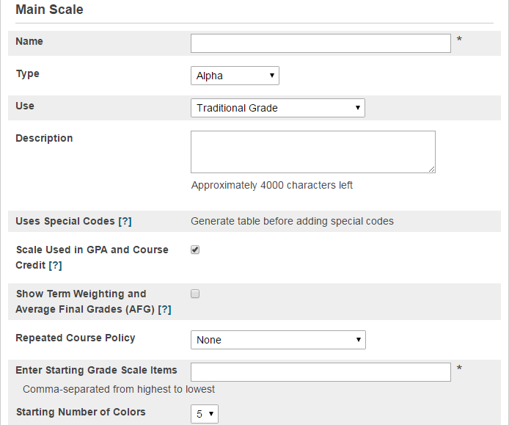
Alpha
Numeric
Special Grades
Traditional Grade
Standards
Traditional Grade and Standards
Notes:
-now a numeric value is no longer needed to be associated with grades
-now you can have alpha or numeric without special codes (W, Inc, Not assessed) these will exist in special codes
-will have a grade scale and a special codes scale for additional marking (Special codes only speak to PTP; PTG (Java version) will not allow this functionality)
- Activity - Create all 3 types of grade scales - starting with traditional alpha scale.
Note: the ‘Show Term Weighting and Average Final Grades (AFG)’ box -- Is a LEA decision to show or not show. (we did not check this during training)

Slide 8
Alpha Grade Scale cont’d
Notes:
Add description as needed
-teacher gradebook values (if the item is checked, then yes the teacher can use this scale to grade)
-In High School you SHOULD NOT mark with the grade value
Gradebook Cutoff% & Values - read VERTICALLY
Cutoff % - teachers give grades in gradebook as percentages
Values = teachers give alpha grades in gradebook A, B, F, etc - tells the system if I give a student a C calculate it as 75 (problematic for secondary schools)
-color level is set by users -- they assist in identifying student levels quickly

Slide 9
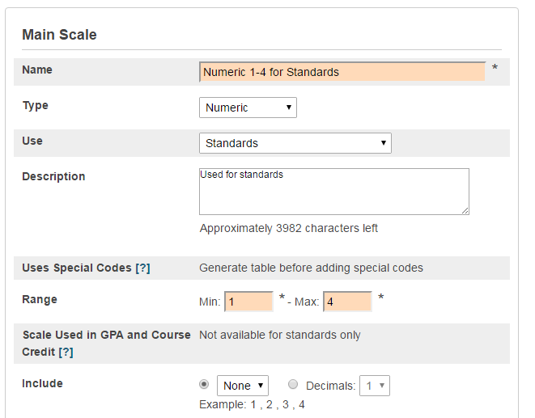
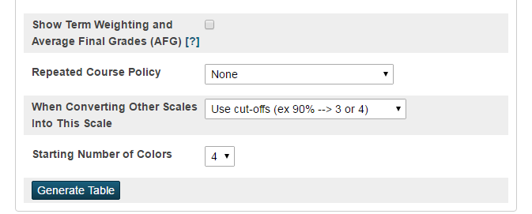
Create Numeric Grade Scale
Notes:
Click New to add Numeric grade scale (this is NEW)
-Name the scale
-Type: numeric
-Use: standards
-Description if needed/wanted
-Uses special codes? (have to generate table/make special codes scale first)
-min: 1 max: 4
-Include: will you be using pluses, minuses?
Show Term weighting - NC does not have to check - set up in District PTPro Settings (weighting)
Reported Course Policy - we don't think NC uses this as we use Grade Suppression Policy set elsewhere

Slide 10
Numeric Grade Scale cont’d.
As long as people are still using the Java based gradebook (PTG), Conversions need to be set up (Standards)
If using PTPro and are moving from standards to traditional grading, Conversions need to be set up.
Notes:
Set descriptions
-as long as ppl are using Java, we do need the conversion set up
-in Pro if they are going from standards to traditional, we will still need a conversion set up.
Any existing conversion scales will be automatically converted to grade scales with the upgrade to PS 10.x

Slide 11
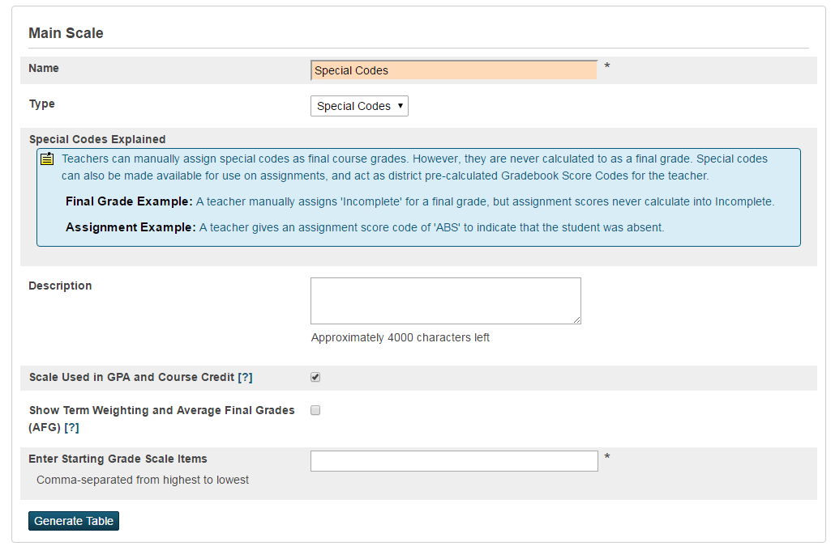
Create Special Codes Grade Scale
Notes:
Click NEW to create Special Codes scale
-the order entered in the list is not important - as long as it’s comma separated (W, INC, NA=not assessed, NHI=Not handed in))
The special codes scale will encompass all special codes used by K-12 and will be attached to the NC 10-Point Scale.

Slide 12
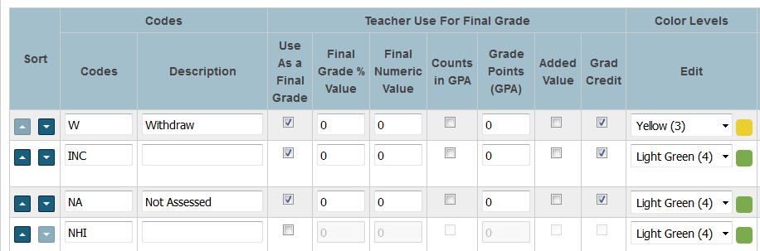
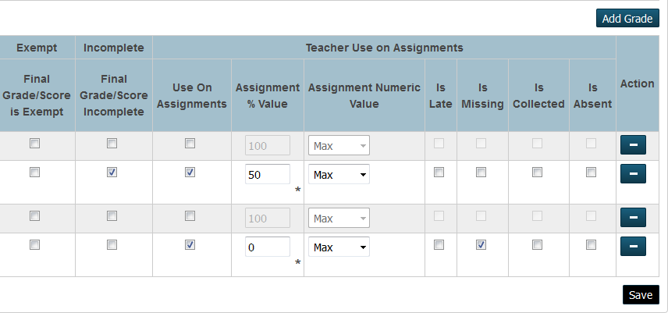
Notes:
After generating the table, this is the next step
-can sort into order
-can add description
-Don't just add tag (late, missing, etc) unless you are giving it a value - PTPro works on values
-Enter a Final Grade Values for those codes used for Final Grade
-On numeric scale - you do not have to enter a final numeric value but it won't hurt if you do, ... check as need -->does it count in GPA? using Added value? Grad Credit?
-ex: withdraw is not in use on assignments so you will uncheck it.
-not handed in would be missing
-normally don’t change grading scale during the school year

Slide 13
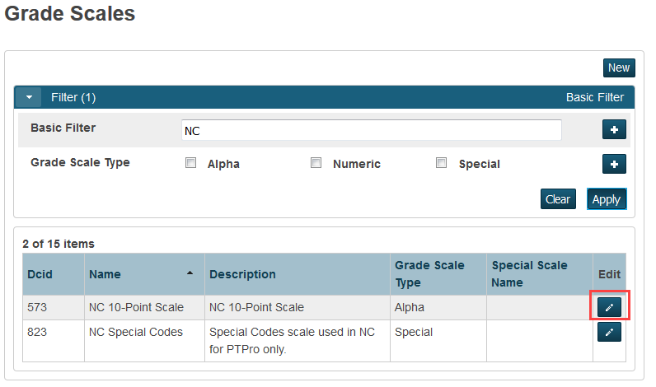
Apply Special Codes Grade Scale to Regular Scales
Notes:
Go back in breadcrumbs to Grade Scales
To Filter out your scales, enter search text and Click apply
Find the NC 10-Point Scale and click the pencil icon to Edit
-edit a scale to apply
-special code example is already created in there but you can/should modify it as needed.

Slide 14
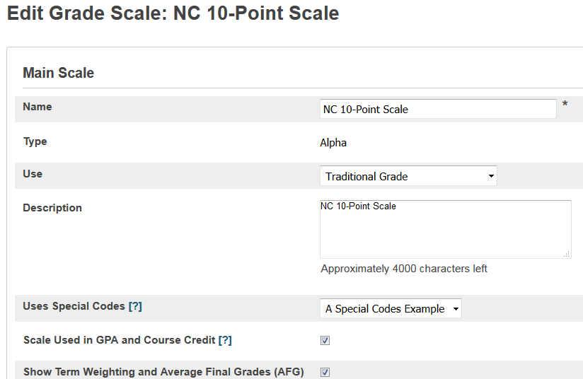
Apply Special Codes Grade Scale to Regular Scales
Select a Special Codes Grade Scale to use along with this 10-point scale.
Scroll to bottom and click
Notes:
When you upgrade to to PS 10/PT Pro--your standard conversions will appear...you may get an error which is caused by the standard conversion not having a 0 value in the grade scale.
PS 10 also creates a Special Code example. They also attach the Special Code example grade scale to every single one of your grade scales. LEAs will need to find the special codes scale and attach it to the NC 10-Point Scale

Slide 15
AGENDA
Creating Grade Scales
Setting Up PowerTeacher Pro
Setting PowerTeacher Pro as the Default Gradebook
Setting Up District Grading Preferences
Creating District Categories for Teachers
Creating Traditional Grade Calculation Formulas
Setting Up Traditional Grade Preferences
Setting Up District Grading Preferences
Configuring Standards Grade Preferences
Configuring Display Settings
School Level
PowerTeacher Pro Settings
District Categories for Teachers
Standards Grade Preferences
Traditional Grade Calcs & Prefs
District Level
Managing Next Year’s Calculations

Slide 16
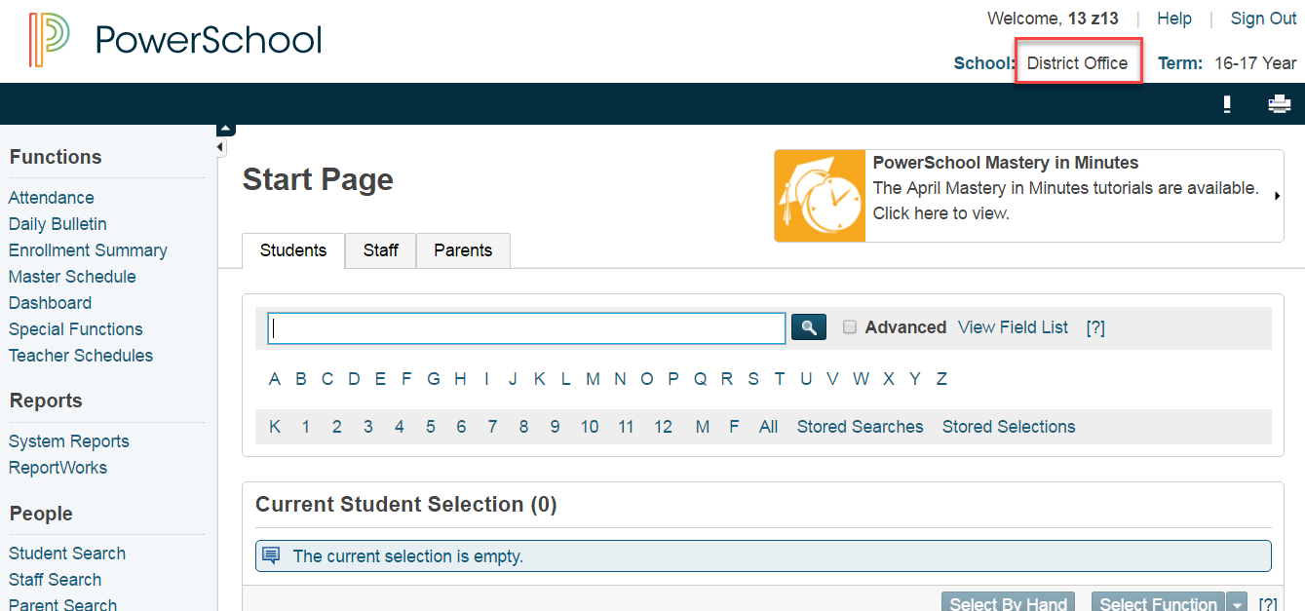
Setting Up PowerTeacher Pro
District means LEA
Notes:
Log into to the PS admin site
Change school to District Office (NOTE: District means LEA)

Slide 17
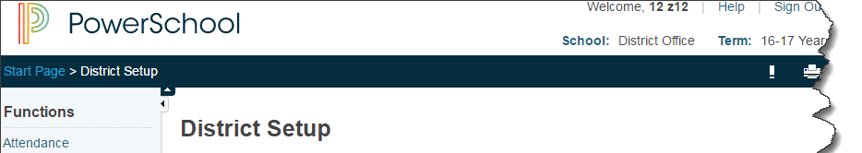
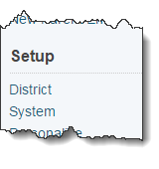
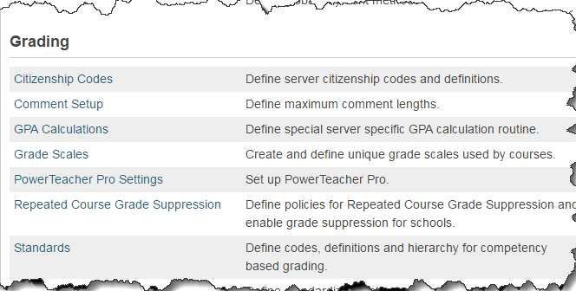
District means LEA
Notes:
District > Power Teacher Pro Settings ….
Gradebook Setup -- Default Gradebook Type (talk more about it at the school level later)
District Settings --- School can trump District , and Teachers can trump both School and District ---- is Okay.
Click on a School to open info ----

Slide 18
AGENDA
Creating Grade Scales
Setting Up PowerTeacher Pro
Setting PowerTeacher Pro as the Default Gradebook
Setting Up District Grading Preferences
Creating District Categories for Teachers
Creating Traditional Grade Calculation Formulas
Setting Up Traditional Grade Preferences
Setting Up District Grading Preferences
Configuring Standards Grade Preferences
Configuring Display Settings
School Level
PowerTeacher Pro Settings
District Categories for Teachers
Standards Grade Preferences
Traditional Grade Calcs & Prefs
District Level
Managing Next Year’s Calculations

Slide 19
Notes:
District > Power Teacher Pro Settings
Gradebook Setup -- Default Gradebook Type (talk more about it at the school level later)
District Settings --- School can trump District , and Teachers can trump both School and District ---- is Okay.
Click on a School to open info ----

Slide 20
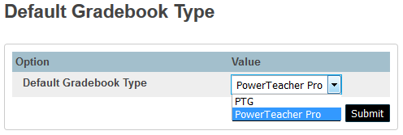
PowerTeacher Pro Settings
CAUTION!: Set this to PTG if you still have teachers in both gradebook types.
Notes:
-will default to PTG in 10 - in SECTIONS table (WILL TALK MORE ABOUT THIS AT THE SCHOOL LEVEL→ In course sections)
-In PS10x - There is a New field in Sections Table called GradebookType
-Setting this will force any NEWLY created sections to use this default gradebook type.
-Existing sections will have to have the new field in the Sections table modified to the gradebook each section is going to use.
-Can be done in Mass using DDA Sections Table : GradebookType
PTG = 1
PowerTeacher Pro = 2
Submit

Slide 21
AGENDA
Creating Grade Scales
Setting Up PowerTeacher Pro
Setting PowerTeacher Pro as the Default Gradebook
Setting Up District Grading Preferences
Creating District Categories for Teachers
Creating Traditional Grade Calculation Formulas
Setting Up Traditional Grade Preferences
Setting Up District Grading Preferences
Configuring Standards Grade Preferences
Configuring Display Settings
School Level
PowerTeacher Pro Settings
District Categories for Teachers
Standards Grade Preferences
Traditional Grade Calcs & Prefs
District Level
Managing Next Year’s Calculations
Notes:
Before going to District and create categories --- go to School level and look at the district categories for teachers ….
LEA level > LEA > GRADING > PowerTeacher Pro Settings > District Categories for Teachers

Slide 22
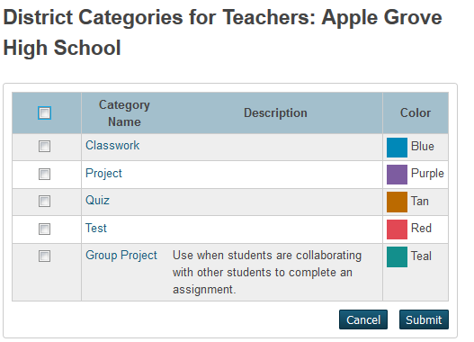
School Level - Looking at District Categories
Navigate: School Level > Setup: School > Grading: PowerTeacher Pro Settings > District Categories for Teachers
Schools can:
View the district created categories
Manage district categories to turn them on/off
Schools CANNOT change properties of the district categories.
In PTPro, teachers see a house next to the district created categories.
Notes:
Schools can view the district created categories
They can NOT change anything about these however, they can ‘uncheck’ one or more of them and not use them.
They can manage categories to turn them on/off
Go BACK to District -- PowerTeacher Pro Settings -- District Categories for Teachers

Slide 23
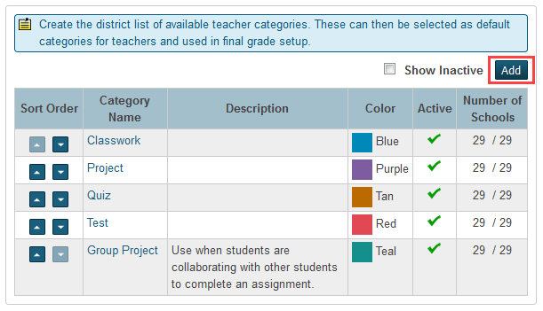
Creating District Categories for Teachers
Navigate: District > Grading: PowerTeacher Pro Settings > Gradebook Setup > District Categories for Teachers
Notes:
Districts can set up categories for teachers (school house)
Change the sort order
Show ‘inactive’ categories
Number of schools that are using the categories Click add to add a category

Slide 24
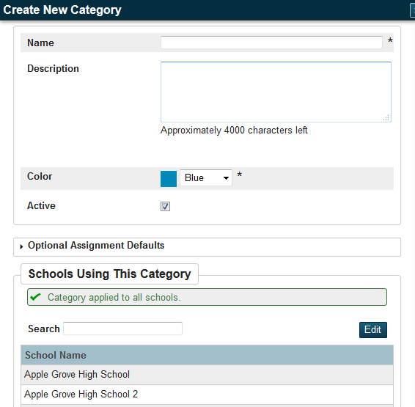
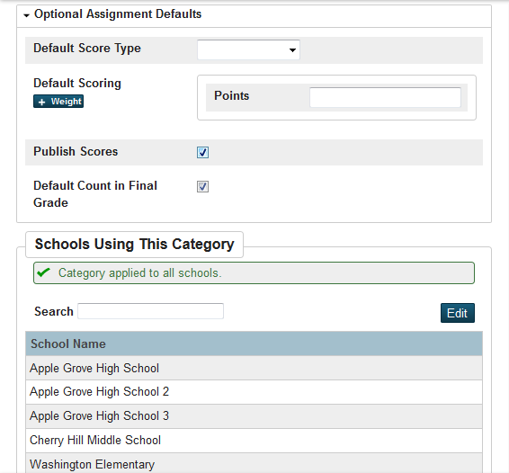
Notes:
Optional defaults can be modified by the teacher
Default Score Type --- Points, %, Grade Scale, Collected Only
Default Scoring - changes depending upon Score Type ----- +Weight ---- (+Extra Points if type is Points)
-select the schools

Slide 25
Calculation Method for Categories
i.e. Q1 = (Tests (40%) + Quiz (20%) + Homework (20%) + Classwork (20%))
District pushing out categories
?
Also pushing out calculation methods using the categories
?
Yes
Yes
No
Notify teachers that district categories AND the calculations so they will use those categories.
No
School will make categories.
Notify teachers that district categories are not included in calculation methods.
Notes:
Districts don’t have to push out categories - District decision
If district deletes category, then it becomes a teacher category therefore a teacher can modify
If pushing out a calculation method for Categories - you have to push out categories and notify teachers
Problem - if district pushes out a calculation for classwork but then the teacher creates a category call daily work and uses it instead, then teacher’s category is NOT included in the calculation - that is why teacher’s must be notified if District is setting up calculation methods on categories.
This is a good video to watch regarding calculation methods in categories: https://www.youtube.com/watch?v=DMx5Jnneyp0

Slide 26
AGENDA
Creating Grade Scales
Setting Up PowerTeacher Pro
Setting PowerTeacher Pro as the Default Gradebook
Setting Up District Grading Preferences
Creating District Categories for Teachers
Creating Traditional Grade Calculation Formulas
Setting Up Traditional Grade Preferences
Setting Up District Grading Preferences
Configuring Standards Grade Preferences
Configuring Display Settings
School Level
PowerTeacher Pro Settings
District Categories for Teachers
Standards Grade Preferences
Traditional Grade Calcs & Prefs
District Level
Managing Next Year’s Calculations

Slide 27
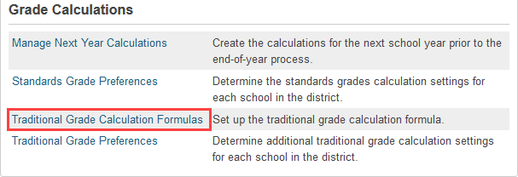
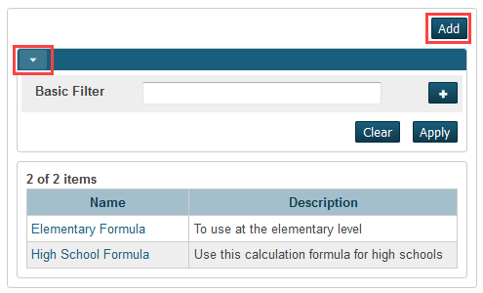
Traditional Grade Calculation Formulas
Navigate: District > Grading: PowerTeacher Pro Settings > Gradebook Calculations: Traditional Grade Calculation Formulas
Triangle opens the filtering option
Notes:
NC has mandated formulas
Currently can only push out a formulas to entire school
Future - can push out formula to Departments, individual courses and grades
NOTE: NC mandates the NC 10-Point Scale as the only scale available for high schools - as far as GPA calculations go.
When ADDing new formula - and managing schools - if you check the box for each school a notification will come up if there is already a formula set for a school to tell you that you are overriding the current formula

Slide 28
Create a Traditional Grade Calculation Formula
This is not always checked after selecting the school(s)
You won’t see Terms until you select one or more schools (by clicking the ‘Manage School Selection’ button
Notes:
-when adding schools you may have to override the current formula
-leave the calculate overall class grades checked

Slide 29
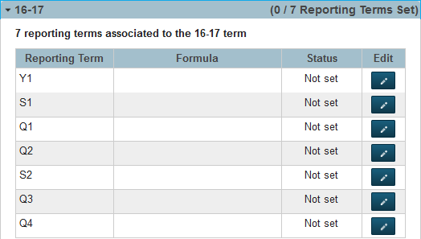
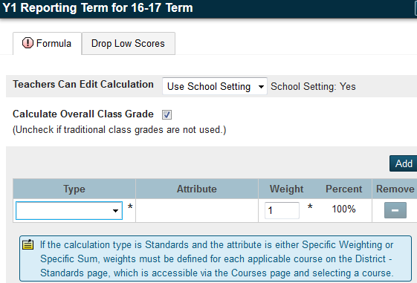
Create a Traditional Grade Calculation Formula
Click the Pencil to the right
The page changes appearance depending upon the formula chosen.
Notes:
-can see the reporting terms in this scheduling term
-click edit to edit terms
If nothing is set up for the formula, it will default to total points
-add additional types for ex:
Can lock down by term level - ie - District can lock down final grade term to calculate S1 & S2, and also not lock down quarter terms - with Categories
Teachers Can Edit Calculation - Don’t forget about the drop down options
Standards attribute can have MEAN - it is appropriate here
New options - if you want to use them - you must go to LEA and set it at the course
Specific Weighting
Specific Sum
Weighting Categories - PTPRo will recalculate accordingly if a teacher does not use one of the categories set up (such as Project). (In NC some districts do mandate that all categories be used)
-fill the options but DO NOT submit --- go to ‘Drop Low Scores’ tab

Slide 30
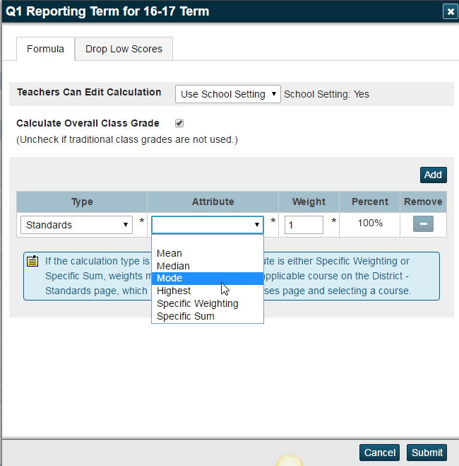
Create a Traditional Grade Calculation Formula
Notes:
Here do standards in the quarter
-can set up the “drop the lowest scores” It is not recommended to set this up at the beginning of the term. Advise teachers this is optional to set up at the end of the term, then recalculate the gradebook grades.
-can lock if teachers do not edit “drop low scores”

Slide 31
Create a Traditional Grade Calculation Formula
Set up formulas for the reporting terms as needed for the district.
Submit the page.
Notes:
-when adding schools you may have to override the current formula
-leave the calculate overall class grades checked
-setting up Term weighting - the Term Weighting Drop Down - has Exact Value Earned - use that UNLESS you are an IB school then use Term Weighting Points

Slide 32
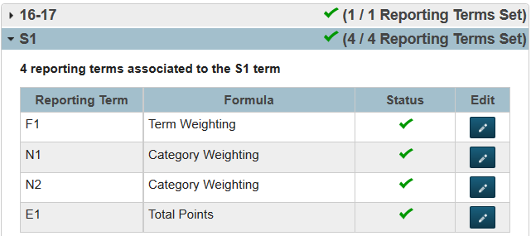
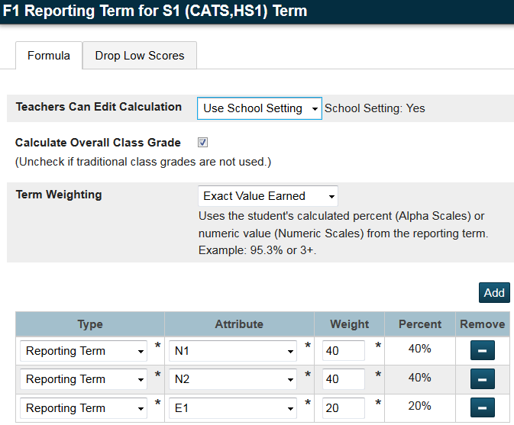
Create a Traditional Grade Calculation Formula
Notes:
-when adding schools you may have to override the current formula
-leave the calculate overall class grades checked
-setting up Term weighting - the Term Weighting Drop Down - has Exact Value Earned - use that UNLESS you are an IB school then use Term Weighting Points

Slide 33
AGENDA
Creating Grade Scales
Setting Up PowerTeacher Pro
Setting PowerTeacher Pro as the Default Gradebook
Setting Up District Grading Preferences
Creating District Categories for Teachers
Creating Traditional Grade Calculation Formulas
Setting Up Traditional Grade Preferences
Setting Up District Grading Preferences
Configuring Standards Grade Preferences
Configuring Display Settings
School Level
PowerTeacher Pro Settings
District Categories for Teachers
Standards Grade Preferences
Traditional Grade Calcs & Prefs
District Level
Managing Next Year’s Calculations

Slide 34
Setting up Traditional Grade Preferences
Navigate: District > Grading: PowerTeacher Pro Settings > Grade Calculations: Traditional Grade Preferences
Notes:
Click high school name

Slide 35
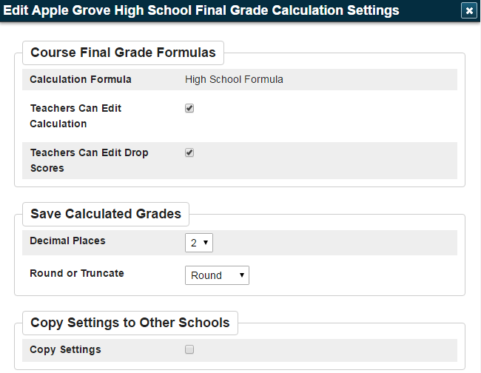
Setting up Traditional Grade Preferences
Notes:
General “preference” for grades
-can edit some but term by term will show which one can’t be set

Slide 36
AGENDA
Creating Grade Scales
Setting Up PowerTeacher Pro
Setting PowerTeacher Pro as the Default Gradebook
Setting Up District Grading Preferences
Creating District Categories for Teachers
Creating Traditional Grade Calculation Formulas
Setting Up Traditional Grade Preferences
Setting Up District Grading Preferences
Configuring Standards Grade Preferences
Configuring Display Settings
School Level
PowerTeacher Pro Settings
District Categories for Teachers
Standards Grade Preferences
Traditional Grade Calcs & Prefs
District Level
Managing Next Year’s Calculations
Notes:
When we go to PS10 - Standards automatically go to the new version

Slide 37
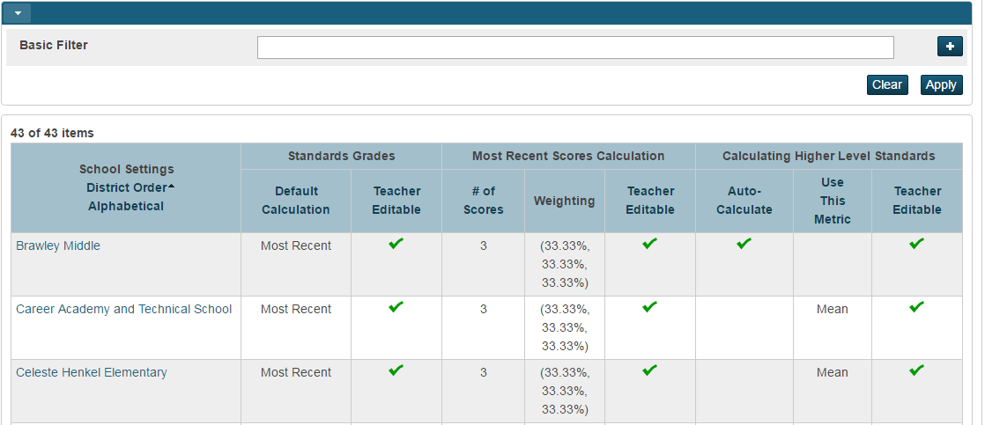
Configuring Standards Grade Preferences
Navigate: District > Under Grading: PowerTeacher Pro Settings > Under Gradebook Calculations: Standards Grade Preferences
Notes:
Click on elementary School name

Slide 38
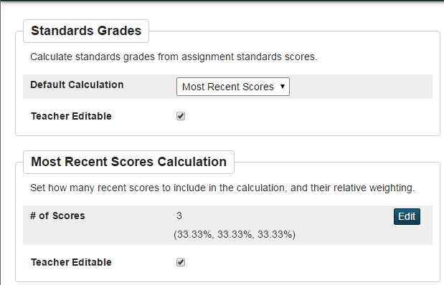
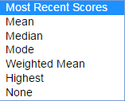
Configuring Standards Grade Preferences
Student learning culminated over time
Average of the scores
Throw out high and low scores
Most frequently occurring score
High-point assignments count more
Best for performance assessments
No default - a case-by-case method
Notes:
Should NOT have the ‘Mean’ as the default calculation at the highest level of Standard which means take the ‘average’ of the assignment standard scores (the top portion of this page) … using the average is not the concept of Standards Based Grading.
It’s okay however to have the ‘mean’ of the lower level standards calculate up to the higher standards (the bottom portion of this page)

Slide 39
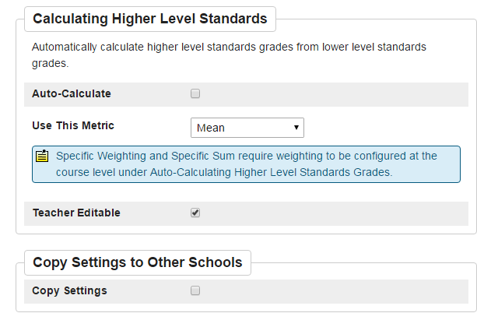
Configuring Standards Grade Preferences cont’d
Select the checkbox to automatically calculate higher level standards grades from lower level standards grades. Deselect the checkbox to remove the auto-calculate feature.
Note: When this checkbox is selected, PowerSchool determines which parent standards are auto-calculated based on the setting on the Courses page.
Notes:
Should NOT have the ‘Mean’ as the default calculation at the highest level of Standard which means take the ‘average’ of the assignment standard scores (the top portion of this page)
It’s okay however to have the ‘mean’ of the lower level standards calculate up to the higher standards

Slide 40
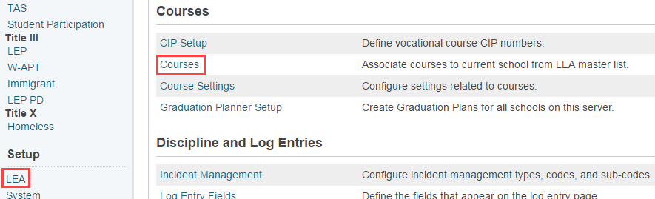
District Standards as Seen at the Course Level
Navigate: LEA > Courses
Search for and select a course and click ‘District - Standards’ tab
Notes:
Go back to District setup → Courses → Filter Course Name by ‘NC Math 1’
Select a NC Math course that has Standards attached

Slide 41
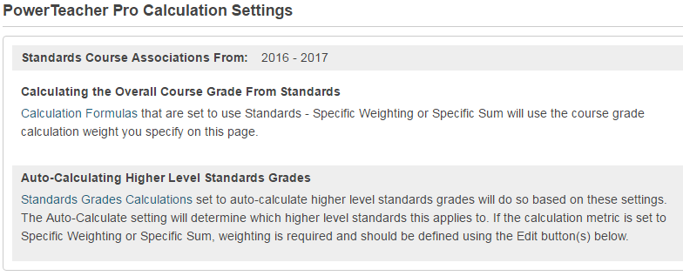
District-Standards Tab- Two Sections
Section 1
Notes:
Can set up district standards (a lot of work)
-will ‘auto calculate” if a higher level is needed
-can edit

Slide 42
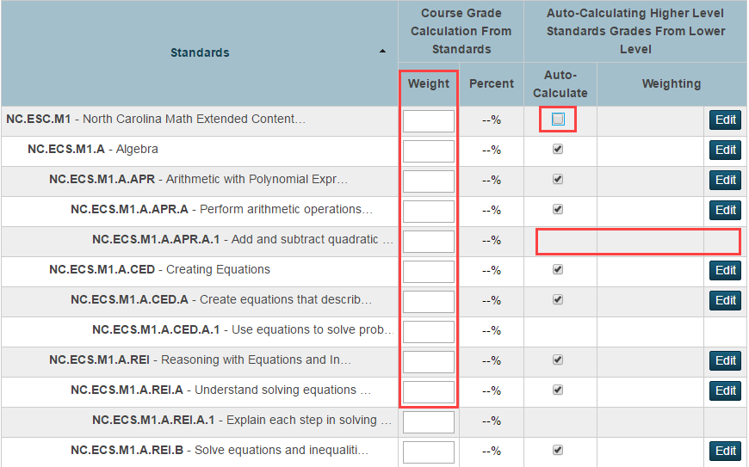
Section 2
Notes:
Point out how to read the fields on the screen (i.e. the auto-calculate, the Weighting etc…),
and why there are not Auto-Calc and Weighting for some standards [because they are the ‘children’ and have nothing rolled up to them … they are the ‘smallest entity standard’
When editing, the scores will adjust
-can add weights to standards

Slide 43
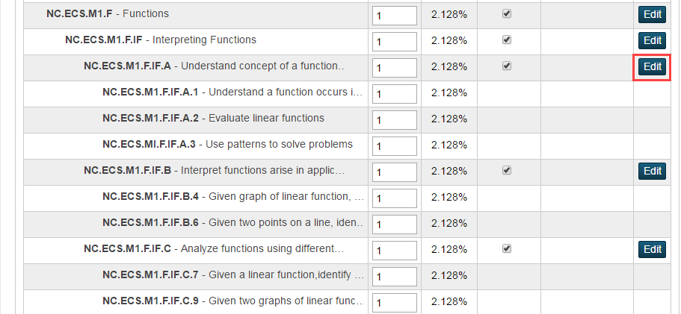
Editing Weights for Sub-Standards
Notes:
When editing weights, score % will auto-adjust
Can weight sub-standards

Slide 44
AGENDA
Creating Grade Scales
Setting Up PowerTeacher Pro
Setting PowerTeacher Pro as the Default Gradebook
Setting Up District Grading Preferences
Creating District Categories for Teachers
Creating Traditional Grade Calculation Formulas
Setting Up Traditional Grade Preferences
Setting Up District Grading Preferences
Configuring Standards Grade Preferences
Configuring Display Settings
School Level
PowerTeacher Pro Settings
District Categories for Teachers
Standards Grade Preferences
Traditional Grade Calcs & Prefs
District Level
Managing Next Year’s Calculations

Slide 45
Configuring Display Settings
Navigate: District > Grading: PowerTeacher Pro Settings > Display Settings
Notes:
Similar to PT Admin
School can trump District , and Teachers can trump both School and District ---- is Okay.
Click School name

Slide 46
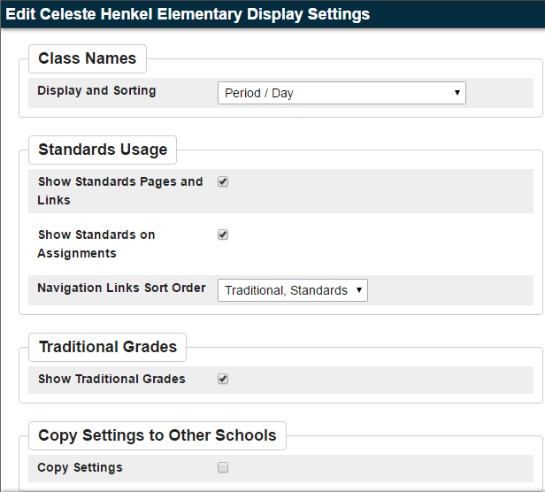
Configuring Display Settings cont’d
Teachers can change these display settings

Slide 47
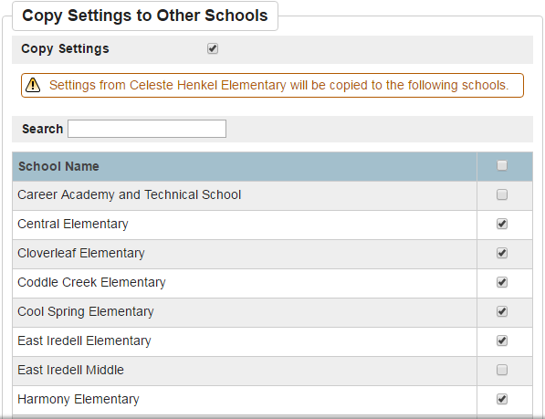
Configuring Display Settings cont’d
After checking the box, the grid of schools display.
Notes:
- teacher can change this display to their preference
Copy Settings to Other Schools - if check the box window opens to manage which schools to copy these settings to
Copy Settings to Other Schools also appears in other areas of district setup (some pages have Manage button, others have Edit button)

Slide 48
Let’s go to School ….
… level, and look at Sections and PowerTeacher Pro Settings
Notes:
Switch to School>School Setup>Grading: PowerTeacher Pro Settings
Display Settings (schools can change display settings and work with the district categories….YES my school uses this category however cannot modify name, color, description)

Slide 49
AGENDA
Creating Grade Scales
Setting Up PowerTeacher Pro
Setting PowerTeacher Pro as the Default Gradebook
Setting Up District Grading Preferences
Creating District Categories for Teachers
Creating Traditional Grade Calculation Formulas
Setting Up Traditional Grade Preferences
Setting Up District Grading Preferences
Configuring Standards Grade Preferences
Configuring Display Settings
School Level
PowerTeacher Pro Settings
District Categories for Teachers
Standards Grade Preferences
Traditional Grade Calcs & Prefs
District Level
Managing Next Year’s Calculations

Slide 50
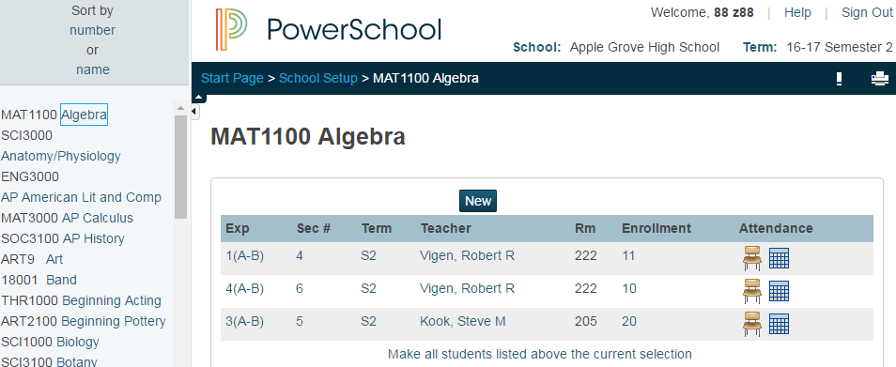
Navigate: School: Setup > School > Scheduling: Sections > Course > Click a section to open
Notes:
-School..sections..pick section..

Slide 51
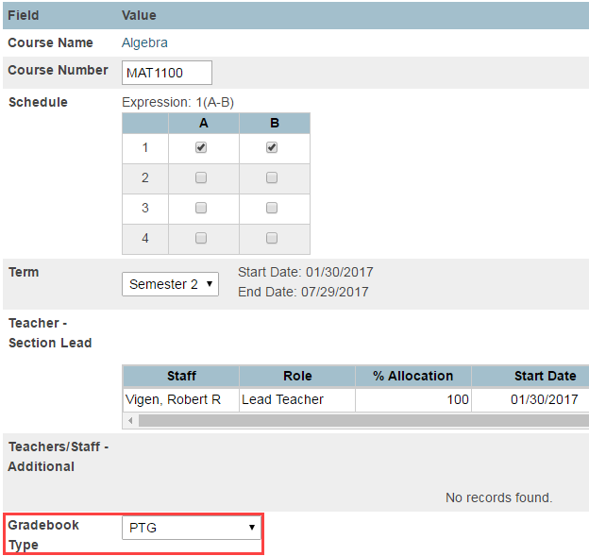
Edit Section
Change the type to ‘PowerTeacher Pro’
Once you go Pro - there is no going back!
Not required to have all sections in the school migrate to PTPro at one time ....
Notes:
Change gradebook type
-one you go Pro, CANNOT go back to PTG
-migration can only happen once and only migrates 1 year of information - the rest stay in PTG
-must have assignments in the year
-PTP needs to be blank (teachers can only be in 1 grade book at a time)
-in DDA you can update all sections at 1 time

Slide 52
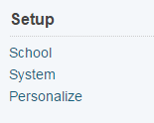
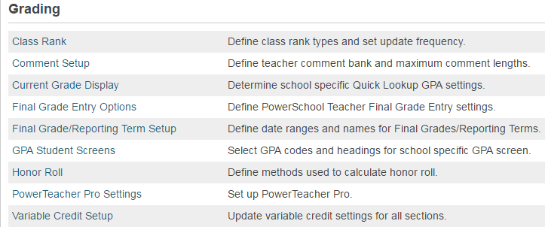
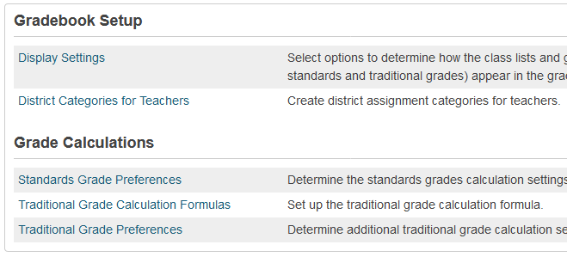
View District Categories for Teachers
Navigate: Change to School level: Setup > School > Grading > PowerTeacher Pro Settings

Slide 53
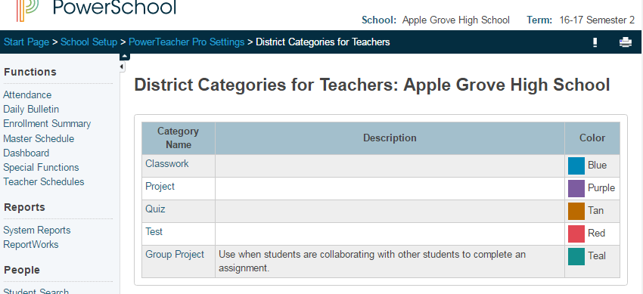
View District Categories for Teachers
Navigate: Change to School level: Setup > School > Grading > PowerTeacher Pro Settings > Gradebook Setup: District Categories for Teachers
Notes:
District level pushes out the categories. Teachers can create a category however IF this district has pushed out categories, they should use the district categories to be included in final grade calculation. Meaning a teacher is not to use their own test category if the district has a test category.

Slide 54
AGENDA
Creating Grade Scales
Setting Up PowerTeacher Pro
Setting PowerTeacher Pro as the Default Gradebook
Setting Up District Grading Preferences
Creating District Categories for Teachers
Creating Traditional Grade Calculation Formulas
Setting Up Traditional Grade Preferences
Setting Up District Grading Preferences
Configuring Standards Grade Preferences
Configuring Display Settings
School Level
PowerTeacher Pro Settings
District Categories for Teachers
Standards Grade Preferences
Traditional Grade Calcs & Prefs
District Level
Managing Next Year’s Calculations

Slide 55
Standards Grade Preferences
Navigate: Change to School level: Setup > School > Grading > PowerTeacher Pro Settings > Grade Calculations: Standards Grade Preferences

Slide 56
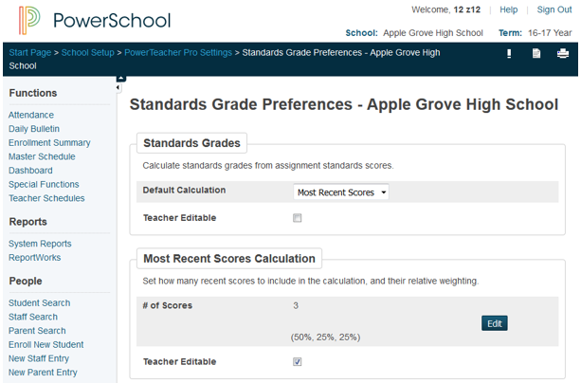
Standards Grade Preferences School Level
School can change this!!! Set Page Permissions to ‘view only’ if you want to lock staff out of making changes to this page
Page 1 of 2
Notes:
PowerSchool 10 will not have PT administrator and user will not have the ability to view GradeBook
Standards Grade Prefs
See what district pushed out … schools can change this ---- This can be locked out using Page Permissions!

Slide 57
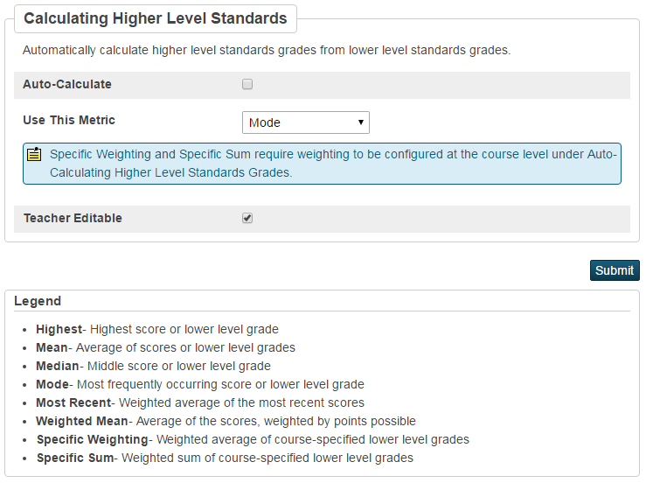
Standards Grade Preferences as seen at School Level
Page 2 of 2
Notes:
Think about the metric used at this high level …. (Mean probably isn’t the best choice)
These preferences are what was set on the district level side

Slide 58
AGENDA
Creating Grade Scales
Setting Up PowerTeacher Pro
Setting PowerTeacher Pro as the Default Gradebook
Setting Up District Grading Preferences
Creating District Categories for Teachers
Creating Traditional Grade Calculation Formulas
Setting Up Traditional Grade Preferences
Setting Up District Grading Preferences
Configuring Standards Grade Preferences
Configuring Display Settings
School Level
PowerTeacher Pro Settings
District Categories for Teachers
Standards Grade Preferences
Traditional Grade Calcs & Prefs
District Level
Managing Next Year’s Calculations

Slide 59
Traditional Grade Calculation Formulas
Navigate: Change to School level: Setup > School > Grading > PowerTeacher Pro Settings > Grade Calculations: Traditional Grade Calculation Formulas

Slide 60
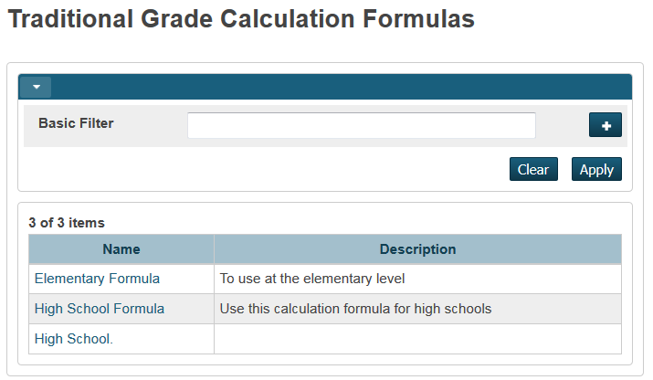
View a formula created at the district level.
What does a school see?
What can a school change?
What can a school NOT change?
Notes:
School, gradebook, PTP settings
Open a High School formula

Slide 61
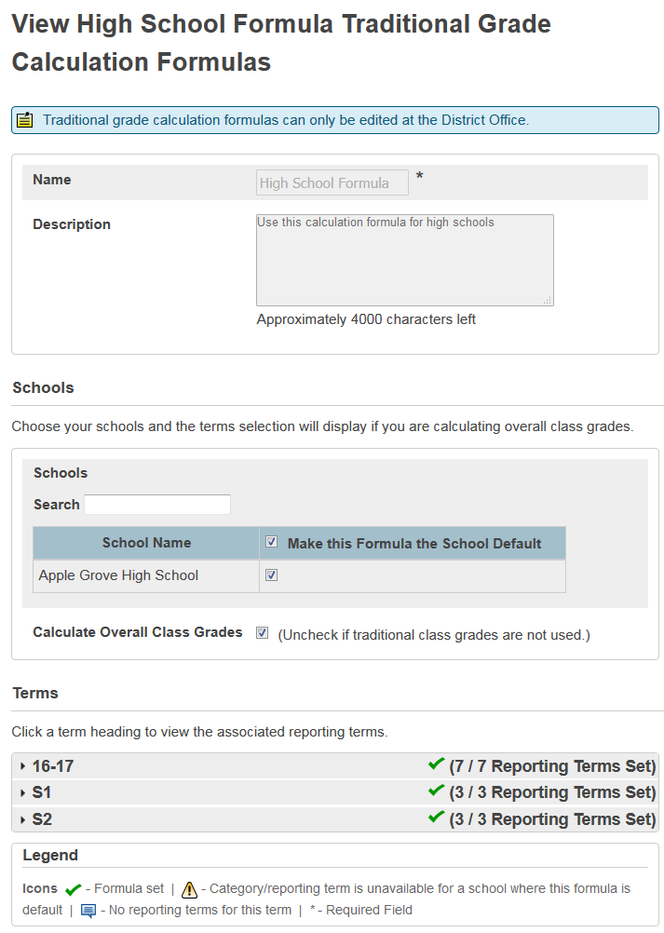
Viewing High School Formula
What’s editable?
Nothing!
(if it is locked down by the district)

Slide 62
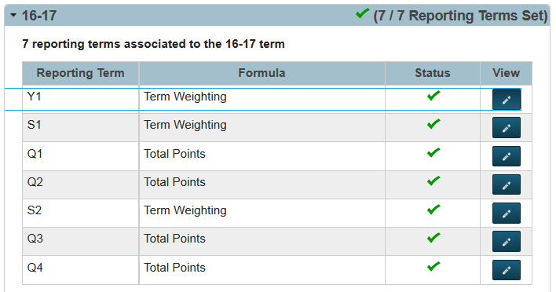
Editable: S1 Formula

Slide 63
Uneditable: S1 Formula

Slide 64
Traditional Grade Preferences
Navigate: Change to School level: Setup > School > Grading > PowerTeacher Pro Settings > Grade Calculations: Traditional Grade Preferences

Slide 65
Traditional Grade Preferences

Slide 66
AGENDA
Creating Grade Scales
Setting Up PowerTeacher Pro
Setting PowerTeacher Pro as the Default Gradebook
Setting Up District Grading Preferences
Creating District Categories for Teachers
Creating Traditional Grade Calculation Formulas
Setting Up Traditional Grade Preferences
Setting Up District Grading Preferences
Configuring Standards Grade Preferences
Configuring Display Settings
School Level
PowerTeacher Pro Settings
District Categories for Teachers
Standards Grade Preferences
Traditional Grade Calcs & Prefs
District Level
Managing Next Year’s Calculations

Slide 67
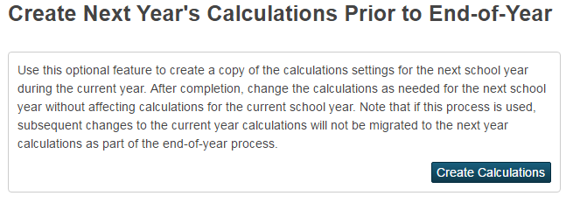
Managing Next Year’s Calculations
Navigate: Change to LEA level: Setup > LEA > PowerTeacher Pro Settings > Manage Next Year Calculations
Will not have any effect on current calculations
In a “bubble” to protect current year calculations

Slide 68
Let’s Talk …..
PowerTeacher Pro
VIEW
ONLY
Role
And, how to launch a teacher gradebook
Migrating Data

Slide 69
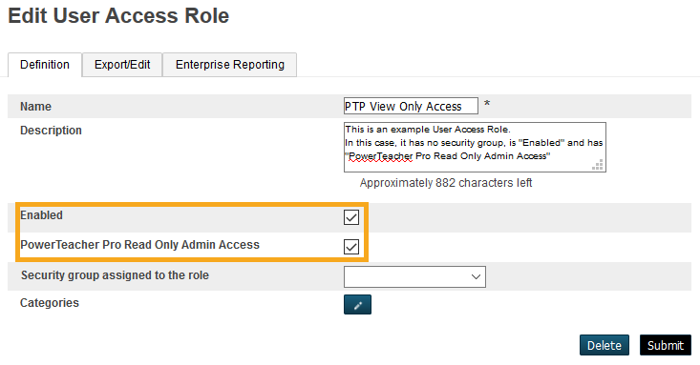
Create a PowerTeacher Pro READ ONLY Security Role
Navigate LEA level: System > Roles Administration > User Access > NEW
Enter name “PTPro View Only Access”
Description if desired.
Check both boxes
Don’t add to a Security Group! Leave this blank!

Slide 70
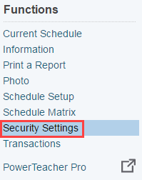
Assign the View Only Role to a Single User
Navigate: Search for and open the staff member account > Security Settings Page > Admin Access and Roles Tab
Click ‘Add’ button

Slide 71
Assign the View Only Role to a Single User
Brings you back to Admin Roles and Access tab - see the role. Scroll to bottom and click
Select the schools the staff member should have PTPro view access for, then, Click Next button
Check the ‘PowerTeacher Pro View Only’ Role, then click OK button

Slide 72
Administrators Viewing Teachers PTPro Gradebook

Slide 73
Different methods to launch PowerTeacher Pro
or
Navigate: Change to School Level > Start Page > Teacher Schedules > Select a Teacher> Click PowerTeacher Pro to launch gradebook
Navigate: Change to School Level > Start Page > Staff tab > Search for and open a staff record > Under Functions - Click PowerTeacher Pro to launch gradebook
Notes:
Start page>Teachers Schedules>Pick a teacher>Click PTPro button launch
-can also pull up a teacher and then click the link on the left for PTP
Note: pop-up windows will open - they are html and not constricted to pop-up blockers

Slide 74
Goes to Java-based Gradebook (PTG)
Notes:
PT Administrator (Navigation blue bar - side bar) goes to Java gradebook …. This will not go away [for viewing old gradebook information]
District, Under Grading goes to PTPro Settings

Slide 75
Migration
PowerSource > Support > PowerTeacher > FAQ: What data migrates
Certain conditions need to be met in order
to successfully migrate assignment data into PTPro
The GradebookType field is set to Powerteacher Pro for section(s) for the current year
No assignments exist in PowerTeacher Pro
At least one assignment must exist in PTG for current year
If the above conditions are met, the first time a teacher launches PTPro, a Migrate Data to PowerTeacher Pro screen appears
If a co-teacher launches PTPro before the lead teacher, all classes in which the co-teacher can edit will be migrated.
Power Source - KBase # 77198
PS10x PTP Data Migration Guide
Notes:
*Final grade calculations DO NOT migrate
Teacher will EVENTUALLY see the wrench if Admin has been in PTG. Section readiness report coming this summer.

Slide 76
Migration - What Data is NOT migrated
Custom grade scales
Score codes
Calculation settings
Content Links
Teacher-defined student fields

