Slide 1
PTP Gradebook Training
Teachers
Slide Deck: http://bit.ly/NCDPI_PTP_Teachers

Slide 2
Agenda
Using PowerTeacher Pro ………………………..……. slide 2
Accessing the Gradebook 6 …………………………………..….. slide 4
→ Navigating the Gradebook
Viewing and Adding Class Descriptions …………………...….. slide 12
Setting Up Display Preferences ………………………………….. slide 15
Setting Up Grading Preferences …………………………………. slide 17
Working with Categories and Assignments ……………..…….. slide 23
Working with Grades ………………………………………………. slide 52
Analyzing Performance ………………………………………….... slide 61
Running PowerTeacher Pro Reports ……………..…………….. slide 77

Slide 3
Using PowerTeacher Pro
Teachers navigate to the HTML-based gradebook directly through the teacher portal. There’s no need to launch a separate application to access the gradebook. The first time you navigate to the gradebook, you’ll see a welcome message that introduces some of the features.
HTML 5 based, no more Java issues!
Adapts to any computer or tablet, including Mac, Windows, iOS, Android, Chromebooks
Access anywhere
Advanced features for both standards-based and traditional grading
District lock-down by SCHOOL in gradebook setup
Notes:
If schools have departments that calculate differently from each other the District or School should have the teachers set up calculations (term or category weighting).
Show Help features (The first time you navigate to the gradebook, you’ll see a welcome message that introduces some of the features.)

Slide 4
Using PowerTeacher Pro ……………………………...…..……. slide 2
Accessing the Gradebook 6 …………………..…..….. slide 4
→ Navigating the Gradebook
Viewing and Adding Class Descriptions …………………...….. slide 12
Setting Up Display Preferences ………………………………….. slide 15
Setting Up Grading Preferences …………………………………. slide 17
Working with Categories and Assignments ……………..…….. slide 23
Working with Grades ………………………………………………. slide 52
Analyzing Performance ………………………………………….... slide 61
Running PowerTeacher Pro Reports ……………..…………….. slide 77

Slide 5
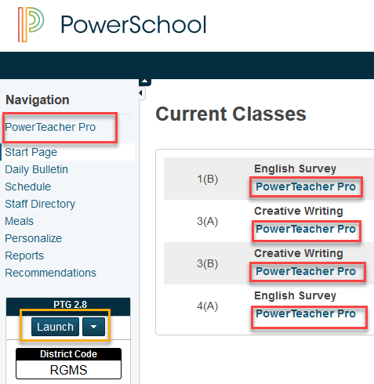
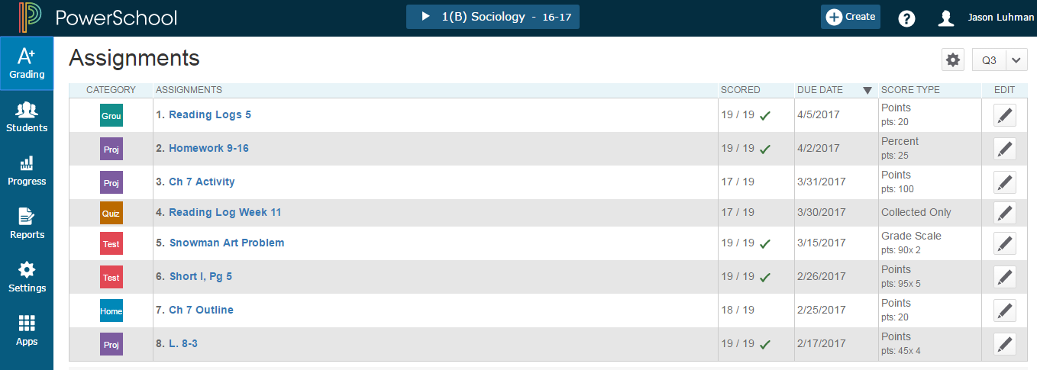
PowerTeacher Portal to open PowerTeacher Pro
Navigation: IAM login > PowerTeacher icon > PowerTeacher Pro Link
Or URL: https://xxxxxxxx.powerschool.com/teachers > Log in >PowerTeacher Pro link
Notes:
PowerTeacher (portal) -- shows teacher’s classes and links to student information.
PowerTeacher Pro Links in the PT Portal- opens in same page
Under each class - the PTPro link will open gradebook in that specific class
In blue rail - the PTPro link opens the gradebook with the first class in list
NOTE: To return to PowerTeacher Portal click the PowerSchool Icon. However, teachers can have PowerTeacher Portal and PowerTeacher Pro Gradebook open at the same time (PC- use right click and open in new tab or window)
PowerTeacher Pro Links in Gradebook under Student’s Charm - opens in a new tab
PowerTeacher Portal Launch Button opens PTG (PowerTeacher Gradebook)

Slide 6
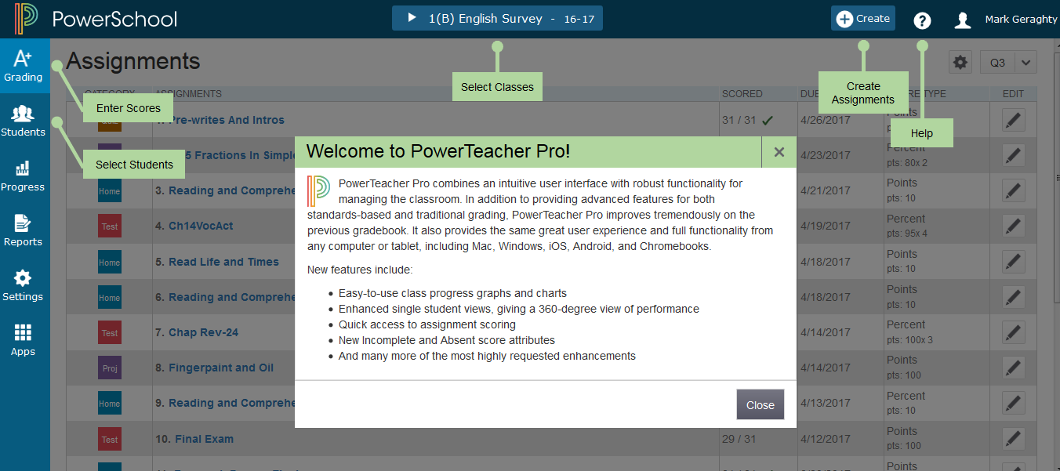
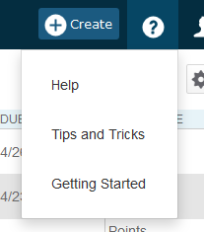
PTPro Help
Notes:
The first time teachers access PTPro they will see this Welcome Message. ….. Click Close.
Robust Help feature - Click on Question mark > clicking Getting Started will show the welcome and navigation bubbles again
Getting Started -- available on several pages- shows navigation bubbles
Tips and Tricks -- (opens in new window) Accessibility View, Show/Hide Page Elements, Scroll Bars Invisible, Reports, Associate Assignments, Save Toner When Using Print Screen and Printing Report, Hot Keys
Help - (opens in new window) Welcome, Table of Contents, Index, Search

Slide 7
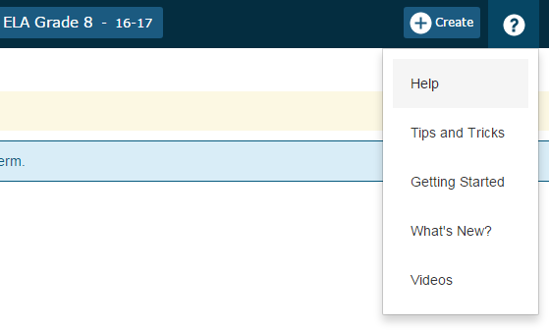
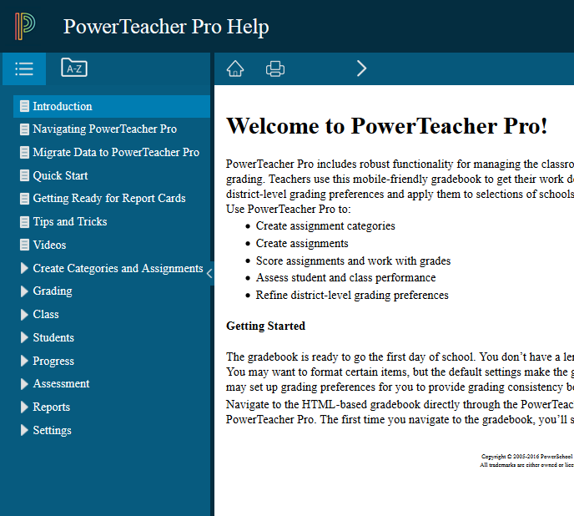
PTPro Help
Notes:
Help - There is access to generic PTPro training videos
Getting Started -- available on several page- shows navigation bubbles
Tips and Tricks -- (opens in new window) Accessibility View, Show/Hide Page Elements, Scroll Bars Invisible, Reports, Associate Assignments, Save Toner When Using Print Screen and Printing Report, Hot Keys
Help - (opens in new window) Welcome, Table of Contents, Index, Search

Slide 8
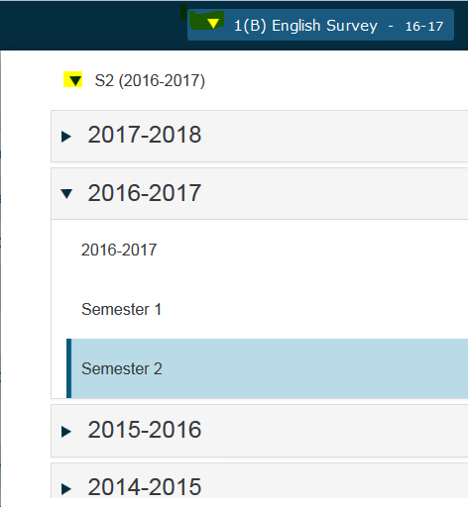
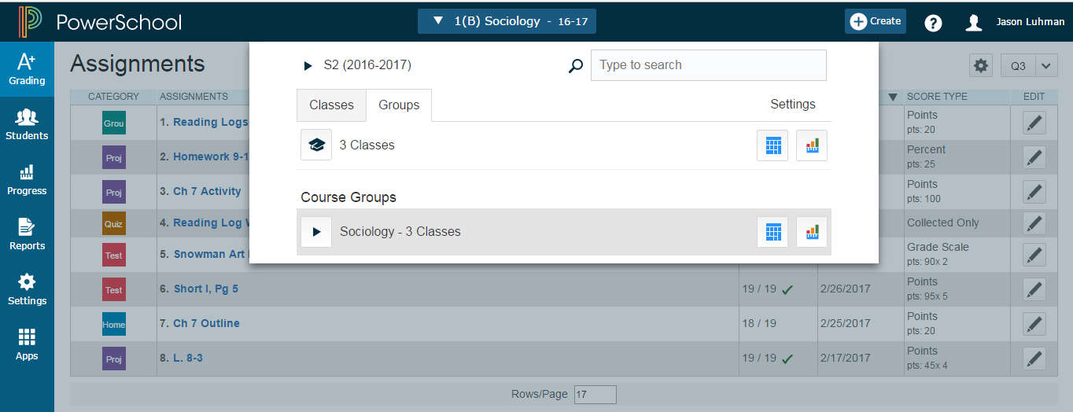
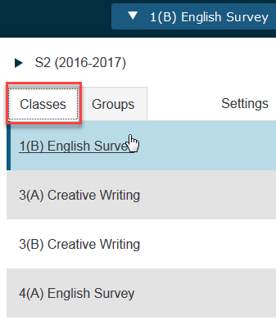
Navigate Classes
Classes - Click Blue Class Button > Classes Tab > pick class to view
Groups - Click Blue Class Button > Groups Tab > Pick group to view all students in that group. Right now, in PT Pro there is no ability for teachers to create groups. Feature is coming in a future release.
Notes:
Classes - Choose from blue button, shows all terms , will show next year term when created in PowerSchool.
Groups
Right now, in PT Pro there is no ability for teachers to create their own groups. This feature is coming in a future release.

Slide 9
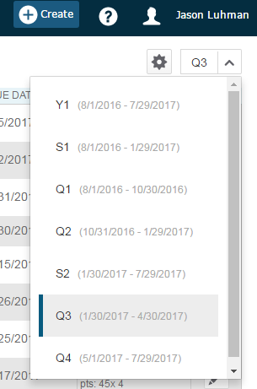
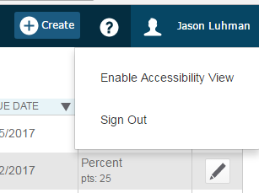
PTPro Views
Terms: Select a reporting term to change the current reporting term that appears in PowerTeacher Pro. Note: On the Assignments page, All appears as an additional option.
Term Complete:
Page Size: To increase the size of certain pages, click teacher name and select Accessibility View on the navigation bar
Notes:
Term menu drop-down
-can select quarters with corner drop down
-teachers can work outside of their current term, a notification will pop up at the top
Can enable Accessibility View
Can change large, medium, small view

Slide 10
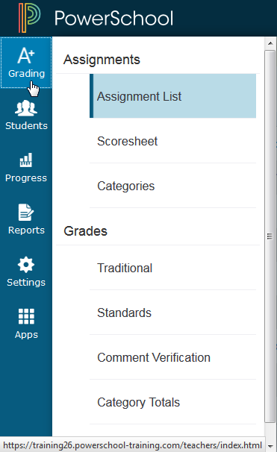
PTPro Charms - A+ Grading
A+ Grading Charm
Teachers spend most of their time here.
Usually in Assignments
Grades - for end of year reporting (can set up traditional and standard grades)
Students Charm
Progress Charm - Track class progress, standards
Reports Charm
Settings Charm
Apps Charm - link to PTPortal
More on these later...
Notes:
Charms on left-hand side of the page
A+ grading charm- teachers spend most of their time here
-usually in Assignments
-grades for end of year reporting (can set up traditional and standard grades)
Student charm can choose a set of students
Progress charm=track class progress, standards
Reports
Settings
Apps-link to PTPortal

Slide 11
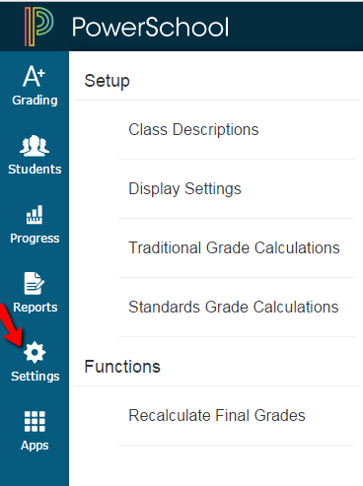
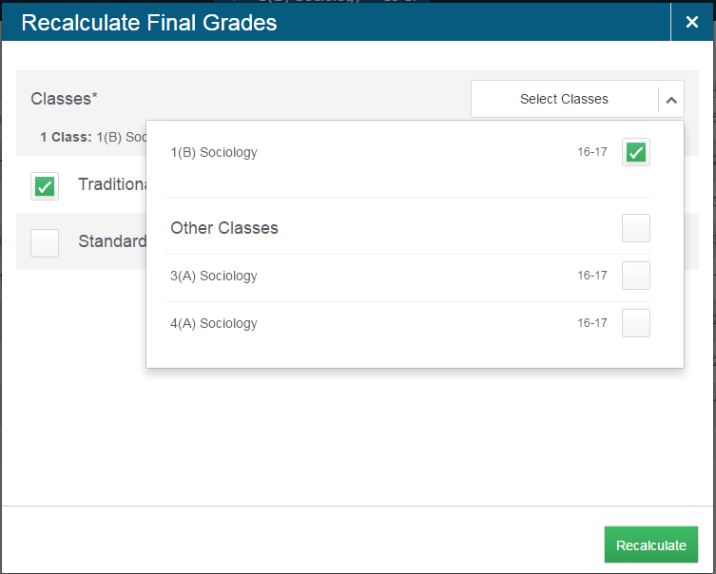
PTPro Charms - Settings > Functions
Options for Traditional or Standards AND which classes you want to recalculate.
Notes:
Settings Charm
Functions
Recalculate final grades: you have the option for traditional or standards AND which classes you want to recalculate

Slide 12
Using PowerTeacher Pro ………………………...………..……. slide 2
Accessing the Gradebook 6 …………………………………..….. slide 4
→ Navigating the Gradebook
Viewing and Adding Class Descriptions …...….. slide 12
Setting Up Display Preferences ………………………………….. slide 15
Setting Up Grading Preferences …………………………………. slide 17
Working with Categories and Assignments ……………..…….. slide 23
Working with Grades ………………………………………………. slide 52
Analyzing Performance ………………………………………….... slide 61
Running PowerTeacher Pro Reports ……………..…………….. slide 77

Slide 13
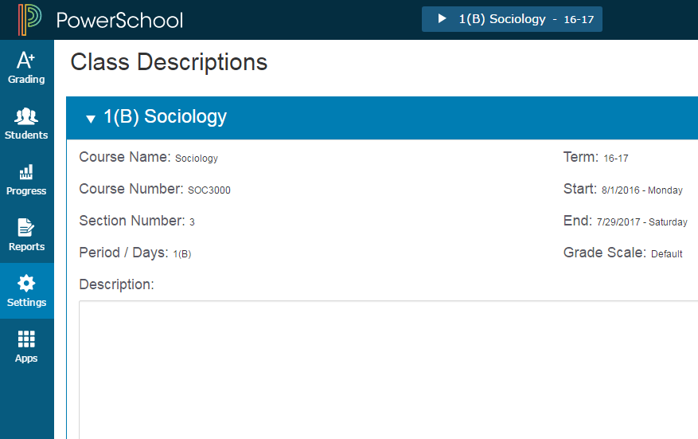
PTPro Charms - Settings > Class Descriptions
Description shows in the Parent and Student Public Portal
no character limit
can add links via html code
HTML button in the future
Notes:
Navigate to Settings Charm
Class Descriptions (Description of course): This is displayed for the parent and student in the public portal
-no character limit
-can add links via html code: will get click a button in the future
-can add in class syllabus info
Note: Grade Scale is a new name in PS 10, called letter grade in PS 9

Slide 14
Activity
Enter a class description.
Show how to navigate to Quick Lookup to see how it looks on the parent / student portal

Slide 15
Using PowerTeacher Pro ………………………………….……. slide 2
Accessing the Gradebook 6 …………………………………..….. slide 4
→ Navigating the Gradebook
Viewing and Adding Class Descriptions …………………...….. slide 12
Setting Up Display Preferences …………………….. slide 15
Setting Up Grading Preferences …………………………………. slide 17
Working with Categories and Assignments ……………..…….. slide 23
Working with Grades ………………………………………………. slide 52
Analyzing Performance ………………………………………….... slide 61
Running PowerTeacher Pro Reports ……………..…………….. slide 77

Slide 16
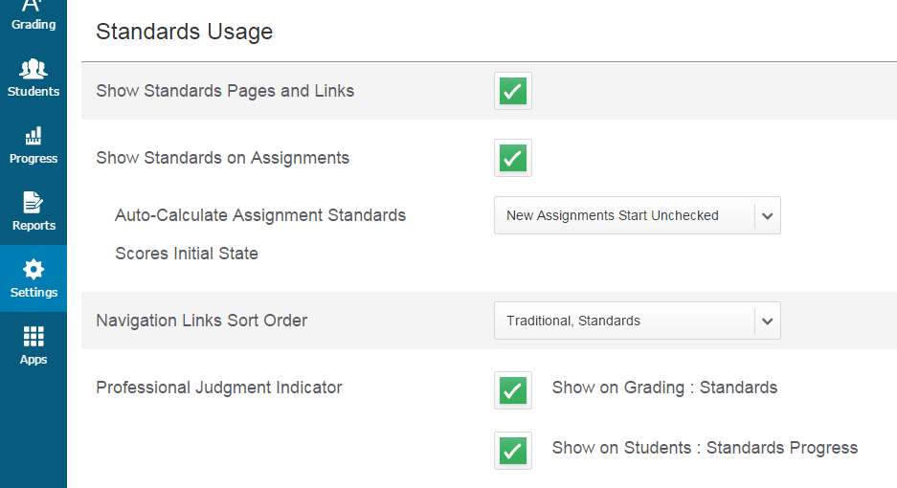
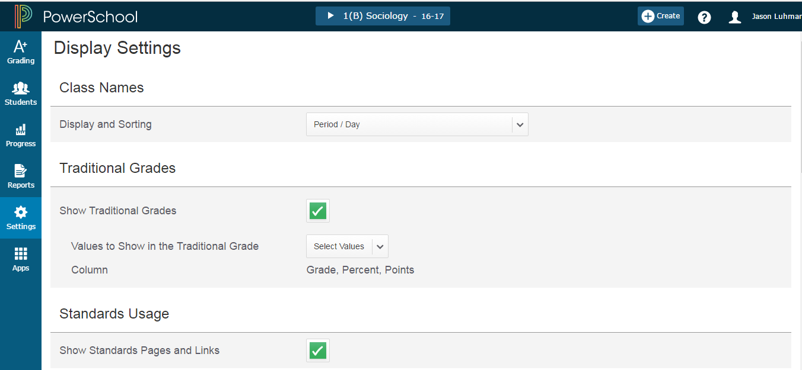
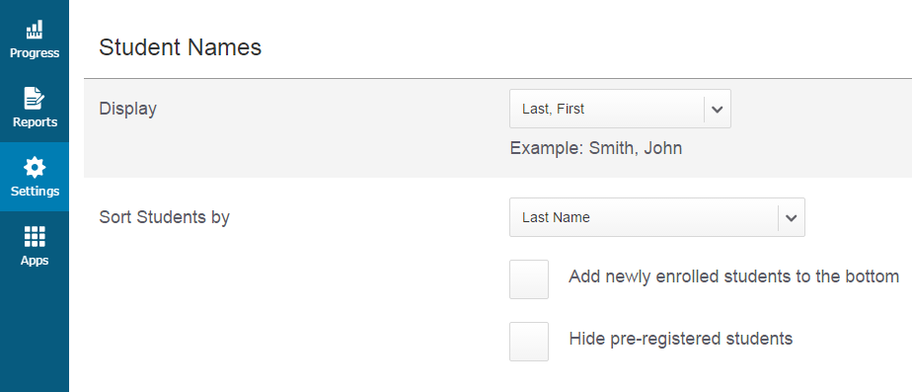
PTPro Charms - Settings > Display Settings
Determines how Teachers want the course to appear
Custom “create your own Class name” coming SOON!
Notes:
Display Settings-impact the display at the top (determines how they want the course to appear)
-will offer custom “create your own name” SOON! It will only show in PT Pro gradebook and on reports within gradebook and NOT on report cards. This lives inside the PTG.
-can choose to show or hide traditional grades
-choose do you want to push standards out
-if looking at both traditional and standard-you can change the option.
Display Settings: in PTG lives in gradebook under Tools. In PTPro lives in Settings Charm.
Choices under Show Traditional Grade (grade, percent, points) show up in FINAL grades column in gradebook scoresheet.
Professional Judgement Indicator- if the system is calculating a final grade based on the calculation we give it, and if it is significantly different than the term average Professional judgement allows teacher to override a standard grade results (student gets 5 out of ten - shows mastery in Math Addition and is low in Math Subtraction) what the system calculates - teacher can mark the Addition as met/exceeds an keep the lower grading on subtraction standard.
To use standards District must set them up first.
If using Standards - Report Cards HAVE to be created with Object Reports for PTPro.

Slide 17
Using PowerTeacher Pro ………………..………………..….…. slide 2
Accessing the Gradebook 6 …………………………………..….. slide 4
→ Navigating the Gradebook
Viewing and Adding Class Descriptions …………………...….. slide 12
Setting Up Display Preferences ………………………………….. slide 15
Setting Up Grading Preferences ……………………. slide 17
Working with Categories and Assignments ……………..…….. slide 23
Working with Grades ………………………………………………. slide 52
Analyzing Performance ………………………………………….... slide 61
Running PowerTeacher Pro Reports ……………..…………….. slide 77

Slide 18
Teacher-Level Grading Preferences
Teachers may configure traditional grade calculations for each section they teach, and may have access to edit Term weights and dropped score preferences.
Teachers may configure standards grades calculations for each section they teach

Slide 19
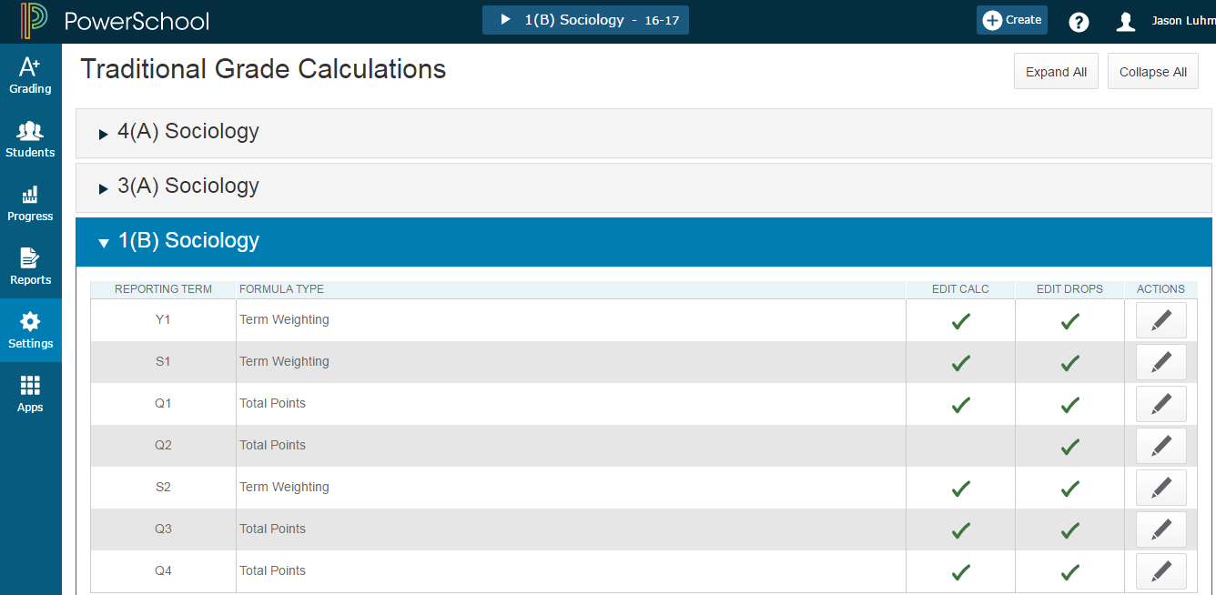
Traditional Grade Calculation Settings
For each class, configure traditional grade calculations for each reporting term (permission to edit required from the district or school).
PowerTeacher Pro > Settings > Traditional Grade Calculations
Notes:
Traditional grades calculations
-Can copy assignments now but NOT terms (this is coming)
If district pushes this down you will not see a check on Edit Calculation (it will not be editable)
If district pushes out category weighting - and a teacher doesn't use one of those categories, the system will re-adjust calculation (spread out weighting evenly) between the categories the teacher did use.

Slide 20
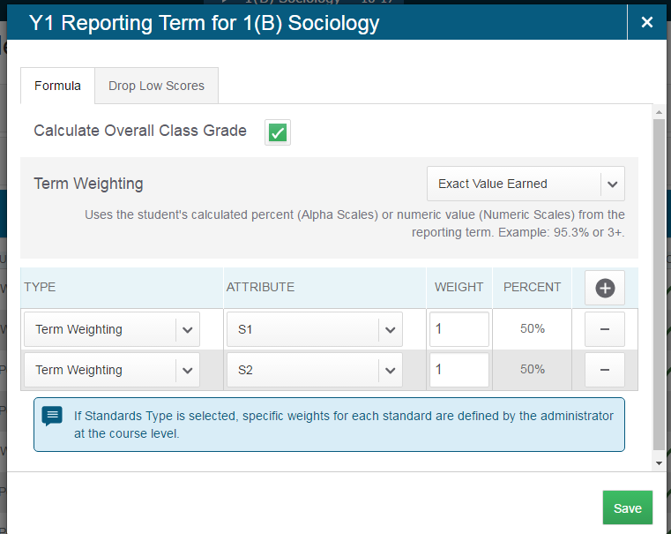
How to Edit a Calculation
PowerTeacher Pro > Settings > Traditional Grade Calculations > Select a Class > Actions
Notes:
Edit grades
-add changes with weight to impact percentages (can use decimals)
If you have selected only Traditional Grades and chose to not show Standards grades, the standards options will still be available throughout PTPro system.

Slide 21
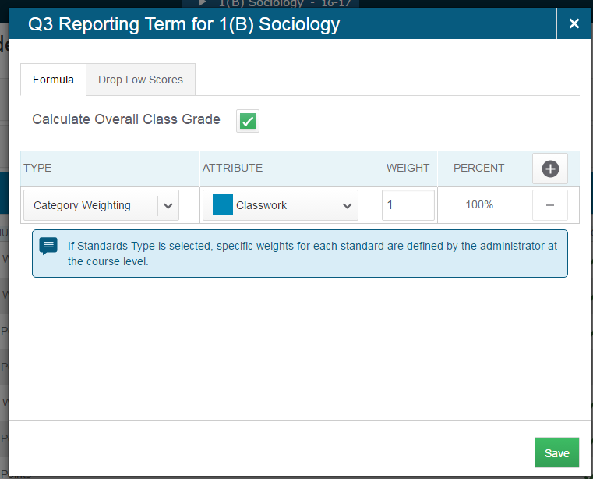
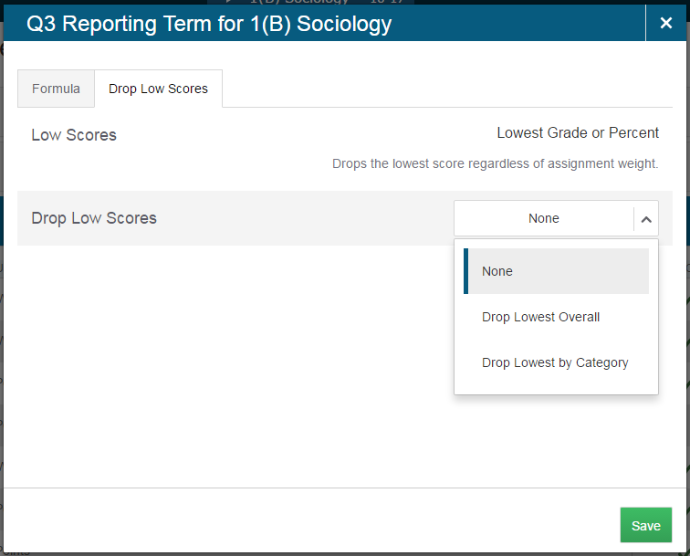
How to Drop Low Scores from Category Assignments
Teachers can drop lowest score if allowed by district. Keep in mind Parent Portal grade views - this is best set up at the end of the term after assignment grades are in.
Notes:
Quarter view with category weighting
-can drop lowest score if allowed by district
District can lock Teachers out of setting Drop Low Scores (by choosing “None”). Districts can also choose to allow teachers to make this decision.

Slide 22
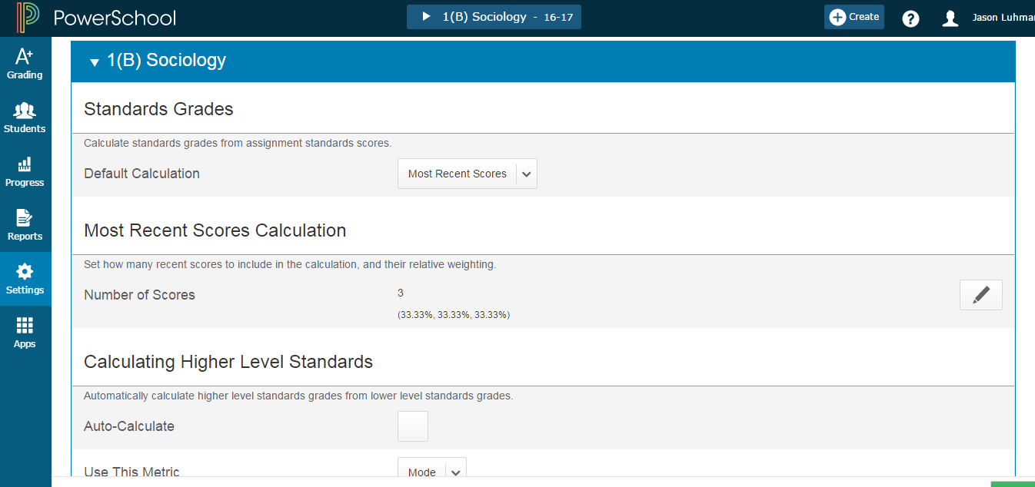
Standards Grade Calculation Settings
For each class, configure standards grades calculations (permission to edit required from the district or school).
PowerTeacher Pro > Settings > Standards Grade Calculations
Notes:
Standards Grade Calculation Settings
-will have a copy feature for semesters (coming soon)
Note: Default Calculation means how am I going to reach the final score.
If the districts chooses 'None' for the default calculation, it will force the teacher to look at the body of work and manually enter the standard grade (top level).

Slide 23
Using PowerTeacher Pro ………………………………….……. slide 2
Accessing the Gradebook 6 …………………………………..….. slide 4
→ Navigating the Gradebook
Viewing and Adding Class Descriptions …………………...….. slide 12
Setting Up Display Preferences ………………………………….. slide 15
Setting Up Grading Preferences …………………………………. slide 17
Working with Categories and Assignments ..... slide 23
Working with Grades ………………………………………………. slide 52
Analyzing Performance ………………………………………….... slide 61
Running PowerTeacher Pro Reports ……………..…………….. slide 77

Slide 24
Creating Categories - Teachers
Teachers can create categories for assignments - Open PTPro > click the Create button.
District may set this in PowerSchool at LEA level - District > PowerTeacher Pro Settings > District Categories for Teachers. Use this page to configure assignment categories in PowerTeacher Pro.
Notes:
District can choose to create Categories and push them out to the schools.
Districts choosing to use category weights in calculation methods, should be communicating this to teachers so they DO NOT inactivate those categories.

Slide 25
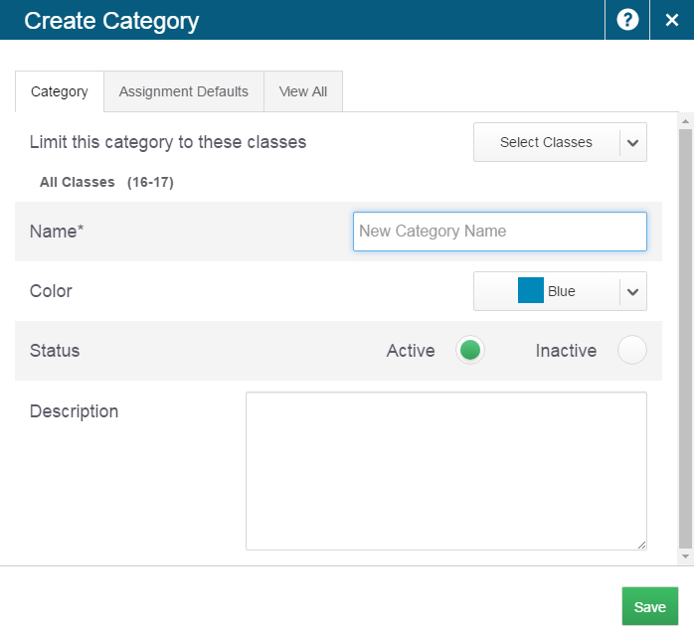
Creating Categories - Category Tab
Teachers have the ability to create a Category set as available in one, some, or all of their classes by using this dropdown selection.
If a category name already exists - you’ll receive an “in use” message
Now have the ability to “inactivate” a category - never delete a category.
Enter a Description (opt.).
Don’t save yet - navigate to Assignment Defaults tab.
Notes:
Can create categories for specific classes - or all classes.
Have participants try typing ‘Test’ --- won’t allow a category with the same name be created.
Choose a Color -- (8 colors to choose from)
Talk about Active and Inactive ---- don’t want to ‘delete’ a category - if not going to use it anymore - Inactivate it --- this will ‘hide’ it.
Enter a description if desired …… DON’T SAVE Yet --- Go to ‘Assignment Defaults’ Tab (if you save now, you will have to go back to the A+ charm to edit it)

Slide 26
Activity
Have participants try typing ‘Test’ won’t
allow a category with the same name
be created.
Choose a Color (8 colors to choose from)
Talk about Active and Inactive --- don’t want
to ‘delete’ a category - if not going to use it anymore -
Inactivate it --- this will ‘hide’ it.
Enter a description if desired …… DON’T SAVE Yet --- Go to ‘Assignment Defaults’ Tab (if you save now, you will have to go back to the A+ charm to edit it)

Slide 27
Creating Categories - Assignment Defaults Tab
By Default this is set to POINTS - options under Select Score Type drop down
Notes:
Assignment Defaults-how you want stuff to be scored
Points is the default - even before you choose a score type
Collected only for standards based grading
Can weight grades and add bonus points
Publishing will be done in assignment if needed

Slide 28
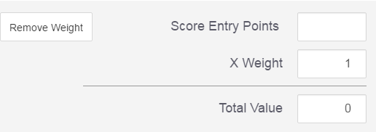
Assignment Defaults - Points Score Type
Record all scores as points - example 25 out of 25, 8 out of 10, 50 out of 100
Notes:
Record all scores as points - example 25 out of 25, 8 out of 10, 50 out of 100
Assignment Defaults-how you want stuff to be scored
Points is the default - even before you choose a score type
Collected only for standards based grading
Can weight grades and add bonus points
Publishing will be done in assignment if needed

Slide 29
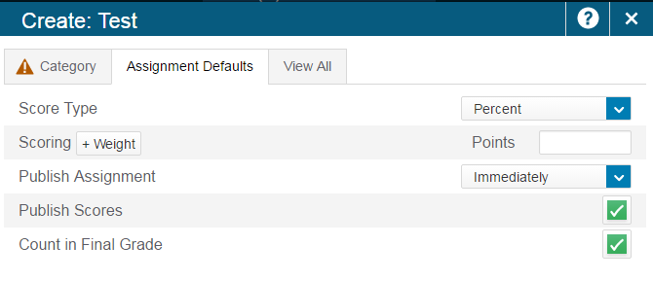
Assignment Defaults - Percent Score Type
Record all scores as percentage values - example 100, 80, 50
Notes:
Record all scores as percentage values - example 100=100%, 80= 80%, 50= 50%

Slide 30
Assignment Defaults - Grade Scale Score Type
This option is not generally used in North Carolina.
Notes:
Record all scores as values from the grade scale

Slide 31
Assignment Defaults - Collected Only Score Type
Record all scores using the collected score indicator. This type has no score value and therefore does not count toward the final grade.
Notes:
Assignment Defaults-how you want stuff to be scored
Collected only for standards based grading
Can weight grades and add bonus points
Publishing will be done in assignment if needed
DON'T SAVE YET -- go to View All Tab
Note: The Points, Grade Scale or Collected Only options can be used. Points is the default. If you choose Percent on the assignment and you are using total points to calculate, you will have to do the math.

Slide 32
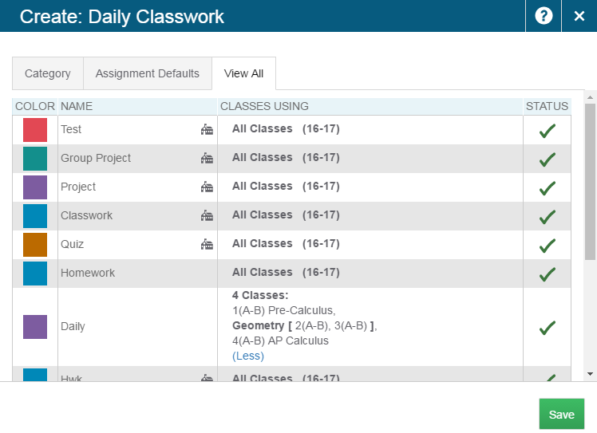
Create Category - View All Tab
The School House icon is an indicator that the category has been created at the district.
If your district has pushed categories to the school, they are probably being used in grading calculations.
Do not delete or inactivate a district category.
Notes:
School house-comes from district created categories
-if district has something , use this not your own
NOTE: If a teacher changes something on the district created category (there are a few things they can change) - a time stamp is put in the config-item table showing the teacher change to that category. Now, if the district pushes a change to that category, that teacher would NOT get that change because they 'modified' it.
Now click SAVE.

Slide 33
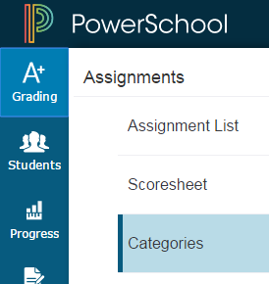
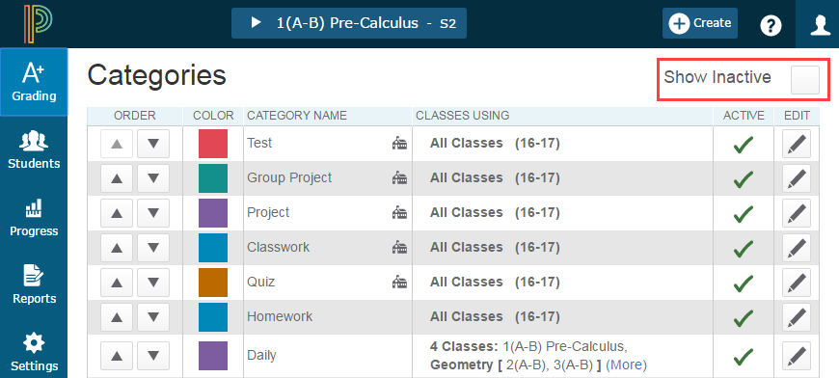
Showing Inactive Categories
Notes:
-school house is district set
-click Show inactive
-can delete if nothing is attached
-Can’t change the color, name or descriptions, but can change the options scoring settings
-Co-teachers will direct them to use the lead teacher’s categories

Slide 34
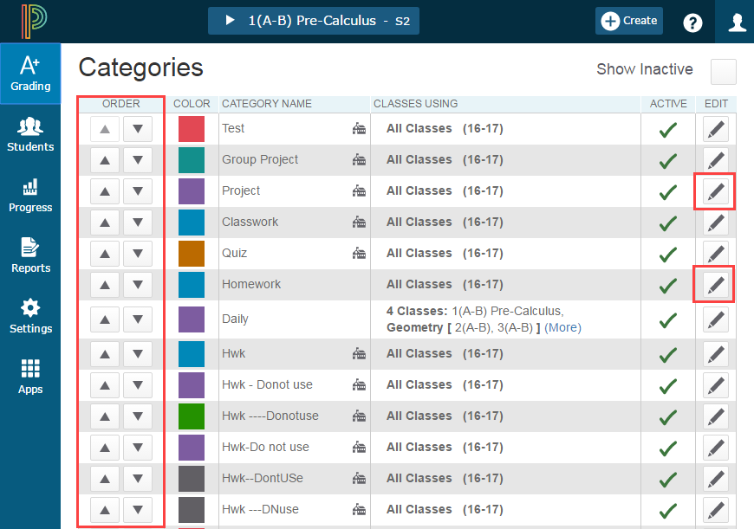
Editing Categories
When editing a District made category - the color, name, and description can NOT be changed - but the scoring options settings can
Click the up or down triangles to move the categories in the order you wish to see them
Notes:
-school house is district set
-click Show inactive
-can delete if nothing is attached
-Can’t change the color, name or descriptions, but can change the options scoring settings
-Co-teachers will direct them to use the lead teacher’s categories

Slide 35
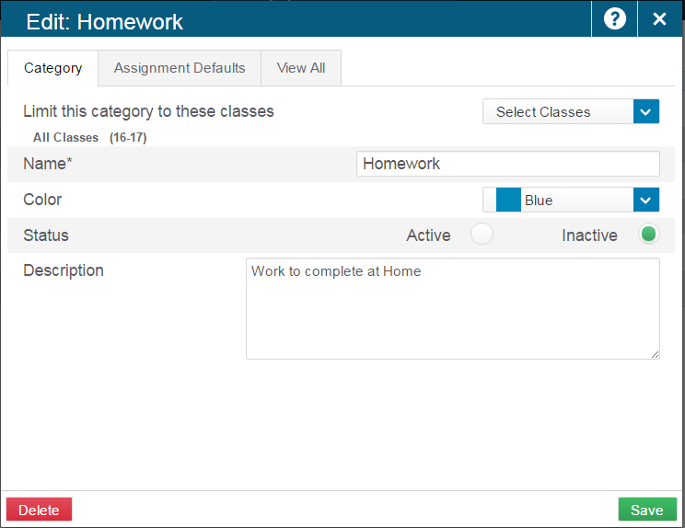
Deleting Categories
Inactivate Categories
Click the pencil to Edit the category - Set the bullet on Inactive
- Submit
Notes:
-school house is district set
-click Show inactive
-can only delete if nothing is attached (but we prefer you inactivate)
-Can’t change the color, name or descriptions, but can change the options scoring settings
-Co-teachers will direct them to use the lead teacher’s categories

Slide 36
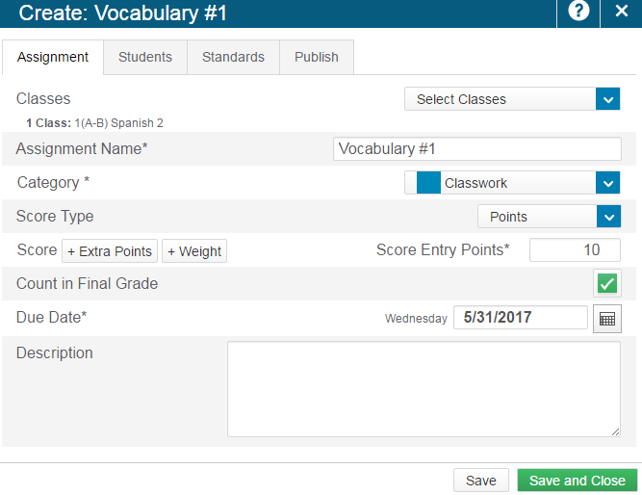
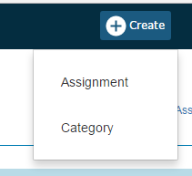
Create an Assignment
Notes:
Create>Assignment
-can override category default on assignments
-choose due date (populates to today if not changed)
-if multiple classes, can set multiple dates using +Per Class button
Create assignment once across all classes --- creates a shared anchor point
When duplicate or copy assignments --- creates individual anchor points
Caution if deleting an assignment with a shared anchor point - all connected assignments in all classes will be deleted whether scored or not. Advised to edit the assignment instead of deleting and deselect (uncheck) the Class that no longer needs this assignment.

Slide 37
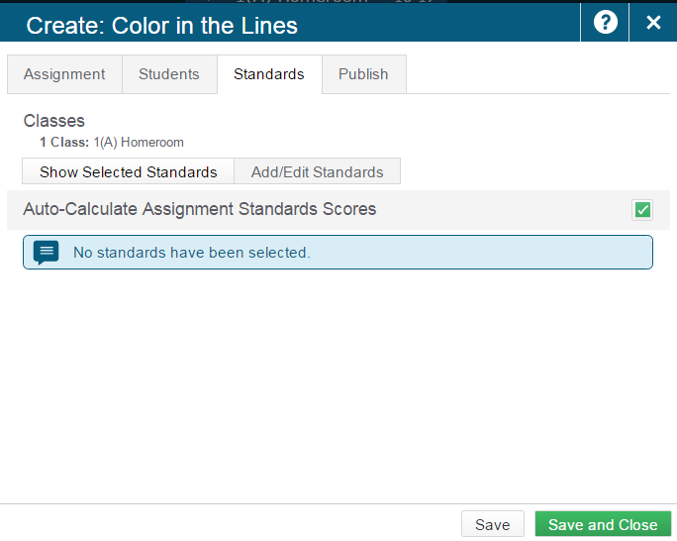
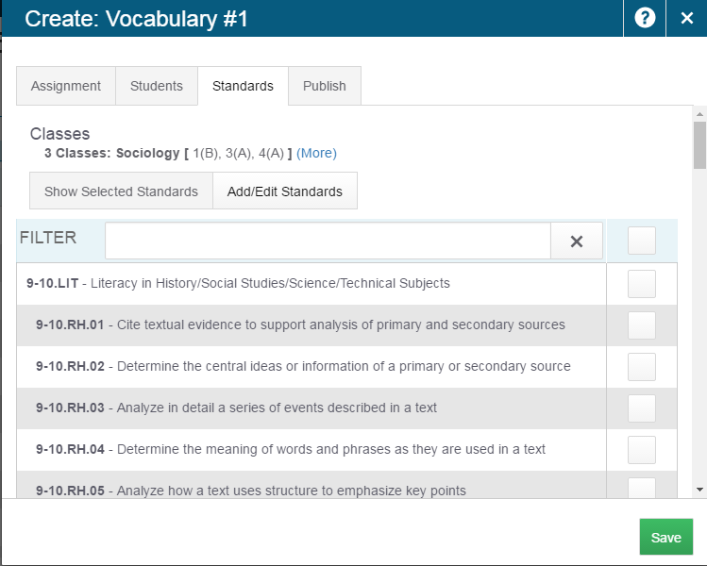
Create an Assignment - Standards Tab
Notes:
Select Show Selected Standards, and then check Auto-Calculate Assignment Standards Scores to automatically calculate standards scores from assignment scores. For more information, see Auto-Calculate Assignment Standards Scores.
Select Add/Edit Standards, and check the boxes next to the standards you want to associated to this assignment. Use the Filter field to limit the number of standards that appear. Once the standards are filtered, you can use the checkbox next to the Filter field to select those filtered standards.

Slide 38
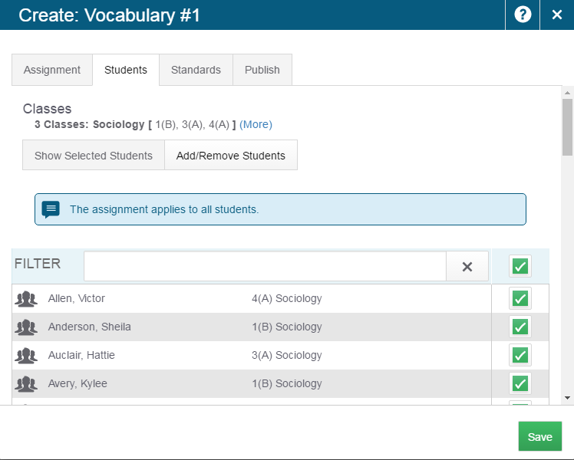
Create an Assignment - Students Tab
Only students with checked boxes will see the assignment.
Notes:
-can have only certain kids to get an assignment
-only student with checked boxes will see the assignment
-can set up standards too

Slide 39
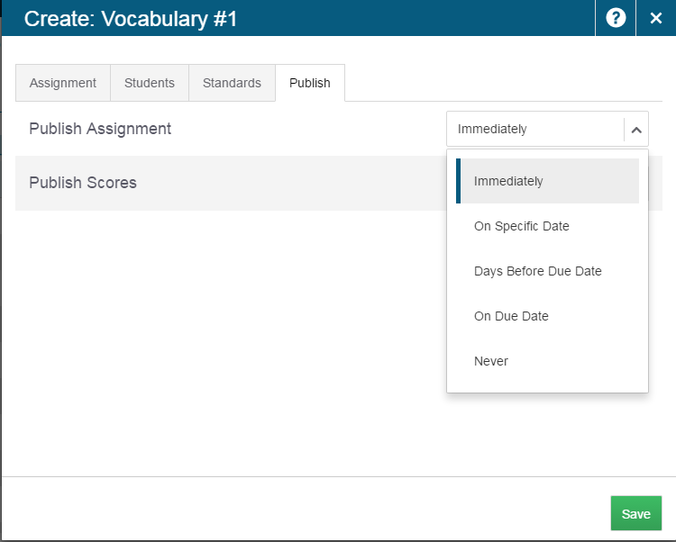
Create an Assignment - Publish Tab
Select the Publish tab to set when the assignment will be shared with parents and students on the PowerSchool Student and Parent portal. Use the Publish Assignments menu to choose when the assignments will be published. Select the Publish Scores checkbox to share the assignment score.
Notes:
Never - if the assignment does not count in the final grade (for example if you are giving a pre test, you may not want this to be used in final grading)

Slide 40
Activity - Create one or more Assignments
Select Create and then choose Assignment.
Select the classes for this assignment
Choose/enter assignment information.
Select the score type for this assignment.
To include the assignment in final grade calculations, verify that Count in Final Grade is selected.
Choose a due date for the assignment.
If multiple classes have been selected, use the +Per Class button to define different due dates for each class, if needed.
Description can include detailed information about the category.
use plain text, HTML, or a combination of both.
Select the Students tab to choose only specific students for which this assignment applies, if applicable.
Select the Standards tab to choose standards to apply to the assignment and whether or not they count in standards grades.
Select the Publish tab to set when the assignment will be shared with parents and students on the PowerSchool Student and Parent portal.
Use the Publish Assignments menu to choose when the assignments will be published.
Select the Publish Scores checkbox to share the assignment score.
Select Save when finished.
Notes:
Select Create and then choose Assignment. On the Assignment tab, select the classes for this assignment from the Select Classes menu . Classes will default to match the class or group of classes you have selected, but can be changed as needed. Choose/enter assignment information. Use the Score Type menu to select the score type for this assignment. The fields change specific to your selection. See Score Types. To include the assignment in final grade calculations, verify that Count in Final Grade is selected. Select the calendar icon to choose a due date for the assignment. If multiple classes have been selected, use the +Per Class button to define different due dates for each class, if needed. Description can include detailed information about the category. This information may be shared with administrators, parents, and students. Enter the description of the assignment using plain text, HTML, or a combination of both. Select the Students tab to choose only specific students for which this assignment applies, if applicable. By default, the assignment will apply to all students in the selected classes. To apply the assignment to just a selection of students, click Add/Remove Students. Then clear the checkbox next to the Filter area and check the boxes next to the selected students’ names. Select the Standards tab to choose standards to apply to the assignment and whether or not they count in standards grades. Select Show Selected Standards, and then check Auto-Calculate Assignment Standards Scores to automatically calculate standards scores from assignment scores. For more information, see Auto-Calculate Assignment Standards Scores. Select Add/Edit Standards, and check the boxes next to the standards you want to associated to this assignment. Use the Filter field to limit the number of standards that appear. Once the standards are filtered, you can use the checkbox next to the Filter field to select those filtered standards. Select the Publish tab to set when the assignment will be shared with parents and students on the PowerSchool Student and Parent portal. Use the Publish Assignments menu to choose when the assignments will be published. Select the Publish Scores checkbox to share the assignment score. Select Save when finished. You can immediately begin scoring the new assignment by selecting Score Assignment at the top of the screen. When you save an assignment, Duplicate and Delete buttons appear on the Edit window. You can copy the assignment you just created, or delete it.

Slide 41
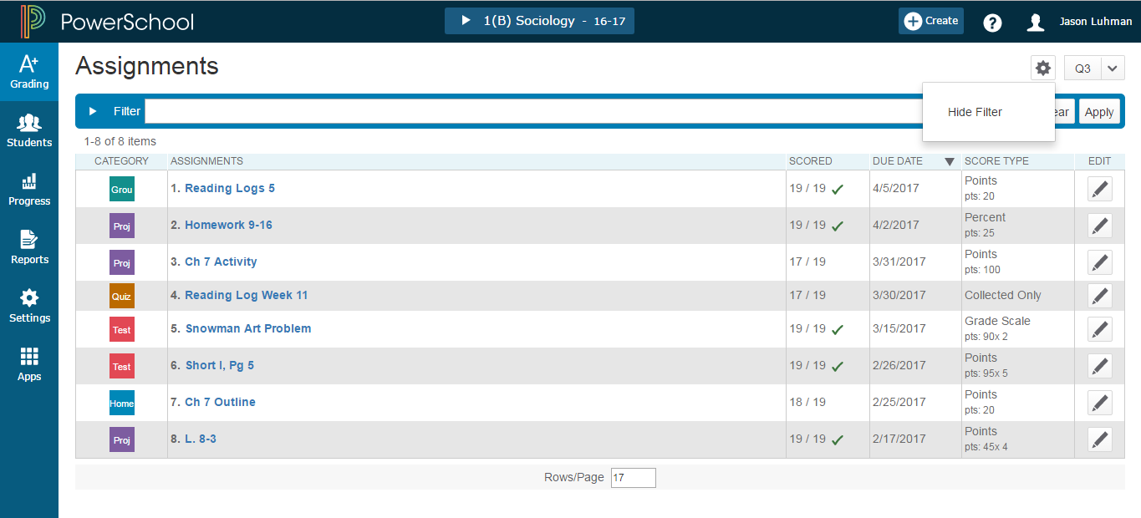
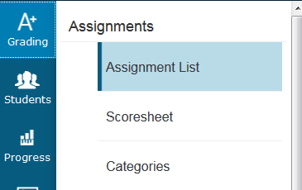
Working with Assignments
Lists assignments in chosen term
Shows Category and link to assignment
Sort columns by clicking on the column titles
Checked means all students have submitted the assignment
Notes:
Can show and hide filter
-list assignments in that term
-category and link to assignment
-sortable columns
-Checked means all students have submitted the assignment
23/23--23 assignments marked out of 23 students

Slide 42
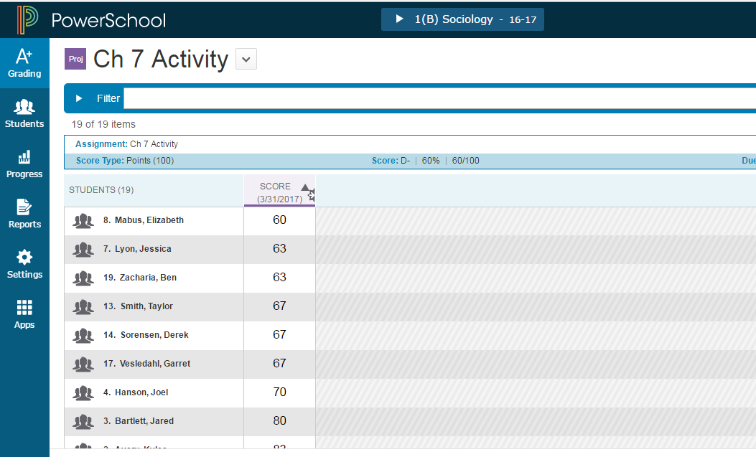
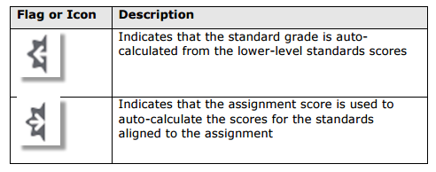
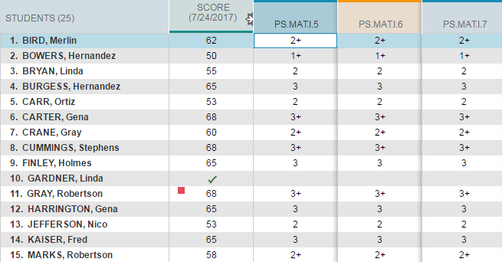
Assignment List
Can click on hyperlinked names
Push Notification (auto-calculate) on score to or from Standards
Columns can be sorted
Notes:
Clicked assignment
Can click on hyperlinked names
-push notification on score
Can be sorted
You can select if you want the assignment score to auto-calculate the standards scores. 1. Select an assignment name on the Assignments page or the Scoresheet. 2. On the Standards tab of the Edit Assignment dialog, select the checkbox if you want the assignment score to auto-calculate to standards scores.

Slide 43
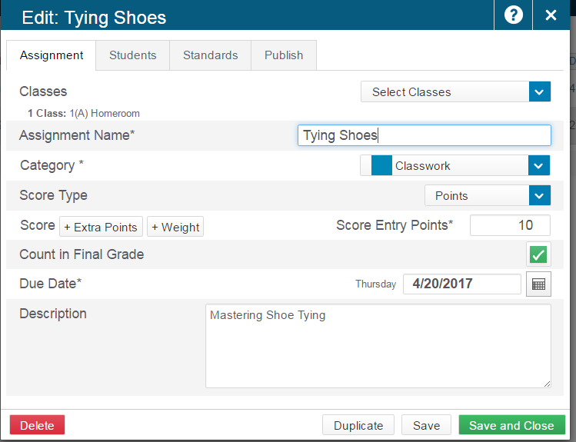
Duplicate an Assignment
Select the Edit icon next to the assignment name on the Assignments Lists page. Select Duplicate. The Assignment Name is automatically highlighted, and is appended with a number. Edit the assignments details and click Save. You can immediately begin scoring the new assignment by selecting Score Assignment at the top of the screen.
Notes:
-now you can duplicate the assignment and change the name (it automatically adds a ‘1’ to the end of the duplicated assignment name)
-can do this across classes too
-be careful when deleting them
Create assignment once across all 3 of her classes --- has a shared anchor point
When duplicate or copy assignments --- it creates individual anchor points

Slide 44
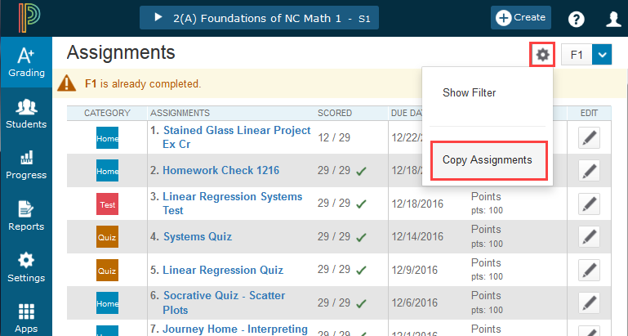
Copying an Assignment
Notes:
Copy function is found in the ‘Gear’

Slide 45
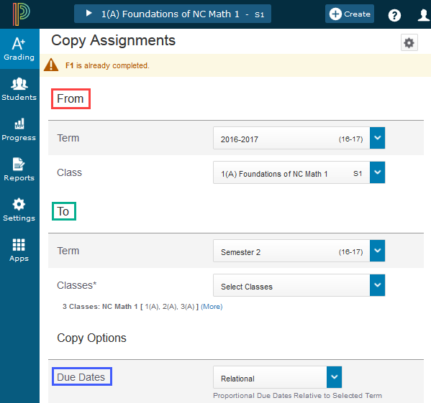
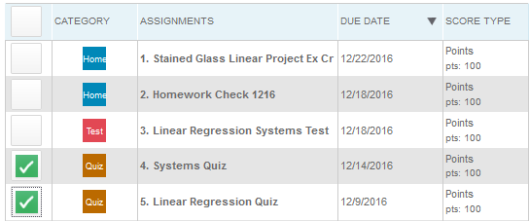
Copying an Assignment
Select the term and class from where you want to copy the assignment(s).
Select the term and class(es) where you want the assignment(s) copied to.
Choose how the due dates of the newly copied assignments should be created.
Exact - uses same date as existing assignment
Relational - creates a date the same number of days from the existing assignment term in the next term. (Ex: existing assignment created 10 days from beginning of the term -- system will calculate a date 10 days from the new assignment term)
Custom - pick a due date from the calendar icon
Check the boxes of one or more assignments that you want copied.
At bottom of screen - Click ‘Copy Assignments’ button

Slide 46
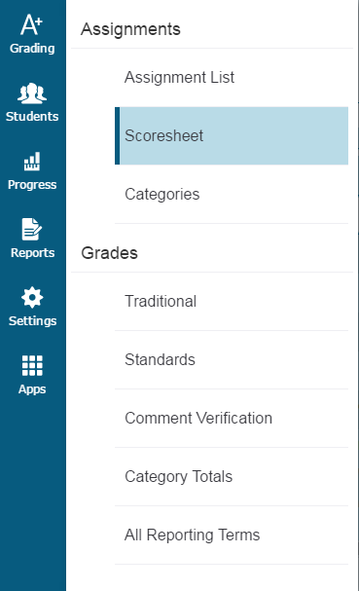
Assignment : Scoresheet
Notes:
Grades are for End of Term

Slide 47
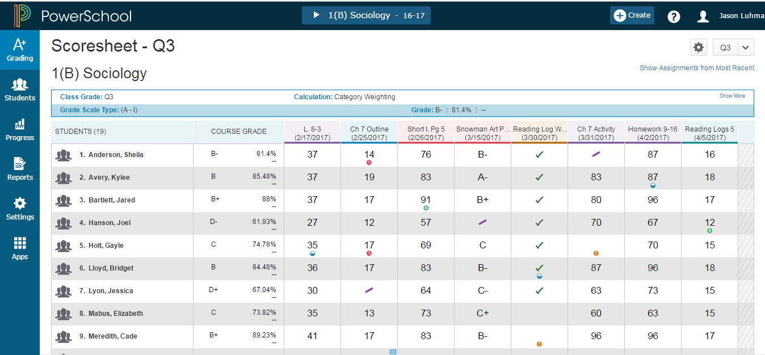
Score Sheet
Calculated final grade
Notes:
Scoresheet
-Grade column for final grade
-Can change view to show assignments from least recent
-will go into assignments with a click
-under gear you can see most recent first
On the charms bar, select Grading, and then select Scoresheet.
Select Show Assignments from Most Recent to sort assignments by date.
To view the scoresheet for a group of classes, choose the group from the Class Selector, then use the Scoresheet Quick Menu to easily switch between the classes within the group.

Slide 48
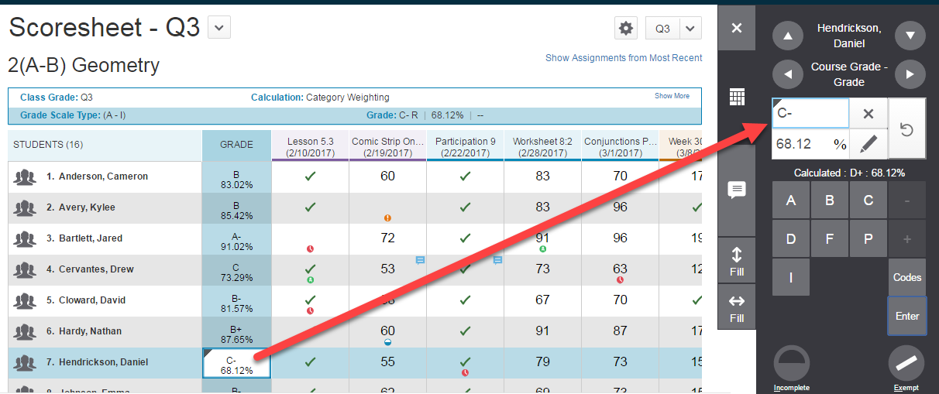
Score Assignments
Manual override triangle
Notes:
Locate the assignment you want to score, and enter the students’ assignment scores in the Score column.
If standards are aligned to the assignment, enter the standards scores in the standards columns. Use the arrow keys on your keyboard or the arrows at the top of the Score Inspector to move to different score cells.
To change the term, make a selection from the Reporting Term menu in the upper right portion of the page.
Use the summary area to view details or make changes to an assignment.
Select the assignment name in the column heading to view a single assignment on the Scoresheet.
If you want to see more students on this page, use the View selector.
Select Save when you are done entering scores.
If the letter grade is manually overwritten the percentage is NOT automatically changed ... it must be manually changed separately.

Slide 49
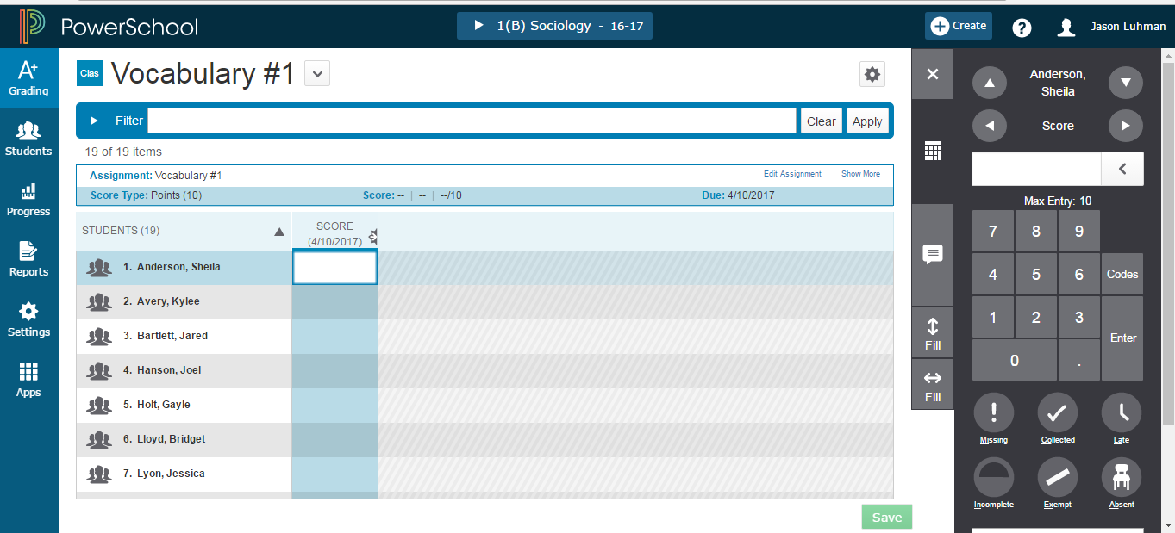
Assignments Flags
Notes:
Will push grade to future grade if this assignment on standards
-show how ‘tag’ functionality
-edit assignment -show more: get to SPECIAL Codes
-score indicators (missing, collected, late, etc..) -exempt-purple slash in box
-if there is a grade, the grade will appear in purple if exempt -can put in “hot keys” with letters
-score inspector (icon that looks like calculator) -comment
** NC Traditional Report Cards pull from one term only! Remember this and train teachers which term to enter their comments in if it needs to show on the NC Traditional Report Card.

Slide 50
Fill Grades, Scores or Comments
Notes:
5. Fill Grades, Scores, or Comments Use the Fill functions to either fill grades or scores for one final grade, or one assignment, for all of the students in a class, or to fill all final grades or all assignment scores for just one student. To fill students’ grades or scores vertically: Select the applicable grade or score cell. Enter the grade or score, select a score flag, or enter a comment in the Score Inspector. Select the Fill icon with the vertical arrows . If a comment exists in the selected field, a pop-up menu appears. For assignment scores, select Scores, Flags, and Comments to fill in all blank score fields for an assignment with the comment, score, and flags you have currently selected on the Score Inspector. For final grades, this option will be called Grades, Flags, and Comments. Select Comments Only to fill in all rows that do not currently have a comment. Grades or scores, and flags will not be affected. Only the comment will be filled. To fill students' grades or scores horizontally: Select the applicable grade or score cell. Enter the grade or score, or select the score flag, or enter a comment in the Score Inspector. Select the Fill icon with the horizontal arrows . Grades or scores, flags, and comments will be filled in cells that do not already have content. The Comments Only option is not available when filling horizontally. Note: Fill will modify fields that will accept the filled value. For example, if you have a 10 point POINTS assignment and a 10 point PERCENT assignment, filling 10 would score both assignments with 10, so the student would receive a 10/10 for the POINTS assignment and a 1/10 for the PERCENT assignment as it is 10% of the assignment value.

Slide 51
Scoresheet Comments and Smart Text Fill
Gear in lower left of Grade means a standard grade was manually overridden
Notes:
Note: little gear in lower left of Grade means a standard grade was manually overridden
Can access district comment bank
-can favorite comments
-special codes can be create by the district
To enter comments manually:
Select the text field at the bottom of the Score Inspector, or select the Comment icon on the Score Inspector and select the larger text field.
Enter comment text. A comment icon appears in the table for the selected field, indicating that a comment exists for that score or grade.
To select comments from the Comment Bank:
Select the Comment icon on the Score Inspector.
Select the Comment Bank button.
To limit the comments that appear in the Comment Bank, enter information in the Filter field and then select Apply.
Select the star next to a comment in the bank to set it as one of your favorite comments. You can then sort the list to display your favorite comments at the top of the list.
Select the checkbox next to one or more comments you want to add to the score.
Choose if you want comments separated by a line break or a space.
Select Insert Comments. A blue Comment icon appears in the student’s score cell. Click the icon to read the comment.

Slide 52
Using PowerTeacher Pro …………………..……………..……. slide 2
Accessing the Gradebook 6 …………………………………..….. slide 4
→ Navigating the Gradebook
Viewing and Adding Class Descriptions …………………...….. slide 12
Setting Up Display Preferences ………………………………….. slide 15
Setting Up Grading Preferences …………………………………. slide 17
Working with Categories and Assignments ……………..…….. slide 23
Working with Grades ……………..………………………. slide 52
Analyzing Performance ………………………………………….... slide 61
Running PowerTeacher Pro Reports ……………..…………….. slide 77

Slide 53
A+ Grading> Grades: Traditional
Notes:
A+ Grading> Grades: Traditional
-score column (Q3 final grade shown)
-tallied information: can see absences, late, missing , incomplete
-does have citizenship option-not pictured here (SNU)

Slide 54
A+ Grading > Grades: Standards
Notes:
A+ Grading>Grades: Standards
-shows standards grading for any standard in that term
-remember to fix those “never” for grades showing if needed
-system will calculate based on options
-lightning bolt (professional judgement indicator)-make a judgement about grade (typically do this in student view)

Slide 55
Review Flags, Tags and Icons
Notes:
Review the scoresheet with participants

Slide 56
Changed Grade Tag
Notes:
-tag will appear for changed grade
-report comments will appear on this column

Slide 57
Working with Final Grades
Notes:
circly arrow takes out override traingle on final grade calculation, returns the original calculation and leaves a pink box outline, pink box outline goes away when page is saved

Slide 58
Navigation under Quick Menu
Notes:
Can navigate via top drop down
-live page to change info

Slide 59
A+ Grading > Grades: Category Totals
Notes:
Category totals -not workable, just review only
Use this page to assess how students performed in one assignment category versus another, or to analyze the difficulty of one category type versus another. For example, if students received significantly lower scores on assignments in the Homework category than in the Test category, you might revisit the homework assignments and analyze the difficulty.

Slide 60
A+ Grading > Grades: Reporting Terms
Notes:
-current term is highlighted
-working area
-can look at an old comment to build on new comment
Use this page to work with the final grades for all reporting terms. Each column represents a reporting term. The column that corresponds to the current term is highlighted.

Slide 61
Using PowerTeacher Pro ………………………..…………..…. slide 2
Accessing the Gradebook 6 …………………………………..….. slide 4
→ Navigating the Gradebook
Viewing and Adding Class Descriptions …………………...….. slide 12
Setting Up Display Preferences ………………………………….. slide 15
Setting Up Grading Preferences …………………………………. slide 17
Working with Categories and Assignments ……………..…….. slide 23
Working with Grades ………………………………………………. slide 52
Analyzing Performance ………….…………………….... slide 61
Running PowerTeacher Pro Reports ……………..…………….. slide 77

Slide 62
Progress > Traditional Grades Progress
The Traditional Grades Progress screen provides a graphical view of the grade distribution across the selected class. The column on the left lists the number of students who have earned each traditional grade in the grade scale. The colors in the graph correspond to the grade scale color levels. To the right of the graph, view a summary of the total number of students who have missing, late, or incomplete assignments.
Notes:
Colors
-demarkation line: those progressing vs those not
-red-bad, green-good.
-click on bar graph to see grade distribution
-can select sections to compare (S1, S2)
The graph on the Traditional Grades Progress page shows the distribution of grades for the class for the selected reporting term. It also shows the aggregate totals for missing, late, or incomplete assignments. On the charms bar, select Progress and then choose Traditional. The class grades progress appears in a graph. Use the class selector to change to a different class, or to select a class group. Select Missing, Late, or Incomplete to view the Traditional Grades page with summary information on each category. Select the progress graph to view the Traditional Grades Distribution screen. Select and then select the Show Trend box. Deselect the Show Trend box to hide the trend column. Select the term you want to compare against. If you are working with multiple classes, you can select if you want the class grouped by student or by class on this screen. Select a Score Distribution chart to view the final grades and trend comparison. Arrows indicate if the grades are trending up or down against the selected comparison term. Select OK to close the screen.
The Traditional Grades Progress screen provides a graphical view of the grade distribution across the selected class.
The column on the left lists the number of students who have earned each traditional grade in the grade scale. The colors in the graph correspond to the grade scale color levels. For example, if the grade scale defines the grades A and A- as dark green, the graph displays a dark green bar that corresponds to the number of students who have an A or A-. The black demarcation line shows where the cutoff is between passing and failing grades. The numbers in the column on the right show the total number of students who have passing grades versus the total number of students who have failing grades.
To the right of the graph, view a summary of the total number of students who have missing, late, or incomplete assignments.

Slide 63
Progress > Standards Progress
Notes:
Progress>Standards Progress (kinda looks like Schoolnet!)
-same as traditional with clickable box
-assignments tell you how many times it has been assessed
The graph on the Standards Progress page shows the distribution of grades for each standard aligned to the course, for the selected class and reporting term.
If you are working with standards, this is the primary page you can use to manage standards and student progress for your class. The page provides an overall view of the standards for the class. From the Standards Progress page, you can assess which standards you may need to focus on to assure proficiency for the students in your class.
On the charms bar, select Progress and then choose Standards. The grade distribution graph for each standard appears.
Use the class selector to change to a different class, or to select a class group.

Slide 64
Students Charm
View student progress,
Manage communication,
Work with assignments.
Notes:
-defaults to current class at the top of page
Analyze performance throughout the term to ensure that students are mastering the skills and standards you are teaching. Review students’ performance as you prepare to complete final grades for report cards, and then use the gradebook to prepare for and conduct parent-teacher conferences.
Other pages in PowerTeacher Pro are optimized to display how an entire class is performing using the Progress pages. The individual student pages, however, provide more detailed information on an individual student. This is particularly useful for entering multiple of scores for a single student, and during parent-teacher conferences to explain why a student earned a particular grade.
On the charms bar, select Students.
Search for a student using the search field. Use the selection buttons to limit the search to a class or all classes for the teacher.
Select a Student View from the menu. The details for the student highlighted in the Students list appears.
Use the Quick Menu to navigate to other pages in the Students section of PowerTeacher Pro.
To view only dropped students, select Show Dropped.
Select a student name to view details for that student.

Slide 65
View a single Student’s Assignments
Notes:
Click on student to go to the last page you had opened but for the specific student (assignments page)
-can show and hide details (attendance, grade, % points)
-can filter
-will allow you to edit
-only show those assignments for this student
-can update grades from this page

Slide 66
View Standards on a single Student
Navigation: Students Charm > Assignments > Select a student > Under Standards click on a grade to open Assignment Standards Detail.
Notes:
Click standards to see specifics for that student

Slide 67
Students - Standards Progress
Notes:
Standards progress for students - how many assignment under Assignments list
-you may see the professional judgement icon again on this page
-check for investigation of grading issues

Slide 68
Students - Standards
Progress Graph
Notes:
-click assignments to see chart to determine if that grade is appropriate
-change grade if needed.
-due dates
-dashed blue line means missing grade for an assessment
-can drill own into “show more” for data
-each standard has a Standard grade

Slide 69
Extra Extra!!
Notes:
-the two little icons to the left of the geer -- one line shows 1 standard, double line shows multiple standards
-can look at specific standards
-using progress options you can add more standards to the graph

Slide 70
Students - Comment Log
Notes:
A+= final grade
-colorful squares= assignment comment
-will show class if in multiple classes
Use this page to review all comments entered for a student. Depending on the types of comments you’ve entered for the student, the comment log may show course grade comments, standards grades comments, and assignment score comments. On the charms bar, select Students. Locate the specific student and then select Comment Log. Select Filter to access the filtering options. Select to add filter settings for the assignment list. Use the pop-up menus to choose the filter options and search operators. Select Apply to execute the filter settings. Select a column heading to change the sort order of comments. Select a Grade/Score field to display the assignment summary information and the Score Inspector. Select the Comment icon on the Score Inspector to change the comment. Select Save.

Slide 71
Students > Demographics
Notes:
This page shows the student demographic information as entered in PowerSchool.
On the charms bar, select Students, and then select Demographics.
Use the Quick Menu links (the arrow next to the page heading) to navigate to other pages in the Students section of PowerTeacher Pro.
Notes: Currently Teachers cannot add additional columns like they can in PTG.
Student Emails do not populate to this demographics screen.

Slide 72
Quick Lookup - Traditional
Notes:
Quick look up screen=parent portal screen!!
-Snapshot of last two weeks of attendance; blanks mean present, dots in box means that class did not meet that day (elementary does not get dots)
-Course
-Terms
-Attendance information

Slide 73
Score Detail
Notes:
Click on grade to see more info
-Teacher comments
-Section description
-”I” icon means you can view more info on the right
-”Grid” icon- you can see standards on that assignment;if you collapse the standards you can see them in more detail. (parent)
Comment symbol is in the view area
-view will give you up to 3 tabs
-boxes to identify what has been flagged

Slide 74
Quick Lookup - Traditional > View Score Detail
Notes:
-click on view to see
-score comments
-assignment description
-category description (if applicable) -many ppl skip this

Slide 75
Quick Lookup - Standards
Notes:
Standards quick look up
-carrot will drop down standards
-only shows what has been assessed
-can adjust school years
This page is the same page that parents, students, and administrators see in PowerSchool and shows the student’s standards grades for all classes in the selected year.
On the charms bar, select Students, and then select Quick Lookup - Standards.
Use the Quick Menu to navigate to other pages in the Students section of PowerTeacher Pro.
Select a grade to view additional details, including the standards grade rollup. In cases where the same student is being assessed on the same standard (for example, Scientific Principles) in different classes at the same time (for example, Q1), the standards grades for each individual section are retained. In addition, they are averaged together to produce a rollup score. The high score is also stored.
Note: to turn off viewing Standards in Parent/Student Portal - it must be turned off by an Admin in PowerSchool. School > Parent/Student Access > Available Features tab > check the box to disable Standards viewing

Slide 76
Students > PowerTeacher Portal
Notes:
PT Portal link from a student’s page will drop you into that student’s back pack
-use select screens for more info
PT Portal link from the ‘Apps’ charm will drop you into the main page of PowerTeacher Porta.

Slide 77
Using PowerTeacher Pro …………………...……………..……. slide 2
Accessing the Gradebook 6 …………………………………..….. slide 4
→ Navigating the Gradebook
Viewing and Adding Class Descriptions …………………...….. slide 12
Setting Up Display Preferences ………………………………….. slide 15
Setting Up Grading Preferences …………………………………. slide 17
Working with Categories and Assignments ……………..…….. slide 23
Working with Grades ………………………………………………. slide 52
Analyzing Performance ………………………………………….... slide 61
Running PowerTeacher Pro Reports.…………….. slide 77

Slide 78
Reports
Working with Reports
PowerTeacher Pro offers a selection of reports to assist you in daily classroom activities, as well as with assessing student performance. You can generate reports for all students who are enrolled in a class, for all students who are enrolled in all your classes, or for specific students. Individual Student Report Multi-Function Assignment Report Scoresheet Report Student Roster Report
Notes:
Section Readiness Report is not available yet .... however, can use under A+ charm -> Grading -> Comment Verification --can be printed to hand in by the teacher to let office know they are done with their grades
Gradebook Preference under Students sort drop down means it will print the student’s preferred name but this functionality is not currently working as of 4/25/2017.

Slide 79
Individual Student Report Criteria Tab
Notes:
Individual student report
-scroll down (next slide)
-will let you sort by number, but will print by name (number is coming)
This is a multi-function report you can generate that is organized by student.
You can generate this report to compile the following information:
Progress reports
Missing and late assignments
Grades
Citizenship
Category totals
Assignment scores
Comments
Summary of student work to present a to parents at conferences or to a principal during a review
Midterm update for students and parent
This report displays all sections accessible by you. However, the name of the Lead teacher for each class displays on the report.

Slide 80
Individual Student Report Criteria Tab
Notes:
Which grades do you want to show

Slide 81
Individual Student Report Students Tab
Notes:
Select the students to print

Slide 82
Individual Student Report Format Tab
Notes:
Select the format of the report

Slide 83
Student Multi-Function Assignment Report
Notes:
Student Multi-Section Report -- districts are using this in PTG as a progress report (the PTPro Multi-Function Assignment Report is not sufficient at this point). PTPro needs something similar to Student Multi-Section Report (with assignments).

Slide 84
Scoresheet Report
Notes:
Run the Scoresheet report to generate a spreadsheet-style summary of student grade and assignment data. You can use this report to view final grades for all reporting terms and assignments that are within a specific date range, for all students.
1. On the Criteria tab, enter a report title in the field provided.
2. Select the classes and student field to include on the report from the provided menus.
3. In the Sort Options section, open the Students menu and choose how you want the students sorted on the report. The Gradebook Preference option defaults to the selection you made on the Display Settings page.
4. In the Items to Include section, choose the categories, final grades, and date range to include in the report.
5. Select the Students tab. Select Include Dropped Students to show dropped students on the report. If you want to run the report for a subset of students, select Add/Remove Students and use the Filter field to search for specific students. Uncheck the boxes next to the students you want excluded from the report.
6. Select the Format tab to specify how you want the report to look.
7. Select Run Report. When using most browsers, the file automatically downloads to the folder you have designated on your computer. When using Safari browser, the report output appears in a window. Choose File > Export as PDF to download the report to your computer.

Slide 85
Student Roster Report Criteria
Notes:
-can sort by birthday
-change the format (TAB) to what you want (excel)
-can create for bus listing or any other listing
Note: No medical alert column --- coming later.
This report displays student demographic information, listed one row per student. You can use this report to generate a list of demographic information by class. By adding blank columns and naming them to fit your needs, you can use this report to keep track of money collected for classroom field trips, or as an emergency contact list. Report Tip: If you previously used the Attendance Grid report in PowerTeacher Gradebook, you can now use the Student Roster report to create a grid of students with blank columns in order to take attendance offline for a field trip, assembly, our outside activity.

