Slide 1
Office Of Civil Rights Data Collection (OCR / CRDC)
State Level Submission Project Status Update
June 19, 2015
Terra Dominguez
State OCR Coordinator
terra.dominguez@dpi.nc.gov

Slide 2
High Level Info
OCR – Office of Civil Rights
CRDC – Civil Rights Data Collection
National Data Collection
Collected every two years
Previous year data
Originally Presented: 10/21/2014

Slide 3
Federal Submission Dates
Submission begins Feb 2015
75 business days to complete submission
We hope to be done much sooner ☺
Originally Presented: 10/21/2014
Updated: 12/2/2014, 1/20/2015

Slide 4
Communications
All communications are sent to staff designated as the ‘OCR Coordinator’.
All communications are then sent via the NC SIS distribution list.
Please make every effort to route OCR notifications to the appropriate staff.
Originally Presented: 10/21/2014

Slide 5
About this Presentation
This presentation is a collection of each status update.
The presentation may be downloaded in full at: http://www.nc-sis.org/course_list.html
Slides from previous updates/webinars have been hidden to allow attendees to focus on current information.
Originally Presented: 11/4/2014

Slide 6
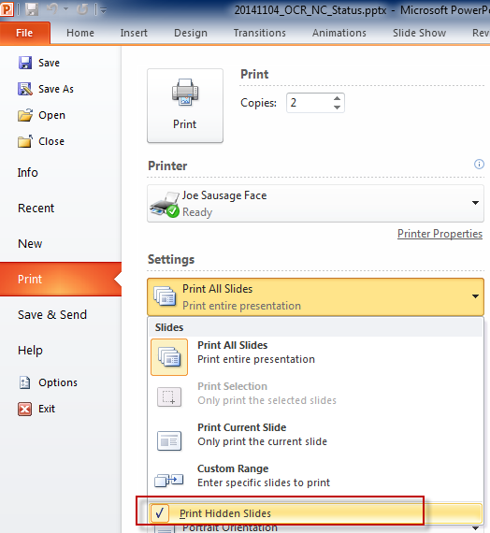
About this Presentation…
Slides that are hidden will print if your print settings are not updated.
If you are using this presentation to follow along with the Status update, the following is recommend:
Click File
Click Print
From Settings, click the Print All Slides drop-down
Uncheck Print Hidden Slides
Originally Presented: 11/4/2014

Slide 7
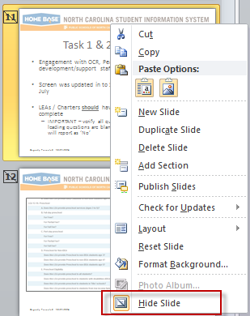
About this Presentation…
To use hidden slides for re-delivery :
Download and open the original PowerPoint file
From the left pane, right click slide
Click ‘Hide Slide’
Originally Presented: 11/4/2014

Slide 8
Updates to Formatting
November 4:
Page numbers
Page numbers do not update if a slide is hidden
‘Originally Presented’ date
Latest ‘Known Issues’ stamped with
December 2:
Slides may be re-ordered
‘Updated’ date added to original date of slide
‘Known Issues’ that are resolved stamped with
Originally Presented: 10/21/2014
Updated: 12/2/2014

Slide 9
Project Tasks
Evaluate SY 13/14 requirements for CRDC
Build CRDC specific screens
Load all student data into PowerSchool
Develop PowerSchool CRDC report logic
Create state level submission files (inclusive of all data requested)
Participate in Federal pilot project
Submit data to the OCR
Review data in Federal tool (LEA level task)
Correct any erroneous data (Collaborative task)
Re-submit (if needed)
Approve Federal Submission (LEA level task)
Originally Presented: 10/21/2014

Slide 10
Task 1 & 2 - Complete
Engagement with OCR, Pearson and SAS development/support staff
Screen was updated in to SY 13/14 Federal Requirements in July
LEAs / Charters should have LEA and School Level forms complete
IMPORTANT – verify all questions have been answered. If leading questions are blank / NULL, any subsequent question will report as ‘No’
Originally Presented: 10/21/2014

Slide 11
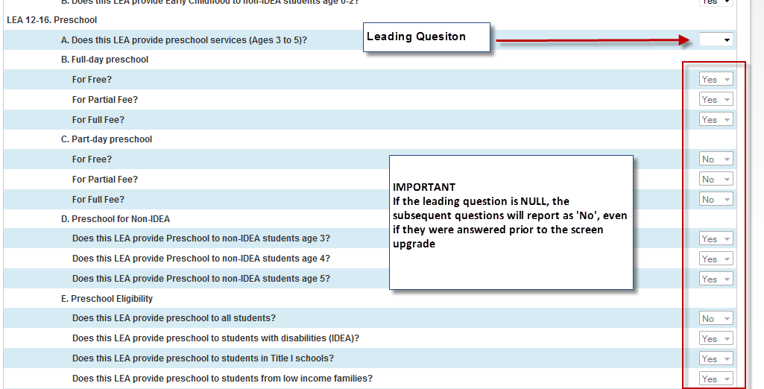
Example
Originally Presented: 10/21/2014

Slide 12
Exclude from CRDC Report (<300 schools)
Include if:
PK center (location)
Private school student receiving services (location)
Student is receiving services but does not attend a public school
Originally Presented: 10/21/2014

Slide 13
Exclude from CRDC Report (<300 schools)…
Exclude if:
Used for grouping; student ADM is associated to another school
Used for assignment / evaluation
FTE School
Unused ‘program’ schools
Originally Presented: 10/21/2014

Slide 14
More Info on Program & <300 Schools
Each LEA is using the NC DPI Program Schools differently and has the opportunity to create schools numbered below 300 in PowerSchool for their own local use.
The NC DPI wants students receiving services included in the OCR counts.
Previously this data was reported in the ‘000’ school. The NC DPI will work with the OCR on how / where the data should be reported. This is a pending item.
Originally Presented: 10/21/2014

Slide 15
One More Thing On <300 Schools…
Schools <300 are not connected to the Education Directory & Demographic Information Exchange (EDDIE)
LEAs / Charters must complete the School Information screen in PowerSchool for each school created at the local level to the fullest extent possible.
If you have questions, issues or concerns please contact the Support Center.
Originally Presented: 10/21/2014

Slide 16
Tasks 3, 4 & 5 - in Progress
3rd Party users
Have been notified and provided import procedures and due dates
Data loaded by the NC DPI in November:
LEP
SAT / ACT
AP Exams
Section 504 – let’s talk..
Originally Presented: 10/21/2014

Slide 17
Section 504 Records in PowerSchool
Data due by LEAs October 17, 2014
CRDC is not reporting on accommodations
Can be added to withdrawn/transferred and graduated student records
Section 504 designation is a local policy
Records in PowerSchool should reflect the start and end dates of the Section 504 designation/plan within your LEA.
Originally Presented: 10/21/2014

Slide 18
Section 504 Records in PowerSchool…
Section 504 designation is a local policy
Records in PowerSchool should reflect the start and end dates of the Section 504 designation/plan within your LEA.
End dates are not required unless:
Student’s plan ends
Student is no longer eligible for Section 504
Originally Presented: 10/21/2014

Slide 19
Section 504 Records in PowerSchool…
Entry Date must be on or before Oct. 1, 2013 to be included in the CRDC
Scenario (Section 504 record) | On CRDC SY 13/14?
Entry Date = 9/17/07, Exit Date = null | Yes
Entry Date = 10/01/13, Exit Date = null | Yes
Entry Date = 10/01/13, Exit Date = 7/14/14 | Yes
Entry Date = 9/17/07, Exit Date = 9/29/13 | No
Originally Presented: 10/21/2014

Slide 20
CRDC Reports in PowerSchool
Still in Development
Must be run at the LEA level
Run in SY 14/15
Do not have Exceptions
Will not need Approval
School level reports include detail views:
Students
Courses
Submission End Date in PowerSchool is will be updated
Originally Presented: 10/21/2014

Slide 21
CRDC Report Known Issues
Scenario | Action/ Resolve
Incorrect Grade Levels CRDC Reports are showing incorrect grade levels. For example: A middle school with PK students reports as having PK-8 and SY 13/14 EDDIE data is accurate. | Resolve: November Maint Wknd Action: Contact the Support Center if your SY 13/14 EDDIE grade levels are not accurate.
IB Program Indicator Reporting courses based on 4th Character | Resolve: November Maint. Wknd
Low / no course enrollment counts | Resolved: November Maint. Wknd
Red Dot of Death | Action: <300 School: terms – are they missing SY 13/14? Do you need it? No = exclude from CRDC New school: terms – are they missing SY 13/14? Yes = exclude from CRDC ( they weren’t there in SY 13/14)
Originally Presented: 10/21/2014

Slide 22
State Submission Files
State level files are in development in parallel with tasks 3 and 4
First iteration due Oct 17, 2014
Includes data from other systems as requested by the OCR
Originally Presented: 10/21/2014

Slide 23
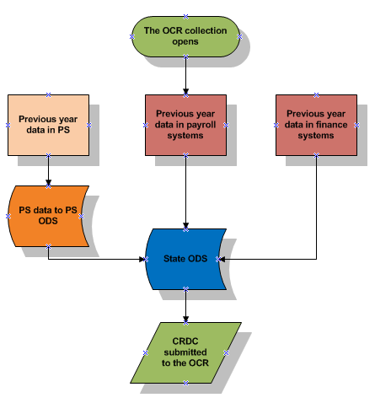
The ‘Other’ Data
Originally Presented: 10/21/2014

Slide 24
Tasks 6 & 7
The NC DPI will participate in the federal pilot
Pilot scheduled to begin week of Oct 20, 2014
Once CRDC reports are complete, LEAs will be notified to run the reports and review the data
LEAs are welcome to run the report prior
LEAs will be notified of the NC DPI federal submission date
Originally Presented: 10/21/2014

Slide 25
Tasks 8, 9 & 10 - Pending
As Federal/State/Local processes becomes solidified, notifications will be sent to OCR Coordinators and NC SIS Coordinators regarding:
Access to Federal Tool
Correction methods
Approval Process
Originally Presented: 10/21/2014

Slide 26
November 4th Agenda
November 4th Status Updates
Review of Known Issues / Recent Fixes
November 14th PowerSchool Maint. Weekend
Reviewing CRDC PowerSchool Data
‘What If’s and Reminders
Originally Presented: 11/4/2014

Slide 27
November 4th Status – Complete
LEAs should have completed:
LEA and School level CRDC PowerSchool Screens
Communication sent 9/22/2014 by Terra Dominguez / NC SIS
SY 13/14 Section 504 records in PowerSchool
Communication sent 9/30/2014 by Terra Dominguez / NC SIS
QRD located: http://www.nc-sis.org/student_information.html
Updates to Incident data (Zero Tolerance)
Communication sent by10/6/2014 by Ken Gattis / NC SIS / Terra Dominguez
Originally Presented: 11/4/2014

Slide 28
November 4th Status – In Progress
Limited English Proficient (LEP)
50% complete
SAT / ACT / AP exam scores
25% complete
3rd party data loads (specific LEAs)
Pending templates from DPI
Originally Presented: 11/4/2014

Slide 29
November 4th Status – In Progress
State level submission file
25 % complete
First iteration of submission file delivered for review
The NC DPI is working with current existing data for testing
Testing in Federal tool - pending
First ‘true submission’ date - pending
LEAs will receive notification prior to first ‘true submission’ to allow final check of PowerSchool data
Originally Presented: 11/4/2014

Slide 30
November 4th Status- Pending
LEA submission validation process
State level Federal OCR webinar Nov 5th
Update on Federal submission window dates
Details of pilot phase expected
Information on Federal tool security anticipated
Originally Presented: 11/4/2014

Slide 31
PowerSchool Maint. Weekend – November 14th
Most fixes will be implemented during the November 14th PowerSchool Maintenance weekend.
OCR Coordinators should begin to examine their data carefully after these updates.
Please report all issues through the Home Base Support Center as soon as possible.
If unable to create a Remedy ticket, please contact Terra Dominguez at: terra.dominguez@dpi.nc.gov
Originally Presented: 11/4/2014

Slide 32
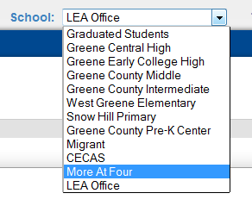
Reviewing CRDC PowerSchool Data
OCR Coordinators should have access to view all schools within the LEA/Charter
CECAS, Migrant, Homeless, DPI FTE School
Contact the PowerSchool Coordinator for appropriate access
LEA Level CRDC Reports are a collection of all schools that have not been Excluded from the CRDC reports
Review slides 11-14 for information on Excluding Schools <300 from the CRDC reports
Originally Presented: 11/4/2014

Slide 33
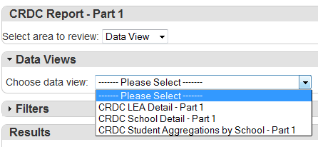
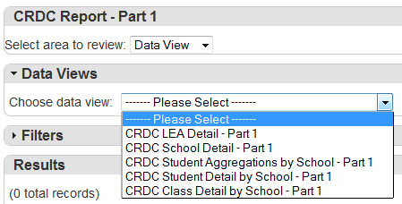
Reviewing CRDC PowerSchool Data…
LEA CRDC
PowerSchool CRDC Data Views have been formatted based on Part 1 and Part 2 of the Federal website’s OCR / CRDC documentation.
http://www2.ed.gov/about/offices/list/ocr/data.html
2013-2014 LEA Form
2013-2014 School Form
School CRDC
Originally Presented: 11/4/2014

Slide 34
Reviewing CRDC PowerSchool Data…
CRDC reports contain filters within the interface
Filters align with Categories (columns displayed within the interface)
Categories align with the OCR / CRDC documentation
CRDC reports can be exported to Excel
Allows filtering from Excel for quick review
User can navigate system to review settings, student records without losing CRDC output
Originally Presented: 11/4/2014

Slide 35
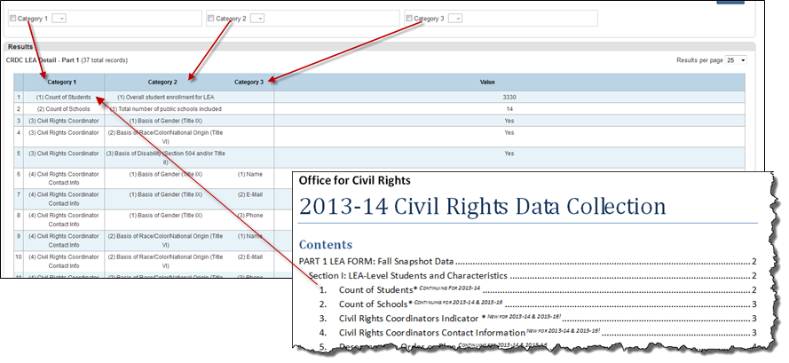
Reviewing CRDC PowerSchool Data…
Originally Presented: 11/4/2014

Slide 36
Reviewing CRDC PowerSchool Data…
School Level Reports have two additional views that allow staff to verify aggregate counts
Student Detail by School (Part 1 & Part 2)
List of all students enrolled as of October 1, 2013 and their indicators
Student Class Detail by School (Part 1 only)
List of all classes as applicable to the CRDC as of October 1, 2013
Originally Presented: 11/4/2014

Slide 37
December 2nd – Agenda
Status Update
Known Issues / Resolved Items
PowerSchool Dec 12 Maintenance Weekend
NC Public Schools OCR Website
Next Steps
Originally Presented: 12/2/2014

Slide 38
December 2nd Status - Complete
LEA and School Screen Data Entry
Section 504 records for SY 13/14
Zero Tolerance updates for SY 13/14 records
LEP data loads
SY 13/14 LEP data is visible on CRDC reports only
Originally Presented: 12/2/2014

Slide 39
December 2nd Status – In Progress
SAT, ACT and AP Exam scores
3rd Party data from select LEAs
PowerSchool CRDC reports
Federal Submission pilot
Originally Presented: 12/2/2014

Slide 40
December 2nd Status - Pending
Completion of PowerSchool CRDC reports
Notification of collection dates from OCR
LEA demonstration of Federal CRDC tool
Logins and security process
Process for reporting issues in the CRDC tool
Originally Presented: 12/2/2014

Slide 41
December 4th – NC Public OCR Website
Federal OCR Report Requirements Documents
Status Webinar link, recording's, presentation
OCR LEA / Charter Contacts
Archived Notifications
http://www.ncpublicschools.org/data/management/ocr/
Originally Presented: 12/2/2014

Slide 43
Who Should be an OCR Contact?
OCR Contacts will be the first staff members who are provided access to the Federal CRDC tool
Staff member who will approve the federal submission (business owner)
Staff member who will support collection process (technical or other staff)
Originally Presented: 12/2/2014

Slide 44
December 4th - Next Steps - LEAs
Review LEA and Charter Contact information
Provide the 10 elements requested on the website
Remedy ticket – Subject: CRDC Contact List
One ticket per LEA/Charter please
Identify technical contact
Identify staff who will approve submission
http://www.ncpublicschools.org/data/management/ocr/
Verify grade levels in all schools using EDDIE
Remedy ticket – Subject: CRDC Grade Levels
One ticket per LEA/Charter please
Originally Presented: 12/2/2014

Slide 45
January 6th - Agenda
Happy New Year!
Status Update
Known / Resolved Issues
NC DPI Courses for OCR
Adding CRDC Reports to Schools
Next Steps
Originally Presented: 1/6/2015

Slide 46
January 6th – Status - Complete
LEA and School Screen Data Entry
Section 504 records for SY 13/14
Zero Tolerance updates for SY 13/14 records
LEP data loads
SY 13/14 LEP data is visible on CRDC reports only
SAT, ACT and AP Exam Scores
SY 13/14 data is visible on CRDC reports only
Originally Presented: 1/6/2015

Slide 47
January 6th – In Progress
3rd Party data from select LEAs
PowerSchool CRDC Reports
Federal Submission Pilot
OCR Coordinators Contact List
Originally Presented: 1/6/2015

Slide 48
January 6th – Status - Pending
Completion of PowerSchool CRDC reports
Notification of Collection Dates from OCR
Demonstration of Federal CRDC tool
Login and Security Process
Process for Reporting / Correcting Data Issues in Federal CRDC tool
Originally Presented: 1/6/2015

Slide 49
NC DPI Courses for OCR
OCR Course | NC DPI Course Code (SY 2013-14)
Algebra I | 2100, 2101, 2102, 9320, 9321, 2103, 2104, 2105, 2106, 2107, 2108
Geometry | 2200, IX65, 2201, 2202
Algebra II | 2300, 2301, 2302
Advanced Math | 2400, 2401, 2402, 2403, 2404, 2405, 2407, 2500
Science | 3320, 3321, 3370, 9232, 9332, 9333, 3420, 3421, 3430, 3431
AP Math | Courses where first character is' 2' and fifth character is '7'
AP Science | Courses where first character is' 3' and fifth character is '7'
AP ‘Other’ | Courses where first character is not '2' or '3' and fifth character is '7'
IB Courses | No courses that begin with Alpha Char,6,7,8 and fifth character is '8' and student is in grades 9-12
Originally Presented: 1/6/2015

Slide 50
Adding CRDC Reports to Schools
Does not replace other required report settings
Specific to year
Can be used for any report in State Dashboards
Can be set at LEA or School level
If a school is not set to Display, does not impact LEA reports
Home Base Bulletin - 12/19/14
Originally Presented: 1/6/2015

Slide 51
Adding CRDC Reports – LEA Level
From LEA Office, navigate to State Reports.
Click the Details icon for selected report.
Click Show/Hide Collection From Schools.
Make the appropriate selection from the Display in Dashboard? drop-down for the applicable school(s).
Click Submit.
Originally Presented: 1/6/2015

Slide 52
PowerSchool CRDC Report Reminders
Run CRDC reports in the current year (Term 14-15)
Re-run reports each time there is an update to
Report logic
Student data
Course data
CRDC screens
Originally Presented: 11/4/2014

Slide 53
PowerSchool CRDC Report – ‘What If…’
‘What If…’ | Do this …
I want to see if my schools have completed the CRDC screens in PowerSchool? | Determine how many schools should be reporting View CRDC School Detail – Part 1 Filter or export and filter by school to peruse through the school level CRDC screen questions
My ‘Overall Student Enrollment’ (CRDC Student Aggregations by School- Part 1) looks wrong? I know I had ‘X’ number of students at the end of the year. | Was your student enrolled as of October 1, 2013? Students who were not enrolled on the snapshot date of October 1, 2013 will not be reported for the SY 13/14 CRDC.
I know my school had more classes than what is reported on the CRDC? | Was the class in second semester? Classes are counted as of October 1, 2013, unless the LEA schedules block courses. Second semester classes are not reported for the SY 13/14 CRDC.
My grade levels are reporting incorrectly? I see PK through 8th grade. I have PK and 6-8th grade only. | Are your SY 13/14 grade levels in EDDIE correct? Yes – Hold tight for the PowerSchool Nov Maint. weekend No – Submit a Support Ticket immediately
Originally Presented: 11/4/2014

Slide 54
Adding CRDC Reports to Schools
Does not replace other required report settings
Specific to year
Can be used for any report in State Dashboards
Can be set at LEA or School level
If a school is not set to Display, does not impact LEA reports
Home Base Bulletin - 12/19/14
Originally Presented: 1/6/2015

Slide 55
Next Steps
Review / Verify Contacts
January 20th – Demo of the Federal OCR Portal
Please continue to report PowerSchool issues!
Originally Presented: 1/6/2015

Slide 56
January 20th - Agenda
OCR Federal Portal Demo
Status Update
Known / Resolved Issues
EC Data
Correcting Previous Year Grade Levels
Next Steps
Originally Presented: 1/20/2015

Slide 57
2013-14 Civil Rights Data Collection (CRDC) Portal Demo
Abby Potts Research Analyst
Originally Presented: 1/20/2015, compliments of the OCR

Slide 58
What is different this year?
NEW opportunity for State Education Agencies (SEAs) to pre-populate CRDC forms with already collected data.
Redesign of the web tool with intuitive navigation and resources to accurately respond to questions.
Ability to grant permissions to schools, others in the district, or the state to upload or enter data.
New tools to view and respond to errors and warnings.
Originally Presented: 1/20/2015, compliments of the OCR

Slide 59
What Federal Resources are Available now?
Find survey materials, excel templates, tip sheets, and lists of data elements to prepare for the 2013-14 and 2015-16 CRDC
Originally Presented: 1/20/2015, compliments of the OCR

Slide 60
Resources
U.S. ED documentation is located: http://www2.ed.gov/about/offices/list/ocr/data.html. Download the “2013-14 Table Layouts with Definitions”
2013-2014 LEA Form
2013-2014 School Form
Full set of CRDC school-level questions for all schools and justice facilities, including high schools, and school with the highest grade no higher than 8 that offer Algebra I or Geometry
2013-2014 Elementary School Form
Only for schools with the highest grade not greater than 6
2013-2014 Elementary/Middle School Form
Only for schools with the highest grade not greater than 8 that do not offer Algebra I or Geometry
CRDC.GRADS360.org
Originally Presented: 10/21/2014,
Updated 1/20/15

Slide 61
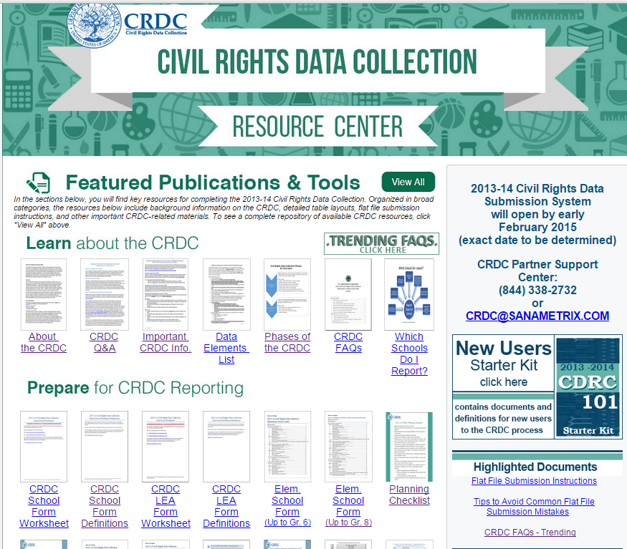
Learn about the CRDC including background information, FAQs, etc.
Opening and due date information.
New users starter kit.
Recently posted or updated documents
Originally Presented: 1/20/2015, compliments of the OCR

Slide 62
Select view all to access excel templates
Vendor letter
Originally Presented: 1/20/2015, compliments of the OCR
School expenditure tips

Slide 63
2013-14 CRDC Schedule
Timeline & What to Expect for the Upcoming Data Submissions
Originally Presented: 1/20/2015, compliments of the OCR

Slide 64
What should you expect for this CRDC?
Phase I: Contact & Directory
Identify a Primary Point of Contact for each school district
Phase II: Data Collection
Phase III: Data Reporting
Submission System Opens
Confirm the list of schools required to report CRDC data (e.g., schools serving students for at least 50% of the day).
School districts collect CRDC data over the course of the school year.
NC will submit data and Districts can certify their CRDC data to the U.S. Department of Education
Originally Presented: 1/20/2015, compliments of the OCR

Slide 65
Frequently Asked Questions
When will the new system open for school districts to submit data?
The new CRDC system will open in February 2015.
What is the due date for the 2013-14 CRDC?
LEAs will have at least 75 days to complete their data submissions after the system opens. Any delay in the opening date will also push back the due date for the CRDC.
Why is the opening delayed?
OCR and NCES needed additional time to test the system to ensure it works as intended for all types of school districts. Additionally, some school districts participating in a pilot of the new tool provided excellent ideas on ways to improve the system. We are working to incoporate those ideas to improve the experience for all LEAs.
Originally Presented: 1/20/2015, compliments of the OCR

Slide 66
How Usernames will be delivered?
Look for an email notification from the CRDC system asking you to confirm your email address. (Check spam filters)
Click on the link to confirm your email address. You then will be prompted to create a password.
Following verification of your account you will have immediate access to the CRDC system, and a confirmation email will be sent to you. Use your email and password for ongoing access to the system.
Originally Presented: 1/20/2015, compliments of the OCR

Slide 67
What does the new Federal tool look like?
2013-14 CRDC Submission System
Originally Presented: 1/20/2015, compliments of the OCR

Slide 68
Home Screen
New unique username & password for each users. Not the same as AWS username and password
Originally Presented: 1/20/2015, compliments of the OCR
Notes:
Previously the LEA username was the LEA ID.

Slide 69
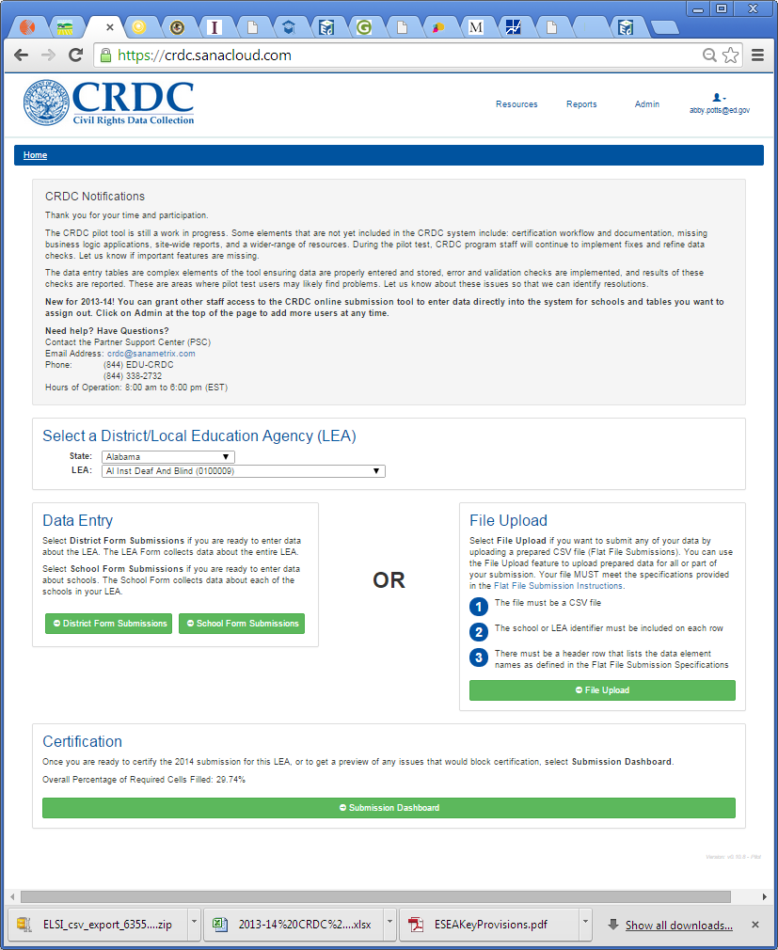
Comprehensive collection of all resources
Error & data reports
Add new users & manage permissions
Viewable for ED, SEA, and some charter schools
Updates and messages posted at the top of the screen.
Select csv file for upload
Review tables
Originally Presented: 1/20/2015, compliments of the OCR

Slide 70
ADMIN: New for 2013-14
Allow access to certain sets of questions on the CRDC to offices or school staff.
Designed for mid-sized to larger school districts
Examples Cases
Enable or Disable SEA access to CRDC forms
Provide the high school athletics director access to the interscholastic athletics data entry tables
Human Resource Office will be able to upload flat files with FTE counts directly into the system to pre-populate forms.
Pre-populate forms with data provided by SEAs
Originally Presented: 1/20/2015, compliments of the OCR

Slide 71
ADMIN
Step #1: Add new users to the CRDC
Step #2: Grant school-level or LEA-level permissions
Originally Presented: 1/20/2015, compliments of the OCR

Slide 72
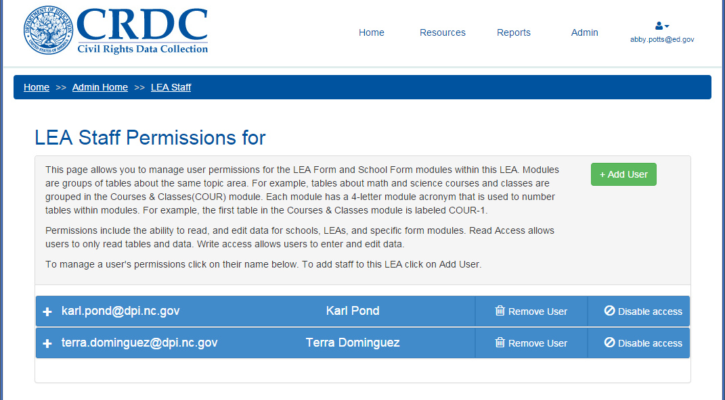
ADMIN
Add new users
Remove users
Manage access to CRDC modules & schools
NC LEAs will see NCDPI already has access to the CRDC site to pre-populate data
Originally Presented: 1/20/2015, compliments of the OCR

Slide 73
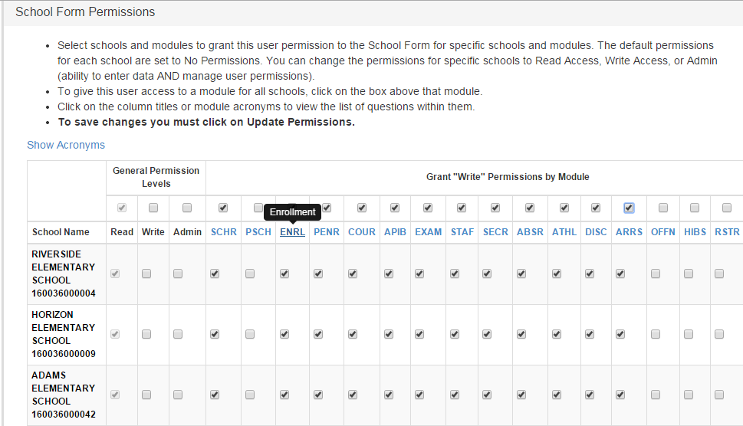
ADMIN
Manage permissions by school and/or by CRDC module
Originally Presented: 1/20/2015, compliments of the OCR

Slide 74
Data Web Screens
Data entry screens, error reports, and onscreen tips
Originally Presented: 1/20/2015, compliments of the OCR

Slide 75
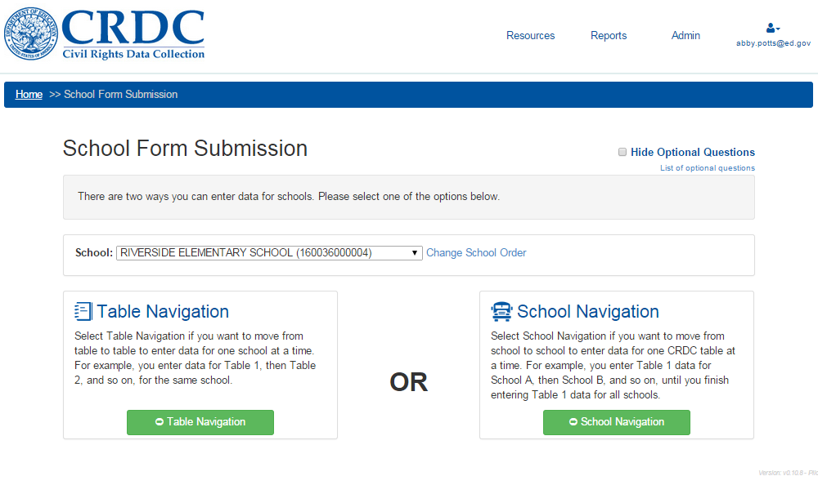
School Screens
Hide optional questions
Set sort order for schools.
New ability to navigate by school or by question.
Originally Presented: 1/20/2015, compliments of the OCR
Notes:
For SEAs providing some, but not all of the CRDC data

Slide 76
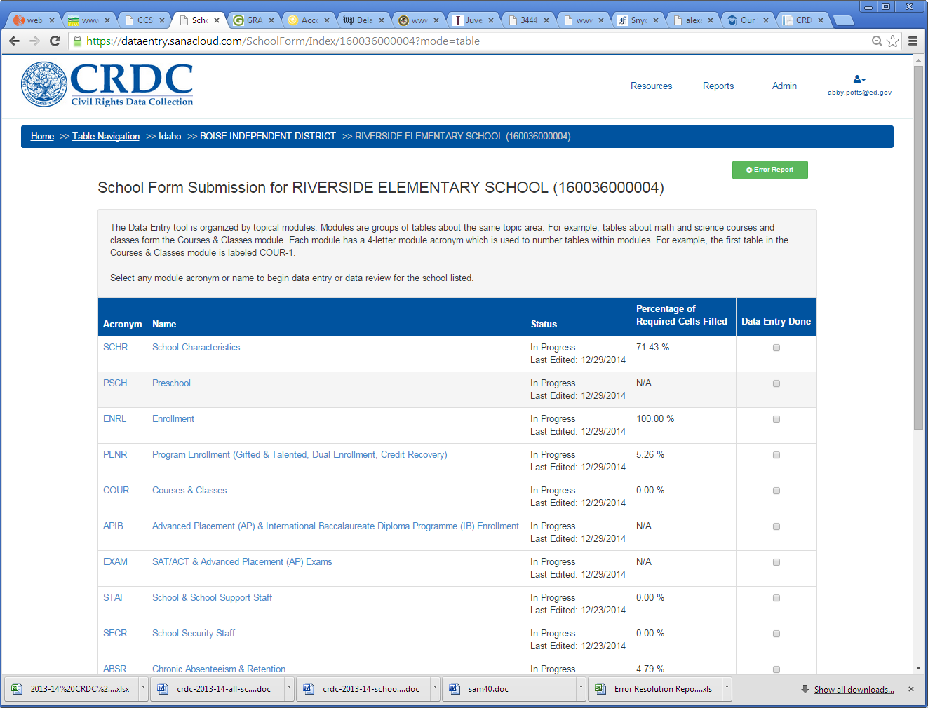
School Status Page
View errors and warnings in submission.
Navigate by “data modules”
Status of data entry: Date last modified and percent complete. Indication of whether the NC DPI has uploaded data.
Originally Presented: 1/20/2015, compliments of the OCR

Slide 77
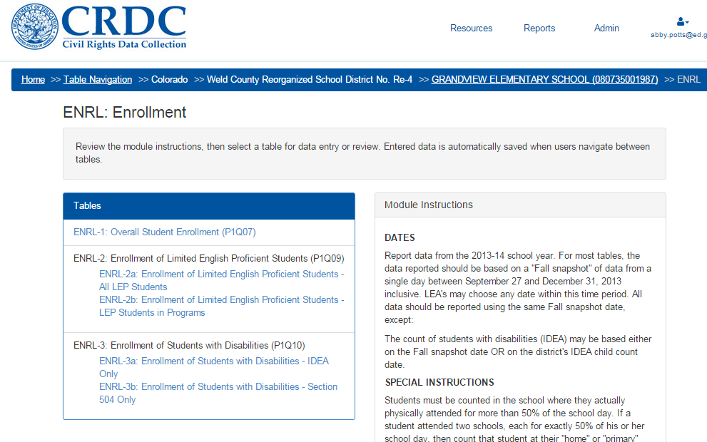
Module Landing Page
General instructions.
CRDC questions or tables. Information in parenthesis links back to the OCR survey form.
Originally Presented: 1/20/2015, compliments of the OCR

Slide 78
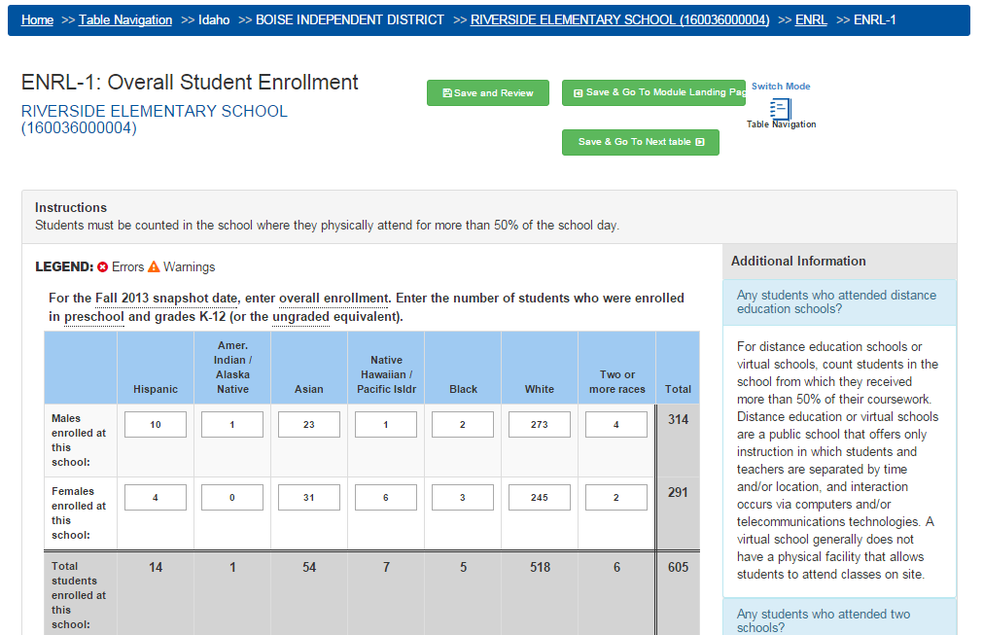
Data Screen
Switch between school mode and table mode navigation.
Review errors and warnings for this table.
“Data request”
Expandable Q&A’s specific to this question.
Auto-totals by race, gender, and grand total.
Originally Presented: 1/20/2015, compliments of the OCR

Slide 79
On-screen Warnings & Errors
Some errors can be resolved by a comment – triggering when plausible, but rare, scenarios occur.
For example, in an LEA with high student mobility, a fall enrollment count of 1 American Indian student is reported but 14 American Indian students chronically absent over the year. To resolve the error, select a reason code.
Warnings and errors will appear on the data entry screens.
Originally Presented: 1/20/2015, compliments of the OCR

Slide 80
Data reports
Downloadable Excel Files of Entered or Uploaded Data
Originally Presented: 1/20/2015, compliments of the OCR

Slide 81
Download a file of all data entered into the system (can also be re-uploaded).
Error report with list of warnings/errors. LEAs can provide comments, make changes to data, and re-upload the file to make corrections.
Originally Presented: 1/20/2015, compliments of the OCR

Slide 82
Additional Resources
Tip Sheets, FAQs, etc.
Originally Presented: 1/20/2015, compliments of the OCR

Slide 83
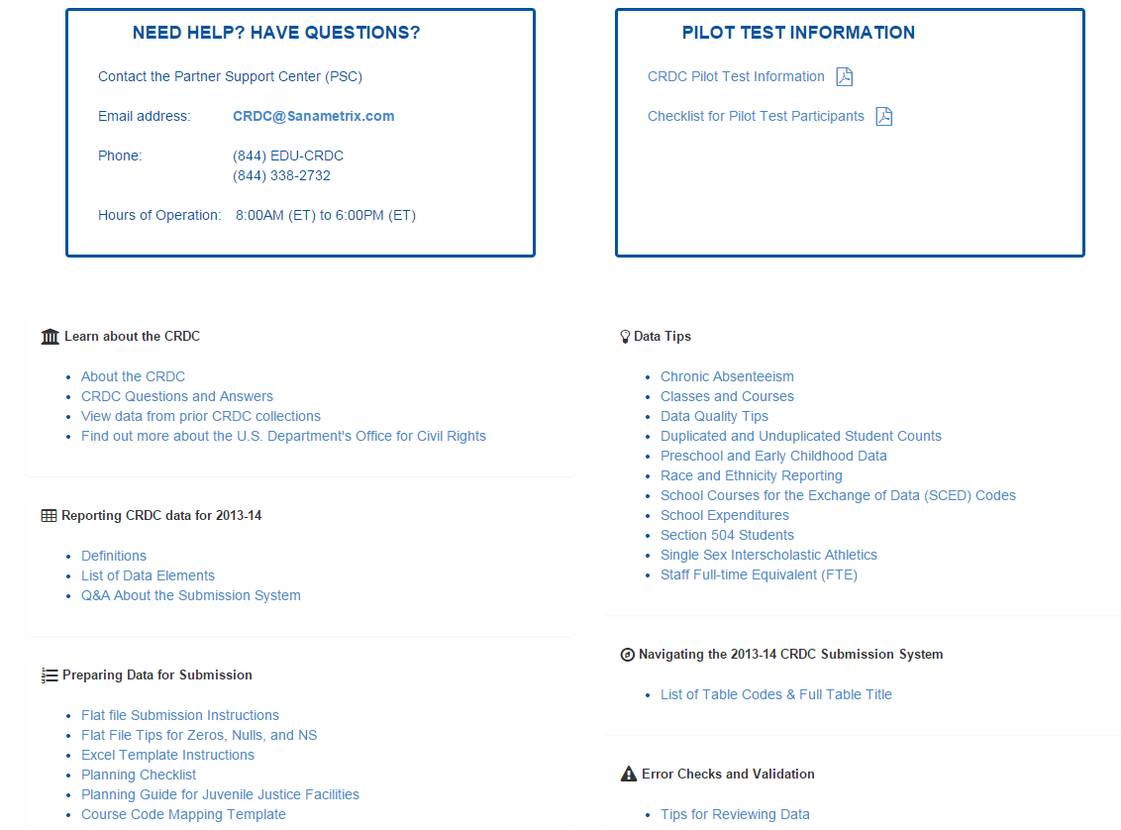
Resources
Originally Presented: 1/20/2015, compliments of the OCR

Slide 84
January 20th – Status - Complete
LEA and School Screen Data Entry
Section 504 records for SY 13/14
Zero Tolerance updates for SY 13/14 records
LEP data loads
SY 13/14 LEP data is visible on CRDC reports only
SAT, ACT and AP Exam Scores
SY 13/14 data is visible on CRDC reports only
Originally Presented: 1/20/2015

Slide 85
January 20th – In Progress
3rd Party data from select LEAs
PowerSchool CRDC Reports
OCR Coordinators Contact List
EC Data Verification and Upload
Grade Level Correction Enhancement
LEA Action Needed: Exclude Graduated Schools
Originally Presented: 1/20/2015

Slide 86
January 20th – Status - Pending
Completion of PowerSchool CRDC reports -February PowerSchool maintenance weekend
Notification of Collection Dates from OCR
Federal Portal Access
Process for Reporting / Correcting Data for the CRDC
Originally Presented: 1/20/2015

Slide 87
January 6nd Known Issues Update
Scenario | Resolve / Action
EC Data – reports are currently picking up any student with indicator, in any year. | Pending: February Maint. Wknd
Retentions (1) – indicator reports incorrectly | Pending: February Maint. Wknd Issue – bug – 4th grade indicator only
Retentions (2) – counts appear incorrect | Resolved: requires more research – appears to be a non issue – please report NOW if you suspect your retentions are incorrect.
AIG – Services reported at wrong school | Resolved: Process issue, report functioning as designed
Originally Presented: 1/6/2015,
Updated 1//20/2015

Slide 88
December 2nd Known Issues Update
Scenario | Resolve / Action
Block Courses are not counted | Pending: December February Maint. Wknd
Grade 13 is not included | Resolved : December Maint. Wknd
Justice Facility Hours appear randomly | Resolved : December Maint. Wknd
AP Special Courses indicator | Resolved : December Maint. Wknd
Originally Presented: 12/2/2014,
Updated 1/6/2015, 1/20/2015

Slide 89
November 4th Known Issues Update
Scenario | Resolve / Action
School Level – Section 504 - ability to update data outside of user’s school School users had the ability to update records of students who had transferred if accessing from the Special Program Enrollment View screen. | Resolved as of October 24th School users still have the ability to create a list of Section 504 students and LEA Coordinators still have access to the Special Program Enrollment View screen. Communicated via NC SIS 10/29/2014
LEA Level - CRDC School Detail – Part 1 reports all data as ‘No’ | Resolved as of November 3rd
Submission End Date for CRDC Reports | Resolved: November Maint. Wknd Update to November 30th (may be re-evaluated)
Section 504 data is not reporting | Resolved: November Maint. Wknd Logic to be updated with ‘contains 504’ statement
Approval Button for CRDC Reports | Resolved: November Maint. Wknd
Unable to see Dashboard in ‘Non-State Reporting’ schools | Resolved: December Maint. Wknd 12/19/2014 Home Base Bulletin
Originally Presented: 11/4/2014
Updated 12/2/2014, 1/6/2015

Slide 90
CRDC Report Known Issues
Scenario | Action/ Resolve
Incorrect Grade Levels CRDC Reports are showing incorrect grade levels. For example: A middle school with PK students reports as having PK-8 and SY 13/14 EDDIE data is accurate. | Resolved: November Maint Wknd Contact the Support Center if your SY 13/14 EDDIE grade levels are not accurate. Enhancement in February that will allow LEAs to make corrections.
IB Program Indicator Reporting courses based on 4th Character | Resolved: November Maint Wknd
Low / no course enrollment counts | Resolved: November Maint Wknd
Red Dot of Death | Action: <300 School: terms – are they missing SY 13/14? Do you need it? No = exclude from CRDC New school: terms – are they missing SY 13/14? Yes = exclude from CRDC ( they weren’t there in SY 13/14)
Originally Presented: 10/21/2014, Updated 12/2/2014. 1/20/2015

Slide 91
Update - EC Data Load
EC Data from PS will not consistently report SY 13/14 student EC records
EC Data from PS is based on a student’s current EC information (CECAS, 3rd Party)
DPI will load EC data using the December 2013 Head Count(SY 13/14)
Data will only be visible from the CRDC reports
Originally Presented: 1/20/2015
91

Slide 92
Previous Year Grade Level Correction PowerSchool Screen
Previous year grade level feed from EDDIE has been stopped in PS Production
Update access for LEA Level staff
Read Only after CRDC is complete
Locate Year ID 2300
Using EDDIE codes, type grade levels, separate grade levels with a colon ( : )
Click Submit
Example: KG:06:07:08
Originally Presented: 1/20/2015
92

Slide 93
Next Steps
Review Contact List sent 1/20/2015
Exclude the PowerSchool Graduated School from CRDC
All LEAs and Charters should run the CRDC reports (at the LEA level) the week of Monday, February 9, 2015

Slide 94
OCR / CRDC Status Webinars
October 21
1pm-2:30
November 4
1pm-2:30
November 18
1pm-2:30
December 2, 2014
1pm-2:30
December 16, 2014
1pm - 2:30
January 6, 2015 –
1pm-2:30
January 20, 2015 –
1pm-2:30
OCR Status Updates will resume in March
New registration link pending
Originally Presented: 10/21/2014, Updated 12/2/2014, 1/5/2015

Slide 95
OCR Symposium Sessions
Symposium (Subject to Change)
Monday, February 23, 2015
Tuesday, February 24, 2015
Looking forward to seeing you at the Home Base Symposium!

Slide 96
March 15th - Agenda
PowerSchool CRDC Report Status
Federal Submission Portal
Submission Window
Access
Provisioning Accounts
Familiarize Yourself with the Tool – Resources
State Data Load Status and Load Schedule
LEA / Charter Responsibilities
Errors, Warnings and EDFacts
Support and Resources

Slide 97
PowerSchool CRDC Report Status
100% of PowerSchool CRDC LEA level reports were run by all LEAs and charter schools
99.1% were re-run during the week of April 13, 2015
Why was this important? Final updates to report logic were made the weekend prior, requiring the need to re-run for the latest changes
PowerSchool Report Views were lost during the first week of May
All LEA level PowerSchool reports have been restored
Originally Presented: 5/15/2015

Slide 98
Federal Portal – Submission Window
The OCR due date has not been determined
Due date will be posted in the NOTIFICATIONS BOX on the Submission Tool
Due date will also be posted on Grads 360
Grads 360 link for CRDC: https://crdc.grads360.org
The NC DPI will send notification to OCR Coordinators
Originally Presented: 5/15/2015

Slide 99
Federal Portal - Accounts
The OCR sent accounts to LEA staff April 16, 2015
Check your SPAM and Junk mail
If you did not receive an account, contact CRDC Partner Support at:
(844) 338-2732 or CRDC@SANAMETRIX.COM
Originally Presented: 5/15/2015

Slide 100
Federal Portal – Provisioning Accounts
Do not remove Karl Pond or Terra Dominguez from your LEA or schools
If these accounts are removed, the state cannot load your data
The state will load the data submitted by the LEAs, the state will not modify LEA data other than stated on slide 107
Originally Presented: 5/15/2015

Slide 101
Federal Portal – Provisioning Accounts
Once data has been loaded by the state, LEAs may remove state access as deemed appropriate
OCR CRDC Federal Resources:
How To Add New Users https://crdc.grads360.org/#communities/pdc/documents/7735
How to Add Back SEA (state) Permissions https://crdc.grads360.org/#communities/pdc/documents/7734
Originally Presented: 5/15/2015

Slide 102
State Data Load - LEA Action Required
LEAs must add Teacher Absenteeism to the Federal Submission Portal to complete the submission
Teacher Absenteeism is a school level data element
The NC DPI has all data elements for the CRDC collection with the exception of Teacher Absenteeism
Originally Presented: 5/15/2015

Slide 103
State Data Load Status
Finance and Expenditure data come from LEA Monthly Financial Report (MFR) and Annual Financial Report (AFR)
Data will be loaded exactly as provided to the state
Originally Presented: 5/15/2015

Slide 104
State Data Load Status
LEA and student level data from the PowerSchool CRDC reports may be transformed for the file submission
Examples:
LEA Level: number of schools on PowerSchool CRDC report may reflect Program /non-public schools. Count will be updated to reflect federally recognized public school count
Grade 13 will be counted as grade 12
Originally Presented: 5/15/2015

Slide 105
State Data Load Schedule
State will begin to load data the week of May 26, 2015
State hopes to conclude data submission June 5, 2015
LEA OCR Coordinators will be notified as each file submission is complete
Data will be submitted to the Federal Submission Portal in stages
Originally Presented: 5/15/2015

Slide 106
State Data Load Schedule - Proposed
May 26, 2015 – Staff and Expenditure Data
May 28, 2015 – LEA Level Part 1 and Part 2
June 1, 2015 – School Level Part 1 and Part 2
Originally Presented: 5/15/2015

Slide 107
June 19 - Agenda
State Data Load Status
LEA / Charter Responsibilities
Errors, Warnings and EDFacts
Finance Data
Teacher Absenteeism Data
Certification
Support and Resources
Originally Presented: 6/19/2015

Slide 108
State Data Load Schedule - Proposed
May 26, 2015 – Staff and Expenditure Data
Completed May 26
May 28, 2015 – LEA Level Part 1 and Part 2
Completed May 28
Week of June 1, 2015 – School Level Part 1 and Part 2
Delayed one week, completed week of June 8
Originally Presented: 5/15/2015, updated 6/19/2015

Slide 109
PowerSchool CRDC Report Status
All LEA level PowerSchool reports have been restored
All School level reports have been restored
Process to be run this weekend to Archive all reports at every level
Originally Presented 6/19/2015

Slide 110
LEA / Charter Responsibilities
Create Federal Portal accounts
Review data submitted by the NC DPI
Update Teacher Absenteeism
Resolve all Errors
Review and document Warnings
Certify the Collection
Originally Presented: 5/15/2015

Slide 111
Federal Portal – Provisioning Accounts
Provisioning accounts to the Federal Portal is at the discretion of the LEA. Some LEAs are:
Provisioning accounts to all Principals
Provisioning accounts to relevant business areas
An example is staff in finance
Allowing only those who certify data to access the Federal Portal
Originally Presented: 5/15/2015

Slide 112
Sooo……What am I Doing?
OCR Contacts were provided user accounts to the Federal Submission Portal
https://surveys.nces.ed.gov/CRDC/
User name is your email address
Forgot your password?
Click the Forgot your Password link.
The system will ask for your user name and send you the reset password
Originally Presented: 6/19/2015

Slide 113
CRDC Submission Portal
First review your LEA for percentage complete, Errors and Warnings
Use the Certification link on the landing page
Originally Presented: 6/19/2015

Slide 114
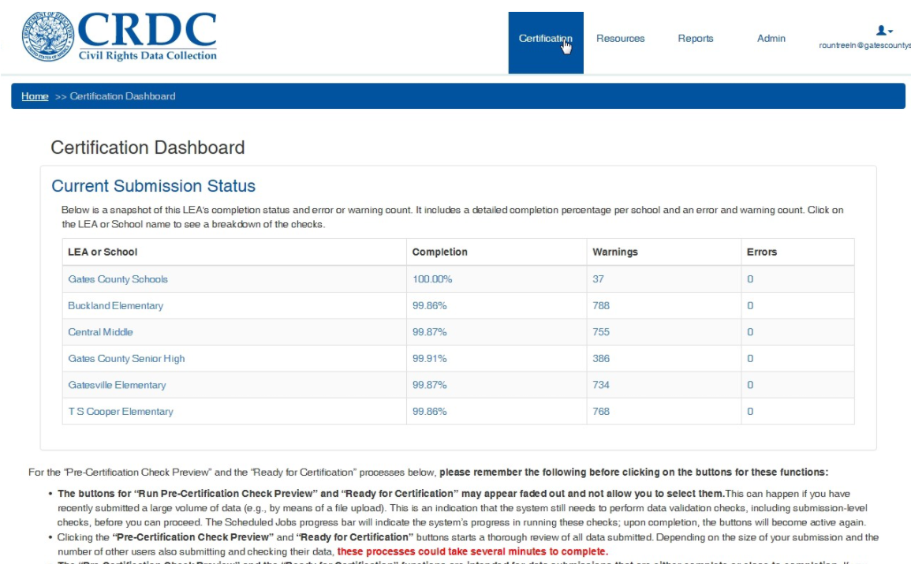
Originally Presented: 6/19/2015

Slide 115
Error Resolution and Warnings
Errors in the Federal Portal must be resolved prior to Certification
Example: Some LEAs/Charters did not fill out the CRDC PowerSchool Screens.
This data must be added to the Federal Portal Manually
Warnings will not halt the Certification process
Warnings may be reviewed and updated as needed
Some elements with Warnings will allow staff to document the discrepancy
Originally Presented: 5/15/2015

Slide 116
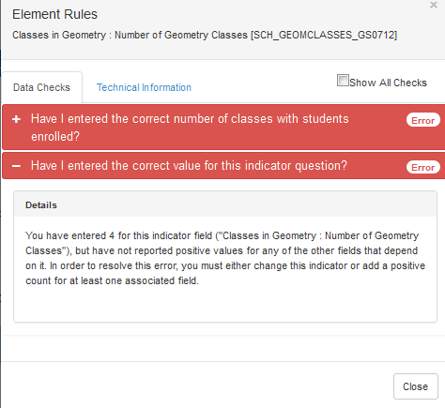
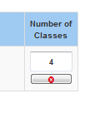
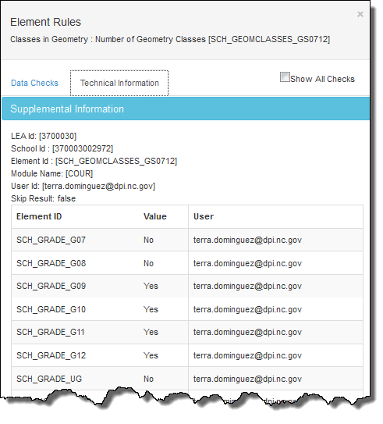
Errors for NC
Must be resolved prior to Certification
Error rates by district vary across state
Errors will provide guidance and elements effected if the Error Icon is clicked
LEAs may download the Error Resolution Report for the entire district
Originally Presented: 6/19/2015

Slide 117
Warning Rates for NC
Do not require resolution prior to Certification
Some warnings provide a notes field
Are exceptionally high for NC school data
All SY 13/14 elements, regardless of school type, were uploaded to the Federal Portal
This means a 0 count was applied to an element if the school type did not collect the data. A large % of warnings are due to 0 counts.
If you have reviewed your data and these fields should be inapplicable, then you do not need to do anything else. The fields will automatically be filled with "N/A" during certification
Warnings are now generated based on data submitted to EDFacts
Originally Presented: 6/19/2015

Slide 118
EDFacts
EDFacts is a tool used by the State to submit the Federal reporting
This year the Federal Portal will validate against previously submitted EDFacts reports
In future submissions, if data has already been provided to the Federal Government, the data will be pre-populated into the Federal Submission Portal.
This enhancement will continue to reduce the amount of time LEAs and Charters spend on the collection and review process prior to certification
Originally Presented: 5/15/2015

Slide 119
Finance Data
Finance and Expenditure data come from LEA Monthly Financial Report (MFR) and Annual Financial Report (AFR)
Data will be loaded exactly as provided to the state
Please review the following sections in the Federal Submission tool carefully:
STAF School & School Support Staff
EXPD School Expenditures (Personnel and Non-Personnel)
Originally Presented: 6/19/2015

Slide 120
Teacher Absenteeism
Manual update at school level
~OR~
Create a template:
Column 1: SCH_ID
Column 1 Format: Numeric
Column 2: SCH_FTETEACH_ABSENT
Column 2 Format: Numeric, 100th decimal
File must be CSV
Populate SCH_ID with your School’s Federal ID
Originally Presented: 6/19/2015

Slide 121
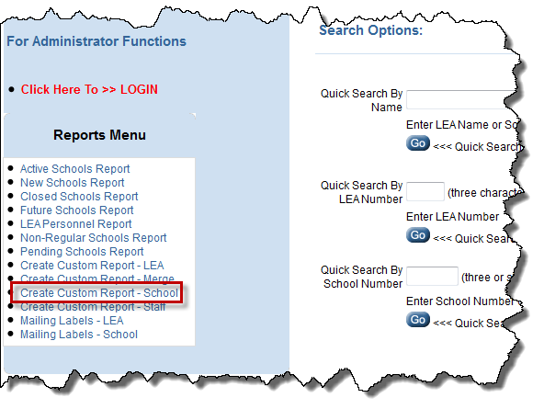
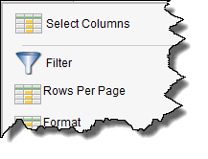
Federal IDs are in EDDIE
http://apps.schools.nc.gov/pls/apex/f?p=125:1:
Click Create Custom Report – School
Click All Schools/All Statuses/All Years
Click Actions
Click Select Columns
Originally Presented: 6/19/2015

Slide 122
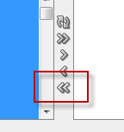
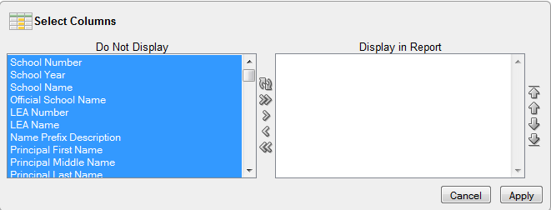
Selecting Elements in EDDIE...
Highlight all elements in Display in Report
Click the Double Chevron pointing left
Double click the following elements:
Originally Presented: 6/19/2015

Slide 123
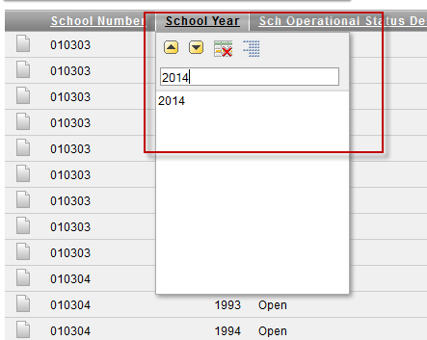
Select Elements in EDDIE...
Elements:
School Number
School Year
Sch Operational Desc
Opening Date
Closing Date
Federal School Number
Click Apply
Filter by School Year 2014
Originally Presented: 6/19/2015

Slide 124
Download Federal IDs from Eddie
Click Actions
Click Download
Download as a .CSV file
Originally Presented: 6/19/2015

Slide 125
Create Federal Upload File
Delete:
Rows for schools not open during the SY 13/14 year
All columns except Federal School Number
Update Federal School Number column header to SCH_ID
Column 1 Format: Numeric
Update the second column header to SCH_FTETEACH_ABSENT
Column 2 Format: Numeric, 100th decimal
Save as .CSV
Originally Presented: 6/19/2015

Slide 126
Certification
Must be completed by August 7, 2015
Originally Presented: 6/19/2015

Slide 127
Federal Portal – Familiarize Yourself
OCR CRDC Federal Resources:
CRDC Survey Tool User Guide https://crdc.grads360.org/#communities/pdc/documents/7728
Logging In and Home Page
Reporting Data
Resources Page (links in the Federal System)
Reports (includes Submission Progress, Error Resolution, User Access, Collection Metrics)
Certification
Originally Presented: 5/15/2015

Slide 128
Support
Issue / Concern | Contact | Contact Info
No access to Federal Portal Incorrect permissions for account School does not exist in the Federal Portal | CRDC Partner Support | (844) 338-2732 or CRDC@SANAMETRIX.COM
Data not loaded for school Questions about data | HBSC Support Center | (919) 807-4357 or Homebase.incidents@its.nc.gov
Originally Presented: 5/15/2015

Slide 129
Resources
Source | Document | Link
NC DPI | Preparing PowerSchool for the CRDC | http://www.nc-sis.org/Documents/school_info/OCR_v9_Final_20150313.pdf
Federal OCR | CRDC Survey Tool User Guide | https://crdc.grads360.org/#communities/pdc/documents/7728
Federal OCR | How to Add New Users | https://crdc.grads360.org/#communities/pdc/documents/7735
Federal OCR | How to Add Back SEA Permissions | https://crdc.grads360.org/#communities/pdc/documents/7734
For all OCR Federal resources, visit: https://crdc.grads360.org/#program
Originally Presented: 5/15/2015

Slide 130
Resources
This presentation
Collection of each status
Evolution of processes
Footers identify first and last update
Some slides re-used and moved for flow
Communications Archive
http://www.ncpublicschools.org/data/management/ocr/archive/
Originally Presented: 6/19/2015

Slide 131
Thank You NC Public Schools!

