Slide 1
National Board Certification A Distinction That Matters
Dr. Sonja Brown, Program Director
National Board Certification Program
North Carolina Department of Public Instruction
2018 - 2019

Slide 2
Board Certification:
A Vehicle for Transforming Teaching
Ron Thorpe’s article: Sustaining the Profession
http://bit.ly/SustainProfession
Notes:
It helps to build a pipeline to accomplished teaching from being a pre-service teacher and inevitably Board Certification. We hope that this will raise teaching standards by investing in Board Certification. This process enable Board-certified teachers to become Teacher Leaders and School leaders.

Slide 3
Essential questions answered in this presentation
What is National Board Certification?
What is accomplished teaching as defined by NBPTS?
What are details pertaining to eligibility, certificate areas, fees, registration, component instructions, and scoring?
What does the initial certification process involve?
How can I find assistance to achieve certification?

Slide 4
What is National Board Certification?
Since 1987 NBPTS has established the profession’s standards of accomplished teaching and created a system to determine if teachers meet those rigorous standards.
NB certification is a voluntary, performance-based, reflective, peer-review process that recognizes the complex nature of teaching and ongoing improvement.
NBPTS is an independent, nonprofit organization led primarily by classroom teachers.
More than 110,000 teachers in all fifty states have achieved NB certification.

Slide 5
NBPTS Five Core Propositions and NCTEP Five Teaching Standards
Serve as members of learning communities
Committed to students and their learning
Responsible for managing and monitoring student learning
Think systematically about their practice and learn from experience
Know the subjects and how to teach them to students
Standard 3:
Teachers know the Content they teach
Standard 1:
Teachers Demonstrate Leadership
Standard 2:
Teachers establish a Respectful Environment for a diverse population of students
~Interconnected Themes~
21st Century Skills/Knowledge
Collaboration
Effective Communication
Ongoing Assessment
Standard 5:
Teachers Reflect on their Practice
Standard 4:
Teachers Facilitate Learning
Notes:
These 5 core propositions are infused in each certificate area. They are recursive in the standards. They are in embedded in the prompts for the portfolio and assessment center exercises.
The learning for teachers begins as they begin to “see” their practice, their teaching behaviors and the choices they make for students through these “lens”.
That’s why there isn’t one “template” for what an accomplished teacher is and why candidates must bring their best work to this process.
Candidates should access the NBPTS Five Core Propositions document on the NBPTS website.

Slide 6
What is accomplished teaching and what does it look like?
What Teachers Do
What Students Do

Slide 7
Candidates Must Demonstrate Clear Connections Between
Instructional Goals
Assessment
Student Learning
Planned Activities

Slide 9
NBPTS Values Accomplished Teaching
Accomplished teaching is defined by the NBPTS Standards, not by NBCTs or by candidate support providers.
Student learning is at the heart of the certification process. Components should demonstrate and reflect the candidate’s impact on student learning.
www.nbpts.org

Slide 10
Fields of Certification
NB has 25 certificate areas based on the developmental level of teacher’s students and the teacher’s subject area(s).
In determining your certification area, be certain to take into consideration the ages of your students.
List of certificates and links to the standards available at http://boardcertifiedteachers.org/first-time-candidates

Slide 11
NB Candidacy Eligibility Requirements
An eligible candidate must have...
a bachelor’s degree
completed three full years of teaching
a valid teaching license

Slide 12
Affordability
The total cost of certification is $1,900, with each of the four components costing $475.
Important price points
$475 for each component
$75 annual registration fee

Slide 13
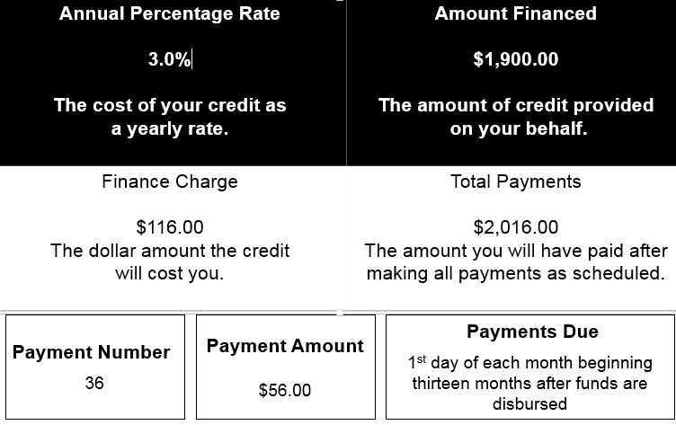
NC Loan Details
Notes:
The details of the loan are: If you borrow the money ($1900) to pay for certification, from the time you apply for the loan, you have a years’ grace period before you start to repay the loan. After that year, your payments kick in and the 3.0 interest starts. You have 3 years to repay this loan and it will only cost $116.00 in interest over the life of the loan. So this is a pretty good loan and of course the Legislators take a look at this and how the program is working each year.

Slide 14
North Carolina
Loan Eligibility Requirements
A teacher must…
be paid from state funds;
three full years of teaching in the North Carolina Public Schools;
Standard Professional II NC license; and
be engaged in direct classroom instruction, library/media or school counseling work 70% of the time over the course of the academic year.
Notes:
In order to qualify for the loan, you must be paid entirely from state funds; you must have three full years of teaching in the North Carolina Public Schools; you must have a valid Standard Professional II NC license; and
be engaged in direct classroom instruction, library/media or school counseling work 70% of the time over the course of the academic year in this setting.

Slide 15
How does NC Support Board Certification ?
North Carolina…
lends the $1,900 assessment fee;
provides up to three days of paid professional leave for new candidates only;
provides 8.0 CEUs for completion of the process; and
pays salary differential of 12% of base salary.
Notes:
Read the slide

Slide 16
REFUNDS and REINSTATEMENTS
Refunds
If you withdraw prior to the withdrawal deadline, you will be eligible for a fee refund, less the nonrefundable and nontransferable $75 registration fee and any service fees. Refund processing time is 4-6 weeks.
You are NOT eligible for a refund if the withdrawal deadline has passed.
Reinstatements
If you have withdrawn your entire registration and wish to be reinstated before the withdrawal deadline, please contact our Customer Support team at 1-800-22TEACH.
Notes:
Read Slide

Slide 17
Registration and Deadlines
Registration Window—April 1st – February
Fee Payment Deadline—February
Change of Certificate, Specialty Area, or Component Selection—February
Withdrawal Deadline—February
ePortfolio Submission Window—April-May
Component 1 Content Knowledge Testing Window —March-June 15th
Score Release – On or before December 31

Slide 18
The Components
Notes:
So let’s talk a bit about the components.

Slide 19
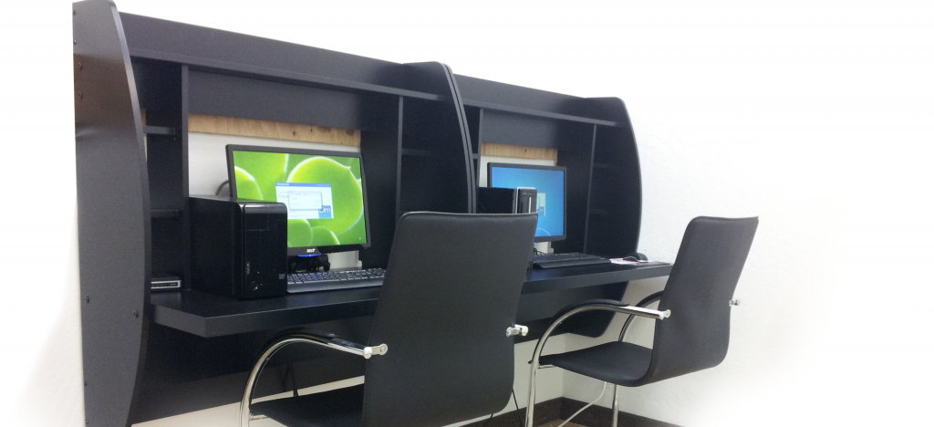
Component 1
Content Knowledge
A computer-based assessment to demonstrate knowledge of and pedagogical practices for their certificate area.
3 constructed response exercises
Approximately 45 selected response items
Notes:
Component 1: Content Knowledge is a computer-based assessment that asks you to demonstrate knowledge of and pedagogical practices for teaching in a content area. You must demonstrate knowledge of developmentally appropriate content, which is necessary for teaching across the full age range and ability level of a teachers’ chosen certificate area. This is assessed through the completion of three constructed response exercises and approximately 45 selected response items. You will have up to 30 minutes to complete each of the three constructed response exercises. The time allotted for the selected response section varies by certificate area, but will be no fewer 60 minutes.

Slide 20
Component 2
Differentiation in Instruction
Overview
Candidates will submit…
student work samples;
instructional materials; and other
evidence using the same criteria.
Notes:
Component 2: Differentiation in Instruction requires that candidates gather and analyze information about individual students' strengths and needs and use that information to design and implement instruction to advance student learning and achievement. This classroom-based portfolio entry is primarily comprised of samples of student work and an accompanying written commentary. A teacher will submit selected work samples that demonstrate the students’ growth over time and a written commentary that analyzes their instructional choices.

Slide 21
Component 3
Teaching Practice and Learning Environment
Overview
Captures details about your instructional planning and requires:
direct evidence of your practice from two video recordings;
instructional materials; and an
analysis of and reflection of your teaching as displayed in two video recordings.
Evaluates evidence of your practice and analysis as it relates to instruction, student engagement, and the learning environment.
Aligned with the Five Core Propositions and the certificate area Standards.
Notes:
Component 3 is a classroom-based portfolio entry that requires video recordings of interactions between the teacher and their students. Two written commentaries, in which the teacher describe, analyze and reflect on their teaching and interactions will also be submitted. Both the videos and the written commentaries should demonstrate how they engage students and impact their learning.

Slide 22
Component 4
Effective and Reflective Practitioner
Completion of classroom-based portfolio entry that require the creation of a profile on a group of students, formative (including student self-assessments) and summative assessments, and participation in a learning community
Candidates also complete a written commentary
Candidates evaluated on knowledge of students, planning, instruction, assessment, partnerships, reflection, and professionalism
Notes:
This portfolio entry requires you to gather information from a variety of sources about a class of students with whom you work and demonstrate your knowledge of assessments and assessment practices to effectively plan for and positively impact these students’ learning. The portfolio will also require you to provide evidence of your collaboration with families, the community, and colleagues and your contributions to learning communities to advance students’ growth. More information coming soon on this Component.

Slide 23
Scoring
Assessment Center (Component 1) – 40%
ePortfolio (Components 2, 3, and 4) – 60%
Differentiation in Instruction (C2) – 25%
Teaching Practice and Learning Environment (C3) – 50%
Reflective and Effective Practitioner (C4) – 25%
Performance based, standards specific, and peer reviewed
Evidence must be clear, consistent, convincing
Separate scores for each component attempted
Information to assist you in making decisions on whether or not to retake, if necessary
Notes:
National Board Certification is a standards-based assessment. Your score reflects the degree to which assessors were able to locate clear, consistent, and convincing evidence that you have met the National Board Standards specific to your certificate field. Teachers can find scoring rubrics in the component instructions.

Slide 24
Scoring
SRIs are machine scored: 1 point for each correct answer, 0 points for each incorrect answer
SRI total score converted to a score between 0 and 4.25
Constructed response items and all portfolio components scored on a 12 point scale (Levels 1-4, +/- variations at each level)
4.25 (4+) – highest score; 0.75 (1-) – lowest score for any scorable item; Not-Scorable = 0

Slide 25
Retake Policy
You must attempt each of the four components within the first three years of candidacy.
○ There is no minimum or maximum score requirement to retake a component. However, once you achieve National Board Certification, retake attempts are no longer available.
○ You have up to two retake attempts for each component and you can retake at any time during the five-year window; retake years do not have to be concurrent or consecutive.
○ You can have a year when you take no components; however, it does not extend your five year window.
The highest score received for an individual component will always be used for total score calculation.
Notes:
Read Slide………
I would wait until all scores are in before I attempted a retake because 1 component might make up for the one that you have the lowest score in.
24

Slide 26
Renewal
As an NBCT, you must complete the Certification Renewal process before your certification expiration date and may only renew certification in your original certificate area. You are offered two opportunities to apply for certification renewal, with the first application window opening late in the eighth year of your current certification and the second opening late in the ninth year.
Renewal fee is $1250
Recent change: www.boardcertifiedteachers.org/maintenance-of-certification.
This new policy is aligned with the movement of 40 state licensure systems to a five-year renewal period, but also reflects the National Board’s effort to make certification more affordable and efficient for all teachers, so that that it can become the norm in the profession.
Notes:
Recent change:
The National Board also recently revised its policy for maintenance of certification, and will require Board-certified teachers to demonstrate their knowledge and skills every five years. This new policy is aligned with the movement of 40 state licensure systems to a five-year renewal period, but also reflects efforts to make certification more affordable and efficient for all teachers, so that that it can become the norm in the profession. Once its introduced in 2021, the National Board will no longer extend certificates through the current 10-year renewal process. This change will take effect for current candidates who certify in 2017 and later. Beginning in 2021, as existing 10-year certificates expire, NBCTs will extend their certificate at five-year intervals through the new MOC process.
Development of the maintenance of certification has not yet started, but the aim is to keep it similar in price and process to completion of a single component of the certification process every five years. This is in contrast to the current renewal process, which requires a “Profile of Professional Growth,” with three interrelated components and a reflection.
Every five years

Slide 27
Your responsibilities as a candidate
Stay in contact with your NB District Coordinator in order to learn about candidate support efforts.
Meet all established deadlines for paperwork and submit pieces in a timely fashion in order to choose the best window of opportunity for yourself.
Visit the NBPTS and NC-DPI websites regularly to stay updated on new developments and information regarding the process.
Keep your contact information updated with NBPTS.

Slide 28
North Carolina National Board Contacts
North Carolina National Board Director
Dr. Sonja Brown, (E) sonja.brown@dpi.nc.gov 919-807-3358 (office), 919-807-3362 (fax)
North Carolina Association of Educators (NCAE)
Angela Farthing, NCAE Center
P.O. Box 27347, Raleigh, NC 27611
700 S. Salisbury St., Raleigh, N. C. 27611
800/662-7924 x227
Angela.farthing@ncae.org
University of North Carolina Wilmington
Somer Lewis, MA NBCT
PDS Director
Watson College of Education- Rm 160
910-962-7244
lewiss@uncw.edu<mailto:lewiss@uncw.edu
The Professional Educators of North Carolina (PENC)
Glennda McKeithan
800-542-8844/919-799-9299
Email: gmckeithan@wcpss.net

Slide 29
National Board for Professional Teaching Standards Resources www.nbpts.org
Application for certification
State-specific information
Resources for…
candidates
support providers
NB Customer Support 1-800-22TEACH (83224)
http://www.nbpts.org/national-board-certification/candidate-center/first-time-and-returning-candidate-resources/; Review all documents on this site before registering!

Slide 30
Questions

