Slide 1
NC MEP SPRING MEETING
APRIL 2021

Slide 2
PLEASE SIGN-IN
https://forms.gle/2NPg9j5y5nF3HZWV7

Slide 3
Welcome MEP Family!

Slide 4
INTRODUCTIONS
New NC MEP Compliance Coordinator
New MEP staff across the state
NC State MEP Staff Roles
Notes:
Dr. Townsend will bring greetings and then turn it over to Susan
Susan – Good morning everyone and thank you for joining us today. I am Susan Brigman, the Section Chief ~ Specialty programs which includes oversight of the Migrant Education Program. We want to begin with welcoming some of our newest MEP staff both at the state and local level. And then I also want to provide you with some clarity on the responsibilities for each of our State MEP staff.

Slide 5
Welcome Hunter Ogletree
For the past 15 years, Hunter has worked with Henderson Couty Public Schools’ MEP.
Starting as a recruiter, he later became a OSY Team Leader.
Most recently, Hunter has served as the MEP Coordinator for HCPS.
Before working with the MEP, Hunter lived and worked in Honduras for three years as a Peace Corps volunteer.
He has a Masters in Business Administration from Gardner-Webb University and a Masters in Adult Education from ECU.
His undergrad studies at UNC made him a true Tar Heel basketball fanatic. He likes to travel, enjoy any outdoor activities, and read during his free time.
Notes:
Hunter is our newest state MEP staff member. He officially starts working at DPI on Monday, May 3rd as our MEP Compliance Coordinator.

Slide 6
New MEP Staff Across the State
Buncombe County
Amber Abunassar – MEP Recruiter
Brunswick County
Elsa Armijos – MEP Coordinator
Dr. Karen Baker – MEP Director
Henderson County
Areli Perez – MEP Coordinator
Notes:
We also want to welcome new MEP staff across the state.....

Slide 7
Looking for MEP staff in…
Buncombe County - MEP Coordinator
Pender County - Recruiter
Henderson County - Seasonal Recruiter
Mitchell County - Recruiter

Slide 8
State MEP Staff Roles
Compliance Coordinator
ID & R Coordinator
Data/Parent and Family Engagement Coordinator
Notes:
For the next few minutes, I would like to share with you the major responsibilities of the state MEP staff to help ensure you direct any questions you have to the appropriate staff person.

Slide 9
Compliance Coordinator – Hunter Ogletree
CCIP MEP Application and Budget Review / Feedback to Consolidated PAs
Technical Assistance for subgrantees re: applications, allowability of expenditures, services provided, etc.
Review and approve subgrantee annual evaluations
MEP PQR Notifications, Procedures, and Reports
Secondary on Consolidated Monitorings of Subgrantee Districts
Training and TA to new MEP Directors/Coordinators
Lead ~ iSOSY Grant
Co-Lead ~ Comprehensive Needs Assessment (CNA) Process
Lead ~ Service Delivery Plan (SDP)

Slide 10
ID & R Coordinator – Juan Carlos Alvarez
PFS Form Review for Regional Recruiters
COE Review for Regional Recruiters
Review and approve ID&R Plans for Subgrantees
Technical assistance for subgrantees re: student eligibility
Provide ID &R Training
Lead ~ Farmworker Advocacy Network (FAN)
Lead ~ Reinterview Process
Co-Lead Comprehensive Needs Assessment (CNA) Process

Slide 11
Data/Parent & Family Engagement Coordinator – Dr. Heriberto Corral
MEP Headcount/Data for Allotments
Troubleshoot and provide training on Migrant School within PS statewide and to regional recruiters and data specialists
Provide/Disaggregate Data for Annual MEP Evaluation
Lead ~ MSIX, including providing trainings throughout the state and troubleshooting account access issues and distributing move notifications
Lead ~ MEP State PAC – including TA to districts/programs regarding parent and family engagement
Lead ~ Annual MEP Summit
Co-Lead ~ Comprehensive Needs Assessment (CNA) Process
Notes:
I will now turn the presentation over to Dr. Heriberto Corral who will share information on the MEP CNAprocess.

Slide 12
Comprehensive Needs Assessment
(CNA)

Slide 13
Overall Objective of the CNA
Informs and guides all aspects of MEP planning because migratory students need to meet State performance targets

Slide 14
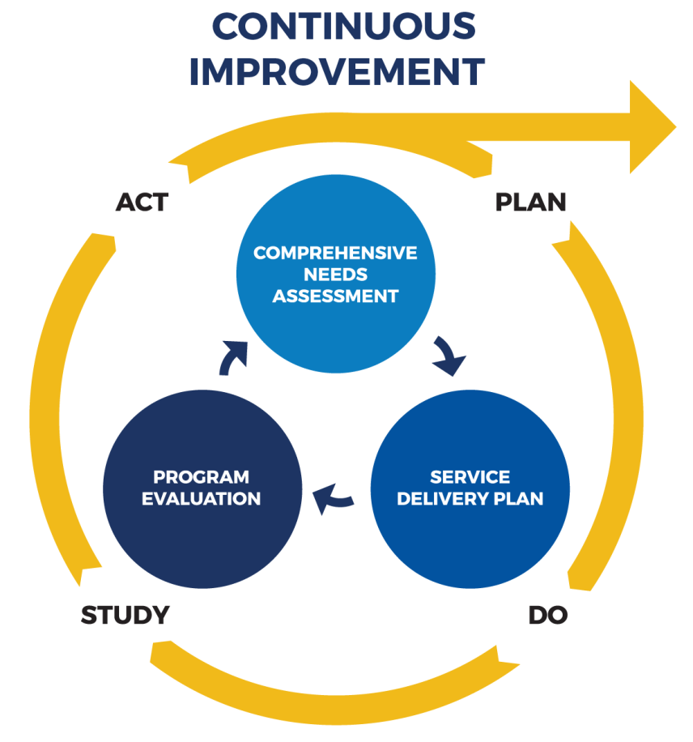
Improvement Process

Slide 15
Another way to look at it…
What are student needs?
How will we address the needs?
How do we know if what we’re doing works?
Concern statements
Strategies
MPOs
Implementation outcomes

Slide 16
Where are we with the CNA?
The previous CNA was completed in 2017.
Due to changes in student demographics (and changes in needs), the OME requires states to update their CNA regularly (about every three years)
We will be following the guidance provided in the OME’s CNA Toolkit
We have scheduled 3 more virtual meetings with the Needs Assessment Committee (NAC) to update the CNA

Slide 17
Elements of the CNA Report
Migratory Student Profile
Concern Statements
Need Indicators
Need Statements
Solution Strategies
Prioritized Concerns

Slide 18
POWERSCHOOL IMPROVEMENTS
&
CHANGES

Slide 19
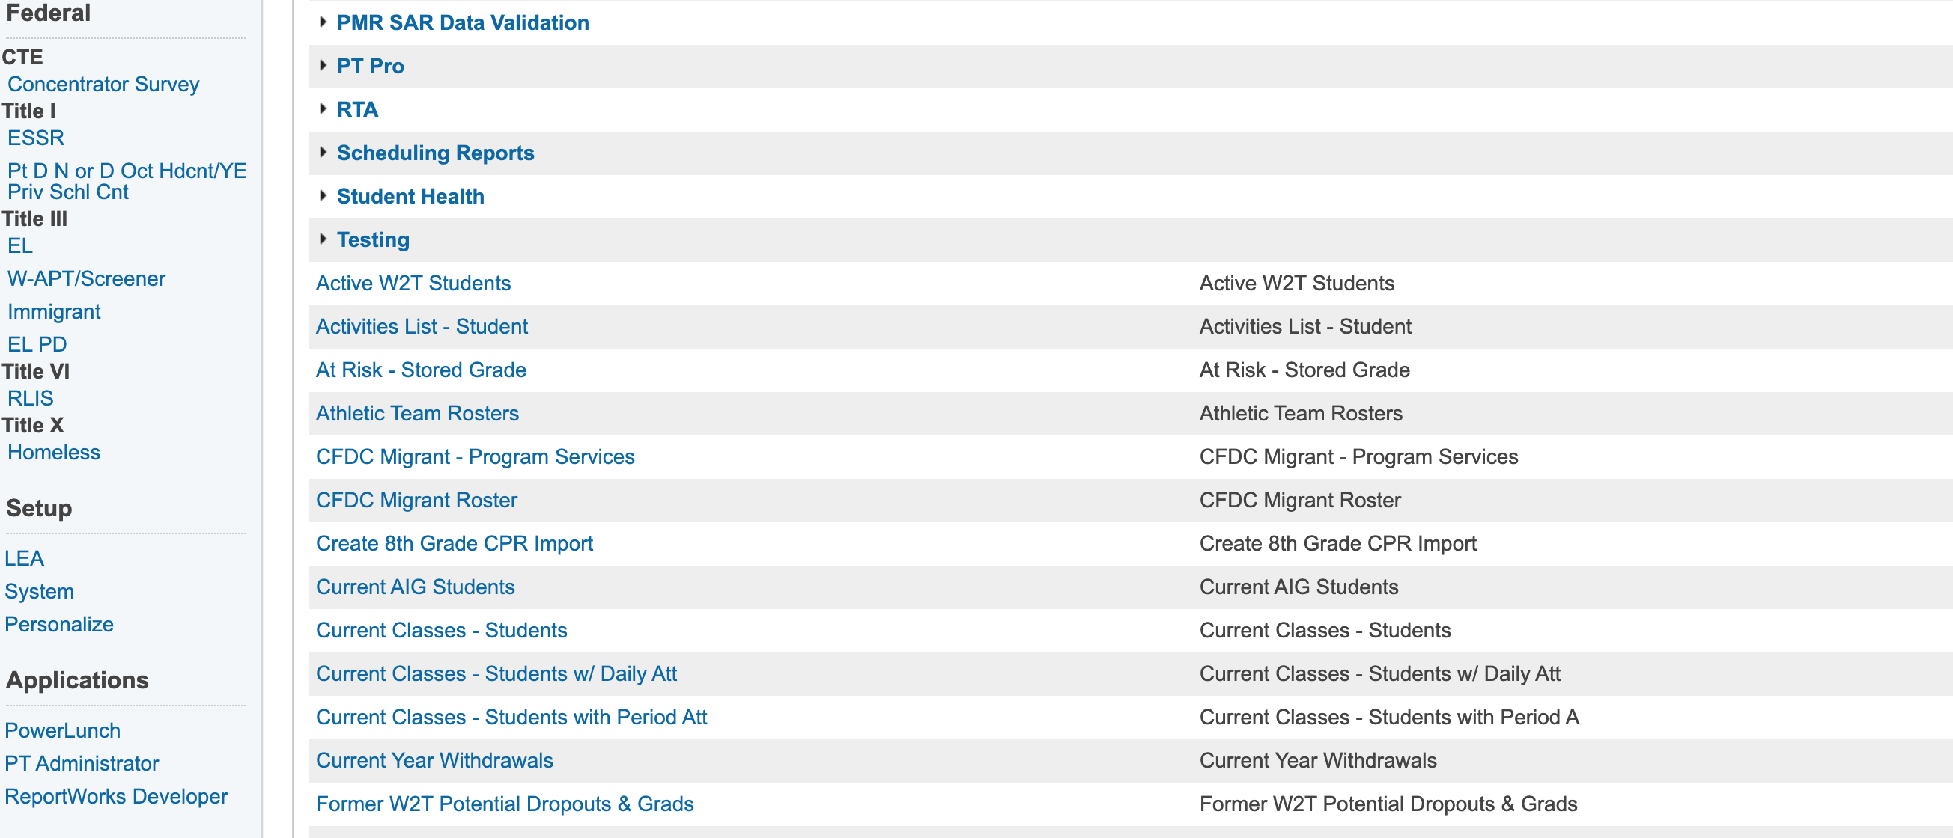
Where MEP Information is in PS
Current Path
Propose Path
It means quicker access and consistency in NC PS for MEP

Slide 20
Non-Eligible MEP in PS

Slide 21
Non-Eligible MEP in PS – Cont.
Why are these migrant children not eligible anymore?

Slide 22
PS FRIENDLY REMINDERS…
Send monthly withdrawals to your Data Specialist
Check the CFDC Migrant Roster at least every other month
Compare PS with MSIX for accuracy and discrepancies
Direct PS ID Duplicates to your district’s PS director or coordinator
Direct MSIX ID Duplicates to NC MSIX Lead (Dr. Corral)
Check the CFDC Migrant – Program Services every other month
Report any discrepancies to your Data Specialist & cc Dr. Corral
Remember to only report services for current migrant children

Slide 23
OME Preliminary Data

Slide 24
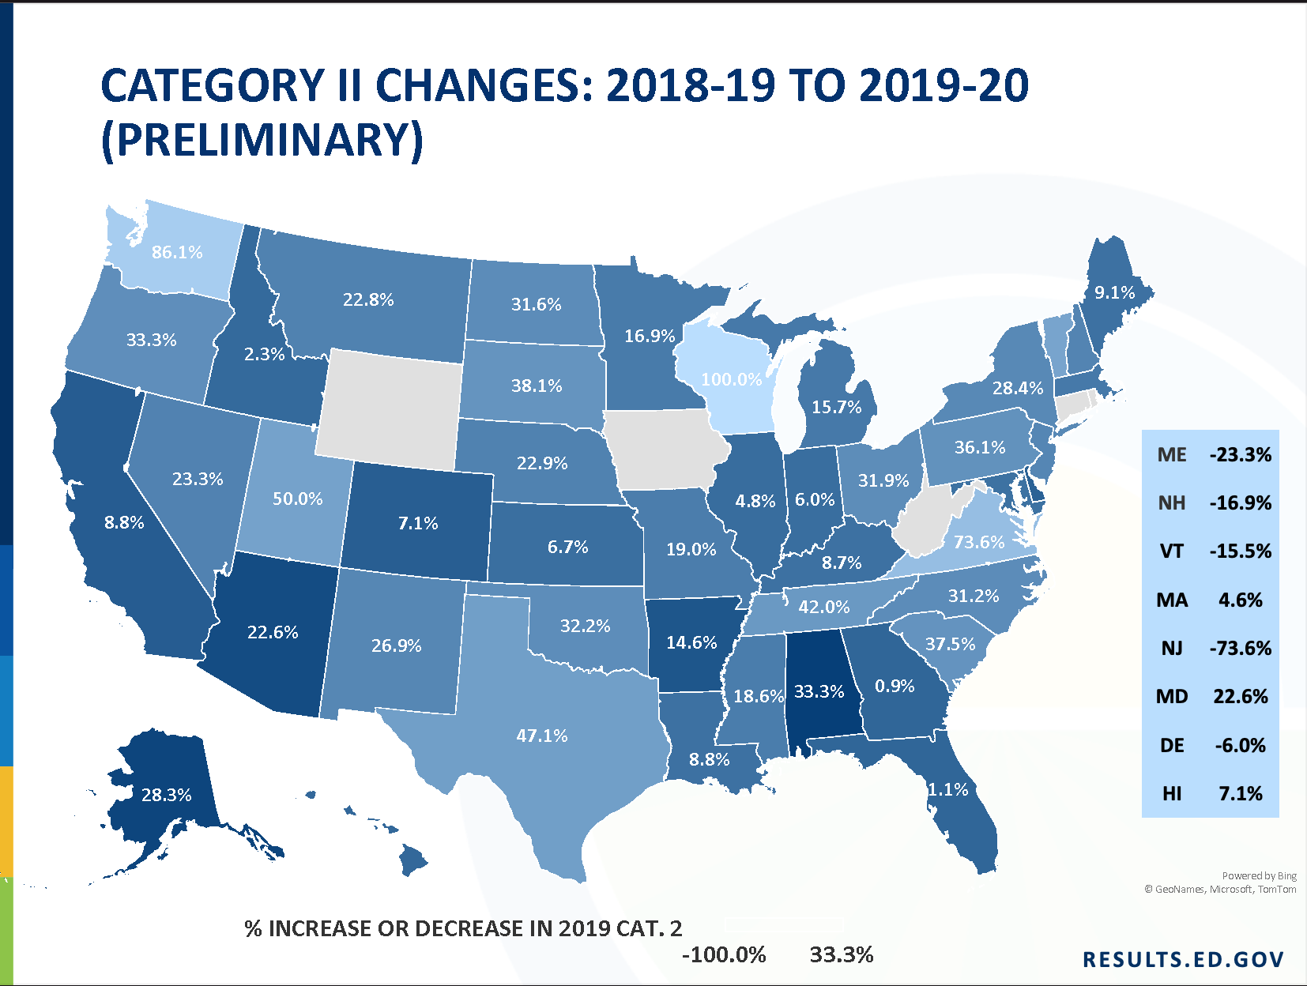
OME Preliminary Data - Cont.

Slide 25
OME Preliminary Data - Cont.
Notes:
Heriberto – I will now turn the presentation over to Hunter Ogletree who will provide us with information on the Consortium Incentive Grants.

Slide 26
Consortium Incentive Grants (CIGs)
ISOSY
IDRC
I2MPACT
MPEC

Slide 27
OSY/Secondary Youth Consortium
North Carolina is a member state – Hope Derry and Hunter Ogletree – NC Reps in the Consortium
Main goal is to increase state and staff capability to provide instruction that will improve the educational attainment of OSY and at-risk secondary students.
www.OSYMigrant.org – Website gives you access to high-quality, easy-to-use, and free material to serve OSY and secondary students.
Notes:
The seven workgroups are:
Career Awareness and Goal Setting
Personal Wellness –
Professional Learning
Pathways Working Group – Hunter is a member of this Workgroup.
Curriculum – Hope is part of this Workgroup.
Technology and Student Portal Workgroup
Mentor Working Group – Hunter is a part of this Workgroup.

Slide 28
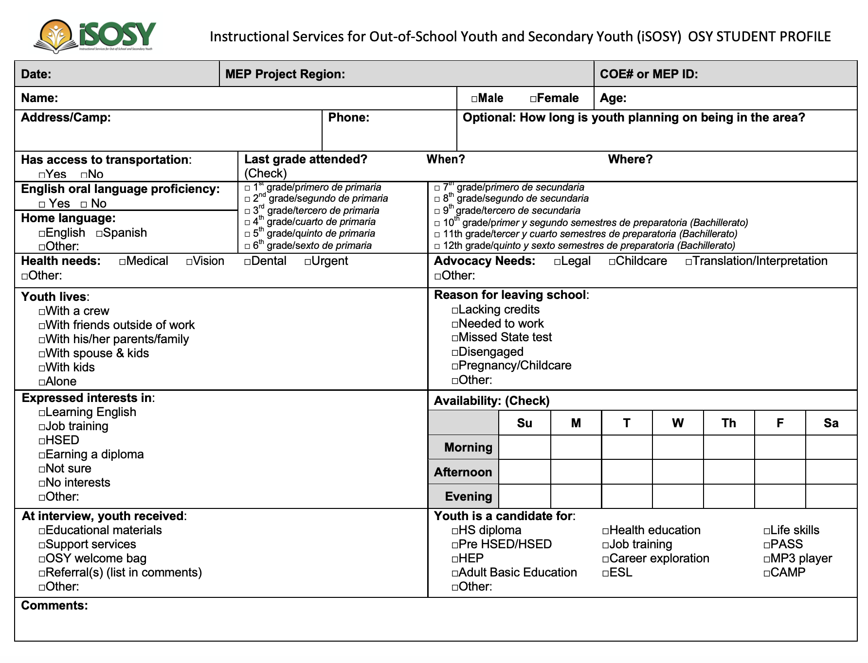
OSY Student Profile
Required to complete OSY Student Profile for all OSY and submit to DPI.
Upcoming June webinar a best-practices/strategies for easily completing OSY Student Profile.
Benefits of completing OSY Profile:
Able to provide a Needs Assessment 029 service code upon completion.
Better able to target individual needs of OSY to better target services.
Able to aggregate the data from the OSY Profiles to better understand overall OSY population in your area

Slide 29
ID&R Consortium
Goal is to improve the proper and timely identification of all migrant children.
NC is not a member state.
Free trainings and professional development around ID&R on a continuous basis.
www.idr-consortium.net
Inspire and Innovate: the Migratory Parent Action Consortium.
Goal is to support MEPs to increase parent involvement through an expanded understanding of parent involvement and enhanced parent involvement activities.
NC is not a member state.
High-quality, easy-to-use, and free parent engagement and family literacy resources.
www.i2mpact.org

Slide 30
Migrant Parent Empowerment Consortium (MPEC)
Goal is to strengthen the involvement of migratory parents in the education of their children, including supporting their children’s mathematics skills needed to be successful in science, technology, engineering, and mathematics (STEM) fields.
www.MigrantLiteracyNet.com – Wide range of free, high-quality, ready-to-go lesson plans for K-12 students to use in MEP instructional activities, such as summer programs.

Slide 31
MSIX
Move To & Move From Report
Fixed and now has more accurate data
Move To NC – 3,119
Move From NC - 1584
My List
OME MSIX Updates - Changes

Slide 32
“Move To” Filter

Slide 33
Move To by Country & State

Slide 34
Select to NC from NC

Slide 35
Move From NC Filter

Slide 36
Select From NC To NC

Slide 37
My Lists and its advantages
District roster
Multiple categories: PFS, EL, Pre-K, Elementary, Middle, High, OSY
Easier to compare with PS for accuracy

Slide 38
OME MSIX Updates - Changes

Slide 39
Data Collection with MSIX – BIG change!

Slide 40
Data Collection with MSIX – BIG Change – Cont.

Slide 41
Data Collection with MSIX – BIG Change – Cont.

Slide 42
Things to Consider with MSIX proposed changes
Funding will be based on MSIX numbers – Cat 1 & 2
ALL MEP staff must be trained in MSIX
Monthly or bi-monthly check ins will be needed
PS will continue feeding information to MSIX so…
Comparison between PS and MSIX will be more frequent
Each Subgrantee needs an active MSIX District Data Administrator
MSIX gains a more important role in data, funding, and relevance

Slide 43
BREAK
Notes:
Susan – Welcome back everyone. Thank you Dr. Corral for providing such detailed information on the C.N.A process and for the updates on powerschool and MSIX. And thank you Hunter for sharing information about the Consortium Incentive Grants. I will now turn the presentation over to Juan Carlos Alvarez who will provide you with some take aways from the IDRC Summer Institute and walk us through the summer reinterview process.

Slide 44
IDRC Summer Institute Take Aways
Advanced scenarios
Safety out recruiting
Partnering with local agencies
Useful Websites:
2017 Census by State - North Carolina | 2017 Census of Agriculture | USDA/NASS
USDA - National Agricultural Statistics Service - Census of Agriculture
EWG Farm Subsidy Database || Home
Local Food Directories: On-Farm Market Directory | Agricultural Marketing Service (usda.gov)
USDA/NASS Census of Agriculture Chapter 1, Table 1
CropScape - NASS CDL Program (gmu.edu)

Slide 45
Summer Re-Interview Process
Re-Interview summer 2021 will be conducted by the NC MEP DPI
Re-interview process will be in person
Using NC MEP Re-interview questionnaire
Form includes name of the recruiter who completed the COE who should accompany the person conducting the re-interview
RHM, work history, type of work, when, MC
Final report in Fall MEP meeting

Slide 46
ID&R COE’s Common Errors
Using 1 digit for dates in general Ex: 4/6/2010
Missing dashes (---) in boxes or spaces not used
Grade level: OS for children under 5 YO not enrolled in a school program.
OSY for children16 YO and older not enrolled in a school program
All others: PK, K, 1 – 12.
Multiple Birth: Y or N, (N/A as response is incorrect)

Slide 47
ID&R COE’s Common Errors
Race code/indicator
Temp work: timeframe comment needed
QW description: start this with an action verb: Picking, cutting, packing, planting, and a noun: strawberries
Comment section: please include the followings: 2bi, 4, 5, 6a if comment is needed
Signatures: Required for multiple COE’s for the same family. COVID comment when necessary
Corrections made by recruiters but no initials-no date

Slide 48
Recruitment during the summer:
Check DOL website for H2A
PPE, facemask, hand sanitizer, extra pens
Make sure you have a plan. Put it on your maps
Write on your calendar where you will visit (safety) time for recruiting
Communication with growers, local partner agencies, network
Signature is not needed still but make sure there's the COVID statement.
If any of your families is moving out: notify your data manager/MSIX/interstate/in state
Follow the safety guidelines - Including transportation
Have some goodies, hats, books, notebooks, dictionaries, etc.

Slide 49
COE Review Form

Slide 50
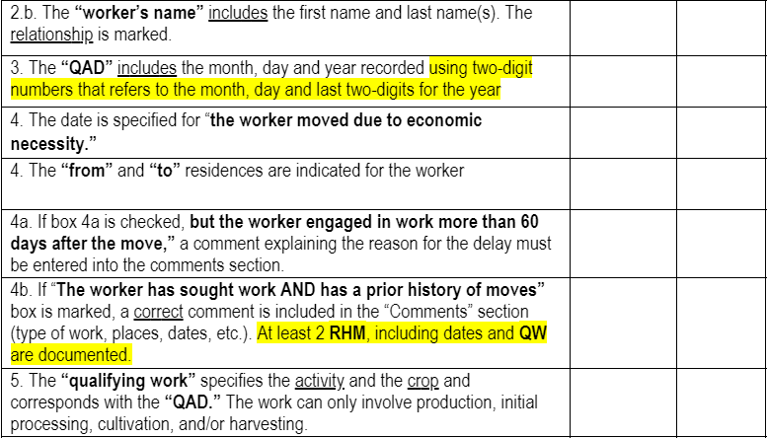
Cont.

Slide 51
Cont.

Slide 52
Cont.
This will be uploaded to the DPI website after the meeting on Thursday, along with a list of QW

Slide 53
NC DATA - A LOOK AT FOUR YEARS BACK

Slide 54
Category 1 or Regular School Year

Slide 55
Category 2 or Summer Intersession

Slide 56
MEP & ELs Numbers

Slide 57
Drop Out Numbers

Slide 58
Priority For Service

Slide 59
Qualifying Arrival Date (QAD)

Slide 60
COEs Increase (I) or Decrease (D) SY17-18 – SY18-19

Slide 61
COEs Increase (I) or Decrease (D) SY18-19 - SY19-20

Slide 62
COEs Increase or Decrease
SY17-18 – SY18-19
SY18-19 – SY19-20
NC Increased by 52%
NC Decreased by 45%
1 LEA did not change 3%
NC Increased by 39%
NC Decrease by 58%
1 LEA did not change 3%

Slide 63
Let’s Talk About Services…

Slide 64
Instructional Services

Slide 65
Supportive Services

Slide 66
Let’s See Both Charts Side by Side
Instructional Services
Supportive Services

Slide 67
SY21-22 Allotment

Slide 68
NC Spending Status
Total allotment – SY20-21 $4,546,402
Carried over – $2,180,626 (48%) from SY19-20
Total Available = $6,727,028

Slide 69
NC Spending Status – Cont.
Y-T-D expenditures = $2,587,111.03
Balance as of March 9-2021 = $4,199,066.96
Percentage spent as of March 9-2021 = 38%

Slide 70
Creative Ways to Utilize Carryover Funds
Survey results:
- Received 25 responses
- Majority of responses indicated using MEP funds for instructional supplies and materials, food, tutors, technology (devices and hotspots, fees) and summer programming.
- Creative uses included: purchasing mattresses, blankets, towels, children's books, toys, PPE; providing educational field trips; paying for medical and dental appointments.
Notes:
Susan – As you know, we asked each of you to complete a survey on the utilization of carryover funds. We received 25 responses. The majority ….

Slide 71
Spotlight: Creative Uses of Carryover
Hunter Ogletree – HCPS – High School Leadership Retreat
Serilda Goodwin- PSRC – Garden Based Reading Program
Notes:
Susan – there were two responses that really interested me....one was from Hunter Ogletree and HCPS who listed a High School Leadership Retreat. I would like to ask Hunter to take a few minutes to provide us with more information about this....
The other response that was of great interest to me was from Serilda Goodwin with PSRC who listed a Garden Based Reading Program. Serilda if you are on the line , would you please share a little more information about this?
Thank you to everyone who completed a survey. We will send the survey responses out to you in the in the next week. At this time I will turn the presentation back over to Dr. Corral.

Slide 72
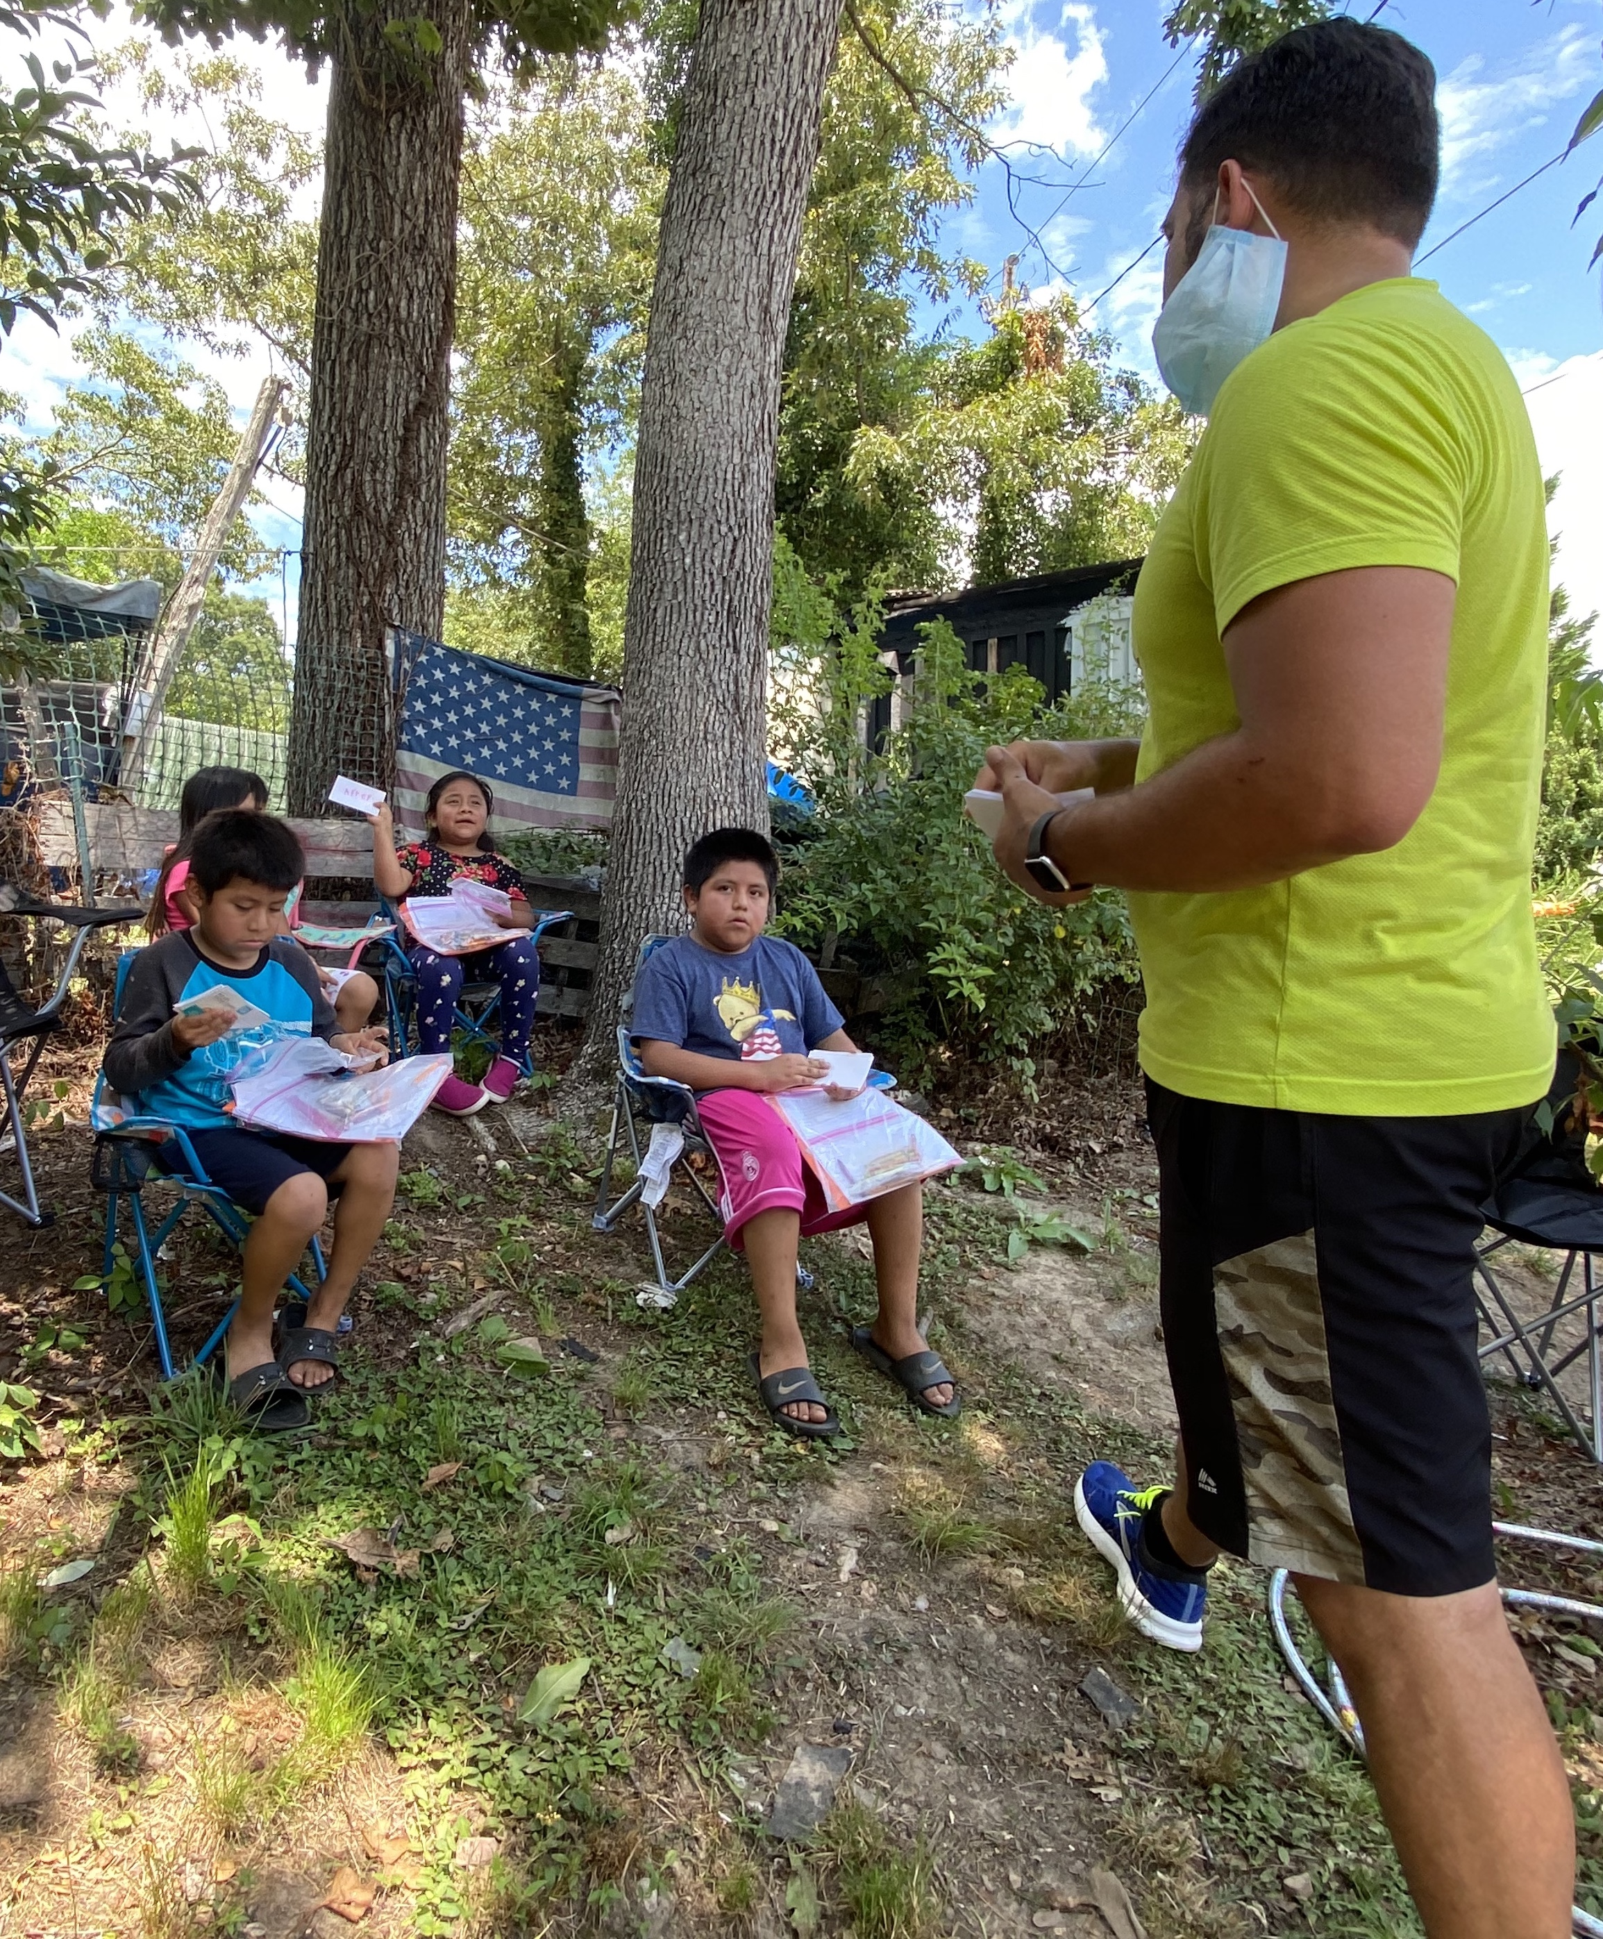
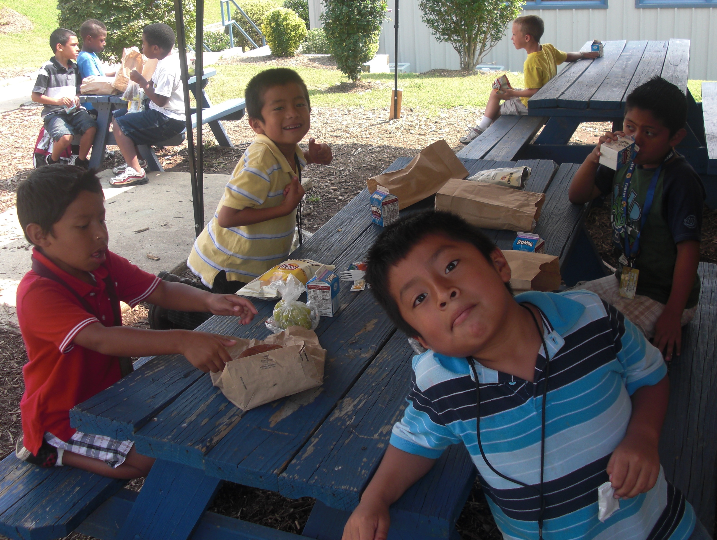
Summer Programs
What challenges are you facing in designing and implementing a summer program to serve your migratory students this summer?
Notes:
Quick open discussion around this question.
Close the discussion highlighting the fact that summer programs are important, highly recommended and suggested. Summer programs, especially this particular summer, will help migratory students overcome learning loss, both from an academic and instructional standpoint but just as important from a socio-emotional standpoint from COVID school closures and remote learning.

Slide 73
Summer Programs
How can your local MEP supplement the Summer Learning Choice for NC Families Act that requires LEAs “to offer all students at least 150 hours or 30 days of summer in-person instruction, along with enrichment activities such as sports, music, and arts”?
Notes:
“The Act is geared toward at-risk students, but attendance is voluntary and is open to any student.” (April 1st News and Observer
Ask this open question in an effort to see if local programs know about the Summer Learning Choice for NC Families Act and to see if local programs have started to think about how their local MEP can supplement it.
Quickly reinforce fact that the Act requires the local Summer School be available to all students in the district.
Transition to next slide.

Slide 74
Ideas for MEPs to Supplement Summer Learning Choice for NC Families Act
Implement an outreach plan to encourage your migratory students to attend.
Offer transportation if your district is not able to offer it for all students.
Use programs funds to have MEP-funded Tutors/Liaisons work with MEP students on supplemental instructional activities during the duration of the summer school program.
Other creative ways for your local MEP to supplement the Summer Learning Choice for NC Families Act?

Slide 75
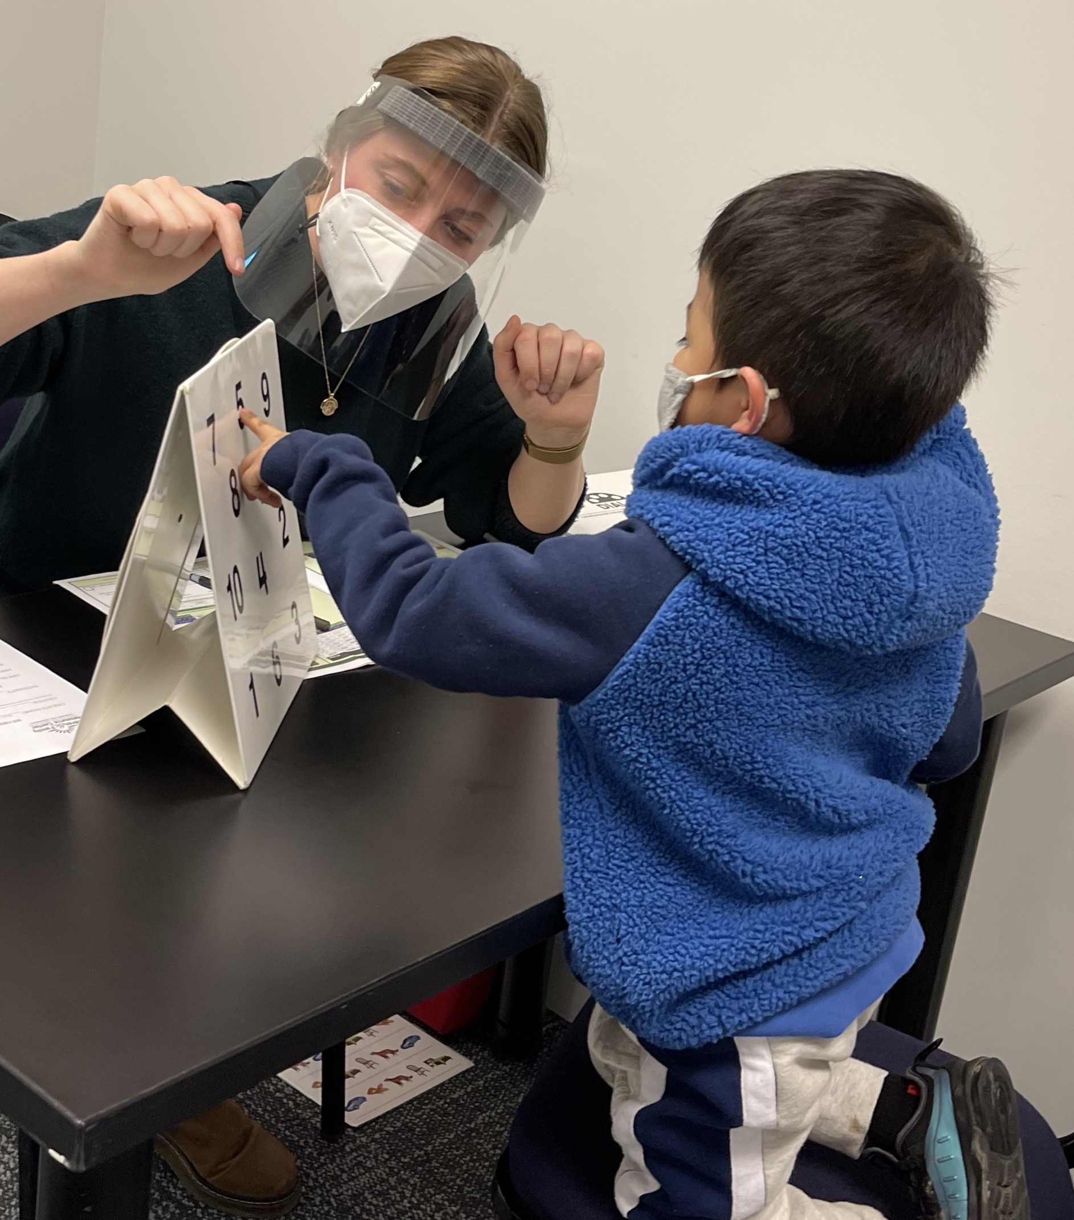
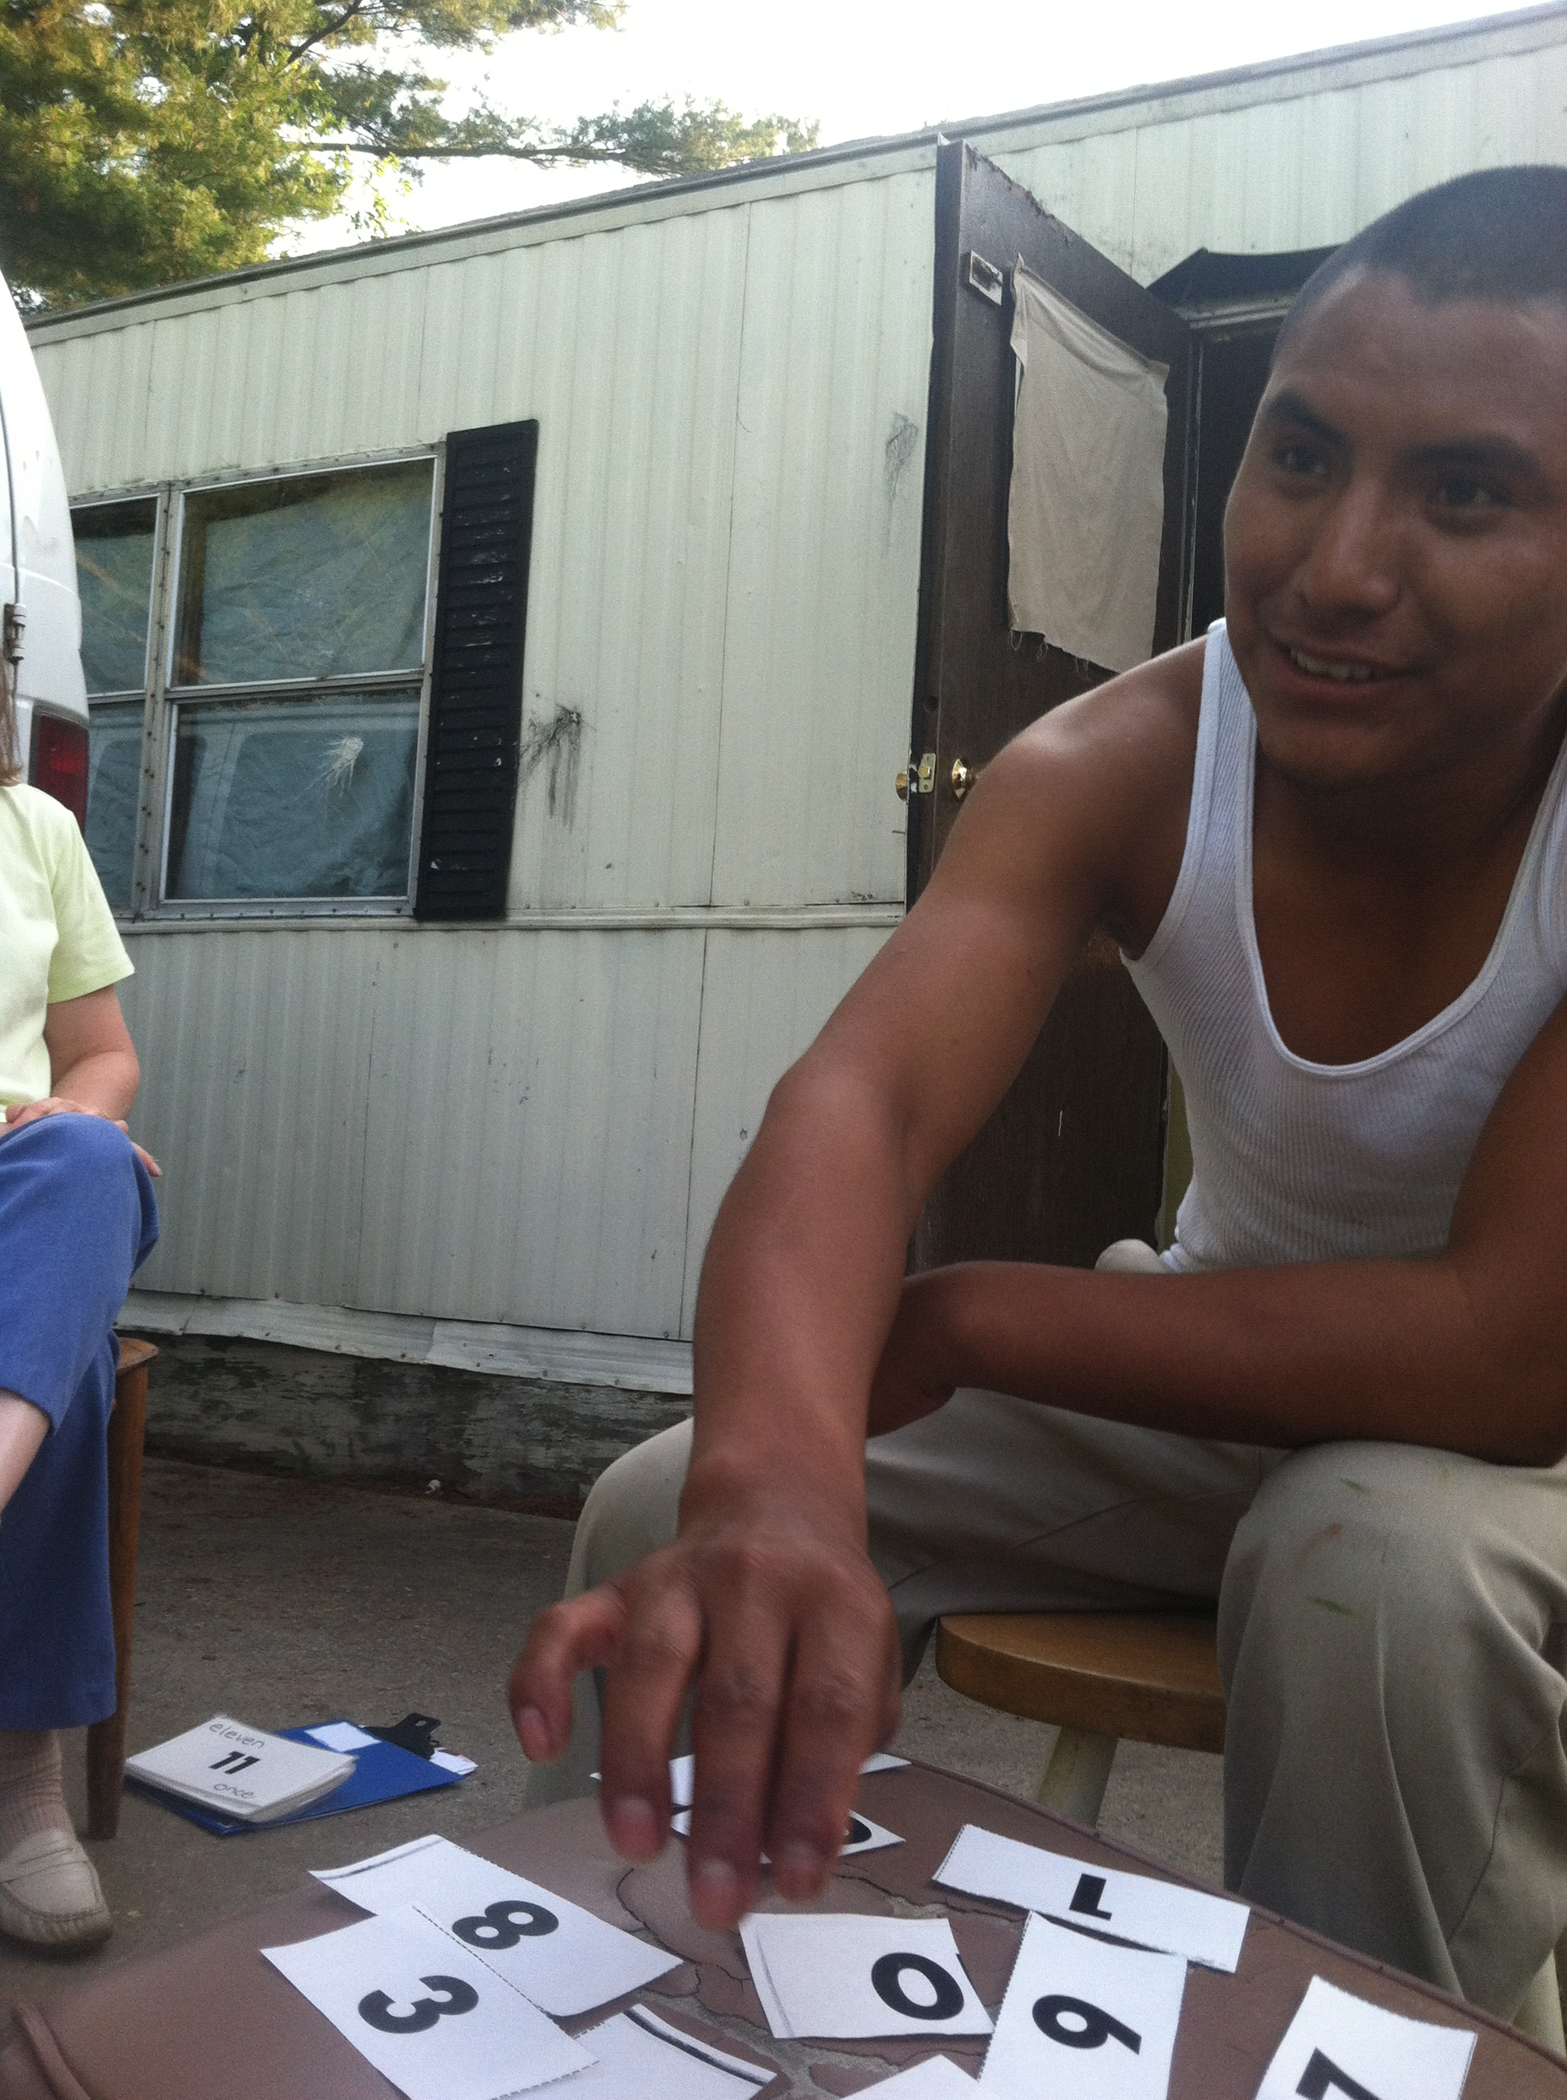
Summer Programs – Pre-K and OSY
What does your summer programming/services look like for Pre-K migratory students?
What does your summer programming/services look like for OSY?
Notes:
Ask these open questions to reinforce the importance of summer programming/services for Pre-K and OSY…… We can’t forgot about these two important populations…..
Quickly show high-qualify quick and easy, and free recourses from iSOSY Consorutium to implement with OSY. https://osymigrant.org
Quickly show high-qualify, quick and easy, and free resources from http://www.preschoolinitiative.org This is the website for the Migrant Pre-K consortium that no longer exist to my knowledge put the website and resources created under the consortium are still active.
Is there an interest among local programs to do a virtual Abriendo Puertos workshop for multiple LEA this summer?

Slide 76
BREAKOUT SESSIONS…

Slide 77
Summer Mini Grant

Slide 78
Please participate of this poll
Notes:
http://etc.ch/2wzS = to participate of the poll

Slide 79
If you answered “Yes” please complete this short form
If Summer Mini Grants were available, would your MEP be able to use those funds?
Yes
Use this link for further information
https://forms.gle/u2hcdGYQJL1Pu1DX9
Notes:
https://forms.gle/u2hcdGYQJL1Pu1DX9

Slide 81
Upcoming Events
Cat 2 (Summer Intersession) Re-enrollment verification: start June 16th Completed by July 9th
Summer Re-interview
Summit May 18th
OSY Webinar
Essay & Art Contest
https://bit.ly/2P641qk

Slide 82
DPI MEP Website
Updated - https://bit.ly/38bdC5W
PQR Instrument Visit
Forms fillable
Work in progress

Slide 83
Feedback Survey… https://bit.ly/32jfJkr
Notes:
https://bit.ly/32jfJkr

Slide 84
Q&A

