Slide 1
Understanding the Continuation of Services (COS) Provisions
Targeted Technical Assistance

Slide 2
Objectives
Understand the different definitions of Continuation of Services (COS) designations
Apply this understanding to scenarios

Slide 3
References
Statute
Title I, Part C of the Elementary and Secondary Education Act (ESEA) of 1965, Section 1304(e)(1), (e)(2), and (e)(3)
Code of Federal Regulations
None
Non-Regulatory Guidance
October 2010, pages 65-68 and 117

Slide 4
COS Provisions
A child who ceases to be migratory during a school term shall be eligible for services until the end of such term
A child who ceases to be migratory may continue to be served for an additional school year, but only if comparable services are not available through another program
Secondary school students who were eligible for services during secondary school may continue to be served through credit accrual programs until graduation
1304(e)(1)
COS1- 060
1304(e)(2)
COS2- 038
1304(e)(1)
COS3- 046

Slide 5
Points to Consider
1st
Are the child’s unmet special educational needs being addressed by the general school program or other local, State, or Federal services
2nd
Has the LEA already served its migratory children who have priority for services (PFS) as well as other eligible migrant students

Slide 6
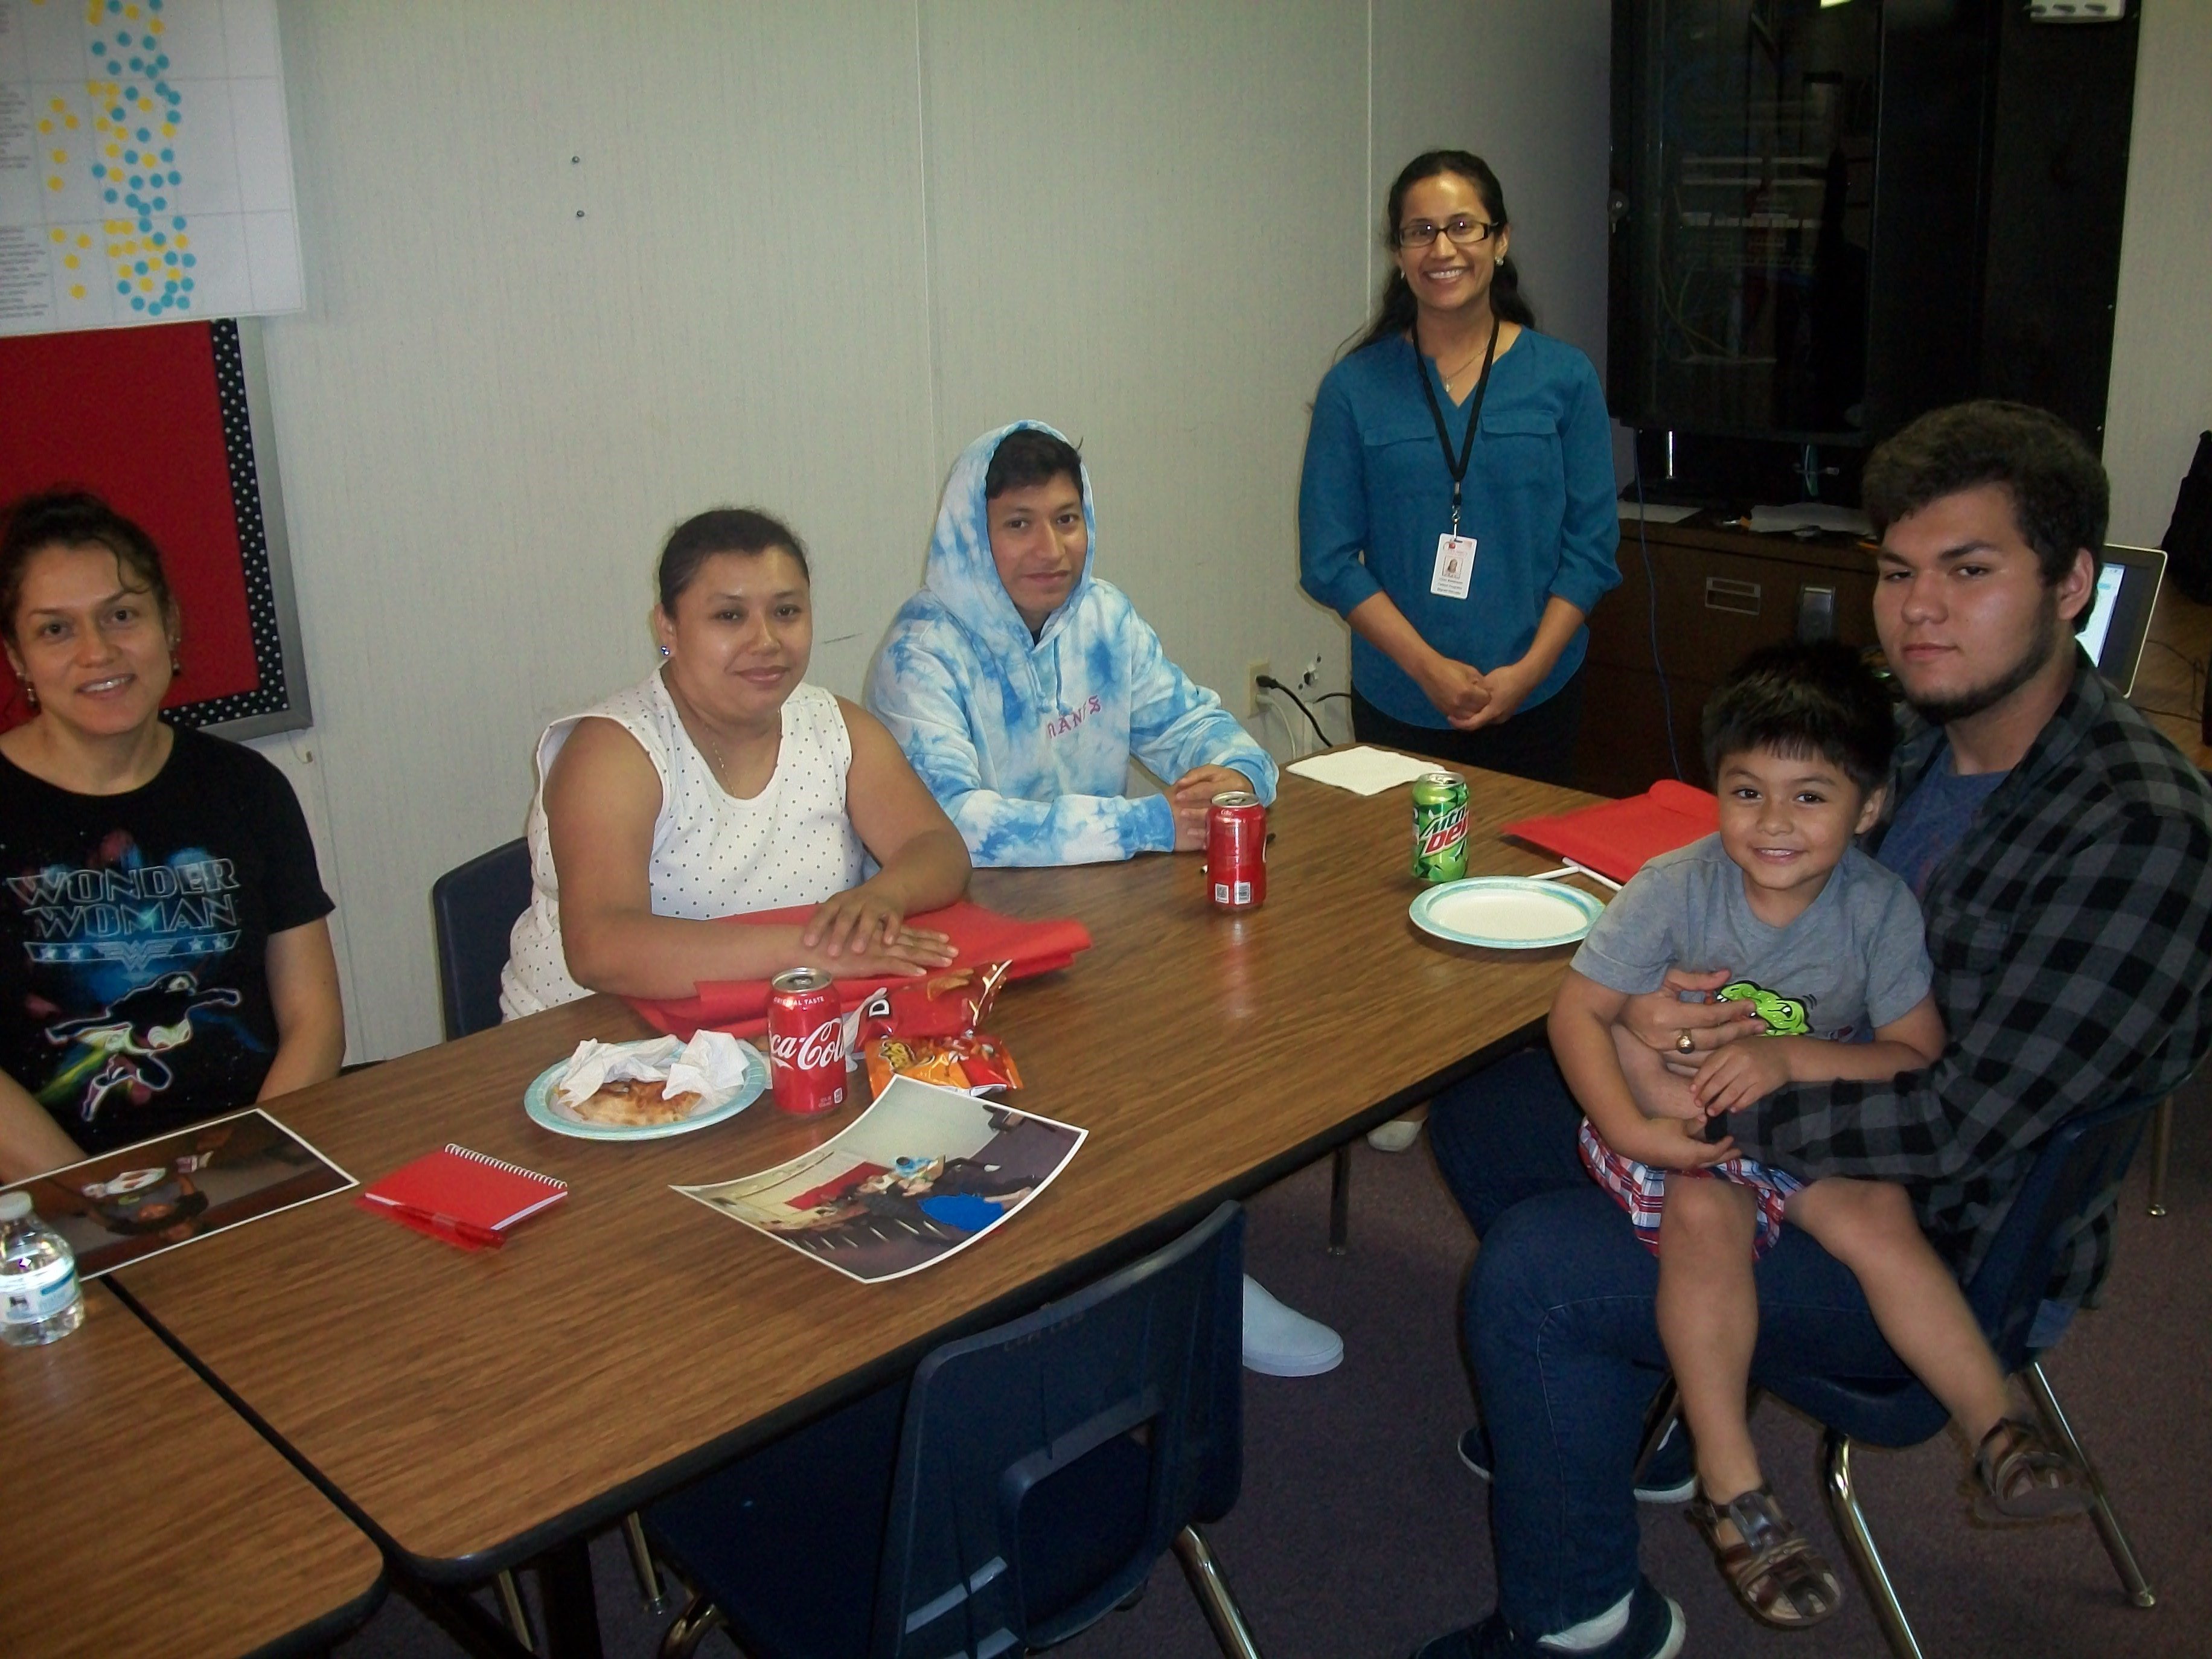
Non-Eligible Students
COS DOES NOT apply to:
Students who are over age 21 ; or
No longer entitled to a free, public education through grade 12
NOTE: LEAs do not receive funds for service provision to COS students

Slide 7
North Carolina Code 060- Section 1304(e)(1)
“A child who ceases to be a migratory child during a school term shall be eligible for services until the end of such term.” •
The LEA may provide services through the end of t h e school term in which the child ceases to be eligible for the MEP.
But not if the individual no longer meets the definition of “children” in section 1115(b)(1).
“Term” means one of the following discrete periods of the school year: fall, spring, summer, intersession. See Non-Regulatory Guidance (NRG), Chapter IX, B33.
No COS form is required for children served under this provision

Slide 8
060 Scenario
Luisa receives reading support services from the MEP and ceases to be eligible on February 28, 2020. An LEA may continue to provide her with MEP services until the last day of the spring term. However, Luisa may not receive services during the summer term unless another COS provision applies.
February
March
April
May
June
July
EOE
Serve until the end of Spring 2020 term

Slide 9
North Carolina Code 038- Section 1304(e)(2)
“A child who is no longer a migratory child may continue to receive services for 1 additional school year, but only if comparable services are not available through other programs.”
For the purposes of this provision, OME considers “school year” to mean the sum of three additional consecutive terms.
Only migratory children who received services at some point during their 36-months of eligibility may “continue to receive services” under this provision.
State/LEA needs to document their efforts to ensure that “comparable services are not available”
A COS form is required for students under this provision

Slide 10
038 Scenario
David’s MEP eligibility expired on November 30, 2020. Under section 1304(e)(1), David is eligible for services until the end of the 2020 fall term. If no comparable services are available for this student, then services may be extended for one additional school year, which OME considers to mean three consecutive terms, i.e., to the end of the 2021 fall term in this scenario. David may not continue to receive services during the 2022 spring term
Fall 2020
Spring 2021
Summer 2021
Fall 2021
Spring 2022
EOE
Service under COS1 (060)
038 designation
Serve until the end of Fall 2021 term

Slide 11
What is a “comparable service?”
One that meets an identified need consistent with the description of “services” in NRG, Chap. V, A1 –
Directly benefits a migrant child;
Is consistent with the State’s CNA and SDP;
Is grounded in evidence based research or, in the case of support services, is a generally accepted practice; and
Enables the program to meet its measurable outcomes and contribute to the achievement of the State’s performance targets.
Examples:
In-school vs. in-home services
Distance-learning vs. classroom-based instruction

Slide 12
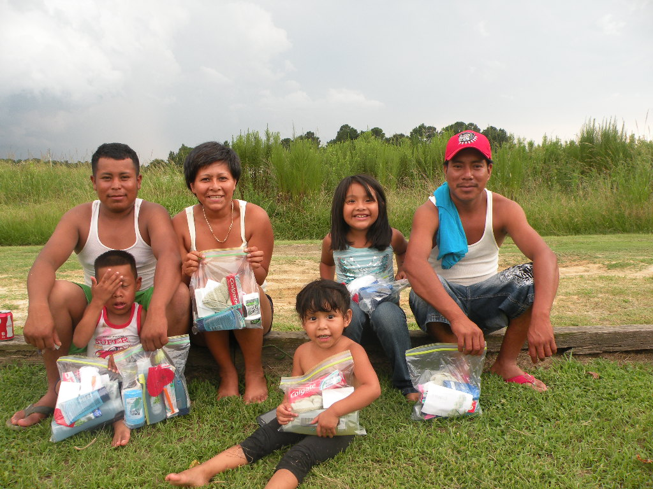
Documentation for Availability of Comparable Services
Describe MEP Services to be provided under COS;
Describe efforts made to find comparable services- e.g.,
  Speak/Communicate with social service agencies
  Follow-up with Federal Program Directors and other directors responsible for district/school programs
  Document the name and title of individuals you spoke with including the date and content of the conversation

Slide 13
North Carolina Code 046- Section 1304(e)(3)
“Secondary school students who were eligible for services in secondary school may continue to be served through credit accrual programs until graduation.”
1304(e)(3) services assist secondary school students who are not on track for graduation or who are at-risk of not staying on track for graduation from high school.
An individual must have been enrolled in secondary school when MEP eligibility ended in order to receive services under this provision
Only secondary school students who received MEP services at some point during their 36-months of eligibility may “continue to receive services” under this provision.
A COS Form is required for students served under this provision

Slide 14
046 Scenario
Marisa receives instructional support services under the MEP because she is behind credits in math and science. Her MEP eligibility ends on February 23, 2020, of her sophomore year. Because she is not on track , or is at risk of not being on track to graduate, she may continue to be supported through credit accrual programs until graduation.
9th grade
10th grade
11th grade
12th grade/graduation
Serve until graduation
EOE

Slide 15
Credit Accrual Programs
Acceptable
Not Acceptable
Tutoring for credit-bearing courses
Tutoring for EOC tests and final exams
Distance or online learning courses to accrue lost credits
Graduation transcript reviews
Independent study to accrue lost credits
Leadership Programs
Field Trips
Summer Programs (unless they are related to credit recovery or accrual)

Slide 16
POP QUIZ!

Slide 17
POP QUIZ!
Ana is a 4th grader whose MEP eligibility ends on March 22, 2020. When she ended eligibility, Ana was receiving MEP-funded after school math tutoring. Title I, Part A will offer supplemental math tutoring during the coming school year.
Is Ana eligible for Continuation of Services?
  YES
If yes, which provision does she qualify for?
  COS1- 060
When will her services end?
  At the end of the Spring 2020 term

Slide 18
Questions?
Heriberto Corral, Ed. D Juan Carlos Alvarez
MEP Administrator, Data Coordinator MEP Administrator, ID&R Coordinator
Heriberto.corral@dpi.nc.gov Juan.Alvarez@dpi.nc.gov

