Slide 1
STEM K-5
Curriculum and Strategies
Carrie Hoke - LS STEM
Pine Lake Preparatory
OCS West Regional Huddle 2018
Notes:
Introduce yourself: 15th year of teaching, range of states, districts, grades, curriculums, etc. Launch Lead teacher.

Slide 2
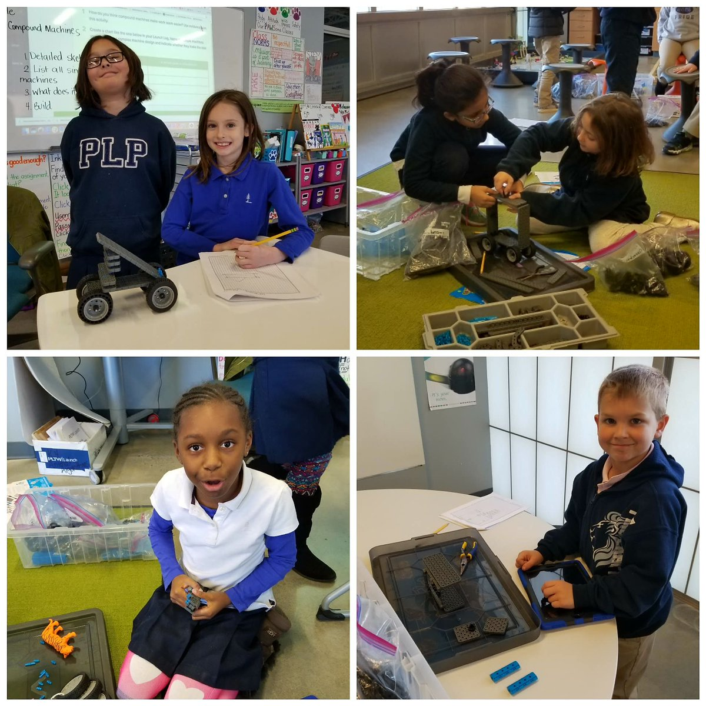
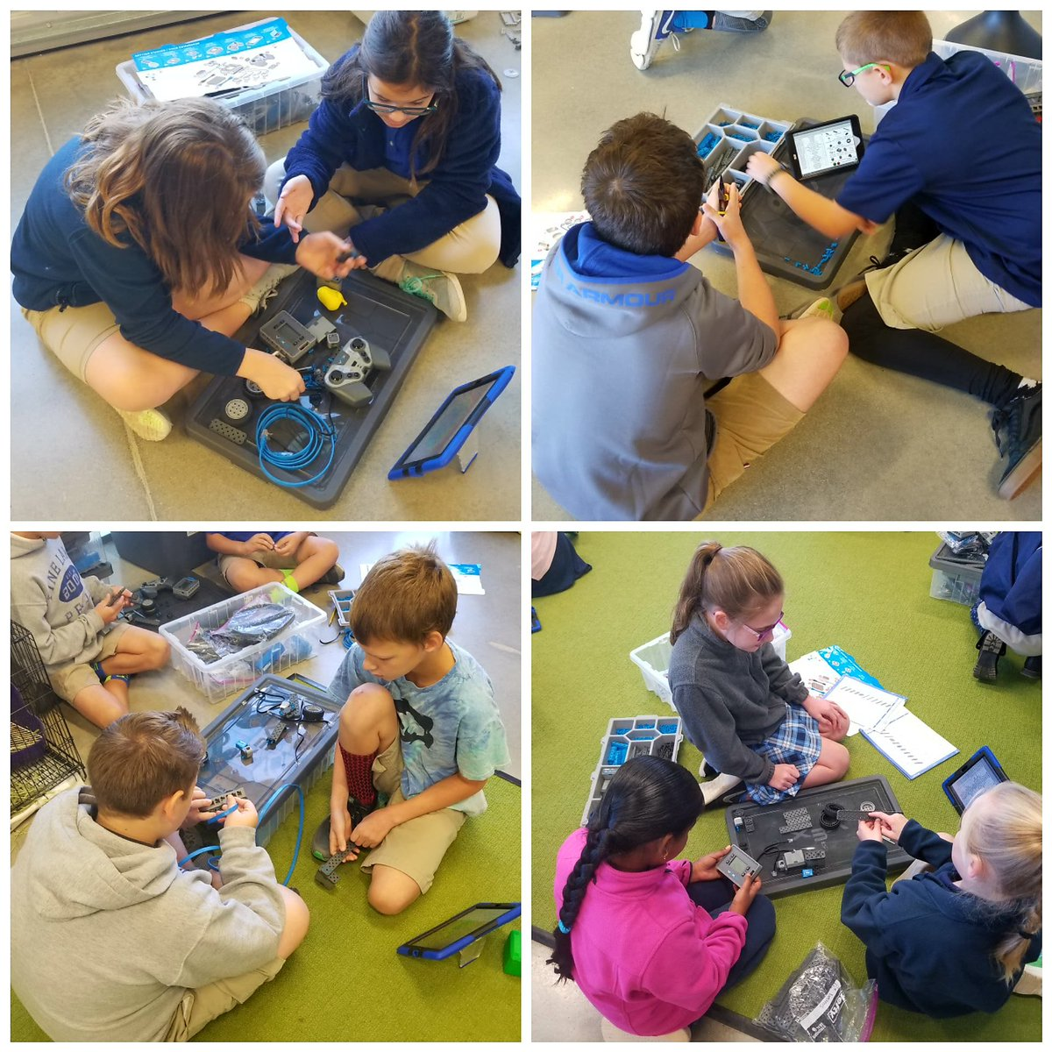
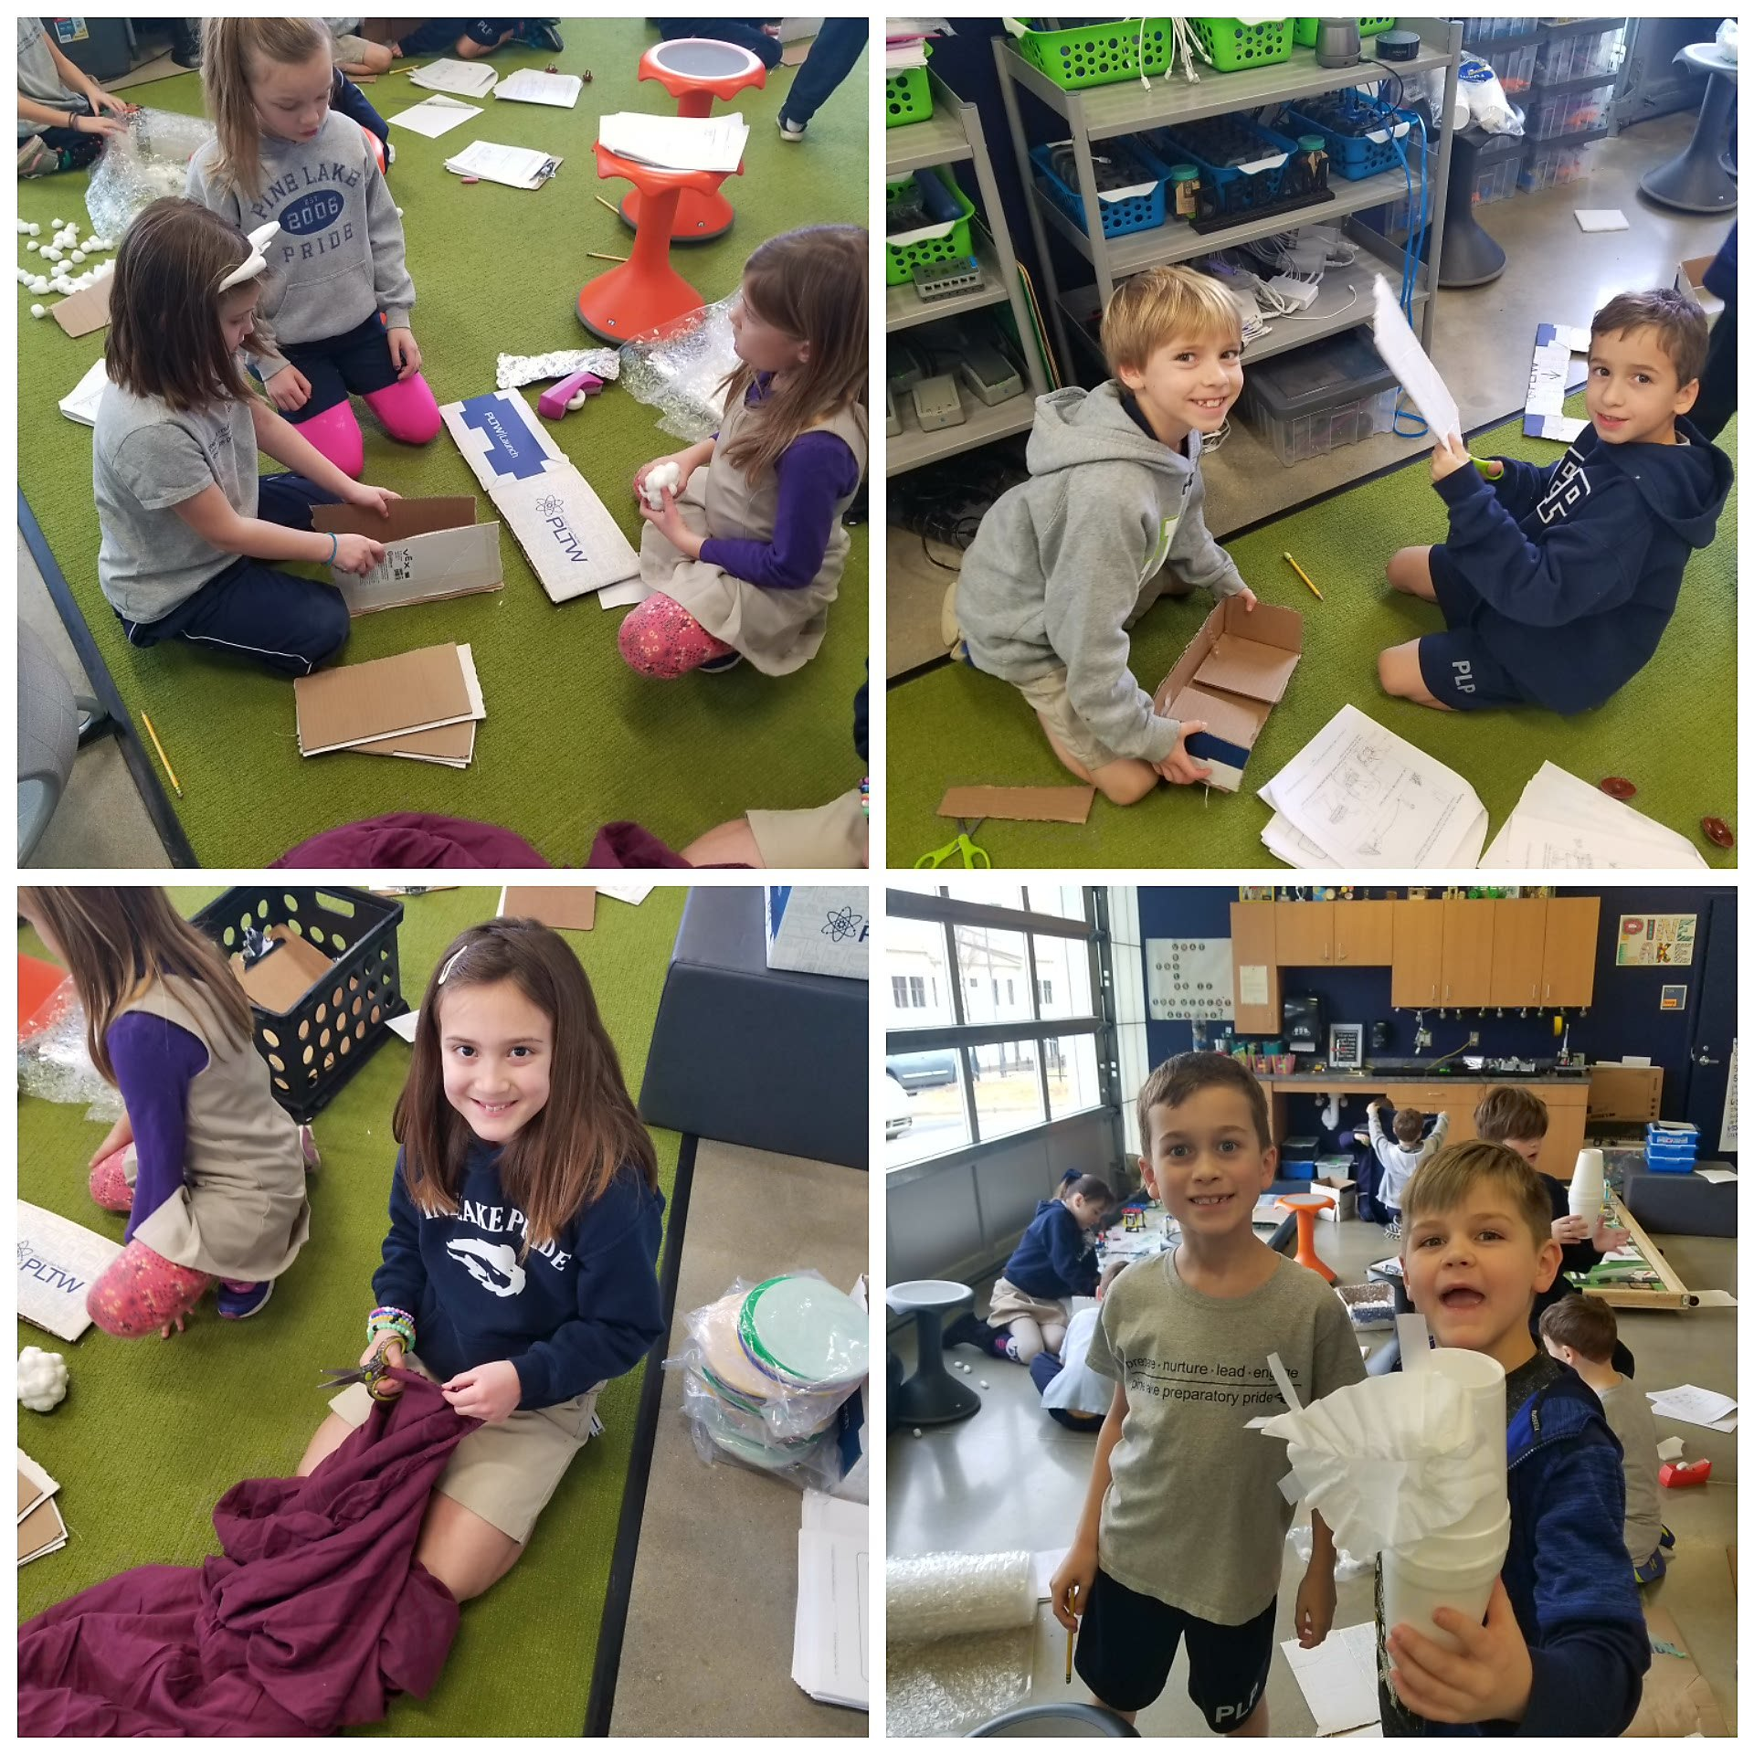
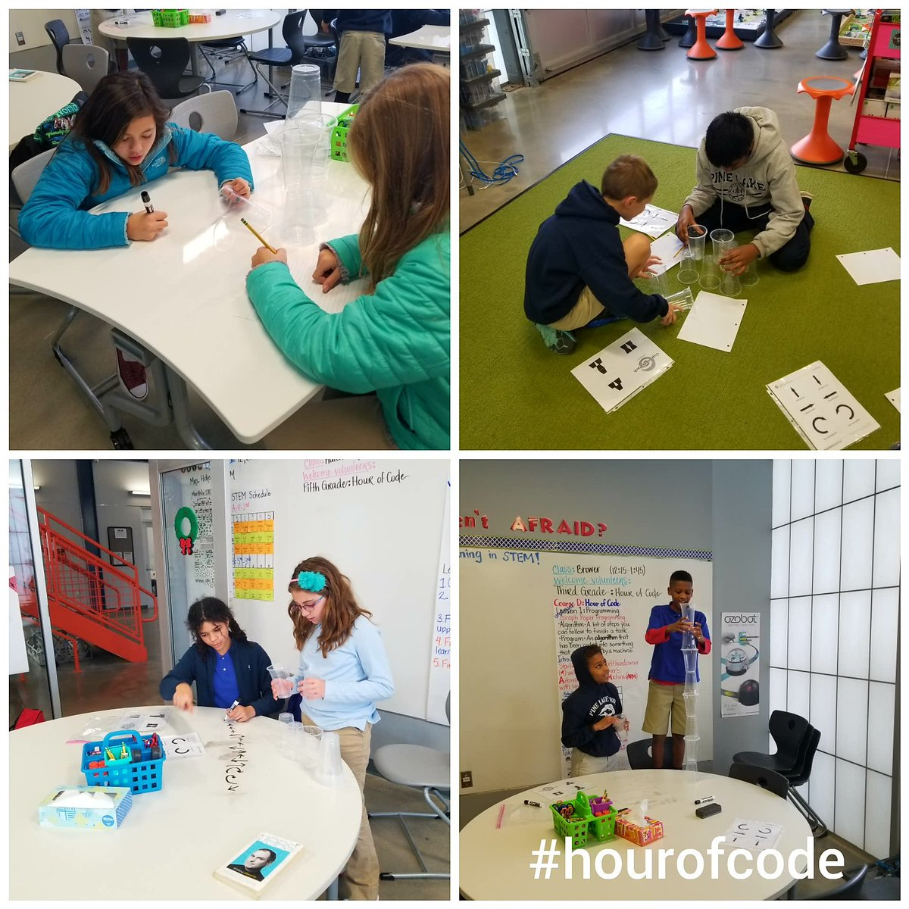
Curriculum
Notes:
Let them know that the curriculum is vertically aligned K-12 and that there is specific training involved. Centered around project based learning.

Slide 3
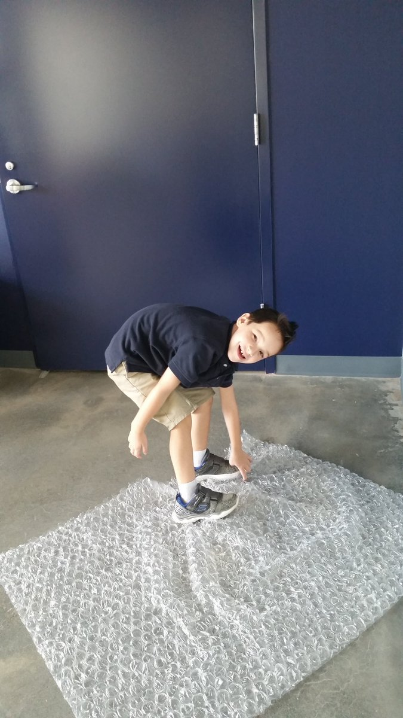
Project Lead the Way
Founded in 1997 by Richard Blais, PLTW is an American non-profit organization that develops STEM curricula for grades K-12.
K-5 STEM currently uses PLTW Launch which is designed to build a strong foundation for middle school and upper school.
All students participate in STEM every 10 days for 90 minutes to complete 2 PLTW Launch modules.
Notes:
Standards alignment is already done for you and is provided on the pltw website. There are over 24 modules to choose from, where everything is laid out for you and the students.

Slide 4
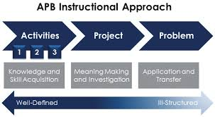
The APB Model
A - Activities
3 activities that begin with a real world problem in a grade level appropriate story
Each hands on activity builds on prior knowledge and skill
P - Project Based
A relatable activity to the final problem that provides connectivity
B - Problem Based
Transfer of knowledge to solve the real world problem using the Engineering Design Process
Notes:
Each module K-5 is designed around the APB model. Let’s take a look at a module in K-2 and then in 3-5. Our technology teacher will be starting her first modules this year.

Slide 5
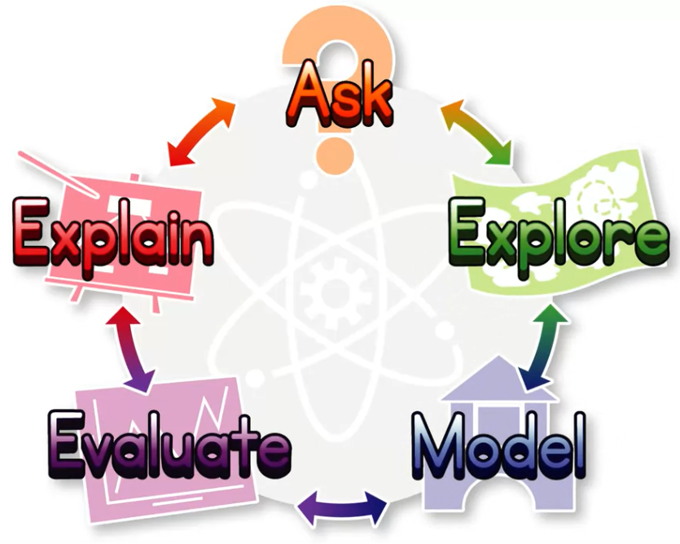
The Engineering Design Process
Ask: What is the problem? Identify what you are trying to solve and write it down.
Explore: There is not just one right answer. Create a number of possible solutions. Draw, sketch, write, etc. Talk with others and be open minded.
Model: Choose the best possible solution that solves the problem. It may not be the one you designed and that’s ok. If you can’t decide, use a decision matrix.
Evaluate: Test your model. Chances are it might not work the first time and you will have to review your notes and make adjustments.
Explain: Reflect! What did YOU like? What could you have been better? What would you change if you could?
Notes:
Let them know that there are possible exit tasks/assessments available through matrix and that there is a summative assessment that PLTW provides for each module.

Slide 6
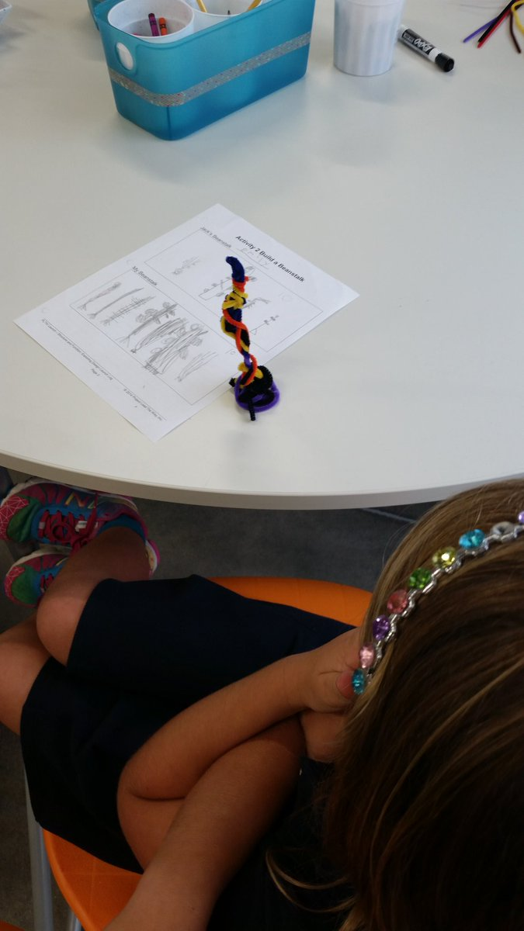
Jack & the Beanstalk
Kindergarten module: Structure and Function
Let’s take a closer look!
Now you try! 10 minutes and 10 pipe cleaners.
Criteria and Constraints
Notes:
Explain to the group that this is the Activity 2 in the module and that the students have already heard the introduction story and read about the real world problem that they will face at the end of the module. (design and build a paintbrush.)

Slide 7
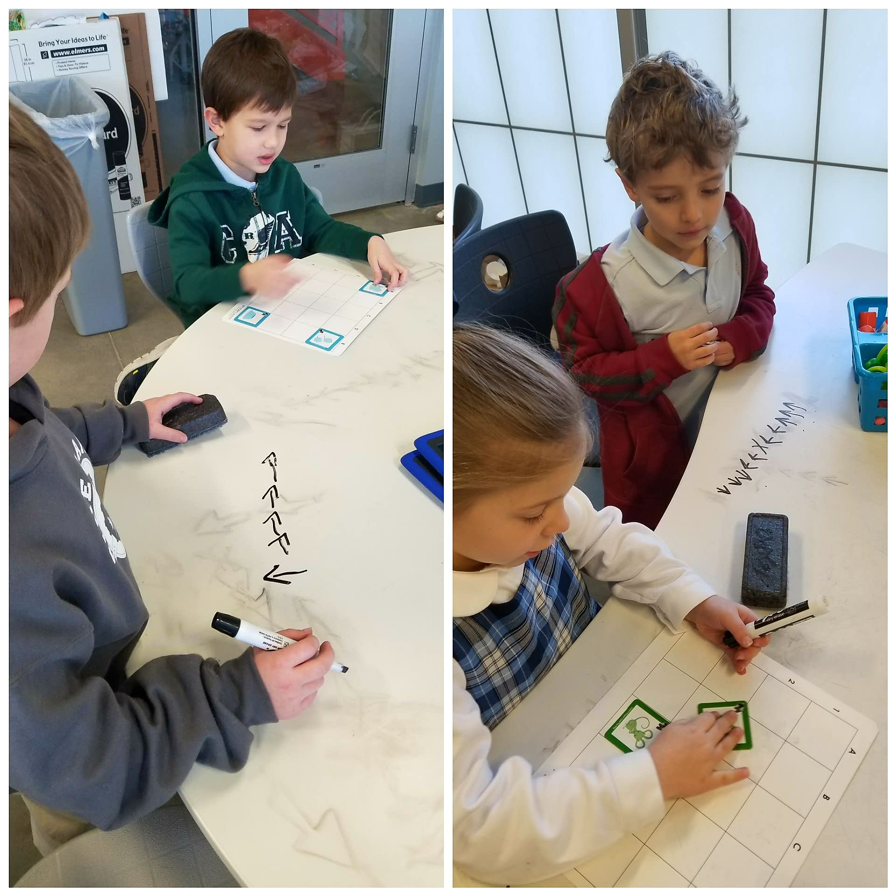
STEM Strategies that Work
Transfer control of the learning process to the students.
Let them fail and then fail again.
Don’t be afraid of a mess.
Keep it open ended.
It’s ok to not know the answer...yet.
Notes:
When they ask if this is good, turn the question around, What do you think? K learning algorithms by playing Animal Maze.

Slide 8
“Everything is hard if you’re not good at it, but you practice.”
- Vince Bertram, President and CEO of PLTW

Slide 9
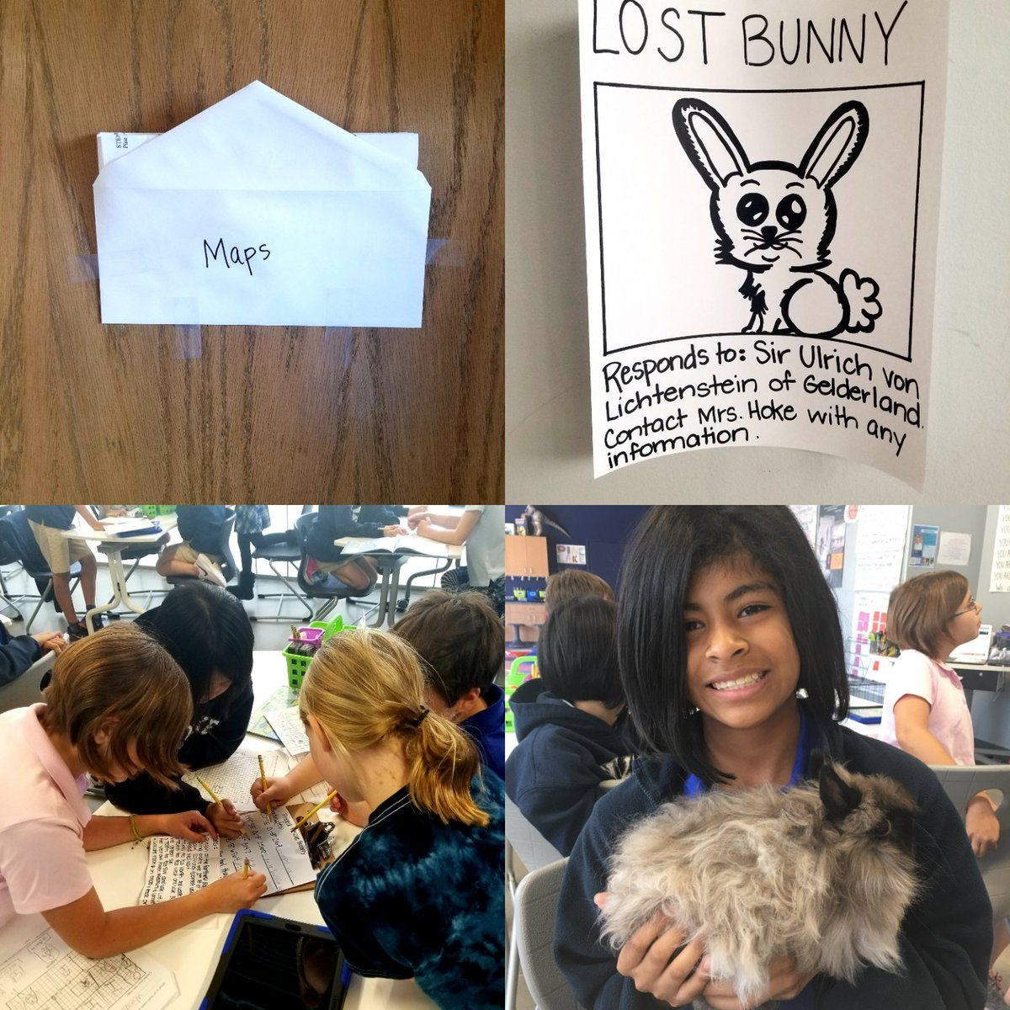
Anything you do in the classroom can be connected, created, and evaluated. It doesn’t have to be separated.
Notes:
Explain that while PLTW is the main curriculum, there are times where I develop other STEM activities relating to the classroom or even holiday events.

Slide 10
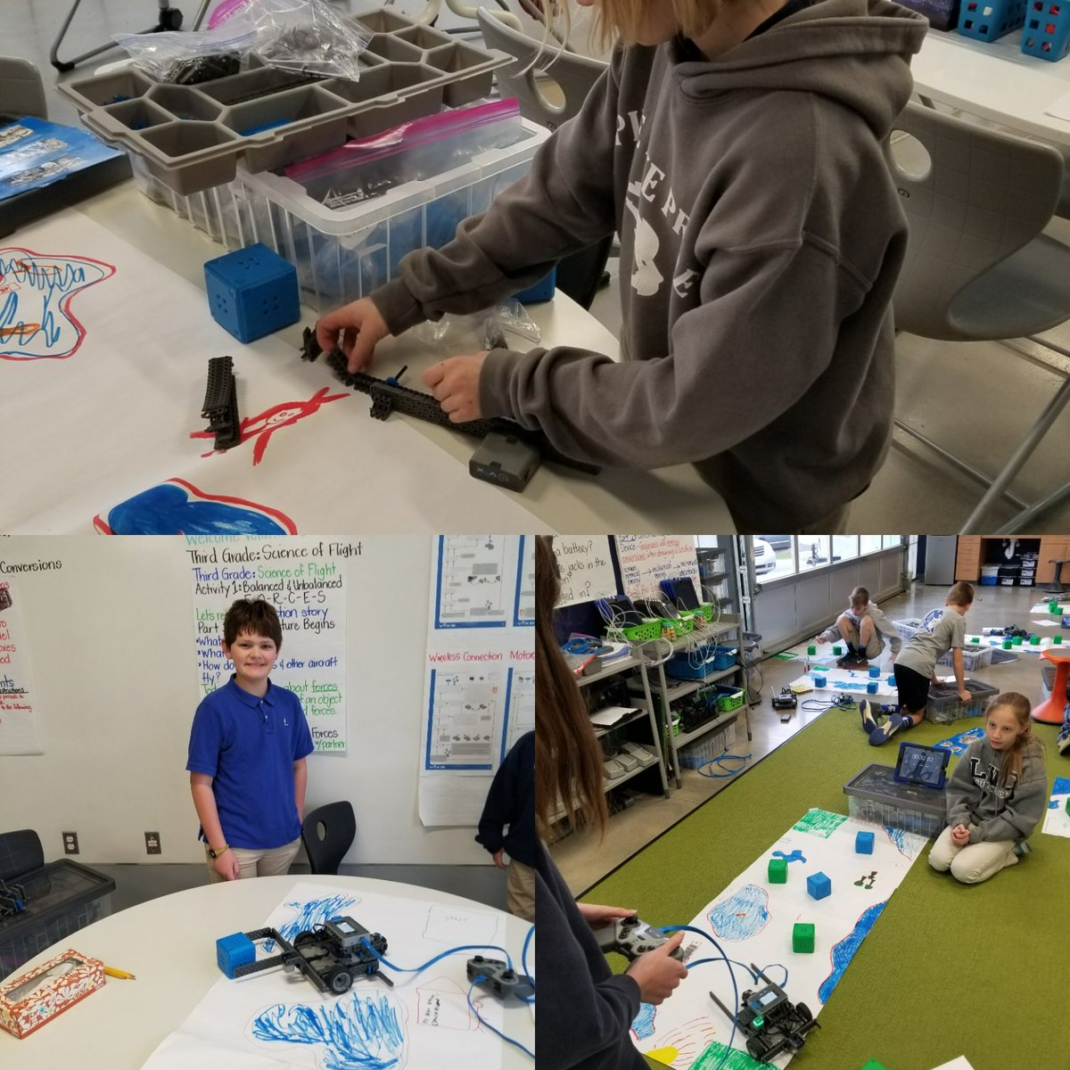
Thanks!
Contact me:
Carrie Hoke
104 Yellow Wood Cir
Mooresville, NC 28115
carrie.hoke@pinelakeprep.org
Twitter: @PLPLSSTEM
https://www.pltw.org/
PLTW Implementation Guide

