Slide 1
Project Based Learning
Carrie Hoke - LS STEM
Pine Lake Preparatory
OCS West Regional Huddle 2018

Slide 2
What is PBL?

Slide 3
Introduction to PBLs
Project based learning, or PBL, is an opportunity for students to work on a particular project that involves a real world problem, over an extended period of time, that integrates several subject areas.
LS STEM meets with each grade K-5 every 10 days for 90 minutes and completes 2 PBLs each year.
PBLs are nothing new! Confucius and Aristotle were early proponents of learning by doing. Socrates modeled how to learn through questioning, inquiry, and critical thinking. John Dewey initially promoted the idea of “learning by doing” in My Pedagogical Creed in 1897.
Notes:
Give 5th grade example of robots in the real world.

Slide 4
PBL Looks Like PBL Sounds Like
Interdisciplinary team working together
Engaging in real world problems
Relevant, hands on activities
Active, student-directed learning
Messy
Team discussions
Brainstorming
Questioning
Collaborating

Slide 5
Getting Started
Establish learning outcomes: What do you want your students to learn? What is the take away?
What is your real world problem: Write an essential, open ended question for your students to solve.
Develop an authentic task: Allow students to be creative and apply information learned to solve the problem.
Develop an assessment or exit task: This could be a rubric, a presentation, a summative, etc. It could be all of the above throughout the process.
Allow students to present: Present as a team. Allow students to develop their own roles, but everyone must participate.
Allow students to evaluate, reflect, and edit as needed: Ask: What went well? What didn’t? What would you change if you had the time and materials? This is a great opportunity for journaling.
Planning is key!
If this is your first PBL, start out small.
There are a ton of resources out there; don’t recreate the wheel unless you absolutely have to.

Slide 6
PBL Activity
Criteria:
Your team must build a tower out of index cards.
The structure must be at least 6 inches tall. (You may use a ruler.)
The function of your tower is to hold a certain amount of weight on top without it falling down.
If your tower falls down, you may use the allotted time to reflect and rebuild.
You may test your tower at any time during the 10 minutes or after as many times as needed.
Constraints:
Your team has a time limit: 10 minutes to brainstorm, sketch, and build a tower.
Your team may only use the following materials: 20 index cards
No other material may be used: NO TAPE OR GLUE
All team members must be included in the process.

Slide 7
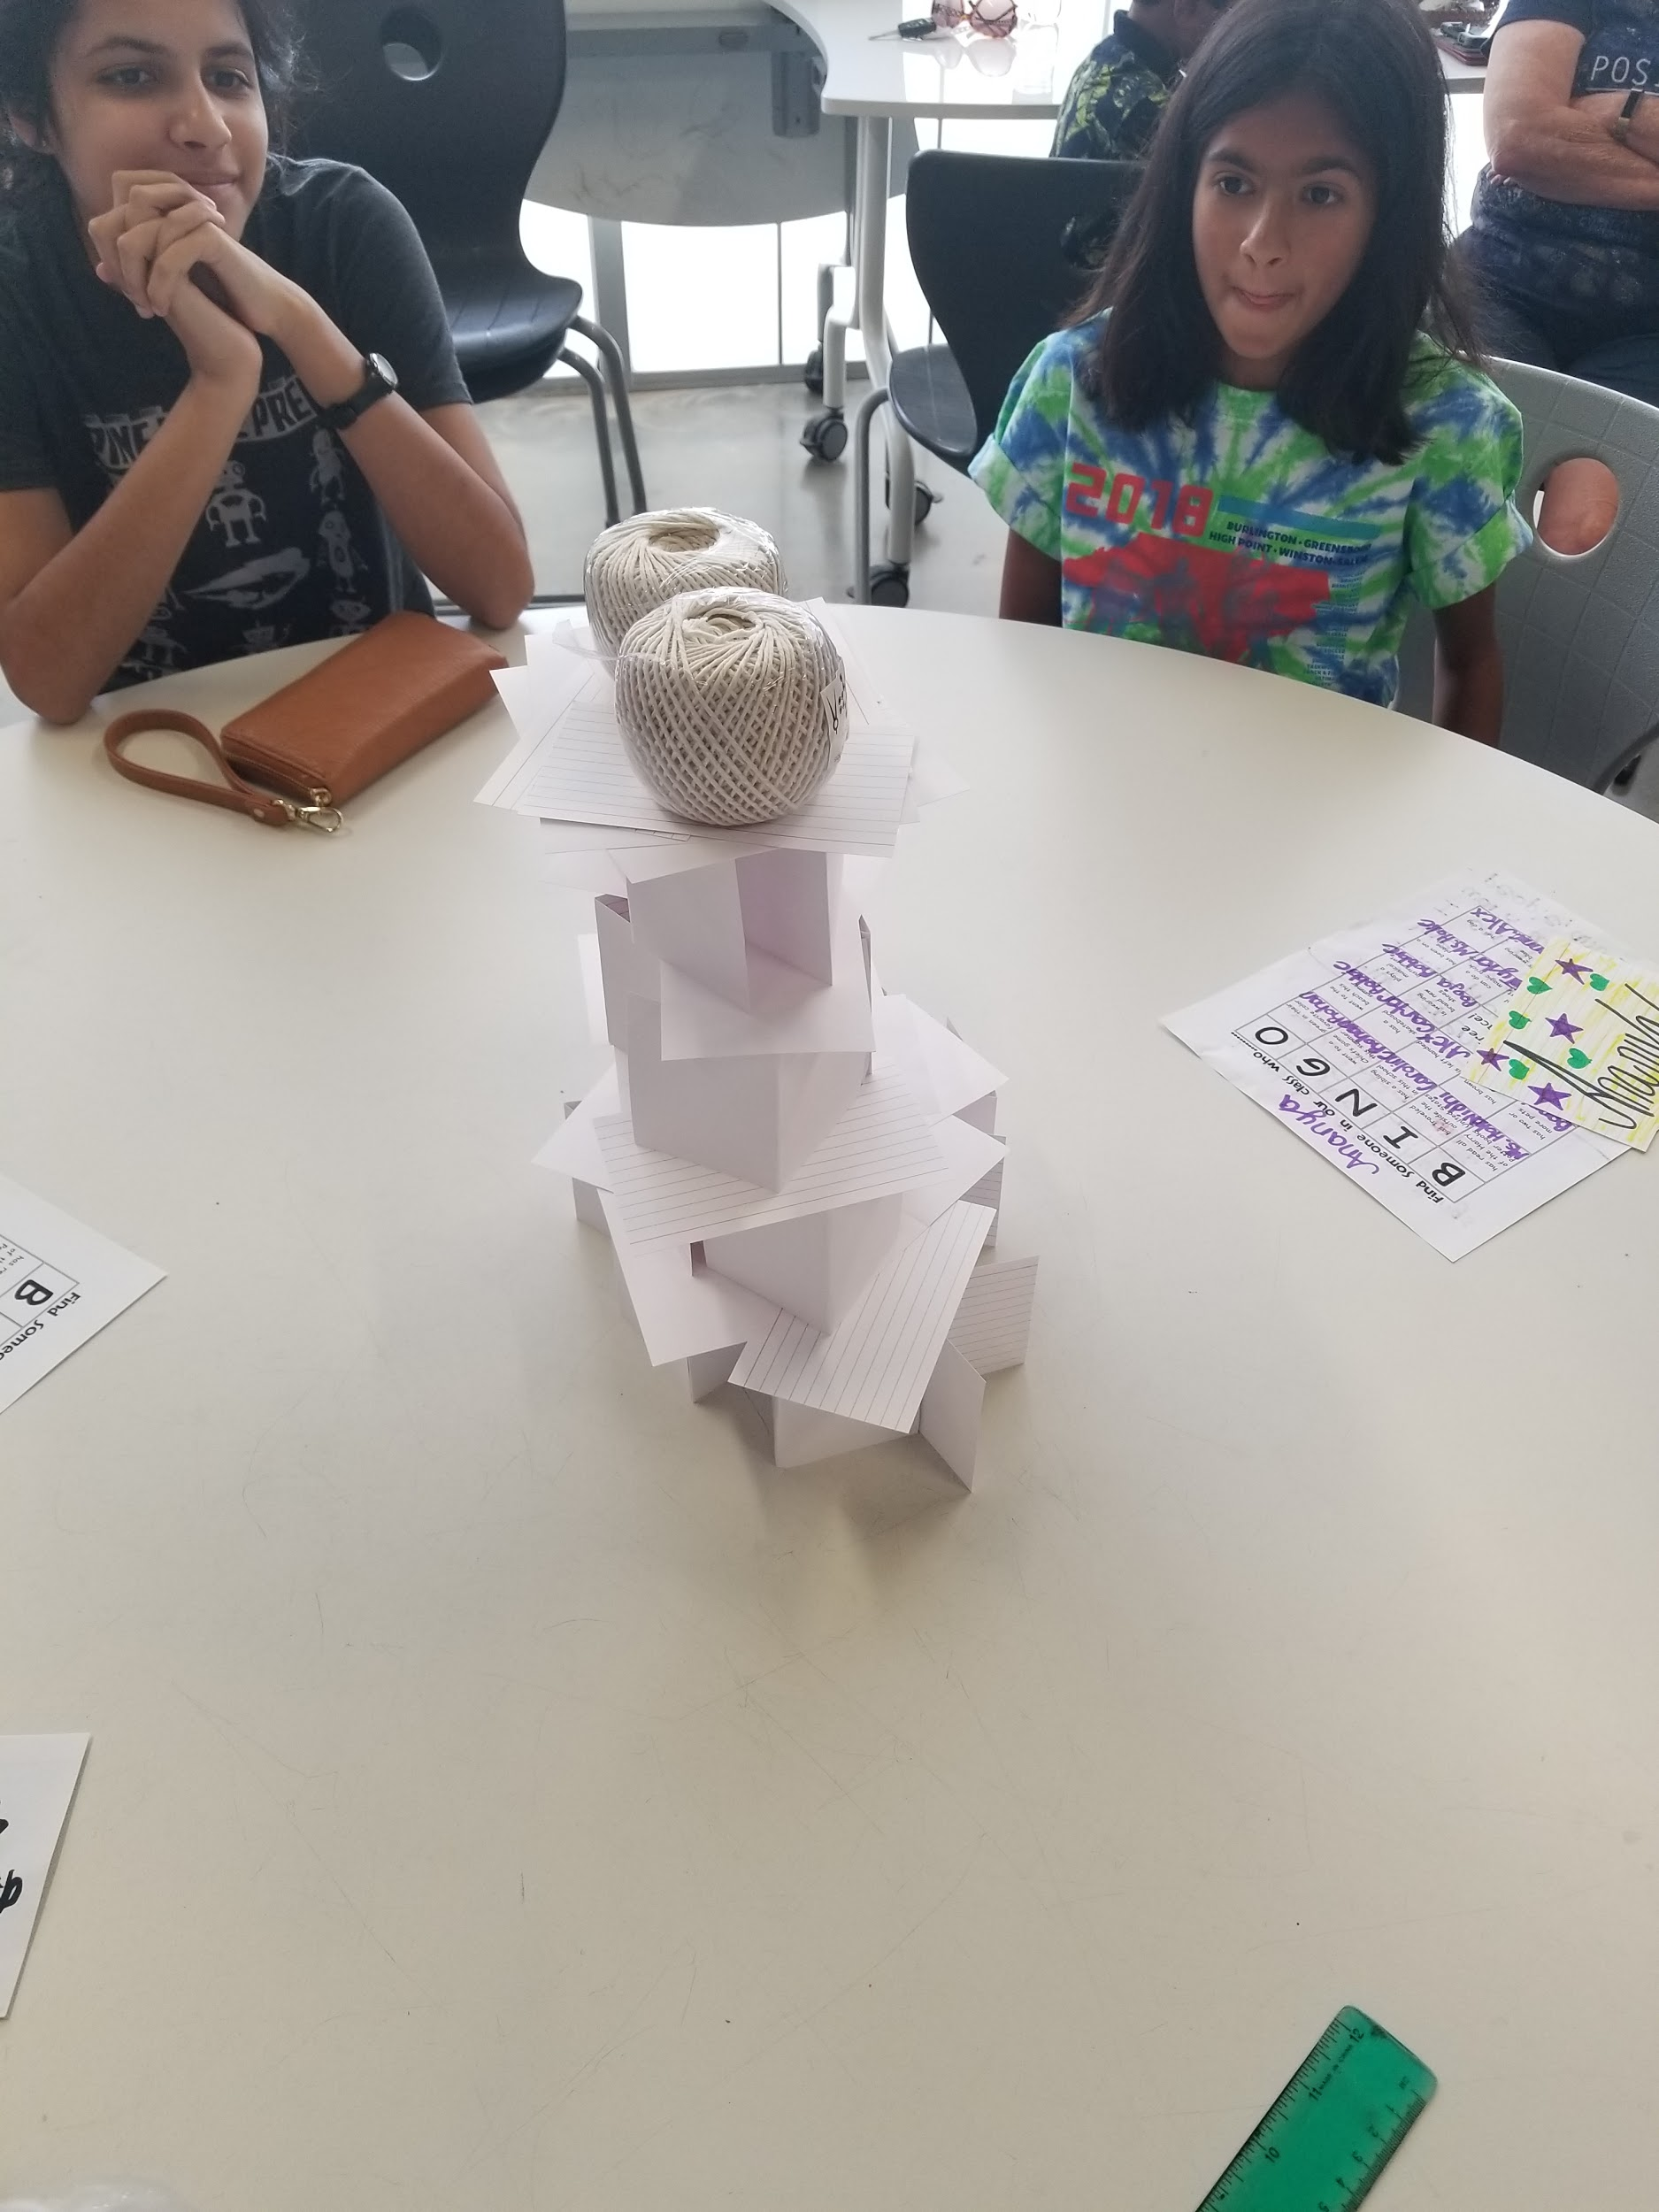
Let’s reflect!
What did you learn?
What subjects/standards did we cover?
How did you work as a team?
How could we differentiate?
How could we build this into a longer project?

Slide 8
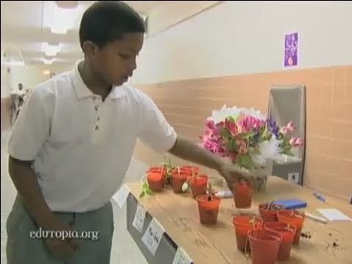
From Worms to Wall Street

Slide 9
PBL Resources:
Getting started with PBLs
The Buck Institute of Education
BIE Project Search
ISTE PBL Resources

Slide 10
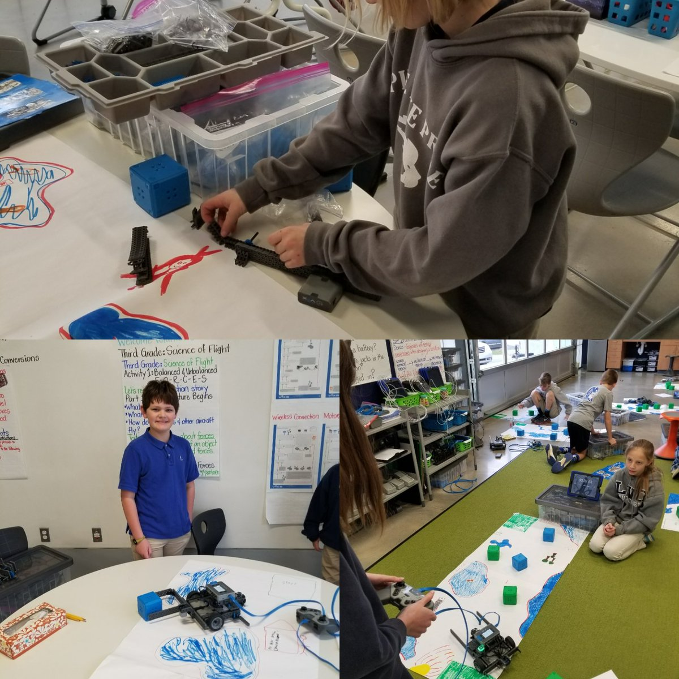
Thanks!
Contact me:
Carrie Hoke
104 Yellow Wood Cir
Mooresville, NC 28115
carrie.hoke@pinelakeprep.org
Twitter: @PLPLSSTEM

