Slide 1

MTSS across the State:
Leveraging the Power of MTSS in your School
Presenters:
Karmen Mills, IABS Consultant - NC DPI
karmen.mills@dpi.nc.gov
Kimberlee Strickfaden, MTSS Coordinator - Pine Lake Prep
kimberlee.strickfaden@pinelakeprep.org

Slide 2

MTSS
definition
our words
NC MTSS is a multi-tiered framework which promotes school improvement through engaging, research-based academic and behavioral practices. NC MTSS employs a systems approach using data-driven problem-solving to maximize growth for all.
School Improvement

Slide 3
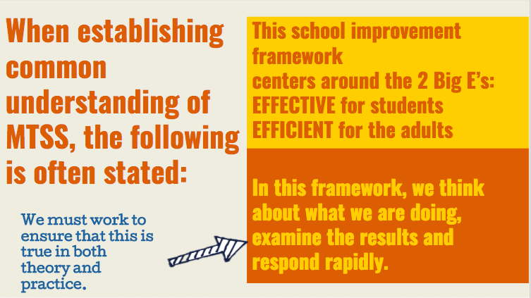

Slide 4
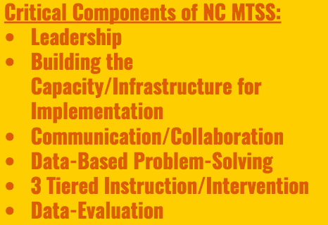


Slide 5

Notes:
0

Slide 6
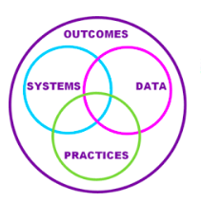
The infrastructure & supports needed to enable the accurate and durable implementation of innovations
Information used to identify status, need for change, and effects of innovations/
Interventions.
Evidenced based innovations that support students

Slide 7

Systems - Leadership
An empowering culture
Effective teams
Ongoing staff support
Notes:
Leadership Team, Problem Solving teams
Principal supports implementation by communicating a vision
Selection Criteria

Slide 8
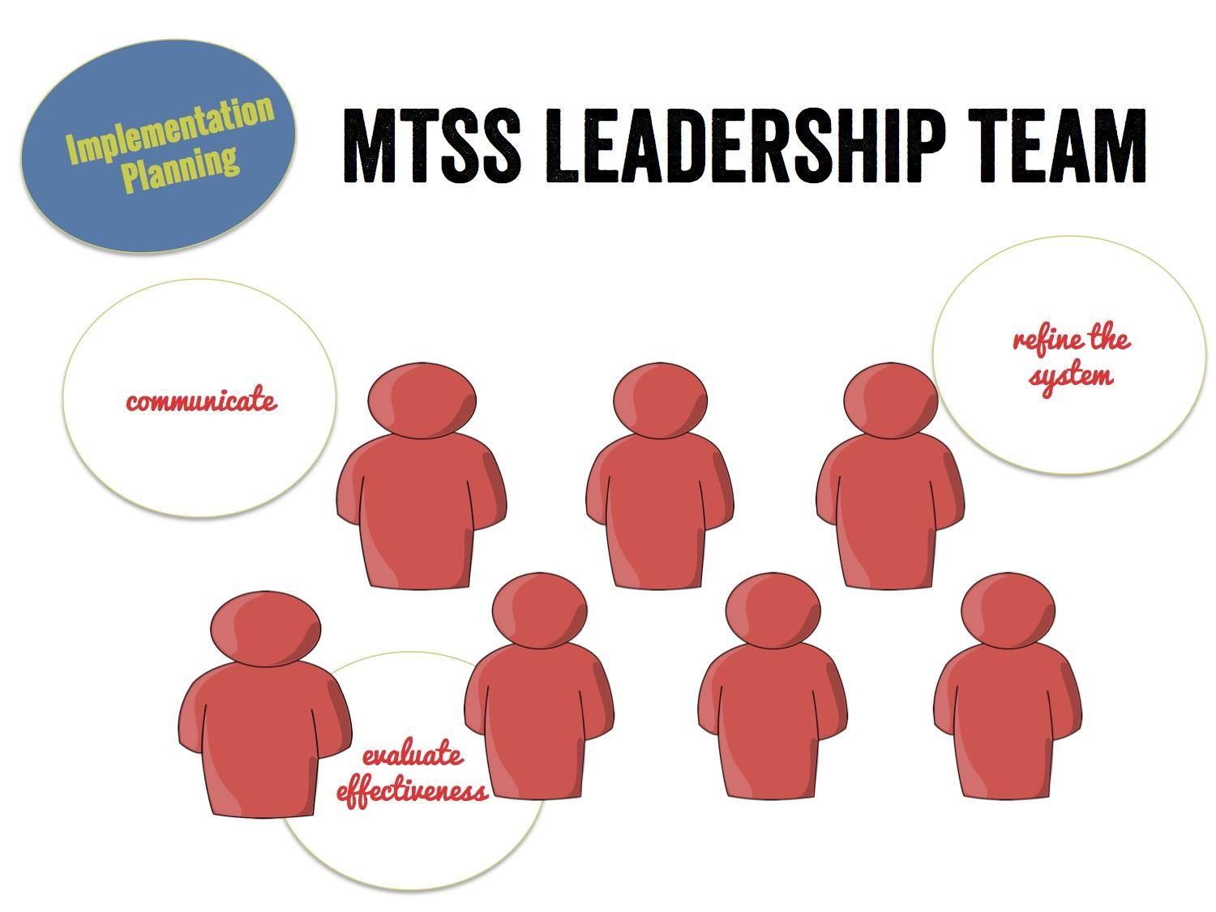
MTSS Coordinator

Slide 9
Systems - Building the Capacity/Infrastructure for Implementation
Ongoing Professional development and coaching
Strategic scheduling and planning
Processes and procedures for data-based problem solving
Notes:
schedule that allows staff to plan and implement instruction and interventions
PLC MEETINGS and teams
Rate 1-3 with a partner. Debrief

Slide 10
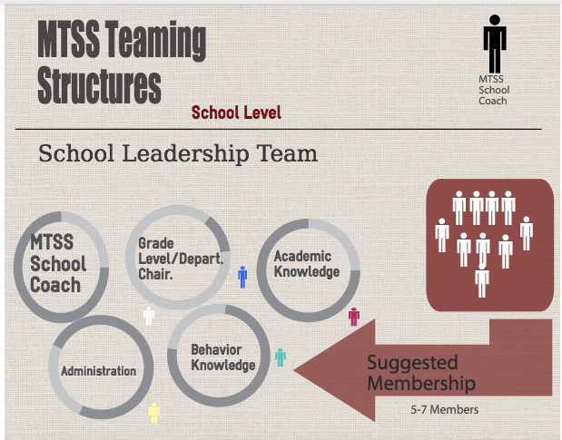
Systems - Communication and Collaboration
Two way communication with all stakeholders
Build the infrastructure to communicate and work with families and other community supports

Slide 11


Data – Data Based Problem Solving
Identify the problem
Analyze the problem
Plan Implementation
Evaluate the plan
Notes:
This includes each school leadership team using a problem-solving cycle to examine school-wide data. Does your school have a problem-solving cycle that each team uses to examine data? 1-3 debrief.

Slide 12
Universal Screening
Critical for Core
whole school
sub-group
grade level
Allows for problem solving:

Slide 13
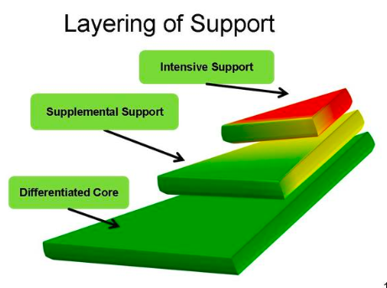
Practices: Three Tiered Instruction and Intervention
Instruction
Curriculum
Environment

Slide 14


Implementation Journey at Pine Lake Prep
Lessons Learned
Problem Solving and Action Planning
Focus on Core
Ideas for Alignment
Recognizing Alignment
Creating a
Leadership Team
Role as MTSS Coordinator
Implementation Journey at
Pine Lake Prep
Role as Coordinator
Notes:
Role as Coordinator (School demographics)
Creating a Leadership Team and shared vision
Look at alignment to work that they have already done (using what we already have including teaming structures)
Focus on the Core
Problem Solving an action planning (next step - Defining Core)
Lessons Learned (Communication planning and getting buy-in from leadership, PD and coaching)

Slide 15

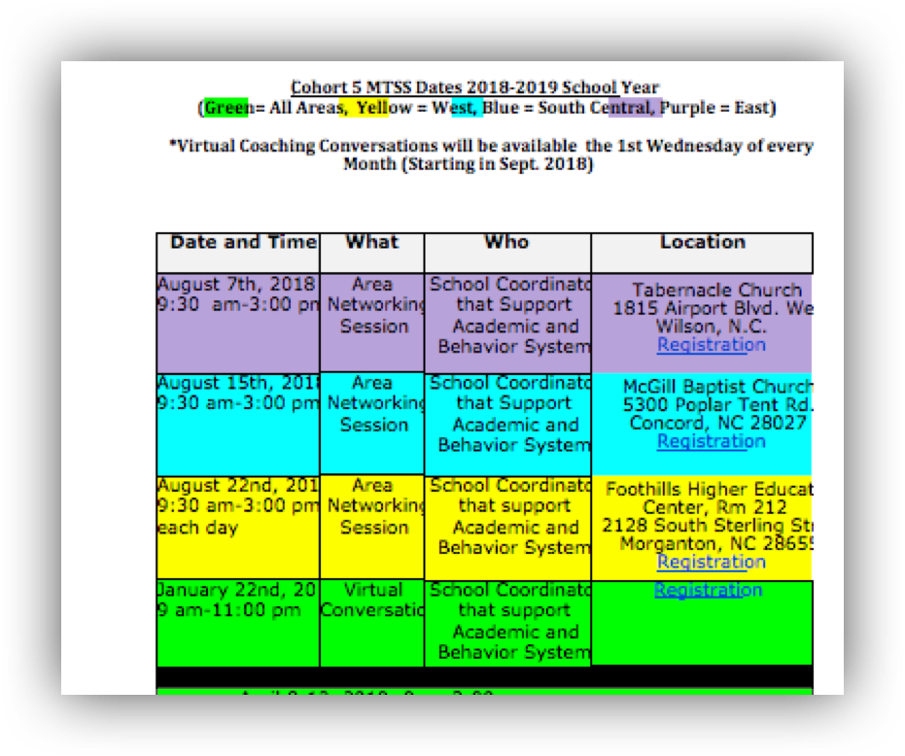
State Support

