Slide 1

KISS
Keep It Simply Simple
Dr. Karol McNeil-Horton

Slide 2
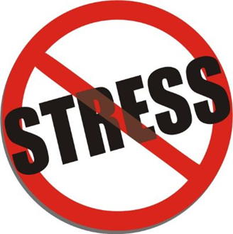
Purpose
Create opportunities for Unity in the Community
Provide stress reducing activities

Slide 3
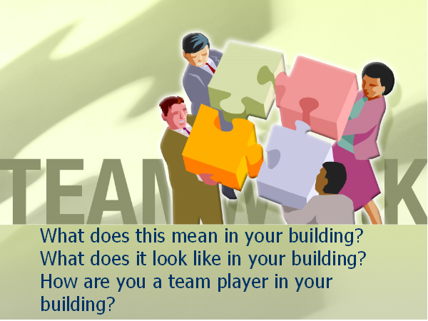

Slide 4
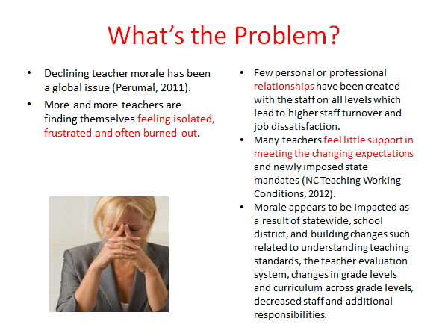

Slide 5
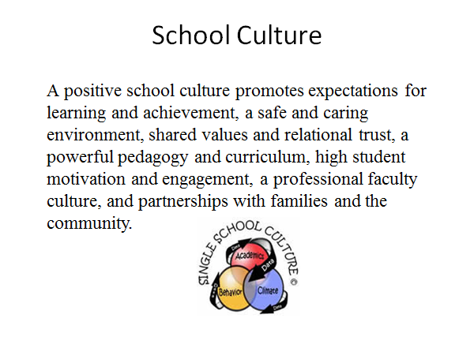

Slide 6
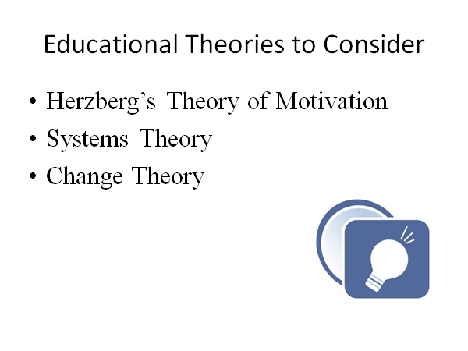

Slide 7
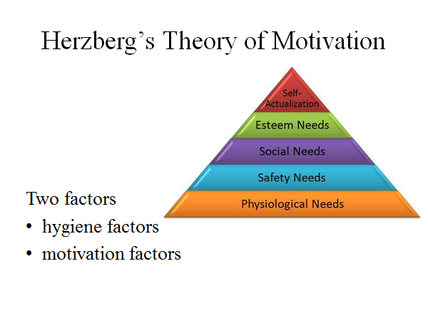

Slide 8
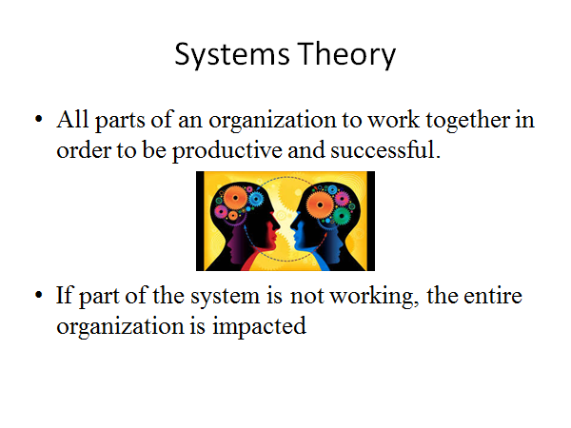

Slide 9
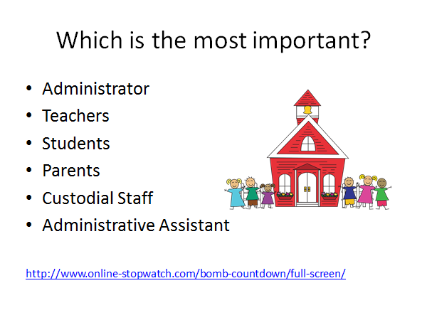

Slide 10
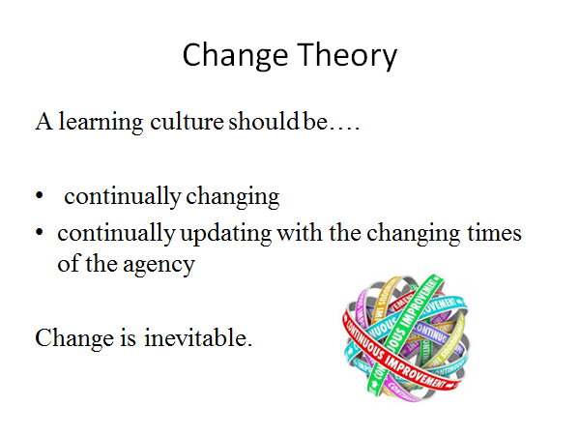

Slide 11
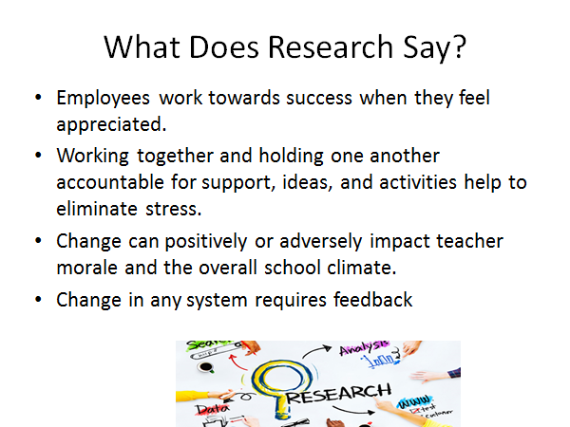

Slide 12
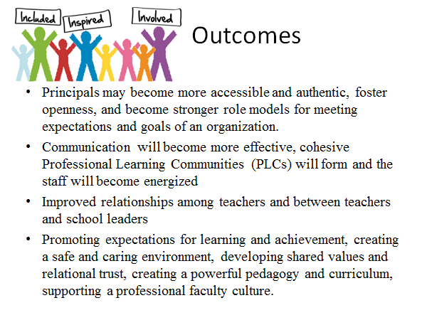

Slide 13
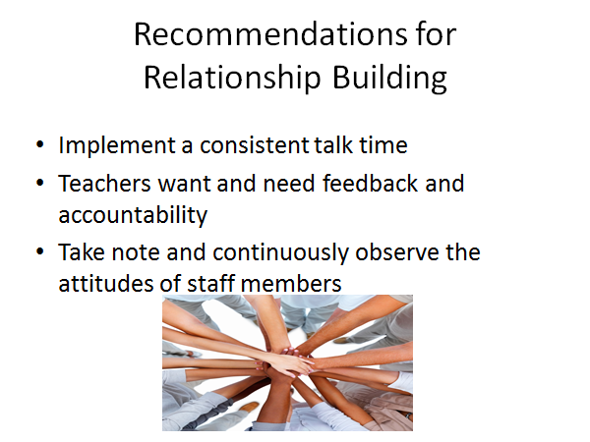

Slide 14

The Good, The Bad, and The Ugly
Chit
Chat
Time

Slide 15
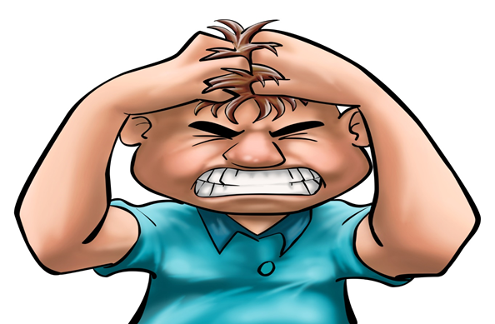
Reality
Stress Happens
Notes:
No matter how organized you are, how good your systems are, or how friendly your work and living environments are, stress can find a way to poke its ugly head in from time to time.

Slide 16

Reflection

Slide 17

What can you do?

Slide 18
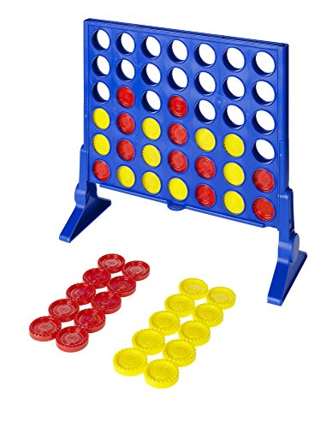
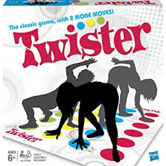
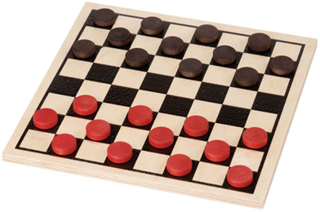
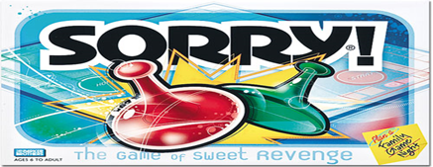
Board Games
Remember these?
Notes:
Candy Land, Chutes & Ladders, Connect Four, or even Twister are always good for a smile.

Slide 19

Journal Writing
Feelings need to be expressed
Convenient at the moment
Focus only on self
Relief

Slide 20
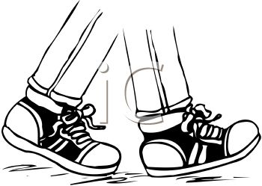
Take a Walk
Chance to regroup
Removes you from situation
Exercise
Notes:
Want a break from the office? Does your house feel like an insane asylum? Slip out the door and let your feet take you somewhere.

Slide 21
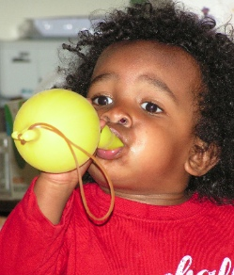
Blow up a Balloon
Deep breathes
Slow breathing
Activate our parasympathetic nervous system
  reduces our heart rate
  relaxes our muscles
Notes:
because you have to use your diaphragm The part of the involuntary nervous system that serves to slow the heart rate, increase intestinal and glandular activity, and relax the sphincter muscles

Slide 22


Call a Friend
Make you laugh
A good ear
Notes:
We all have someone whose voice alone perks us up.
Give them a buzz, even for a few minutes.
they will likely put a smile on your face and calm you down

Slide 23
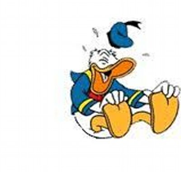
Laugh
Reduces the stress hormones cortisol, adrenaline and dopac
Changes the mood
Those who laugh often have lower stress levels (WEBMD, 2011)
https://www.youtube.com/watch?v=i8eV7FYeWys
Notes:
Is the best medicine
says researcher Dr. Lee Berk of Loma Linda University in California.
"By seeking out positive experiences that make us laugh, we can do a lot with our physiology to stay well."
it isn't always possible to plop down on the couch and watch your favorite comedy, you can stick a few of your favorite stand up routines on your iPod and sneak them in when you're feeling stressed.

Slide 24
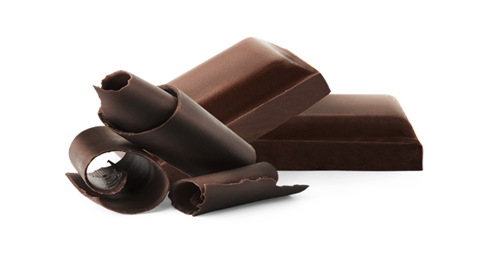
Eat Chocolate
Clinical trial in Lausanne
eat 40 grams of dark chocolate daily for 2 weeks
antioxidants and other ingredients improve metabolism and healthy gut bacteria
Notes:
Swiss scientists call the "chocolate cure".

Slide 25

Plan Something Fun
Take a trip
Go to dinner
Visit a museum or theme park
Notes:
Now’s the time. Not only will you take your mind off things, but you’ll be spending time eagerly anticipating a great getaway or meal later. It’s a win-win situation.

Slide 26
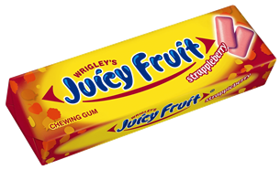
Chew Gum
Melbourne’s Swinburne University and the Wrigley Science Institute in Chicago
  Can help relieve mild to moderate stress
  Make you more alert and help you multitask
Another study found
anxiety levels dropped by 17 percent in mildly stressed people
alertness levels we also found to be 19 percent higher than non-chewers
67 percent more effective when asked to multi-task

Slide 27

Medicine in the Music
"One good thing about music, is when it hits you, you feel no pain."
Bob Marley
Reduces stress in both healthy folks and those with health issues
Decreases blood pressure
Slows down heart rate
Reduces anxiety levels, especially in heart patients

Slide 28

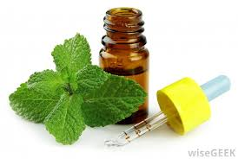
Peppermint Power
Cooling and energizing.
Stress-relieving aroma.
Notes:
Add a few drops to your bath, or dap a few drops directly on your body then get into the tub, for near-instant stress relief, relieve tension headache pain

Slide 29

Take a Hot Bath
Slow body and mind down
Add bubbles and a few candles
Notes:
Gives your body a kick, which in turn will give your mind a kick too
and you have the ultimate soothing atmosphere. A rubber ducky is optional.

Slide 30
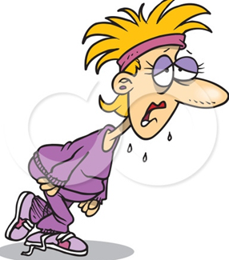
Work up a Sweat
Exercise
Aerobics
Playing outside
Cycling
Jumping rope
Notes:
Have some pent up frustrations? There’s no better way to get rid of them than by exercising.
You’ll be too busy working up a sweat to worry about what’s stressing you out. Picture the stress leaving your body through your pores

Slide 31

Phone Mom
A voice is as good as a hug for stress release
A study in the US showed that when young girls were suddenly put in a stressful situation, the sound of their mom’s voice reduced stress hormone levels and boosted levels of the comforting hormone oxytocin
Notes:
"It's clear that a mother's voice can have the same effect as a hug, even if she's not there," says Dr Leslie Seltzer of the University of Wisconsin-Madison.

Slide 32




You Can Do It Too!
Select one of these or a different activity to share that helps you release stress.
Play board game
Comedy on the computer
Write in journal
Call and talk to a friend or mom
Go for a walk around the building
be sure to grab a pedometer

Slide 33
Interventions
https://www.youtube.com/watch?v=xKY6YrKamqM

Slide 34
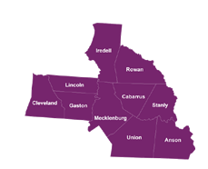
Contact Information
Dr. Karol McNeil-Horton
SW Regional Education Facilitator
karol.vaughn@cms.k12.nc.us
http://regedfac.ncdpi.wikispaces.net/home

