Slide 1
Brevard Academy Peer Mentoring Program
2018-2019

Slide 2
Development
Inspire leadership
Decrease student apathy
Build relationships across grade levels - between middle school and elementary school students
Not enough adults to partner with all needs in the building for mentors

Slide 3
What is it about?
Building healthy relationships across grade levels
Mentors sharing their own personal successes and tools they have used to better themselves
Building leadership skills in students
Building skills in younger students to build resilience and self-regulate
Goal-setting with students

Slide 4
Who are our mentors?
7th and 8th graders who choose to be a part of the program
Currently, we have 35 7th-and 8th-graders who are mentoring one or two of the 50 K-5th mentees
If mentors have more than one partner, they are assigned to two in the same grade level.
Mentors represent school leaders.
They can lose this opportunity if they receive office referrals and are not following basic rules of school.

Slide 5
How do we recruit our mentors?
We meet with 7th- and 8th- graders to present the opportunity
At this time, the program is explained to the students to inspire interest.
It is promoted as positive leadership role in the school community.
Success stories are shared from past mentoring experiences which generates curiosity.
Next, names of younger students who might benefit from a mentor are recommended by the staff.

Slide 6
How does the program work?
Student names are collected, and mentors and mentees are partnered (NO easy task!)
The idea is to match students by
Goals
Personality
Interests
Folders are created and provided to the mentor and contain pertinent information for the mentors.
Ideas of what to cover and discuss with the mentee
Tools and techniques to use with that particular student
Goal setting sheets for the day
Folders provide 5 minute focused check-in opportunities.
Notes:
(Use examples of folders and Mentors goes down first thing in morning - check in with their homeroom teacher, then head to their mentee’s class with their folder. Do the activity assigned. Each activity takes about 5 minutes

Slide 7
Energy!
We started this program last school year in January, and it has grown tremendously!
BA had 20 partnerships last year
This year we have 50 younger students partnered with a mentor
The older students have come in excited to share their experiences and in “giving” to the younger kids, their own cup is being filled and making a difference to their behavior throughout the day!
The younger students are so happy to see their mentor each day, and it has made a tremendous difference to the start of their day and their motivation to learn and be a good citizen at BA.

Slide 8
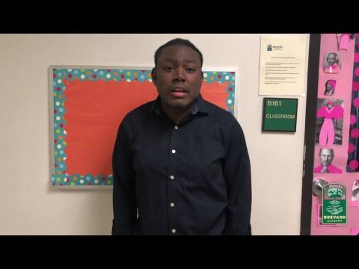
Testimonials

Slide 9
Future of the Program -Leadership at BA
6th-grade current Safety Patrollers (learning to be leaders)
6th-grade will train 5th-graders in safety patrol during the last quarter of the school year
6th-graders will shadow current 7th- and 8th-graders last quarter to learn mentoring program
6th-grade will partner with either 3rd-or 4th-grade to provide some academic support to learn how to lead younger students
Summer B.A. Leadership Camp to include Peer Mentor, Peer Mediation, Safety Patrol, and Classroom Helper training.

Slide 10
Now What?
How can you get started?
Some questions to consider…..
Who would you get on board at your school to start this program?
How would you identify the mentors/ mentees?
Who would organize the folders/ topics/ discussions?
Build a timeline of start date. Start small and build from there

Slide 11
Feedback/ Questions
What questions do you have about the program?
Any feedback or ideas on ways to improve what we are doing?

Slide 12
How can you get started?

