Slide 1


Charter School Leadership Institute
Leadership WIthin an MTSS Framework
Oct. 18, 2018
https://tinyurl.com/CSLIMTSS2018

Slide 2
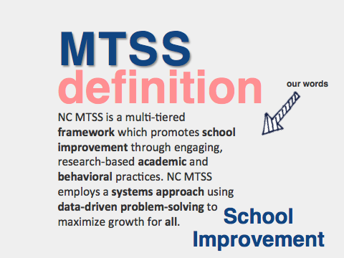

Slide 3

When establishing common understanding of MTSS, the following is often stated:
This school improvement framework
centers around the 2 Big E’s:
EFFECTIVE for students
EFFICIENT for the adults
In this framework, we think about what we are doing, examine the results and respond rapidly
We must work to ensure that this is true in both theory and practice.
Notes:
Speaker Notes:
If you’ve participated in MTSS overviews or initial professional development designed to establish common understanding, you’ve undoubtedly heard these two statements:
This school improvement framework centers around the 2 Big E’s: EFFECTIVE for students EFFICIENT for the adults
In this framework, we think about what we are doing, examine the results and respond rapidly.
Take a moment to reflect: Is this true? Is this how MTSS is currently perceived in your LEA?
We must work to ensure that this is true in both theory and practice.

Slide 4

MTSS Should Make the Difficult Job of
Teaching Easier AND Increase Student Achievement
cc: Hindrik S - https://www.flickr.com/photos/63991153@N00
Notes:
This statement should be in the forefront of everything we do. If this isn’t true - we need to closely examine our current plans for building this infrastructure.

Slide 5


What Does MTSS Look Like?
Insert your image here

Slide 6
Critical Components of NC MTSS:
Leadership
Building the Capacity/Infrastructure for Implementation
Communication/Collaboration
Data-Based Problem-Solving
3 Tiered Instruction/Intervention
Data-Evaluation
Connections
Notes:
Presentation section: Introduction by making connections to current implementation efforts
Speaker Notes:
Let’s begin by checking in to our work of building a multi-tiered system of support. Here we see the six critical components that support an MTSS. When we consider these components, we understand that these are the foundational elements to total school improvement. As we become familiar with ECATS,, you will see that ECATS can and will support and compliment this school improvement framework
Also, Explain that these are the components which SAM measured. If we are doing these things well we will be improving our current systems, processes and procedures. Maybe ask audience to reflect which areas they are thinking about in Summer planning? A share out?

Slide 7

Our goal is to have
teachers
FEWER
do
things
BETTER

Slide 8
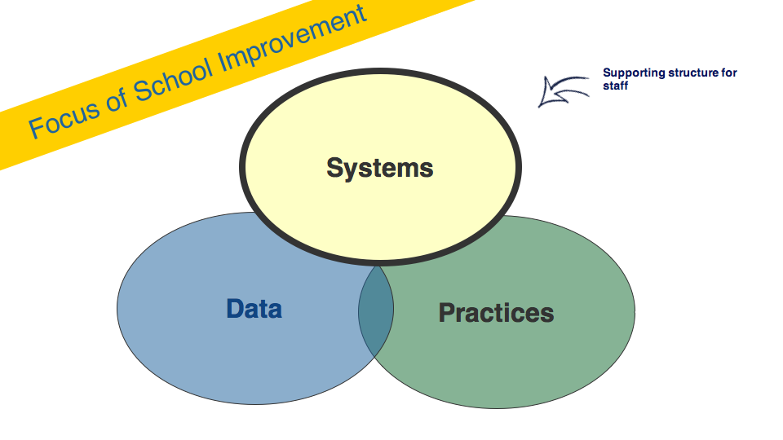

Slide 9

sys•tem
noun
a set of principles or procedures according to which something is done; an organized scheme or method.
The system, itself,
(the set of principles),
is not what you see

Slide 10
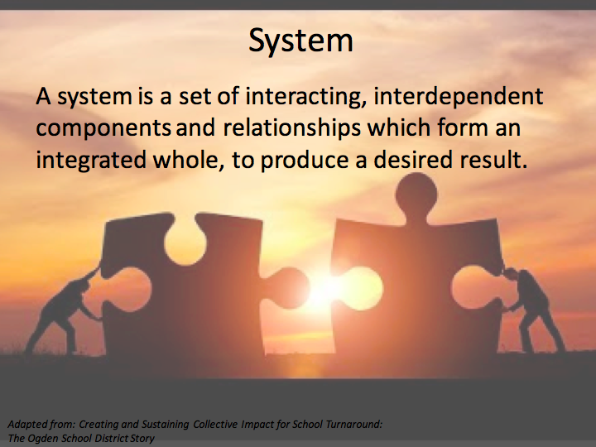

Slide 11
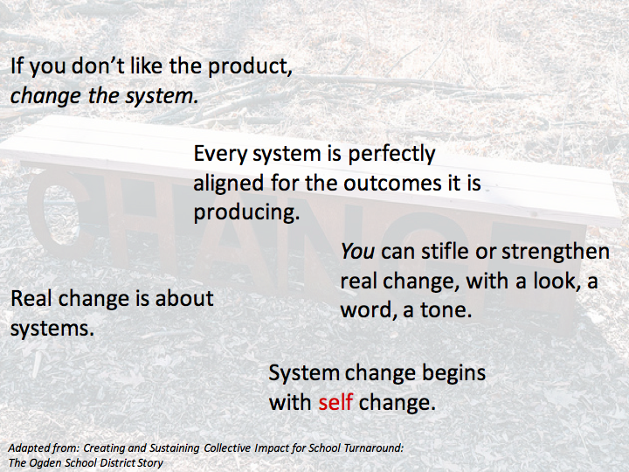

Slide 12

Leadership: It’s not a question of “Who is he/she?”
Notes:
Expand on the PLC theme – leadership becomes “us”
Within an MTSS, when we consider Leadership, it’s not thought of as an individual

Slide 13

Leadership: It’s a question of, “Who are they?”
Notes:
Rather - leadership is baked into the DNA of the school - we can’t depend on a single individual to lead this work - definitely a team approach
Have participants rate where they currently would rate 1-3 their school on this component (1= we’ve got a lot of work to do 3= this is a real strength) with a partner. Debrief

Slide 14

School Leadership Team
communicate
refine the system
evaluate effectiveness

Slide 15
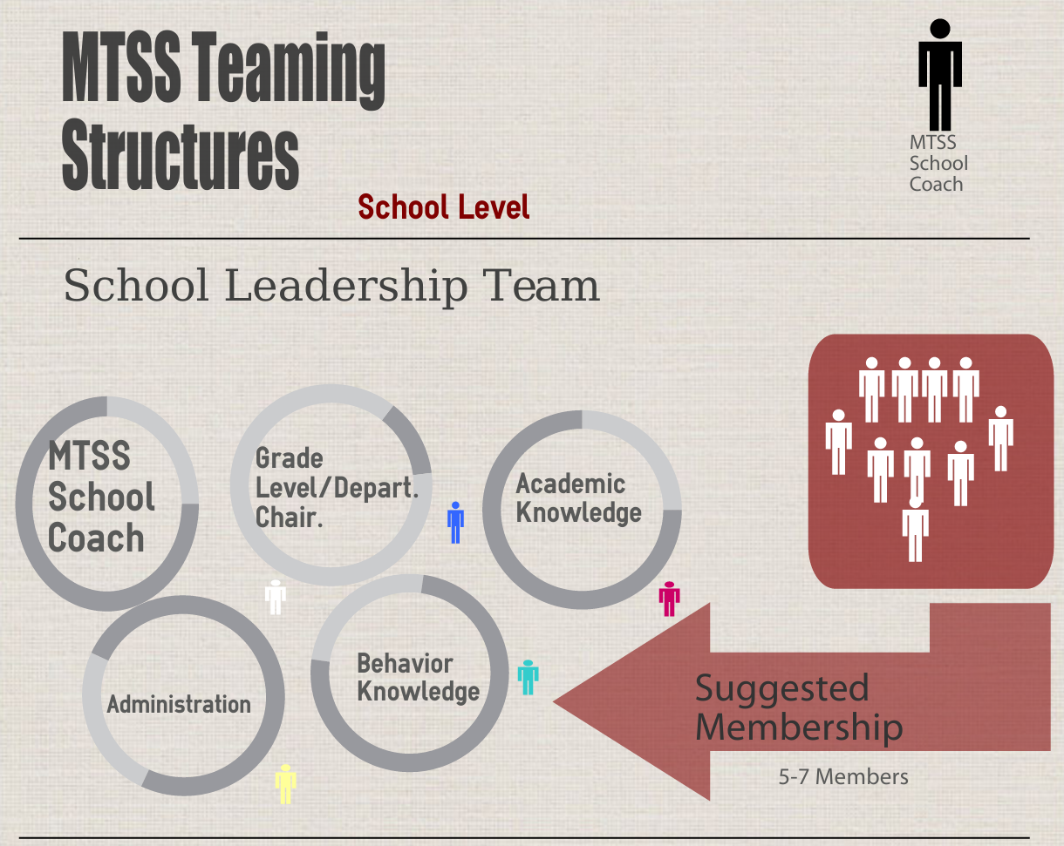
This team identifies broad school-wide support

Slide 16
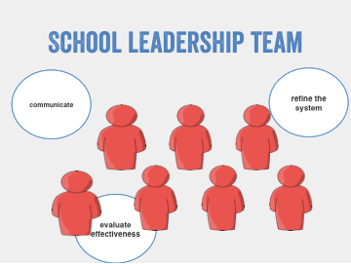
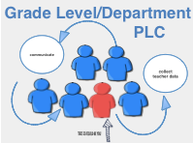
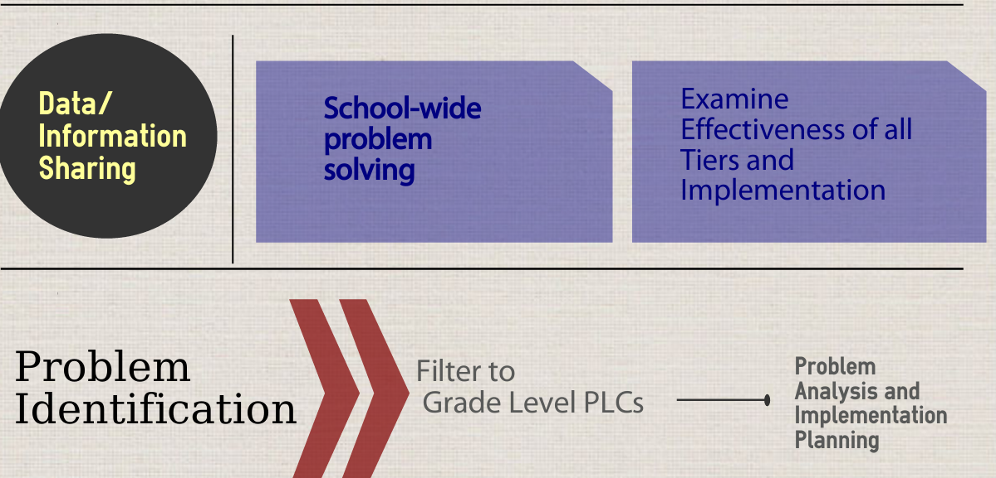

Slide 17
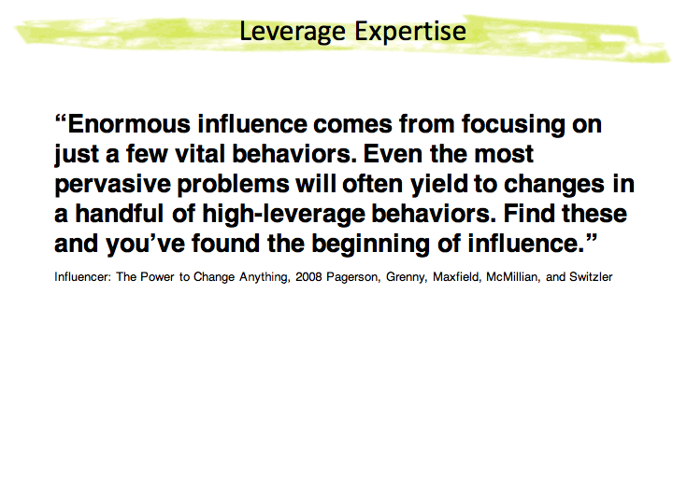

Slide 18
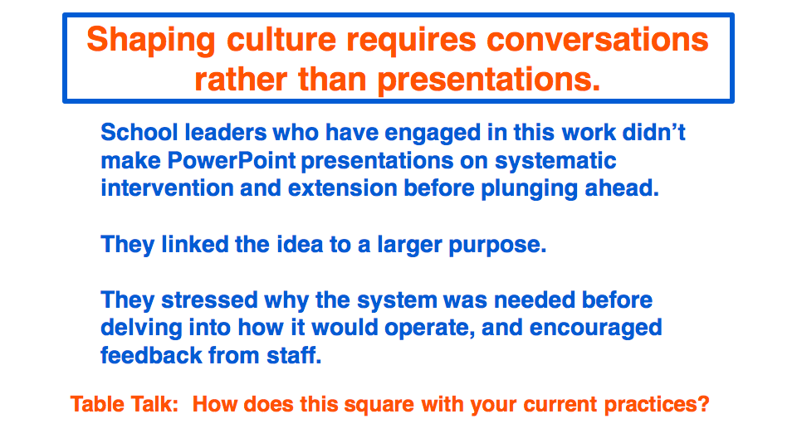

Slide 19
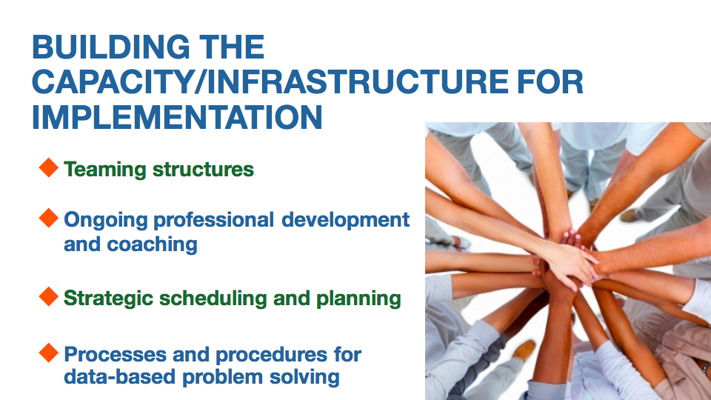

Slide 20
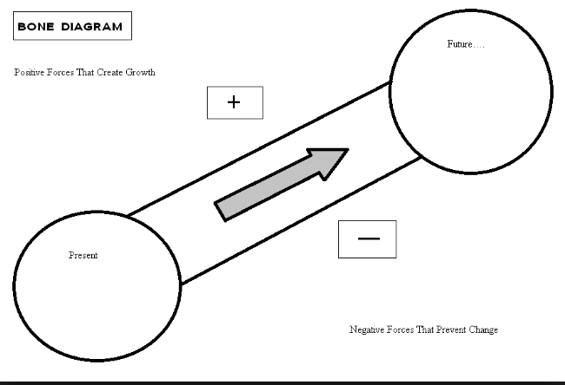
Notes:
Template

Slide 21


