Slide 1

The McKinney-Vento Act and Compliance Requirements
2018 Charter School Leadership Institute
October 18, 2018
Patricia Lentz, Program Specialist
NC Homeless Education Program located at the SERVE Center at UNCG
Federal Program Monitoring and Support Services Division
North Carolina Department of Public Instruction

Slide 2
NC Homeless Education Program (NCHEP)
NCHEP ensures that all children and youth experiencing homelessness have access to the public education to which they are entitled to under the federal McKinney-Vento Act.
NCHEP ensures that North Carolina's state policies are in compliance with federal law.
NCHEP oversees all programmatic aspects of the state homeless education program while DPI oversees the fiscal components of the program.
NCHEP reports to NCDPI.
NCHEP is part of the Federal Program and Monitoring Support Division.

Slide 3
NCHEP Main Responsibilities
Provide technical assistance to LEAs and charter schools on homeless education
Monitor all LEA and charter school homeless education programs for compliance with the McKinney-Vento Act
Host compliance meetings and trainings for homeless liaisons and other school personnel
Handle disputes on enrollment and services provided to homeless students
Collaborate on activities for compliance with the Regional Title I Administrators

Slide 4

Federal Law
The McKinney-Vento Act is a federal law designed to increase the school enrollment, attendance, and success of children and youth who lack a fixed, regular and adequate nighttime residence.

Slide 5
Federal Law
States, districts and charter schools must develop, review and revise policies to remove barriers to the school enrollment and retention of homeless children and youth.
McKinney-Vento defines enrollment as attending classes and participating fully in school activities.
McKinney-Vento Act supersedes state or local law or practice when there is a conflict (U.S. Constitution, Article VI).
McKinney-Vento Act was reauthorized through ESSA (Every Student Succeeds Act) on December 10, 2015.
Resource:
US Dept of Education’s “Every Student Succeeds Act (ESSA)” web page is located at https://www2.ed.gov/policy/elsec/leg/essa/index.html?utm_content=&amp;utm_medium=email&amp;utm_name=&amp;utm_source=govdelivery&amp;utm_term.

Slide 6
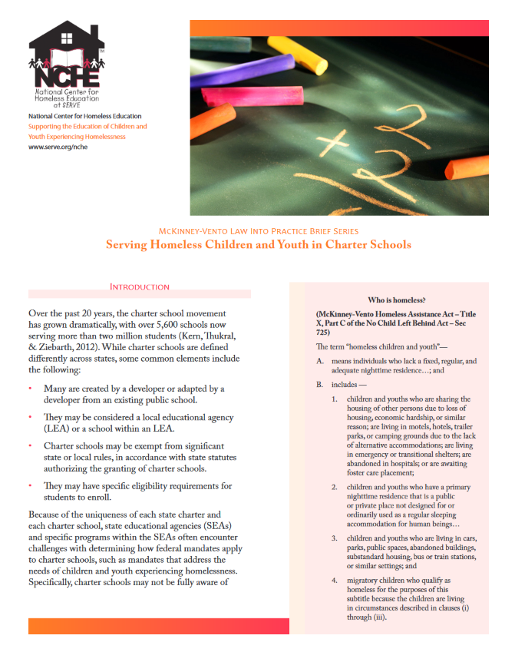
National Center for Homeless Education (NCHE) Resource for Charter Schools
NCHE Briefs Web Page:
https://nche.ed.gov/pr/briefs.php
Serving Homeless Children and Youth in Charter Schools
Determining Eligibility for McKinney-Vento Rights and Services – Updated August 2017
Guiding the Discussion on School Selection
Transporting Children and Youth Experiencing Homelessness – Updated August 2017

Slide 7
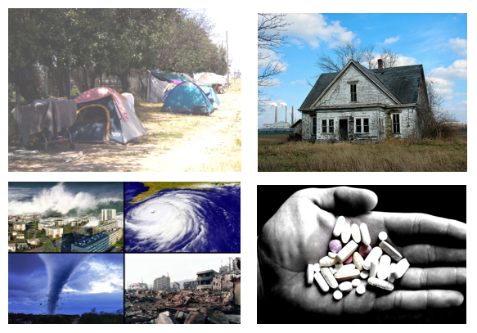
Causes of Homelessness
Lack of affordable housing
Poverty
Increase in low vs. middle wage employment
Health problems
Lack of health insurance
Addiction disorders, mental health
Domestic violence
Natural and other disasters
Abuse/neglect/family dysfunction (unaccompanied homeless youth)

Slide 8

Impacts of Homelessness on Children and Youth
There is higher incidence of acute and chronic illnesses, depression and anxiety.
Homelessness in early childhood is associated with poor classroom engagement and poor social skills in early elementary school.
The achievement gaps between homeless and low-income elementary students tend to persist, and may even worsen, over time.
A youth who experiences homelessness is 87% more likely to drop out of school.

Slide 9
Barriers to Education for Homeless Children and Youth
Poor health, fatigue, hunger
Emotional trauma, depression, anxiety
Stereotypes and lack of awareness
Under-identifications
High mobility resulting in lack of school stability and educational continuity
Enrollment requirements (school records, health records, proof of residence, guardianship)
Lack of transportation
Lack of school supplies, clothing, etc.

Slide 10
NC McKinney-Vento Student Counts
Unduplicated Counts

Slide 11
NC Prosperity Zones – 2016 - 2017SY
Duplicated Counts

Slide 12
McKinney-Vento Act: Main Themes
School access
School stability
Support for academic success, including academic accrual
Child-centered, best interest decision making
Role of the local homeless liaison
Subgrant requirements
Transportation
Preschool
Higher Education
Resource:
US Dept of Education’s “Every Student Succeeds Act (ESSA)” web page is located at https://www2.ed.gov/policy/elsec/leg/essa/index.html?utm_content=&amp;utm_medium=email&amp;utm_name=&amp;utm_source=govdelivery&amp;utm_term.
.

Slide 13

Enrollment Rights of Homeless Children and Youth
Receive a free, appropriate public education
Immediate enrollment
Remain in the school of origin, if in the student’s best interest
Receive transportation assistance, when requested
Receive appropriate educational services comparable to other students
Receive free school meals
Resource on Free School Meals: https://nche.ed.gov/downloads/briefs/nutrition.pdf

Slide 14
Homeless Liaison Responsibilities
Identification
Enrollment
Access to Services
Referrals
Parental Information
Public Notice
Disputes
Transportation Services
Professional Development
Unaccompanied Homeless Youth
Collaboration
Resource: NCHE brief titled, “Local Homeless Education Liaisons: Important Information for New Liaisons,” Feb. 2015, located at https://nche.ed.gov/downloads/briefs/new-liaisons.pdf.
Notes:
Every LEA must designate a McKinney-Vento liaison able to carry out his/her legal duties. 11432(g)(6)

Slide 15
Local McKinney-Vento Liaisons
Every LEA must designate a McKinney-Vento liaison able to carry out his/her legal duties. 11432(g)(6)
Liaisons must ensure that—
McKinney-Vento students enroll in and have full and equal opportunity to succeed in school.
Children and youth in homeless situations are identified by school personnel through outreach and coordination with other entities and agencies.
Public notice of MV rights is disseminated in locations frequented by parents, guardians, and unaccompanied youth, in a manner and form understandable to them.
NAEHCY ESSA resources: http://www.naehcy.org/educational-resources/essa

Slide 16
McKinney-Vento Liaisons (cont.)
Liaisons must ensure that (cont.)—
School personnel providing McKinney-Vento services receive professional development and other support.
Children, youth and families have access to and receive educational services for which they are eligible, including Head Start, early intervention (IDEA Part C) and other preschool programs.
Children, youth and families receive referrals to health care, dental, mental health, substance abuse, housing and other services.
NAEHCY ESSA resources: http://www.naehcy.org/educational-resources/essa

Slide 17
Definition of Homelessness
Individuals who lack a fixed, regular and adequate nighttime residence.
FIXED
A residence that is stationary, permanent and not subject to change.
REGULAR
A residence that is used on a regular basis (i.e. nightly).
Adequate
A residence that is sufficient for meeting both the physical and psychological needs typically met in home environments.
Can the student go to the SAME PLACE (fixed) EVERY NIGHT (regular) to sleep in a SAFE AND SUFFICIENT SPACE (adequate)?
If the living situation does not meet all 3 components, then the situation is considered homeless. Decisions are case-by-case.
Notes:
Step 1: Get the facts.
Step 2: Analyze the facts.
Does the living situation fit into one of the specific examples of homelessness listed in the law?
Does the living situation fit another type of situation that is not fixed, regular and adequate?
Step 3: District liaison makes eligibility decision.

Slide 18

Test Your Knowledge!
Which types of nighttime residency are most frequently identified in any given school year?
Living in cars and living in parks
Living under bridges and living in abandoned buildings
Sharing a home due to loss of housing and sharing a home due to economic hardship

Slide 19
Test Your Knowledge!
Which types of nighttime residency are most frequently identified in any given school year?
Living in cars and living in parks
Living under bridges and living in abandoned buildings
Sharing a home due to loss of housing and sharing a home due to economic hardship

Slide 20
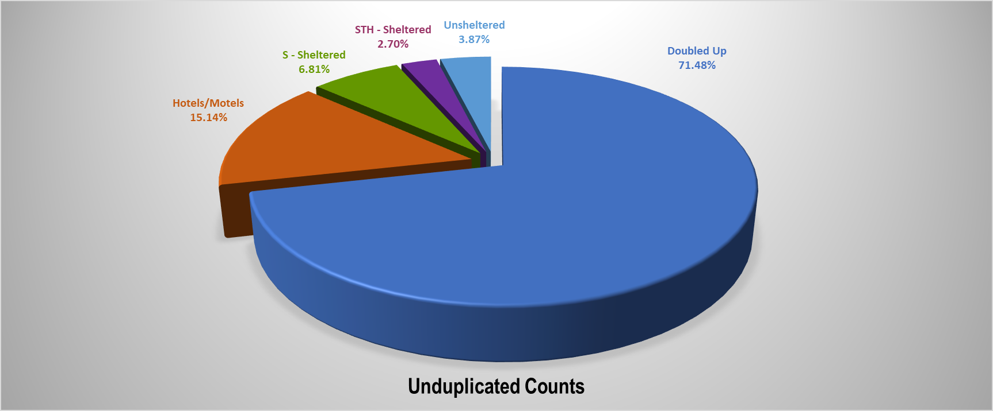
Primary Nighttime Residency – 2016 - 2017SY

Slide 21
Definition continued…
Sharing a home due to loss of housing
Sharing a home due to economic hardship
Living in motels / hotels
Living in trailer parks
Living in a shelter
Abandoned in hospitals
Living in cars
Living in parks
Living in camp grounds
Living in abandoned buildings
Living under bridges
Living at bus / train stations
Migratory children
Unaccompanied homeless youth
Human trafficking
Other
NCHE Determining Eligibility brief: https://nche.ed.gov/downloads/briefs/det_elig.pdf

Slide 22
School Stability
In determining best interest, the LEA shall:
Presume that keeping the student in the school of origin is in the student’s best interest.
Unless contrary to the request of the parent, guardian, or unaccompanied youth.
Consider student-centered factors, including the impact of mobility on achievement, education, health, and safety.
Give priority to the parent’s/guardian’s request.
Give priority to the youth’s request (in the case of an unaccompanied youth). 11432(g)(3)(B)(i)-(ii)
NAEHCY ESSA resources: http://www.naehcy.org/educational-resources/essa

Slide 23
School Stability continued…
Applies when students lose housing during the year or during the summer. 11432(g)(3)(A)(i)(I)
School of origin:
School attended when permanently housed or school in which last enrolled, including a preschool.
The designated receiving school at the next grade level for feeder school patterns, when the student completes the final grade level served by the school of origin. 11432(g)(3)(I)
NAEHCY ESSA resources: http://www.naehcy.org/educational-resources/essa

Slide 24
Enrollment in Preschool
State McKinney-Vento plans must describe procedures that ensure that homeless children have access to public preschool programs administered by the SEA or LEAs. 11432(g)(1)(F)(i)
Preschools are included in the school of origin definition. 11432(g)(3)(I)
Liaisons must ensure access to Head Start, early intervention (IDEA Part C), and other preschool programs administered by the LEA. 11432(g)(6)(A)(iii)
NAEHCY ESSA resources: http://www.naehcy.org/educational-resources/essa
Notes:
Preschool Enrollment Strategies:
Facilitate enrollment: include homelessness in needs assessments and priorities; put McKinney-Vento families at the top of waiting lists; provide enrollment forms on-site at shelters and motels.
Expedite records by working together: joint release forms; share records within a family.
Develop joint/streamlined procedures and forms: joint intake forms; provide uninterrupted services as children move.
Work with families and providers to meet school of origin and comparable transportation requirements appropriately for young children.
Cross-train preschool, school, and service providers.

Slide 25
School Stability continued…
When remaining in the school of origin is not in the student’s best interest or what the parent, guardian or youth requests: 11432(g)(3)(C)(i)
McKinney-Vento students are entitled to immediate enrollment in any public school that students living in the same attendance area are eligible to attend; even if:
Students do not have required documents, such as school records, records of immunization and other required health records, proof of residency, guardianship, or other documents; or
Students have missed application or enrollment deadlines during any period of homelessness.
The terms “enroll” and “enrollment” include attending classes and participating fully in school activities. 11434a(1)
SEAs and LEAs must develop, review, and revise policies to remove barriers to the identification, enrollment and retention of children and youth in homeless situations, including barriers due to outstanding fees or fines, or absences. 11432(g)(1)(I)
NAEHCY ESSA resources: http://www.naehcy.org/educational-resources/essa

Slide 26
Participation in Extra-Curricular Activities
Enrollment: “attending classes and participating fully in school activities.”
Includes extra-curricular activities offered through the school.
Program fees and deadlines can be waived
Districts should look at other funding or community support to pay for these items.
McKinney-Vento subgrant and/or Title I, Part A set-aside funds can be used to assist with program fees; however, these funds cannot be used for uniforms or other supplies needed for participation.
To the extent that lack of transportation is a barrier, it would be required to provide the student access to or from extra-curricular activities.
Notes:
J10-12 provides further detail in Non-Regulatory Guidance (March 2017).

Slide 27
School Stability continued…
If the LEA determines that it is not in the student’s best interest to attend the school of origin or the school requested by the parent, guardian or youth, the LEA must provide a written explanation of the reasons for its determination, in a manner and form understandable to such parent, guardian, or unaccompanied youth, including information regarding the right to appeal. 11432(g)(3)(B)(iii)
NAEHCY ESSA resources: http://www.naehcy.org/educational-resources/essa

Slide 28
School Enrollment
If a student does not have immunizations, or immunization or other health records or screenings, the liaison must immediately assist in obtaining them; the student must be enrolled in the interim. 11432(g)(3)(C)(iii)
Enrolling schools must obtain school records from the previous school, and students must be enrolled in school while records are obtained. 11432(g)(3)(C)(ii)
Schools must maintain McKinney-Vento students’ records so they are available quickly. 11432(g)(3)(D)
NAEHCY ESSA resources: http://www.naehcy.org/educational-resources/essa

Slide 29
Key Provisions of Transportation
LEAs must provide transportation to and from the school of origin, including until the end of the year when the student obtains permanent housing, at a parent’s or guardian’s request (or at the liaison’s request for unaccompanied youth).
If staying in the same LEA, that LEA must provide or arrange transportation to the school of origin.
If crossing LEA lines, both LEAs must determine how to divide the responsibility and share the cost, or they must share the cost equally. 11432(g)(1)(J)(iii)
LEAs also must provide students in homeless situations with transportation services comparable to those provided to other students. 11432(g)(4)(A)
LEAs must eliminate barriers to the identification, enrollment and retention of students experiencing homelessness (including transportation barriers). 11432(g)(1)(I)

Slide 30
Transportation Considerations
Districts can consider other safe transportation options beyond the school bus – be creative!
School district determines the mode of transportation.
The excess cost of transportation can be paid for with McKinney-Vento subgrant funds and Title I set aside funds for homeless students.
Excess cost means the additional cost of transporting a homeless student to his/her school of origin over what is spent on a nonhomeless student.

Slide 31
Charter School Transportation Considerations
If a student is eligible for identification at the time of enrollment, there is no obligation to provide transportation by the charter school.
If a student is eligible for identification after enrolling and attending, there is an obligation to provide transportation, even if the charter school does not typically provide transportation to other non-McKinney-Vento students.
Resource: NCHE briefs titled:
Serving Homeless Children and Youth in Charter Schools, 2013, located at https://nche.ed.gov/downloads/briefs/charter.pdf.
Transporting Children and Youth Experiencing Homelessness, Updated August 2017 located at https://nche.ed.gov/downloads/briefs/transportation.pdf.

Slide 32
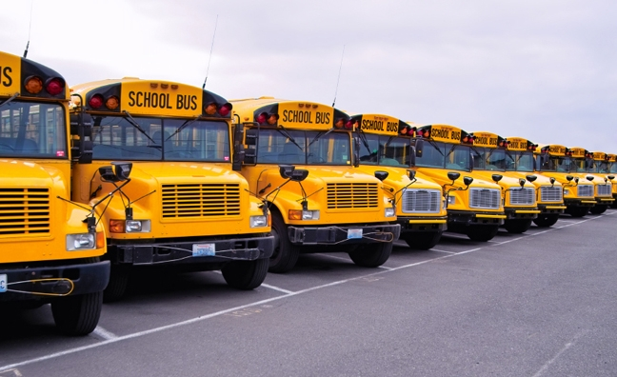
Transportation Strategies
Develop close ties among local liaisons, school staff, pupil transportation staff, and shelter workers
Use school buses (including special education, magnet school and other buses)
Develop formal or informal agreements with school districts where homeless children cross district lines
Use public transit where feasible
Use approved carpools, van or taxi services
Reimburse parents and youth for gas
Pursue inter-agency solutions

Slide 33
Test Your Knowledge!
Your homeless liaison has just determined that Richard Thompson is McKinney-Vento eligible after learning that he is doubled up with friends after his house was destroyed by fire last night. There was not enough room for Richard to stay with his family with other family friends. It is late April and the liaison has also determined that remaining in his school of origin (your charter school) is in his best interest.
The conversation has now turned to discussion of transportation to get Richard to/from school on a daily basis. If Richard requests transportation, is the school obligated to provide it?
❑ Yes  No

Slide 34
Test Your Knowledge!
Your homeless liaison has just determined that Richard Thompson is McKinney-Vento eligible after learning that he is doubled up with friends after his house was destroyed by fire last night. There was not enough room for Richard to stay with his family with other family friends. It is late April and the liaison has also determined that remaining in his school of origin (your charter school) is in his best interest.
The conversation has now turned to discussion of transportation to get Richard to/from school on a daily basis. If Richard requests transportation, is the school obligated to provide it?
✓
❑ Yes  No

Slide 35
Unaccompanied Homeless Youth (UHY)
An unaccompanied youth is any student not living in the physical custody of a parent or legal guardian.
An unaccompanied homeless youth meets eligibility for McKinney-Vento based on whether the living situation is fixed, regular and adequate.
Unaccompanied + Homeless = Unaccompanied Homeless Youth
No lower age limit.
Upper age limit is school age defined by the state.
NC upper limit is 21.
No citizenship requirement
(Plyler vs. Doe).
School districts cannot:
require a caregiver to obtain legal guardianship
Discontinue enrollment due to lack of responsible adult or inability to produce guardianship or other paperwork

Slide 36

Unaccompanied Homeless Youth in NC
School Year | Student Count
2012-13SY | 2677
2013-14SY | 2355
2014-15SY | 2610
2015-16SY | 2454
2016-17SY | 2650

Slide 37
Unaccompanied Homeless Youth…. “On Their Own”
Family conflict or crisis
Parental incarceration, substance abuse, illness, death, etc.
Foster care issues: aging out of the foster care system; running away from a foster care placement
Family homelessness
Being asked to leave the home
Choosing to leave home on their own
Abandoned by family
Other

Slide 38
Unaccompanied Homeless Youth…
Special Provisions …
Homeless liaison will …
Unaccompanied homeless youth do not need a parent/guardian to enroll or have access to services.
Local homeless liaisons must support the student in making decisions and understanding his/her rights.
Assist in enrolling in school.
Assist in obtaining school/ medical records.
Inform unaccompanied homeless youth of services they are eligible for under the McKinney-Vento Act.

Slide 39
Unaccompanied Homeless Youth… Enrollment Strategies
Three common methods for enrolling unaccompanied homeless youth:
Self enrollment
Caregiver enrolls
Homeless liaison enrolls
School districts cannot:
Require a caregiver to obtain legal guardianship.
Discontinue enrollment due to lack of responsible adult or inability to produce guardianship or other paperwork.
These methods also apply for unaccompanied homeless youth who wish to participate in extra-curricular activities.

Slide 40
What If We Don’t Agree? Dispute Resolution
If a dispute arises over eligibility, school selection or enrollment in a school:
The student shall be immediately enrolled in the school in which enrollment is sought, pending resolution of the dispute (including all available appeals).
The parent, guardian or unaccompanied youth must be provided a written explanation of decisions made by the school, LEA or SEA, and how to appeal them.
The parent, guardian or youth must be referred to the liaison, who must carry out the dispute resolution process as expeditiously as possible.
The liaison shall ensure unaccompanied youth are immediately enrolled pending resolution of the dispute. 11432(g)(3)(E)
NAEHCY ESSA resources: http://www.naehcy.org/educational-resources/essa

Slide 41
Avoiding Disputes
Designate and train appropriate liaisons and school-based contacts. 11432(g)(1)(J)(ii), (iv); 11432(g)(6)(A)(ix)
Rectify concerns raised during monitoring.
States are now required to monitor LEAs. 11432(f)(5)
Develop and implement good local policies on identification, enrollment, retention; barriers due to fees, fines, and absences; credit accrual; full participation in academic and extra-curricular activities; enrollment of unaccompanied youth; school stability; transportation; privacy; inter-district collaboration.
NAEHCY ESSA resources: http://www.naehcy.org/educational-resources/essa

Slide 42

Support for Academic Success: Participation and Credit Accrual
States must have procedures to eliminate barriers to academic and extracurricular activities, including magnet school, summer school, career and technical education, advanced placement, online learning, and charter school programs. 11432(g)(1)(F)(iii)
States must have procedures to identify and remove barriers that prevent youth from receiving appropriate credit for full or partial coursework satisfactorily completed while attending a prior school, in accordance with State, local, and school policies. 11432(g)(1)(F)(ii)
Liaisons must implement those procedures. 11432(g)(6)(A)(x)
NAEHCY ESSA resources: http://www.naehcy.org/educational-resources/essa

Slide 43
Support for Academic Success: Coordination with Other Laws/Programs
LEAs must coordinate McKinney-Vento and special education services within the LEA, and with other involved LEAs. 11432(g)(5)(D)
Information about a McKinney-Vento student’s living situation is a student education record subject to FERPA. 11432(g)(3)(G)
Local liaisons are authorized to affirm that students meet the Department of Housing and Urban Development (HUD) definition of homelessness, to qualify them for HUD homeless assistance programs. 11432(g)(6)(D)
NAEHCY ESSA resources: http://www.naehcy.org/educational-resources/essa

Slide 44

Support for Academic Success: Access to Higher Education
All McKinney-Vento youth must be able to receive assistance from counselors to advise such youths, and prepare and improve the readiness of such youths for college. 11432(g)(1)(K)
Liaisons must ensure unaccompanied youth are informed of their status as independent students and may obtain assistance from the liaison to receive verification of that status. 11432(g)(6)(A)(x)(III)
This Photo by Unknown Author is licensed under CC BY-NC-ND
NAEHCY ESSA resources: http://www.naehcy.org/educational-resources/essa
This Photo by Unknown Author is licensed under CC BY-ND

Slide 45
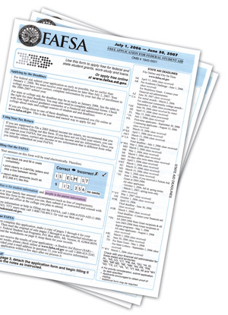
Higher Education: The FAFSA
Youth who meet the definition of “independent student” can complete the FAFSA without parental income information or signature.
Unaccompanied youth are automatically considered independent students.
Must be determined to be unaccompanied and homeless after July 1 of the prior year.
Youth who are unaccompanied, at risk of homelessness, and self-supporting are also automatically considered independent students.
Must be determined as such during the school year in which the application is submitted.
NAEHCY ESSA resources: http://www.naehcy.org/educational-resources/essa

Slide 46
The FAFSA continued…
Determination must be made by:
a McKinney-Vento Act school district liaison,
a HUD homeless assistance program director or their designee,
a Runaway and Homeless Youth Act program director or their designee, or
a financial aid administrator.
Youth who have been in foster care at any time after age 13 are also automatically independent.
More info and sample letters are available at: http://www.naehcy.org/educational-resources/higher-ed
NAEHCY ESSA resources: http://www.naehcy.org/educational-resources/essa

Slide 47
Support for Success: Title IA
McKinney-Vento students attending any school in the LEA are automatically eligible for Title IA services. 20 USC 6315(c)(2)(E)
State report cards must disaggregate achievement and high school graduation data for McKinney-Vento students. 20 USC 6311(h)(1)(C)
Local plans must: 20 USC 6312(a)(1); (b)(6)
Include timely and meaningful consultation with McKinney-Vento liaisons.
Be coordinated with McKinney-Vento programs.
Describe the services provided to McKinney-Vento students, including with reserved funds, to support their enrollment, attendance and success.
NAEHCY ESSA resources: http://www.naehcy.org/educational-resources/essa

Slide 48
Title IA: Reservation of Funds
All LEAs that receive Title IA funds must reserve (set aside) the funds necessary to provide homeless children services comparable to services provided in Title IA schools. 20 USC 6313(c)(3)
Amount must be based on the total LEA allocation prior to expenditures or transfers.
Amount may be determined based on a needs assessment and should involve the liaison.
Amount must be sufficient to provide comparable services to homeless students, regardless of other services provided with reserved funds.
NAEHCY ESSA resources: http://www.naehcy.org/educational-resources/essa

Slide 49
Title IA Reservation continued…
USED’s guiding principles for using Title IA funds
Services must be reasonable and necessary to enable homeless students to take advantage of educational opportunities.
Funds must be used as a last resort when services are not reasonably available from another public or private source.
NAEHCY ESSA resources: http://www.naehcy.org/educational-resources/essa

Slide 50
Title IA Reservation continued…
Funds may be used: 20 USC 6313(c)(3)
For homeless children and youth attending any school in the LEA.
For services not ordinarily provided to other students.
To fund the McKinney-Vento liaison.
To provide transportation to the school of origin.
For educationally related support services, including preK.
NAEHCY ESSA resources: http://www.naehcy.org/educational-resources/essa
Notes:
This transportation is for “excess transportation cost.”

Slide 51
Title IA Reservation continued…
USED Examples of Uses of Title IA funds:
Clothing, particularly if necessary for dress code or physical education classes.
Fees to participate in the general ed program.
School supplies
Birth certificates necessary to enroll in school
Food (in connection with educational programming)
Medical and dental services, immunizations, glasses, hearing aids
Counseling services
Outreach services
Extended learning time; Tutoring services
Fees for AP, IB, GED testing
NAEHCY ESSA resources: http://www.naehcy.org/educational-resources/essa

Slide 52
Homeless Set Aside Funds… Prohibited Uses
Transportation to/from the school of origin
Rent
Utilities
Clothing for parents
Class rings, yearbooks, or other school year memorabilia
Other
NAEHCY ESSA resources: http://www.naehcy.org/educational-resources/essa
Notes:
The prohibition here relates to the basic cost of transportation to/from school.

Slide 53
Disciplinary Issues
Disciplinary action should not be taken against a student for issues related to homelessness, rather strategies to support the student should be implemented.
For disciplinary issues not related to homelessness, typical disciplinary policies of the LEA, charter school or lab school would apply.

Slide 54
Liability and Reporting
Following federal law and providing appropriate services are evidence of reasonable care and can help shield the school from liability.
Violating federal law and denying services are evidence of negligence.
MV requires eliminating barriers to enrollment and retention in school.
Schools must enroll youth immediately. School is the safest and best place for youth.
Educators are mandated to report suspected abuse and/or neglect on a case-by-case basis.
Homelessness alone is not abuse/neglect.
Talk with the young person.

Slide 55
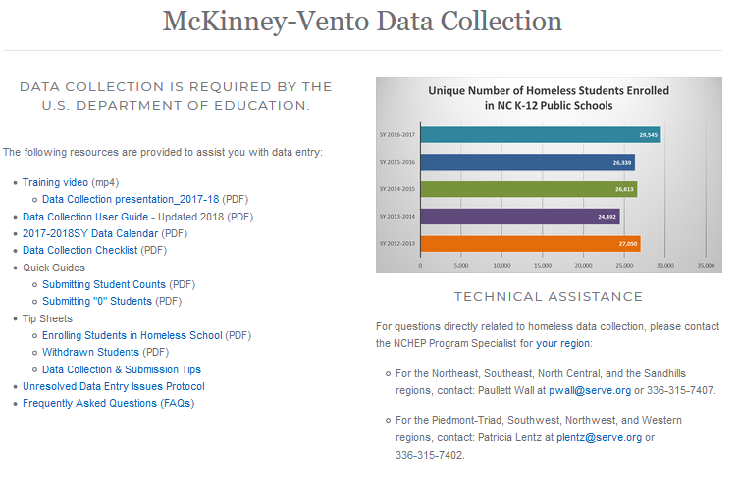
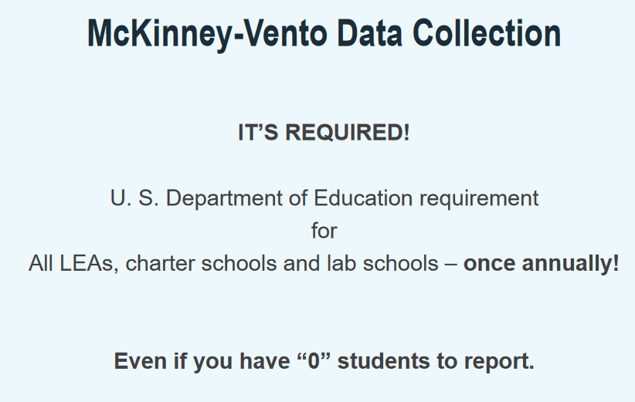
Annual Data Collection
June 15th
NCHEP Data Collection Web Page: https://hepnc.uncg.edu/data-collection/

Slide 56
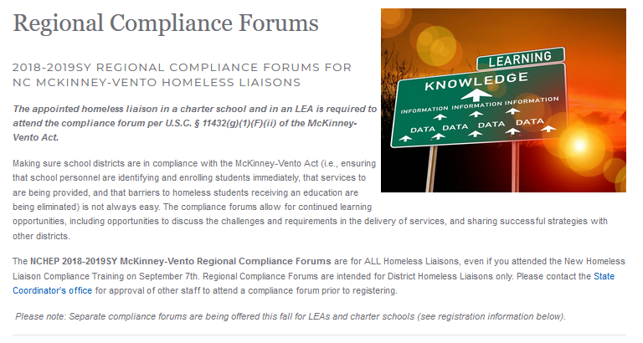
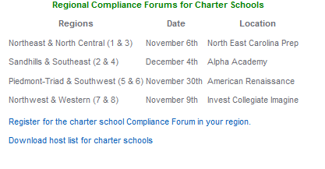
Regional Compliance Forums
NCHEP Regional Compliance Forum Web Page: https://hepnc.uncg.edu/regional-compliance-forums/

Slide 57
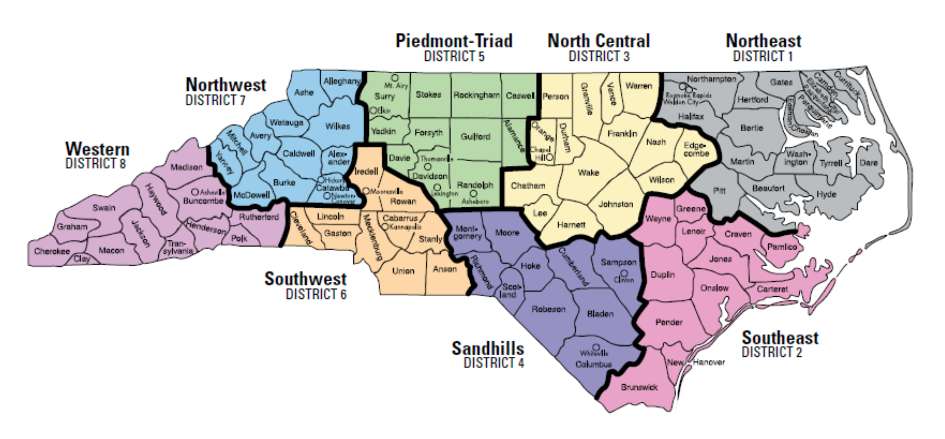
NC Homeless Education Program Service Map
Lisa Phillips, State Coordinator – lphillip@serve.org
NC Department of Public Instruction
Office of the Deputy State Superintendent of Innovation
Federal Program Monitoring and Support Division
Website: https://hepnc.uncg.edu/ or http://www.ncpublicschools.org/program-monitoring/homeless/
Patricia Lentz
plentz@serve.org
Piedmont-Triad
Northwest
Southwest
Western
Paullett Wall
pwall@serve.org
Northeast
Southeast
North Central
Sandhills

Slide 58
Additional Technical Assistance and Resources
National Center for Homeless Education
U.S. Department of Education’s Technical Assistance Center for the
Education of Homeless Children and Youth
www.nche.ed.gov
US Dept. of Education’s ESSA Web Page
https://www2.ed.gov/policy/elsec/leg/essa/index.html?utm_content=&amp;utm_medium=email&amp;utm_name=&amp;utm_source=govdelivery&amp;utm_term
US Dept. of Education’s Non-Regulatory Guidance Document
https://www2.ed.gov/policy/elsec/leg/essa/160240ehcyguidance072716updated0317.pdf

Slide 59

Questions

