Slide 1
BUDs/Adjustments and Local Bank Transactions

Slide 2
DPI Resources for UPDATING CASH PROCESSING
Due to the State’s implementation of North Carolina Financial System (NCFS), DPI is modifying several of our cash processes for the PSUs. The following document outlines the changes to Cash, BUD processing.
DPI Modernization – UPDATE CASH PROCESSING IMPACTS
cash-update-05-05-23.pdf (govdelivery.com)
Each LEA must provide DPI with Local Bank information. Please use the link below to set up the ACH Bank Account Authorization to allow the LEAs to move funds from your LOCAL bank to the State Treasurer State Account.
https://www.dpi.nc.gov/documents/fbs/finance/cash/ach-bank-account-authorization-form/open

Slide 3
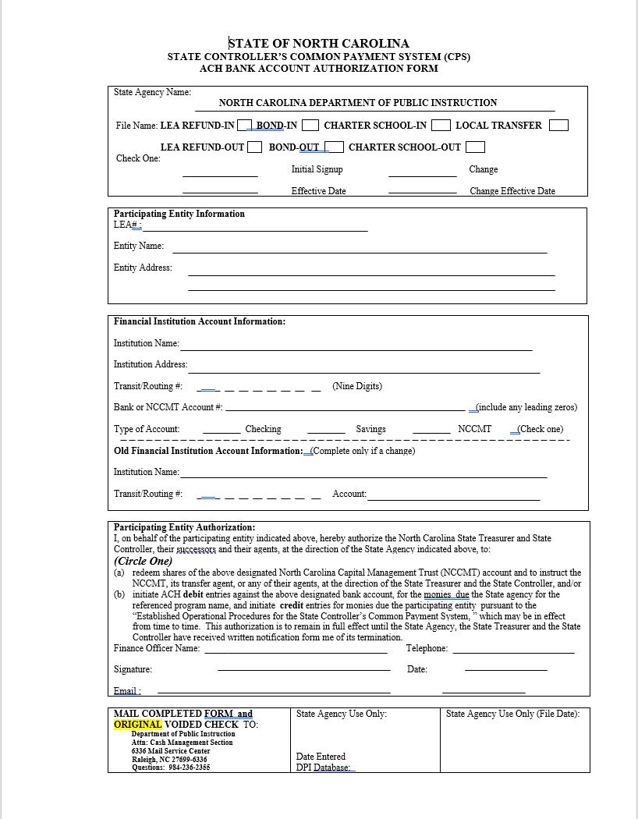
ACH Authorization Form

Slide 4
Determine Transfer Needed
Are all checks written out of your local bank account, state disbursing account, or combination?
● Generate a report showing all expenses written from State and
Federal Codes
  ○ Checks
  ○ ACH
  ○ BUDS
● Confirm the Cash that was requested (ordered) in Cash Mgt
System is actually in CORE bank account
● Transfer Amount from CORE into your Local Account
● Transfer Amount from your Local Account into the CORE bank account

Slide 5
Wire funds from LEA CORE account into Local
Bank Account
Complete form to set up Wire Template with CORE
https://www.nctreasurer.com/media/1562/download?attachment
Manuals
https://www.nctreasurer.com/divisions/financial-operations/banki
ng/guidelines-manuals-and-handbooks

Slide 7
North Carolina Department of State Treasurer
CORE Banking (CB$) Help Desk
Phone: 919-814-3916
Email: CBS.help@nctreasurer.com

Slide 8
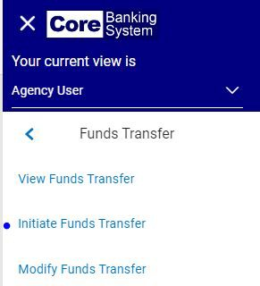
Transfer from CORE to Local Account

Slide 9
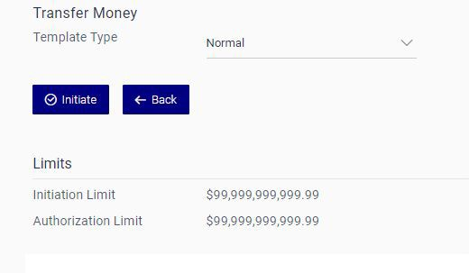

Slide 10
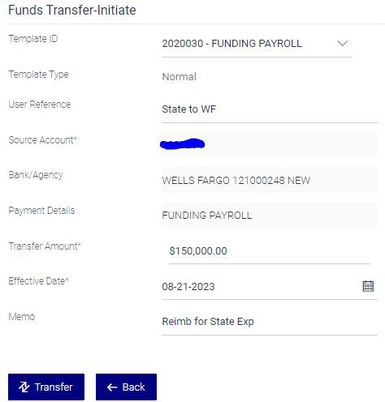

Slide 11
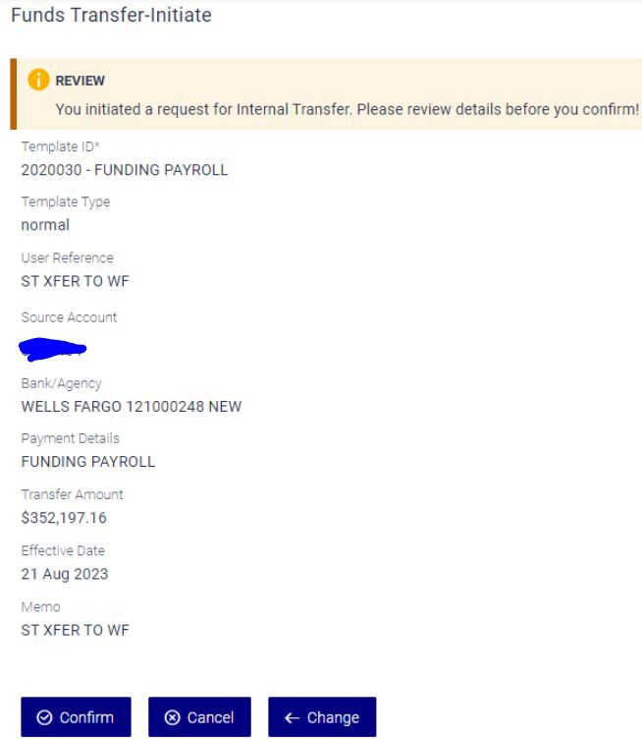

Slide 12
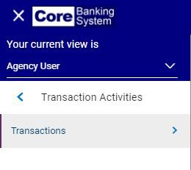
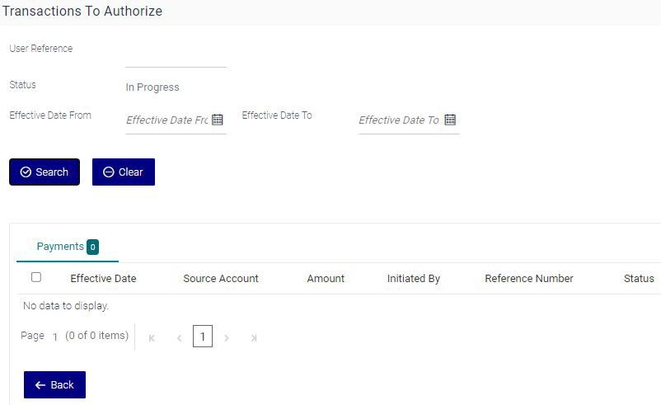

Slide 13
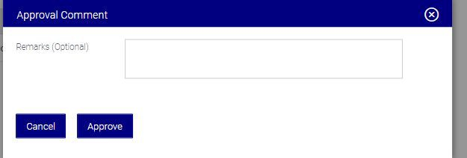

Slide 14
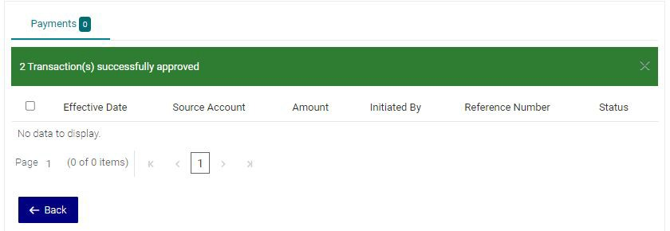

Slide 15
Transfer from Local Account into LEA CORE Account
Complete ACH Bank Account Authorization Form
https://www.dpi.nc.gov/documents/fbs/ﬁnance/cash/ach-bank-account-authorization-form

Slide 16
North Carolina Department of Public Instruction
North Carolina Department of Public Instruction
Help Desk
Division of School Business
Phone: 919-716-1840

Slide 17
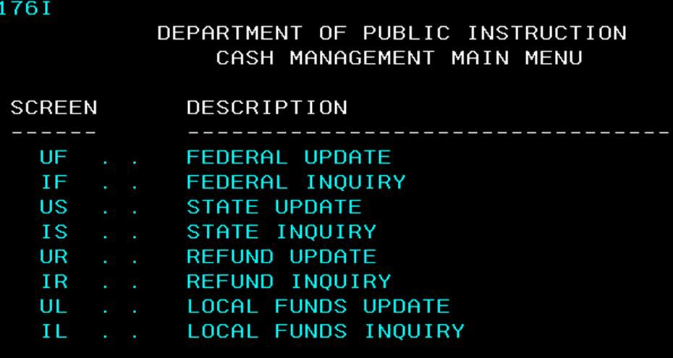
Transfer from Local Account to CORE
Use Cash Management System to Process Transfer - UL

Slide 18
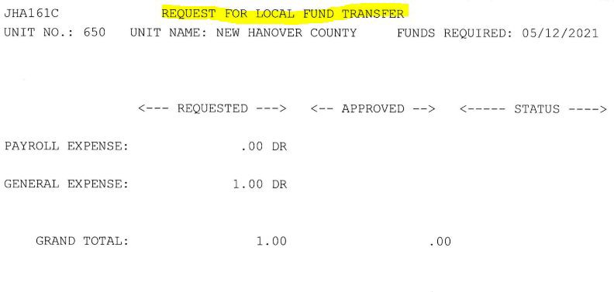
Transfer from Local Account to CORE
Use Cash Management System to Process Transfer - UL
999
LEA NAME COUNTY

Slide 19
Jessica Vaughan
North Carolina Department of Public Instruction
Cash Management Accountant I
NC Dept. of Public Instruction 6336 MSC
Raleigh, NC 27699-6336
Telephone: 984-236-2429 Jessica.Vaughan@dpi.nc.gov

