Slide 1
Leveraging Parent Grievances
July 2018
Stephenie Clark, Education Consultant
NCDPI Office of Charter Schools

Slide 2
Big Question of the Session
How can schools leverage parent complaints as VALUABLE feedback?

Slide 3
Session Outcomes
Participants will:
Self-assess current grievance protocols
Practice active listening skills within context of a grievance
Strategize on how to turn grievances into win-win situations
Identify next steps to enhance grievance protocols

Slide 4

Self-Assessment Time
Use the self-assessment rubric to rate your school’s grievance protocols.
The self-assessment is broken down into best practice categories of Responsiveness, Active Listening, Transparency, Empathy, and Solution-Oriented Thinking.
The rating scale ranges from Always to Never.

Slide 5
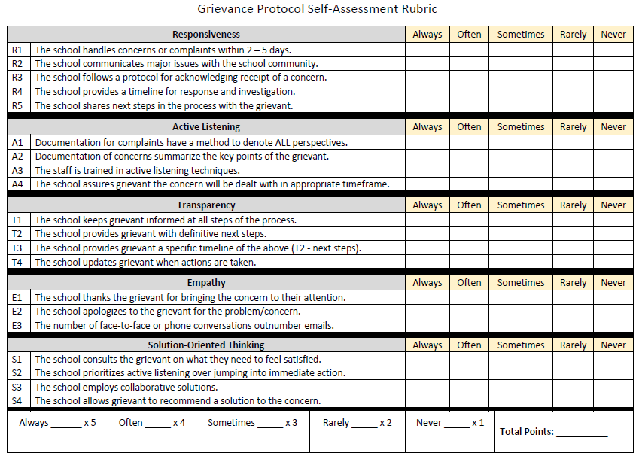

Slide 6
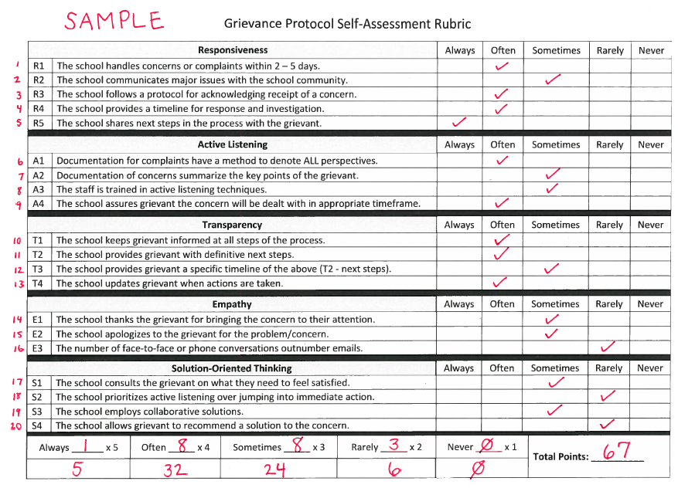

Slide 7

Self-Assessment Results
80 – 100 points Excellent
60 – 79 points Good
41 – 59 points Fair
20 – 40 points Poor

Slide 8
Active Listening Skills
Tune out distractions
Ask questions to guide the conversation, otherwise – zip it and listen intently
Concentrate on what is being said, not your response
Don’t interrupt - people don’t like to be cut off
Focus on the triple threat: tone, inflection and body language
Restate what the grievant says
Take notes

Slide 9
Scenario #1
I am not sure why Stephenie is failing all her classes this year! She did much better last year. I am concerned that you have not been keeping me informed and up to date on her progress. If I had known her grades were so terrible, I could have sent her to an afterschool tutoring program. How are you going to fix this?!

Slide 10
Scenario #2
I demand to talk to someone about Ms. Green. My son Jimmie has been coming home the past few days crying. He says that Ms. Green is always picking on him and never allows him to answer a question. I mean what kind of school does not allow a kid to answer a question?! This teacher is a bully and has been treating my child like this in front of his peers. I want my son moved to another class – today!

Slide 11
Scenario #3
I’m here to drop my student off for the first day of class, and I want to inform you that I WILL BE COMING IN WEEKLY to check that the teacher and staff are doing their jobs correctly. Last year my student was in trouble all the time, and for no reason. I have no hesitation taking this further if I have to!

Slide 12

How to Create the Win-Win
Glass Half Empty or Half Full?
Doesn’t Matter…
It Is REFILLABLE!

Slide 13

Change Your Thinking
Transition from Introspection to Extrospection
Recognize grievances as a form of feedback
Complaints provide your school with data points
Operations, academics, governance
Identifies inconsistencies, trends, blind spots
Creates opportunity to set measurable goals
Use complaint resolution as an opportunity to develop “loyal customers”

Slide 14
Find the Silver Lining
Example 1 – Parent enters front office very upset that the bus has been showing up late, causing them to be late to work.
Considerations:
What additional questions would you have?
Data – what do you have, need, want?
What might be influenced from this scenario?
What is the silver lining?

Slide 15
Find the Silver Lining
Example 2 – During the month of October, SLT has experienced written/phone complaints from 7 different 2nd grade families.
Considerations:
What additional questions would you have?
Data – what do you have, need, want?
What might be influenced from this scenario?
What is the silver lining?

Slide 16
Find the Silver Lining
Example 3 – During the April Board Meeting, a group of parents show up with a written letter outlining multiple issues with the school: including bullying, operational issues, academics, and staffing.
Considerations:
What additional questions would you have?
Data – what do you have, need, want?
What might be influenced from this scenario?
What is the silver lining?

Slide 17
Enhancing Your Protocols
Preventative Care
Increase the BOD and School Leadership visibility to the school community
Town halls, coffee chats, weekly videos, etc.
Establish and monitor consistency across classes/grades
Increase the opportunities for parents to provide feedback
Surveys, live chats, regular calls, dedicated feedback form on website

Slide 18
Enhancing Your Protocols
During the Grievance
Ensure protocol is systematic
Track and categorize complaints
Monitor timeliness and resolution in accordance with a set goal
Document, document, document

Slide 19
Enhancing Your Protocols
Data Analysis Afterwards
Make this a standing agenda item at meetings
School Leadership Team Meetings
Board of Directors Meetings
Keep a Tracker. Accuracy is KEY!
Conduct pulse checks multiple times throughout the year
BOY/MOY/EOY surveys, teacher surveys, teacher reported data points
Set measurable goals that tie into data collected

Slide 20
Track What Matters the Most!
Data tracked should align with the mission and vision of the school.
Sample Data Points from Grievances:
Grade level
Date
Type of issue (create categories)
Individual(s) involved

Slide 21
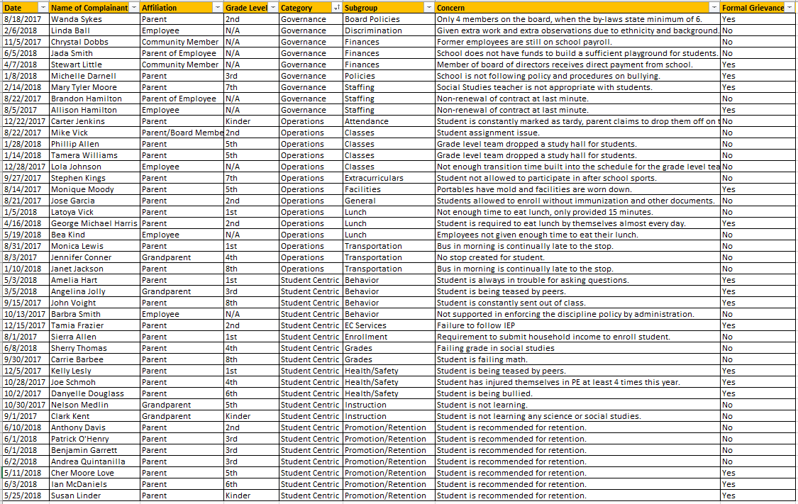
Sample Grievance Tracker

Slide 22
Data Analysis
What are the highlights?
Where should we dig a little deeper?
Is more information needed?
If so, what type?
Are there any trends, blind spots or inconsistencies?
What changes can we make?
What data should we track in the future?

Slide 23





Questions
Contact Information:
Stephenie Clark, MBA
Education Consultant
NCDPI Office of Charter Schools
919-807-3492
Stephenie.Clark@dpi.nc.gov

