Slide 1

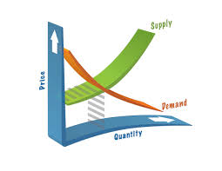
Flippping
Out
Flipping
Matt Hubacher: Pine Lake Prep Upper School Social Studies
https://tinyurl.com/ybh7nep2

Slide 2
What Is A Flipped Classroom?
In a flipped classroom, class time and homework time are reversed.
Students watch brief videos on their own time
Class time that was spent copying notes is now available for
  discussion
  application
  practice of the concepts
  Individual time with students helping them to be successful

Slide 3
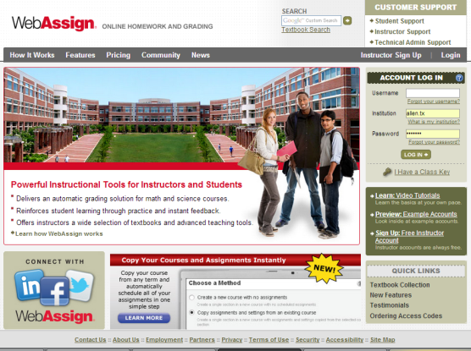
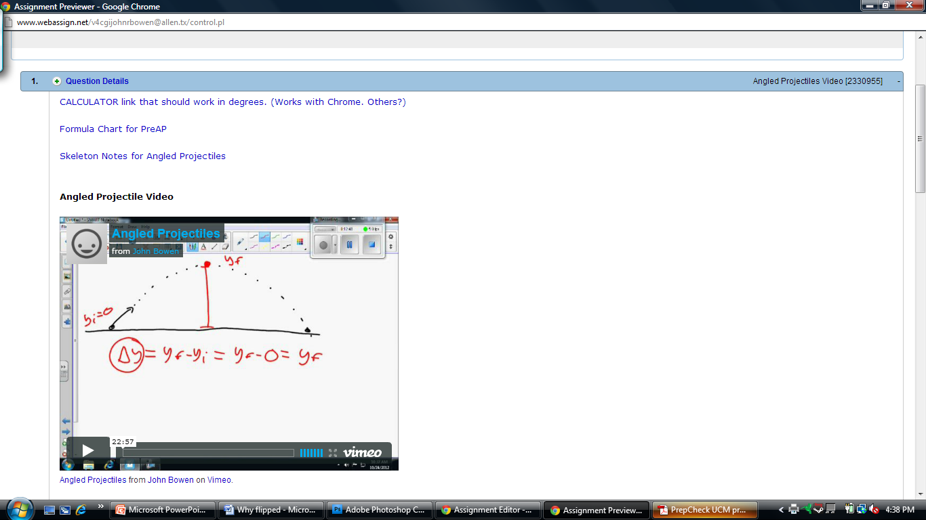
Pre-Class Preparation
Students watch the video lecture that teaches the content and provides examples.
Students take notes
  Standard uses guided notes
  Honors take notes
ALL:
  Complete Canvas Quiz
Use Canvas Discussion Board to comment and help each other if needed.
Other LMS can support

Slide 4
Expectations for Students
Plan time to watch the videos and take notes when you are still fully awake and able to make connections to the content.
Fully engage with the video—no interruptions from social media sites, television, music, or cell phones.
This is not a passive activity like watching TV. Think and take notes.
Pause, rewind, or re-watch portions of the video when the teaching is going too fast or when you need a minute to process what was taught.
Communicate with me via e-mail or in person if you have questions, or if there are issues with watching the videos.
  Tech concerns!

Slide 5
Why Flip the Classroom? Why Now?
Class time can be used for higher-level application and practice activities, instead of on copying information.
Students of all abilities can excel by watching the video as many times as they need to. Students can pause and rewind the instruction!
It can help busy students get ahead, or make up work when they miss class.
Students get help when they need it, before they get frustrated.
Economics is concept based. Civics is more fact based. More class time is needed to try out concepts.
  Flipping works best for concepts!

Slide 6
Day-to-day teaching strategies
Begin with a warm-up
Go over student questions from the video
Take a quiz on the flipped material
Application of and practice time for the material
  Class discussions, simulations, webquests, centers activities, video clips, debates, etc.
If students have not watched the video lecture for homework, they can watch it during class, but they will automatically receive a score of 50%. Anything we do in class, they will be required to complete for homework, in addition to watching the next evening’s video lecture

Slide 7
Flipping Do’s and Don’ts
DO hold students accountable
  If they stop watching the videos, you are toast.
DON’T give other homework, allow class time for other work
DO post videos in batches to let kids work ahead
  The freedom to manage their own time is a skill they need
DON’T flip the whole year
  They will fatigue
DO use the new found class time to try new things that students will enjoy. They will buy in if they think it is worth it.
DON’T ignore student feedback. Adjust to what works best for your students!
DO make your videos “timeless”

Slide 8
Video Options
Make your own
QuickTime (Mac)
Screencast-o-Matic
  Picture in picture option
Many Others...
Use Existing Content
YouTube
Khan Academy
Textbook resources
Options are endless...

