Slide 1



Notes:
Lori begins.

Slide 2
Do Now…
Working alone, silently and with no help
from your mobile devices, circle the correct
answer to each of the 25 items on your
pre-assessment. (3-5 min)

Slide 3
Dynamic Teaching Yields
Dynamic Results
An Introduction to Tiered and Differentiated Instruction
Steve Pond
Peak Charter Academy
107.spond@nhaschools.com

Slide 4


Slide 5


Slide 6


Slide 7
SO… what’s wrong with this?

Slide 8
SO… what’s wrong with this?
Unlike JDB, (The JD Beauty Company), we can’t make the same hairbrush and sell it to 3 different groups of people.
Unlike a hairbrush, differentiated instruction is NOT one size fits all. You can’t take the same learning experience and just give it to every student.
We MUST differentiate the instruction and academic experiences that we provide to our students.

Slide 9
Take a moment to talk to a peer...
How do you know HOW to teach?

Slide 10
Research shows how we teach is based primarily on 4 key influences…
1. We teach the way WE were taught in school. (mostly modeling our favorite teachers)

Slide 11
Research shows how we teach is based primarily on 4 key influences…
1. We teach the way WE were taught in school. (mostly modeling our favorite teachers)
2. We teach the way WE learn best. (our personal preference/learning style)

Slide 12
Research shows how we teach is based primarily on 4 key influences…
3. We teach the way someone told us how to teach. (learned from peers as beginners)

Slide 13
Research shows how we teach is based primarily on 4 key influences…
3. We teach the way someone told us how to teach. (learned from peers as beginners)
4. We teach the way that people learn best. (Brain friendly principles/environments)

Slide 14
Direct Instruction
Focuses on strict, scripted implementation of lesson, activities, assessments
Teacher fully controls and directs student learning experiences
Excludes, disregards individual, cultural, community differences and values
Deskills teachers by routinizing work & downplaying professional capacity
Places teacher/child in rigid relationship where teacher has all the power
Limits differentiation, creativity and innovation in teaching and learning.
We remember 10% of what we read
20% of what we hear
30% of what we see
(Allan Luke, Australian Association for Research in Education http://www.aare.edu.au/blog/?p=439)

Slide 15
Whole Group, Teacher-Led, Direct Instruction is LEAST effective.

Slide 16
Whole Group, Teacher-Led, Direct Instruction is LEAST effective.
Pair/partner students by ability/interest or learning profile

Slide 17
Whole Group, Teacher-Led, Direct Instruction is LEAST effective.
Pair/partner students by ability/interest or learning profile
Alone time: give students 1-on-1 individualized support

Slide 18
Whole Group, Teacher-Led, Direct Instruction is LEAST effective.
Pair/partner students by ability/interest or learning profile
Alone time: give students 1-on-1 individualized support
Tiered/differentiated small groups help you meet & grow students

Slide 19
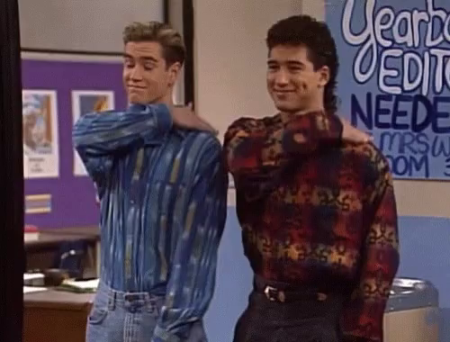
When you start doing these 3 things,
give yourself a PAT on the back!

Slide 20


Slide 21
Rick Wormeli’s Guiding Principles
1. We can’t teach all kids in same way and/or expect them to all to learn the same way…

Slide 22
Rick Wormeli’s Guiding Principles
1. We can’t teach all kids in same way and/or expect them to all to learn the same way…
2. “Fair” does not mean “same” or “equal.”

Slide 23
Rick Wormeli’s Guiding Principles
1. We can’t teach all kids in same way and/or expect them to all to learn the same way…
2. “Fair” does not mean “same” or “equal.”
3. “Fair” means everyone gets support they need to be successful in reaching targets, and that may mean their instruction differs.
(Rick Wormeli, “Fair Isn’t Always Equal”)

Slide 24


Slide 25
How did the coach teach Michael?

Slide 26
How did the coach teach Michael?
How did Leigh Anne teach Michael?

Slide 27
How did the coach teach Michael?
How did Leigh Anne teach Michael?
What did “S.J.” (the brother) know?

Slide 28
How did the coach teach Michael?
How did Leigh Anne teach Michael?
What did “S.J.” (the brother) know?
What did coach learn from Leigh Anne?

Slide 29
How did the coach teach Michael?
How did Leigh Anne teach Michael?
What did “S.J.” (the brother) know?
What did coach learn from Leigh Anne?
…SO WHAT IS THE “TAKEAWAY?”

Slide 30
We HAVE to get to know our students…

Slide 31
We HAVE to get to know our students…
How do they like to learn?
Where is their level of learning currently “at?”
What are their joys and concerns?
What are they interested in?

Slide 32
6 steps to effective differentiation
1. Evaluate previous summative/standardized data.

Slide 33
6 steps to effective differentiation
1. Evaluate previous summative/standardized data.
2. Observe your students and their performance.

Slide 34
6 steps to effective differentiation
1. Evaluate previous summative/standardized data.
2. Observe your students and their performance.
3. Use pre-assessment before, and formative assessment throughout, to assess learning.

Slide 35
6 steps to effective differentiation
4. Use data to group students in classes/levels of need according to demonstrated mastery.

Slide 36
6 steps to effective differentiation
4. Use data to group students in classes/levels of need according to demonstrated mastery.
5. Focus on the same standard, but without changing the target learning objective, engage group members’ in specific activities aligned with levels in DOK, Bloom’s & Dale’s work.

Slide 37
6 steps to effective differentiation
4. Use data to group students in classes/levels of need according to demonstrated mastery.
5. Focus on the same standard, but without changing the target learning objective, engage group members’ in specific activities aligned with levels in DOK, Bloom’s & Dale’s work.
6. Challenge all learners to grow, no matter where they begin. Each activity should support growth.

Slide 38
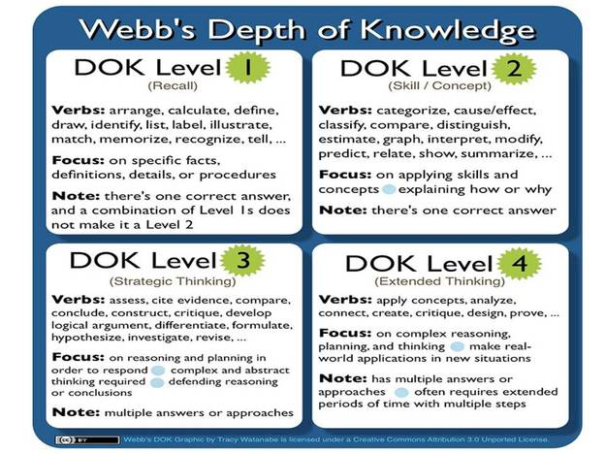

Slide 39
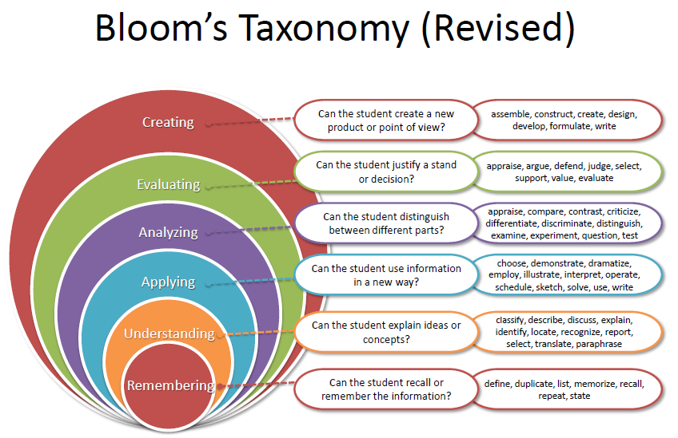

Slide 40
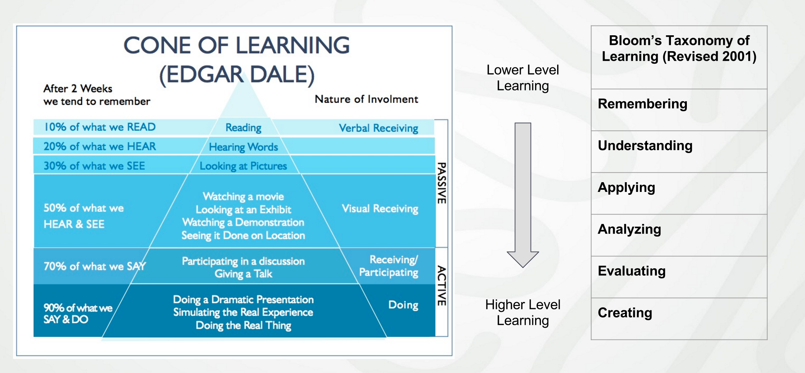

Slide 41
Pre-assessment
The purpose of pre-assessment is to gather information for differentiating instruction. You can’t differentiate until you've assessed kids against a rubric for demonstrating prior learning of an objective” - Harry Wong

Slide 42
Pre-assessing, but still teaching all kids the
same way and at the same level means…
    1/3 likely already know the material
    1/3 are likely to be able to learn it
    1/3 may not “get” it at all

Slide 43
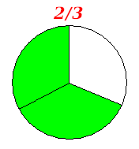
Only teaching one way can leave
up to 2/3 of your students “out!”

Slide 44
Benefits:
Assessing for Readiness → greater growth & achievement

Slide 45
Benefits:
Assessing for Readiness → greater growth & achievement
Assessing for Interest → greater motivation

Slide 46
Benefits:
Assessing for Readiness → greater growth & achievement
Assessing for Interest → greater motivation
Assessing for learning style/profile → greater efficiency and engagement
(Betty Hollis "Differentiating Instruction in a Whole Group Setting")

Slide 47
To pre-assess effectively…
Build your unit around 3-5 key, over-arching concepts that all students should develop and demonstrate proficiency after engaging in learning with you.
Develop your pre-assessment with 5 questions per concept.
Evaluate your data using the frameworks of 60% as a demonstration of proficiency and 80% as mastery
(Rick Wormeli, Michael Shackleford)

Slide 48

Let’s see what you know about famous television shows…

Slide 49


Slide 50
IMPORTANT - BEFORE PRE-ASSESSING, BE SURE TO STRESS...
This doesn’t “count” for a grade…
Just show me what you know, so I know how to teach.

Slide 51
How did you do?
1. C 11. C 21. B
2. B 12. B 22. C
3. D 13. C 23. D
4. A 14. A 24. A
5. C 15. D 25. B
6. D 16. A
7. C 17. C
8. B 18. B
9. D 19. D
10. B 20. C
Be sure to calculate your score as directed in the bottom right corner on the
back of your
pre-assessment.

Slide 52
If I was teaching a class on “Famous Television Shows,” the data from the pre-assessment you took would have allowed me as the teacher to assess your mastery of 5 key concepts (shows) of my instruction.

Slide 53
If I was teaching a class on “Famous Television Shows,” the data from the pre-assessment you took would have allowed me as the teacher to assess your mastery of 5 key concepts (shows) of my instruction.
Once I know how proficient each of you are with each key concept (show), and overall, I can tier, or divide, you into ability groups based on your learning needs and differentiate the instruction I plan and deliver to you.

Slide 54
Pre-assessing for each concept helps you to identify…
Students whose proficiency is below 60% in all areas (low learners who need support to meet minimum proficiency)

Slide 55
Pre-assessing for each concept helps you to identify…
Students whose proficiency is below 60% in all areas (low learners who need support to meet minimum proficiency)
Students whose proficiency was below 60% in one or 2 areas but above 60% in all others (mid-level learners who can do “on target” work but need to fill some gaps)

Slide 56
Pre-assessing for each concept helps you to identify…
Students whose proficiency is below 60% in all areas (low learners who need support to meet minimum proficiency)
Students whose proficiency was below 60% in one or 2 areas but above 60% in all others (mid-level learners who can do “on target” work but need to fill some gaps)
Students with high mastery (80%+) in all areas that need challenging opportunities to engage them in higher-level learning and more importantly, growth)

Slide 57
Pre-Assessment: Summary
Step 1: Begin with the end in mind. Identify no more than 3-5 essential learning/key concepts per unit.
Step 2: Pre-assess students on each key concept (no more than 5 items per standard) & evaluate performance data.
Step 3: Tier your students based on their initial proficiency data and use formative assessments throughout the unit to monitor their learning and understanding of key concepts as instruction progresses.

Slide 58
Tiered Instruction
“Tiered instruction and assignments allow teachers to help kids grow and ready
themselves at different levels of complexity
while learning the same objective.” – Betty Hollis

Slide 59
If your pre-assessment data shows you have…
- Students who have mastered (80%+) concept(s) → Increase the rigor in which you engage them on their tier

Slide 60
If your pre-assessment data shows you have…
- Students who have mastered (80%+) concept(s) → Increase the rigor in which you engage them on their tier
- Students who pre-assess as proficient (60%+) → Engage them for higher level learning on their tier

Slide 61
If your pre-assessment data shows you have…
- Students who have mastered (80%+) concept(s) → Increase the rigor in which you engage them on their tier
- Students who pre-assess as proficient (60%+) → Engage them for higher level learning on their tier
- Students who score below proficiency (-60%) → Help them develop basic understanding of key concepts

Slide 62

Everyone learns the same standards, but at different levels on Bloom/DOK. Change the rigor, NOT the standard.

Slide 63
What is Rigor? (Cash, Kryza)
Rigor =

Slide 64
What is Rigor? (Cash, Kryza)
Rigor = Depth & Complexity

Slide 65
What is Rigor? (Cash, Kryza)
Rigor = Depth & Complexity
Depth = Level of information needed to solve complex and abstract problems within or across disciplines

Slide 66
What is Rigor? (Cash, Kryza)
Rigor = Depth & Complexity
Depth = Level of information needed to solve complex and abstract problems within or across disciplines
Complexity = the level of thought that the brain goes through to manage information

Slide 67


Slide 68

How did Mr. Holland tier instruction for Lou?

Slide 69
How did Mr. Holland tier instruction for Lou?
Was Lou expected to demonstrate the same performance standard?

Slide 70
How did Mr. Holland tier instruction for Lou?
Was Lou expected to demonstrate the same performance standard?
Did Lou succeed?

Slide 71
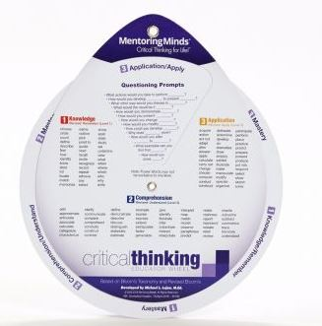

Slide 72

True or False?
(R.I.P Adam West AKA Batman)

Slide 73
True or False?
1. If you have rigorous standards, you have a rigorous course.

Slide 74
True or False?
1. If you have rigorous standards, you have a rigorous course.
FALSE
Rigor isn’t as much about the standards as it is about how you ask students to reach the standards- the degree of depth and complexity in which you engage learning.

Slide 75
True or False?
2. Rigor means harder.

Slide 76
True or False?
2. Rigor means harder.
FALSE
Work can be difficult for a variety of reasons including unclear instruction, a lack of necessary resources, a lack of adequate support, demands too great for the time allotted, etc. Thus, it is a mistake to think that just because students had difficulty completing their work, they have engaged in a rigorous assignment.

Slide 77
True or False?
3. Rigor means more.

Slide 78
True or False?
3. Rigor means more.
FALSE
Rigor is about the quality of the work students are asked to do, no the quantity. In fact, rigorous classrooms often have less assignments and homework because students are deeply engaged in higher level dialogues, activities and learning.

Slide 79
True or False?
4. Rigor is a matter of content.

Slide 80
True or False?
4. Rigor is a matter of content.
FALSE
Just because you select highly rigorous content does not guarantee a highly rigorous learning experience for students. How you ask students to engage in the content ultimately determines the level of rigor of your course.

Slide 81
True or False?
5. Younger students can’t engage in rigorous instruction.

Slide 82
True or False?
5. Younger students can’t engage in rigorous instruction.
FALSE
The key is to make sure that your rigorous instruction is developmentally, and age, appropriate.
http://onlyexcellence.blogspot.com/2011/11/seven-myths-about-rigor.html

Slide 83
Tiered Instruction: Key Points
Tiered lessons must be planned w/target standards in mind, and be both rigorous, and relevant.

Slide 84
Tiered Instruction: Key Points
Tiered lessons must be planned w/target standards in mind, and be both rigorous, and relevant.
The learning standards are not negotiable, but the routes we take our students to learning them are.

Slide 85
Tiered Instruction: Key Points
Tiered lessons must be planned w/target standards in mind, and be both rigorous, and relevant.
The learning standards are not negotiable, but the routes we take our students to learning them are.
Tiered assignments/activities must be similar but vary by depth and complexity of learning and engagement.

Slide 86
In Summary
- Pre-assess to determine groups/class placement
- Ensure that students learn the same standard, but at different levels of depth and complexity.
- Different students can do different things in different ways.
- Keep students engaged at their level to avoid boredom (high-level learners) or avoidance (low-level learners)
- Differentiated instruction IS fair & right for all students.

Slide 87
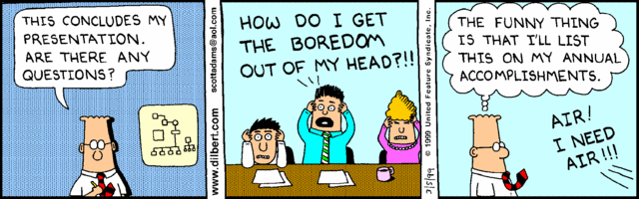
Any questions?

Slide 88
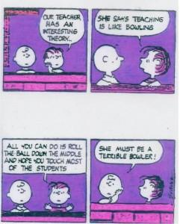
Launch

