Slide 1
Realizing the Dream:
District and Charter School Collaboration in North Carolina
Meredith Flowe
Interim Executive Director
The Centers for Exceptional Children
meredith@thecfec.org
www.thecfec.org
Lisa Gordon Stella
Law Office of Lisa Gordon Stella, PLLC
lisa@lgstellalaw.com
www.lgstellalaw.com

Slide 2

Concept for Public Charter Schools
In part, “research and development” laboratories for public education
Incubating innovative practices that could be transferred to district-run public schools.

Slide 3
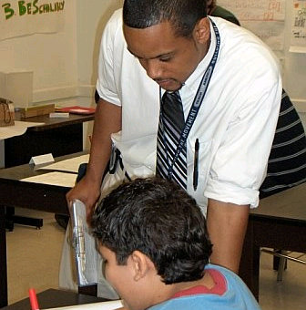
Challenges for Collaboration Efforts
Districts & County Commissioners do not know how many public charter schools will be approved to open and where they will locate.
This creates challenges for implementing long-term school building strategies.

Slide 4
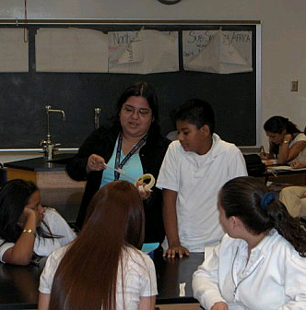
Challenges for Collaboration Efforts
Charter schools concerned if districts participate in authorization process, districts would only block issuance on new charters.
Charters and district-run schools have not yet co-located in NC
Charters have alleviated the needs to build new facilities in some fast-growing urban districts.

Slide 5
Funding – District vs. Charter Perspective
Districts
When students choose charter schools, districts lose the PPR
Districts in NC have no decision-making role in charter schools opening in their communities, thus they feel a loss of control over this funding.
Districts cannot reduce funding as fast as they lose revenue
Fixed capital costs
May lose only a few students per class per school, which does not reduce human capital or operational costs
Rural districts impacted more quickly
Charter Schools
Issue of inequity. In NC, charters receive about 76% of PPR received by districts.
Primarily less due to not receiving public funds for facilities and transportation, BUT this cuts into classroom funds.
CS Transportation Pilot FY18
Lack economies of scale for transportation & nutrition
Charter schools may use state and local funds to finance facilities and provide transportation, but this cuts into their classroom funds.

Slide 6

Potential for Collaboration in NC
Incentives for charters to engage with districts to plan collaboratively on meeting the needs of the most challenging and expensive students, including EC and ELs.
Potential revenue generating resources districts that have economies of scale to contract with charters to provide these services.
Ways for districts to exercise some oversight of charter schools within their districts without charter schools significantly compromising their autonomy.

Slide 7

Examples of Effective Collaboration
The Denver Compact
Denver Public Schools formed a Collaborative Council, consisting of senior district staff and elected charter representatives
Meets monthly to develop policy recommendations and share successful practices
Forms work groups to address EC, ELs, finance, and alternative education
Notes:
http://portfolio.dpsk12.org/wp-content/uploads/2015/07/DPSDistrictCharterCollaborationCompact.pdf

Slide 8

Examples of Effective Collaboration
Issues Denver Compact is addressing:
Creating common school performance standards
Creating transparent and rigorous charter authorizing practices grounded in a school quality framework
Student-based budgeting and transparent funding formulas for both district and charter schools
Flexibility in transportation
Facility support for charter schools

Slide 9
Durham Charter Collaborative
A North Carolina Non-Profit dedicated to fostering charter school collaboration as well as district charter relationships.
Monthly Meetings
Charter collaborations, including: job fairs, vendors, & professional development
Fostering charter school relationships and best practices
Annual presentation to County Commissioners
Relationship building with community and traditional public school system

Slide 10
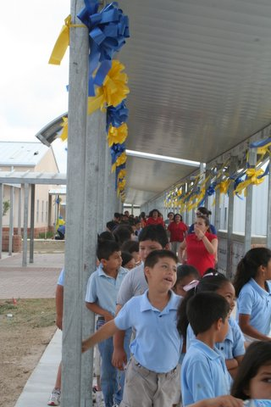
Discussion
What are examples of collaboration or potential collaborations in your community?
What are areas of collaboration that would be mutually beneficial to districts and charters?
Are there any legislative or regulatory changes NC should be considering?

