Slide 1
Charter School Financial Post Legislative Webinar
Alexis Schauss,
Chief Business Officer of NC Public Schools

Slide 2
Agenda
Charter School Funding Overview
2017-19 Legislation Affecting Base Allocation
2017-19 Legislation – Restricted Funds
Where We Are Now
What’s Next

Slide 3
Charter School Funding Overview

Slide 4
Charter School Overview
Number of Schools 185
Number of Students (budgeted) 111,604
% of allotted ADM 7.2%
Total funding 2018 $581 million

Slide 5
Allotted Average Daily Membership 1998 to 2019
Source: Highlights of NC Public School Budget http://www.ncpublicschools.org/docs/fbs/resources/data/highlights/2018highlights.pdf

Slide 6
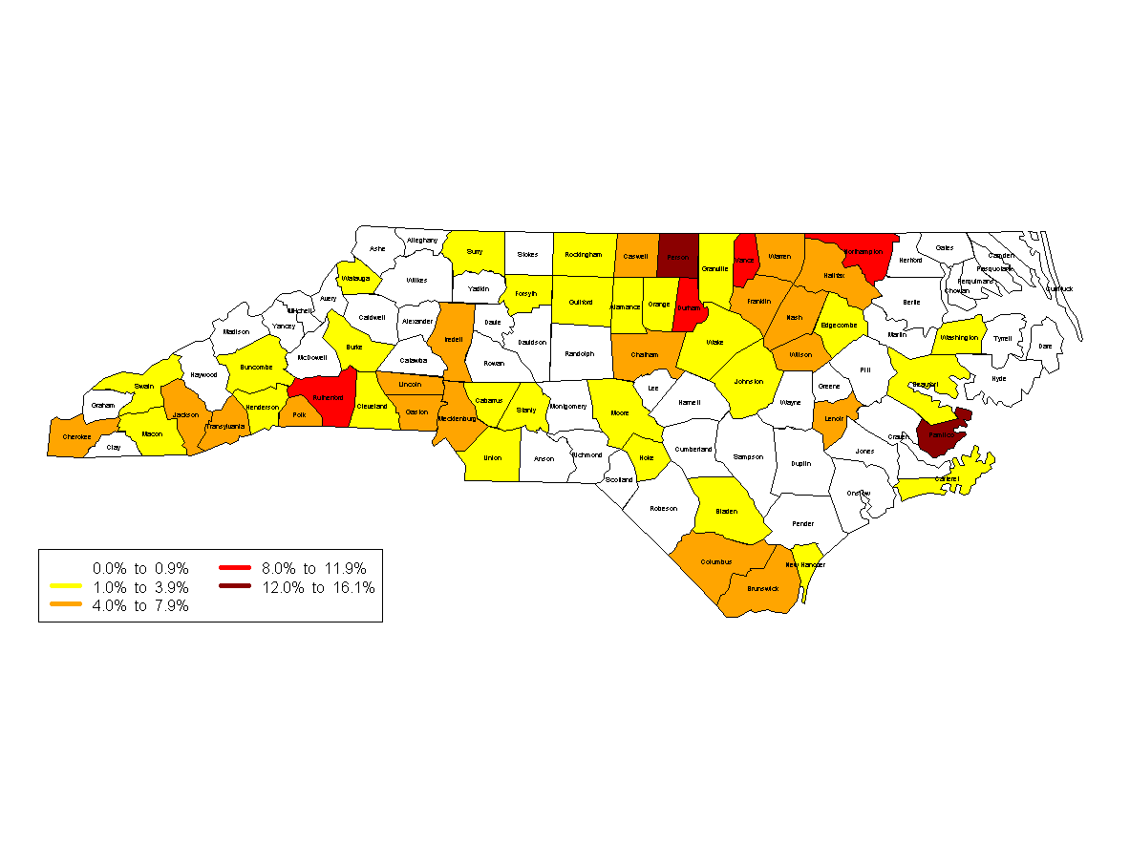
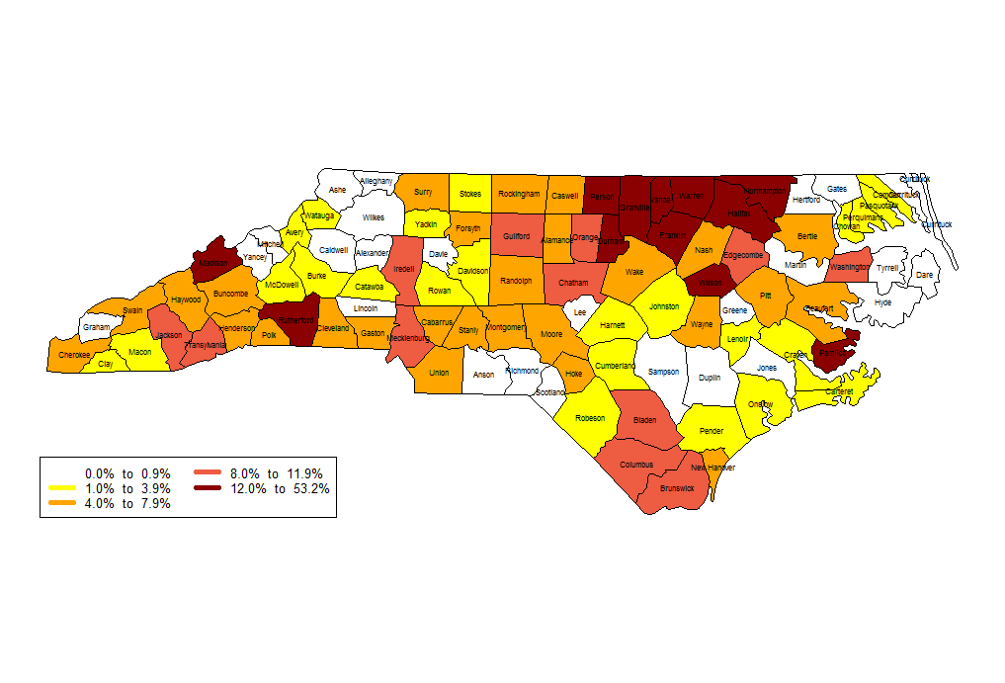
Percentage of Public School Students in Membership at Charter Schools, 2017 - 2018
Percentage of Public School Students in Membership at Charter Schools, 2011- 2012
Source: http://www.ncpublicschools.org/docs/fbs/resources/data/csmembersmap.pdf

Slide 7
State Base Allocation per Average Daily Membership 2006 to 2019

Slide 8
Charter School Funding
Base funding is calculated as a per pupil equivalent of the funding provided to the LEA in which the charter is located.
New schools and high growth are funded in the first year based on the LEA in which those students reside.

Slide 9
Main Causes for Variance in Base Allocation – Categorical Allotments
Low Wealth Supplement
Supplemental funding provided to counties whose ability to generate local revenue is below the State average.
The supplemental funds offset some of the variance from local funding.
77 of the 115 LEAs receive supplemental funds ranging from $41.23 to $765.75 per ADM (2018), depending how far the LEA is from the State average.

Slide 10
Main Causes for Variance in Base Allocation
Small County
Supplemental funding to county districts with an ADM less than 3,300.
27 of the 115 LEAs receive supplemental funding ranging from $506 to $3,116 (2018).
Small rural counties generally have smaller schools, so the administration funding per ADM is higher. Wake Co. school based administration - $204. Mitchell Co. $456.

Slide 11
Main Causes for Variance in Base Allocation
Student Poverty
LEAs with higher poverty receive a higher per pupil in At Risk funding
Chapel Hill Carrboro $138.54
Halifax $402.16
Notes:
$34 attributed to poverty for CH-C$274 attributed to poverty for Halifax

Slide 12
State Base Allocation by LEA 2018-19
Source: http://www.ncpublicschools.org/fbs/allotments/state/
Hyde ($10,890) and Tyrell Counties ($11,096) excluded

Slide 13
Main Cause in different increase between 2018 and 2019
Average increase 5%
Range of increase 1% to 12.6%
Reasons:
Change in legislation
Change in student poverty %
Change Small county status
Notes:
$506 per ADM to $3,116 per ADM

Slide 14
Increase of State Base Allocation from 2017-18 to 2018-19
Cherokee Co
Average increase 5%
Weldon City

Slide 15
2017-19 Legislation Affecting Base Allocation

Slide 16
Salary Increases – Teachers and Instructional Support
Total State funds on teachers and instructional support salary and benefits is over $5.3 billion
The GA has appropriated $486m to
teacher pay in 2017-19
Average increase 6.5%
Range 0% to 13.4%
Educator Years | Bachelor Salary
1 | $3,500
2 | $3,600
3 | $3,700
4 thru 14 | +$100
15-24 | $5,000
25+ | $5,130

Slide 17
Other Salary Increases
Principal Schedule increased by 6.9%
Asst Principal Teacher increase + 2%
Others 2%

Slide 18
Benefits Increase
Health $5,869 to $6,104
Retirement 17.13% to 18.86%
Charter school base allocation includes the funding for these benefits regardless of the school’s participation in TSERS or SHP.
Notes:
4% increase in health

Slide 19
Additional Teacher positions
SL2018-2 provided funding for program enhancement teachers.
1 teacher per 191 ADM in K-5
Funded at 25% in 2018-19 ($61m)
Charter School equivalent - Approx. $48 per ADM
Notes:
Next year an addl 25%

Slide 20
Reduction in Central Office
$18m reduction to this appropriation in 2017-19.
Charter School share of the reduction – Approx. $36 per ADM

Slide 21
Other legislation
Small Co – Affects Cherokee only
Low Wealth – Affects Wayne only

Slide 22
Academically and Intellectually Gifted
AIG increase
2019 $1,339.14
2018 $1,314.56
1.9% increase on 4% of the LEA ADM

Slide 23
Children with Disabilities
Full Funding: 2019 $4,442.34 per headcount
2018 $4,125.27
7.7% increase
12.75% cap on LEA+CS headcount
LEA and charter school are funded for each student with disabilities but may be at a discounted amount.

Slide 24
2017-19 Legislation – Restricted Funds

Slide 25
Restricted Funding – Principal Bonus
Principals supervising a school for the majority of the school year 2017-18 are eligible for a bonus if the school is in the top 50% in growth.
2018 “moving to exceeds” bonus plan eliminated.
Growth | School Grade A, B or C | School Grade D or F
Top 5% | $10,000 | $20,000
Top 10% | $ 7,500 | $15,000
Top 15% | $ 5,000 | $10,000
Top 20% | $ 2,500 | $ 5,000
Top 50% | $ 1,000 | $ 2,000

Slide 26
Restricted Funding – Principal Bonus
Principal is not eligible if the last work day is prior to October 1st.
Bonus is to be paid out no later than October 31st.
The bonus is NOT subject to retirement.
The bonus, if awarded, will be allotted in PRC 048.
Payments MUST be coded to 1-5410-048-180.
Failure to follow the accounting instruction may result in an audit exception or reversion of funds.

Slide 27
Restricted Funds – Teacher Bonus
Bonus | Coding | Amount | Notes
3rd Grade reading | 1-5110-046-180 | TBD | DPI calculates the amount of the bonus and notifies the schools.
4th & 5th grade reading | 1-5110-048-180 | $2,000 | Bonus was reduced from 2018 (was $2,150). DPI to provide the teacher names.
4th - 8th Grade Math | 1-5110-048-180 | $2,000 | Bonus was reduced from 2018 (was $2,150). DPI to provide the teacher names.
AP/IB/AICE | 1-5260-048-180 | $50 per test Max $3,500 | DPI allots based on total tests. Charter must determine the teachers.
CTE | 1-5120-048-180 | $25 or $50 per test. Max $3,500 | DPI sends the eligible teachers and amounts to the schools.
To be qualified for the bonus, the teacher must be employed in the charter school until January 1st 2019.
Teacher bonuses must be paid by January 31st.

Slide 28
School Safety Grants
Administered through the Center For Safer Schools http://www.ncpublicschools.org/cfss/
School Resource Officers
Addl $5m recurring funding added to the $7m
Application process closed July 13
45 charters awarded grants
Matching requirement $2 state:$1 non state

Slide 29
School Safety Grants
Administered through the Center For Safer Schools http://www.ncpublicschools.org/cfss/
School Mental Health Support Personnel
$10m non recurring funding
Application process closed July 31
Salary and Benefits of nurse, counselor, psychologist and/or social worker

Slide 30
Transportation Grants
2017-18 Only.
Not available in 2018-19

Slide 31
Where are we now…

Slide 32
Allotted
Base allocation
34% based on projected ADM
EC
April 1 headcount – 60 day transfer
LEP
NCVPS adjustment
School Connectivity
SRO grants

Slide 33
What’s Next….
Recalculate base per month 1 ADM
Fines and forfeitures
EC transfers – 60 day window
Summer camp reversion (Oct 31^{st)}
Bonus funds (Dec)

Slide 34
100% of allocation after Month 1
In operation for at least 3 years and
DPI has reviewed 3 years’ financial statement audits
No material weaknesses in last 2 years
No Probationary noncompliance in last 2 years
No Disciplinary noncompliance in last 3 years

Slide 35
Installment Allocations
After Month 1 final (last year 11/9)
68% of the annual allocation based on Month 1 ADM LESS amount expended
Before the end of February
Final 32%

Slide 36
Monthly allocation
Charter schools on Disciplinary noncompliance status receive the allocations in monthly installments with the last installment in May.

Slide 37
Questions

