Slide 1
Healthy Start Academy
Charter Leadership Session

Slide 2
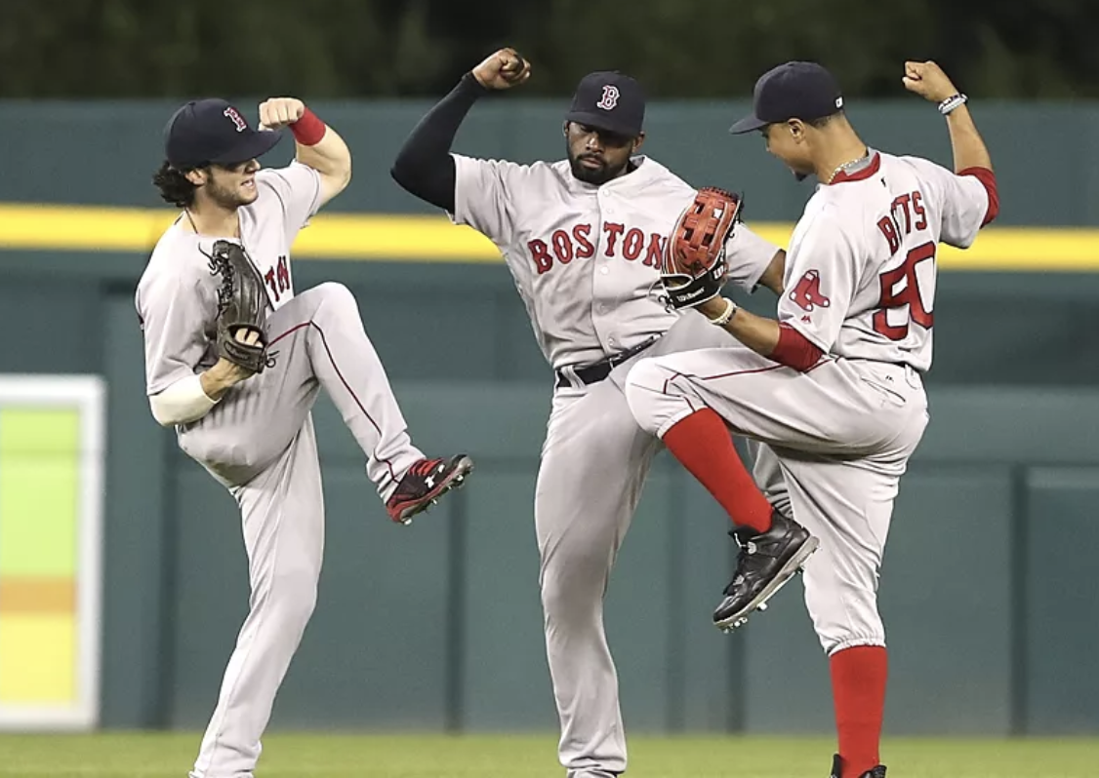
Do Now
Think about the best team that you have been on.
  What made it effective?
  Why?
Notes:
Turn and talk on this item

Slide 3
Objectives
Provide you with some basic strategies you can implement this year to improve the functioning of your leadership team.
Share some exemplars and resources that you can easily modify.

Slide 4
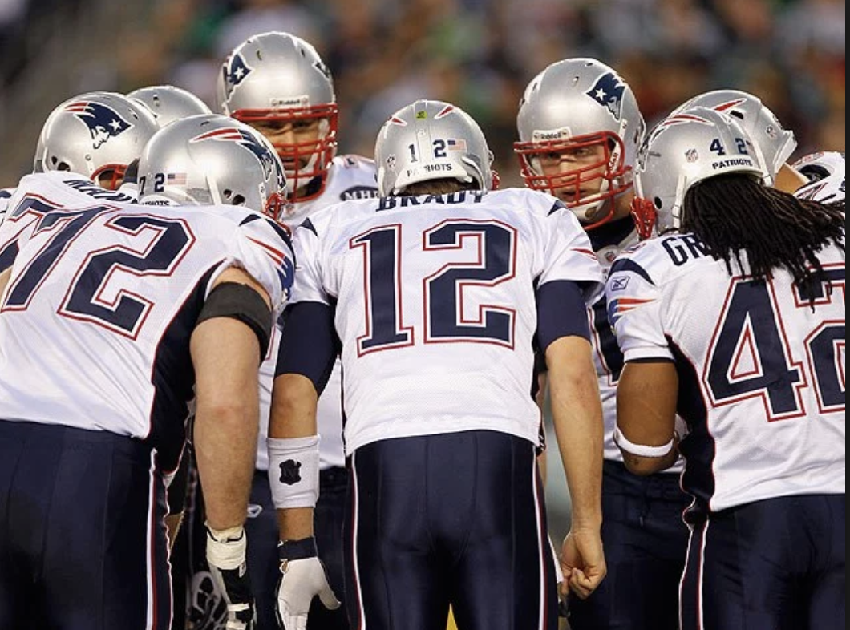
Leadership Teams – 2 Key Steps
Build a Cohesive Leadership Team
Create Organizational Clarity

Slide 5

Leadership Teams – 2 Steps
”We we wear a lot of hats.”
“Everyone picks up the slack”

Slide 6
Key Idea #1
If roles are not clearly defined, the work will be unnecessarily confusing, imbalanced, and often, undone.

Slide 7
How to Build a Leadership Team
Clarify everyone’s role
Determine what teams they are on
Determine what their (the team’s) purpose is
Decide on the frequency that the team needs to meet to accomplish that purpose

Slide 8
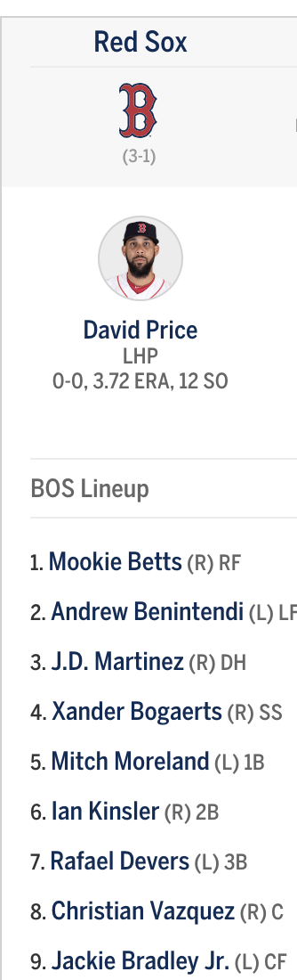
Work Burst – 5 min Silent Solo
Define your secondary leaders
Write down their role and primary responsibilities
Who is in your lineup?

Slide 9
Establish Teams and Objectives
What is the absolute smallest number of people that need to be on a team?
How frequently do these teams need to meet?
What is the purpose and goals?

Slide 10
Key Considerations
Teams of more than 8 people are not effective - think School Leadership Team with like 10 people on it. That’s not really a true management team - it’s a communication dissemination vehicle.
If people don’t want to meet then you have to ask yourself if the meeting is really necessary or ask yourself if you have the right people.
Frequency at a school can be tricky - school days are like Dog Years - 1 day = 5 days in a normal workplace…

Slide 11
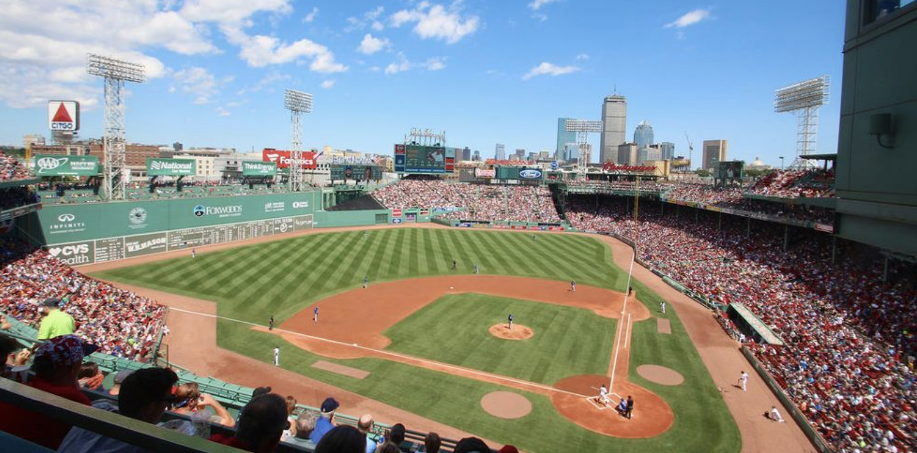
Work Burst – 7 minute Silent Solo
Complete chart by filling out each secondary leader
Don’t think too much about it – just get as much done as you can in 5 minutes

Slide 12
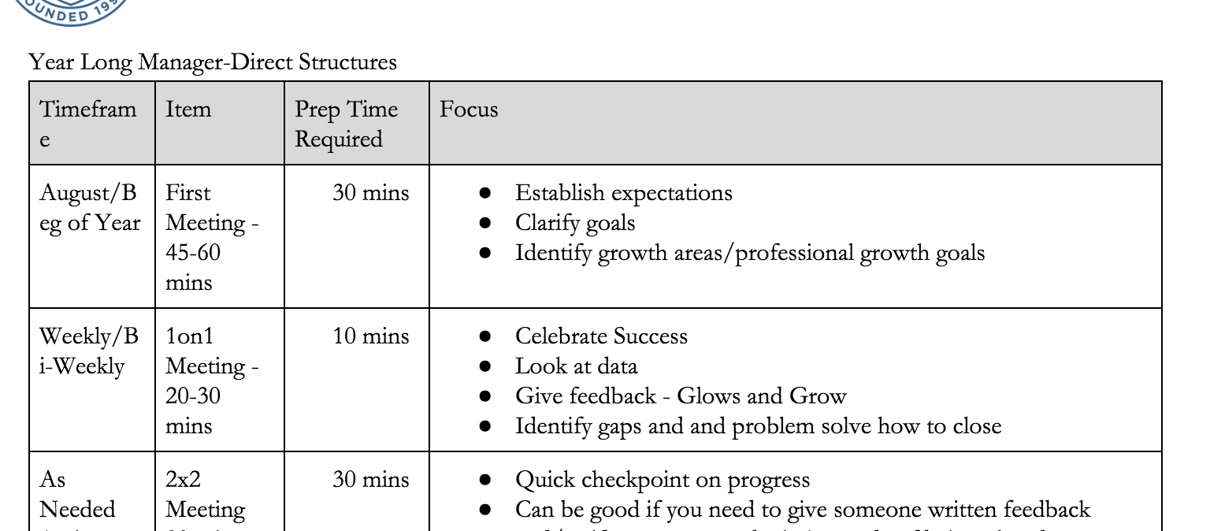
Managing Individuals
Part of ensuring high quality teams is managing each team member as individuals.
3 parts to individual management
  Goals
  Weekly or Bi-Weekly 1on1s
  Bigger Rock Reviews (Mid-Year, Annual, 2x2)

Slide 13
Key Idea #2
Everyone needs to be managed.
Everyone needs to be on a team.
Everyone needs goals.
Yes, even high performers.
Especially high performers.

Slide 14

Let’s talk about Goals
Teachers aren’t the only ones with goals
Role Specific
Measurable

Slide 15
Work Burst – 5 minute Silent Solo
Complete chart by filling out for directs
Don’t think too much about it – just get as much done as you can in 5 minutes

Slide 16
Key Idea #3
What gets managed gets done.

Slide 17



Systems!
You need strong systems to manage all of the tasks and outcomes from meetings and check-ins
Use technology!

Slide 18
Materials
https://goo.gl/QYPKq2

