Slide 1
Evaluation Results 2018-19
North Carolina Migrant Education Program

Slide 2
Implementation
Demographics, Parent Involvement, Professional Development, and Instructional and Support Services

Slide 3
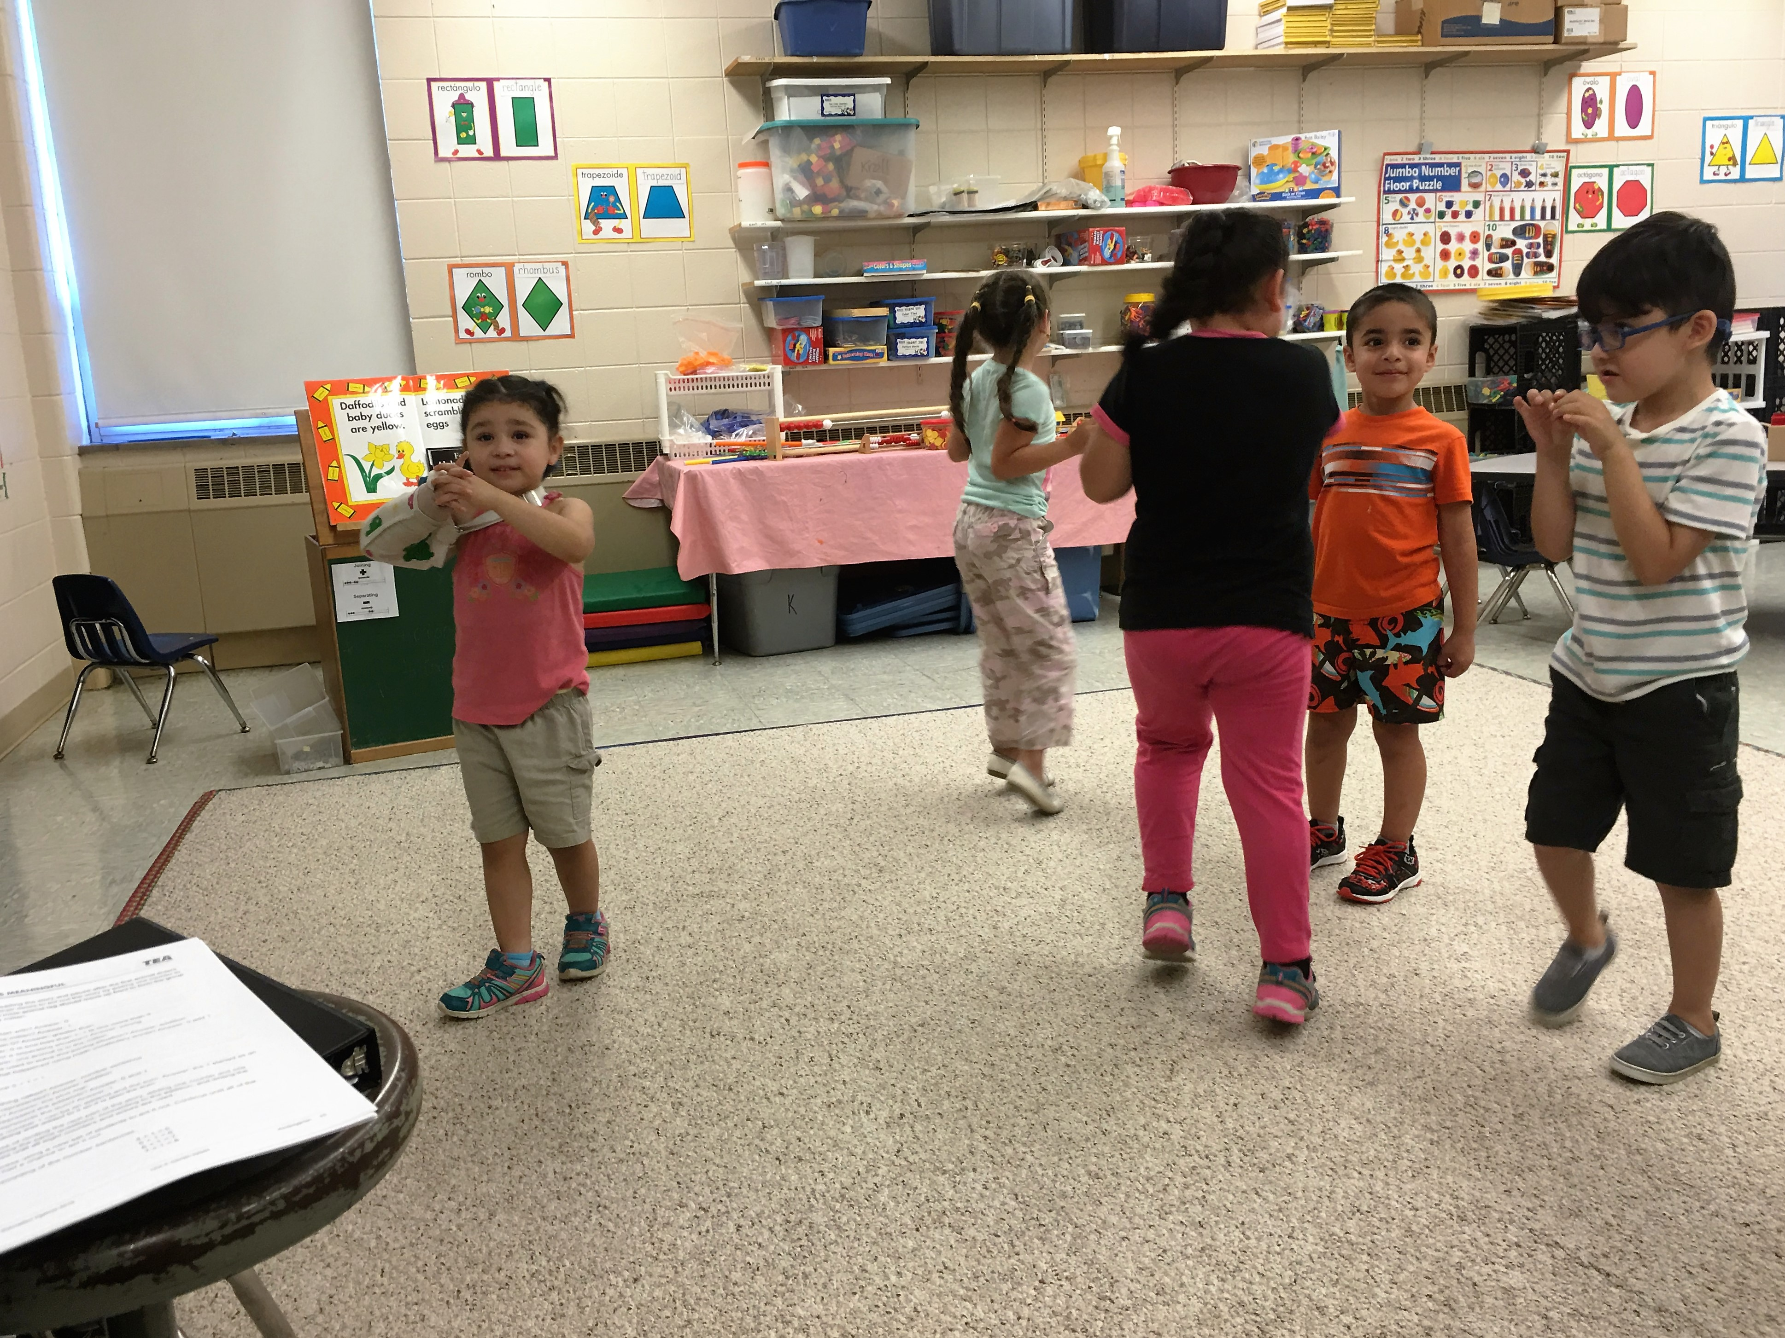
MEP Staff Say…
I really enjoyed the panel of students. We hear their perspective of the program. With the students, we can show how the program is affecting their lives.

Slide 4
Demographics and Services
Number of Eligible Migrant Students 2013 to 2018

Slide 5
Demographics and Services
Demographics for the 2017-18 Performance Period

Slide 6
Demographics and Services
Percent Served with Instructional and Support Services

Slide 7
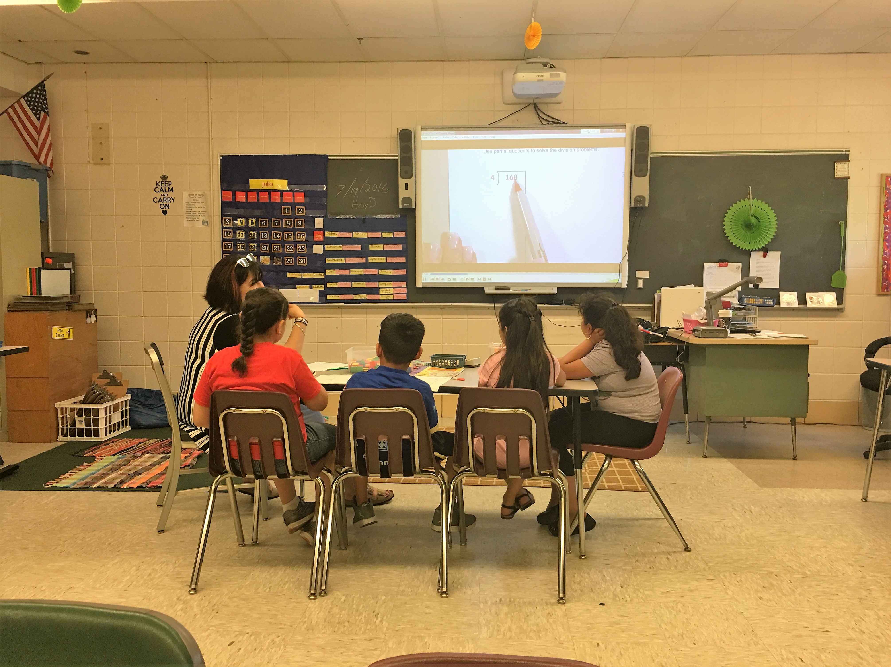
A Parent Says…
Before the summer school, my children really didn’t like to read, but now they do.

Slide 8
Strategy Implementation
This chart shows the percentage of funded MEP sites that rated themselves as succeeding or exceeding expectations for each strategy on the Fidelity of Strategy Implementation (FSI) tool. Sites that marked N/A are NOT included in the percentage calculation.

Slide 9
Results
State performance targets and MPO results for preschool, elementary school, middle school, high school, and out-of-school youth (OSY).

Slide 10
State Performance Targets
2018 ELA Results and Targets
Group | # Tested | % Students scoring proficient | 2018 Goal | Difference
3-8 Migrant | 1,176 | 33.2% | 47.8% | -14.6%
3-8 All Students | 711,302 | 57.3% | 47.8% | +9.5
HS Migrant | 146 | 25.3% | 53.0% | -27.7
HS All Students | 118,378 | 59.9% | 53.0% | +6.9

Slide 11
State Performance Targets
2018 Mathematics Results and Targets
Group | # Tested | % Students scoring proficient | 2019 Goal | Difference
3-8 Migrant | 1,163 | 39.2% | 52.4% | -13.2
3-8 Non-migrant Students | 679,953 | 54.3% | 52.4% | +1.9
HS Migrant | 155 | 31.6% | 46.5% | -14.9
HS Non-migrant Students | 118,492 | 56.7% | 46.5% | +10.2

Slide 12
Graduation Targets
High School Graduation
Targets are for percentages of all students meeting and exceeding standards | 2016 | 17-18 | 18-19 | 19-20 | Long Term Goal 26-27
Graduation Rate | 85.9 | 86.8 | 87.7 | 88.6 | 95.0
We need migrant student graduation rates for the most recent year for which data are available.

Slide 13
State Performance Targets ELA

Slide 14
State Performance Targets Math

Slide 15
State Performance Targets Graduation
Graduation Rates for the 4-Year Cohort
State Performance Target | Non- Migratory Students | Non-PFS Migratory Students | PFS Migratory Students | All Migratory Students
86.8% | 86.3% | N/A | N/A | 63.6%

Slide 16
Measurable Program Outcome (MPO) Results

Slide 17
MPO Results: Preschool
MPO met!
MPO 1a: By the end of 2018-19, 80% of children that participated in Family Literacy activities will show an increase in school readiness as measured by a developmental skills assessment.
Number Assessed | Number w/ Matched Pre/Post | Mean Pre | Mean Post | Mean Gain | # (%) Gaining
28 | 13 | 14% | 39% | +25% | 100%

Slide 18
MPO Results: Preschool
MPO met!
MPO 1b: By the end of 2018-19, 80% of staff who attended training on Family Literacy and/or School Readiness will rate the usefulness of training as a 4 or 5 on a 5-point scale.
Survey Question | N | # (%) Poor (1) | # (%) Fair (2) | # (%) Good (3) | # (%) Very Good (4) | # (%) Excellent (5) | # (%) 4 and 5
How useful was the Migrant PreK Emergent Literacy: Getting Kids Ready for Kindergarten workshop? | 32 | 0 (0%) | 0 (0%) | 1 (3%) | 6 (19%) | 25 (78%) | 97%

Slide 19
MPO Results: Elementary
MPO met!
MPO 2a: By the end of 2018-19, 80% of PFS students in grades K-5 who participated in regular school year MEP instructional services will have a supplemental Personal Education Plan (PEP) for Migrant Education.
Grade | Number PFS Students Receiving Instruction | Number PFS with a PEP | Percent of PFS with a PEP | MPO met?
K | 59 | 50 | 85% | Yes
1 | 50 | 42 | 84% | Yes
2 | 59 | 50 | 85% | Yes
3 | 49 | 44 | 90% | Yes
4 | 45 | 35 | 78% | No
5 | 32 | 27 | 84% | Yes
Total | 294 | 248 | 84% | Yes

Slide 20
MPO Results: Elementary
Partially met
MPO 2b: By the end of 2017-18, 50% of migratory students in grades K-5 will receive MEP summer services.
Grade | All Eligible | Served Summer Term |  | MPO met? | PFS Students | PFS Served Summer Term |  | MPO met?
 |  | N | % |  |  | N | %
K | 292 | 107 | 37% | No | 27 | 10 | 37% | No
1 | 301 | 130 | 43% | No | 52 | 30 | 58% | Yes
2 | 305 | 159 | 52% | Yes | 50 | 40 | 80% | Yes
3 | 314 | 136 | 43% | No | 58 | 40 | 69% | Yes
4 | 298 | 138 | 46% | No | 38 | 24 | 63% | Yes
5 | 250 | 111 | 44% | No | 37 | 29 | 78% | Yes
Total | 1,760 | 781 | 44% | No | 262 | 173 | 66% | Yes

Slide 21
MPO Results: Elementary
MPO met!
MPO 2c: By the end of 2018-19, 80% of migratory students in grades K-5 with matched pre/post assessment results in a summer program will show a positive gain between assessments.
Grade | Number Assessed | Number w/ Matched Pre/Post | # Gaining | % Gaining | MPO met?
K | 24 | 12 | 11 | 92% | Yes
1 | 33 | 19 | 18 | 95% | Yes
2 | 37 | 25 | 22 | 88% | Yes
3 | 40 | 31 | 25 | 81% | Yes
4 | 36 | 24 | 22 | 92% | Yes
5 | 38 | 28 | 25 | 89% | Yes
Total | 208 | 139 | 123 | 88% | Yes

Slide 22
MPO Results: Elementary
MPO met!
MPO 2d: By the end of 2017-18, PFS migratory students in grades 4-5 who received instructional services will increase their scale scores on ELA EOGs by an average of 2 points.
Grade | Number w/2016-17 and 2017-18 EOG Results | Mean 2016-17 Scale Score | Mean 2017-18 Scale Score | Average Gain | MPO Met?
4 | 15 | 431.2 | 437.9 | 6.7 | Yes
5 | 5 | 436.2 | 441.4 | 5.2 | Yes
Total | 20 | 432.5 | 438.8 | 6.4 | Yes

Slide 23
MPO Results: Elementary
MPO met!
MPO 2e: By the end of 2017-18, PFS migratory students in grades 4-5 who received instructional services will increase their scale scores on Mathematics EOGs by an average of 2 points.
Grade | Number w/2016-17 and 2017-18 EOG Results | Mean 2016-17 Scale Score | Mean 2017-18 Scale Score | Average Gain | MPO Met?
4 | 15 | 444.6 | 446.5 | 1.9 | No
5 | 5 | 442.2 | 446.2 | 4.0 | Yes
Total | 20 | 444.0 | 446.4 | 2.4 | Yes

Slide 24
MPO Results: Middle School
MPO met!
MPO 3a: By the end of 2018-19, 80% of PFS students in grades 6-8 who participated in regular school year MEP instructional services will have a supplemental Personal Education Plan (PEP) for Migrant Education.
Grade | Number PFS receiving instruction | Number PFS with a PEP | Percent of PFS with a PEP | MPO met?
6 | 37 | 30 | 81% | Yes
7 | 34 | 30 | 88% | Yes
8 | 39 | 32 | 82% | Yes
Total | 110 | 92 | 84% | Yes

Slide 25
MPO Results: Middle School
Partially met
MPO 3b: By the end of 2017-18, 50% of migratory students in grades 6-8 will receive MEP summer services.
Grade | All Eligible | Served Summer Term |  | MPO met? | PFS Students | PFS Served Summer Term |  | MPO met?
 |  | N | % |  |  | N | %
6 | 277 | 119 | 43% | No | 45 | 35 | 78% | Yes
7 | 227 | 93 | 41% | No | 44 | 31 | 70% | Yes
8 | 220 | 96 | 44% | No | 37 | 26 | 70% | Yes
Total | 724 | 308 | 43% | No | 126 | 92 | 73% | Yes

Slide 26
MPO Results: Middle School
Not met
MPO 3c: By the end of 2018-19, 80% of those migratory students in grades 6-8 with matched pre/post assessment results in a summer program will show a positive gain between assessments.
Grade | Number Assessed | Number w/ Matched Pre/Post | # Gaining | % Gaining | MPO met?
6 | 15 | 12 | 11 | 92% | Yes
7 | 17 | 13 | 8 | 62% | No
8-9 | 17 | 13 | 5 | 38% | No
Total | 49 | 38 | 24 | 63% | No

Slide 27
MPO Results: Middle School
MPO met!
MPO 3d: By the end of 2017-18, migratory students in grades 6-8 who received instructional services will increase their scale scores on ELA EOGs by an average of 2 points.
Grade | Number w/2016-17 and 2017-18 EOG Results | Mean 2016-17 Scale Score | Mean 2017-18 Scale Score | Average Gain | MPO Met?
6 | 3 | 434.7 | 439.3 | 4.7 | Yes
7 | 8 | 443.4 | 446.1 | 2.8 | Yes
8 | 8 | 438.1 | 439.3 | 1.1 | No
Total | 19 | 439.8 | 442.2 | 2.4 | Yes

Slide 28
MPO Results: Middle School
Not met
MPO 3e: By the end of 2017-18, migratory students in grades 6-8 who received instructional services will increase their scale scores on Mathematics EOGs by an average of 2 points.
Grade | Number w/ 2016-17 and 2017-18 EOG Results | Mean 2016-17 Scale Score | Mean 2017-18 Scale Score | Average Gain | MPO Met?
6 | 3 | 447.7 | 442.0 | -5.6 | No
7 | 8 | 446.1 | 446.4 | +0.3 | No
8 | 8 | 437.4 | 437.8 | +0.4 | No
Total | 19 | 442.7 | 442.1 | -0.6 | No

Slide 29
MPO Results: Secondary and OSY
MPO met!
MPO 4a: By the end of 2018-19, 80% of PFS students in grades 9-12 who participated in regular school year MEP instructional services will have a supplemental Personal Education Plan (PEP) for Migrant Education.
Grade | Number PFS receiving instruction | Number PFS with a PEP | Percent of PFS with a PEP | MPO met?
9 | 48 | 39 | 81% | Yes
10 | 26 | 21 | 81% | Yes
11 | 10 | 8 | 80% | Yes
12 | 8 | 8 | 100% | Yes
Total | 92 | 76 | 83% | Yes

Slide 30
MPO Results: Secondary and OSY
MPO met!
MPO 4b: By the end of 2018-19, 75% of OSY that participated in project-directed instructional services will score 80% on content-based assessments.
Grade | Number with scores on life skills assessment | Number scoring 80%+ | Percent scoring 80%+ | MPO met?
OSY | 152 | 136 | 89% | Yes

Slide 31
MPO Results: Secondary and OSY
MPO met!
MPO 4c: By the end of 2018-19, 30 OSY will attend Goal Setting Workshops (GSWs) and attain an acceptable or above score on a GSW project-based activity rubric.
Grade | Number attending GSW | Number scoring proficient | Percent scoring proficient | MPO met?
OSY | 106 | 104 | 98% | Yes

Slide 32
MPO Results: Secondary and OSY
MPO 4d: By the end of 2018-19, the percentage of migratory students who received instructional services and completed English II by the end of 10th grade will increase by 2% with baseline set from 2017-18 data.
MPO 4e: By the end of 2018-19, the percentage of migratory students who received instructional services and completed Math I by the end of 10th grade will increase by 2% with baseline set from 2017-18 data.
There is not enough data to set baseline for these MPOs. The State will examine data collection/reporting and revise the MPOs for 2019-20.

Slide 33
Congratulations!
73% of MPOs met

Slide 34
Recommendations
Part of the Continuous Improvement Cycle

Slide 35
Evaluator Recommendations
Examine State-level use of funds to ensure that resources are dedicated appropriately to meet the needs of migratory children.
Provide technical assistance to local programs in the identification of students with PFS.
Continue efforts to improve migratory parent and family engagement.
Continue efforts to increase summer instructional services and employ consistent assessment of progress.

Slide 36
Evaluator Recommendations ontinued
Provide technical assistance and training to improve implementation of strategies.
Review MPOs related to regular term instruction to determine better measures reflecting the breadth of services provided and update the SDP and evaluation plan.
Update the Statewide Comprehensive Needs Assessment.
Establish procedures for determining results for PFS students for GPRA measures and all State performance targets.
All projects implementing family literacy services should use a school readiness assessment.

Slide 37
Recommendations
Based on these results and last year’s program, what recommendations do you have?

Slide 38
Let’s Continue Improving in 2019-20!

