Slide 1
Field Safety plan & summer services
North Carolina Migrant Education Program
June 11th, 2020

Slide 2
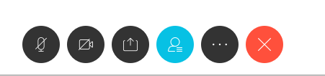
Logistics and sign-in
Please mute your mic
Open your cell phone camera and hold it up to the screen. This will open a prompt to access the sign-in sheet through your internet browser

Slide 3
Objectives and agenda
Agenda
NCMEP Field Safety Plan
Plan components/overview
Supplies/materials needed to implement the plan
Guidance for implementing the plan
Supplemental Service Codes
Summer Services
Available Resources
Examples from the Field
Open Discussion
Provide subgrantees with an understanding of how to conduct outreach and recruitment as safely as possible using the NCMEP Safety Plan
Review commonly used service codes and how they can be used during distance services
Assist subgrantees in determining safe and effective summer services
Facilitate open discussion about service provision and outreach in the midst of the pandemic
Notes:
I will first cover our agenda for the webinar today. (Read agenda)
Our objectives for today are the following: (read objectives)

Slide 4
NCMEP Field Safety Plan
Purpose: provide a safety plan to implement when conducting in-person outreach and recruitment in a way that balances CDC best practices with the need to reach one of the most vulnerable populations
Developed in collaboration with SCMEP, two medical doctors, two Ph.Ds from the Center for Worker Health, a Nurse Practitioner, a Physician’s Assistant, and two outreach staff from NC Farmworker Health Programs.
Photo: Joe Raedle |Credit: Getty Images
Notes:
We will start off with a general overview of the field safety plan. The purpose of the creating this was to provide a safety plan to recruiters and outreach staff in the MEP that balances CDC best practices with the need to reach one of the most vulnerable populations during this pandemic
The plan was developed in collaboration with our neighbors to the South, the other Carolina (South Carolina). The consulted with a medical doctor, a nurse practitioner, and a physician’s assistant in designing their plan. After the shared their plan with us, I forwarded it to Dr. Arcury and Dr. Quandt at the Center for Worker Health. It was also reviewed by the Medical Director from the NC Farmworker Health Program who you heard speak on our webinar last week as well as two outreach directors from the NC Farmworker Health Program. When you read the plan, it may seem like our approach is overly cautious. However, the MEP and the medical staff who evaluated the plan are in agreement that these measures provide the most assurance that we are protecting our migratory families and ourselves.

Slide 5
NCMEP Field safety plan overview
Overview and Methodology
Protocols for Outreach and Services
Before going to a camp
Visiting current NCMEP students vs non-current NCMEP students
Encountering a sick individual
Arrival at the camp or home
Contactless drop measures
Tutoring/Giving a Class
Dealing with a Breach
Arriving back home
Times not to go out
Notes:
I sent the plan out yesterday afternoon, but if you haven’t had a chance to look at it, the first page provides an overview of the plan and the methodology used. The rest of the document contains an outline of the protocols that should be followed on days that you plan to conduct field-based recruitment or services. In the subsequent slides, we will cover each of the protocols

Slide 6
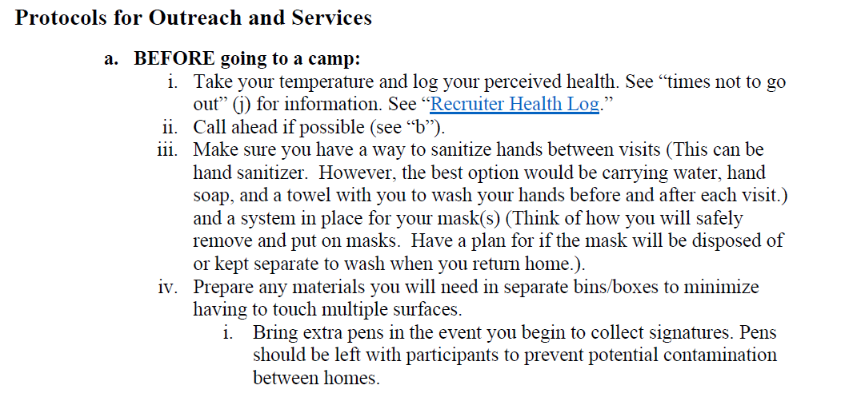
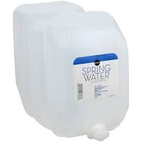
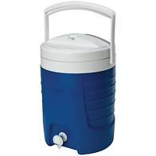
Protocol to follow before going to a camp
The best option for cleaning your hands is with soap and water instead of with hand sanitizer
Plan for masks
Disposable vs Cloth Face Covering
Put on a fresh mask between visits if possible
Migrant funds can be used to purchase pens to leave with families in the case that you will collect signatures
Put MEP contact info on pens
Notes:
The protocols are sequenced to mirror the way in which you would typically conduct outreach or recruitment, starting with preparation for going into the field. The first protocol covers the steps you should follow before heading out the door.
Recruiters and other staff conducting outreach should take their temperature and log their perceived health in some type of log that their supervisor can access. We will take a look at an example of a log on the next page. I also shared a sample log with you yesterday evening that you may duplicate and use for yourself.
(click to trigger first bullet) Before leaving your house you need to be sure that you have a way to sanitize your hands between visits. The best way to clean your hands is with soap and water so it is ideal to carry some type of water source with a spout so that you can easily wash your hands. I have two examples of water sources that would be ideal for handwashing purposes. Of course, the first can be purchased more cheaply. However, the blue water cooler is more sturdy and may last longer. They can both be refilled for multiple uses. Even though you should be carrying a water source, hand soap, and hand towel with you, it is also a good idea to have hand sanitizer as well.
After ensuring that you have the proper supplies to sanitize your hands, you must make a plan for your disposable masks or cloth face coverings. My suggestion is to have a recycled plastic bag where you can throw dirty masks and/or cloth face coverings after each stop. You should change into a fresh mask/face covering after each visit. If for some reason this isn’t possible, you must leave the mask on, without touching it, while you drive to the next location. Essentially, you would have to keep the mask on for the duration of your visits, including travel, without touching it. Recruiters/service providers can use the masks that we have sent to each subgrantee for outreach. I would suggest giving each recruiter 2-3 packages (5/package) so that they have enough masks to change between visits.
Finally, you will need to prepare your materials. If you are making three stops, you should have three separate boxes/bins. You should have all the materials in that bin that you will need for that stop, including writing utensils. You can use your migrant funds to purchase multiple pens that can be left with families in case you begin collecting signatures or in case an individual uses the pen/pencil.

Slide 7
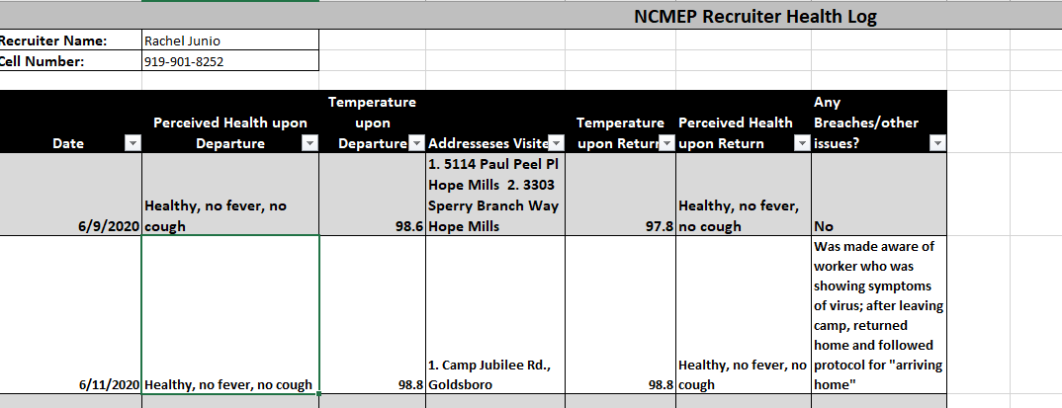
Indicate the status of your health, noting if you are fever-free and with no respiratory symptoms
Record all addresses visited
Describe any breaches that occurred
Notes:
This is a screenshot of the Recruiter Health Log. This is the log that all regional recruiters are required to use. Recruiters, service providers, and other outreach staff should adopt something similar. As outlined on the previous slide, before you get in your car, you will log your perceived health and temperature.
After you return, you will record each address visited and note your perceived health and temperature again. We did purchase digital forehead thermometers for our recruiters to use to take their temperatures. You may do the same. If there were any breaches in protocol, you should also note those. We will talk more in depth about the breaches in a bit.

Slide 8
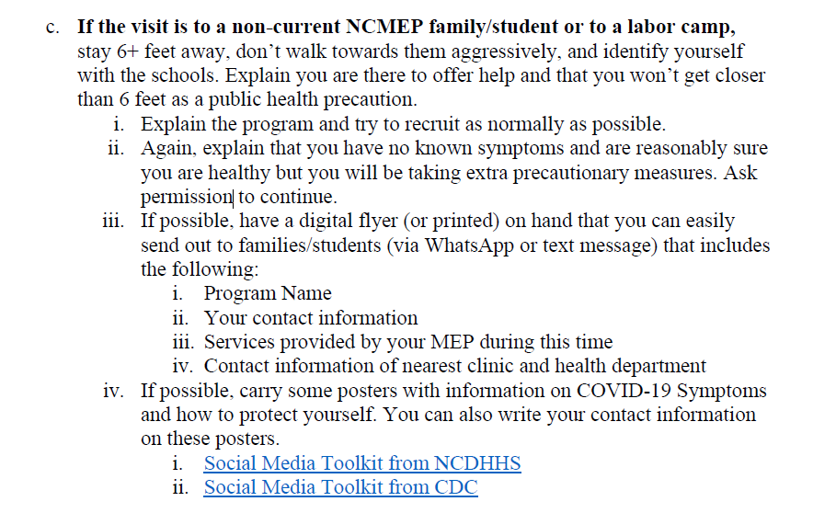
Notes:
The next two protocols describe steps to take when you are visiting a current MEP family versus and non-current MEP family.
Obviously, it would be much easier to visit a current MEP family since you likely have their contact information and would be able to set up an appointment with them and explain the protocol you must follow when you arrive at their house.
If you are visiting a non-current MEP family or a labor camp you have not visited this season, ensure that you are maintaining social distancing and explain to the individuals that you are maintaining this distance as a public health precaution. Start off by explaining the program and asking permission from the individuals to continue with the information. Provide the individuals or families with a flyer that describes the services your program is currently offering during the pandemic. You can give printed flyers, but keep a digital version on your phone so that you have the option to send it via WhatsApp or text message if the individuals or families feel more comfortable.
It is also a good idea to carry posters or flyers with information about COVID that can be left with families or individuals regardless of whether or not they qualify. I would also encourage you to carry multiple copies of the NC Farmworker Health Program map to share with families and highlight the clinics that serve your district. I sent this out in Monday’s email.

Slide 9
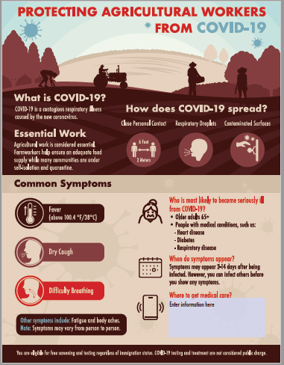
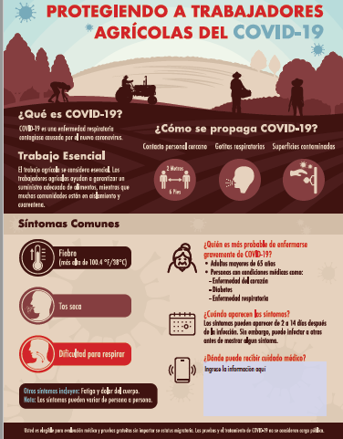
Notes:
These are some examples of some flyers that would be good to have on hand. The flyer on the right was created by our Regional Recruiters, Aubrey and Juan Carlos. It emphasizes the services they are currently able to provide such assistance with making medical appointments, pre-k enrollment, materials to protect yourself during the pandemic. It also includes their contact information with a number that participants can use to call/text or whatsapp.
The flyers on the left side provide information on how ag workers can protect themselves during COVID-19. The best thing about these is that there is a text box on the bottom right of each poster where a program can type their information as well as the information of the nearest clinic to leave at camps or at homes. I also shared this poster with you.

Slide 10
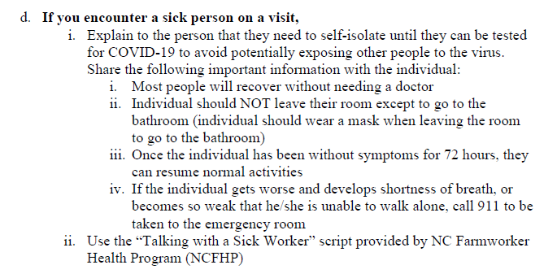
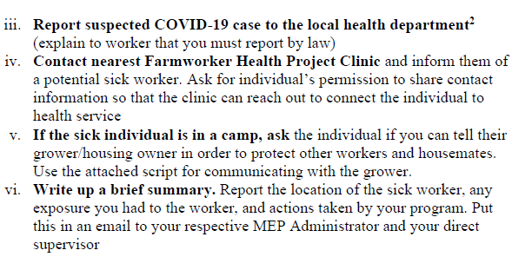
Protocol to follow if you encounter a sick individual (d)
We are not medical professionals and cannot diagnose individuals. However, if an individual is presenting with symptoms of COVID-19, documentation and communication is of upmost importance
Notes:
So this may be the most anxiety inducing protocol to talk about… what should you do if you encounter a sick person? First of all we have to remember that we can’t diagnose anyone. We can educate ourselves on the symptoms of COVID-19 and if we encounter or hear of someone in a home/camp that is experiencing those symptoms, it is our ethical duty to report a suspected case to the local health department.
If you happen to come into contact with a person experiencing symptoms, you need to explain that they will need to self-isolate until they can be tested. The NCFHP shared a script for talking with a sick worker that briefly explains what they need to do, their legal rights around work and sick time, and steps you are required to take as a mandated reporter. I sent the script out a couple of weeks ago, but also sent it again in the recent email.
After explaining next steps to the worker, you will need to contact the local health department to report the suspected case and facilitate an appointment for testing if needed. Then, if the worker agrees, you should also contact the nearest FHP clinic and inform them of a potential sick worker. The clinic can reach out to the worker and take over health advocacy from there.
The most important piece of this protocol is documentation. You need to write up a brief summary and e-mail the summary to your direct supervisor and to your NCMEP Administrator. It is very important that this is done for contact tracing purposes. If you encounter a potentially sick worker, you need to go home after the visit and follow the “arriving home” protocol. If you came within 6 feet of the worker, you must also self-quarantine for 14 days. This would be an example of something that would be reported as a breach on your Health Log.
I will pause here for questions in case anyone needs to ask a clarifying question.

Slide 11
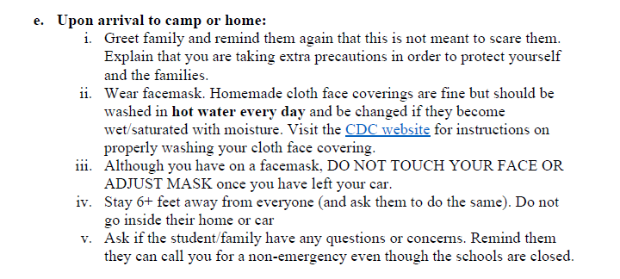
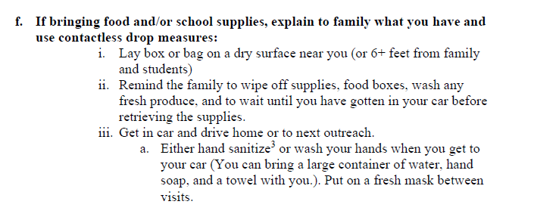
Protocol for Arrival at Camp or Home
Protocol for Contactless Material Drop-off
Notes:
Hopefully, you will not have to use the protocol on the previous slide. My hope is that you will be able to follow the two protocols on this slide with minimal problems. However, we have to be realisti and understand that labor camps, not so much individual family housing, are potential hot beds for spreading the virus. Therefore, it is important that you are prepared.
These two protocols explain what to do when you arrive at a camp and how to safely provide families with food/school supplies or other materials. The most important thing to note is that once you get out of your car and put on your mask, you should not touch your face or adjust your mask. If you are providing materials to families, remind them that they should wipe off the materials and wash any fresh produce. When you leave the visit, you need to take off your mask and wash your hands. You should put a fresh mask on before arriving at your next visit.

Slide 12
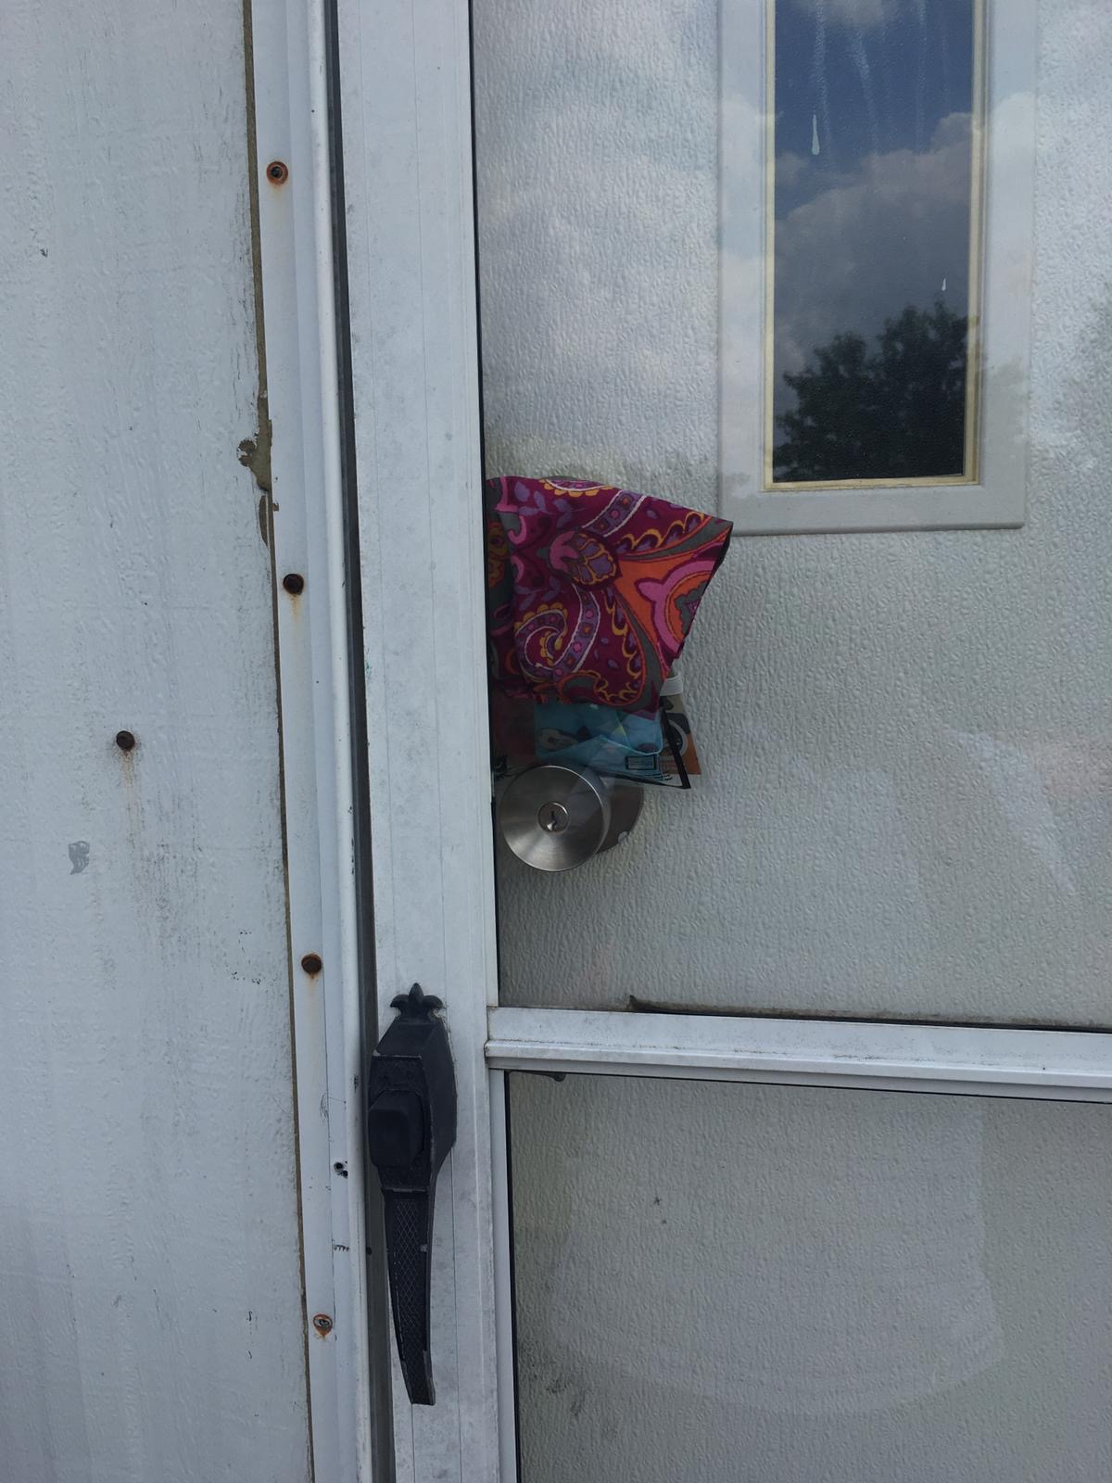
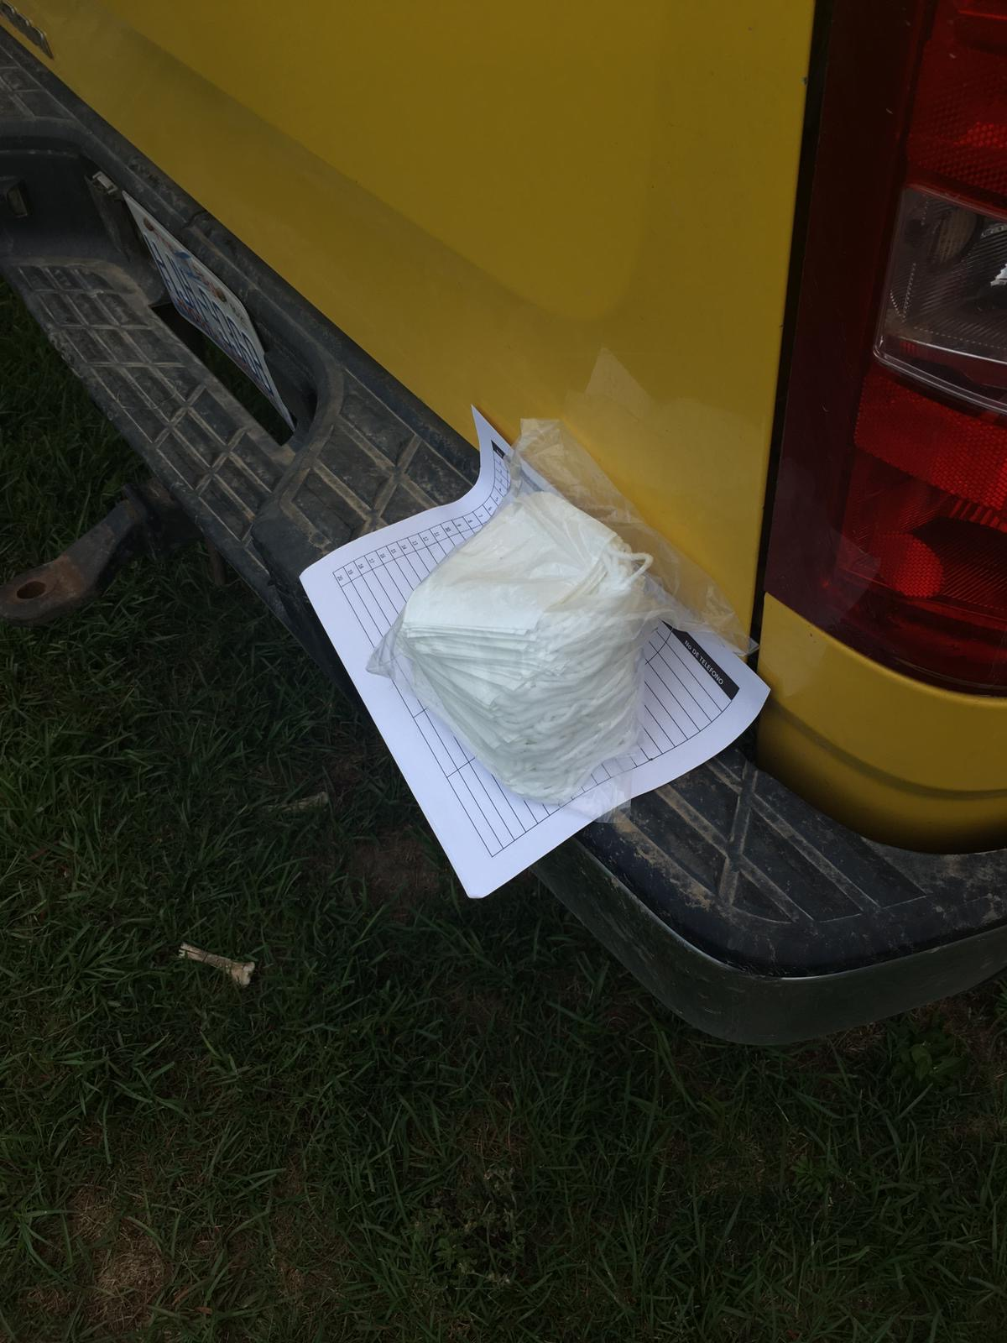
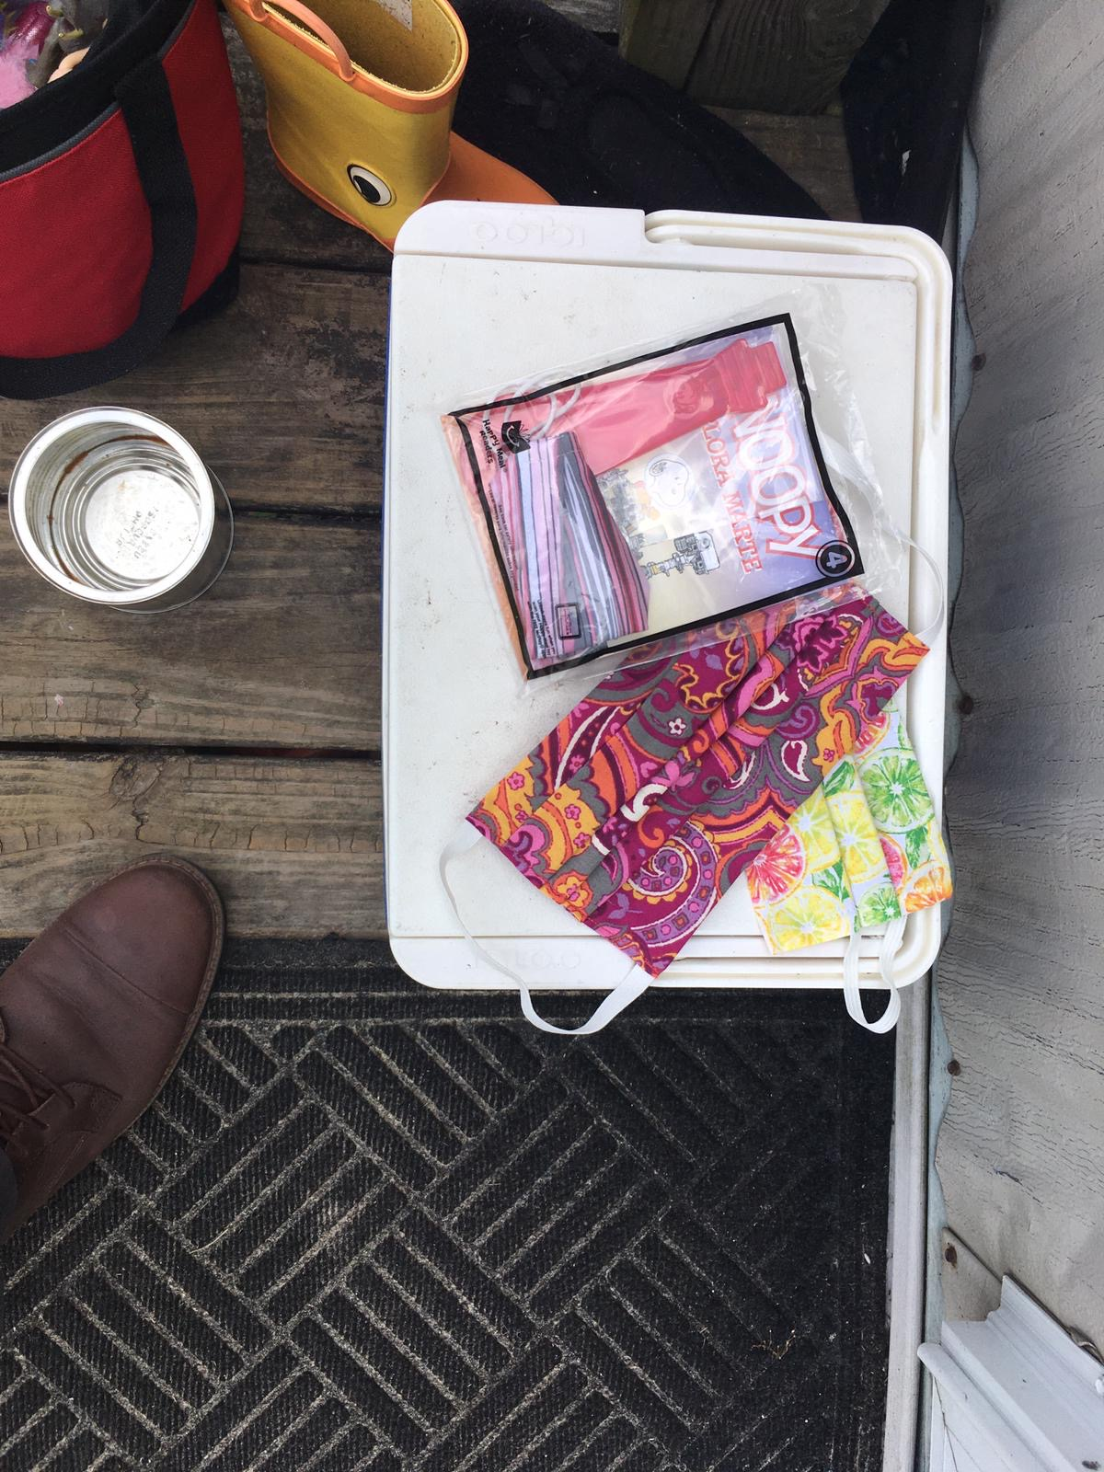
Notes:
Here are some examples of how LCPS has been doing contactless drops. I provided them with several donated handmade childrens masks recently and they have been delivering them by leaving them on the doorsteps or hanging them on the door. They are also providing a children’s book with the masks. This could be one way to continue to provide migratory students with literary support during this time.
The middle picture is of masks that were left on the bumper of a contractor’s truck with a sign-up sheet. There is a suspected sik person at this camp, so the MEP communicated with the contractor about dropping off masks for everyone to wear and to see if he could pass around a sign-up sheet with contact iformation so that the recruiter can call potential qualifying individuals.

Slide 13
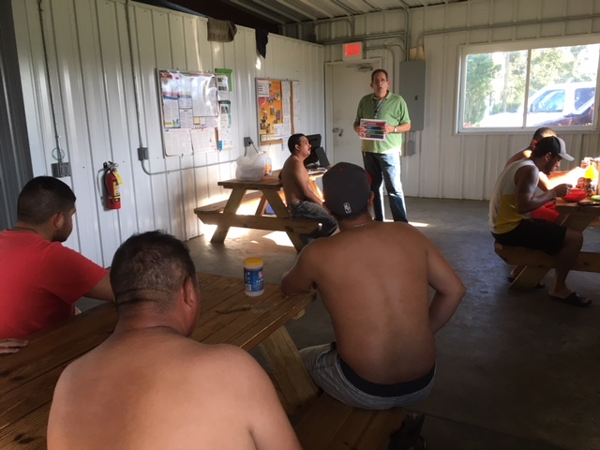
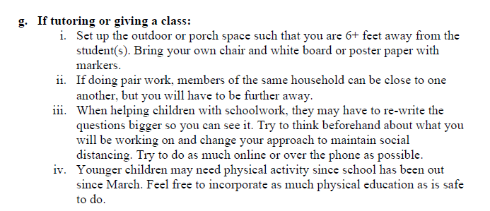
Protocol for Tutoring or Giving a Class
Class should be set up outside
6 feet/ 3 meters
Participant is too close
What’s wrong with this picture?
Notes:
What about giving a class or providing tutoring? We know that kids are at their wits end with virtual learning and some of us are too. So, providing in-person instructional services is still possible using this protocol.
As usual, you must maintain social distancing and we are currently requiring our regional recruiters to set up outside. You may want to consider purchasing a folding table, a white board with easels, and some smaller white boards that students can write on and hold up. If you are using these smaller whiteboards, they should be in a bin that will only be used for that camp. These smaller white boards and markers should be sanitized once arriving back at your home or office.
Based on the protocol, what do you see that’s wrong with this picture?
What questions do you have about conducting the visit before we talk briefly about breaches?

Slide 14
Protocol for addressing a breach
What is a “Breach”
Unable to maintain social distancing (closer than 6 feet to participants)
Touching mask between visits
Entering a participant’s home
Exposure to a sick individual
Begin to feel ill
Notes:
As we mentioned before, documentation of a breach is extremely important. If there is a breach, you need to reschedule the remainder of your visits for the day, go home, and follow the protocol outlined in “when arriving to your home.”
Examples of a breach would be --- (read slide)
It is important to record the breach on your recruiter health log and in an email to your direct supervisor.

Slide 15
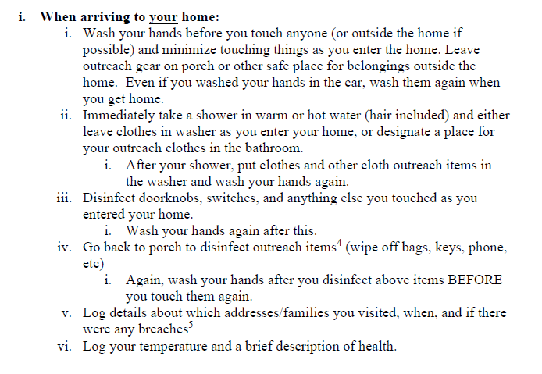
Protocol for arrival at your home
Ensure that you document all addresses visited as well as your perceived health
In addition to disinfecting your doorknobs, switches, etc., disinfect your steering wheel, car door handles, and other frequently touched surfaces in your car
This can be done at the same time you disinfect your outreach items or before you enter your home
Notes:
Finally, you’ve arrived back home! Wash your hands again (using your car handwashing station if possible) and take a shower as soon as you get home. Don’t bring any of your outreach items into the house with you until you’ve disinfected them. Your clothes should go directly into the washer or you should have a designated place for them in your bathroom (separated from your other dirty clothes) such as a cinching trash bag.
After you shower, if you haven’t already, put your clothes, masks included, into the washer and wash your hands again. Then, disinfect any surfaces you touched on the way into your home. Wash your hands after doing this.
Then, disinfect outreach items including ipads and cell phones. It is also suggested to disinfect the frequently touched surfaces in your car like your steering wheel, car door handles, et. After you do this, wash your hands again.
Now that you’ve washed all the skin off your hands, you can record the details of your day in your recruiter health log.

Slide 16
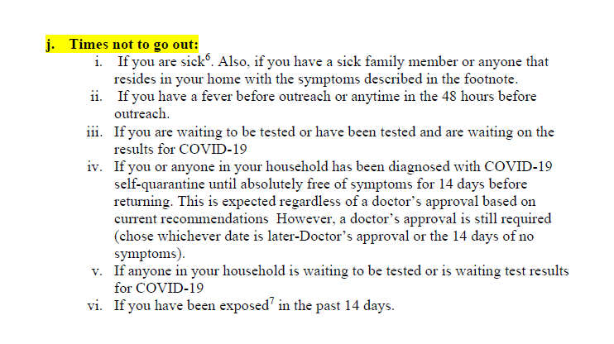
If you have a new and unexplainable rash, gastrointestinal problems, cough, congestion, shortness of breath, loss of taste or smell, or fever, you should not conduct field work
Notes:
This is the most self-explanatory part, and I know all of you have good common sense to know when you should not go out. Obviously, don’t go out if you are sick, even if its not with symptoms of COVID. The only point of clarification I will make is to the “exposure” piece in roman numeral 6. Exposure means that you have come within 6 feet of someone who has tested positive for COVID-19. Pause for questions

Slide 17
Supplies and Materials Needed to Implement this field Safety plan
Cloth face coverings or disposable masks (carry enough to change after each visit)
Water source with a spout to wash hands
Hand soap
Hand towel or paper towels
Disinfectant wipes or disinfecting spray
Hand sanitizer
Multiple pens to leave with participants
Plastic bins or bankers boxes to separate outreach materials
This Photo by Unknown Author is licensed under CC BY-SA-NC
Notes:
Hopefully you will not have to look like this guy in the picture on the right but there are some required items that you need to implement the field safety plan. The first is cloth face coverings or disposable masks. We’ve already talked about how you should bring enough masks or cloth face coverings with you to put a fresh one on each time. Again, make sure you have a bag to put your dirty masks in.
You will also need disinfectant wipes or spray to clean surfaces such as your IPAD, cell phone, frequently touched surfaces in your car, your whiteboard, etc. Disinfectant sprays and wipes are still hard to come by so I’ve linked an article on how to make your own. We made our own alcohol based disinfectant spray and added a few drops of essential oil to make it smell better and it has worked well.
You need a portable handwashing station which includes a water source with a spout, hand soap, and hand towel or paper towels

Slide 18
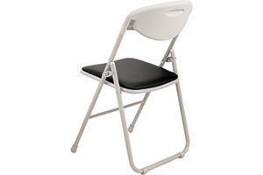
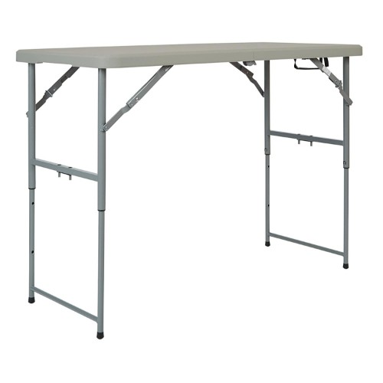
Suggested Supplies & Materials
Small folding table and chairs (for outside classes/tutoring)
Easel with white board
Shade tent
Posters with MEP Contact Information
Gloves (to be used for pumping gas)
COVID-19 Bags
This Photo by Unknown Author is licensed under CC BY-NC-ND
This Photo by Unknown Author is licensed under CC BY-NC
This Photo by Unknown Author is licensed under CC BY-NC-ND

Slide 19
Guidance for implementation of the safety plan
This is the field safety plan that all Regional Recruiters and NCMEP Administrators are following
It is strongly encouraged that district MEPs adopt this plan for their own staff
Directors/Coordinators are encouraged to have candid conversations with other district leaders to explain the importance of continued outreach to migratory families during the pandemic

Slide 20
Supplemental Service codes
Adapting services to meet the needs of students during the COVID-19 Pandemic

Slide 21
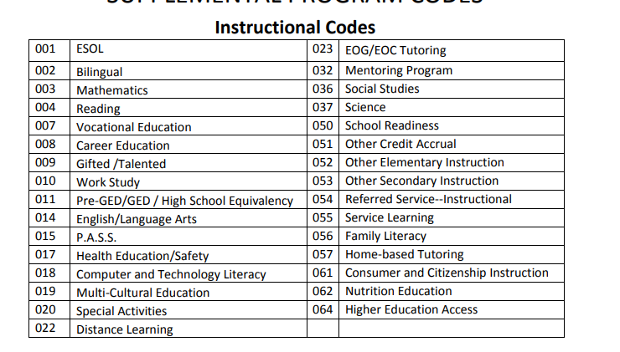
School Readiness (050) can be used when providing virtual instruction and activities to Pre-K students to prepare them for Kindergarten
c
c
Family Literacy (056) can be used when providing digital classes/programs to families that are focused on developing literacy skills and ways that parents can support children through at-home learning
Nutrition Education (062) should only be used for instruction around healthy eating and food preparation
Computer and Technology Literacy (018) can be used when providing instruction to students on how to utilize various digital platforms, providing instruction on digital media literacy, and/or providing instruction on how to access and complete tasks in the new digital learning world
Pre-GED/GED/High School Equivalency (011) can be used when providing instruction to OSY to assist them in completing their GED or in getting admitted to the HEP program
Service codes for instructional services in various subjects can be utilized when providing distance-learning instruction in a particular subject
Special Activities (020) should be used only for short-term, structured activities such as summer programming or virtual field trips
Health Education/Safety (017) can be used when providing students and families with information about COVID-19 and how to keep themselves healthy
Distance Learning (022) should only be used during the summer if you are providing instruction to students to assist them in completing a class for credit

Slide 22
Health Support (048) can be used when the MEP pays for services to support the health and wellness of students (physicals, vision screenings, dental screenings, etc)
Material Support (063) should only be used when the MEP is providing supplies and materials to families that address basic human needs (food, clothing, shelter)
Internet access (033) can be used when the MEP provides internet access to students (MEP-funded hotspots)
Social Work/Outreach (031) can be used when conducting activities that assist migratory students in accessing the full range of services available to them. This could include facilitating meal delivery.
Guidance/Counseling (030) can be used when helping students with techniques to enhance educational or personal development. This could include goal setting workshops, small group/individual discussions around healthy ways to cope with stress/isolation, and/or providing mini-lessons around mental health

Slide 23
Summer Services
Guidance on providing services to migratory students during the summer

Slide 24
Summer Technical Assistance
NCMEP Administrators will be providing technical assistance and training via WebEx
Technical assistance will include the following:
PFS Determination Protocol
Clarification on Service Coding
Using Migrant PS Data to Drive Program Decisions

Slide 25
General Guidance for Summer Services
Follow protocols in the NCMEP Field Safety Plan
Work with district to determine the feasibility of providing some in-person services to migratory students
Utilize migratory funds to support the purchase of additional supplies/materials
Utilize resources that are already available

Slide 26
Available Resources
Pre-K Students
Preschool Initiative Learning Kits
Home-based learning Resources
Resources for Summer Learning
K-12 Students
Migrant Literacy Net
21st Century STEM Initiatives
Mental Health Mini-Lessons/Resources
Resources for ELs during Remote Learning
Free Lesson Units- Sparked Innovations
OSY
English for Daily Life Lessons
Healthy Living Mini Lessons
GOSOSY Resource Library

Slide 27
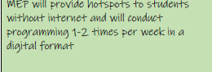
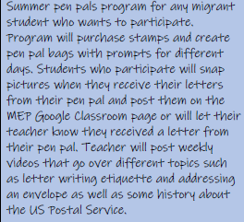
Examples from the field

Slide 28
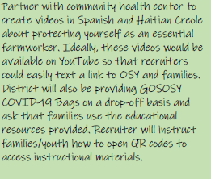
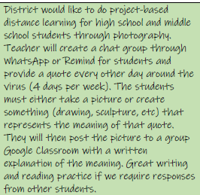
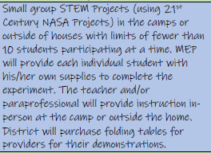

Slide 29
Open Discussion

Slide 30
Be on the Lookout!
MEP Summer Term begins on June 16th and ends on August 31st
Dr. Corral will send out Enrollment Verifications soon after June 15
EVs will likely be due during the second week of July
Webinar for Recruiters to discuss recruitment strategies (Date TBD)

Slide 31
Please complete the evaluation
Scan the QR Code with your phone or click here to navigate to the online evaluation

Slide 32
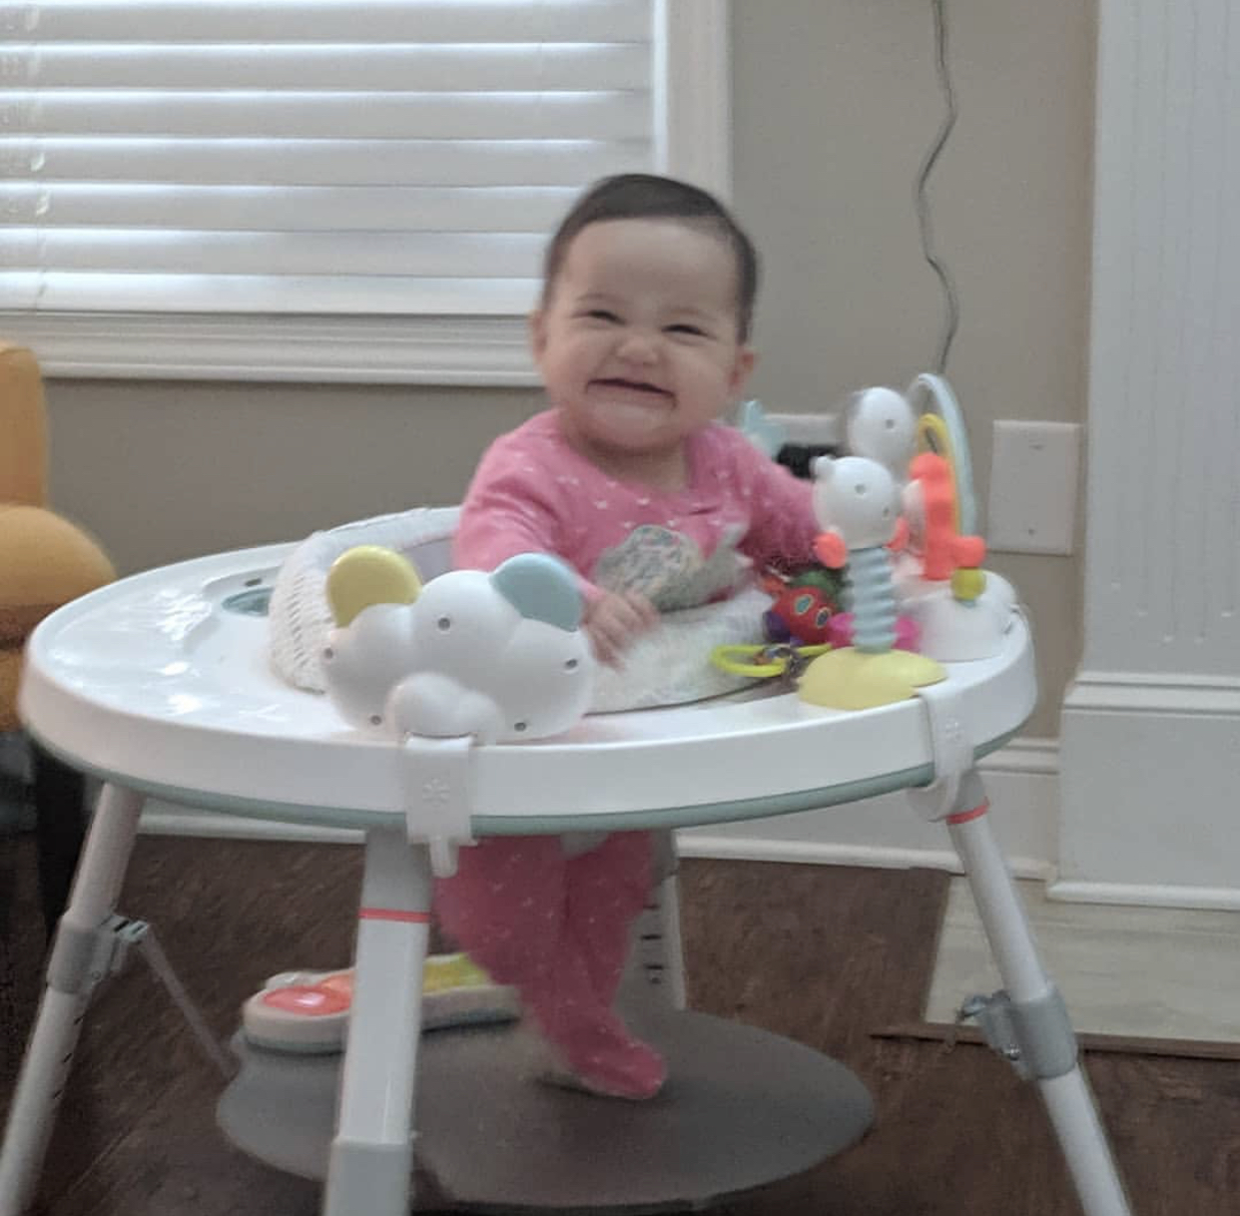
Questions?
I love MEP staff! You make me smile!
Rachel Wright Junio, NCMEP Program Administrator, Eastern Regions
Rachel.wrightjunio@dpi.nc.gov
(910) 302-7331
Heriberto Corral, Ed.D, NCMEP Program Administrator, Western Regions
Heriberto.corral@dpi.nc.gov

